Slide 1
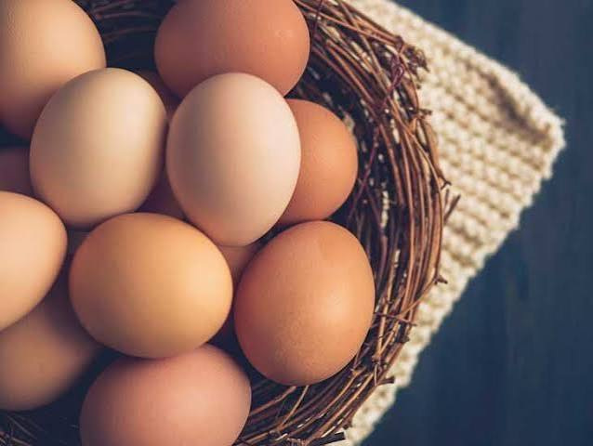
ASSESSMENT STRATEGIES
for Lab & Theory Components
From Performance to Competency
Richard Kugelmann, CEC®, CCA®, AAC®
NCRLA Educator Bootcamp • September 21, 2026
Notes:
SLIDE 1 — TITLE / WELCOME (1 minute),Welcome the group and establish that this will be practical, not an academic lecture on assessment.,Suggested opening: “We’re going to spend the next hour looking at assessment through something every culinary program teaches—egg cookery.”,Frame the larger question: How do we know when a student is actually becoming competent?

Slide 2
Students want feedback.
“Students want feedback.”
How did I do? • What did I do right? • What do I need to change?
STANDARD
PERFORMANCE
ASSESSMENT
FEEDBACK
PRACTICE
IMPROVEMENT
Notes:
SLIDE 2 — STUDENTS WANT FEEDBACK (2.5 minutes),“If there’s one thing I’ve learned from teaching culinary students, it’s that students want feedback. They want to know: How did I do? What did I do right? What did I do wrong? How do I get better?”,Turn: “But feedback is actually near the end of the story. For feedback to mean anything, a lot had to happen before we got there.”,Reveal the cycle: Standard → Performance → Assessment → Feedback → Practice → Improvement.,“This is our roadmap for the next hour.” Do not explain every component yet.

Slide 3
What does “competent” actually mean?
Doing it once?
Doing it correctly?
Doing it consistently?
Doing it better the second time?
Attempt #1 tells me where the student is.
Attempt #2 tells me what the student learned.
Notes:
SLIDE 3 — WHAT DOES COMPETENT MEAN? (3.5 minutes),Audience interaction: Ask, “When you say a student is competent in a culinary skill, what does that actually mean to you?” Take 2–3 responses.,Develop the definition: competency begins when we can observe performance and measure it against a clearly established standard, but one successful performance does not necessarily establish competency.,Land: “Attempt #1 tells me where the student is. Attempt #2 tells me what the student learned.”

Slide 4
Exposure vs. Foundational Skills
EXPOSURE
FOUNDATIONAL
Galantine
Ballotine
Knife skills
Mise en place
Egg cookery
Cooking methods
Some skills broaden a student’s culinary knowledge.
Foundational skills build a cook.
Notes:
SLIDE 4 — EXPOSURE VS. FOUNDATIONAL SKILLS (3 minutes),Tell the galantine/ballotine story in ~45 seconds: learned them in Garde Manger roughly 40 years ago; valuable exposure, but not 40 years of competency.,Contrast with knife skills, mise en place, cooking methods, egg cookery—skills cooks use repeatedly.,Land: “Some skills broaden a student’s culinary knowledge. Foundational skills build a cook.” Foundational skills need repetition.

Slide 5
Why egg cookery?
TIME & TEMPERATURE
PROTEIN COAGULATION
HEAT MANAGEMENT
MISE EN PLACE
SEQUENCING
CONSISTENCY
The egg may be the product we’re assessing,
but the student is demonstrating far more than egg cookery.
Notes:
SLIDE 5 — WHY EGG COOKERY? (3 minutes),Ask: “So why am I using eggs for this?”,Eggs look deceptively simple. Ingredients/equipment are simple and cost is relatively low, but proper and consistent preparation requires many competencies.,Briefly connect the six items on screen to actual performance.,Eggs also give immediate visible evidence of overcooking, browning, coagulation, shaping and handling.,Land: “The egg may be the product we’re assessing, but the student is demonstrating far more than egg cookery.”

Slide 6
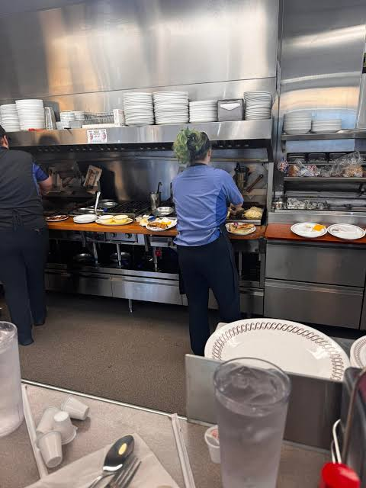
Watch the cook.
• EGGS
• MEATS
• HASH BROWNS
• WAFFLES
• TOAST
• MODIFICATIONS
• TICKETS
“That’s competency.”
Notes:
SLIDE 6 — WATCH THE COOK / WAFFLE HOUSE (3.5 minutes),“Let me talk about Waffle House for a minute.” Humor: most of us have probably been there at least once, maybe around 2 AM. Not fine dining; nobody has tweezers out; nobody is building a galantine.,“I’ve told students: sit at the counter sometime and don’t watch your food. Watch the cook.”,Paint the picture: eggs multiple ways, hash browns, meats, waffles, toast, modifications, tickets, multiple cooking surfaces, synchronizing orders.,Ask audience: “What skills are you actually watching?” Take responses: timing, organization, multitasking, heat control, communication, sequencing, consistency, recovery.,“A really good Waffle House cook, in my opinion, is one of the most skilled cooks in our industry.” Land: “That’s competency.”,Connect back: beginning students start smaller, but egg cookery begins developing the same foundational skills.

Slide 7
Students cannot hit a target they cannot see.
“Make me a good omelette.”
What does “good” mean?
If I’m going to assess against a standard,
the standard must exist before the student starts cooking.
Notes:
SLIDE 7 — STUDENTS CANNOT HIT A TARGET THEY CANNOT SEE (2.5 minutes),“Before I can fairly assess a student’s performance, I have a responsibility as the instructor: Have I clearly taught them what success looks like?”,“Make me a good French omelette” is not really a standard. What does good mean? Color? Texture? Shape? Seasoning? Browning? Interior?,“If I’m going to take points away because their omelette doesn’t meet my standard, that standard needs to exist before they start cooking.”,Demonstration matters: show technique, explain it, and show the finished product. Transition: “So let’s define one.”

Slide 8
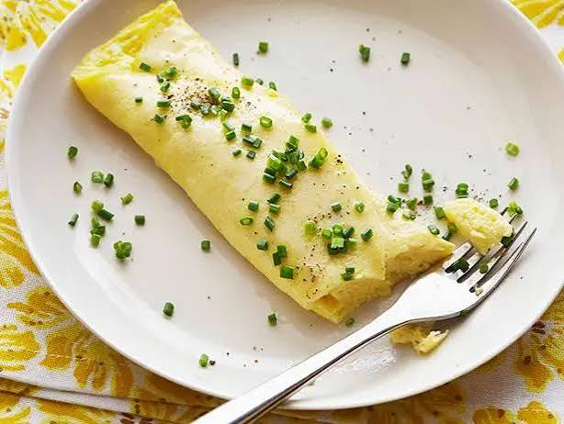
What would you assess?
Notes:
SLIDE 8 — WHAT DOES A GOOD FRENCH OMELETTE LOOK LIKE? (3 minutes),Use the actual prepared omelette if available. Ask: “If this were the student product sitting in front of you, what would you assess?” Let the room build the rubric: color, shape, texture, doneness, seasoning, presentation, moisture.,Reveal criteria: pale exterior/little or no browning; tender/moist interior; proper coagulation; oval/rolled shape; even seasoning; clean presentation.,Land: “The demonstration and the rubric should be telling the student the same story.”,Transition: “But there’s a problem if all I do is stand here and look at the finished omelette. The product only tells me part of the story.”

Slide 9
What does a good French omelette look like?
Pale exterior / little or no browning
Tender, moist interior
Proper coagulation
Proper oval / rolled shape
Even seasoning
Clean presentation
What would you assess?
The demonstration and the rubric should be telling the student the same story.
Notes:
SLIDE 8 — WHAT DOES A GOOD FRENCH OMELETTE LOOK LIKE? (3 minutes),Use the actual prepared omelette if available. Ask: “If this were the student product sitting in front of you, what would you assess?” Let the room build the rubric: color, shape, texture, doneness, seasoning, presentation, moisture.,Reveal criteria: pale exterior/little or no browning; tender/moist interior; proper coagulation; oval/rolled shape; even seasoning; clean presentation.,Land: “The demonstration and the rubric should be telling the student the same story.”,Transition: “But there’s a problem if all I do is stand here and look at the finished omelette. The product only tells me part of the story.”

Slide 10
Assess the process AND the product.
PRODUCT
PERFORMANCE
Color
Texture
Doneness
Shape
Seasoning
Presentation
Mise en place
Organization
Technique
Heat control
Sequencing
Sanitation / Safety
Time management
Notes:
SLIDE 9 — PRODUCT AND PERFORMANCE (2 minutes),“If I only look at the omelette when the student puts it in front of me, I’ve missed an enormous part of what just happened.”,Maybe product is good but station was a disaster; maybe waste/sanitation/sequence were poor. Or maybe the student worked beautifully but made one technical error.,“The finished plate tells me what they produced. Watching them work tells me how they produced it.” Both matter.

Slide 11
The Egg Cookery Practical
10 MINUTES
20 MINUTES — EXECUTION
MISE EN PLACE
1 Hard-Cooked Egg
1 Soft-Cooked Egg
1 Poached Egg
1 Three-Egg French Omelette
Organize station
Gather equipment
Portion ingredients
Plan the sequence
BURNERS OFF
6 EGGS TOTAL
Notes:
SLIDE 10 — THE EGG COOKERY PRACTICAL (3 minutes),Before this practical, students have already been taught, seen demonstrations, practiced and know the standards. “I’ve taught you. You’ve practiced. Now show me what you can do.”,Explain 10-minute planning period: organize, gather, portion, even put hot water in pots—but burners stay OFF.,Those ten minutes are already assessment: read the assignment? think through sequence? gather everything? develop a plan?,“Mise en place isn’t just having your ingredients in little cups. Mise en place includes thinking.”,After 10 minutes, clock starts; 20 minutes execution. Ask audience: “If you were the student, what’s your plan?” Take 2 quick responses.

Slide 12
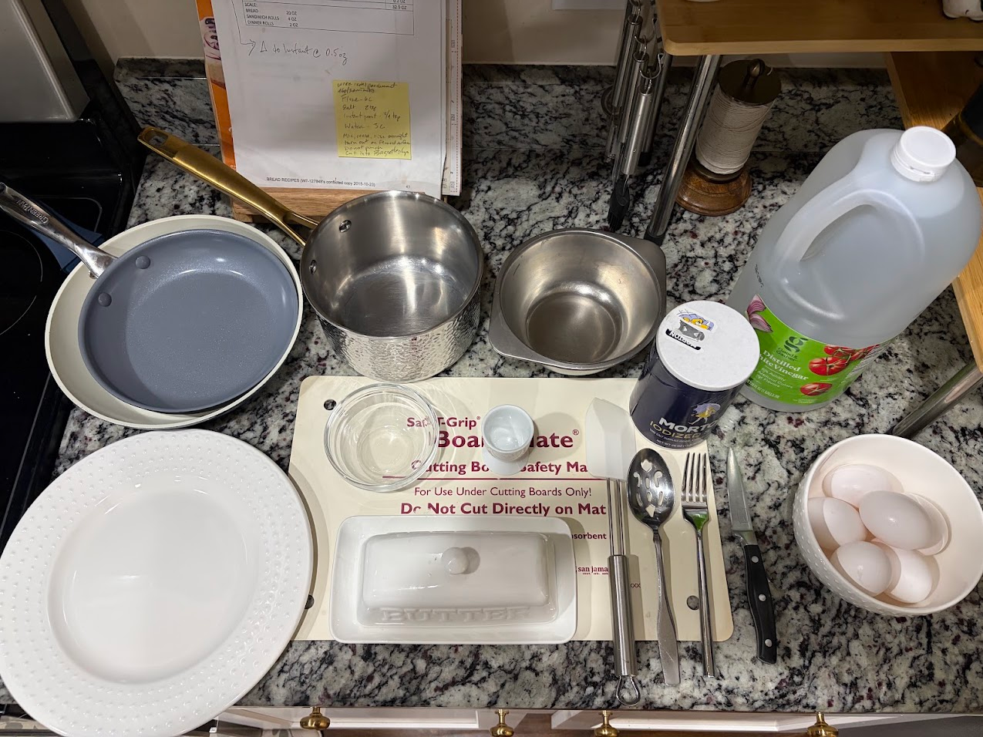
The Egg Cookery Mise en Place Example
Notes:
SLIDE 11 — I wanted to make sure I wasn't asking students to do something that only worked on paper, so I ran the practical myself. I completed all four preparations in 14 minutes, which confirmed for me that the 20-minute execution window is realistic while still requiring planning and organization.”

Slide 13
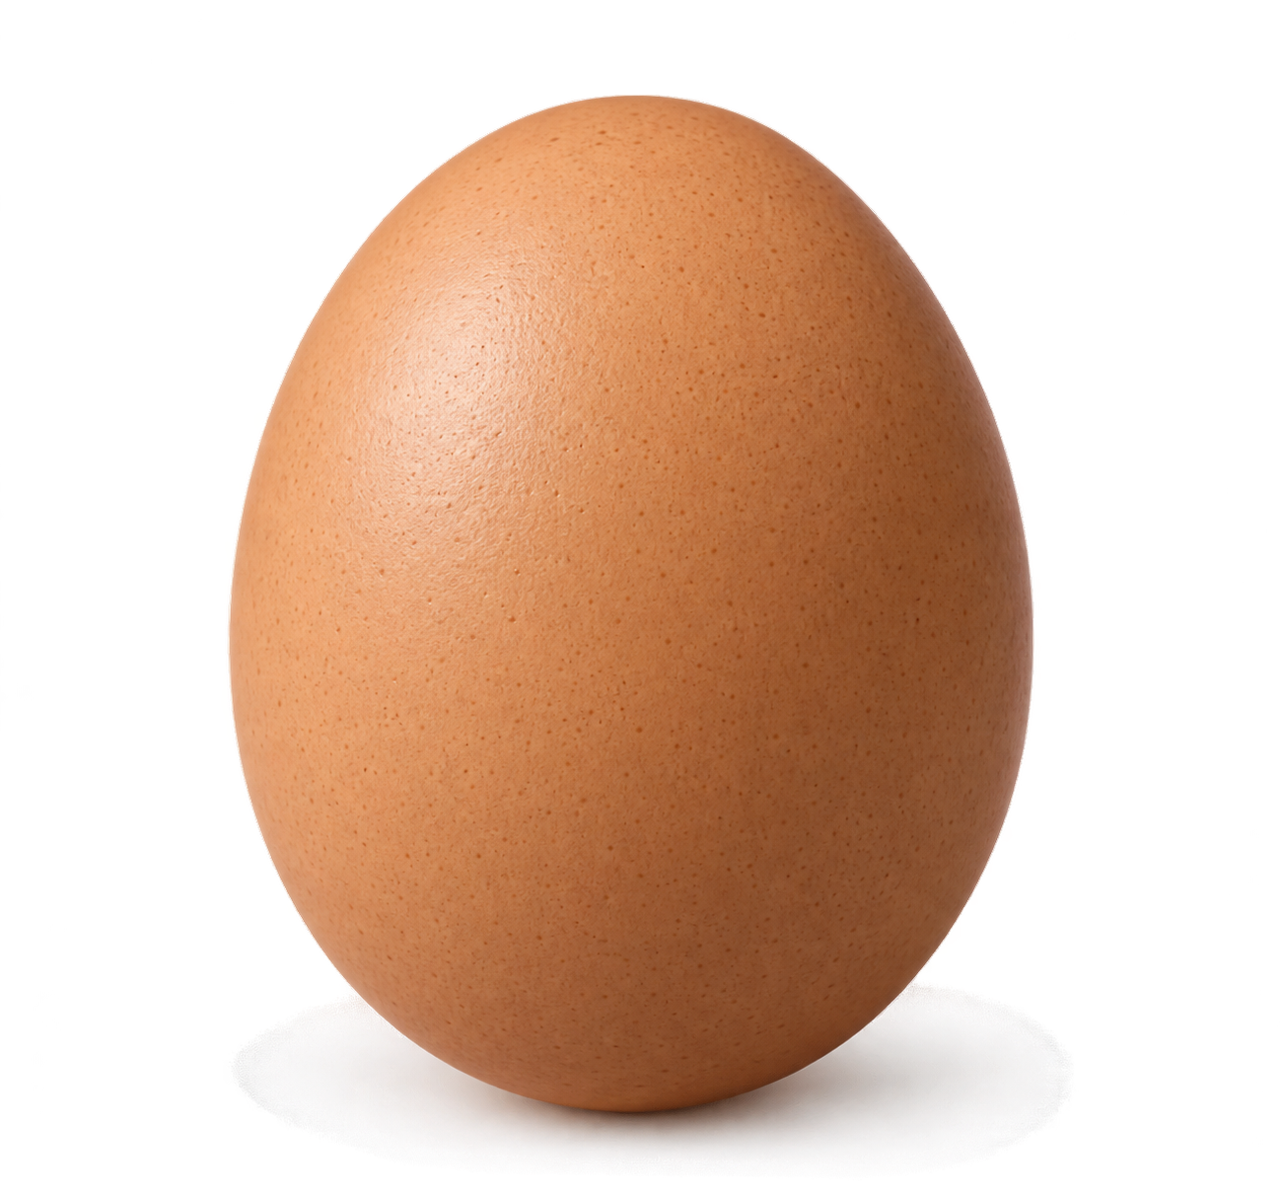
Six eggs. That’s it.
Broken yolk intended for poaching?
Use it in the omelette.
Use an intact egg for poaching.
ADAPTABILITY • PROBLEM-SOLVING • RESOURCE MANAGEMENT • DECISION-MAKING
The rules of the practical should support the learning outcome you’re trying to measure.
Notes:
SLIDE 11 — SIX EGGS. THAT’S IT. (2.5 minutes),“They need six eggs to complete the practical. So I give them six eggs.”,Scenario: student cracks egg intended for poaching and breaks the yolk. Ask audience: “What should the student do?” Use broken-yolk egg in omelette; use intact omelette egg for poaching.,Now we assessed adaptability, problem-solving, resource management, decision-making—not just egg cookery.,“Things don’t always go according to plan in a kitchen. Competent cooks adjust.”,Qualification: rules should support the learning outcome. If resource management matters, six eggs makes sense; if only poaching technique matters, perhaps issue another. Don’t make it hard just to be hard.,Unless safety issue, resist rescuing. “Whose competency are we assessing—the student’s or ours?”

Slide 14
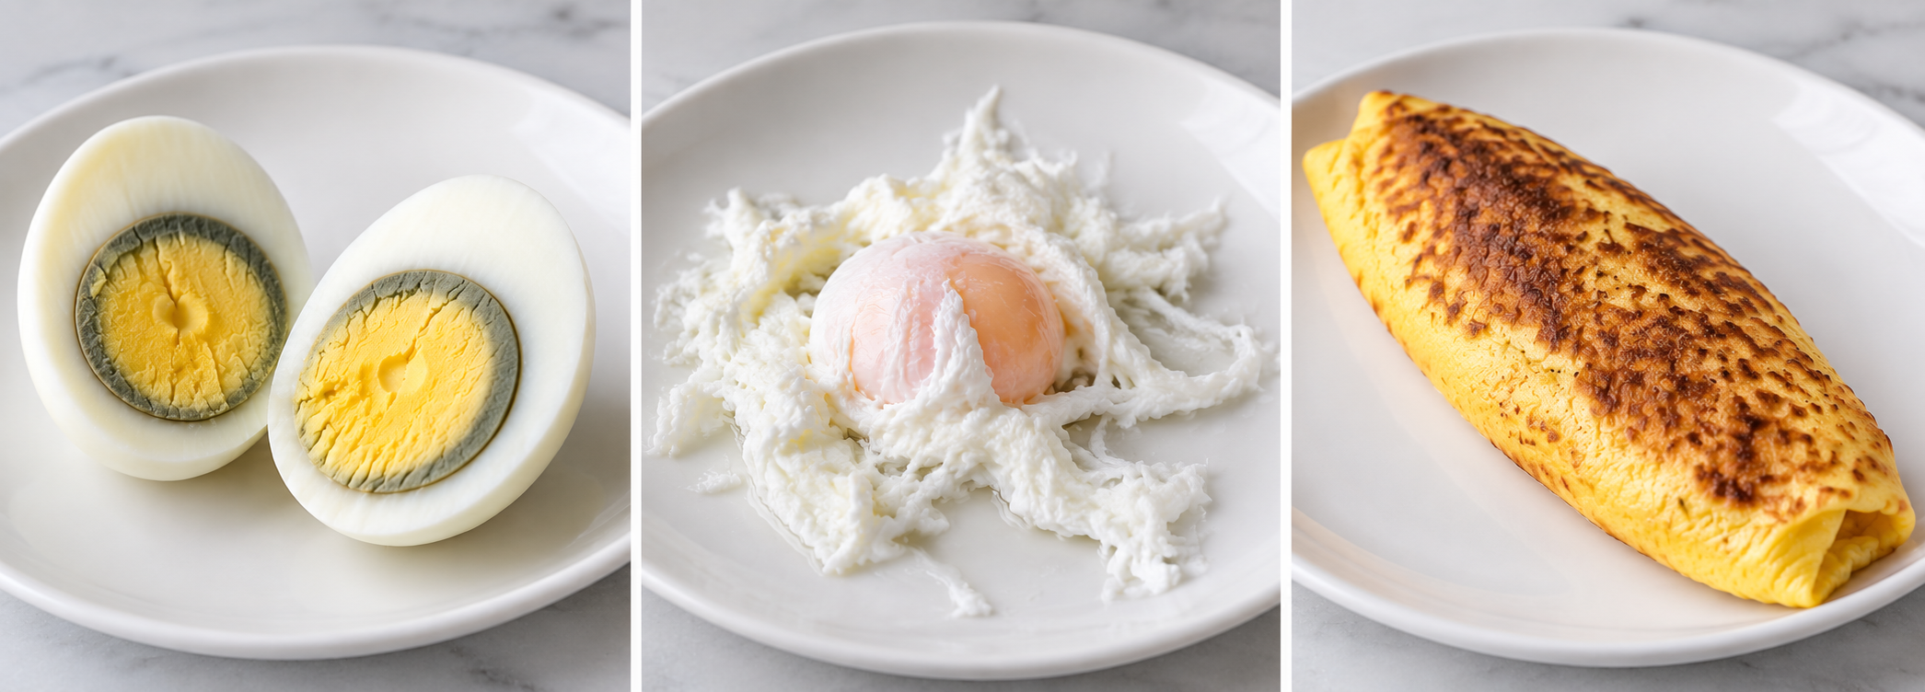
Let the product ask the question.
WHAT HAPPENED?
WHY?
HOW WOULD YOU CORRECT IT?
Observation
Understanding
Application
Same poor product. Different learning need.
Student A: “I don’t know what happened.” Student B: “My pan was too hot; I controlled it too late.”
Assessment should help us determine not only what went wrong — but why it went wrong.
Notes:
SLIDE 12 — LET THE PRODUCT ASK THE QUESTION (3 minutes),Explicitly connect to theory component. Traditionally theory and lab are separated; written testing has value, but theory doesn’t always have to be separate from the practical.,Use browned omelette: “What happened?” “Why?” “What would you change?” Theory now has context.,Two-student example: same poor product. Student A doesn’t know what happened; Student B knows pan was too hot and heat control came too late. Different learning need.,Student A may not understand the principle; Student B may understand it but lack physical execution.,Land: “Assessment should help us determine not only what went wrong, but why it went wrong.” The why is often theory.

Slide 15
Four questions after any practical
What happened?
OBSERVATION
1
Why did it happen?
UNDERSTANDING
2
What should have happened?
KNOWLEDGE OF THE STANDARD
3
What will you change next time?
APPLICATION
4
KNOW IT → DO IT → EXPLAIN IT → CORRECT IT
Notes:
SLIDE 13 — FOUR QUESTIONS (2 minutes),“These four questions can be used with almost anything we teach.” Quick examples: bread didn’t rise, sauce broke, chicken skin didn’t brown, knife cuts inconsistent, biscuits tough, omelette browned.,A two-minute conversation can reveal a lot about what the student understands.,Distinguish: generally ask these after the performance, not coach the student through the assessment.,Land: “The purpose of culinary theory isn’t simply to know culinary information. It’s to help students make better culinary decisions.”,Transition: “Now I’ve watched the student, evaluated the product, asked questions. What do I do with all that information?”

Slide 16
A grade isn’t feedback.
76%
Your pan was too hot. You developed exterior color before the eggs properly set. On the next attempt, concentrate on controlling the pan temperature as the eggs coagulate.
What does that tell the student?
A grade tells the student how they performed.
Feedback should tell them what to do next.
Notes:
SLIDE 14 — A GRADE ISN’T FEEDBACK (2.5 minutes),Show 76%. Ask: “What does that tell the student?” It tells pass/fail, points, grade impact—but does it tell them how to make a better omelette?,Contrast with specific feedback about pan heat and exterior color.,Land: “A grade tells the student how they performed. Feedback should tell them what to do next.”,Feedback should be specific and manageable. If you have 8 notes, don’t necessarily unload all 8. Focus on highest-value corrections, e.g., production sequence and heat control.,“Good feedback doesn’t simply catalog everything that went wrong. It helps the student decide what to work on next.”

Slide 17
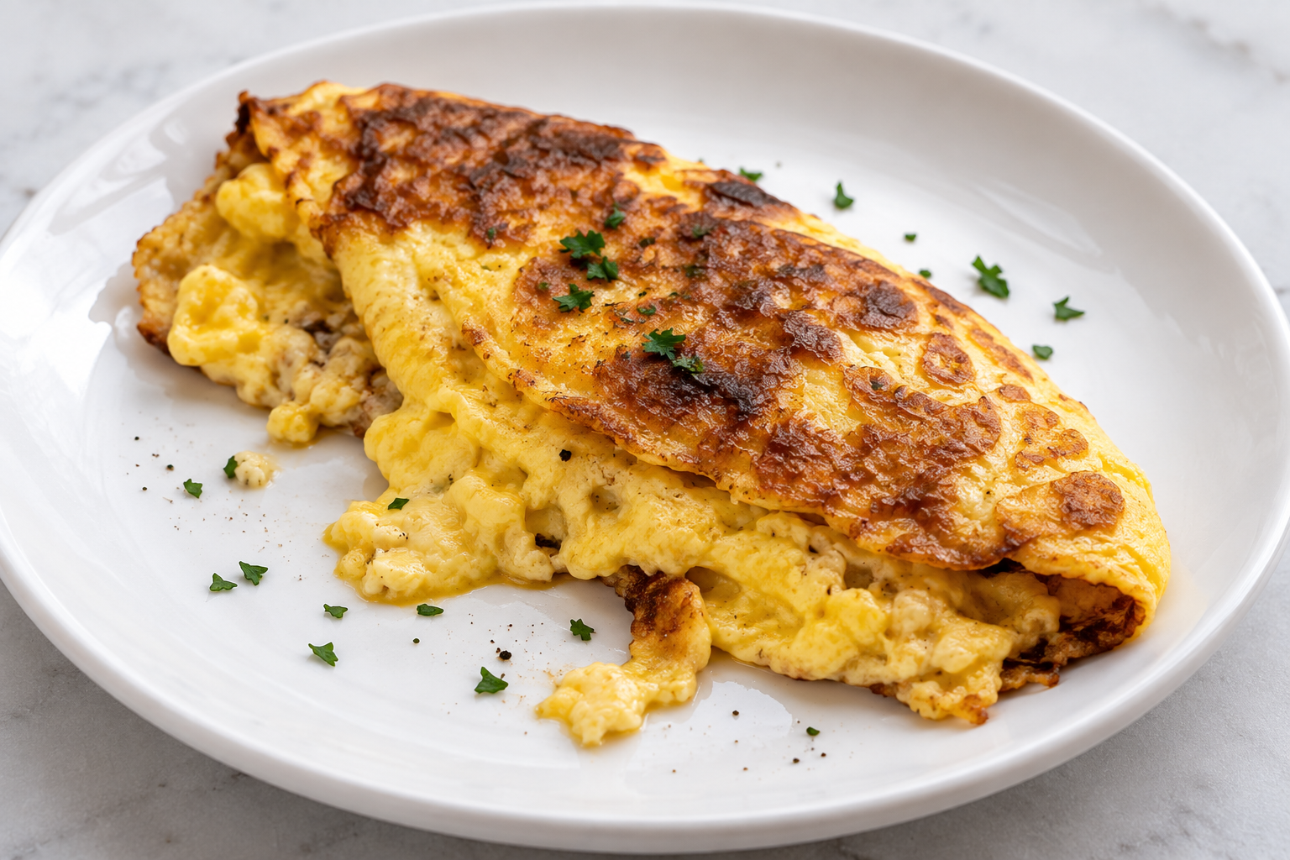
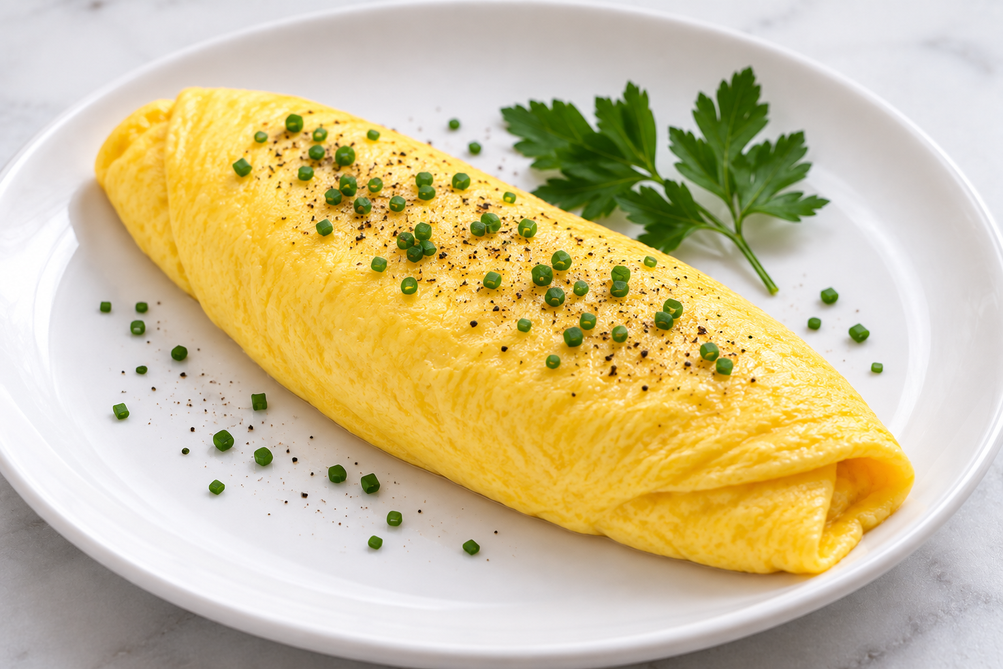
Attempt #1 → Attempt #2
ATTEMPT #1
ATTEMPT #2
ASSESSMENT
+
FEEDBACK
What changed?
Attempt #1 tells me where the student is. Attempt #2 tells me what the student learned.
Notes:
SLIDE 15 — ATTEMPT #1 → ATTEMPT #2 (2.5 minutes),“I’ve given good feedback. They understand what happened. They know what to change. And next week we move on to chicken. Wait a minute.”,We just told them how to improve but didn’t give another opportunity. Feedback loses value.,Bring back: “Attempt #1 tells me where the student is. Attempt #2 tells me what the student learned.”,Hypothetical: #1 brown/dry/poor shape; #2 less color/moister/better heat control/improved shape. #2 may still not be perfect.,“Improvement and competency aren’t necessarily the same thing.” But improvement is evidence that feedback affected performance—evidence of learning.

Slide 18
Repetition builds competency.
REPETITION
SKILL
CONFIDENCE
CONSISTENCY
Not just “Do it again.”
Do it again with purpose.
Faster isn’t always better. Better is better.
Confidence grows when students can see themselves improving.
Notes:
SLIDE 16 — REPETITION BUILDS COMPETENCY (2.5 minutes),Bring back knife-skills example briefly: demonstrate julienne, establish dimensions, time yourself, give students initial goal, assess accuracy/yield/technique/organization/time, feedback, then “Okay. Do it again.”,They now have experience + assessment + feedback.,“Repetition isn’t simply doing the same thing again. It’s doing it again with something specific you’re trying to improve.”,“Faster isn’t always better. Better is better.” Improvement may be consistency, yield, station, safety—not just speed.,Confidence: “We’re not building confidence by telling students they’re great. We’re building confidence by helping them actually get better.”,Eventually competency must become consistency. One good omelette could be luck. Can they do it again, tomorrow, while other things are happening? Callback to short-order cook.

Slide 19
The complete cycle
STANDARD
PERFORMANCE
ASSESSMENT
FEEDBACK
PRACTICE
↻
IMPROVEMENT
COMPETENCY → CONSISTENCY
Notes:
SLIDE 17 — THE COMPLETE CYCLE (2 minutes),“We’re back where we started.” Quickly walk: establish standard; student performs; assess process/product; specific feedback; another opportunity to practice; look for improvement. Repeated cycles move toward competency and consistency.,Final educator question: “Think about one foundational skill you teach. How many opportunities do students actually have to perform it after the first time you teach it?” Pause.,“Are we assessing competency—or are we assessing exposure?” Do not answer it.

Slide 20
TOMORROW…
YOU’RE THE STUDENT.
THE FRENCH OMELETTE CHALLENGE
DEMONSTRATION
ATTEMPT #1
ASSESSMENT
FEEDBACK
ATTEMPT #2
What changed?
Standard • Performance • Assessment • Feedback • Practice • Improvement
Notes:
SLIDE 18 — TOMORROW, YOU’RE THE STUDENT (2 minutes),Change the energy. “We’ve spent almost an hour talking about students. Today you’ve had the comfortable job—you’ve been the educators. Tomorrow, I’m taking that away from you. Tomorrow, you’re the students.”,Reveal French Omelette Challenge: demonstration → Attempt #1 → assessment → feedback → Attempt #2.,“This is not a competition to find out who makes the best omelette.” Given mixed experience levels, the real question is: What changed? What did you learn? What feedback? What did you intentionally change? What happened on Attempt #2?,Close: “As culinary educators, we’re ultimately not trying to produce students who can follow our directions while we’re standing beside them. We’re trying to develop cooks who can observe, think, make decisions, recognize problems, make corrections, and consistently produce to a standard.”,Final callback: “Standard. Performance. Assessment. Feedback. Practice. Improvement.”,“Tomorrow, we’ll put that process to work—and we’ll see what your omelettes have to say about it.”

Slide 21
Questions, Comments, and Contact Information
If you would like a copy of this slide deck and/or digital copies of the handouts, please email:
richard.kugelmann@cpcc.edu
PRACTICE
Notes:
SLIDE 17 — THE COMPLETE CYCLE (2 minutes),“We’re back where we started.” Quickly walk: establish standard; student performs; assess process/product; specific feedback; another opportunity to practice; look for improvement. Repeated cycles move toward competency and consistency.,Final educator question: “Think about one foundational skill you teach. How many opportunities do students actually have to perform it after the first time you teach it?” Pause.,“Are we assessing competency—or are we assessing exposure?” Do not answer it.

