Slide 1

2026 NC ProStart Educator Conference

Slide 2
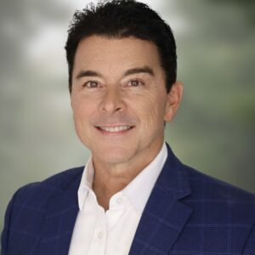

Allen Thomas, NCRLA President & CEO

Slide 3



Slide 4

Trash Talk

Slide 5
What’s one resource you learned about at this event that you’ll take back to your classroom?
What’s one activity that you learned about or used at this event that you’ll be using in your classroom?
What advice would you offer to your fellow culinary teachers?

Slide 6
Brain Dump!

Slide 7
2026 NC ProStart Educator Conference

Slide 8
Housekeeping

Slide 9
Housekeeping
Paid for parking last night? Please forward the receipt to Courtney to have it included in your mileage reimbursement
Substitute payments
Mileage checks-sent to you at your school
Stipend payments-sent to your attention, made out to your school

Slide 10

Navigating ProStart

Slide 11

What Is Required Each Year?
Use the ProStart textbooks, lab manuals, and teacher resources as your curriculum
Complete the annual data collection survey — due September 30, 2026
Two signatures on the program agreement (digital is fine!)

Slide 12
What Are the Optional Opportunities?
Attend this conference — you're here now!
Use the online educator resources
Attend Fall Student Bootcamps
Work with Courtney on industry connections
Pursue the Pre-Apprenticeship pathway
National PD is now online, self-paced
Help students earn the COA and other credentials
Apply for a Rachael Ray Grant
Participate in the NC ProStart Invitational

Slide 13
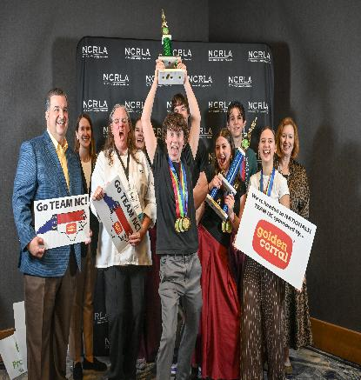
Wherever You Are, You Belong Here
Not doing the “extra stuff” is the bare minimum — and that's okay
Sometimes the bare minimum is all we can accomplish. That doesn't affect your status as a ProStart school.
Stipends reward however much you choose to participate — they don't punish however little

Slide 14
Quick Question Break
✓ Welcome & Orientation — ~2 min for questions
Still Ahead:
Money & Incentives
Getting Set Up
Online Resources
Building Industry Connections
Credentials & the COA
Pre-Apprenticeship Pathway
Competition (NCPI)
Scholarships
This Week & Wrap-Up

Slide 15
Teacher Incentives: Up to $1,875 Per Teacher
Schools with multiple participating ProStart teachers can receive a stipend for each one.
Amount | Activity | Timing
$750 | Complete your annual survey | September
$175 | Attend PD in Charlotte | September
$175 | Bring students to bootcamp | October
$50 | Student submits a complete scholarship application | March
$275 | Bring a team to competition | March
$225 | Guide a student to their COA | Jan or June
$225 | Move a student into pre-apprenticeship | Jan or June
$750 + $1,125 (6 more activities) = $1,875 max, per teacher, per year
This room has already earned the $750 + $175 stipends — funds distribute by month's end. There's still time for everything else!

Slide 16

Stipend Extras — Costs Covered For You
PD trip is on us — hotel & mileage covered
Bootcamp travel, reimbursed
Show up to competition, get refunded
Questions? Courtney Hamm — chamm@ncrla.org

Slide 17
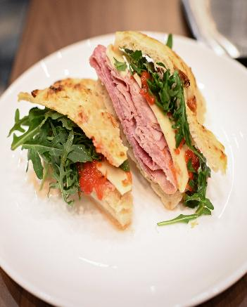
Stipend FAQ: Where Does the Money Go?
Paid directly to the school
Use it for anything that benefits your culinary program
No specific reporting required
Words are great — photos are even better!

Slide 18
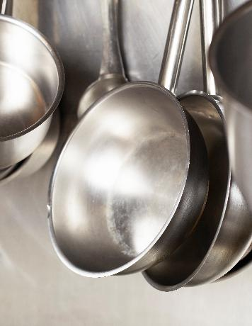
Apply for a Rachael Ray Grant
Up to $5,000 for program expenses
Deadline extended to Monday, September 28 this year
No grant writer needed — just speak passionately about your program
Does require dollar reporting — keep your receipts!
NC usually wins 1–2 of these grants each year

Slide 19
Quick Question Break
✓ Money & Incentives — ~2 min for questions
Still Ahead:
Getting Set Up
Online Resources
Building Industry Connections
Credentials & the COA
Pre-Apprenticeship Pathway
Competition (NCPI)
Scholarships
This Week & Wrap-Up

Slide 20

Textbooks & Materials
Courtney can purchase lab manuals & teacher resources for schools that need them
Only 3rd edition — heads up if your school uses 2nd edition
Email Courtney FIRST with counts to secure your discount
ServSafe is now built into the textbooks — two for one!

Slide 21
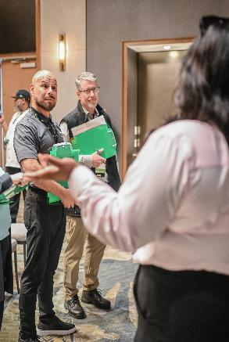
Educator Qualifications & Becoming a ServSafe Proctor
No extra credentials required beyond state requirements
Becoming a proctor is free. The steps:
  1. Hold a current ServSafe® Manager Certification
  2. Complete the tutorial & training video
  3. Pass the ServSafe Advanced Online Test
  4. Complete the Proctor Tutorial & quiz
  5. Agree to Brand & Performance Standards
  6. Update your profile and submit

Slide 22

Course Codes & Curriculum Fit
Course codes: FH10, FH11, FH12, FH13, FH14
Offer at least one FH course each year to remain a ProStart school
ProStart exams are in addition to your state assessments
Notes:
The main goal is teaching to DPI standards first — then add in ProStart curriculum in whatever way fits your students best.

Slide 23

Program Agreement
Signed by the teacher, plus Principal or CTE Director
Only one signature beyond the teacher's is needed
Comes back to Courtney for final signature & filing

Slide 24
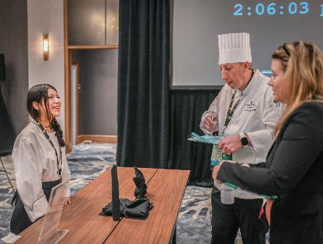
Who to Contact
Courtney Hamm
  Everything ProStart — chamm@ncrla.org
Gwen Turner
  DPI standards questions — she's in the room today!

Slide 25
Quick Question Break
✓ Getting Set Up — ~2 min for questions
Still Ahead:
Online Resources
Building Industry Connections
Credentials & the COA
Pre-Apprenticeship Pathway
Competition (NCPI)
Scholarships
This Week & Wrap-Up

Slide 26

Online Educator Resources
Curriculum Resources
Professional Development
Classroom Teaching Tools
ProStart Competition Resources
🖼
Suggested image:
a laptop or website screenshot

Slide 27

Online Educator Resources
Student Bootcamp Information
Program Implementation & Forms
Educator Toolkit
NC ProStart News

Slide 28
Quick Question Break
✓ Online Resources — ~2 min for questions
Still Ahead:
Building Industry Connections
Credentials & the COA
Pre-Apprenticeship Pathway
Competition (NCPI)
Scholarships
This Week & Wrap-Up

Slide 29
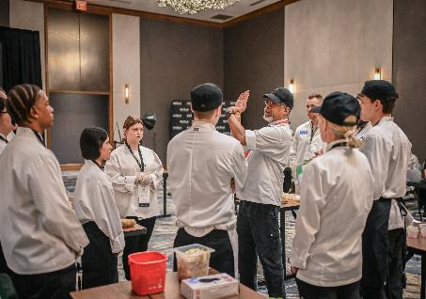
Connect with Industry
Try not to cold-call — start with a warm connection
A friend, part-time job, existing partner, a student's job, or a chef from this week
Courtney can help recruit and reach out too
Notes:
Give Courtney specifics (date, time, number of students) for a one-off request, or let her work on a longer-term relationship for you. She's compiling a list of NCRLA members within an hour of every school.

Slide 30
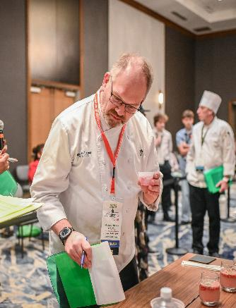
Building Industry Partnerships
Industry Advisory Board
Work-Based Learning Sites
Guest Chef / Manager Visits
ProStart Mentor Network
Competition as PBL

Slide 31
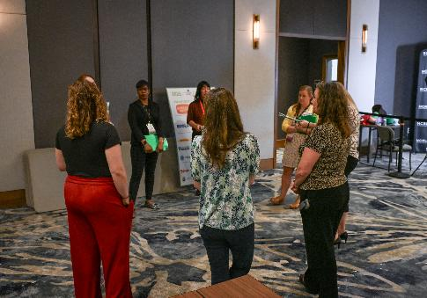
Become an Apprenticeship Sponsor Ally
We need employers within an hour of every school
They just agree to interview pre-apprenticeship completers
$1,000 sign-on bonus for the employer

Slide 32
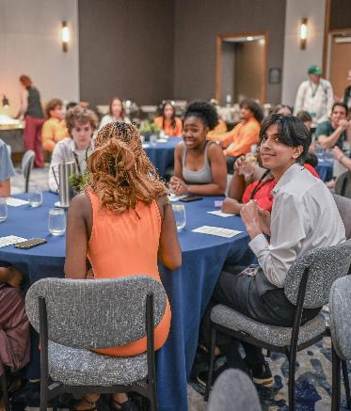
Lowest-Effort Ways to Start
Student Bootcamp — the zero-effort starting point
One guest speaker or site visit — Courtney can coordinate
Attend competition without competing

Slide 33
Quick Question Break
✓ Building Industry Connections — ~2 min for questions
Still Ahead:
Credentials & the COA
Pre-Apprenticeship Pathway
Competition (NCPI)
Scholarships
This Week & Wrap-Up

Slide 34
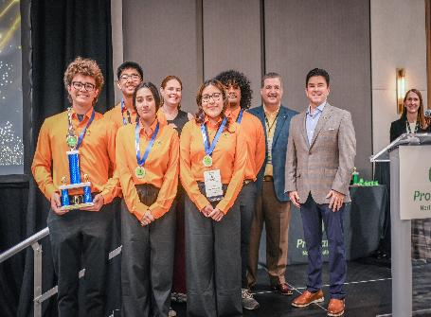
The ProStart Certificate of Achievement (COA)
Complete three levels of Culinary Arts & Hospitality
Pass both national exams — minimum 70%
Log 400+ verified work hours
120 of those hours come from Culinary Arts II!

Slide 35
Which Credential Should My Student Pursue?
Only one Tier 3 credential is tracked/funded per district through DPI — students can earn more than one, but extras aren't state-funded or tracked.
Credential | Format | Best For
ServSafe Food Handler $ | Optional; entry-level intro | Any student, as an early first step
ServSafe Manager | Aligned with CA2 (FH11/FH12) | Food-safety foundation for all students
ACF CFC / CPC (Tier 3) | One-day written + practical exam | Students ready to enter a BOH role immediately after graduation
ProStart COA (Tier 3) | 2 exams + work hours + skills checklist, over time | Students pursuing university — scholarships & dual credit
Pre-Apprenticeship | Courses + 2 credentials + work-based learning | Students who want workforce entry AND continued study

Slide 36

Certificate of Achievement Exams
Administered online by you — everyone here is a registered proctor!
100 questions each, 70% or higher to pass
Exams can be retaken, but the fee is paid again
This is changing: soon, students will opt in before their first exam. When it does, Courtney will help get all your Culinary Arts II students registered so they can start tracking hours right away.

Slide 37

Certificate of Achievement Skills Checklist
75 total competencies
  57 job-related observable skills
  18 employability skills
Must demonstrate a minimum of 52

Slide 38
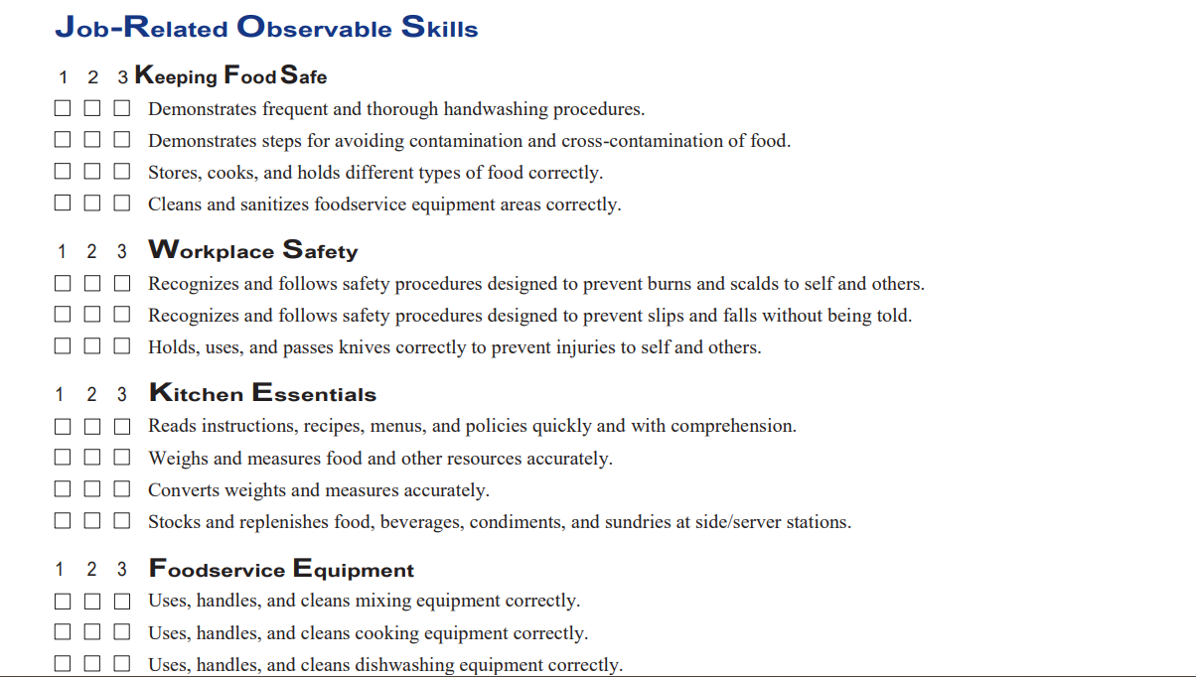
Certificate of Achievement Skills Checklist

Slide 39

COA: You're Probably Closer Than You Think
Students already working in industry? They should be getting their COA.
The hardest part — work hours — is likely already covered
Even this year's CA3 students are in a great spot to start

Slide 40
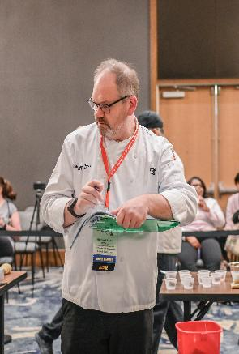
400 Work Hours
400 total − 120 from CA II = 280 remaining
Starting spring of junior year → under 4.5 hrs/week
Start as a senior → average 7-8 hrs/week
Any hospitality-related job counts
No nearby employer? Courtney can help.

Slide 41
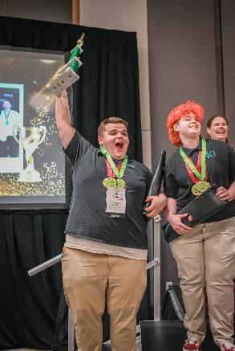
COA Approval Process
Student passes both exams (70%+) and logs work hours
Educator completes the Work Skills Checklist
Educator forwards paperwork to Courtney
Courtney approves — student gets their COA!

Slide 42
Quick Question Break
✓ Credentials & the COA — ~2 min for questions
Still Ahead:
Pre-Apprenticeship Pathway
Competition (NCPI)
Scholarships
This Week & Wrap-Up

Slide 43

The Culinary Pre-Apprenticeship Pathway
Complete required courses (“B” or higher, CA I–III)
Earn at least two credentials
Complete work-based learning
Needs an employer within an hour — Courtney can help!
Notes:
Required credentials: ServSafe Food Protection Manager (required), plus one of: Culinary Arts Pre-Professional Assessment & Certification (AAFCS), ProStart COA, or CFC (ACF). Work-based learning: a state-wide competition (approved PBL, NCPI, FCCLA Culinary/Baking, or SkillsUSA Culinary). It's free for employers to participate.

Slide 44

Why Pre-Apprenticeship Changes Everything
Tuition Waiver at Community College
Work Hours Transfer Forward
Progressive Wages from Day One
Stackable Credentials & College Credit
NC Career Works Benefits!
Notes:
Tuition Waiver: students who complete a qualifying pre-apprenticeship and enroll in a registered apprenticeship within 120 days of graduation may qualify for a community college tuition waiver. Work Hours Transfer: hours logged in the pre-apprenticeship transfer directly into a registered apprenticeship. Progressive Wages: registered apprentices earn wages that increase as their skills grow. Stackable Credentials: participants can earn an industry certification, a college degree, or both, with minimal out-of-pocket cost.

Slide 45
Quick Question Break
✓ Pre-Apprenticeship Pathway — ~2 min for questions
Still Ahead:
Competition (NCPI)
Scholarships
This Week & Wrap-Up

Slide 46
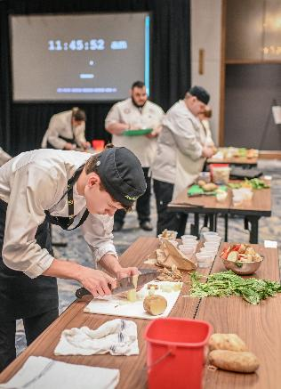
NC ProStart Invitational (NCPI)
Culinary
  Teams of 5; 3-course meal in 60 minutes
Restaurant Management
  Teams of 5; present an original restaurant concept
Technique Competition
  Individual skills contest — a great entry point

Slide 47
Costs and funding:
Intent to Participate/registration fee
  $150 until October 1, $225 until November 1, $300 until full
  Individual $20/$35/$50
What do I need for Intent to Participate?
  Fill out the form, Courtney sends an invoice. Must be paid, non-refundable.
  You can bring multiple teams per school
  Individual competitions will be finalized by November 1 and must be selected by December 1
Team Stipends
  Each teacher that brings at least one team will get $275 in a program stipend.
  Each management team gets at least $500 back
  Each culinary team gets at least $1,500 back

Slide 48

What's New for 2027
General
  Reformatted, reorganized, and streamlined
  Eligibility: up to 3 years total (2 competing + 1 as manager)
Culinary
  Required cooking method for 2027: Shallow Poach. Cooking methods must also be in the footer of the presentation menu
  Dices are not used for judge evaluation (but can still be used in dishes)
  Equipment for decorative knife cuts is allowed, to create uniform cuts are not permitted.
  Formatting/ordering the proposal incorrectly adds a penalty.
Management
  No build-your-own/substitution menus without penalty
  Team managers can consult with their team during the break segments and can participate in judge feedback.
  Cost-per-click for social media has been adjusted.

Slide 49
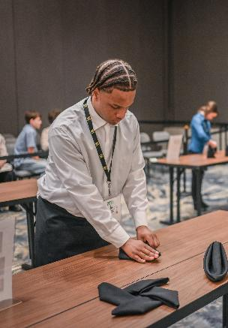
Never Competed Before? Start Here
Not recommended for students currently in Culinary Arts I
A basic prep template was already shared with your survey response
Every team started with zero prior experience
Not ready to field a team? Attend as a judge, ambassador, or volunteer

Slide 50
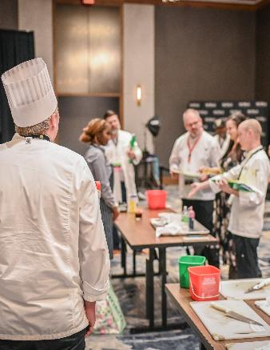
NCPI Prep Schedule — Culinary Track
Suggested — not required
Phase 1: Sept 1–26 Foundation & concept
Phase 2: Sept 29–Nov 14 Proposal development
Phase 3: Nov 17–Dec 19 Refinement & practice
Phase 4: Jan–Feb 2027 Final submission

Slide 51
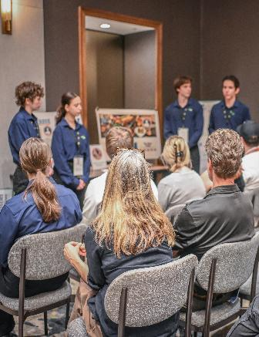
NCPI Prep Schedule — Management Track
Suggested — not required
Phase 1: Sept 1–Oct 3 Team formation & concept
Phase 2: Oct 6–Nov 14 Written proposal
Phase 3: Nov 17–Dec 19 Presentation practice
Phase 4: Jan–Feb 2027 Final submission

Slide 52
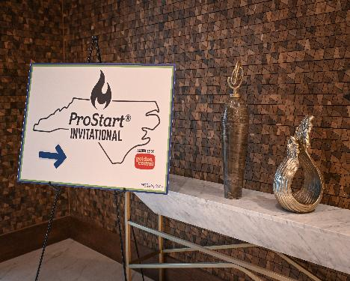
Field Trips & Waivers
Bootcamp — normal school field trip process
NCPI — requires a student/parent waiver
Nationals — a similar waiver applies

Slide 53
Quick Question Break
✓ Competition (NCPI) — ~2 min for questions
Still Ahead:
Scholarships
Wrap-Up

Slide 54
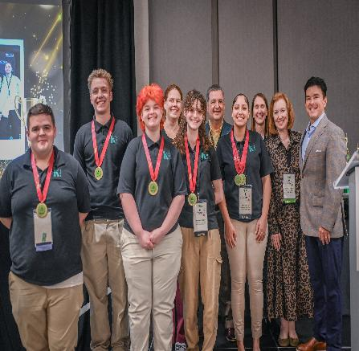
NCRLA Foundation Scholarships
$43,500 awarded in 2026 to 13 NC students
Applications open Nov 4, 2026 · deadline Feb 26, 2027
ProStart has a dedicated scholarship — the Pepsi scholarship

Slide 55
2026–2027 Scholarship List
Share this with every eligible student — ncrla.org/foundation/grants-scholarships
Scholarship | Amount | Key Eligibility
Jimmy Alfano Scholarship | $4,000 × 3 | Restaurant employees; preference for independent restaurant experience
Lynn Minges Scholarship Fund | $4,000 × 1 | Passion for hospitality & community impact; demonstrated leadership. New in 2026.
William F. Carl Scholarship | $3,500 × 3 | Children of hospitality employees; under age 24; attending 2- or 4-year NC program
LM Restaurants' Family | $2,500 × 2 | LM Restaurants team members; minimum 6 months continuous employment
Pepsi 'Service that Sells' | $5,000 × 1 | ProStart students & alumni pursuing hospitality education; customer service experience required
Mikel Weber Scholarship | $1,000 × 1 | Any student furthering education in pursuit of a hospitality career

Slide 56
Quick Question Break
✓ Scholarships — ~2 min for questions
Still Ahead:
This Week & Wrap-Up

Slide 57

2026–27 Key Dates
Sept 1, 2026 NCPI early-bird registration opens
Sept 2026 Rachael Ray Grants due (extended to Sept 28)
Sept 21–22, 2026 This conference — you are here!
Sept 30, 2026 NCRLA Data Collection due
Oct 13, 2026 Bootcamp — Selma
Oct 27, 2026 Bootcamp — Charlotte
Nov 3, 2026 NCPI Intent to Participate due
Nov 4, 2026 Scholarship applications open
Feb 5, 2027 NCPI proposals due
Feb 26, 2027 Scholarship applications close
Mar 7–8, 2027 NC ProStart Invitational
Apr 23–25, 2027 National ProStart Invitational

Slide 58

Questions?
Notes:
Suggested image: a group photo of this year's attendees, or the NC ProStart logo animated/confetti treatment.

