Slide 1

2026 NC ProStart Educator Conference
Opening Session: Welcome & Orientation
Charlotte, NC | September 21–22, 2026

Slide 2
Welcome, ProStart Educators!

Slide 3
Welcome & Thank You
Thank you for taking two days out of your classroom to be here with us
Special thanks to Piedmont Natural Gas for hosting us at their Technology & Design Center
Your NCRLA team on site this week — come find us anytime:
  Courtney Hamm and Holly Folker

Slide 4
Welcome to Our New Schools!
Martin County High School
Hickory Career and Arts Magnet
The Center of Applied Science and Technology
High Point Central High School
Career Center (Forsyth County)
Olympic High School
Aspire Trade High School
Weaver Academy
Cherryville High School

Slide 5
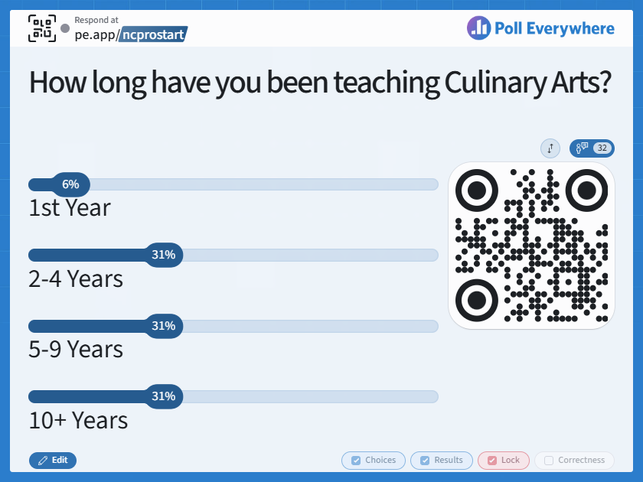

Slide 6
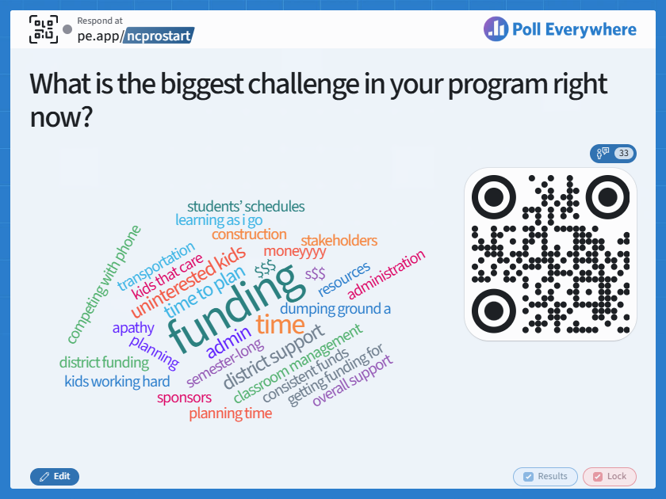

Slide 7
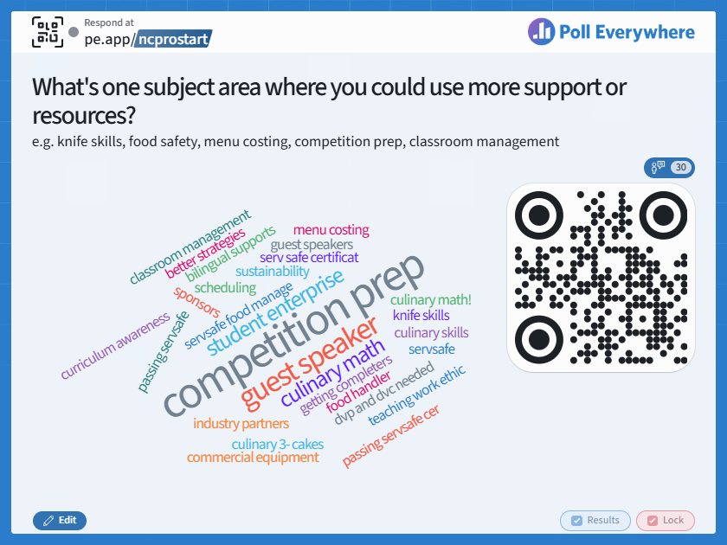

Slide 8
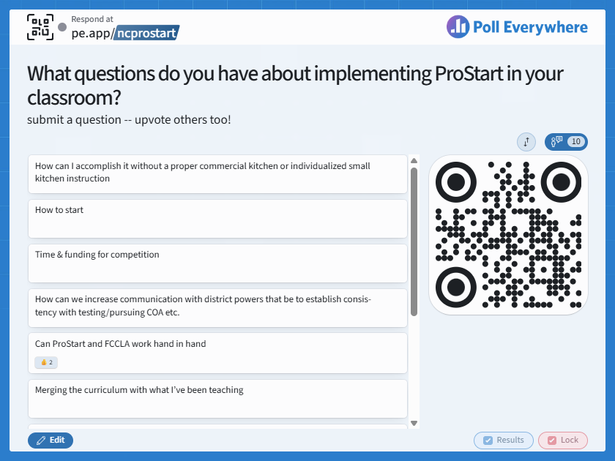

Slide 9
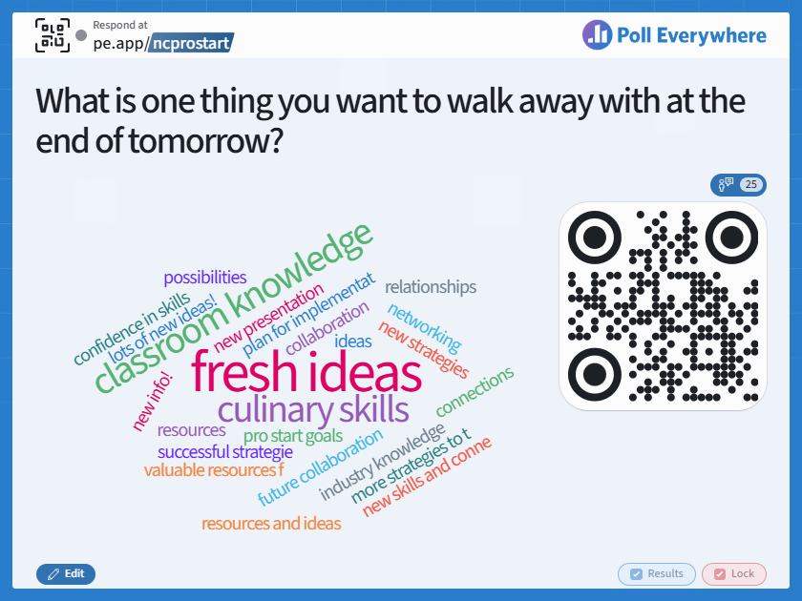

Slide 10
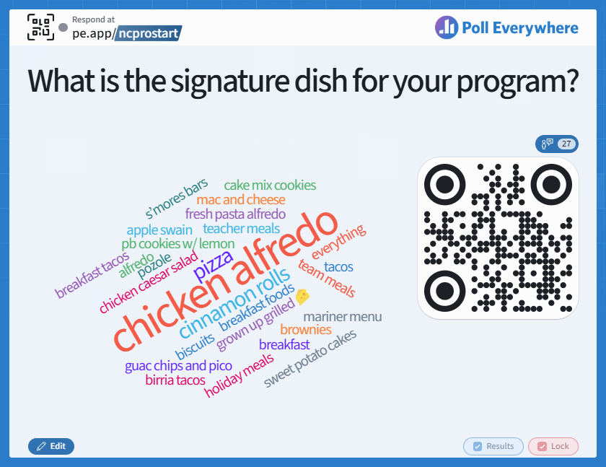

Slide 11
How the Breakout Rotations Work
You'll rotate in small groups through three rooms: Duke Energy Innovation Lab, Piedmont Innovation Lab, and the Video Conference Room
Every group attends a different session in each time slot
Check the back of your nametag for your personal schedule
Today: 5-minute breaks between sessions
Tomorrow: slightly longer breaks, since there are more hands-on sessions
Please help clean up your space at the end of each session so it's ready for the next group

Slide 12
Give Us Your Feedback
Look for the QR code posted next to each room door
Scan it after each session to tell us what worked — and what didn't
Takes less than a minute
Your feedback shapes next year's conference, so please be honest!
Anyone who submits a name along with *any* feedback response will be eligible to win one of three $50 Amazon Gift Cards! You are welcome to leave feedback without submitting your name, as well.

Slide 13
Monday at a Glance
9:00am Registration & Light Breakfast
9:30am Welcome & Orientation — you are here!
10:05am–12:10pm Breakout Sessions 1 & 2
12:10pm Lunch
12:45–2:50pm Breakout Sessions 3 & 4
3:00–4:00pm Breakout Session 5
6:00–9:00pm ProStart Educator Recognition Dinner — Goodyear House

Slide 14
Tuesday at a Glance
8:30am Networking & Light Breakfast
9:00am–12:30pm Breakout Sessions 1–3
12:30pm Lunch
1:15–2:00pm Open Conversation & Session Closing
2:00–3:30pm ProStart Educator Session (confirmed ProStart educators)

Slide 15
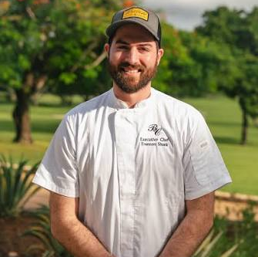
[Add Photo]
Chef Trenton Shank
Executive Chef, Old Chatham Golf Club
Leading: Culinary Hands-On Skills & Competition Prep
Notes:
Our first presenter this week is Chef Trenton Shank, and he actually has a ProStart story of his own — he grew up in the Dallas-Fort Worth area and won the National ProStart Invitational back in high school, which earned him a scholarship to the New England Culinary Institute, where he graduated as valedictorian. From there he cooked at Twin Farms in Vermont, then became Executive Chef at Fess Parker Winery in Santa Barbara. In 2020, he and his wife, pastry chef Emma Spalding Shank, opened Plum Southern Kitchen and Bar in Durham, which was named Best Overall Restaurant in 2024 by Durham Magazine. After a run at Brier Creek Country Club, where he was a 2025 NCRLA Chef Showdown finalist, he's now Executive Chef at Old Chatham Golf Club. Today he's leading several of our hands-on skill sessions, and he's teaming up with Chef Michael Beers this afternoon for Preparing Students for Competition.

Slide 16
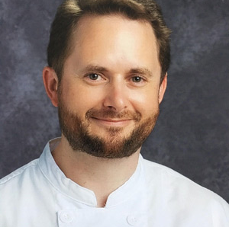
[Add Photo]
Chef Dominic Hawkes
ProStart Educator Extraordinaire
Leading: From Industry to Instruction / Every Student Starts Somewhere
Notes:
Chef Dominic Hawkes is a Master Chef of Great Britain with nearly three decades in foodservice. He got his start in top London hotels like the Ritz and the Radisson Edwardian, then ran Food and Beverage for the Charlotte City Club for nineteen years before moving into teaching. He's co-authored several culinary arts and food safety textbooks, runs a popular YouTube channel called Chef Hawkes, won the Carolina Classic Cook-Off, and has even been featured on PBS Charlotte. Today he's leading two sessions — From Industry to Instruction, about making that transition from the industry to the classroom, and Every Student Starts Somewhere, about meeting your students where they are.

Slide 17
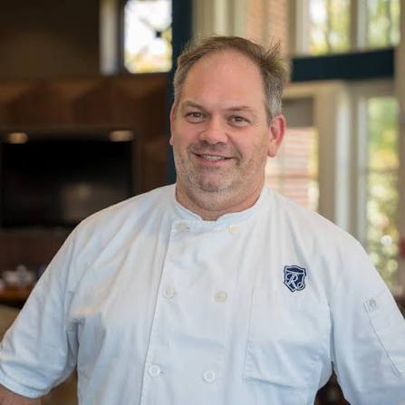
[Add Photo]
Chef Michael Beers
CEC — Executive Chef, River Run Country Club
Leading: Menu Costing, Hands-On Skills & Competition Prep
Notes:
Chef Michael Beers grew up on a small farm in upstate New York and trained through a formal apprenticeship, cooking his way through New York, London, Arizona, France, and Boston before landing in North Carolina. He spent a decade as Executive Chef at several White Mountain resorts, later served as personal chef to NASCAR champion Brad Keselowski, and today he's Executive Chef at River Run Country Club in Davidson. He was named 2024 Food and Beverage Professional of the Year and serves as lead culinary judge for the NC ProStart Invitational — so you're in very good hands today and tomorrow. He's teaching Menu Costing for Culinary Educators today, co-leading Preparing Students for Competition, and running hands-on skill sessions tomorrow.

Slide 18
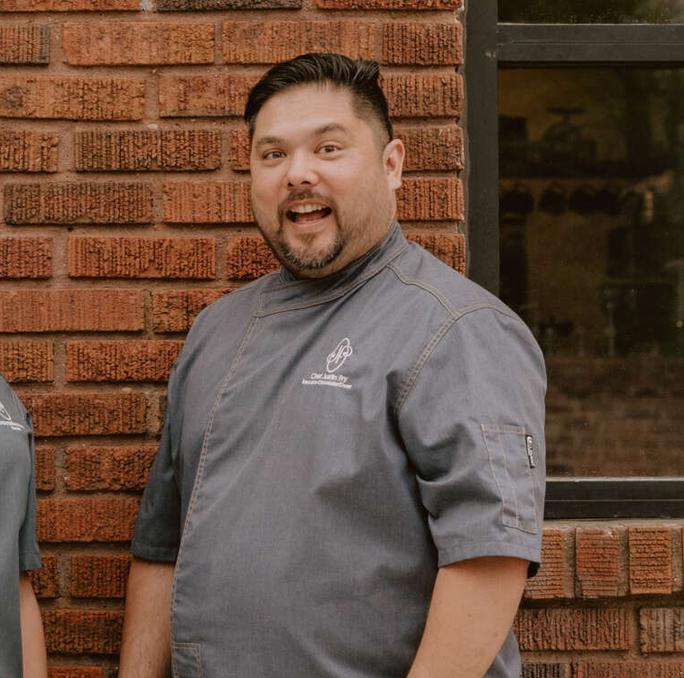
Chef Justin Fry
Founder, JF Chocolat
Leading: Culinary Hands-On Skills
Notes:
Chef Justin Fry is the founder of JF Chocolat, the premier chocolate purveyor here in the Charlotte region. After completing the Pastry Arts program at Johnson and Wales University in Denver, he worked at the historic Willard Hotel in Washington, D.C., serving dignitaries and celebrities, before honing his craft under a renowned chocolatier in Fort Myers, Florida. He was later named national Chocolatier of the Year, and in 2016 he placed first at the US Pastry Competition in New York City, earning the title Pastry Chef of the Year. He joins us today for one of our hands-on skill sessions this afternoon.

Slide 19
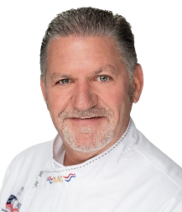
Chef Richard Kugelmann
CEC® · CCA® · AAC® — Central Piedmont Community College
Leading: Assessment Strategies & Hands-On Skills
Notes:
Chef Richard Kugelmann brings decades of culinary leadership to this conference. He's owned restaurants in Fayetteville and led Culinary Arts programs at both Fayetteville Tech and Central Piedmont Community College, where he retired as Dean of Skilled Trades and Public Services. He's a past president of the North Carolina chapter of the American Culinary Federation, and in 2019 he was inducted into the American Academy of Chefs. He's leading Assessment Strategies for Lab and Theory Components today, and he'll be running hands-on sessions tomorrow as well.

Slide 20
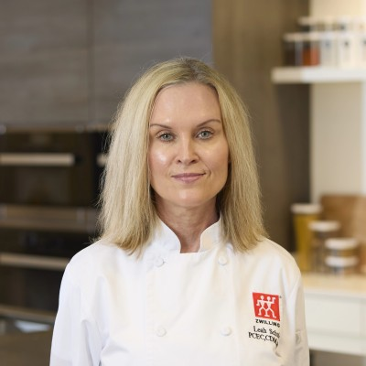
Chef Leah Schuler
Culinary & Nutrition Professional — Culinary Educator
Leading: Culinary Hands-On Skills
Notes:
Chef Leah Schuler brings together hands-on industry experience with a strong background in culinary education. Over her career she's worked across culinary training, product demonstrations, presentations, and hospitality, and she's especially good at translating technical kitchen knowledge into engaging, practical experiences for students and professionals alike. She's also passionate about mentoring the next generation of culinary and foodservice professionals, bringing a real-world industry perspective into the classroom. She'll be with us tomorrow morning leading one of our hands-on skill sessions.

Slide 21
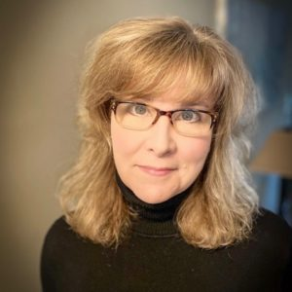
Carolyn Griffin, NCRLA
Food Safety & Lodging Regulations Specialist
Leading: Food Safety
Notes:
And finally, Carolyn Griffin is our own NCRLA Food Safety and Lodging Regulations Specialist. She earned her biology degree from UNC Wilmington and spent thirty years as a registered environmental health specialist, including twelve years as a regional field supervisor covering all one hundred counties in North Carolina. She developed the training for North Carolina's adoption of the 2009 Food Code and received the Richard Dietrichson Award for her work advancing environmental health education statewide. She joined NCRLA in 2022, and she's an incredible resource, so take advantage of having her here — she's leading our Food Safety sessions tomorrow.

Slide 22
Tonight: ProStart Educator Recognition Dinner
Goodyear House, Charlotte — 6:00–9:00pm
For confirmed ProStart educators
Attendance is required for NC educators to receive the portion of the stipend tied to this workshop
The restaurant is about 25 minutes from the hotel — please carpool
Plan to leave the hotel no later than 5:30

Slide 23
Logistics & Housekeeping
Restrooms
Please silence phones during sessions
Questions any time — just find someone on the NCRLA team

Slide 24
Let's Get Started!
Enjoy the 2026 NC ProStart Educator Conference

