Slide 1

2025 North Carolina
ProStart Leadership Training

Slide 2
Navigating ProStart

Slide 3

What is required each year?
Use the ProStart textbooks, lab manuals, and teacher resources as your primary textbook (any edition, although 1st edition books are being phased out)
Complete the annual data collection survey
Two signatures on the program agreement (digital is fine)!

Slide 4
What are the optional opportunities?
Attend the annual ProStart Leadership Summit—THIS EVENT
Use the online educator resources
Attend Fall Student Bootcamps
  Monday, November 17 at Sysco in Concord
  Thursday, November 20 at Sysco in Selma
Work with Courtney to reach industry members for tours, school visits, and mentorship
Attend the National ProStart Educator Professional Development event
  Receive your ProStart Educator Certificate
Help Students achieve the Certificate of Achievement (COA) and other
credentials
Apply for a Rachael Ray Grant
Participate in the North Carolina ProStart Invitational

Slide 5
Online Educator Resources
Curriculum Resources
  Course Standards
  Teacher guides, blank lesson plans, PowerPoints, etc.
Professional Development
  Information about this event, including downloadable presentations
  Information about the National Professional Development Event (including scholarships)
Classroom teaching tools
  Videos, handouts, online resources, Spanish language tools, lab ideas
ProStart Competition Resources
  National culinary dish photos
  Rules and forms
  Registration Links

Slide 6
Online Educator Resources
Student Bootcamp Information
  Registration Links
  Downloadable Presentations
Professional Development
  Information about this event, including downloadable presentations
  Information about the National Professional Development Event (including scholarships)
Program Implementation & Forms
  General Handbooks and guides
  Certificate of Achievement
  Industry Engagement
  Scholarships
Educator Toolkit
  Event more general guides and handbooks
  Program Calendars
  Discount programs
  Fact sheets about ProStart
NC ProStart News
  Links to past ProStart newsletters

Slide 7
Attend Fall Student Bootcamps
Registration includes breakfast and lunch for all attendees
NCPI participation is not required
Meet and learn from industry professionals

Slide 8
Connect with Industry
Reach out to Courtney for local industry connections
  Guest lectures, site visits/tours, mentor, competition coaching, etc.
Use the resources on the Educator Resource Guide
  Industry Engagement Fact Sheet
  ProStart Brochure
  What to Expect when you Hire a ProStart Student
Consider starting an advisory committee
  Courtney can help!

Slide 9
National ProStart Professional Development/ProStart Educator Certificate
National Event
  Has been held in New Orleans in July in the past—details for 2026 TBC
2025 Registration (not including hotel) $650-$750
  Separate registrations for CTE Administrators ($250) and Level Up program for past attendees ($350)
National scholarships are available!
  $2,000 to cover registration and hotel accommodations at host hotel
  Courtney will share the application in a monthly newsletter
ProStart Educator Certificate is awarded to all educators that attend and pass the exam
  Good for 5 years
  Can be renewed with 75 hours of industry-based training or engagements and
  participating in teaching in the Level Up program

Slide 10
Help students earn the Certificate of Achievement and other credentials
ServSafe Food Manager is a Tier 2 Credential with a $25 Teacher Credential Payment
  Teachers must have their ServSafe Food Manager Certificate and be registered as an educator/proctor with ServSafe
  Exams are $37.99, but eligible for a 10% discount for ProStart schools. 20% discount is available during September for National Foods Safety Month
All culinary 3 students must take the Pre-PAC as the proof of learning, even if seeking a Certificate of Achievement
Certificate of Achievement is a Tier 3 Credential with a $50 Teacher Credential Payment
  Two exams, $19-$22 each (depending on which book edition you use). 10% discount for ProStart schools
  Work Experience
  Skills Checklist

Slide 11
Certificate of Achievement Exams
Administered online by registered ProStart Educators/Proctors (everyone here is registered!)
Exams line up with each textbook (level 1 and level 2)
  100 questions each, must get 70% or higher to pass
  Exam Specifications (and practice exams) available on Educator Resource Guide
Credential funding is available through the district—work with your CTE staff and Courtney on purchasing exams
Exam administration handbook is available with step-by-step details on how to purchase exam codes, schedule exams, and administer the exam session
  On the Educator Resource Page under “Program Implementation and Forms”
Students currently “opt-ed in” for the Certificate of Achievement after
passing the level 1 exam and can begin entering work hours

Slide 12
Certificate of Achievement Skills Checklist
Available online under “Program Implementation and Forms” and then “Certificate of Achievement”
Contains 75 competencies
  57 Job-related observable skills (keeping food safe; workplace safety; kitchen essentials; foodservice equipment; stocks, sauces, and soups; fruits and vegetables; serving guests; potatoes and grains; breakfast food and sandwiches; nutrition; controlling foodservice costs; salads and garnishing; purchasing and inventory; meat, poultry, and seafood; marketing and the menu; desserts and baked goods; sustainable practices)
  18 Employability skills (communication, dependability and presentation, judgement, workplace)
Must demonstrate a minimum of 52 competencies
Competencies can be observed at multiple jobs, volunteer experiences, and during Culinary Arts & Hospitality II
Each supervisor uses one column on the checklist. Multiple checklists may be submitted if necessary

Slide 13
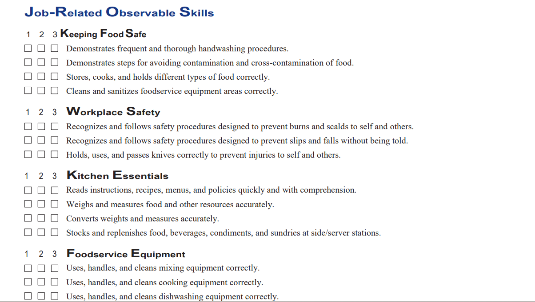
Certificate of Achievement Skills Checklist

Slide 14
400 Work Hours
Must be supervised and hospitality/food related
  Any position at any restaurant
  Concession stands
  Catering work
  School-based enterprise
  Can be a volunteer position!
120 hours is obtained by every student completing Culinary Arts & Hospitality II
  Teacher sends a letter or form verifying total hours
Additional 280 hours (less than 2 hours per week over 3 years) through work experience
  Students in Culinary Arts & Hospitality IV are also eligible to earn hours through classwork
  Must be documented with:
    Paystub showing hours worked or
    Year-end W-2 and pay rate or
    Least preferred A signed letter from the supervisor verifying the hours worked
All hours must be documented by the student on chooserestaurants.org
  Can be added daily, weekly, once a month, once a year…hours must match documentation

Slide 15
COA Approval Process
Student passes both exams with 70% or higher
Student enters all work hours into chooserestaurants.org platform and provides documentation to educator
Educator/supervisors complete Work Skills Checklist
Educator logs on to chooserestaurants.org platform and verifies:
  work experience is correct and matches documentation
  exams have been passed
  Work skills checklist has been completed
Educator forwards all paperwork (checklists and work verification) to Courtney at NCRLA
Courtney verifies and approves application
Student and educator receive an approval email
  Student can log on to print COA
  Student will also receive paper COA in the mail

Slide 16
Apply for a Rachael Ray Grant
Application available each fall
  Announced in ProStart updates and direct emails
For current programs or at schools that have committed to a ProStart program in the upcoming year
Up to $5,000 for any expenses related to your ProStart program
  Equipment
  Field Trips
  Food
  Professional Development
  Competition
  Etc.
Application does require a letter from a student, so start early!

