Slide 1

7
PROFESSIONAL EXPECTATIONS

Slide 2
Learning Objectives, Part 1
Define professionalism as it relates to the foodservice industry.
List the basic expectations for all employees in the foodservice industry.
Describe the optimal attitude for a restaurant employee.
Explain how employees demonstrate ethics in the workplace.
Describe the diversity of the restaurant industry and the role of diversity, equity, and inclusion (DEI) practices.

Slide 3
Learning Objectives, Part 2
Define stereotype, prejudice, and bias, providing one example of each term.
Recognize the benefits of teamwork in the foodservice workforce.
Explain the link between your personal health and wellness and success in your job.
List ways of avoiding and managing stress.
Identify time management strategies.

Slide 4

7.1 The Expectations of an Industry Professional, Part 1
Professionalism is a combination of trained skills, polite and positive behaviors, and good judgment.
Professionalism helps earn respect from coworkers and managers.

Slide 5
7.1 The Expectations of an Industry Professional, Part 2
Your Role in the Operation’s Success
A mission statement clearly states the company’s goals, vision, and values.
Every employee at a restaurant has a part in achieving a company’s mission.

Slide 6
7.1 The Expectations of an Industry Professional, Part 3
Your Presence at Work
Employers and guests expect employees to have a professional image.
Traditionally, for example, cooks and chefs wear:
Comfortable, polished shoes that are kitchen-safe
Pants that fit well; solid white for pastry chefs
Clean, ironed, double-breasted white jacket
Clean, ironed apron
Clean neckerchief, usually knotted or tied cravat style
Hat or toque

Slide 7
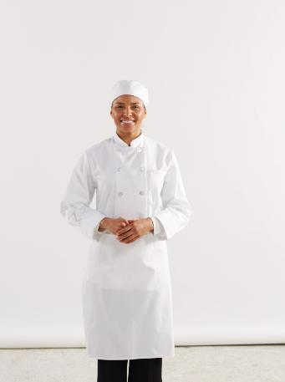
7.1 The Expectations of an Industry Professional, Part 4

Slide 8
7.1 The Expectations of an Industry Professional, Part 5
Your Attitude at Work
Your attitude at work reflects the respect you have for yourself, your work, and other people.
Employees with positive attitudes are more likely to be nice around guests and coworkers.

Slide 9
7.1 The Expectations of an Industry Professional, Part 6
Your Actions at Work
Personal Responsibility
You are responsible for following directions and doing tasks in the time frame your manager assigns.
Communicate often and clearly to help avoid and solve problems.
Ethics
Ethics are moral values that a group of people holds that often guide their decisions
Codes of conduct help everyone understand what acceptable or unacceptable behavior is in a particular context.

Slide 10
7.1 The Expectations of an Industry Professional, Part 7
Your Actions at Work, cont.
The American Culinary Federation has a code of conduct for its members. The Culinarian’s Code outlines four areas of responsibility for culinary professionals:
To themselves
To coworkers
To the business
To guests

Slide 11
7.1 Knowledge Check
What is the link between professionalism and respect?
In the service industry, how does each employee play a role in an operation’s success?
What goes into a restaurant employee’s professional image?
What is the purpose of workplace ethics in a foodservice operation?

Slide 12
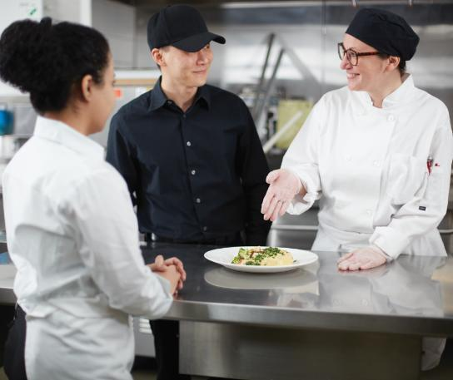
7.2 Your Relationships at Work, Part 1
Your relationships at work shape people’s views of you—and the way you treat others can make or break your success in the restaurant industry.

Slide 13

7.2 Your Relationships at Work, Part 2
Workplace Diversity
Diversity is the practice of including people of different races and nationalities, religions, gender identities, sexual orientations, ages, abilities, experiences, and opinions. Diversity, equity, and inclusion (DEI) are values that promote fair treatment and full participation of all people.

Slide 14
7.2 Your Relationships at Work, Part 3
Workplace Diversity, cont.
Prejudice is an opinion not based on reason or actual experience. Bias is a tendency toward a certain idea or belief based on prejudice.
Examples that could affect the restaurant industry include:
Employees giving better—or worse—service to guests who look a certain way
Managers letting their prejudices and biases affect who they hire
Employees of certain races or ethnicities being promoted more slowly—or faster—than others

Slide 15
7.2 Your Relationships at Work, Part 4
Showing Empathy
Empathy is the act of identifying with the feelings, thoughts, and attitudes of another person.
Employee to manager: “Sam called in sick again today. He’s been out a lot lately. It’s been hard on all of us!”
Manager to employee: “I know that it’s been tough on you and the rest of the team. I appreciate that you’ve all pitched in to keep everything running smoothly. I’m working on the situation so that it won’t continue to be a problem.”

Slide 16
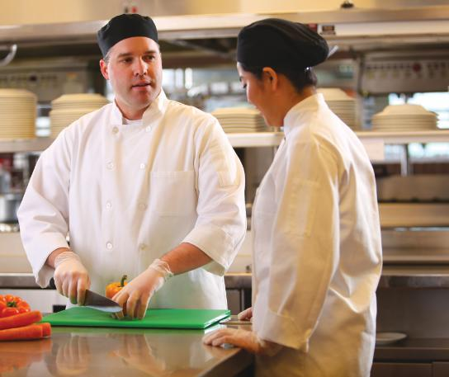
7.2 Your Relationships at Work, Part 5
Feedback
Feedback is helpful information that tells a person what about their actions or performance is working well and what needs improvement.

Slide 17
7.2 Knowledge Check
What is the importance of diversity, equity, and inclusion (DEI) in a workplace?
Provide an example of a stereotype and how it can affect the labeled person.
Write a paragraph to explain to a coworker why teamwork is so important and how it benefits them.
What kind of feedback do effective managers provide to employees?

Slide 18

7.3 Personal Health and Wellness, Part 1
For career success, you need to take care of your body and mind.
Staying healthy is the key to learning skills, getting experience, and being successful.

Slide 19

7.3 Personal Health and Wellness, Part 2
Tips for Health and Wellness
Eat healthy and stay hydrated.
Move your body.
Get enough sleep.
Take advantage of employers’ resources.
Avoid illegal drugs, alcohol, and tobacco.

Slide 20
7.3 Personal Health and Wellness, Part 3
Stress Management
Stress is a state of mental or emotional strain or tension.
Clues that your stress is a problem include:
Irritability
Anger
Depression or excessive negative thoughts
Headaches
Indigestion or other stomach problems
Pain in neck or lower back
Changes in appetite
Problems with sleep
Getting sick more often

Slide 21
7.3 Personal Health and Wellness, Part 4
Stress Management, cont.
Tips for managing stress:
Avoid stress.
Deal with problems. Stay healthy.
Build a supportive network.
Balance work and fun.
Deal with your emotions.
Use social media carefully.
Work on financial stability.
Find a job that makes you happy.
Ask for help.

Slide 22
7.3 Personal Health and Wellness, Part 5
Time Management
Tips for effectively managing time:
Plan
Mindfully use time
Set goals
Prioritize
Use time management tools

Slide 23
7.3 Knowledge Check
What are some realistic ways of staying healthy?
How can a little stress be a positive thing?
What are the signs that stress is becoming a problem?
What skills will help you effectively manage your time?

Slide 24
Business Case Follow-Up
William begins work for Cocina Mexicana in the summer, when it’s easy to balance his work hours with other responsibilities. But then he starts practice for the cross-country team. Then school begins, and he agrees to help run the school paper. Soon he starts to feel as though he doesn’t even have time to eat. He finds himself getting frustrated with his coworkers when they make mistakes. When he lies down to sleep at night, his mind races and keeps him awake. What is the cause of these problems? Describe two solutions for addressing them.
William meets with his manager, Diego, to explain the trouble he’s been having meeting his responsibilities. How might he communicate this to Diego in a professional way? How might Diego respond in a way that shows empathy?

