Slide 1
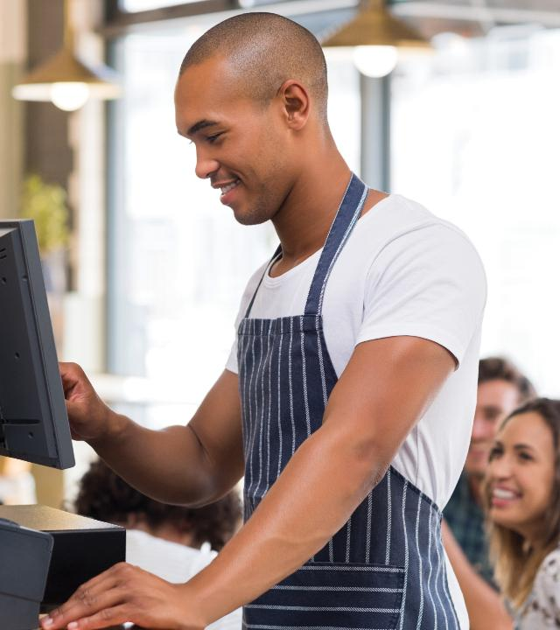
5
WELCOME TO THE FRONT OF THE HOUSE

Slide 2
Learning Objectives
  Compare the duties, roles, and responsibilities of each service staff role.
  Explain the process for handling guest reservations and special requests.
  Indicate the appropriate way to greet guests and take their orders tableside.
  Illustrate how suggestive selling benefits a foodservice operation.
  Differentiate between contemporary service styles and three traditional service styles.
  Describe how to properly set and clear items from a table.
  Identify the types of hot and cold beverages, and describe how they are served.
  Understand the steps in processing guest payments.

Slide 3
5.1 Service Staff Roles and Responsibilities, Part 1
A formal service structure might include the following front-of-house (FOH) staff roles and responsibilities:
  Maître d’hôtel
  Headwaiter
  Captain
  Front waiter
  Apprentice

Slide 4
5.1 Service Staff Roles and Responsibilities, Part 2
More commonly, full-service restaurants use a modified service structure—a smaller and more relaxed structure that might include the following roles and responsibilities:
  Floor manager
  Host or hostess
  Server
  Runner/buser (dining room attendant)

Slide 5
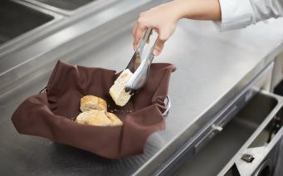
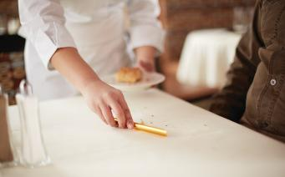
5.1 Service Staff Roles and Responsibilities, Part 3
Service Tools and Stations
In full-service restaurants, servers carry many different service tools and serving utensils. A few examples:
  Corkscrew
  Crumber
  Shell cracker
  Tongs
Serving utensils are not used in many contemporary full-service restaurants because most items are arranged on individual plates before they are served.

Slide 6
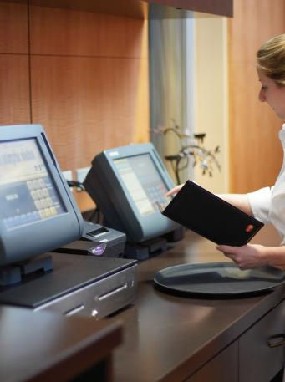
5.1 Service Staff Roles and Responsibilities, Part 4
Service Tools and Stations, cont.
A service station is an area in the front of the house where certain service items are stored, such as napkins, silverware, cups and saucers, condiments, menus, and water glasses.
Many restaurants also feature service stations that house the point-of-sale (POS) devices.

Slide 7
5.1 Service Staff Roles and Responsibilities, Part 5
Reservations and Requests
Reservations must be recorded in one place and contain information to help FOH staff prepare for a guest’s visit.
Reservation software prompts FOH staff to record the following information:
  Guest name
  Guest contact information
  Date and time of arrival
  Number of people in the party
  Any special needs or requests the guest might have

Slide 8
5.1 Service Staff Roles and Responsibilities, Part 6
Greeting Guests and Taking Orders
Guests are greeted by a host or hostess, who provides the first impression—in appearance, friendliness, and attentiveness.
In a full-service operation without a host or hostess, these tasks fall to the server or floor manager.

Slide 9
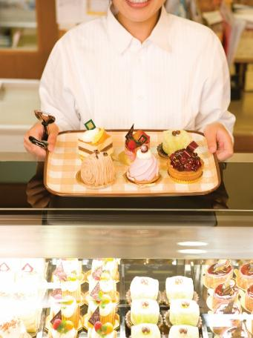
5.1 Service Staff Roles and Responsibilities, Part 7
Suggestive Selling
Suggestive selling involves recommending menu items to maximize guest satisfaction and increase the check.
The best sales tool for servers is an in-depth knowledge of the menu.

Slide 10
5.1 Service Staff Roles and Responsibilities, Part 8
Alcohol Service
Alcohol is frequently integral to a dining experience. Each state has its own liquor laws and oversees the sale and service of alcohol within its borders.
Any foodservice operation that serves alcohol and employs underage servers must understand the state laws for alcohol service.

Slide 11
5.1 Knowledge Check
What is the most important responsibility for any FOH staff role?
Compare and contrast taking guest orders with a POS system and taking orders with a paper pad and a pen. What are the strengths and weaknesses of each method?
Explain how sales is part of a server’s job. How might suggestive selling benefit servers?

Slide 12
5.2 Service Styles and Setups, Part 1
Every foodservice operation has a certain service style.
This way of serving food can often define how people come to think of that operation as a whole.
The roles and responsibilities of service staff differ based on which service style is used.

Slide 13
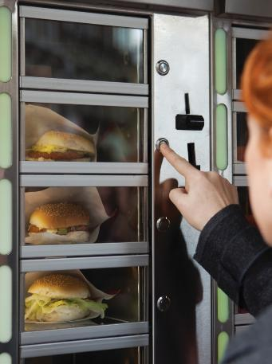
5.2 Service Styles and Setups, Part 2
Contemporary Service
Quick service dining typically involves no servers. Instead, guests order at a counter or serve themselves at a buffet.
Other forms of quick service dining include:
  Drive-throughs
  Carryout
  Vending machines
  Cafeteria service

Slide 14
5.2 Service Styles and Setups, Part 3
Traditional Service
Traditional service style reflects one of several cultural influences, three of which are American, French, and English. Each service style matches the menu, theme, and décor of a restaurant.

Slide 15
5.2 Service Styles and Setups, Part 4
Traditional Service, cont.
American service:
  Plated in the kitchen
  Complete meal served on one plate
  Easy and consistent
  Fewest service tools and utensils used
French service:
  Elegant, but expensive
  Food presented from a tableside cart called a guéridon
  Finishing touches applied tableside
  Additional server skills required

Slide 16
5.2 Service Styles and Setups, Part 5
Traditional Service, cont.
English service (family style dining):
  Bowls and platters of food placed on the table
  Self-service around the table or someone from the party serves
  Simplest and lease expensive

Slide 17
5.2 Service Styles and Setups, Part 6
Traditional Service Table Settings: Overview
Each service style features different types of silverware, drinking glasses, and china appropriate for certain food items.

Slide 18
5.2 Service Styles and Setups, Part 7
Traditional Service Table Settings: Silverware
It’s common for servers in traditional service to bring additional silverware as guests need it.
Contemporary service uses basic silverware.
In quick service or fast casual operations, you will only find forks, knives, and spoons; sometimes, they might be in the form of disposable sets.

Slide 19
5.2 Service Styles and Setups, Part 8
Traditional Service Table Settings: Drinking Glasses
The drinking glasses, mugs, and cups used in traditional service come in many shapes and sizes and are usually made of clear glass, plastic, or ceramic.

Slide 20
5.2 Service Styles and Setups, Part 9
Traditional Service Table Settings: China
The most important part of traditional service table setting is the china (or dishware).
Like silverware and glasses, plates have been adapted to fit various types of food.

Slide 21
5.2 Knowledge Check
Define contemporary service style. Provide an example of a contemporary service restaurant you have visited, and highlight the elements of contemporary service style used there.
Compare and contrast the three traditional service styles.
Identify when the following plates would be used: charger plate, dinner plate, salad plate, bread-and-butter plate, soup plate.

Slide 22
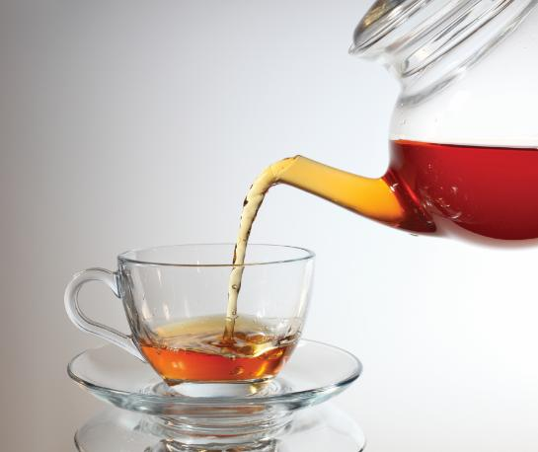
5.3 Beverage Service, Part 1
It is good for a restaurant to offer a range of beverages geared toward their typical guests.
The profit margin on beverages is generally high and good for a restaurant’s bottom line.

Slide 23
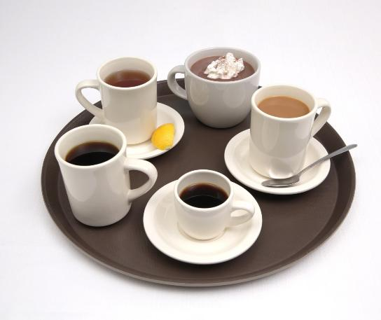
5.3 Beverage Service, Part 2
Coffee, Tea, and Cocoa
Coffee is made from ground coffee beans that are roasted to develop flavor.
Tea is made from the leaves of certain plants
Hot chocolate is made from actual chocolate bars, while hot cocoa is made from cocoa powder or shaved chocolate and sugar stirred into heated milk or water.

Slide 24
5.3 Beverage Service, Part 3
Service of Hot Beverages
If a guest is dining in, servers must address the following concerns:
  Cup and saucer are served on the right, with the handle facing four o’clock.
  Teaspoons are placed on the right side of the guest.
  Hot water is served with tea.
  Sweeteners and milk or cream containers are placed with handles facing to the right.
  In some operations, a small dish is placed to collect used tea bags, empty sweetener packets, and empty cream cups.
  Check with guests periodically to see if they need refills or more milk, cream, or sweetener.

Slide 25
5.3 Beverage Service, Part 4
Cold Beverages
Restaurants usually offer cold beverages, including iced tea, soft drinks, and bottled water.
Most restaurants provide all guests with tap or filtered tap water at no charge.
Mocktails, nonalcoholic versions of cocktails, are becoming popular as an alternative to alcoholic drinks and soda.

Slide 26
5.3 Beverage Service, Part 5
Cold Beverage Service
Follow these service procedures for cold beverages:
On tables without tablecloths, place either a coaster or napkin in front of the guest.
Place the drink on the napkin or coaster.
  Place either a teaspoon, iced tea spoon, or straw next to the drink (as needed).
  Place appropriate sweeteners on the table (as needed).
  Include a small dish to collect sugar packets and other refuse, to prevent them from touching the table.

Slide 27
5.3 Knowledge Check
What happens to coffee when it is held too long?
When serving hot beverages, where should the cup, saucer, and teaspoon be placed?
What kinds of hot and cold beverages might a restaurant offer if their typical guests include families with children?

Slide 28
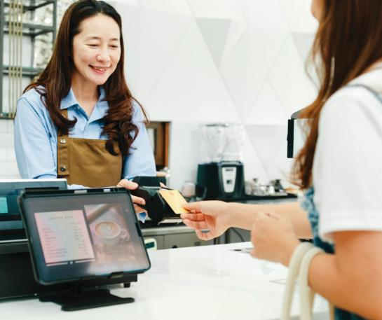
5.4 Processing Payments, Part 1
Processing payments is a vital function for FOH staff.
The way in which payment is processed can make the difference between a one-time guest and a repeat guest.

Slide 29
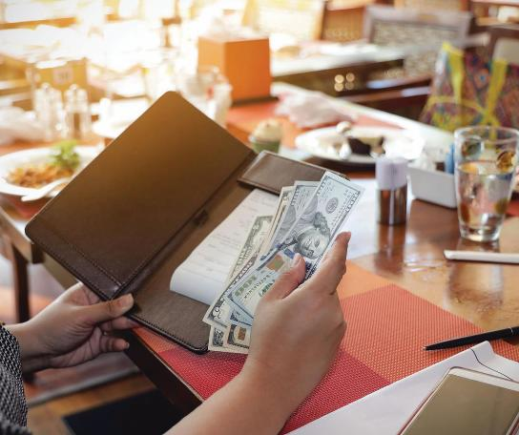
5.4 Processing Payments, Part 2
Gratuities
Tips are a guest’s way of thanking FOH staff—and even kitchen staff—for providing excellent service.

Slide 30
5.4 Knowledge Check
Summarize how a server processes a guest’s payment tableside.
How might a server cope with disappointment when a guest tips poorly for great service?

Slide 31
Business Case Follow-Up
Medina just hired two new young servers. She must train them on how to properly deliver food and beverages to tables. What things should she include when training them on delivering hot beverages to guests? What about placing and removing dishes?
Medina has seen two online complaints about reservations that were not handled properly at Salvatore’s. What should she say to the hostess who put the reservations into the digital point-of-sale reservations system?

