Slide 1
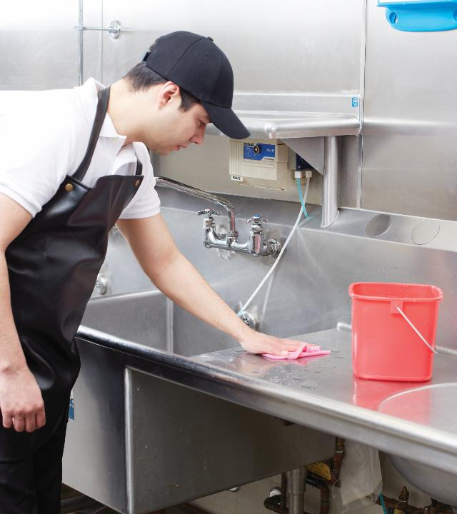
3
Introduction to Food Safety

Slide 2
Learning Objectives, Part 1
  Define a foodborne-illness outbreak.
  Explain the costs associated with a foodborne-illness outbreak.
  Identify those at high risk of contracting a foodborne illness.
  List the ways food can become unsafe.
  Define FAT TOM.
  Break down the characteristics of TCS food.
  Explain how to identify and prevent cross-contamination.

Slide 3
Learning Objectives, Part 2
  Define “time-temperature abuse.”
  Compare different thermometer types and explain how each type helps keep food safe.
  Name the most common food allergens.
  Explain the methods for preventing allergic reactions to food.
  Summarize why a food defense system is needed.
  Name the government agencies that regulate the restaurant and foodservice industries.
  Explain what a food safety management system is and how it works.

Slide 4
3.1 Foodborne Illness and Its Costs, Part 1
Foodborne illness is a disease transmitted to people by food.
A foodborne illness outbreak occurs when:
Two or more people get the same illness after eating the same food.
An investigation is conducted by state and local regulatory authorities.
The outbreak is confirmed by laboratory analysis.

Slide 5
3.1 Foodborne Illness and Its Costs, Part 2
There are many ways in which foodborne illness can affect an operation, including:
  Loss of guests and sales
  Loss of reputation
  Negative media exposure
  Lowered staff morale
  Lawsuits and legal fees
  Staff absenteeism
  Increased insurance premiums
  Staff retraining

Slide 6

3.1 Foodborne Illness and Its Costs, Part 3
Populations at High Risk for Foodborne Illnesses
High-risk populations have weakened immune systems and are at higher risk of getting foodborne illness.
The immune system is the body’s defense against illness.

Slide 7
3.1 Foodborne Illness and Its Costs, Part 4
Populations at High Risk for Foodborne Illnesses, cont.
Who is at high risk?
  Elderly people: Immune systems weaken with age.
  Pre-school age children: Very young children have not yet built up strong immune systems.
  People with compromised immune systems: People with cancer or on chemotherapy, people with HIV/AIDS, and transplant recipients all have weakened immune systems. Certain medications can also weaken immune systems.

Slide 8
3.1 Knowledge Check
How can you identify a foodborne-illness outbreak?
Which populations are at highest risk of getting a foodborne illness and why?

Slide 9
3.2 Forms of Contamination, Part 1
A hazard is something with the potential to cause harm.
Contamination means that harmful elements are present in food, making it unsafe to eat.
Pathogens are microorganisms that cause illness.

Slide 10
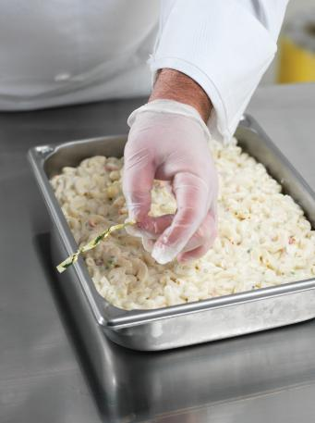
3.2 Forms of Contamination, Part 2
Food can become unsafe through any of the following practices:
  Poor personal hygiene
  Time-temperature abuse
  Cross-contamination
  Poor cleaning and sanitizing
  Purchasing from unsafe sources

Slide 11

3.2 Forms of Contamination, Part 3
Biological Contamination
Four types of pathogens can contaminate food:
  Viruses
  Bacteria
  Parasites
  Fungi

Slide 12
3.2 Forms of Contamination, Part 4
Biological Contamination: Viruses
Viruses are the leading cause of foodborne illness.
The best ways to prevent the spread of viruses are to:
  Stay home if vomiting or if you have diarrhea or jaundice.
  Wash your hands.
  Avoid using bare hands with ready-to-eat food.

Slide 13
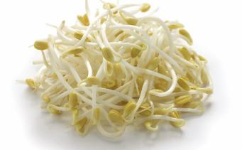
3.2 Forms of Contamination, Part 5
Biological Contamination: Bacteria
Bacteria need six conditions to grow. Use FAT TOM to remember these conditions:
  Food
  Acidity
  Temperature
  Time
  Oxygen
  Moisture

Slide 14
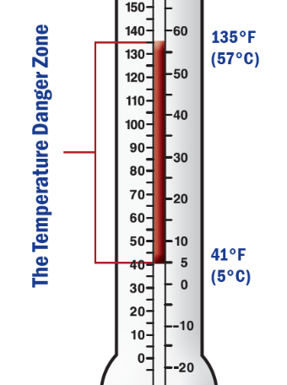
3.2 Forms of Contamination, Part 6
Biological Contamination: Bacteria, cont.
You can control the growth of most bacteria by keeping food out of the temperature danger zone (TDZ) which is between 41°F and 135°F (5°C and 57°C).

Slide 15
3.2 Forms of Contamination, Part 7
Biological Contamination: Parasites
  Parasites get nourishment and protection from other living organisms known as “hosts.”
  Parasites can live in cows, chickens, pigs, and fish.
  Illness caused by parasites is preventable, for example, by purchasing from approved, reputable suppliers is the best form of prevention.

Slide 16
3.2 Forms of Contamination, Part 8
Biological Contamination: Fungi
Fungi are found in air, soil, plants, water, and some food.
The two forms of fungi are mold and yeast.
Both forms grow well in acidic food with little moisture, for example, in jams, jellies, cured meat, syrup, honey, and fruit or fruit juice.

Slide 17
3.2 Forms of Contamination, Part 9
Biological Toxins
Biological toxins (poisons) get into food in two ways:
  Natural occurrence, for example, in poisonous wild mushrooms
  Contamination, for example, when a fish eats toxic algae

Slide 18
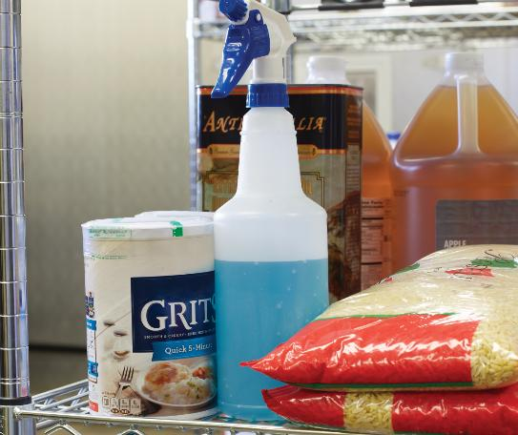
3.2 Forms of Contamination, Part 10
Chemical Contamination
Chemical contaminants in foodservice might come from:
  Cleaners
  Sanitizers
  Polishes
  Machine lubricants
Follow proper storage and handling procedures.

Slide 19
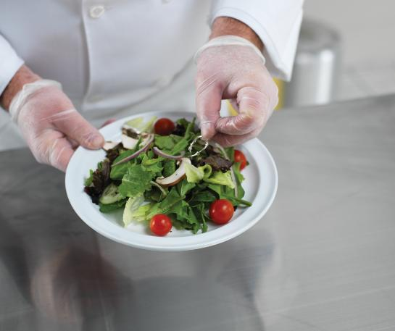
3.2 Forms of Contamination, Part 11
Physical Contamination
Physical contamination happens when objects get into food. Most contamination can be prevented by:
  Inspecting food closely when it is received
  Practicing good personal hygiene
  Following safe preparation procedures

Slide 20
3.2 Knowledge Check
What six conditions are needed for bacteria to grow?
What is the temperature danger zone and why is it a problem?
Describe the three primary ways of preventing physical contamination.

Slide 21
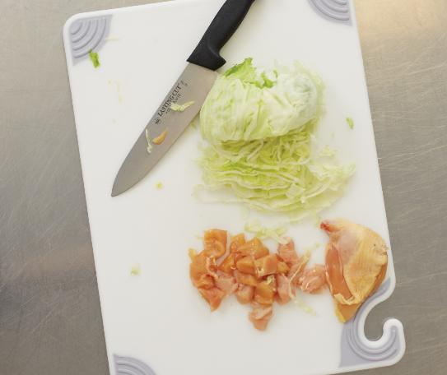
3.3 Cross-Contamination, Part 1
Cross-contamination occurs when pathogens spread from one surface or food to another.

Slide 22
3.3 Cross-Contamination, Part 2
To prevent cross-contamination, employees must:
  Make sure workstations, cutting boards, and utensils are clean and sanitized.
Not allow ready-to-eat (RTE) food to touch surfaces that have come in contact with raw meat, seafood, or poultry.
Clean and sanitize work surfaces and utensils between each product preparation.

Slide 23
3.3 Knowledge Check
What is the most basic way of preventing cross-contamination?
If you only have one worktable for food preparation, what steps can you take to prevent cross-contamination?

Slide 24
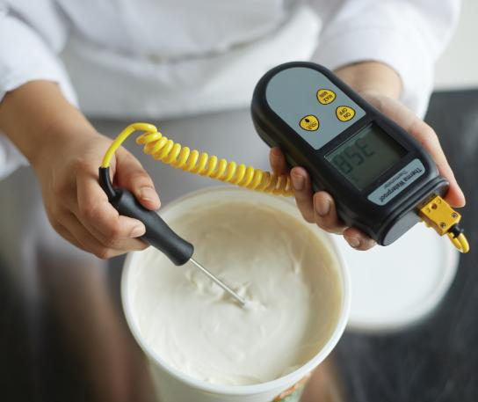
3.4 Time-Temperature Abuse, Part 1
  Time-temperature abuse occurs when food:
    Remains in the TDZ for too long.
    Is cooked to the wrong internal temperature.

Slide 25
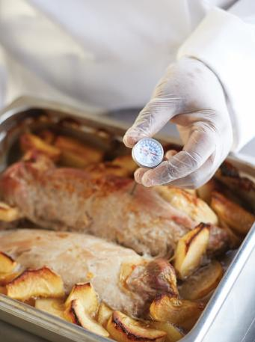
3.4 Time-Temperature Abuse, Part 2
Thermometers
Bimetallic stemmed thermometers are common in the restaurant industry.
Thermometers need to be regularly calibrated—adjusted to ensure an accurate reading.

Slide 26

3.4 Time-Temperature Abuse, Part 3
  How to Calibrate Thermometers
  The ice-point method involves adjusting a thermometer based on the temperature at which water freezes.

Slide 27
3.4 Knowledge Check
What can happen if TCS food has been time-temperature abused?
What precautions should you take after using a thermometer to check the temperature of food?

Slide 28
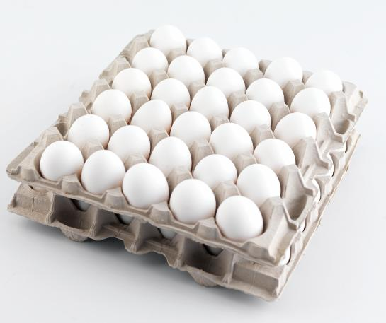
3.5 Food Allergies, Part 1
A food allergy is the body’s negative reaction to a food protein, or food allergen.
When an allergen comes in contact with another food and their proteins mix, it is called cross-contact.

Slide 29
3.5 Food Allergies, Part 2
The "Big Nine" Food Allergens
  Milk
  Soybeans (soy)
  Eggs
  Wheat
Fish, such as tuna or cod
Crustacean shellfish, such as crab, lobster, and shrimp
Peanuts
Tree nuts, such as almonds and pine nuts
Sesame

Slide 30

3.5 Food Allergies, Part 3
Serving Guests with Food Allergies
Follow these steps for an allergen special order:
Inform guests about food allergens on menus.
Listen to guests.
Takes notes.
Communicate the special order to back-of-house staff.
Deliver the special order safely.

Slide 31
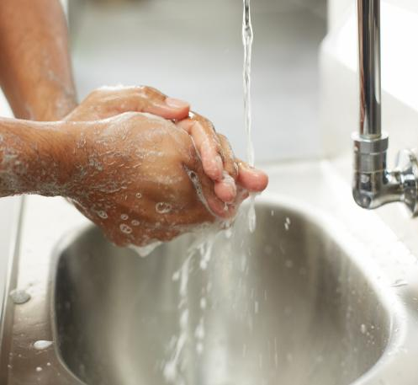
3.5 Food Allergies, Part 4
Prepping Orders for Guests with Food Allergies
Check deliveries carefully.
Cover and store food in specific containers.
Clean and sanitize.
Wash hands and change gloves.
Use separate utensils and equipment.
Prepare the special order correctly.

Slide 32
3.5 Knowledge Check
How can servers prepare to address the needs of guests with food allergens?
Describe cross-contact.

Slide 33
3.6 Food Defense, Part 1
“If you see something, say something.”
Steps to Prevent Deliberate Food Contamination
Control access to food storage and preparation areas.
Wear uniforms and name tags.
Report anything suspicious.

Slide 34
3.6 Food Defense, Part 2
United States Regulation and Food Safety
  The Food and Drug Administration (FDA) writes the FDA Food Code, which recommends specific food safety regulations for the restaurant and foodservice industry.
  An inspection is a formal review or examination to see if an operation is following food safety laws.

Slide 35
3.6 Knowledge Check
1. How are federal, state, and local governments each involved in food safety?
2. Explain the potential repercussions of failing a food safety inspection.

Slide 36
3.7 Food Safety Management Systems
A food safety management system is a group of procedures and practices that prevent foodborne illness.
Active managerial control is when a manager proactively controls risk factors for foodborne illness.

Slide 37
3.7 Knowledge Check
“Our management plan is to notice the food contamination problems that we have and then solve them.” What is the flaw in this approach?
What can a manager do to actively control risk factors for foodborne illness?

Slide 38
Business Case Follow-Up
As a manager, what role does Medina play in ensuring the food at Salvatore’s is safe for guests?
Medina wants to do a special training with servers and kitchen staff for accommodating guests with food allergies. How might she communicate the most common allergies to her staff, some of whom do not speak English as a first language?

