Slide 1

2
Career Opportunities

Slide 2
Learning Objectives
Explain the importance of entry-level jobs to people interested in the foodservice industry.
List and describe the roles of typical back-of-house staff and front-of-house staff.
List and describe the roles of typical restaurant management and support staff.
Describe the nine common job skills important in the restaurant and foodservice industry.
Explain the value of working with a mentor to develop career skills.
List common ways of working on your professional development.
Describe how professionals network and why it is important.

Slide 3

2.1 Foodservice Careers, Part 1
Overview
Entry-level jobs
Industry job categories:
Back-of-the-house
Front-of-the-house
Restaurant management and support

Slide 4
2.1 Foodservice Careers, Part 2
Entry-Level Jobs
An entry-level job requires little or no experience. Foodservice offers many entry-level positions:
90 percent of restaurant managers started in entry-level positions.
80 percent of restaurant owners started in entry-level positions.
The U.S. Bureau of Labor Statistics notes that most chefs and head cooks start in the kitchen in other roles, such as line cook.

Slide 5
2.1 Foodservice Careers, Part 3
Industry Job Categories
Three main categories for restaurant and foodservice jobs:
Back-of-the-house
Front-of-the-house
Restaurant management and support

Slide 6

2.1 Foodservice Careers, Part 4
Back-of-the-House
Back-of-the-house employees usually work in the background, outside of a restaurant’s public space. In the kitchen, they often:
Receive, store, prepare, and cook food
Manage the kitchen and equipment

Slide 7
2.1 Foodservice Careers, Part 5
Prep cook
Station cook/line cook
Banquet chef
Sous chef
Chef
Back-of-the-House, cont.
Typical back-of-the-house jobs:
Dishwasher
Kitchen manager
Expediter

Slide 8

2.1 Foodservice Careers, Part 6
Front-of-the-House
Front-of-the-house employees work directly with guests. In general, they:
Sell food and drinks
Keep guests happy

Slide 9
2.1 Foodservice Careers, Part 7
Front-of-the-House, cont.
Typical front-of-the-house jobs:
Host/hostess
Cashier
Server
Quick-service counter server
Buser
Runners
Headwaiter/maître d’
Captain
Front waiter
Back waiter
Floor manager/supervisor
Bartender
Barback
Barista
Wine steward/sommelier

Slide 10
2.1 Foodservice Careers, Part 8
Manager
Assistant manager
Purchasing manager/buyer
Receiving and storing
Inventory manager
Bookkeeping and accounting
Information technology
Marketing and sales professionals
Human resources
Restaurant Management and Support
Typical restaurant management and support jobs:
Owner-operator and entrepreneur
District manager
Multi-unit manager
General manager

Slide 11

2.1 Foodservice Careers, Part 9
Restaurant Management and Support, cont.
In some operations, many support functions are performed by a manager or owner.
Larger organizations may employ a broadliner such as Sysco, US Foods, and Gordon Food Services. Companies such as Automatic Data Processing (ADP) and Paychex can provide human resources support and compliance services.

Slide 12
2.1 Knowledge Check
Why are entry-level positions so important in the restaurant and foodservice industry?
What makes back-of-the-house employees, who rarely have contact with guests, so important to those guests?
How does the role of the front-of-the-house host/hostess compare with that of a buser?
What is the role of a restaurant general manager?

Slide 13
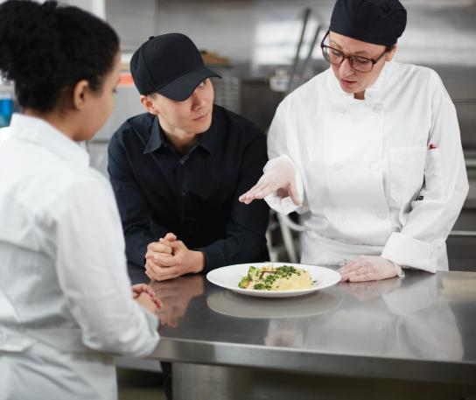
2.2 Career Skills Needed for a Successful Career, Part 1
Overview
Identifying the key skills
Developing the skills

Slide 14
2.2 Career Skills Needed for a Successful Career, Part 2
Identifying the Key Skills
Hard skills: Based on facts and the ability to do certain tasks well
Soft skills (or interpersonal skills): Based on dealing well with people
Emotional intelligence: Understanding human emotions and how they affect behavior

Slide 15
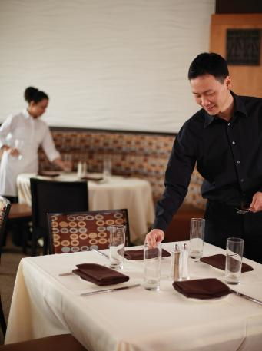
2.2 Career Skills Needed for a Successful Career, Part 3
Identifying the Key Skills, cont.
Common job skills and traits important in the restaurant and foodservice industry:
Positive attitude
Good communication
Team player
Willingness to learn
Technology skills
Math skills
Analyzing and problem-solving skills
Food safety knowledge
Product knowledge

Slide 16
2.2 Career Skills Needed for a Successful Career, Part 4
Developing the Skills
No matter what career you pursue, you can develop your skills now by:
Committing to do your best.
Working part-time in the industry while in school.
Accepting challenges in school.
Working to learn new skills.
Being active in clubs and activities.
Volunteering in the community.
Researching the industry.
Building technological skills.
Grabbing opportunities to improve your learning and work habits.

Slide 17

2.2 Career Skills Needed for a Successful Career, Part 5
Developing the Skills, cont.
A mentor is someone who advises and guides you along your career path.

Slide 18
2.2 Knowledge Check
Why are math skills considered important in the restaurant and foodservice industry?
When is the right time to begin to learn the skills you need in the foodservice industry?
What kind of person makes a good mentor?

Slide 19
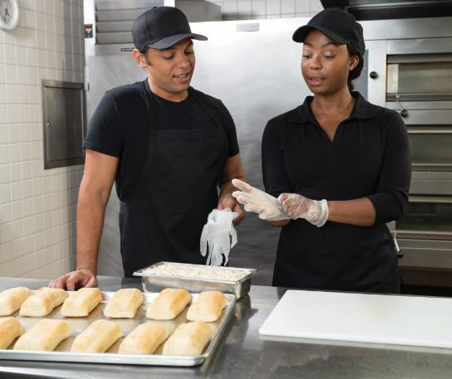
2.3 Staying Educated and Involved, Part 1
Overview
Continuous learning
Networking

Slide 20
2.3 Staying Educated and Involved, Part 2
Continuous Learning
Opportunities for continuous learning in the foodservice industry include:
Industry publications
Professional organizations
Certifications
Continuing education

Slide 21
2.3 Staying Educated and Involved, Part 3
Networking
Networking is the process of connecting with people and building relationships.
These relationships can lead to career advancement, information about industry updates, and greater knowledge and skills.

Slide 22
2.3 Staying Educated and Involved, Part 4
Networking, cont.
How do you network?
Attend industry conferences
Participate in online professional development sites
Build relationships with chefs and managers you work with
Internships
Enter culinary and management competitions
What else can you do?
Community events: career days, forums, charity events, and service projects
Restaurant association events

Slide 23
2.3 Staying Educated and Involved, Part 5
Networking, cont.
Networking relationships must work two ways:
You benefit from individuals in your network.
They benefit from you.

Slide 24
2.3 Knowledge Check
Why is professional development important?
What does a certification show a potential employer?
What are the benefits of networking?

Slide 25
Business Case Follow-Up
How would you compare Medina’s career path with the career paths of other restaurant managers?
Now that Medina is a manager at Salvatore’s, what are some ways that she can continue her professional development?

