Slide 1

1
WELCOME TO THE INDUSTRY

Slide 2
Learning Objectives
  Differentiate among the eight types of dining establishments.
  Describe the commercial and noncommercial segments of the restaurant and foodservice industry, including examples of businesses in each segment.
  List examples of businesses within the three segments of the hospitality industry.
  Recognize key historical, social, scientific, and political advances in the world that affected the evolution of the restaurant and foodservice industry.
  Explain the role of entrepreneurs in the growth of the restaurant and foodservice industry.
  List examples of how chefs have been critical to the growth of the restaurant and foodservice industry.

Slide 3
1.1 The Restaurant and Foodservice Industry, Part 1
Commercial Restaurant and Foodservice Segment
  Restaurants
  Catering and banquets
  Retail
  Stadiums and other entertainment venues
  Travel industry

Slide 4
1.1 The Restaurant and Foodservice Industry, Part 2
Noncommercial Foodservice Segment
  Schools and universities
  Healthcare facilities
  Business and industry
  Clubs
  Government

Slide 5
1.1 The Restaurant and Foodservice Industry, Part 3
The Hospitality Industry
  Services people use away from home
  Feelings guests take away from an operation, based on service, care, attention, and physical environment

Slide 6
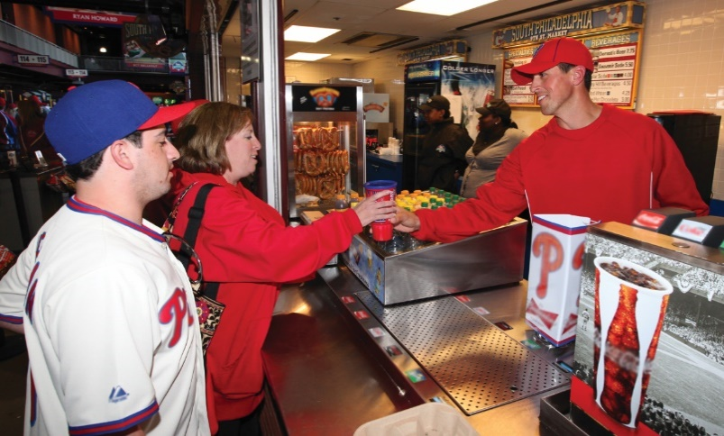
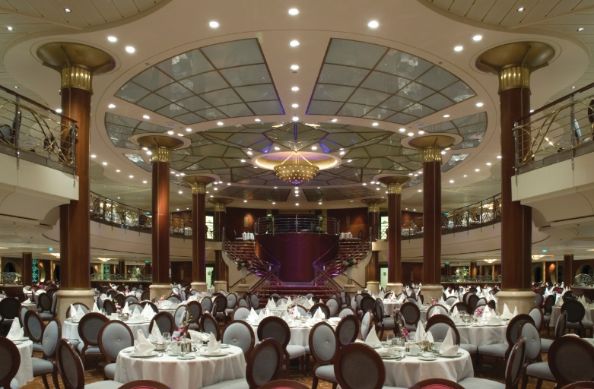
1.1 The Restaurant and Foodservice Industry, Part 4
The Hospitality Industry, cont.
Foodservice—a key sector of hospitality—includes restaurants, retail operations, and hotel dining.

Slide 7
1.1 Knowledge Check
Give examples of each of the eight types of dining establishments.
You manage a wellness spa that offers a menu of services for its membership and includes a smoothie bar that also sells healthy snacks. Would your business fall under the commercial or noncommercial segment of the restaurant and foodservice industry?
How do restaurants and other foodservice operations fit into the hospitality industry?

Slide 8


1.2 The History of the Restaurant and Foodservice Industry, Part 1
Overview
  The Rise of Clubs—Ancient Greece
  The Growth of Farming—The Middle Ages
  Spices, Cafés, and Guilds—The Renaissance through the French Revolution
  Inns—Colonial North America
  From Cafeterias to Elegance—The Late 1800s
  The Rise of Modern Restaurants—The Twentieth Century
  The Global Industry—Today and Beyond

Slide 9
1.2 The History of the Restaurant and Foodservice Industry, Part 2
The Rise of Clubs—Ancient Greece
  Lesche (LES-kee): Private clubs that offered food to members
  Phatnai (FAAT-nay): Other establishments that catered to travelers, traders, and diplomats
The Growth of Farming—The Middle Ages
The rise of Christianity:
  United Europe
  Ended the idea that trees and forests were sacred
  Gave way to the modern conception of farming

Slide 10
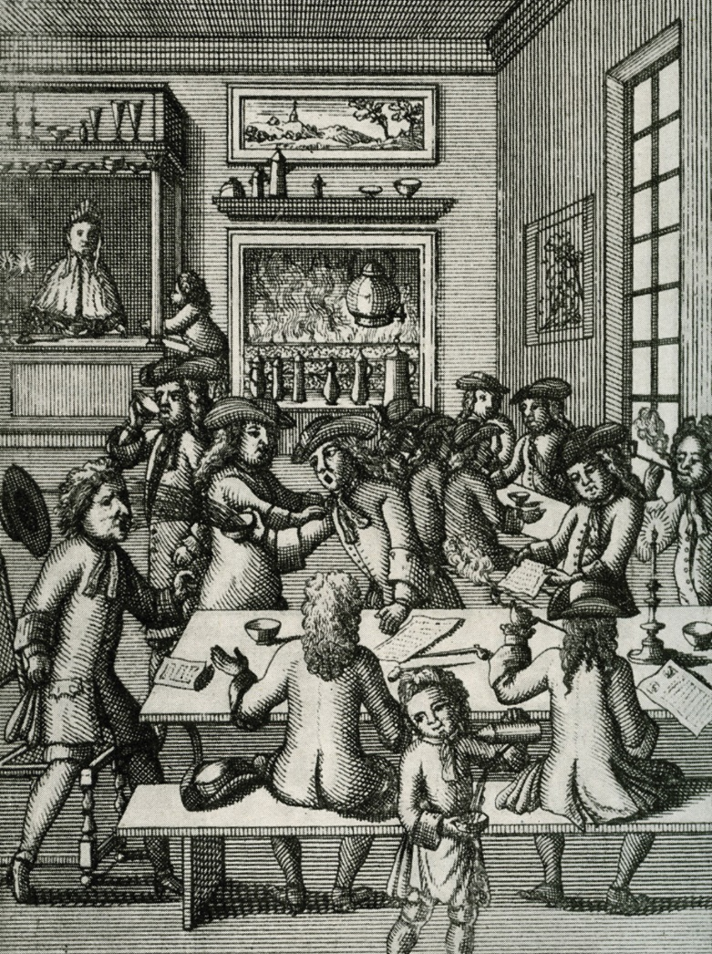
1.2 The History of the Restaurant and Foodservice Industry, Part 3
Spices, Cafés, and Guilds—The Renaissance through the French Revolution
The popularization of spices and increased world travel shifted artistic and philosophical mindsets toward food, giving rise to the following:
  Epicurean lifestyles
  Haute cuisine
  Cafés
  Guilds
  Restorante

Slide 11
1.2 The History of the Restaurant and Foodservice Industry, Part 4
Inns—Colonial North America
  The emergence of East Coast cities, spurred by immigration, led to the development of inns which:
    Offered food and lodging
    Had little care for meal preparation

Slide 12
1.2 The History of the Restaurant and Foodservice Industry, Part 5
From Cafeterias to Elegance—The Late 1800s
  On the East Coast, high-class, multi-course restaurants emerged.
  In California, cafeteria-style allowed for quick service.
  Along railroads, entrepreneurs opened restaurants to serve passenger needs.

Slide 13

1.2 The History of the Restaurant and Foodservice Industry, Part 6
The Twentieth Century
Modern restaurants emerged because of these factors:
  High employment
  Growing economy
  More cars

Slide 14
1.2 The History of the Restaurant and Foodservice Industry, Part 7
The Global Industry—Today and Beyond
The global industry reflects:
  Expansion of national chain restaurants
  Local and sustainable options
Foodservice and restaurants:
  Maintain tradition
  Respond to societal changes

Slide 15
1.2 Knowledge Check
How did the introduction of Christianity to Germany lead to the start of farming?
How did the growth of international trade lead to the first café and the acceptance of eating in public?
What was the origin of the cafeteria?

Slide 16
1.3 Entrepreneurs and Chefs in the Industry, Part 1
Overview
  The Role of Entrepreneurs
  The Role of Chefs

Slide 17
1.3 Entrepreneurs and Chefs in the Industry, Part 2
The Role of Entrepreneurs
An entrepreneur starts and runs a business. Most begin with just one operation or business and expand. Notable examples include:
    Ruth’s Chris Steak House
    Steak and Ale
    Red Lobster
    Food trucks

Slide 18
1.3 Entrepreneurs and Chefs in the Industry, Part 3
The Role of Entrepreneurs, cont.
Harvard Business School identified 10 specific characteristics and skills important for entrepreneurs:
  Curiosity
  Willingness to experiment
  Adaptability
  Decisiveness
Self-awareness
Risk tolerance
Comfort with failure
Persistence
Innovative thinking
Long-term focus

Slide 19
1.3 Entrepreneurs and Chefs in the Industry, Part 4
The Role of Chefs
Marie-Antoine Carême:
  Viewed cuisine as a branch of architecture
  Perfected French sauces
  Defined haute cuisine
  Trained many chefs

Slide 20
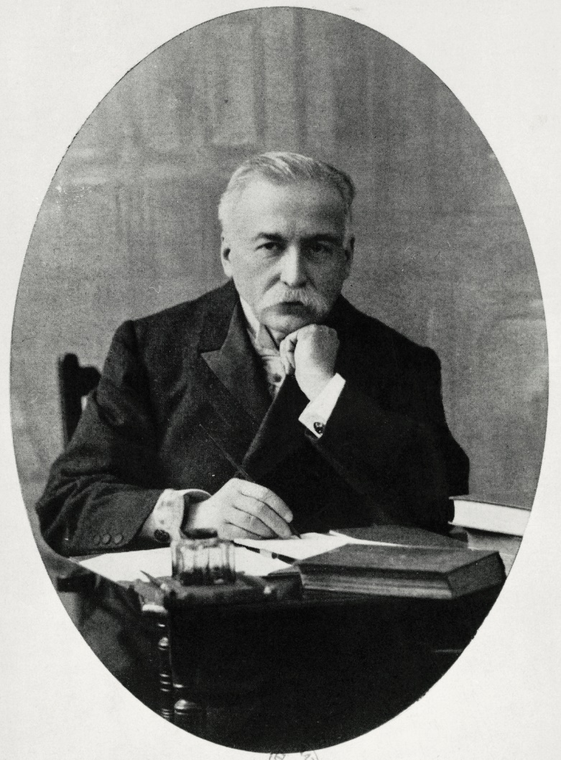
1.3 Entrepreneurs and Chefs in the Industry, Part 5
The Role of Chefs, cont.
Georges August Escoffier
“King of the Kitchen”:
  Translated haute cuisine into contemporary cuisine
  Established rules of conduct and dress for chefs
  Developed the “kitchen brigade system”

Slide 21

1.3 Entrepreneurs and Chefs in the Industry, Part 5the 20th Century
The Role of Chefs, cont.
  Influential chefs of the 20th century:
  Fernand Point
  Julia Child
  Paul Bocuse
  Alice Waters
  Ferdinand Metz

Slide 22
1.3 Entrepreneurs and Chefs in the Industry, Part 6
The Role of Chefs, cont.
  Chefs of the 21st century are visible:
  Television appearances
  Competitions
  Internet exposure
  “Celebrity chefs”

Slide 23
1.3 Knowledge Check
Why are entrepreneurs important to the restaurant and foodservice industry?
How have chefs been critical to the growth of the restaurant and foodservice industry?

Slide 24
Business Case Follow-Up
How will understanding the history of Salvatore’s restaurant in relation to the restaurant industry be useful to Medina when dealing with both the back and front of the house?
People enjoyed dining out long before Salvatore’s existed. Reflecting on the restaurant industry throughout history, when do you think that the concept of serving guests became really important? Explain your answer.

