Slide 1

2025 North Carolina
ProStart Leadership Training

Slide 2
Competition Overview and Best Practices

Slide 3
Culinary Competition

Slide 4
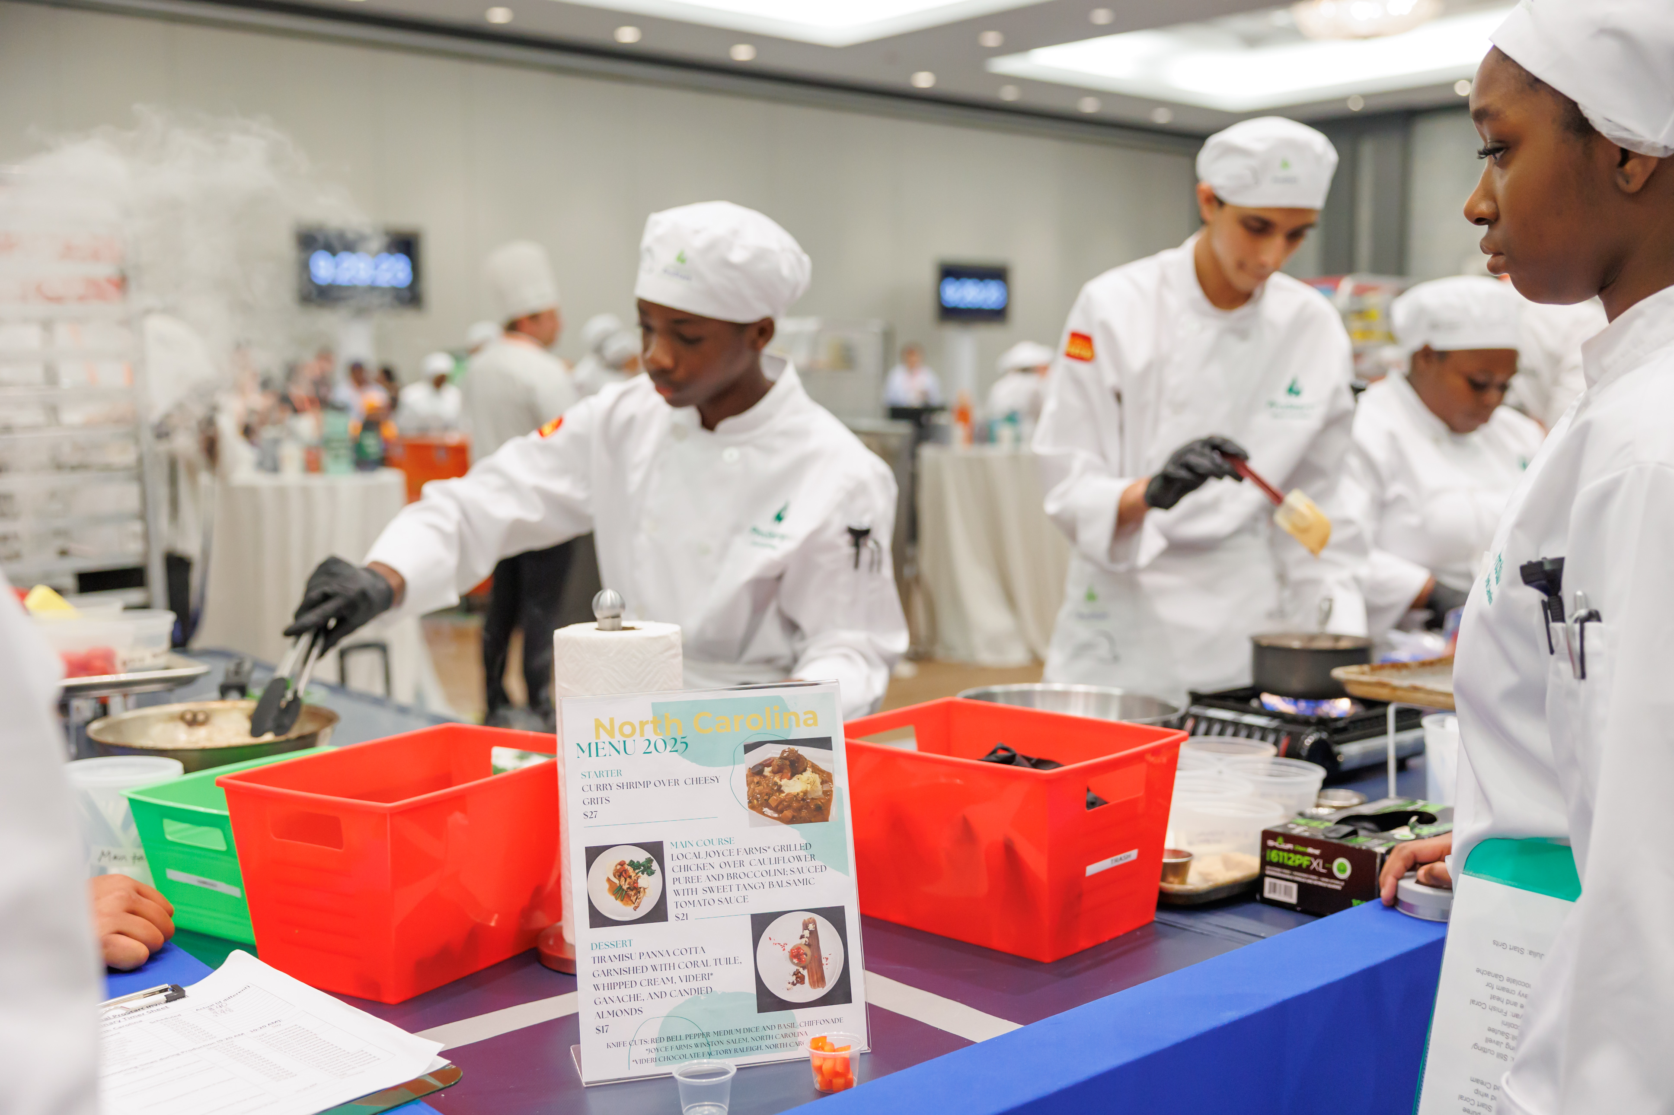

Purpose
Students showcase culinary skills, teamwork, and creativity.
Goal: Prepare a 3-course meal (starter, entrée, dessert).
Judged on taste, presentation, safety, and professionalism.

Slide 5
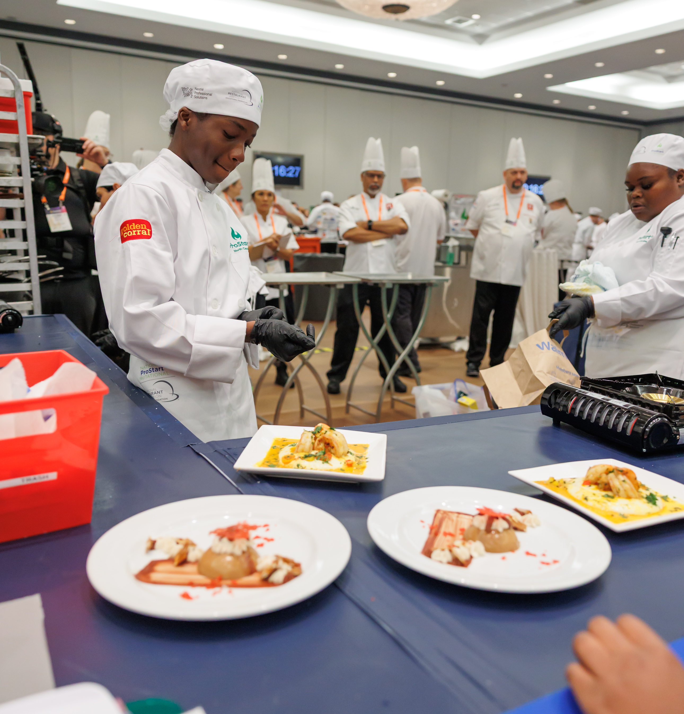
Competition Format
Teams of 2–4 students (+ optional team manager).
Two identical meals: one for judging, one for display.
Strict timing and sanitation requirements.
20 minutes to set up
60 minutes to prepare with penalties for going over/disqualification after 10 minutes

Slide 6
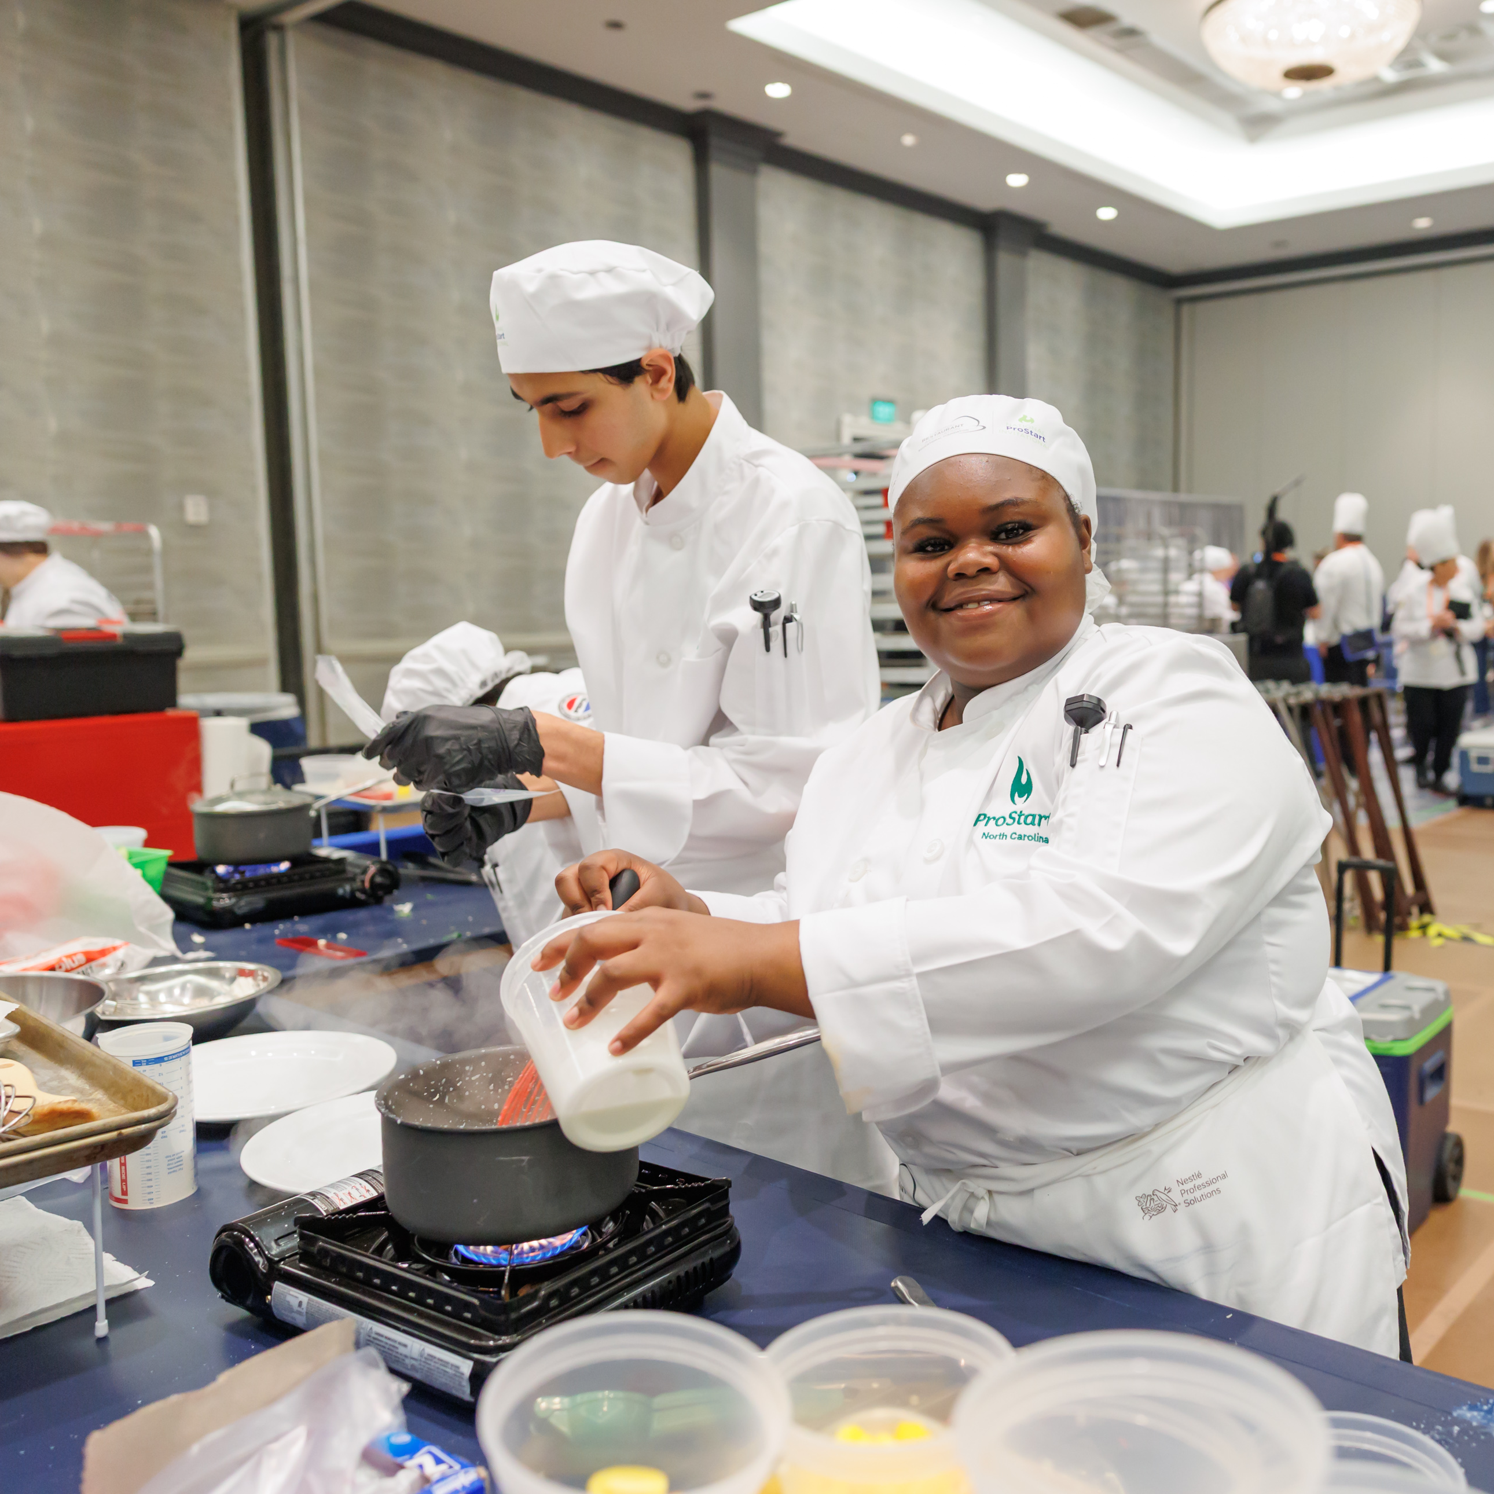
Menu & Rules
Starter: 4–6 oz soup, salad, or appetizer.
Entrée: 4–6 oz protein + 2 sides + sauce.
Dessert: 3+ oz sweet item.
Must use at least 2 cooking methods (Poach, shallow poach, braise, pan fry, steam, and sauté)
Must demonstrate and use 2 knife cuts on fruits, vegetables, or herbs only (Rondelle, Diagonal, Batonnet, Julienne, Large Dice, Medium Dice, Small Dice, Brunoise, Paysanne, Chiffonade, Tourne)

Slide 7
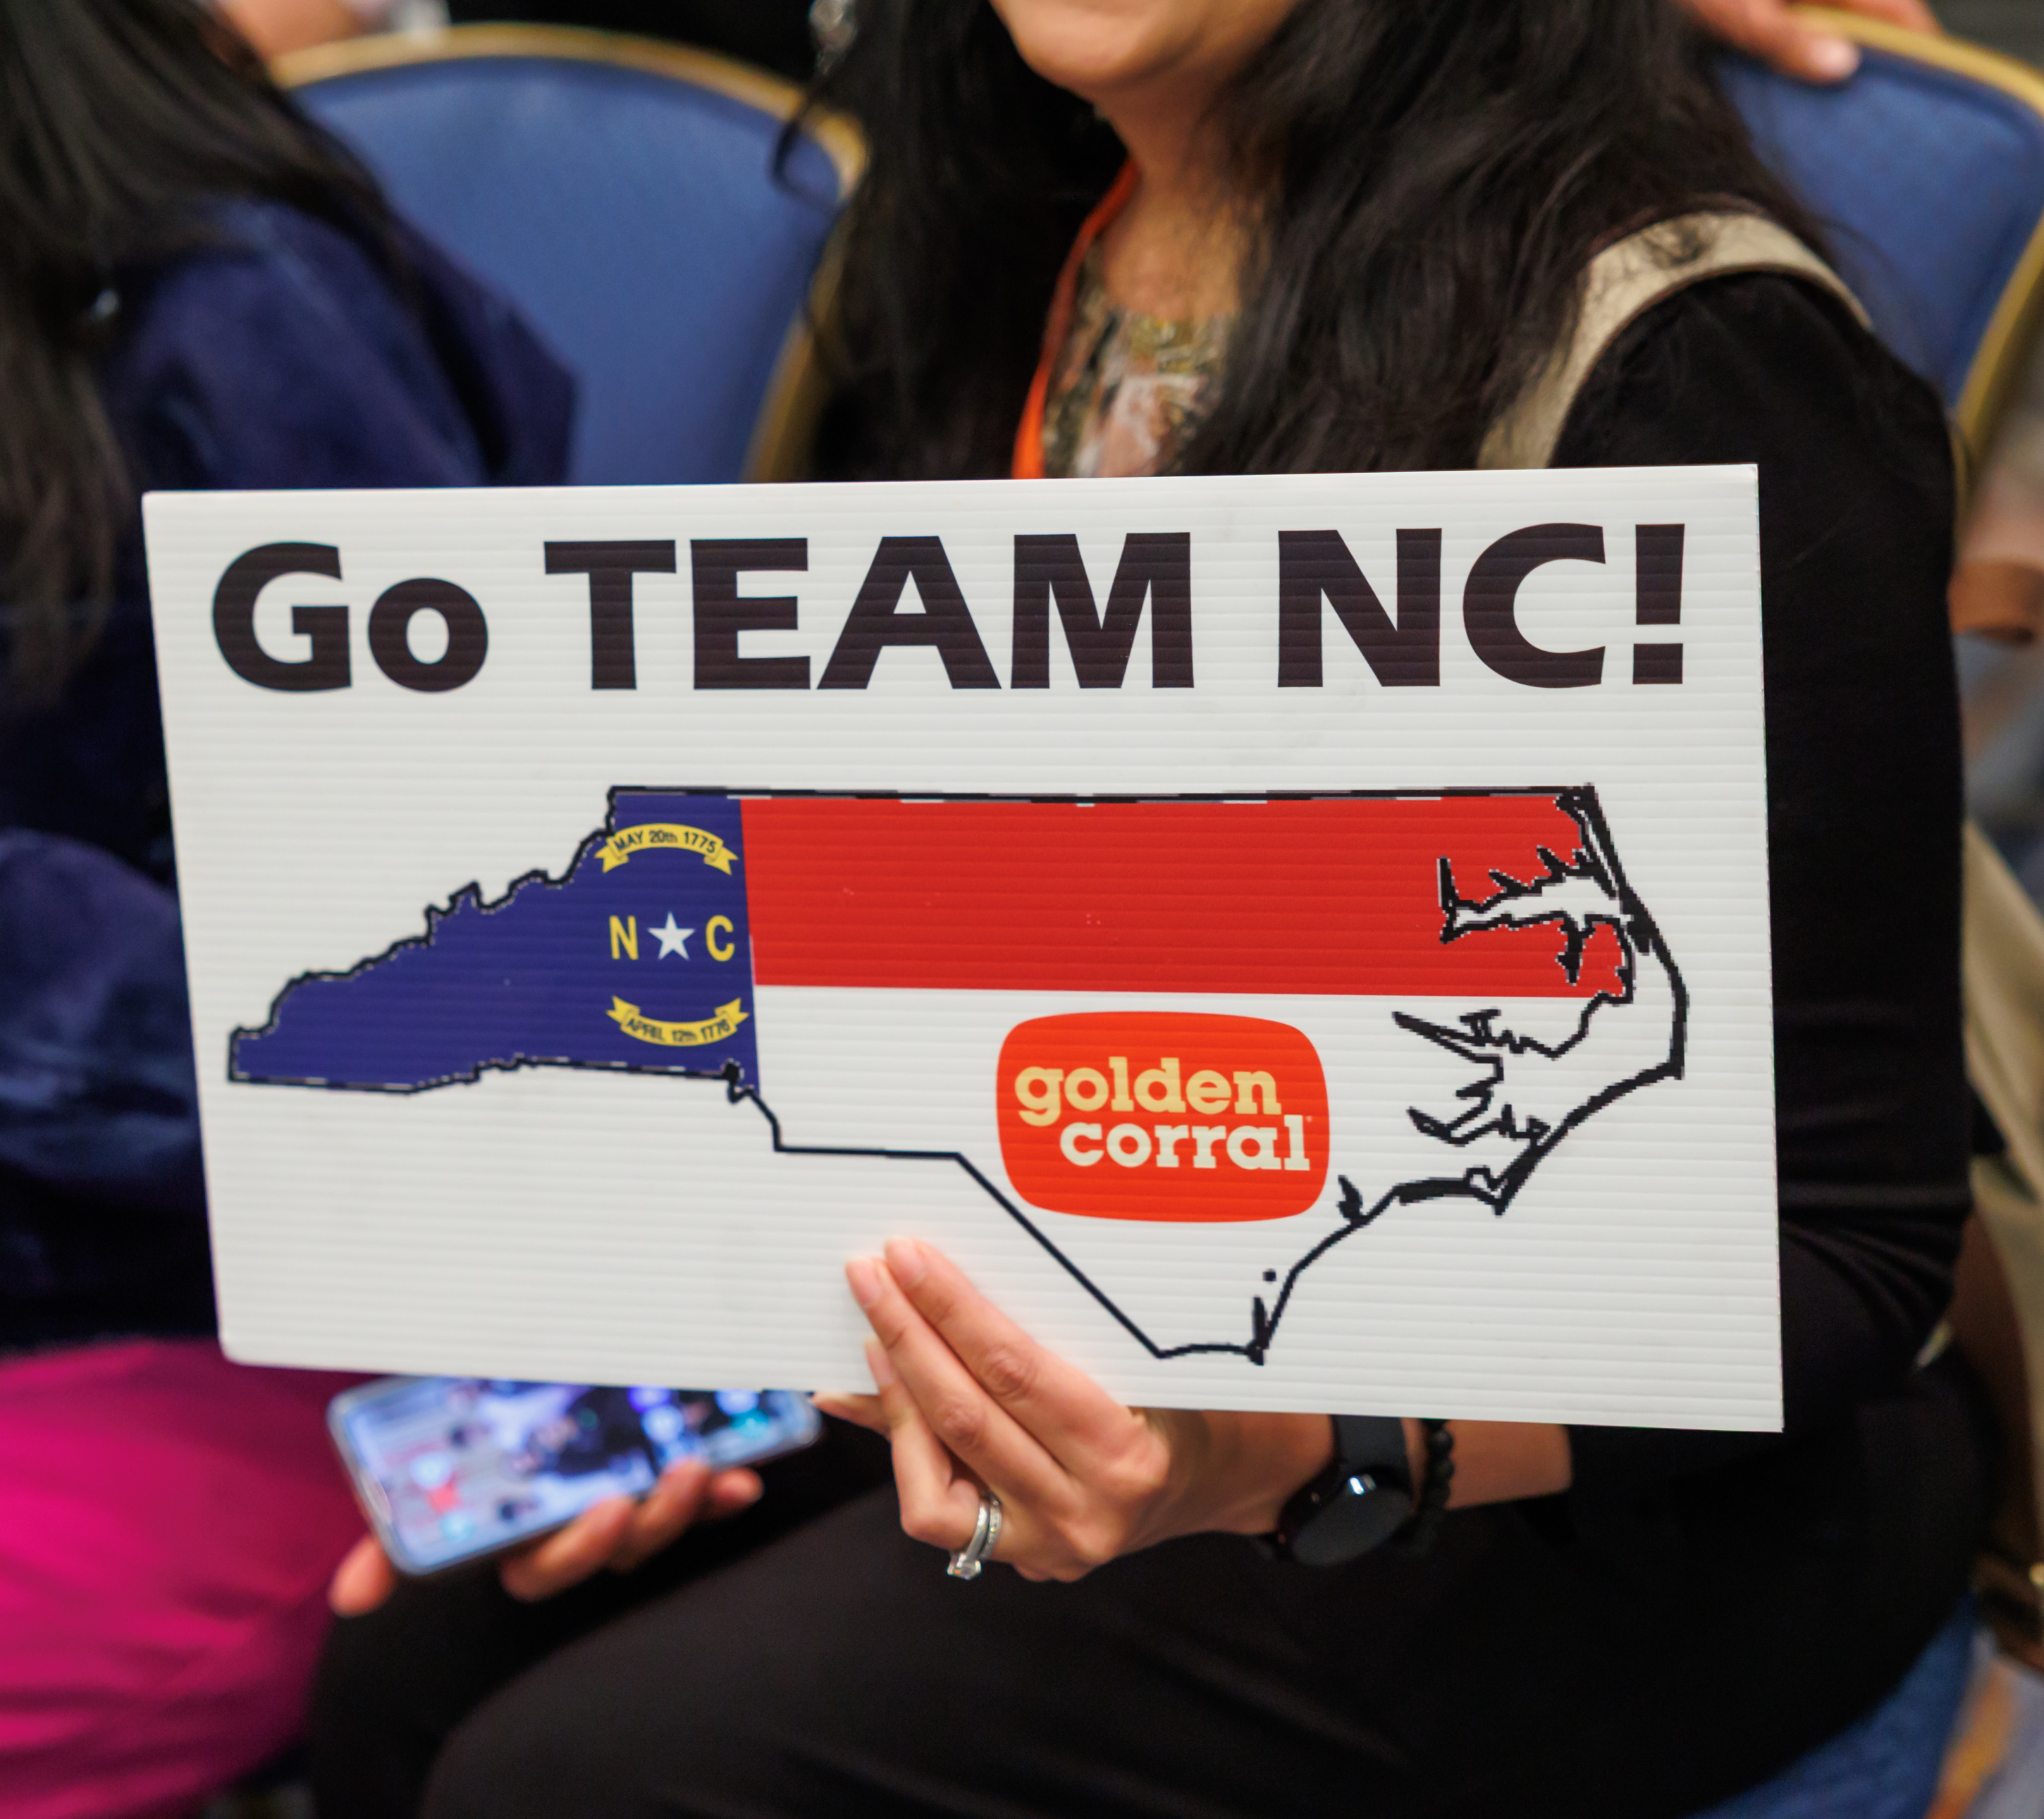
Scoring Breakdown (100 pts)
Product Check-In – 5
Knife Skills/Presentation – 10
Work Skills & Organization – 15
Safety & Sanitation – 15
Taste & Presentation
Starter – 15
Entrée – 20
Dessert – 15
Menu & Recipe – 5

Slide 8
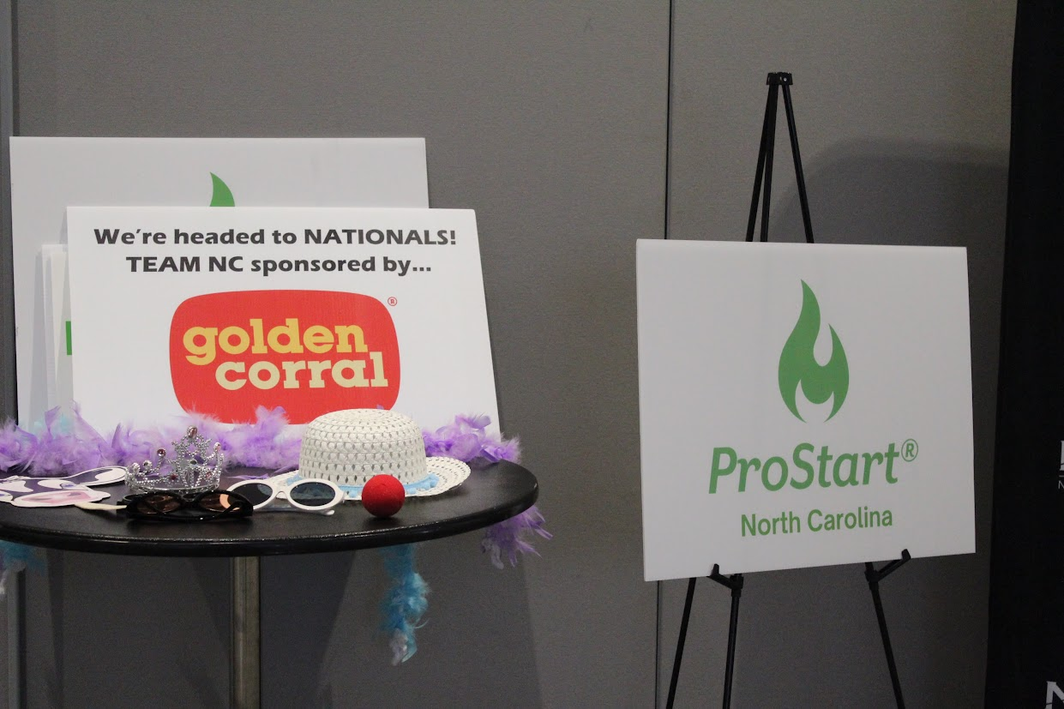

Major Deductions and Disqualifications
Late proposal submittal—5 pts.
Not in uniform-5pts.
Did not submit updated proposal (if necessary)-5pts.
Prohibited equipment or ingredients-5pts. each
Team manager violations-5pts.
Outside dishware-5pts.
Early or Late more than 10 minutes-disqualified
Use of additional heat sources-disqualified

Slide 9
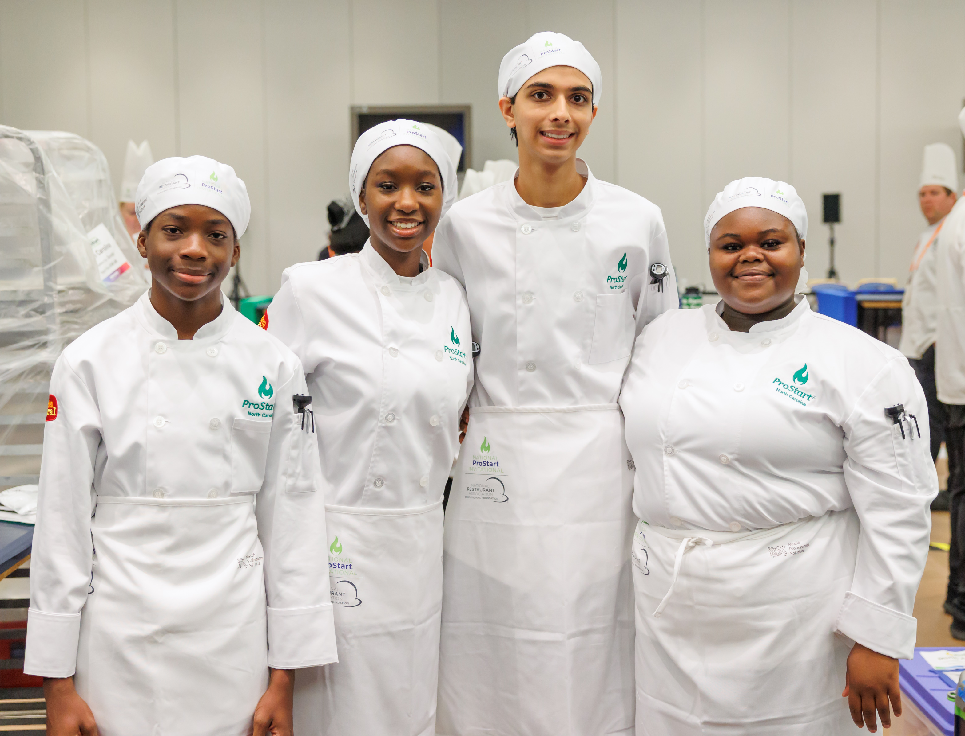
Key Takeaways
Follow all the basic rules!
Teamwork + timing + technique = success.
Uniforms required: chef coats, hats, aprons, non-slip shoes.
Creativity and precision make teams stand out.

Slide 10
Management Competition

Slide 11
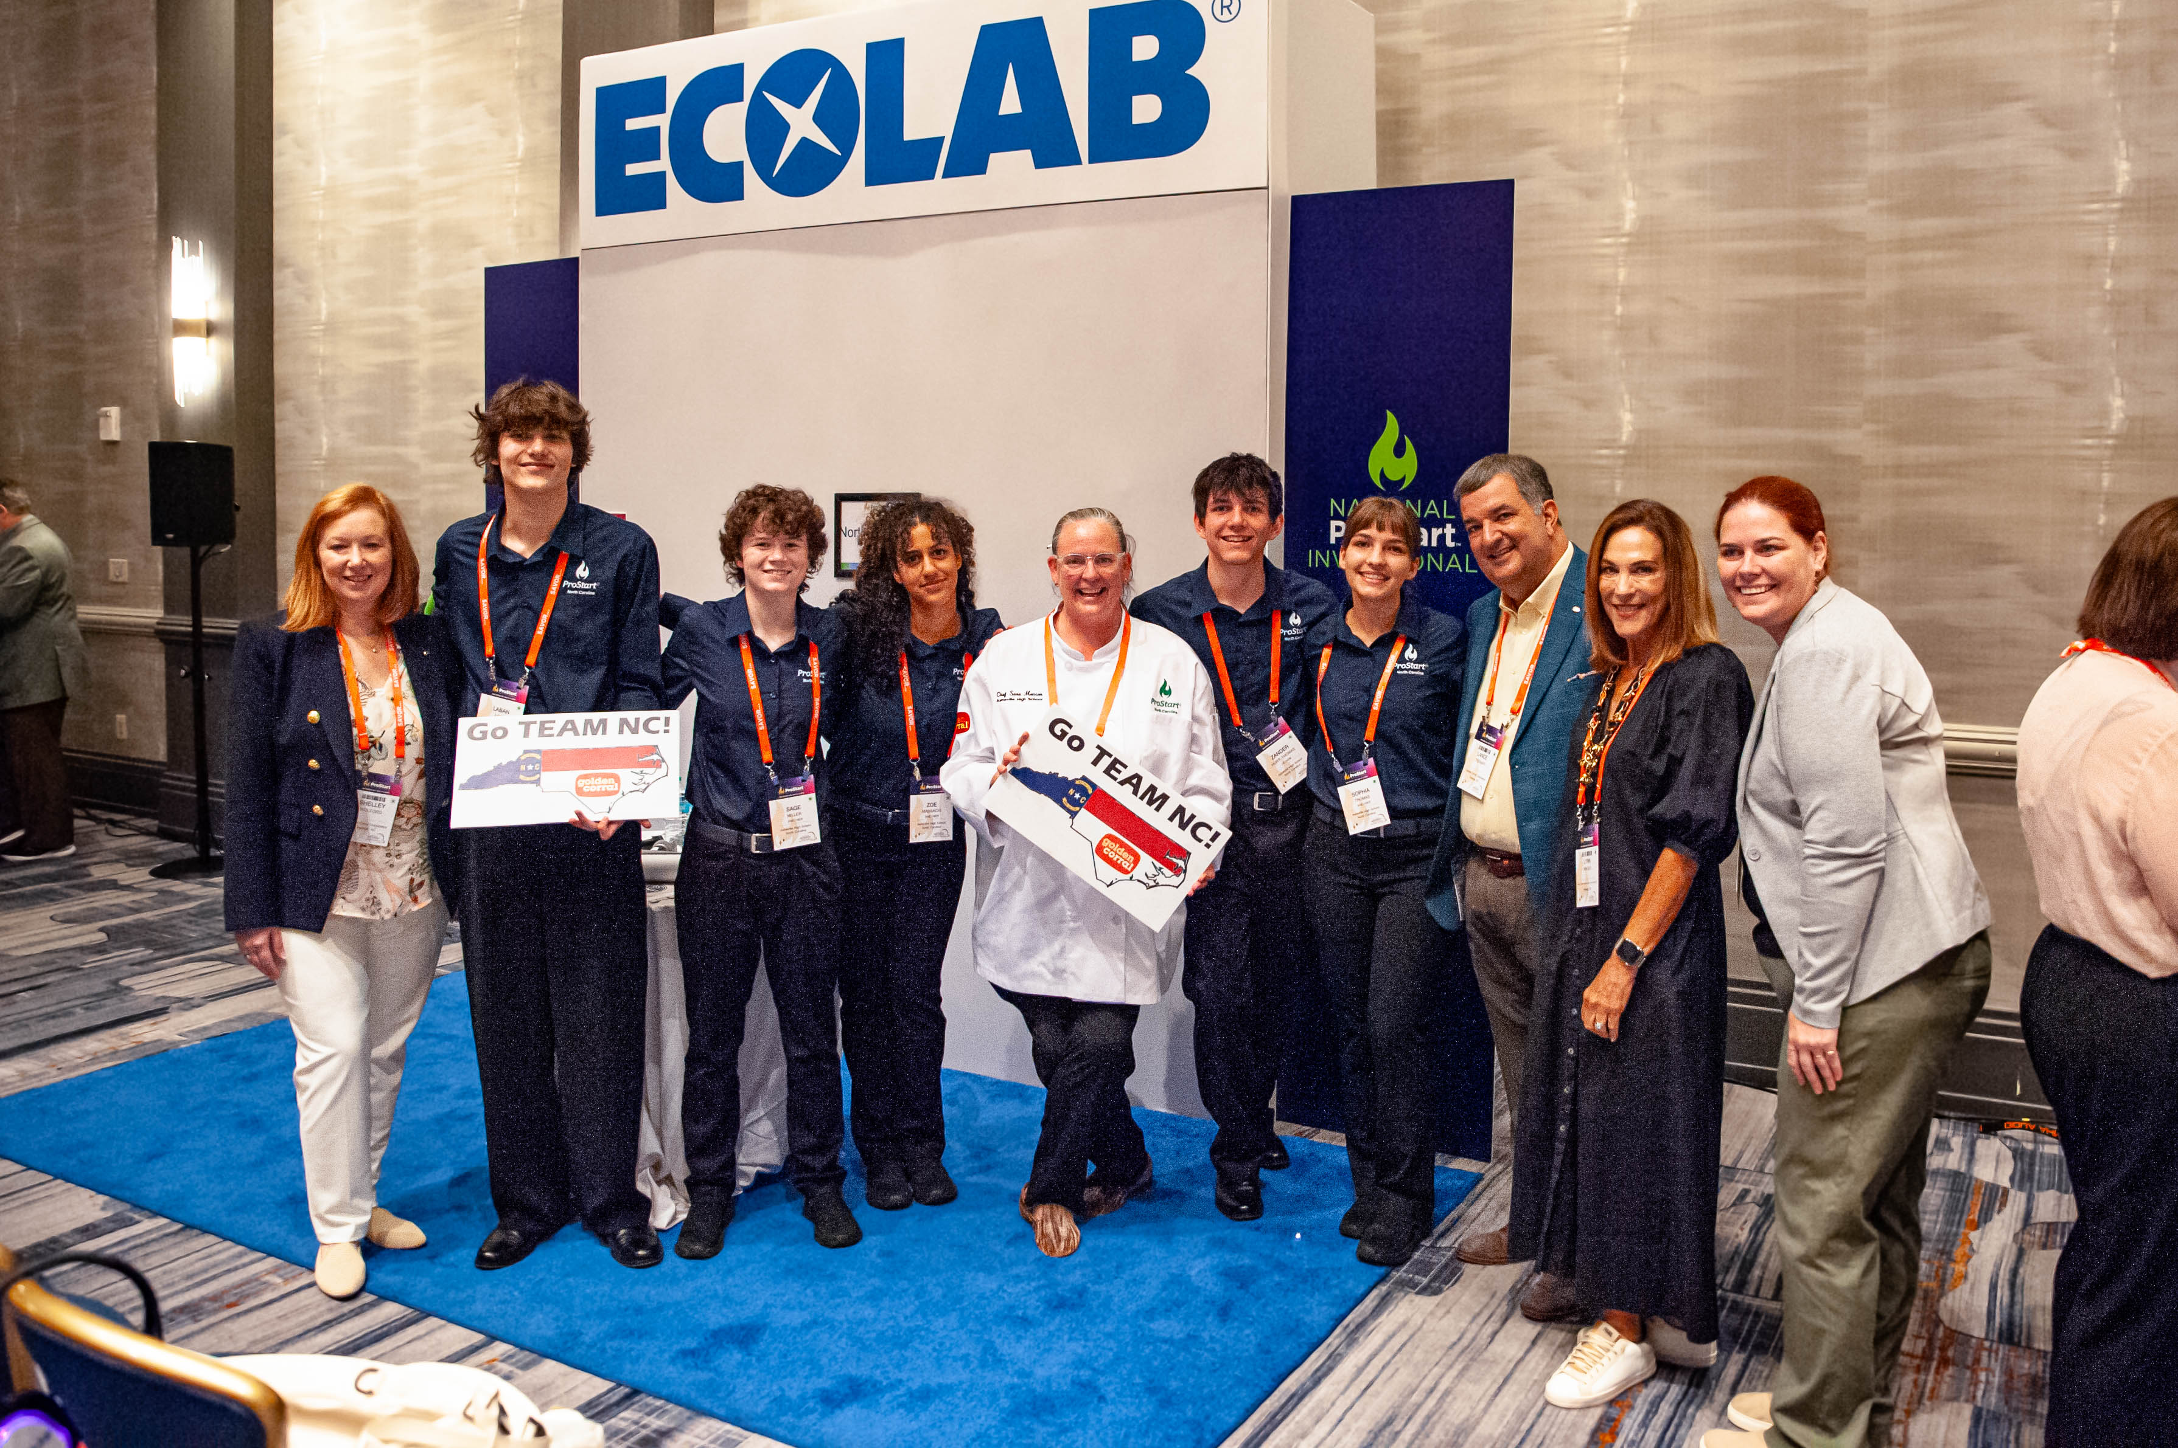
Purpose
Teams develop and pitch a restaurant concept.
Combines business planning, marketing, and operations.
Judges evaluate creativity + practicality.

Slide 12
Competition Format
Teams of 2–4 students (+ optional team manager).
Deliverables: Written proposal + posters
Judges rotate between groups for multiple presentations
7 minutes for proposal and questions, 3 minutes break

Slide 13
Proposal & Presentation Elements
Restaurant concept (type, hours, target market).
Menu: 12 items + costing for 1 recipe + 1-4 photos
Floorplan, Décor & style description.
Organizational chart (staffing)
SWOT Analysis
Two marketing tactics: 1 traditional, 1 optional social media.

Slide 14
Scoring Breakdown (200 pts)
Concept – 30
Menu & Costing – 35
Marketing – 40
Operations – 30
Critical Thinking – 55 (largest category)
Materials Check-In – 5
Menu/Recipe Costing – 5

Slide 15
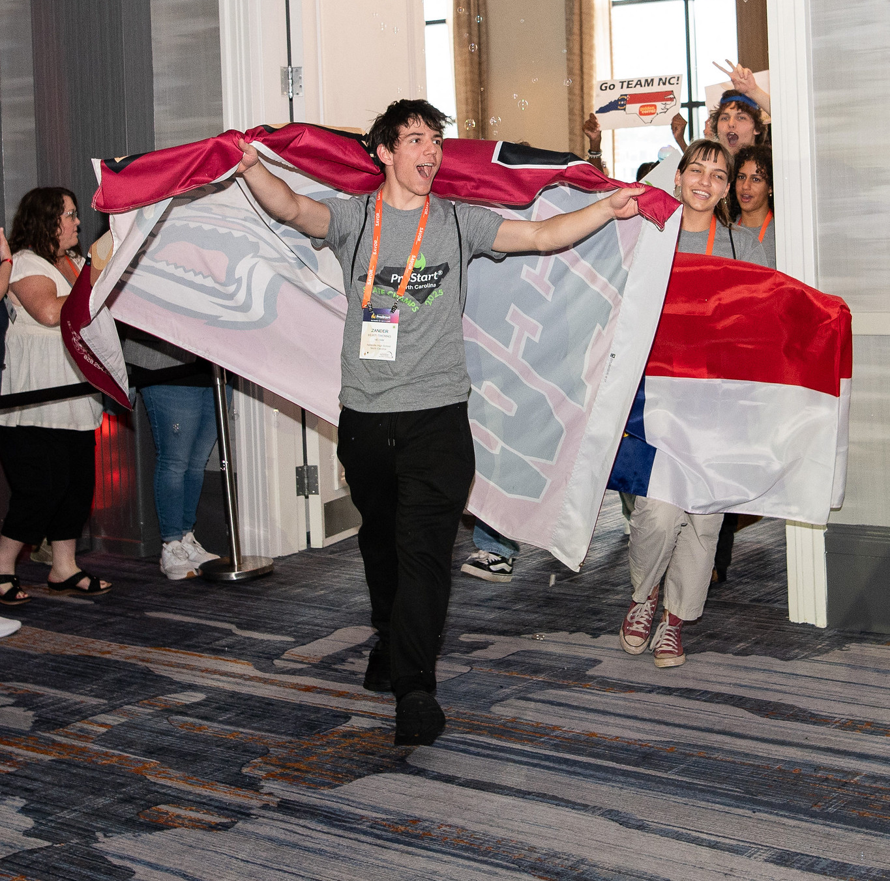
Deductions and Disqualifications
Late proposal submittal—5 pts.
Not in uniform-5pts.
Posters don’t meet specifications-5pts.
Not in ProStartville or matching scenario-5pts. each
Incorrect number of menu items, recipes, food costing, menu pricing, or marketing tactics-5pts. each
Use of alcohol or “adult consumables” in menu or promotions-5pts. each
Failure to check in materials or for presentation during assigned times-disqualification

Slide 16
Key Takeaways
Follow all the basic rules!
Creativity + business sense required.
Judges want clear vision and problem-solving.
Critical Thinking carries the most weight.

