Slide 1



@ProStart
/ProStartProgram
/ProStartProgram
NRAEF.org/ProStart
/GoProStart

Slide 2
COA Training Coordinators, Educators, & Students

Slide 3
ProStart COA Overview
The Certificate of Achievement (COA) is an industry-recognized certificate provided to ProStart students who have:
Passed Foundations of Restaurant Management and Culinary Arts (FRMCA) exam Levels 1 and 2
Completed 400 hours of industry work experience
To attain a COA, students must show proof of work or involvement in the restaurant, foodservice, and/or hospitality industries totaling 400 hours.
Students may meet the requirement by participating in either paid foodservice jobs or “alternative” hospitality-related jobs or activities. Jobs may be paid or unpaid (due to the nature of the task).
Verified their mastery of 52 out of 75 (70%) workplace competencies ranging across both hard and soft skills

Slide 4
ProStart COA Overview
A COA application will be automatically created for students once they pass their FRMCA Level 1 exam.
Students are then able to enter valid work hours from up to one year prior to and three years following the date of the Level 1 exam. For example:
John Doe passes his Level 1 exam on 5/5/2017.
John Doe can go back in his records and enter work hours he completed from 5/5/2016 and forward.
His COA application will expire on 5/5/2020.
Note: a COA does not expire.

Slide 5
ProStart COA Work Hours
Students may have as many positions or employers as necessary to achieve 400 cumulative work hours.
As students are pursuing their work hours, supervisors (not educators or students) should complete the Workplace Experience Checklist to indicate in which competencies students have demonstrated mastery.
The Work Experience Checklist can be downloaded from the student’s COA Tracker.

Slide 6
students

Slide 7
Student COA Responsibilities
Register on ChooseRestaurants.org.
Track and enter hours and competencies.
Give supporting documentation to educator for review.

Slide 8
Creating a Username and Password
Visit Chooserestaurants.org.
Click “Login” at the upper right hand corner.
Click “Create New Profile.”
If you have already registered on ChooseRestaurants.org, please do not create a new login!

Slide 9
Creating a Username and Password
Enter the information requested. All information with a red asterisk is required.
Please ensure that any information entered is accurate and your secret question is something you will remember.
Please use legal name and permanent address. This is where all COAs will be mailed!
Click “Register.”
Write your username and password down and save it in a safe place. Consider providing a copy to your instructor for safekeeping.
If you are having trouble accessing your account, please contact ProStart@nraef.org.

Slide 10
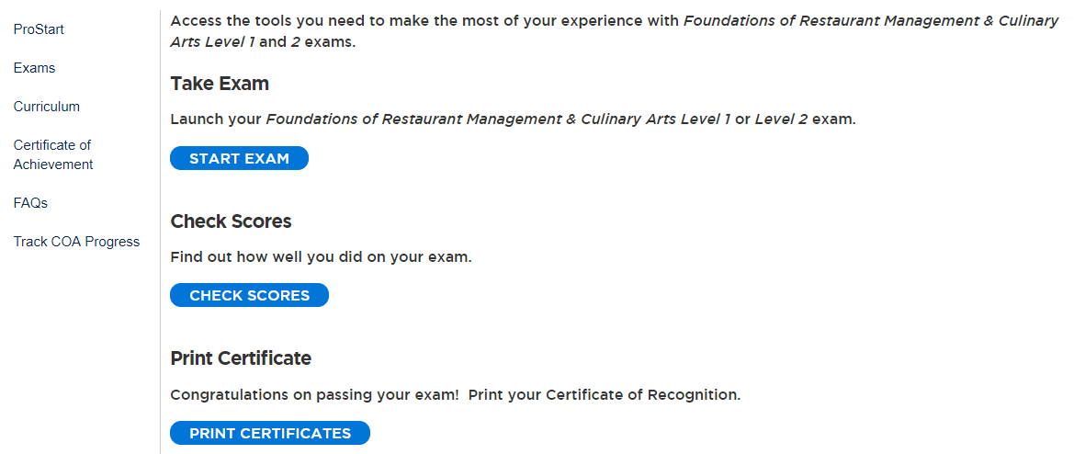
Tracking COA Work Hours
Log in to ChooseRestaurants.org
Click “ProStart Exams for Students.”
Click “Track COA Progress.”

Slide 11
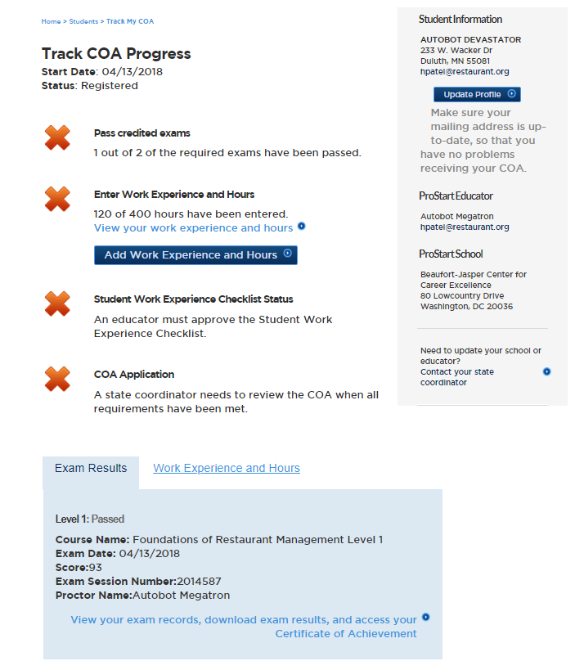
You should see at least one completed exam record.
Click “Add Work Experience & Hours.”

Slide 12
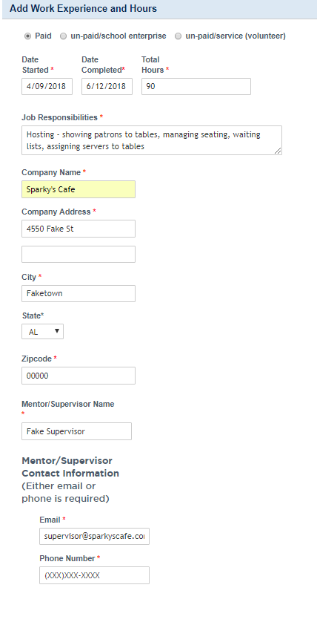
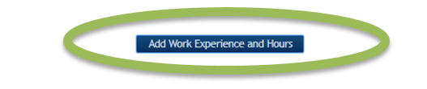
Enter the information requested. All information with a red asterisk is required.
Click “Add Work Experience & Hours” to confirm entry.
You’ll see the balance of work hours on your COA homepage increase as you enter more hours.

Slide 13
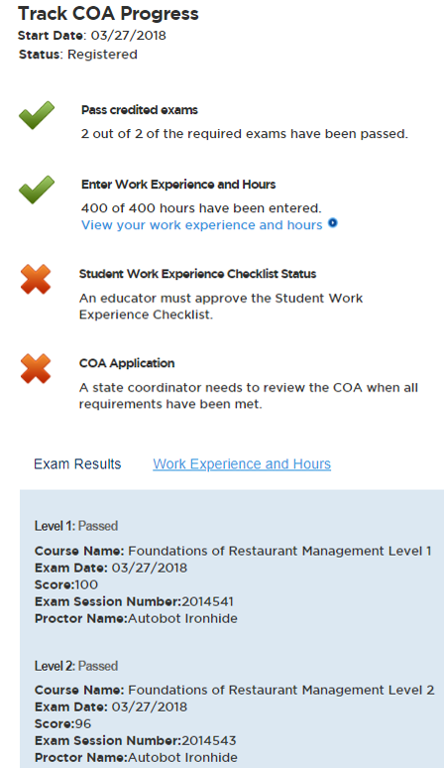
COA Progress
As requirements are met, green checkmarks replace red Xs, indicating progress toward the COA.
Students are responsible for completing the first two requirements:
Passing credited exams
Entering work experience and hours
You can review exams and work experience and hours at the bottom of the COA tracker.

Slide 14
COA Progress
When students have reached this stage, they should provide educators with all relevant documentation, including:
Proof of work hours (i.e. pay stubs, record of volunteer hours, etc.)
Work Experience Checklist completed and signed by supervisors verifying proficiency in at least 52/75 (70%) of the competencies.
Students should keep a copy of all documents submitted to educators for their own records.

Slide 15
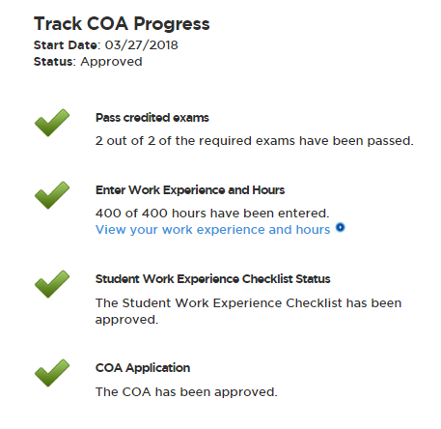
After Approval
Once educators and Coordinators approve the COA application, students will see four green checkmarks in their COA Tracker.

Slide 16
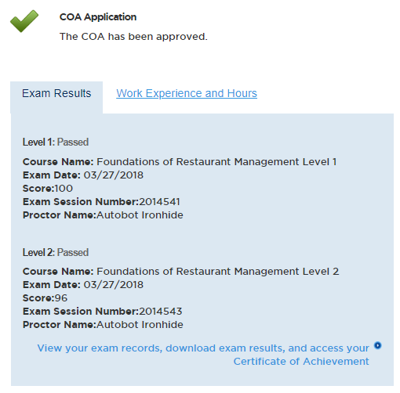
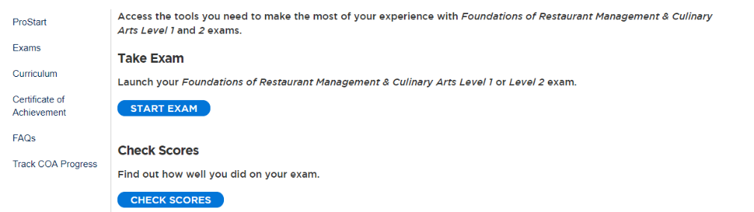
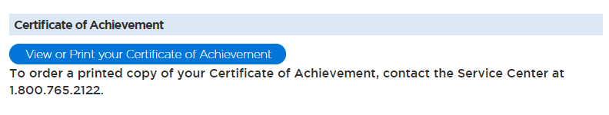
Accessing E-Certificates
A hard copy of the student’s COA will be mailed to the address listed in their ChooseRestaurants.org account.
Students can access their certificates in electronic form through their ChooseRestaurants.org account.
There are two ways to access the COA:
From your COA Tracker
From your Exam history:
Click “ProStart Exams for Students”
Click “Exams”
Click “View or Print your Certificate of Achievement.”

Slide 17
educators

Slide 18
Educator Responsibilities
Register on the website.
Review and approve student documentation of work hours and competencies.
Send supporting documentation to Coordinator within agreed upon time frame.

Slide 19
Creating a Username and Password
Visit Chooserestaurants.org.
Click “Login” at the upper right hand corner.
Click “Create New Profile.”
If you have already registered on ChooseRestaurants, please do not create a new login!

Slide 20
Creating a Username and Password
Enter the information requested. All information with a red asterisk is required.
Please ensure that any information entered is accurate and your secret question is something you will remember.
Click “Register.”
Write your username and password down and save it in a safe place.
If you are having trouble accessing your account, please contact ProStart@nraef.org.

Slide 21
Linking Students
Your students will be linked to you through exams.
Once students pass their FRMCA Level 1 exam, you will have access to their COA applications.
You may access at any time to review their progress, but should not enter any work hours or complete any entries on their work experience checklist.

Slide 22
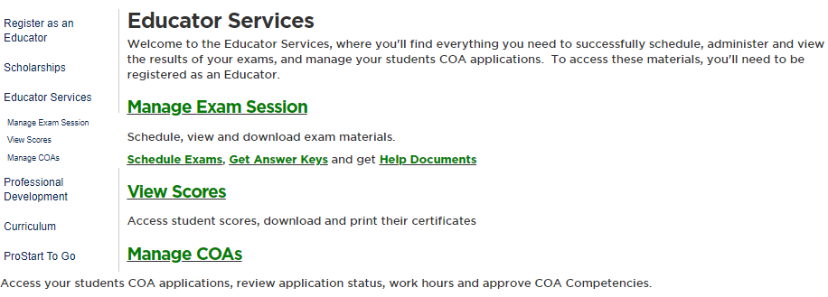
Tracking COA Progress
Log in to ChooseRestaurants.org
Click “ProStart Exams for Educators.”
Click “Manage COAs.”

Slide 23
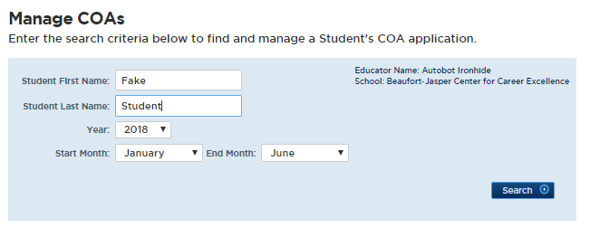
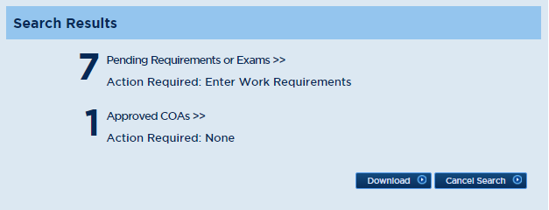
Tracking COA Progress
Enter the student’s first and last name and a date range for their COA application.
Please note that if a student completed their first FRMCA exam in the first half of the academic year, you may need to alter the year in which you search for their COA application.
To review all COA applications associated with you as the educator, leave the student name fields blank.
This will pull all COA applications associated with the selected date range.
Click on the appropriate search result area.
Pending Requirements or Exams
Approved COAs

Slide 24
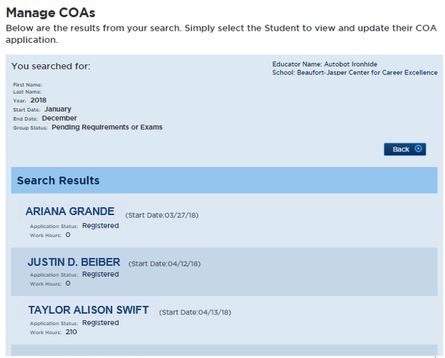
Click on each student’s application to view their progress.

Slide 25
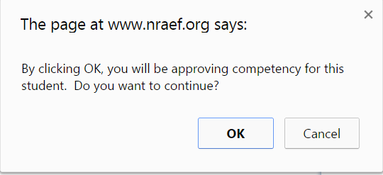
Approving Applications
Review submitted student documents.
Do submitted work hours match with paystubs?
Are at least 52 of the 75 competencies checked off by a supervisor?
Is the checklist signed and dated by a supervisor?
Click “Approve Competency.”
A popup may appear. Click “OK.”

Slide 26
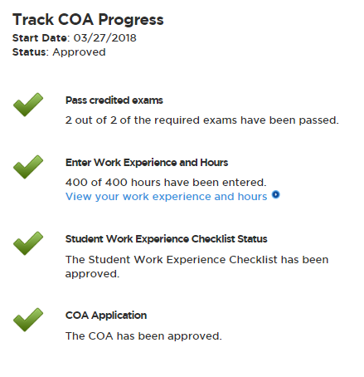
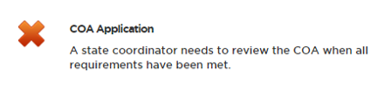
Approving Applications
A third checkmark will appear.
When educators have reached this stage, they should provide their State Coordinator with all relevant documentation, including:
Proof of work hours (i.e. pay stubs, record of volunteer hours, etc.)
Work Experience Checklist completed and signed by supervisors verifying proficiency in at least 52/75 (70%) of the competencies.
Educators should keep a copy of all documents submitted to Coordinators for their own records.

Slide 27
coordinators

Slide 28
Coordinator COA Responsibilities
Must be registered as a Coordinator.
Determine method for educators to submit documentation.
Approve COA applications.
Notify NRAEF of any issues/technical problems.

Slide 29
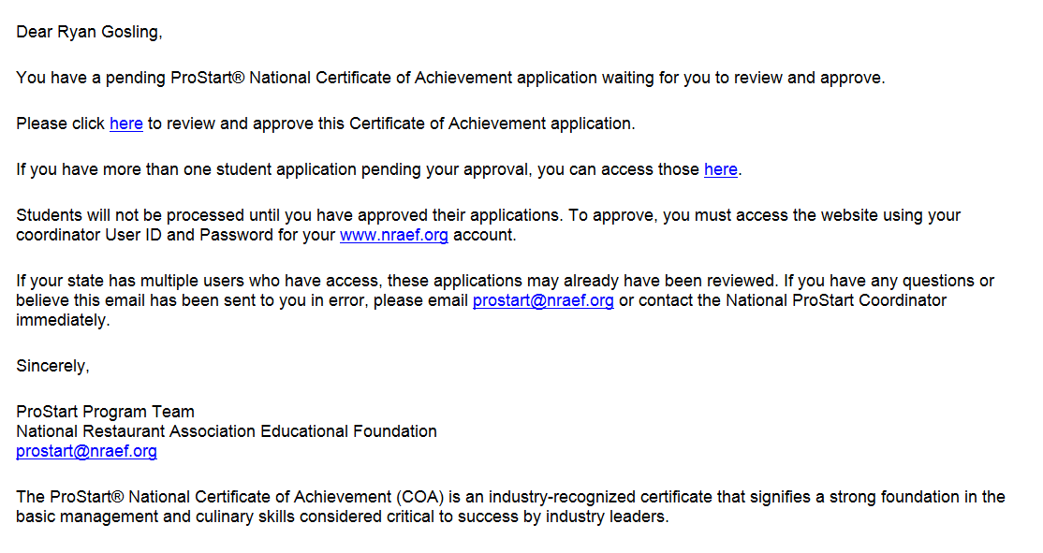
Coordinator Notification
When the competencies (and thus the application) are approved, an auto-email is generated letting the state coordinator know there is a COA application available for review.
Sample Email to Coordinator

Slide 30
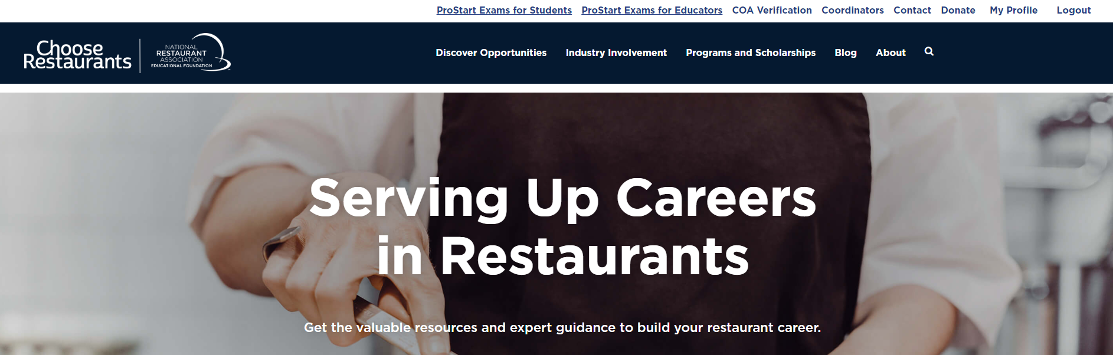
Coordinator Approval
When a Coordinator clicks on the approval email, they will be redirected to ChooseRestaurants.org.
Sign in will be required.
Click the Coordinator tab when logged in.

Slide 31
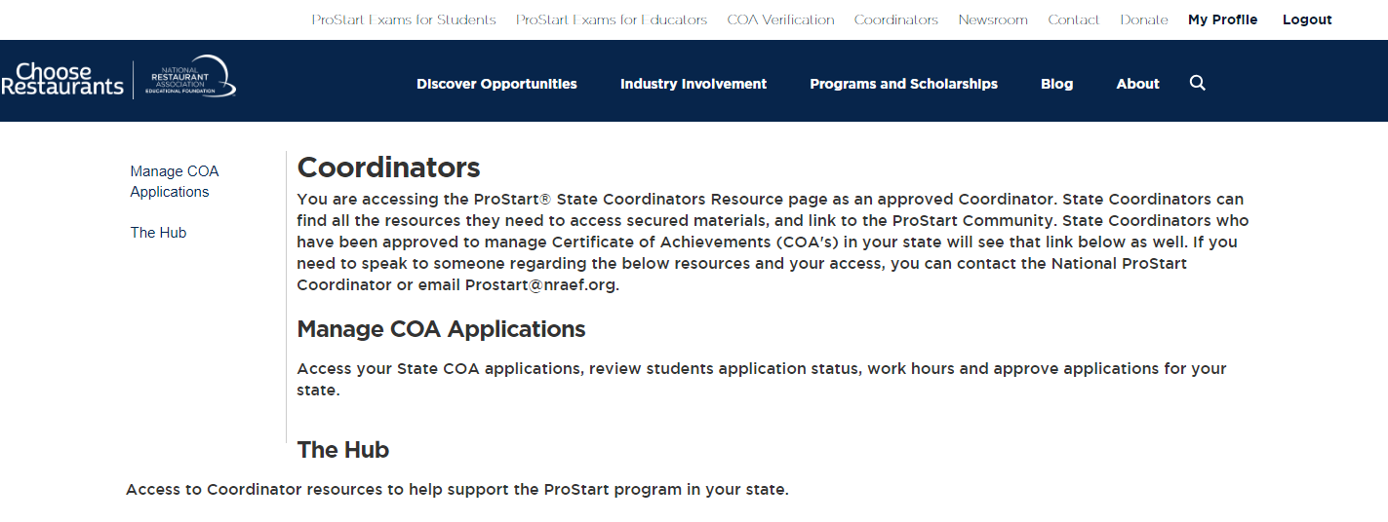
Coordinator Approval
Click “Manage COA Applications.”

Slide 32
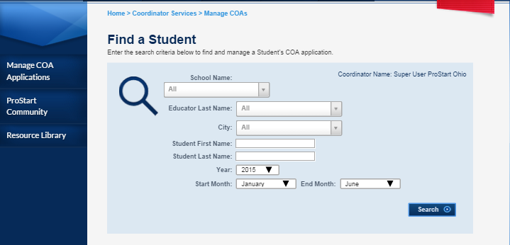
Coordinator Approval
You will be able to enter the information required to pull the student’s COA application.
Each of the search criteria can be used independently or together to search for students testing by: time period, school, educator, or student’s name.
Notes:
This is what the “Coordinator Manage COAs” page looks like. Please keep in mind the year and months are very important! For example if you entered Year: 2015 between January and June you would get all the students in your state who have passed a test and started an application during that time.
You’ll follow the same steps outlined in the “Educator” section to search for and approve student applications.

Slide 33
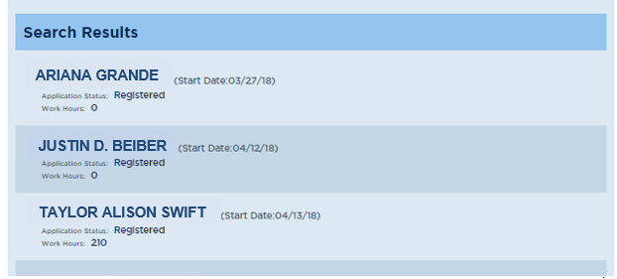
Tracking COA Progress
Results will arise based on the criteria entered.
If you search by time period (e.g. April-June 2018) you’ll get results for any student who had a COA application started in that period.
Searching by name or educator will narrow the results significantly.
Click on “Pending Requirements or Exams.”
Click the appropriate student’s name.

Slide 34


Approving Applications
Review student documents submitted by the educator.
Do submitted work hours match with paystubs?
Are at least 52 of the 75 competencies checked off by a supervisor?
Is the checklist signed and dated by a supervisor?
If the student’s application is correct, click “Approve.”
The student’s application should then show under the list of “Approved COAs” the next time you search for them.

Slide 35
After Approval
Recommend that Coordinators keep track of COA applications.
Incomplete, pending, approved, rejected, etc.
A COA is mailed to the student address on file in ChooseRestaurants.org.
Ensure students keep their address updated if work hours are completed after graduation.
E-certificates are also available, but only in the student view.
Coordinators may request copies of COAs through ProStart@nraef.org.

Slide 36
Record Keeping
SRAs must keep records of COAs for at least 5 years.
To ensure the COA meets the tests for a valid and verifiable industry credential.
Can be stored in hardcopy or uneditable, electronic forms (e.g. PDFs).
Must be available to NRAEF within 24 hours notice for auditing purposes.
Remember!
COA documents include Personally Identifiable Information (PII).
Laws vary by state when it comes to collection, safeguarding, and disposal of PII.
Coordinators are urged to consult with legal counsel before making document storage decisions.

Slide 37
Common issues - students

Slide 38
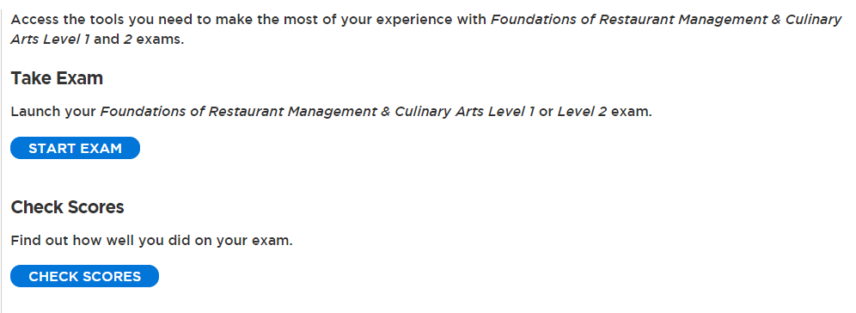
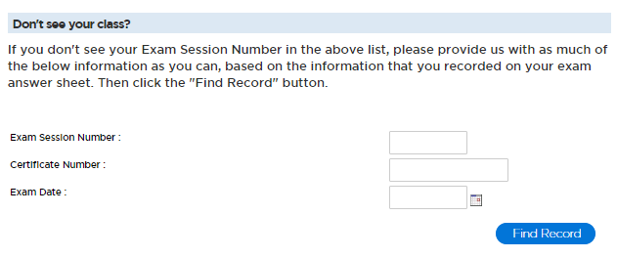
Missing an Exam
If you have taken a Foundations Exam that is not appearing in your COA Tracker, please follow the steps below to add the exam to your profile.
Log in to ChooseRestaurants.org.
Click “ProStart Exams for Students.”
Click “Check Scores.”
Enter the Exam Session Number and date on the following screen. If you don’t know it, please ask your educator or exam proctor.
Click “Find Record.”
If no records are found, please contact the Service Center at ServiceCenter@restaurant.org for further support.

Slide 39
Multiple Student Accounts
If you have multiple accounts on ChooseRestaurants.org, you’ll need to request a records merge.
To merge the records:
Email the Service Center at ServiceCenter@restaurant.org.
Include the student name, educator name, exam session number(s), and the username for the account you’d like as your primary login.
Allow adequate time for the merge to occur. Merge requests can take approximately 2-3 weeks.

Slide 40
Cannot Access E-Certificate
If your COA has been approved and issued, but you are still struggling to download it on ChooseRestaurants.org, this is a technical error.
To access your e-certificate:
Email the Service Center at ServiceCenter@restaurant.org.
Include the student name, and username for the account where the COA has been approved.

Slide 41
Common issues - educators

Slide 42
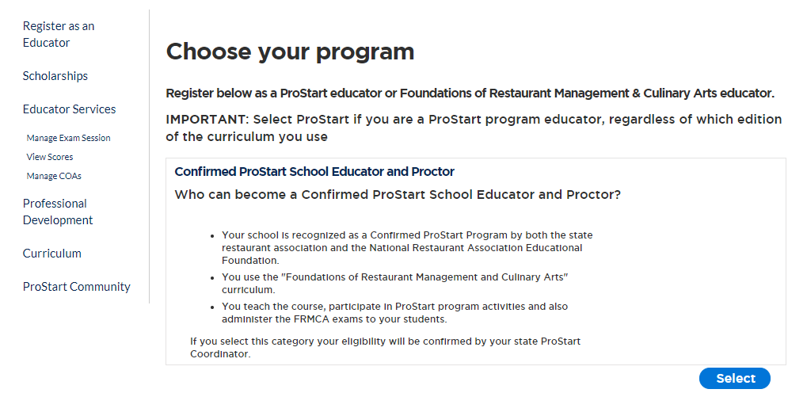
Access Denied
If an educator receives an “Access Denied” message when trying to access COA applications, this likely means they are not currently registered as a ProStart Educator.
Log in to ChooseRestaurants.org
Click “ProStart Exams for Educators.”
Click “Register as an Educator.”
Select “Confirmed ProStart School Educator and Proctor.”
This request will go to the Coordinator for approval.
Contact ProStart@nraef.org for additional assistance.

Slide 43
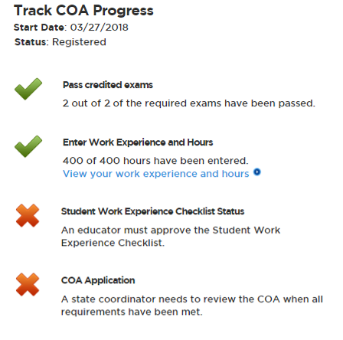
Cannot Approve Student Competencies
If the “Approve Competency” button does not appear, even though the student’s exams and hours are complete, this is a technical error.
Please contact your ProStart State Coordinator, who will reach out to ProStart@nraef.org for resolution.
This error often occurs when a student has completed well over their 400 required hours. It is an easy fix.

Slide 44
@ProStart
/ProStartProgram
/ProStartProgram
NRAEF.org/ProStart
/ProStartProgram

