Slide 2
Steps in controlling food costs
Nine stages include:
Purchasing
Receiving
Storing
Preparation
Cooking (production)
Holding (production)
Cooling (production)
Reheating (production)
Service (sale)
Notes:
It is important to remember, though, that a restaurant is also a business. Success is not only about making and sharing great food. Running a business correctly
involves managing costs. And at a restaurant, that means understanding how much the food you serve really costs. You might love one particular dish, but if it
is not a popular menu choice and costs twice as much as other dishes…well, is it worth it?
Food costs must be controlled during all nine stages of the food flow process—from the actual purchasing of food items to how they are served to guests.
The nine stages include:
Purchasing: An operation must spend wisely and buy good-quality product. An operation that is spending too much for a product is wasting money and
ultimately losing potential revenue.
Receiving: Management or well-trained staff need to be in charge of receiving to ensure safety and quality standards and accuracy of orders.
Storing: Storage facilities must be safe, sanitary, and efficient. Improperly stored food will be wasted, and wasted food increases food costs.
Preparation: All products should be used as efficiently as possible. Operations must have detailed specifications for preparation and cooking.
Cooking (production): Incorrectly cooked food goes to waste, and incorrectly portioned food also results in waste, both of which add to food costs.
Holding (production): If food is not being served immediately, it must be kept out of the temperature danger zone.
Cooling (production): To hold food correctly, it must be cooled. There are many specific ways to cool food quickly and safely.
Reheating (production): How you reheat food depends on whether you are reheating for immediate service or for hot holding.
Service (sale): Good service helps ensure mistakes are avoided both during ordering and in the kitchen.
Inefficiencies at any stage of the food flow process result in higher food costs, so it is crucial for any operation to closely monitor all aspects of how the
business functions.

Slide 3
Determining food cost
Food cost:
Dollar value of food used by operation
  Certain time period
Sold
Given away
Wasted
Spoiled
Incorrectly prepped
Overportioned
Overproduced
Stolen
Notes:
Food cost is the dollar value of the food used by an operation during a certain period. It includes the cost of any food that has been used for any reason.
This includes food that has been sold, given away, wasted, spoiled, incorrectly prepped, overportioned, overproduced, or stolen.

Slide 4
Determining food cost
Inventory:
Food product in storage
Expressed in units, dollar values, or both
Weekly or monthly
Opening inventory:
Physical inventory
Beginning of given period
Closing inventory:
Physical inventory
End of given period
Notes:
To calculate food cost, you must compare some inventory data. Inventory is the food product in storage and can be expressed in terms of units, dollar values,
or both. Opening inventory is the physical inventory at the beginning of a given period. The closing inventory is the inventory at the end of a given period. Most
operations calculate inventory and food cost monthly, but some do it weekly.

Slide 5
Determining food cost
Food cost formula:
(Opening inventory + Purchases = Total food available) – Closing inventory = Total food cost
Notes:
Use the following formula to calculate food cost:
(Opening inventory + Purchases = Total food available) – Closing inventory = Total food cost
Some operations further refine the cost of food sold to get a more accurate number of how all the food is being used. They may deduct employee meals
and complimentary items to guests from the cost of food sold.

Slide 6
Determining food cost percentage
Total food cost percentage:
Relationship between sales and food cost
Analyze food cost percentage by comparing to:
Company standards
Historical costs
Industry standards
Total food cost ÷ Food sales = Food cost percentage
Notes:
Total food cost percentage is the relationship between sales and the cost of the food that went into those sales. You can analyze food cost percentage by
comparing it to company standards, historical costs, or even industry standards. In most cases, the standard food cost percentage is a target determined by
management. The formula is:
Total food cost ÷ Food sales = Food cost percentage
Example: If you sell a meal for $20 and your food costs for that meal are $6, your food cost percentage is 30 percent.
By expressing the cost of food sold in percentages, it can be compared on a month-to-month or week-to-week basis regardless of any change in sales.
Controlling this percentage becomes a key factor in the operation’s profitability.
Food cost is a variable cost. It should increase or decrease in direct proportion to an increase or decrease in sales if all of the operation’s procedures and
standards are followed correctly.

Slide 7
Establishing standard portion costs
Standard portion cost:
One serving or portion
Prepared using standardized recipe
Create accurate selling price
Notes:
Most operations have standardized recipes that are followed every time a menu item is prepared. For every standardized recipe, an operation should establish
a standard portion cost, which is the exact amount that one serving, or portion, of a food item should cost when prepared according to the item’s standardized
recipe. To calculate an accurate selling price, you need to calculate an accurate cost per portion. This will help you determine if your sales are contributing to
your profitability.
See Essential Skills, How to Determine Standard Portion Cost, on page 222.

Slide 8
Establishing standard portion costs
Recipe cost card:
Calculate standard portion cost
Table of ingredient costs
  Each item in standardized recipe
Every multiple-ingredient item
Notes:
A key control in getting the proper relationship between a menu item’s cost and its selling price is the recipe cost card. See Figure 9.2. This is a tool used
to calculate the standard portion cost for a menu item. It is a table of ingredient costs for each item in the standardized recipe. If recipe cost cards are not
used, the selling price is nothing more than a guess. As with the standardized recipe, there should be a recipe cost card for every multiple-ingredient item
listed on the menu.

Slide 9
Recipe cost card

Slide 10
Recipe yields
Recipe yield:
Number of portions recipe produces
Identify portion size—volume or weight
Calculate total recipe yield
Total yield = Total weight or volume of finished product ÷ Portion size
Notes:
A recipe yield is the number of portions that a recipe produces. To determine how many portions a recipe will produce, you must first identify the portion
size that you want to serve, either by weight or volume. Then you can calculate the total yield of the recipe. Weigh or measure all ingredients according to the
same method of measurement identified for the portion size (weight or volume). The formula to calculate total yield is:
Total yield = Total weight or Total volume of finished product ÷ Portion size (by weight or volume)
For example, in a recipe for macaroni and cheese, the volume of the macaroni and the cheese sauce must be calculated.
Assume that:
• One portion of macaroni and cheese is 8 fluid ounces.
• The recipe calls for 24 cups of cooked macaroni.
• One cup of cooked macaroni is equal to 8 fluid ounces.
Therefore, 24 cups of cooked macaroni multiplied by 8 fluid ounces (one portion) equals 192 fluid ounces of cooked macaroni.
• Two quarts of cheese sauce converts to 64 fluid ounces (32 fluid ounces per quart, so 2 × 32 = 64).
The total volume of the macaroni and cheese recipe is:
192 fluid ounces of cooked macaroni + 64 fluid ounces of cheese sauce = 256 fluid ounces of finished macaroni and cheese
Then, the total volume can be divided by the portion size to provide the yield of the recipe:
256 fluid ounces of finished macaroni and cheese ÷ 8 fluid ounces per portion = a yield of 32 portions
Understanding recipe yields is one of the keys to successful food preparation and controlling food costs. The measurements given in recipes must be followed
exactly. If the number of portions a recipe yields is unknown, or if a recipe is not being portioned properly, it can cost an operation substantial amounts of revenue.

Slide 11
Converting recipe yields
Formula for increasing or decreasing recipe yields:
Identify desired yield
Desired yield ÷ Original yield = Conversion factor
Multiply each ingredient by conversion factor
Convert answers to measurable amounts
Make adjustments if needed
  Equipment
  Temperature
  Time
Notes:
Decide how many servings you need (desired yield).
Use the following formula:
Desired yield ÷ Original yield = Conversion factor (the number by which you would multiply the ingredients)
For example, if your chili recipe serves 80 and you need to serve 40: 40 ÷ 80 = 0.5. The conversion factor is 0.5.
Multiply each ingredient amount by the conversion factor. This keeps all the ingredients in the same
proportion to each other as they were in the original recipe.
As needed, convert answers to logical, measurable amounts. Think about the equipment you will use for measuring.
For example: 6⁄4 cups flour = 1½ cups; 12 tablespoons brown sugar = ¾ cup
Make any necessary adjustments to equipment, temperature, and time. For example, the depth of food in a pan
affects how fast it will cook. Use pans that are the correct size for the amount of food—neither too large nor too small.

Slide 12
Controlling portion sizes
Portions can be controlled by:
  Weight
  Volume
  Count
Inconsistent portioning—inconsistent products
Notes:
To meet a standard food cost, you must control portions. Portions can be controlled by weight, volume, or count. For example, an eight-ounce portion
of steak, a one-ounce ladle of dressing, or 12 shrimp. It is important that staff use portion-control devices rather than guessing. Otherwise, you may end up
serving portions that are bigger than what the menu price has been calculated for, which will result in the operation losing money. On top of that, inconsistent
portioning can lead to inconsistent products, which can lead to unhappy guests.

Slide 13
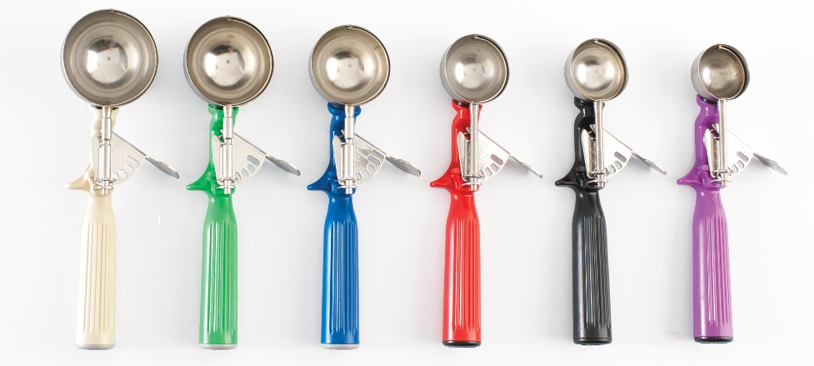
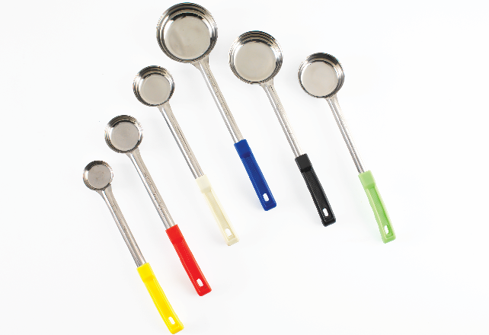
Controlling portion sizes
Equipment for accurate portioning:
Scoops
Serving dishes
Ladles
Ramekins, bowls, cups, and so on
Serving spoons
Portion scales

Slide 14
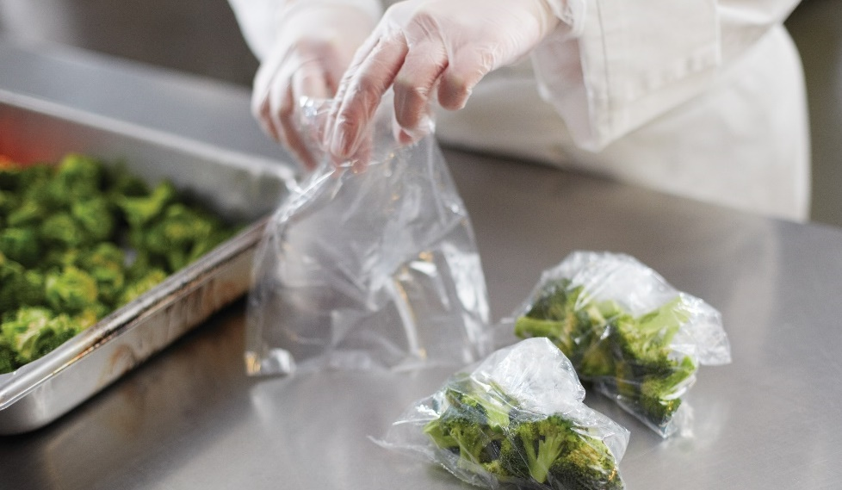
Controlling portion sizes
Preportioned items:
Portioned prior to service
Smoother rush periods
Fewer errors
Control food costs
Notes:
Preportioned items are menu ingredients that have been accurately portioned prior to service. Preportioning items before serving is another mechanism for
ensuring that portions are the right size. For example, vegetables that have been precut, weighed, and sealed in plastic bags until used for side items are
a good example of preportioning. See Figure 9.5. The more preportioning that can be done, the smoother rush periods will be, the fewer errors will be made,
and the more food costs will be controlled in both the short and long run.

Slide 15
Monitoring production volume and cost
Produce quantities close to amount needed
Maintain standard food costs and sales
Leftovers—repurpose
Running out of food—disappoint guests
Notes:
While standardized recipes and portion control are very important, preparing the wrong amount of food can still be a major problem. Every operation should
strive to produce quantities as close to the amount really needed as possible in order to maintain standard food costs and sales. If the operation produces too
much food, leftovers are the result.
Often these leftovers cannot be sold because their appearance and taste do not meet company standards. Sometimes repurposing the food can salvage the
extra volume. For example, some operations add leftover beef or chicken to soups. However, the leftovers rarely bring the same amount of revenue as the
original product.
On the other hand, not producing enough and running out of an item (otherwise known as a “stockout”) can disappoint guests. This increases the risk
that they will not return to your operation. Either of these situations is a lose-lose for the restaurant. Produce too much and food cost goes up; produce too little
and sales are lost. The answer to this dilemma is in the food production chart.

Slide 16
Food production charts
Product produced during meal period
Well-structured product sheet ensures
  Product quality
  Avoiding product shortages
  Minimize waste, spoilage, theft, energy costs, and administrative costs
Notes:
A food production chart, or production sheet, is a form that shows how much product should be produced by the kitchen during a given
meal period. A well-structured production sheet can ensure product quality, avoid product shortages, and minimize waste, spoilage, theft,
energy costs, and administrative costs.

Slide 17
Sample food production sheet

Slide 18
Food production charts
Forecast portions of menu items use:
Sales history
Percentage of total sales each item provides
Multiply by customer forecast
Estimated projections
Notes:
Sales history is critical in helping to forecast how many portions of each menu item to produce on a given day. First, determine what percentage of the
total sales each menu item provides. Then multiply the percentages by the customer forecast to predict how many portions of each menu item to produce.
For example, a restaurant runs these items every Monday on its menu:
• Chicken parmesan
• Roast loin of pork with dressing
• Broiled salmon with lemon butter sauce
• Roast sirloin of beef au jus
• Linguine Alfredo
Having run these items for a while, the restaurant has a sales history. From the sales history, management knows that when this menu runs, the following percentages are sold:
• Chicken parmesan: 22 percent
• Roast loin of pork with dressing: 18 percent
• Broiled salmon with lemon butter sauce: 15 percent
• Roast sirloin of beef au jus: 35 percent
• Linguine Alfredo: 10 percent
Management then predicts how many guests will come in on that Monday. One hundred eighty guests are expected, so the following portions of each item should be produced:
• Chicken parmesan (180 × .22) = 40
• Roast loin of pork with dressing (180 × .18) = 32
• Broiled salmon with lemon butter sauce (180 × .15) = 27
• Roast sirloin of beef au jus (180 × .35) = 63
• Linguine Alfredo (180 × .10) = 18
Total portions: 180
Of course, these are estimated projections, not exact figures. So an operation would want to make slightly more or less depending on the circumstances at
that exact time (for example, weather, construction, time of season, and so on).

Slide 19
Menu pricing
Menu:
Primary sales tool
Reflect overall cost of operation
Menu price should include:
Purchasing costs for food
Preparing costs for food
Serving costs
Labor, rent, utilities
Notes:
The menu is the primary sales tool in most restaurant and foodservice operations. Ideally, the menu will reflect the overall cost of running the
operation. That means the price of an item should include all of the costs needed to purchase, prepare, and serve it, along with other costs such as
labor, rent, utilities, etc. In short, the success of the operation hinges on proper menu pricing.

Slide 20
Quality standards for purchasing, receiving, and storing
Choose credible suppliers:
Ethical and reliable
Approved supplier lists
  Food safety
  Quality
  Price offerings
Clear specification sheets
Notes:
Some of the quality of the food you serve to guests has been determined well before the dish is placed in front of them. Whatever your budget for food might
be, you should always strive to buy the best-quality food available for the price. Remember that you cannot make a poor-quality ingredient better once it is in
your kitchen.
Choosing a credible supplier is key. Suppliers must be ethical and reliable. Many companies create approved supplier lists, based on the food safety,
quality, and price of the suppliers’ offerings. Clear specification sheets will also help ensure that you buy the right product for what you need to do.
For example, you may be able to buy vegetables for soup at a lower price point than those for a salad, because appearance is less important for
soup ingredients.

Slide 21

receiving
Proper delivery timing
Frequent deliveries
  Preserve food quality
Notes:
Operations must receive deliveries in the most efficient, safe, and effective way possible. Deliveries should happen when business at the operation is slow.
An operation does not want staff to worry about receiving and putting away products at the same time they are helping guests. Proper delivery timing can
only be accomplished by establishing a good relationship with vendors, so that an operation can count on them to consistently deliver food when wanted.
Frequent deliveries can help preserve food quality. Some food must be delivered daily, while other food can safely be delivered weekly. An operation may need
to weigh the advantage of daily and weekly deliveries for freshness against the added time that receiving takes. The menu and service style of the operation
factor into decisions such as these.

Slide 22
receiving
Delivery specification guidelines:
Fish
  Fresh—daily
  Frozen—weekly
Produce
  Bulk and hardy vegetables—weekly
  Delicate—daily
Notes:
Here is an example of guidelines for delivery specifications in a full-service restaurant:
Fish: Fresh fish should be delivered daily. Frozen fish should be delivered weekly.
Produce: Bulk and hardy vegetables should be delivered weekly. Delicate or specialty produce, such as wild mushrooms, mesclun mix lettuce,
and tropical fruit (e.g., mangoes, kumquats), with a short shelf life should be ordered daily according to its specifications sheet.

Slide 23
receiving
Delivery specification guidelines:
Dried goods
  Shelf stable—bulk ordering
Meat
  2–3 times/week
Dairy
  Twice/week
Notes:
Dried goods: Specialty products exist that are shelf stable and do not need to be ordered daily. Gain a
financial advantage by bulk ordering some specialty sauces or specialty items for the pastry department,
such as chocolates, flours, and decorations. But when ordering bulk, an operation also must consider
financial savings versus storage space and the potential loss due to pilfering or pest infestation.
Meat: Meat should be ordered and delivered at least two or three times per week. This will depend
mostly on the operation’s usage and storage capacity.
Dairy: Order dairy products at least twice a week. Most cheeses are stored in the cooler.

Slide 24
receiving
Receiving procedures:
Identify designated receiving area
  Clean, well lit, easily accessible
Copy of purchase order
  Issued by buyer
  Specifies types, quantities, prices
Purchasing specifications available
  Check requirements
Notes:
Well-defined procedures help ensure that an operation’s standards for quality and quantity are being met. These might include:
Identify a designated “receiving area” of the kitchen. The receiving area should be clean, well lit, and easily accessible.
Get a copy of the purchase order. This is the document issued by the buyer to the seller, specifying the types, quantities, and agreed-on prices for products.
Have a copy of the purchasing specifications available. These can help the staff to check requirements.

Slide 25
receiving
Receiving procedures:
Check item’s quantity
  Count or weigh items
  Check against purchase order and invoice
Check item’s quality
  Check freshness and accuracy
  Take temperatures
Notes:
Check an item’s quantity. If the items are purchased by count, count them. If the items are purchased by weight,
weigh them, particularly meat and produce. Check the delivery quantity against both the purchase order and invoice.
Check an item’s quality. Open the shipment boxes and check for freshness and accuracy for all items. Have a
thermometer available to take the temperature of food items.

Slide 26
receiving
Receiving procedures:
Verify invoice’s other details
  Compare prices
  Check math
Put away promptly
  Store dairy, meat, poultry, seafood first
  Frozen food, produce, dry goods
  Secure storage area
Process paperwork
  Keep copies
Notes:
Verify the invoice’s other details. Compare the prices on the invoice to those on the purchase order to ensure that they match.
Check the math on the invoice, even if it is a computer-generated invoice. If everything is in order, sign the invoice. If something
must be returned, have the driver write out a credit memo for the item or circle the item on the invoice and state the reason for
the return.
Put the goods away promptly. Store dairy, meat, fresh poultry, and fresh seafood first; then frozen food, produce, and dry goods.
Prompt storage protects against food spoilage and theft. Secure the storage area when everything is in its place.
Process the paperwork. Keep copies of the signed purchase order and the signed invoice for accounting purposes.

Slide 27
storing
Storage procedures:
Recommended storage temperatures
Proper labels
Rotate food—FIFO
Inventory schedules
Clean
Functioning properly and efficiently
Notes:
Poor storage procedures and facilities can greatly increase food costs due to waste and increased labor costs, so it is critical that operations create quality
standards for proper storage.
Obviously, monitor perishable food daily to preserve its quality. Some food items have manufacturer’s recommendations for storing the product, such as a
recommended storage temperature. Store food with proper labels and rotate all products in storage following the FIFO (first-in, first-out) system. Each operation
should have inventory schedules for the freezer, cooler, and dry goods sections of its storage. Schedules should be followed regularly to ensure that every product
is being used safely and efficiently and so that no product is going to waste.
In addition to checking the food in the storage facilities, the storage facilities themselves should be checked regularly to make sure they are clean and
functioning properly and efficiently.

Slide 28
storing
Freezers:
Keep food frozen solid—0°F (–18°C)
Speed racks or shelving
  Air movement
Clean once/week
Check temperatures regularly
Notes:
The following is a list of items to monitor for each storage unit:
Freezers: These must be at a temperature that will keep food frozen solid—0°F (–18°C), according to the FDA. Walk-in freezers should have speed
racks, or shelving, to provide enough space for items to have enough room to freeze properly. Air movement is crucial in both the freezer and cooler.
Clean freezers at least once a week.
Temperature: Both freezers and coolers must be tested for the correct temperature regularly.

Slide 29
storing
Coolers:
41°F (5°C) or lower
Avoid placing products on sheet pans
  Limits air circulation
Monitor daily—cleanliness
Check temperatures regularly
Notes:
Coolers: These must be able to hold food at 41°F (5°C) or lower. Coolers and freezers have a fan blowing the cold air around in the room. Avoid
placing product on sheet pans, because this limits air circulation. The cooler should be monitored on a daily basis to ensure cleanliness.
Temperature: Both freezers and coolers must be tested for the correct temperature regularly.

Slide 30
storing
Dry storage:
Dangers to dry and canned food
  Moisture and heat
Temperature—between 50°F and 70°F (10°C and 21°C)
Shelving 6 inches off ground
Notes:
Dry storage: Moisture and heat are the biggest dangers to dry and canned food. The temperature of the storeroom should be between 50°F
and 70°F (10°C and 21°C). All shelving in any of the areas must be at least six inches (15 centimeters) off the ground. This space is necessary to
make access difficult for rodents and to provide enough space to clean underneath the shelving on a daily basis.

Slide 31

Quality standards for food production and service
Quality assurance measures:
Prior to service—taste each item
Verify quality—during holding
Check appearance of dishes
Notes:
As discussed earlier, standard portion sizes, standardized recipes, and standard portion costs are all food production standards. These standards help to ensure
quality as well as consistent costs. Guests receive the same quality of food on each visit to the operation, which, in turn, helps ensure the success of the
business by building the operation’s reputation and creating regular guests.
For restaurant chains, these standard procedures ensure that the meal served in one location is similar to the same meal in another location. But having these
standards does not guarantee that mistakes will not be made from time to time. So it is important that operations have quality assurance measures in place from
the beginning right up to the service stage of the food flow process.
Prior to service, managers should taste each item to ensure it meets the operation’s standard. For any item that could suffer a quality problem during
holding (such as a sauce breaking), check periodically to verify its quality. Check the appearance of a dish before serving it. Visual evaluation before
serving a dish catches problems that can be corrected easily, such as a lack of garnish or a dish that has not been held at a specified serving temperature.
Some operations have specifications for exactly how a plate should look when it leaves the kitchen. If something does not look right, that is usually
the first clue that there may be a larger problem.

Slide 32
Quality standards for food production and service
Monitoring food quality:
Involve all staff
Consider and value opinions
Corrective actions:
Revise product specifications
Revise procedure
Revise recipe
Select new vendor
Notes:
Regularly monitoring food quality is not difficult to do, but it may take time to turn it into a habit for everyone. It is also essential that all staff—management,
the executive chef, waitstaff, front-of-the-house staff, and kitchen staff—are involved and that their opinions are considered and valued.
When a problem’s cause or causes are discovered, the manager must work with the entire staff to implement the correction. Examples of corrections include
revising product specifications, revising a procedure, revising a recipe, or selecting a new vendor. The faster a problem is identified and a correction is
made, the more costs will be kept under control.

Slide 33
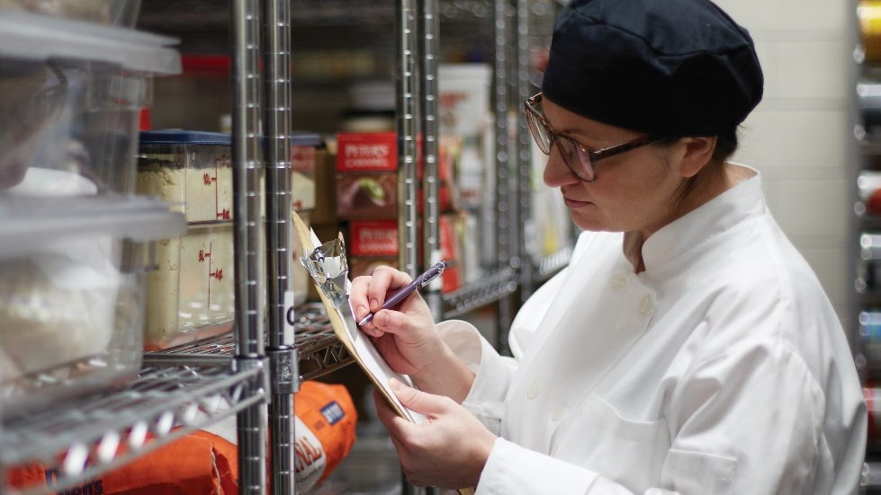
Quality standards for inventory
Physical inventory:
Count and record each item
Monitor inventory:
Products ordered efficiently/timely manner
No product wasted
FIFO system
Food costs
Notes:
Taking inventory is yet another cost-control measure. Taking physical inventory means counting and recording the number of each item in the
restaurant. Literally count each item or scan bar codes with handheld scanners.
Closely monitor inventory to ensure that products are ordered in an efficient and timely manner. That way, operations are less likely to run out of product,
which could disrupt food production and, ultimately, negatively affect the guests’ experience. Closely monitoring inventory also helps ensure that no product goes
to waste. Operations that know what products have been purchased, when they were purchased, and how long they have been in-house are more likely to
effectively use the FIFO system. Minimizing waste keeps costs down as the use of only the freshest products helps keep sales up.
Food costs cannot be calculated without an operation closely monitoring the products being purchased and used.

Slide 34
Quality standards for inventory
Opening inventory:
Calculate total values
Multiply unit cost by item number
Closing inventory:
Total dollar value of inventory
End of period
Notes:
At the start, or opening, of a given inventory period, calculate total values of each item by multiplying the unit cost of the item by the number of items in inventory. For example, if 18 cans of
peaches are in inventory and each can costs $2.38, the total value of canned peaches is $42.84 (18 × $2.38 = $42.84).
After calculating a total count for each inventory item, calculate the closing inventory or the total dollar value of the inventory at the end of a period.

Slide 35
Quality standards for inventory
Closing inventory value:
Latest purchase price
  Multiply number of units—each item by recent price
  Quick method
Actual purchase price
  Multiply number of units—each item by price paid
  More accurate method
  Time consuming
Notes:
The value of the closing inventory can be determined using either of the following two methods:
Latest purchase price: Multiply the number of units of each item by the most recent price paid for the item.
This method is one of the quickest ways to determine inventory.
Actual purchase price: Multiply the number of units of each item by the price actually paid for each unit.
This method is more accurate than the latest purchase price, as it takes into account price changes over the period.
However, it is more time consuming to track the price changes.
It is important to note that closing inventory values will usually differ slightly depending on which method is used.

