Slide 2
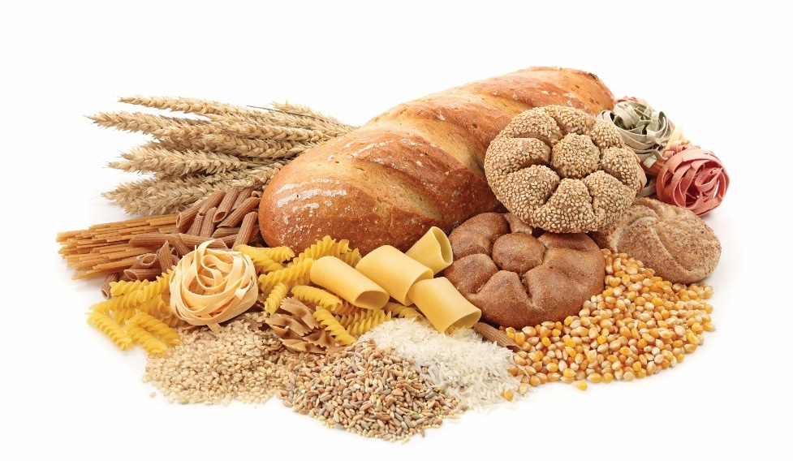
Types of Potatoes
All potatoes are tubers
Tubers are underground stems; can grow new plant
Potato types vary with starch and moisture content
High-starch potatoes
  Dense
  Good for baking or frying
Medium-starch potatoes
  Moist
  Good for potato salad
Low-starch potatoes
  Small, immature
  Good for boiling or steaming
Notes:
All potatoes are tubers. These are fat underground stems of the plant that can
grow a new plant. However, all potatoes are not the same. Potato varieties differ
in starch and moisture content, shape, and skin color. That is why different
varieties produce a different end product. Potatoes are categorized by their
starch and moisture content. The starch content of any potato increases with
the potato’s age.
High-starch, low-moisture potatoes are dense because they have a high amount
of dry starch. These potatoes’ starch granules swell and separate as they cook,
which makes the potato fluffy. High-starch, low-moisture potatoes are best when
baked, puréed, or fried. They include Idaho and russet potatoes. Also included
in this category are sweet potatoes and yams.
Medium-starch, medium-moisture potatoes are versatile. The high moisture
prevents the potato from absorbing some water, and therefore it swells less
when cooked. These potatoes are great at holding their shape, so they are
good for potato salads and potato cakes. This category of potato is best for
boiling, steaming, sautéing, oven roasting, stewing, mashing, and braising.
Medium-starch, medium-moisture potatoes include chef’s all-purpose, Yukon
Gold, and yellow-fleshed potatoes.
New potatoes are low-starch, high-moisture potatoes. These are smaller,
immature potatoes and do not have the same starch levels at this stage of
growth. New potatoes are best for boiling, steaming, and oven roasting.
Table 7.1 lists the characteristics of the different types of potatoes.

Slide 3
Types of Potatoes
Chef’s/all-purpose potatoes:
Medium starch, medium moisture
Irregularly shaped
Good for mashing, puréeing, braising, sautéing
Notes:
Characteristics:
• Medium starch, medium moisture
• Drier and less starchy than russet potatoes
• Less expensive than russet potatoes
• Tend to be irregularly shaped
• Most suited to preparation in which the final shape of the potato is not visually important (mashing, puréeing, scalloping, and for soups)
Best Cooking Methods:
Mashing
Puréeing
Braising
Sautéing

Slide 4
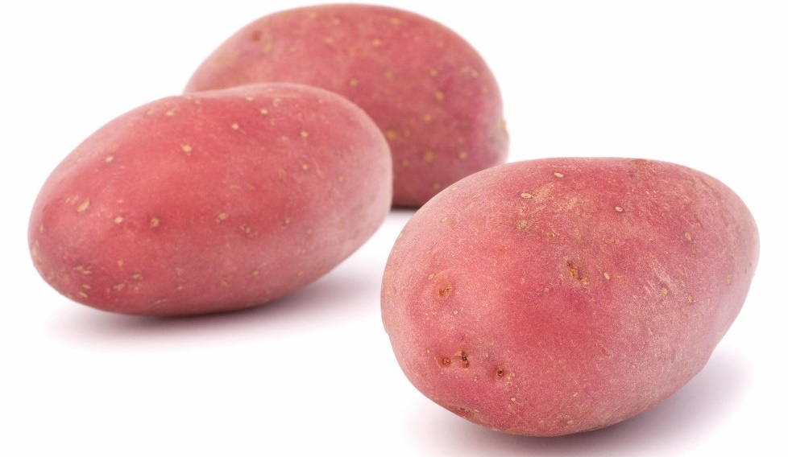
Types of Potatoes
New potatoes:
Low starch, high moisture
Immature potatoes, less than 2 inches in diameter
High in sugar
Keep shape well
Good for boiling, steaming, roasting
Notes:
Characteristics:
• Low starch, high moisture
• Immature red potatoes that are harvested when they are very small, less than two inches in diameter
• Unlike other baking potatoes, new potatoes are high in sugar
• Boiling and steaming brings out the natural sweetness and fresh flavor of new potatoes
• Good to use in any preparation where the potato must keep its shape
Best Cooking Methods:
Boiling
Steaming
Roasting

Slide 5
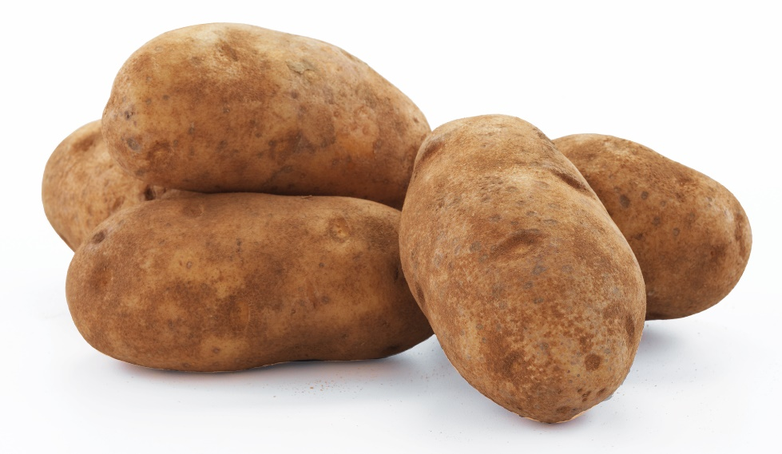
Types of potatoes
Russet potatoes:
High starch, low moisture
Also called Idaho potatoes
Standard baking potato
Flesh is mealy and white
Good for baking, frying, mashing, roasting, broiling
Notes:
Characteristics:
• High starch, low moisture
• Referred to as Idaho potatoes, although many other states also produce these potatoes
• The standard white baking potato
• Skin is generally a brownish-red color
• Flesh is mealy and white
• Are available in many shapes and sizes
• Often used to make French fries
Best Cooking Methods:
Baking
Frying
Mashing
Roasting
Broiling

Slide 6
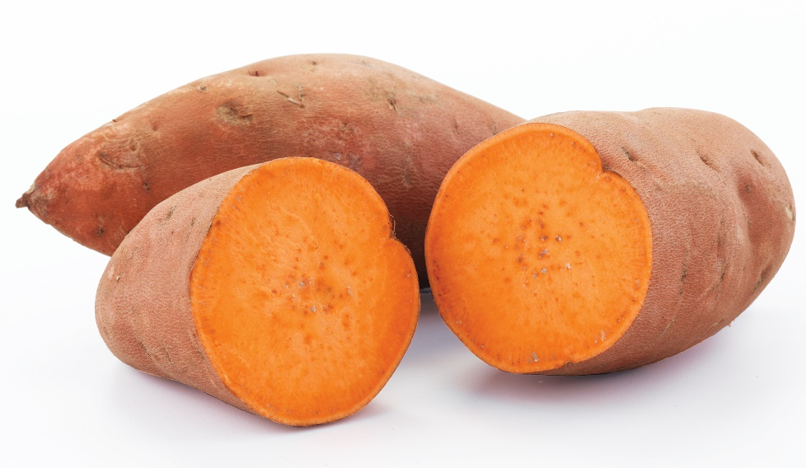
Types of potatoes
Sweet potatoes:
High starch, low moisture
Orange, mealy flesh
High sugar content
Good for boiling, baking, puréeing, roasting
Notes:
Characteristics:
• High starch, low moisture
• Thick skin ranges in color from light to brownish red
• Have an orange, mealy flesh that is very high in sugar
• Unlike the russet or chef’s potato, sweet potatoes are available canned, in a sweet, sugary sauce
• Available year-round
• Are popular ingredients in breads, pies, puddings, soups, and casseroles
• Can be swapped with yams
Best Cooking Methods:
Boiling
Baking
Puréeing
Roasting

Slide 7
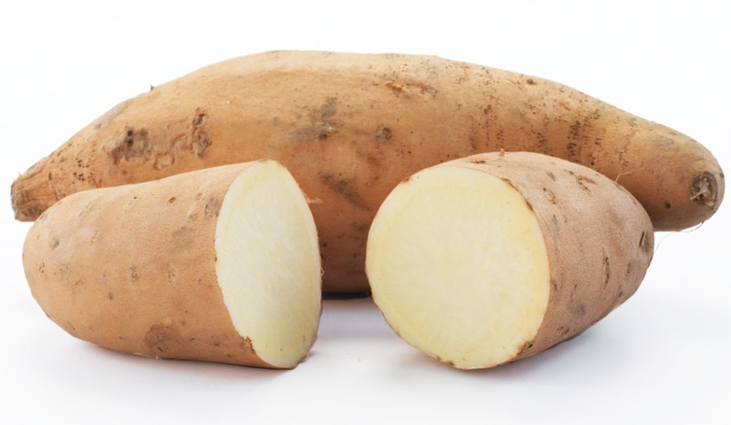
Types of potatoes
Yams:
High starch, low moisture
Not related to sweet potato
Originated in Asia
More natural sugar and moisture than sweet potatoes
Good for baking, puréeing, frying
Notes:
Characteristics:
• High starch, low moisture
• Not related to the sweet potato
• Originated in Asia
• Less sweet than sweet potatoes
• Range in color from creamy white to deep red
• Have more natural sugar and a higher moisture content than sweet potatoes
• Can be swapped with sweet potatoes
Best Cooking Methods:
Baking
Puréeing
Frying

Slide 8
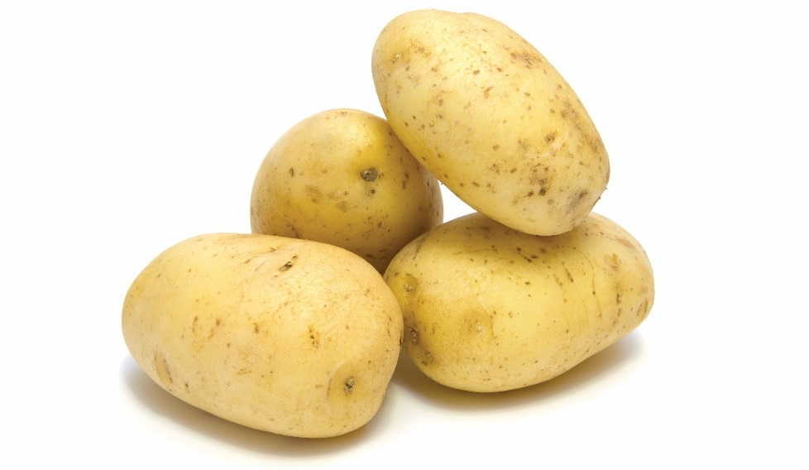
Types of potatoes
Yellow-fleshed potatoes:
Medium starch, medium moisture
Popular in the U.S.
Yukon Gold is a common variety
Good for mashing, puréeing, baking, frying
Notes:
Characteristics:
• Medium starch, medium moisture
• Have become increasingly popular in the United States in recent years
• Common in other parts of the world, including Europe and South America
• Produce a golden color and a buttery flavor
• Good, all-purpose potatoes
• Yukon Gold is one well-known variety
• Especially good for potato pancakes
Best Cooking Methods:
Mashing
Puréeing
Baking
Frying

Slide 9
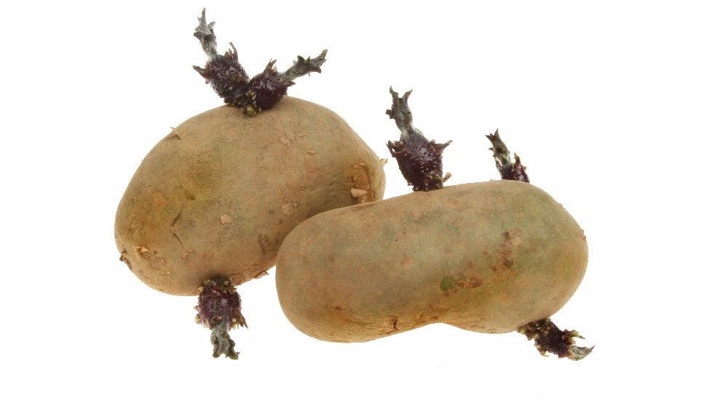
Selecting potatoes
Dry, firm, and smooth
No dark spots, green areas, sprouting, soft spots, mold, large cuts/bruising
Market options: fresh, frozen, refrigerated, canned, dried
Notes:
When selecting potatoes, choose potatoes that are dry, firm, and smooth. Do
not accept potatoes with dark spots, green areas, sprouting, soft spots, mold, or
large cuts/bruising.
A wide variety of market options exists when purchasing potatoes. These forms
include fresh, frozen, refrigerated, canned, and dried. Value-added forms are
also available, such as potatoes cut into shapes.

Slide 10
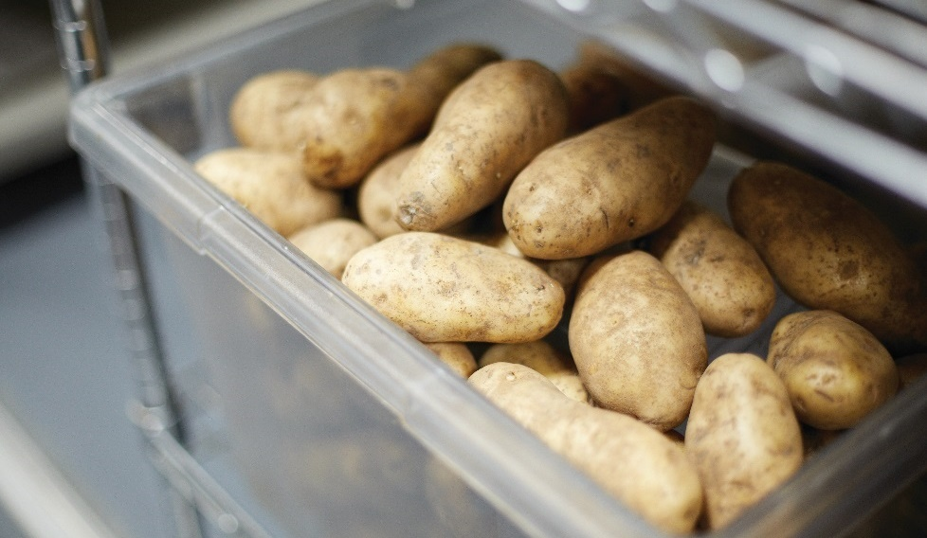
Storing potatoes
Ideal storage temperature: 45°F to 55°F (7°C to 13°C)
Cool, dry place
Ventilated container in indirect light
Potatoes exposed to light can turn green
Green potatoes: increased levels of chlorophyll and solanine
Store for one week
Notes:
Ideal storage temperatures for potatoes range from 45°F to 55°F (7°C to 13°C).
This is above proper refrigerator temperatures, so it is best to find a cool, dry
place for storage. All potatoes are best stored in ventilated containers in indirect
light. Figure 7.1 shows potatoes in a ventilated container.
Potatoes that are exposed to light may develop a greenish color. The green
color is from chlorophyll, and is itself harmless. However, it is an indication of an
increased level of solanine (SOLE-ah-neen), a potentially harmful, bitter-tasting
substance. Potato sprouts can also contain solanine. Cut away and discard
sprouts and any green portions before using potatoes. Always discard potatoes
if you have any doubts about their freshness or safety. Figure 7.2 shows
greenish potatoes with sprouts.
It is best to store potatoes for a maximum of one week, although some varieties
can be stored longer. For example, the maximum storage period for russet and
all-purpose potatoes is 30 days. Store yams for up to two weeks. Store sweet
potatoes for up to one week.

Slide 11
Preparing potatoes
Inexpensive, nutritious, versatile
Boiled, steamed, baked, deep-fried, puréed
Different potatoes produce different results
Single-stage technique
  Baked or boiled potatoes
Multiple-stage technique
  Lyonnaise potatoes
Notes:
The potato is one of the most popular vegetables because it is inexpensive,
nutritious, versatile, and tasty. Apply any cooking methods, including boiling,
steaming, baking, sautéing, deep-frying, and puréeing, to produce a number
of preparations with special flavors, textures, and appearances. Different
potato varieties (based upon their moisture and starch content) will produce
different results.
The two categories for cooking potatoes are single-stage and multiple-stage
techniques. In the single-stage technique, potatoes are cooked directly from the
raw state to the finished state by using one cooking method. Boiled and baked
potatoes are examples of potatoes cooked with single-stage techniques.
In a multiple-stage technique, potatoes are prepared using more than one
cooking method before they are a finished dish. One example of potatoes
prepared using the multiple-stage method is lyonnaise (LEE-on-AZE) potatoes.
In this recipe, the potatoes are precooked, sliced, and then fried with onions, as
shown in Figure 7.3.
Whenever possible, cook potatoes in their skins to retain their nutrients. Cover
the cut and peeled potatoes in a liquid to prevent discoloring.

Slide 12
Cooking Potatoes
Boiling
  Easy cooking method
  First step in other methods—puréeing
Steaming
  Good for new potatoes
  Cook in water until tender
Baking
  Served in their skins
  Wrap in foil or rub with oil
  Idahos or russets good for baking
Notes:
Boiling
Boiling is one of the easiest methods of cooking potatoes. In addition, boiling is
often the first step for other preparations, such as puréed potatoes.
Steaming
Steaming is an especially good cooking method for new potatoes because of
their high moisture content. Steam new potatoes until they are very tender. Like
boiled potatoes, serve them right away or hold and use with another dish.
Baking
Unlike boiled and steamed potatoes, baked potatoes are always served in their
skins. The best baking potatoes are Idahos or russets. There are a variety of
ways to bake potatoes:
• Wrap potatoes in foil prior to baking to keep the skin crispy, which makes the inside less fluffy.
• Rub the potato with oil to keep the skin soft while allowing the inside to get soft and fluffy.
• Bake with no foil or oil to leave the skin crisp.

Slide 13
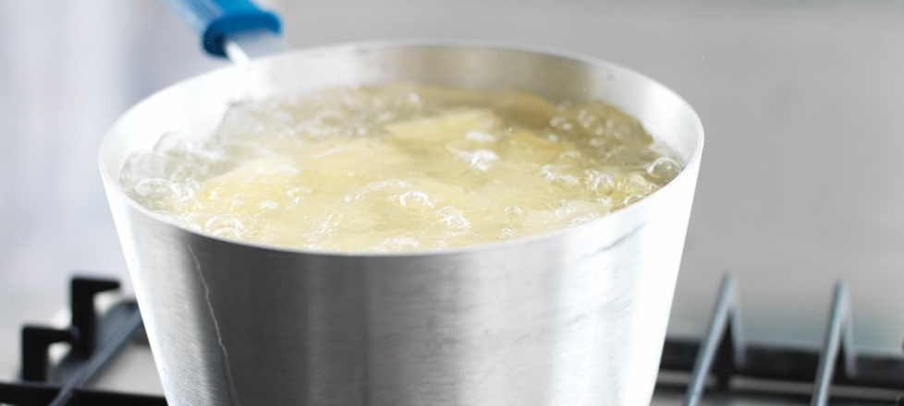
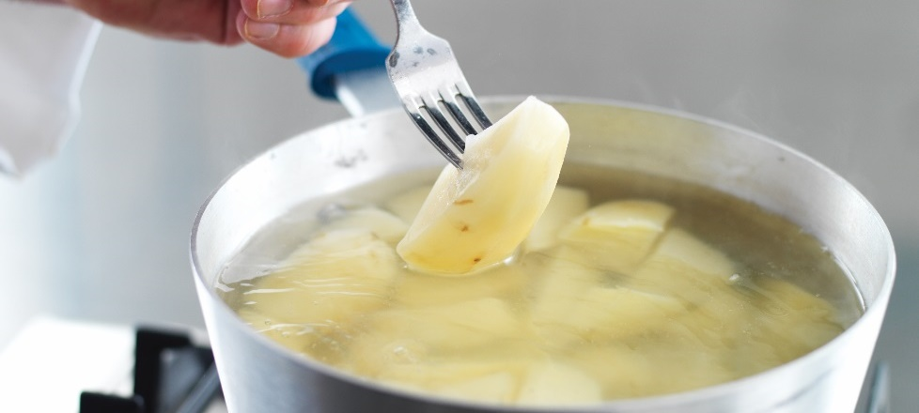
Boiling potatoes
Place potatoes in pot of cold, salted water
  Enough liquid to cover potatoes
Bring water to boil
  Simmer until done.
To test for doneness
  Pierce with fork or knife
  Serve immediately or hold for up to an hour
Notes:
ESSENTIAL SKILLS: BOILING POTATOES
Place washed potatoes in a pot of cold, salted water with enough liquid to cover them.
Bring the water to a boil and simmer until they are done.
To test for doneness, pierce the potato with a fork or knife. If the fork slides easily through the potato, the potato is done.
The boiled potato can then be served immediately or held for up to an hour.

Slide 14
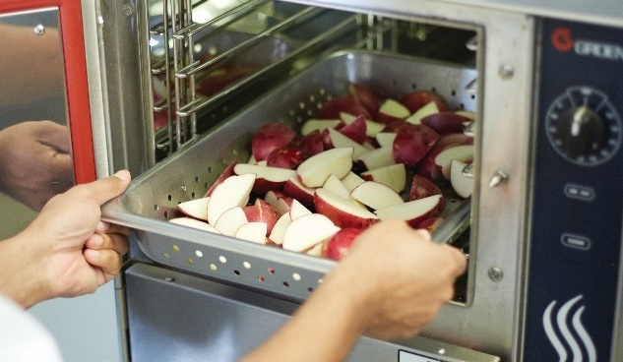
Steaming potatoes
Place potatoes in perforated pan
  Single layer for even cooking
Steam the potatoes until done
To test for doneness
  Pierce with fork or knife
  Serve immediately or hold for up to an hour
Notes:
STEAMING POTATOES
Place washed potatoes into a perforated pan in a single layer for even cooking.
Make sure there is adequate space between the potatoes to allow for steam circulation.
Steam the potatoes until they are done.
To test for doneness, pierce the potato with a fork or knife. If the fork slides easily through the potato,
the potato is done. The steamed potato can then be served immediately or held for up to an hour.

Slide 15
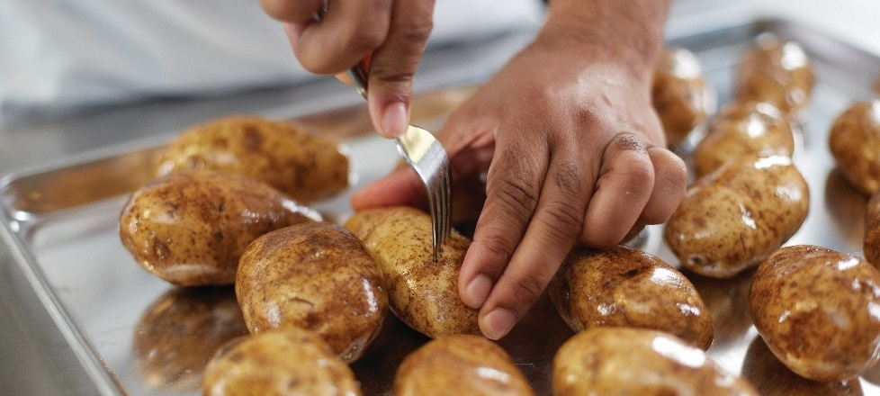
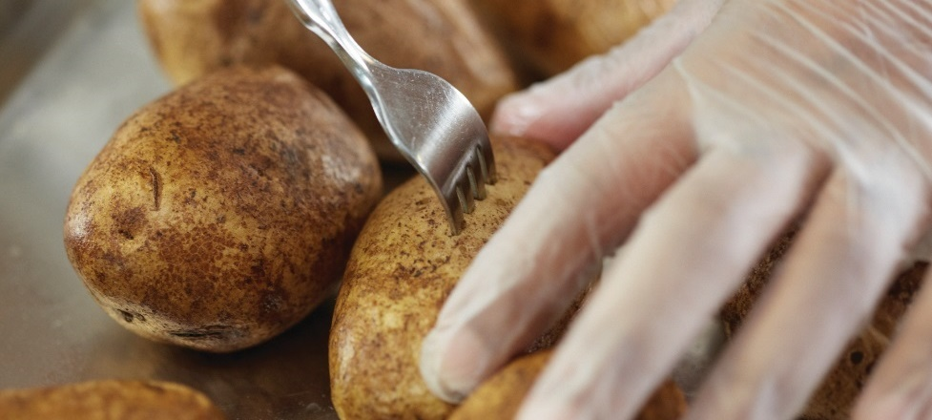
Baking potatoes
Scrub potatoes clean
Pierce potato with a fork
Cook directly on an oven rack or sheet pan
To test for doneness
  Pierce with fork or knife
  Serve immediately
Notes:
ESSENTIAL SKILLS: BAKING POTATOES
Scrub all potatoes clean, no matter the technique.
Pierce the potato with a fork to allow heat and steam to escape and prevent the potato from exploding.
Cook baked potatoes directly on an oven rack or sheet pan.
To test for doneness, pierce the potato with a fork or knife. If the fork slides easily through the potato, the potato is done.
The baked potato can then be served immediately.

Slide 16
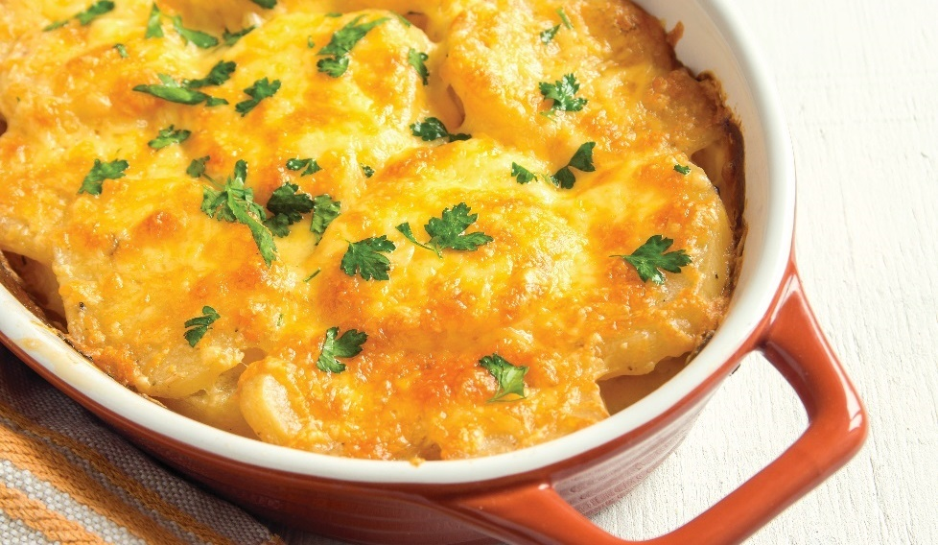
Preparing potatoes
Baking dishes:
Cooked in casseroles
Combine with cream or sauce and bake in buttered pan
Portioned easily and held for later
Notes:
Baking Dishes
For casserole potato dishes, combine peeled and sliced raw potatoes with
heavy cream, sauce, or uncooked custard. Slowly bake these dishes in a
buttered pan. Toppings include bread crumbs, butter, and grated cheese,
after which the food preparer broils the dish briefly to give it a golden-brown
color. These potatoes are excellent for banquet service because servers can
divide them into individual portions very easily, and they can be held without
losing quality.

Slide 17
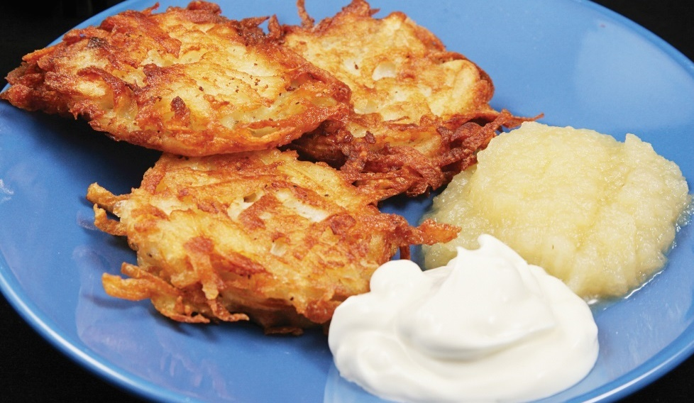
Preparing potatoes
Sautéing:
Best to use chef’s potatoes
Crisp exterior, tender interior
Cook in oil or butter, flipping frequently
Popular version is latkes, or potato pancakes
Notes:
Sautéing
Chef’s potatoes are the best for sautéing. Sautéed potatoes should have a crisp,
evenly browned exterior with a tender interior. Sauté the potatoes in oil or butter,
stirring or flipping them frequently until they are golden brown. For best results,
serve immediately.
Make potato pancakes with grated potatoes and other ingredients. Pan-fry them
to a crispy brown. They are traditional in many Eastern European cuisines, as well
as in American-Jewish cooking, where they are called latkes (LAHT-keys). Latkes
are traditionally served with apple sauce and sour cream.

Slide 18
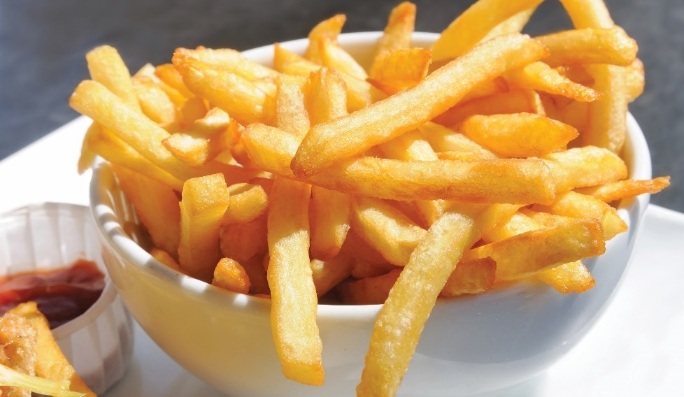
Preparing potatoes
Deep-frying:
French fries, cottage fries, steak fries
Fry in fat at 350°F to 375°F (177°C to 191°C)
Serve immediately; do not hold
Notes:
Deep-Frying
Another popular method of cooking potatoes is deep-frying. Use this method
to make French fries, cottage fries, steak fries, and many other fried potato
dishes. Russet potatoes are best suited for deep-frying because of their low
moisture content.
At service time, fry potatoes in fat heated to 350°F to 375°F (177°C to 191°C) until
golden brown. Deep-fry in two stages because of the long cooking time. When
they are done, place the potatoes on a paper towel and season immediately. Do
not hold deep-fried potatoes; serve immediately.

Slide 19
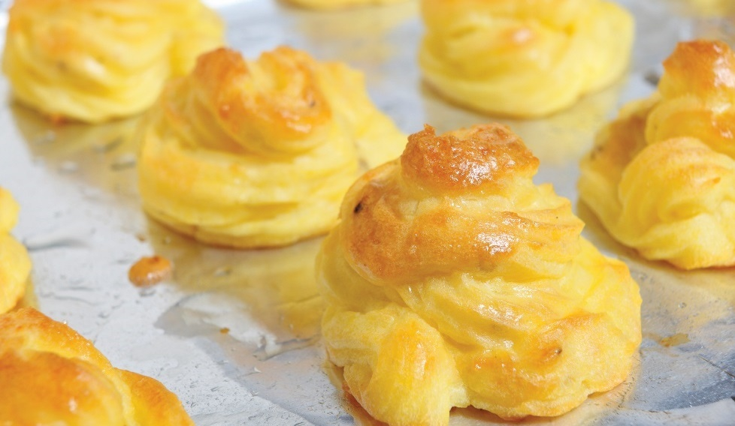
Preparing potatoes
Mashed or puréed:
Puréeing is often first step in many dishes
  Mashed potatoes, duchesse potatoes, potato croquettes
Boil, steam, bake first, then combine with other ingredients
Notes:
Mashed or Puréed
Puréeing potatoes is another way to prepare them. Puréed potatoes are
important as the basis of many popular dishes, including mashed or whipped
potatoes, duchesse potatoes, and potato croquettes.
For puréed, whipped, and mashed potatoes, first boil, steam, or bake the
potatoes before combining them with other ingredients or mashing. Hold them
for service in a bain-marie or a steam table. Refrigerate puréed potatoes that
are to be used in other dishes for several hours.

Slide 20
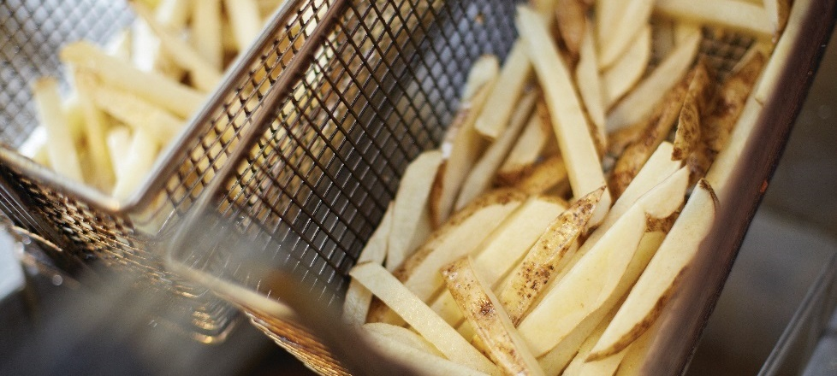
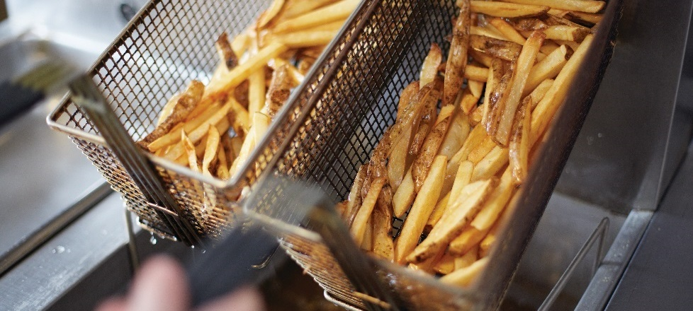
Deep-frying potatoes
Cut potatoes into appropriate shapes
  Store in cold water until ready to use
Dry fries completely
Blanch fries for 30 seconds in 300°F (149°C) oil
  Drain well
  Keep chilled until service
For service, raise the oil temperature to 350°F (177°C)
  Deep-fry the potatoes until golden brown and cooked completely
  Season (if desired) and serve immediately
Notes:
Cut potatoes into appropriate shapes for service (batonnet, country fries, etc.). Store in cold water until ready to use.
Dry fries completely with paper towels.
Blanch fries for 30 seconds in 300°F (149°C) oil and let drain well. Keep chilled until service.
For service, raise the oil temperature to 350°F (177°C). When the oil is ready, deep-fry the potatoes until golden brown
and cooked completely. Season (if desired), and serve immediately.

Slide 21
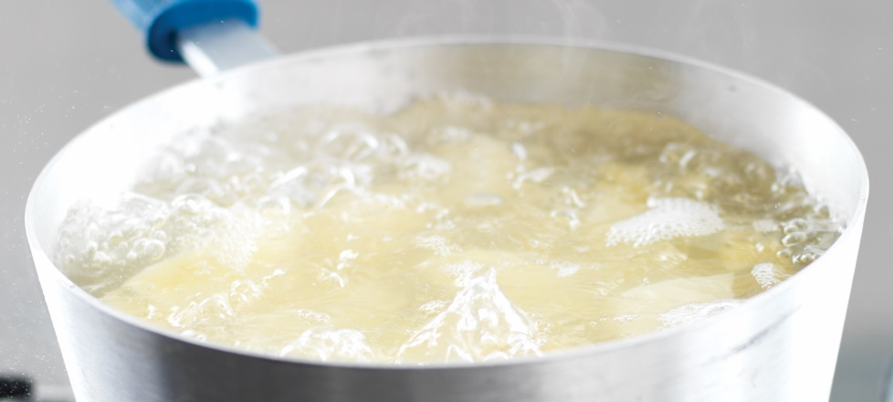
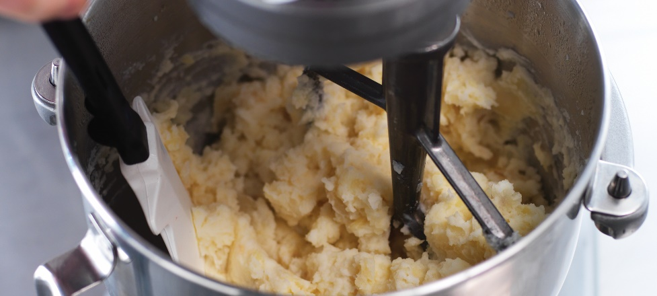
Mashed potatoes
Cut potatoes into even-sized pieces—one inch
  Store under water until ready to use
Rinse potatoes
  Place in pot with salted cold water
Bring water to boil
  Boil potatoes until they are tender
  Drain very well
Add seasonings, melted butter, and milk or cream
  Mash potatoes until almost smooth
Serve immediately
Notes:
Cut potatoes into even-sized pieces, approximately one inch. Store under water until ready to use.
Rinse potatoes, and place in a pot with salted cold water to cover.
Bring the water to a boil. Boil potatoes until they are tender. Drain very well.
Add in seasonings, melted butter, and milk or cream. Mash potatoes until almost smooth.
Serve immediately.

Slide 22
LEGUMES AND GRAINS
Legumes are seeds from pod-producing plants
Often in dried form
Good source of carbohydrates and fiber
Four categories of legumes
  Beans
  Peas
  Nuts
  Seeds
Notes:
Legumes (LEG-yooms) are seeds from pod-producing plants. Dried legumes
have many uses in cooking, from salads and appetizers to main courses and
desserts. They are an excellent source of carbohydrates and fiber.
Legumes can be broken down into different categories:
• Beans
• Peas
• Nuts
• Seeds
Each category has unique properties that give it distinctive flavors and nutrient values.

Slide 23
BEANS
Seeds from legume plants
Often kidney shaped
Many varieties, sizes, colors
Notes:
A bean is an edible seed, often kidney-shaped, from various plants of the legume family. Please note that there are many varieties of beans available that are not on the list (such as heirloom varieties).

Slide 24
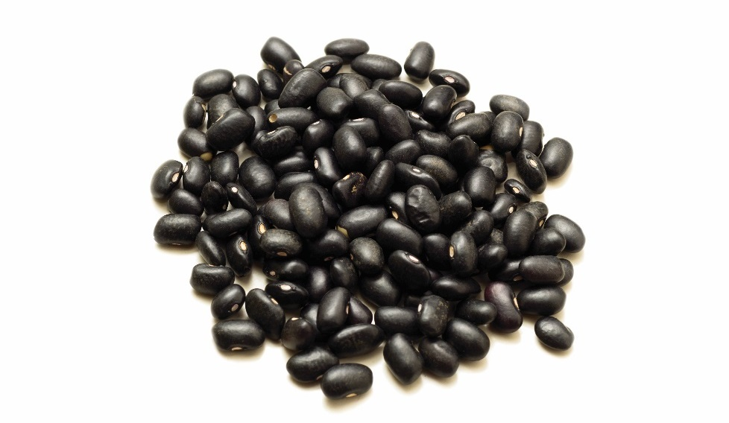
TYPES OF BEANS
Black/turtle:
Large, black exterior
Light, creamy interior
Sweet flavor
Used in soups, stews, salsas, salads, side dishes

Slide 25
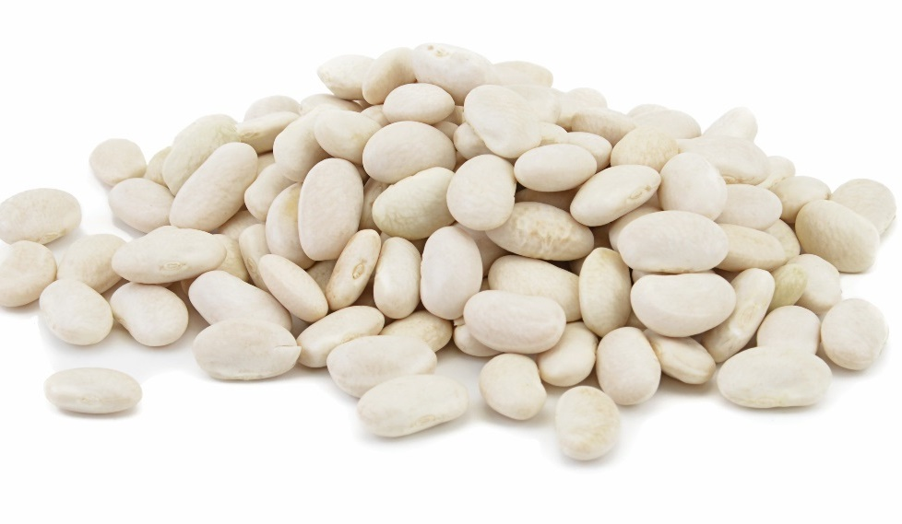
Types of beans
Cannellini/Italian kidney:
Medium, white, kidney shaped
Nutty flavor
Used in minestrone, salads, stews, side dishes

Slide 26
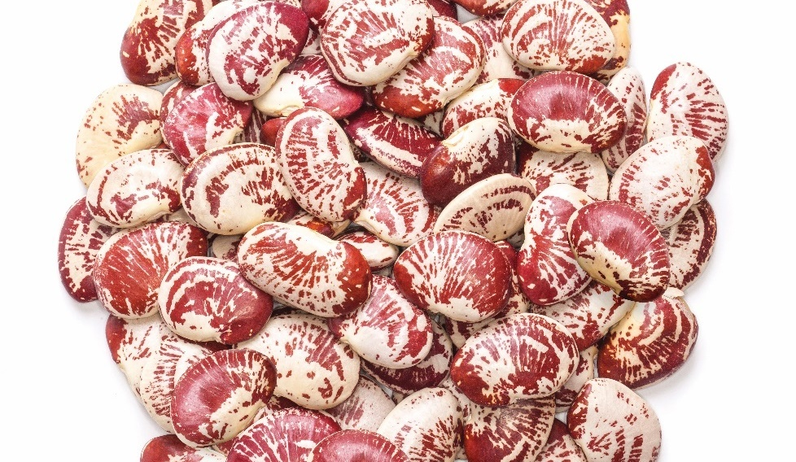
Types of beans
Cranberry:
Small, round, maroon markings
Nutty flavor
Used in soups, stews, salads, side dishes

Slide 27
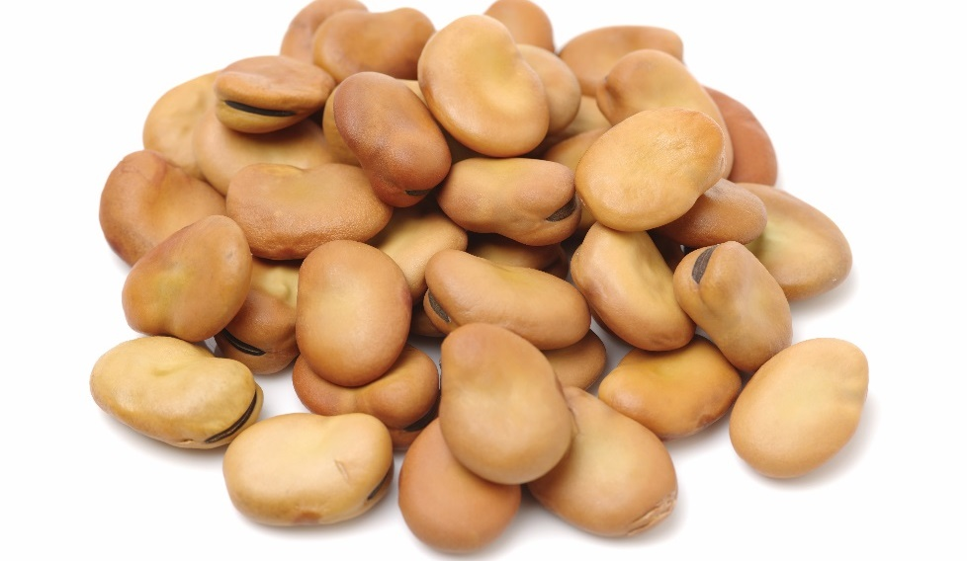
Types of beans
Fava/broad:
Large, flat, oval, tan
Popular in Mediterranean and Middle Eastern cuisine
Used in falafel, soups, stews, salads, side dishes

Slide 28
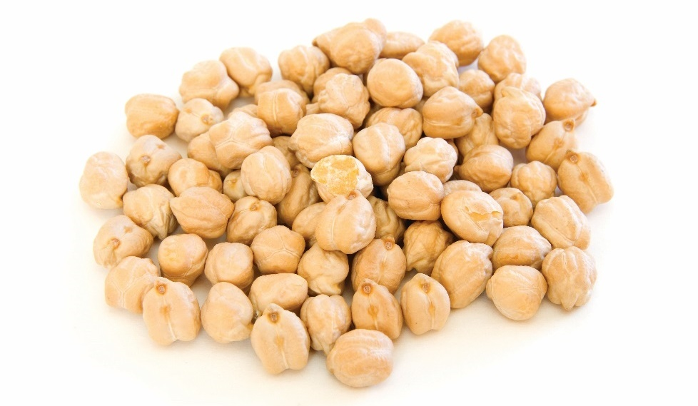
Types of beans
Garbanzo/chickpeas:
Medium, acorn-shaped, beige
Nutty flavor
Popular in many ethnic dishes
Used in couscous, hummus, soups, stews, salads,
side dishes

Slide 29
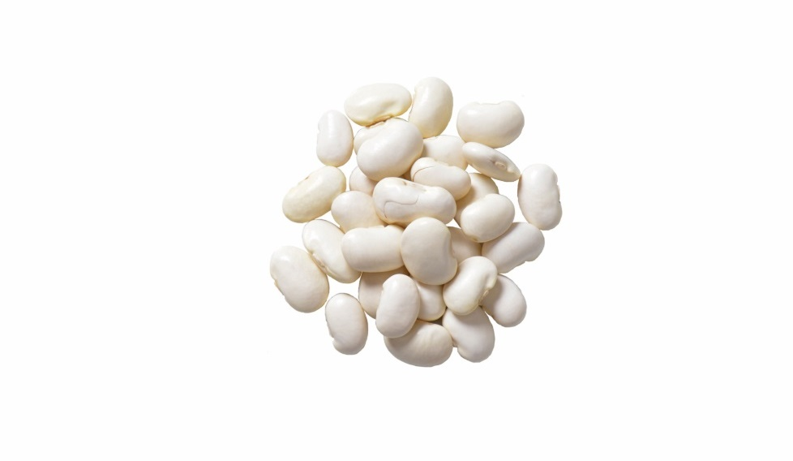
Types of beans
Great northern:
Large, slightly rounded, white
Mild delicate flavor
Used in soups, stews, casseroles, side dishes

Slide 30
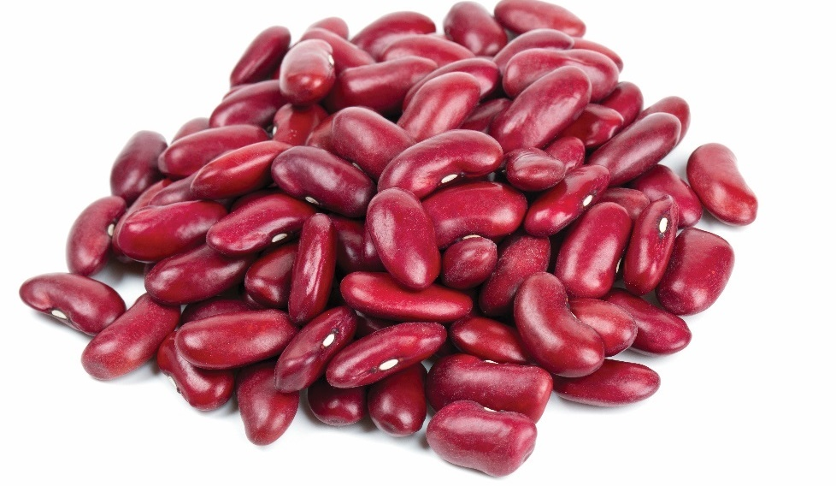
Types of beans
Kidney:
Medium, kidney shaped, pink to maroon
Full-bodied flavor
Used in chili con carne, refried beans, beans and rice, soups, stews, casseroles, side dishes

Slide 31
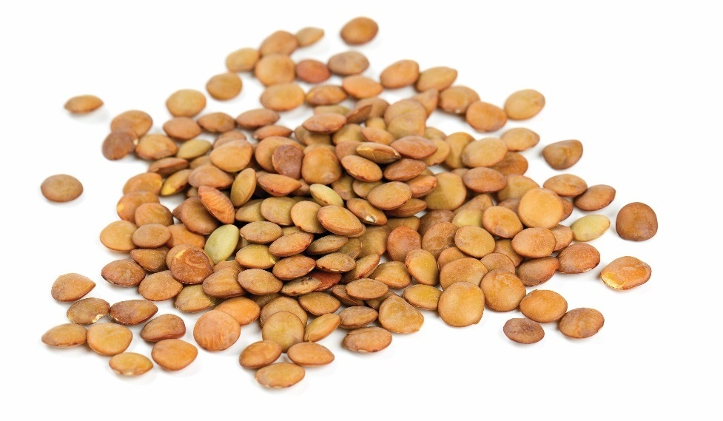
Types of beans
Lentils:
Small, round
Varieties include French/European, Egyptian, red, yellow
Served as an accompaniment whole or pureed
Used in soups, stews, salads, side dishes

Slide 32
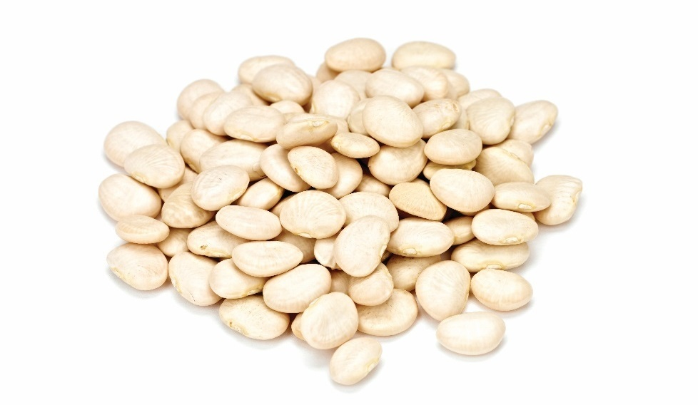
Types of beans
Lima/butter
Medium, white/pale green
Slightly kidney-shaped
Buttery taste
Used in succotash, soups, stews, salads, side dishes

Slide 33
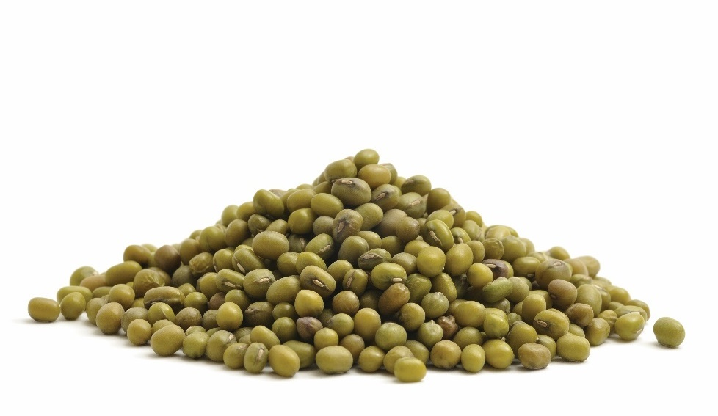
Types of beans
Mung
Small, round, green
Sprouted for bean sprouts
Ground into flour to make cellophane noodles and
bean threads

Slide 34
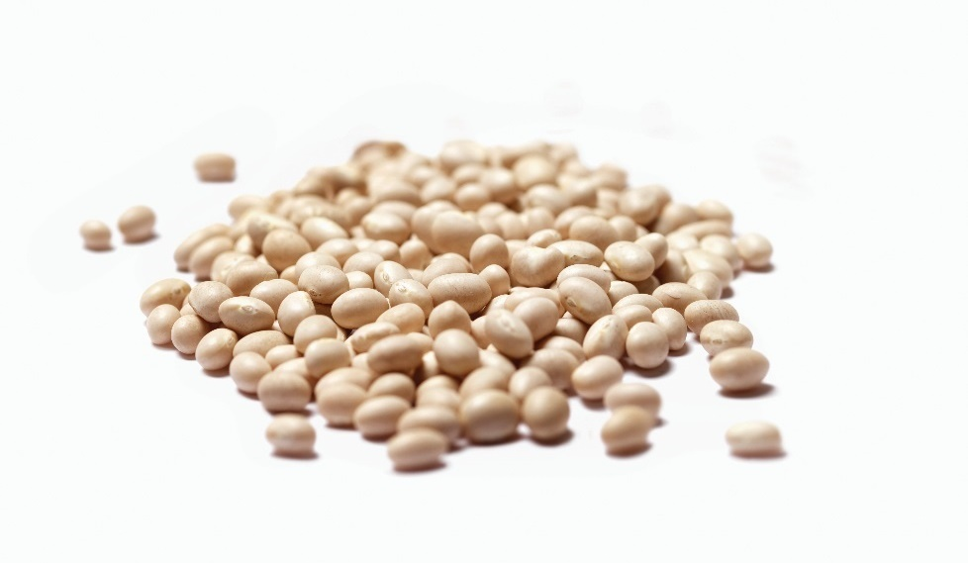
Types of beans
Navy/Yankee:
Small, round, white
Used in baked beans, chili, soups, salads

Slide 35
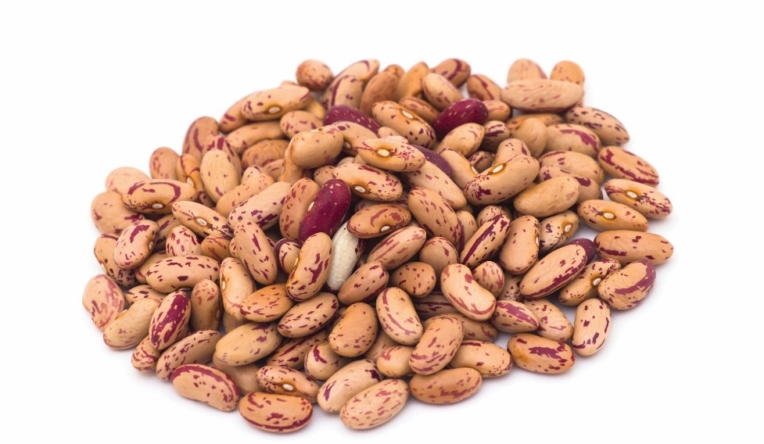
Types of beans
Pinto/Red Mexican:
Medium, beige with brown streaks
Kidney shaped
Used in chili, refried beans, stews, soups

Slide 36
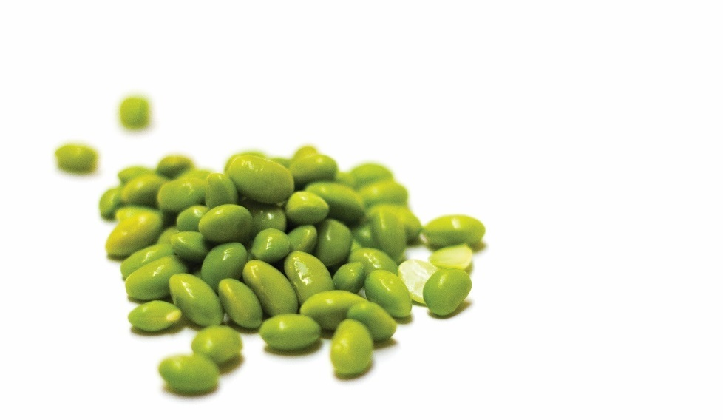
Types of beans
Soybeans:
Small
Red, yellow, green, brown, and black
Pea- to cherry-shaped
Bland flavor
Dried version is mature bean
Used in soups, stews, casseroles, side dishes

Slide 37
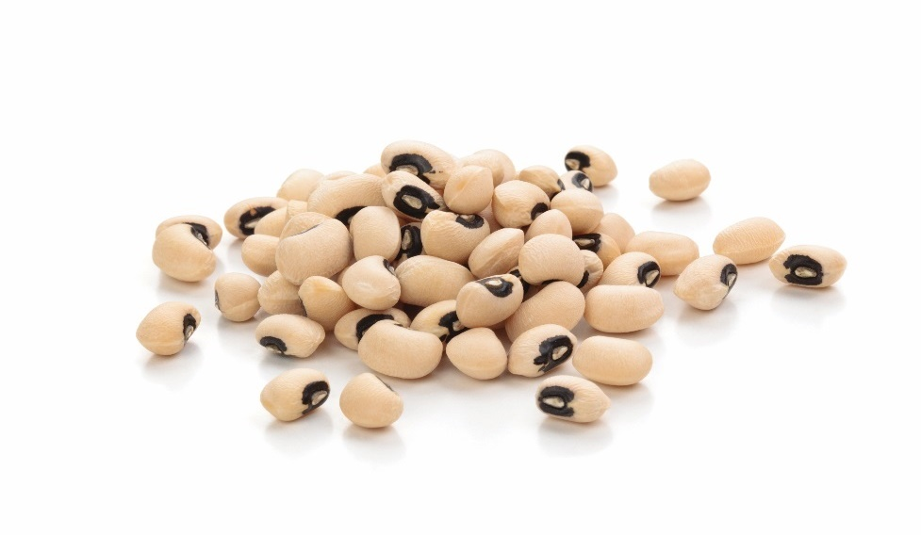
Types of peas
Black-eyed:
Small, beige with black “eye”
Kidney-shaped
Used in Hoppin’ John, soups, side dishes
Notes:
The pea is a round, edible seed that is a plant and part of the legume family.

Slide 38
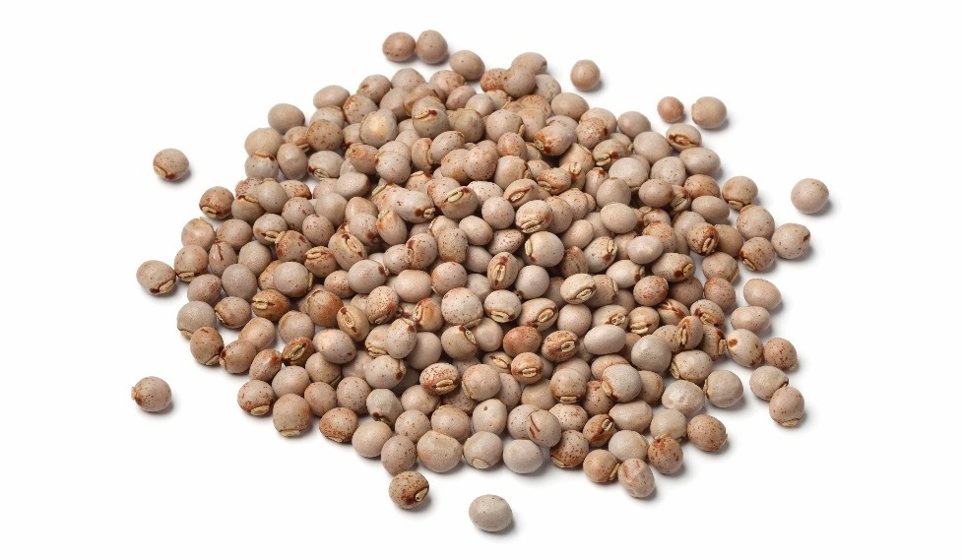
Types of peas
Pigeon/gandoles:
Heirloom bean
Small, nearly round, beige with orange spotting
Popular in African, Caribbean, Indian cuisine

Slide 39
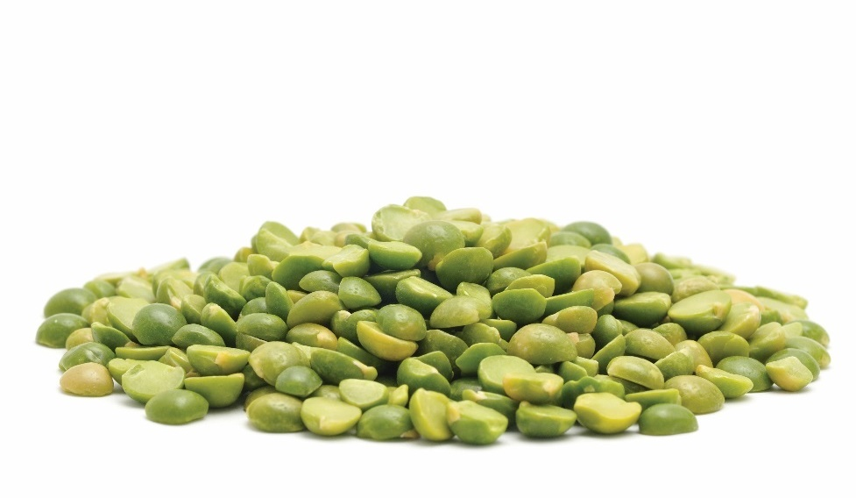
Types of peas
Split:
Small, round, split
Earthy flavor
Used in split pea soup, salads, side dishes

Slide 40
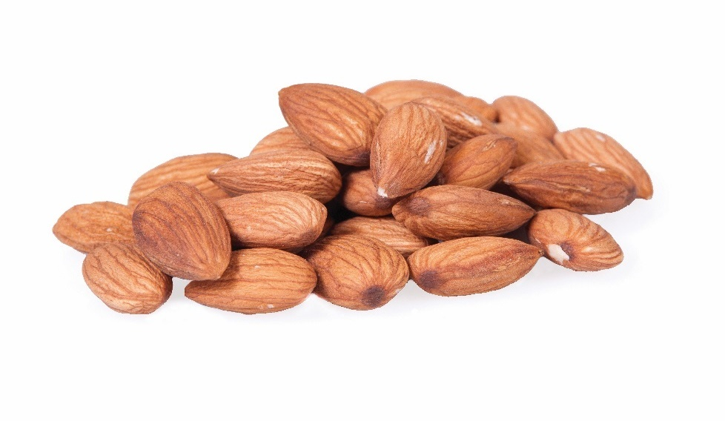
Types of nuts
Almond:
Teardrop-shaped
Pale tan, woody shell
Sweet flavor
Available in shell or shelled, blanched, slivered, sliced, split, chopped, ground
Produce almond paste, almond butter, almond oil
Used raw and in baked goods, confections, granola,
curry dishes
Notes:
A nut is a fruit composed of a hard shell and a seed, which is generally edible.
Description:
• Teardrop-shaped
• Pale tan, woody shell
• Sweet flavor
• Available whole in shell or shelled, blanched, slivered, sliced, split, chopped, ground
• Used to produce almond paste, almond butter, and almond oil
Common Culinary Uses:
• Raw, toasted, or cooked
• In baked goods, confections, granola, curry dishes
• Eaten out of hand

Slide 41
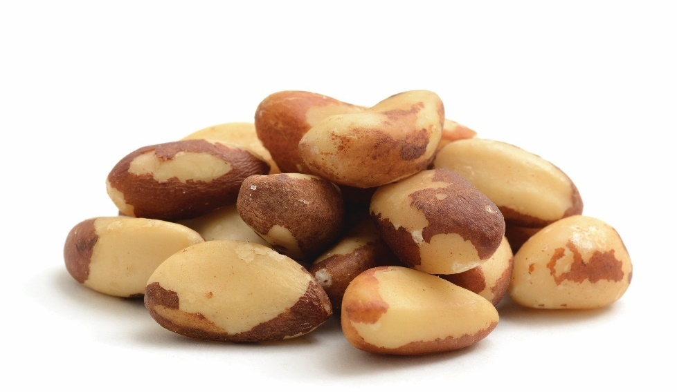
Types of nuts
Brazil:
Large, triangular
Dark brown exterior, hard shell
White interior, rich nut
Eaten raw, toasted, cooked, in baked goods
Notes:
Description:
• Large, triangular nut
• Dark brown exterior, hard shell
• White interior, rich nut
Common Culinary Uses:
• Raw, toasted, or cooked
• Eaten out of hand
• Baked goods

Slide 42
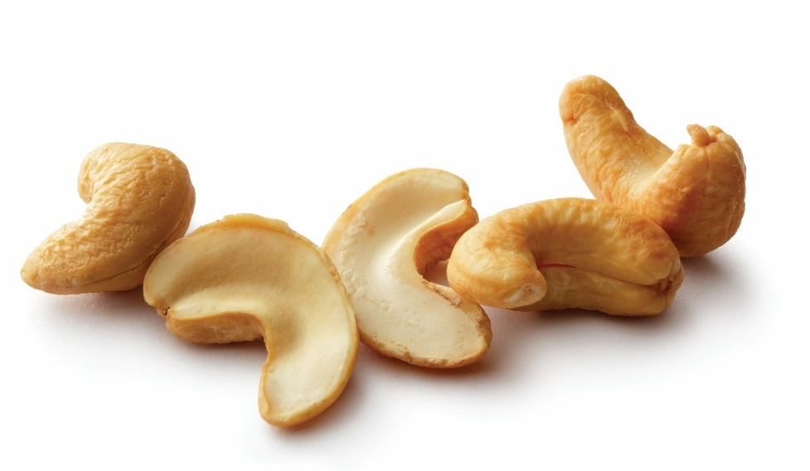
Types of nuts
Cashew:
Kidney shaped, tan
Buttery, slightly sweet flavor
Only sold hulled
Cashew butter
Eaten raw, toasted, cooked, in baked goods
Notes:
Description:
• Kidney-shaped
• Tan
• Buttery, slightly sweet flavor
• Only sold hulled (its skin contains oils similar to those in poison ivy)
• Used to produce cashew butter
Common Culinary Uses:
• Raw, toasted, or cooked
• Baked goods, confections
• Eaten out of hand

Slide 43
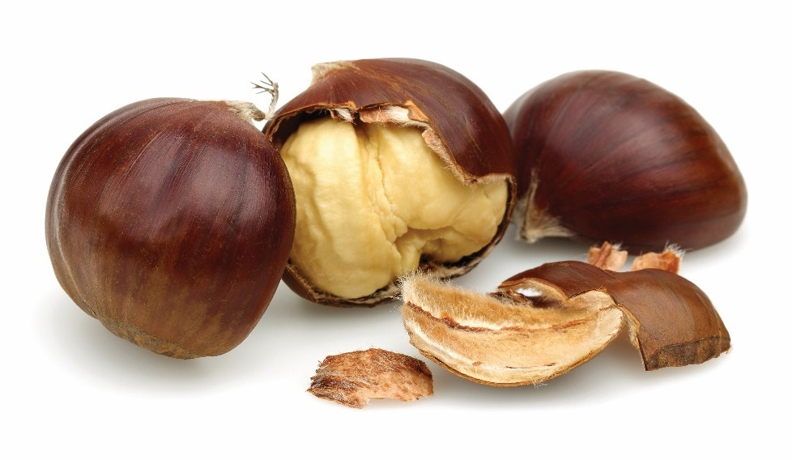
Types of nuts
Chestnut:
Large, round to teardrop-shaped
Hard, glossy, dark-brown shell
Off-white nut
Sweet flavor
Available in shell, canned in water or syrup, frozen, dried, or puréed
Eaten raw, cooked, roasted, boiled, puréed
Sweet and savory dishes
Notes:
Description:
• Fairly large
• Round to teardrop-shaped
• Hard, glossy, dark-brown shell
• Off-white nut
• Sweet flavor
• Available whole in shell, canned in water or syrup, frozen, dried, or puréed
Common Culinary Uses:
• Raw or cooked
• Sweet and savory dishes, roasted, boiled, puréed

Slide 44
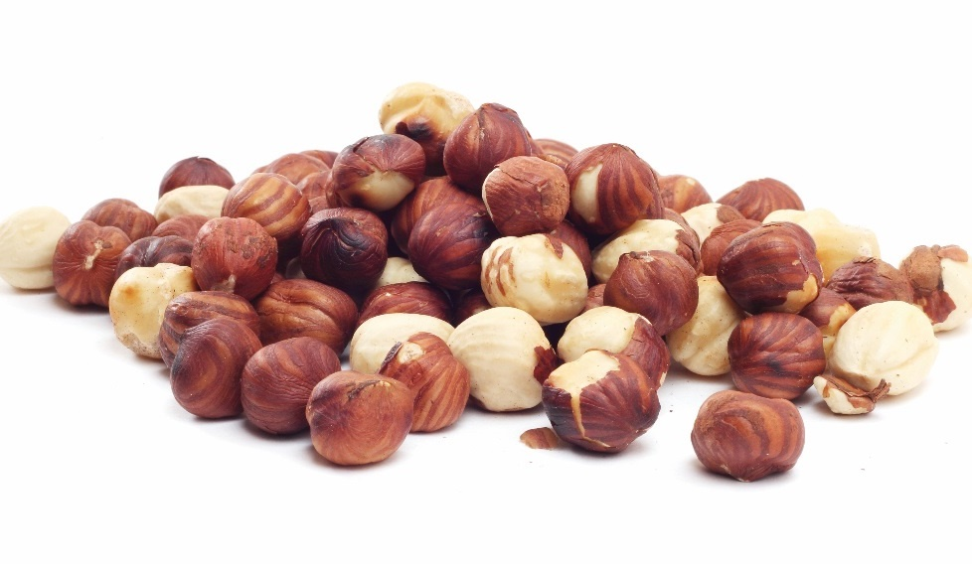
Types of nuts
Hazelnut/filbert:
Small, nearly round
Smooth, hard shell
Rich, sweet delicate flavor
Available in shell or shelled
Blanched, whole, chopped
Eaten raw, toasted, cooked, in baked goods, salads, cereals
Sweet or savory dishes
Notes:
Description:
• Small
• Nearly round
• Smooth, hard shell
• Rich, sweet, delicate flavor
• Available whole in shell or shelled
• Blanched, whole, chopped
Common Culinary Uses:
• Raw, toasted, or cooked
• Sweet or savory dishes, baked goods, salads, cereals

Slide 45
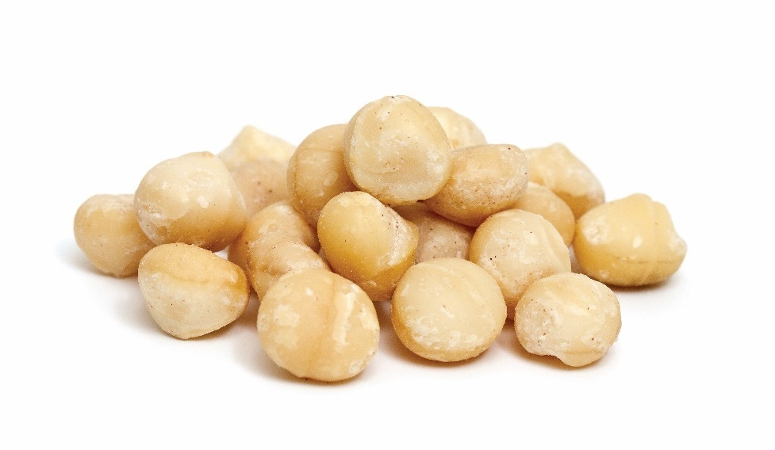
Types of nuts
Macadamia:
Nearly round
Extremely hard shell
Golden-yellow nut
Rich, slightly sweet, buttery flavor
Eaten raw, roasted, in baked goods, confections
Available shelled only
Notes:
Description:
• Nearly round
• Extremely hard shell
• Golden-yellow nut
• Rich, slightly sweet, buttery
• Available shelled only
Common Culinary Uses:
• Raw or roasted
• Baked goods, confections
• Eaten out of hand

Slide 46
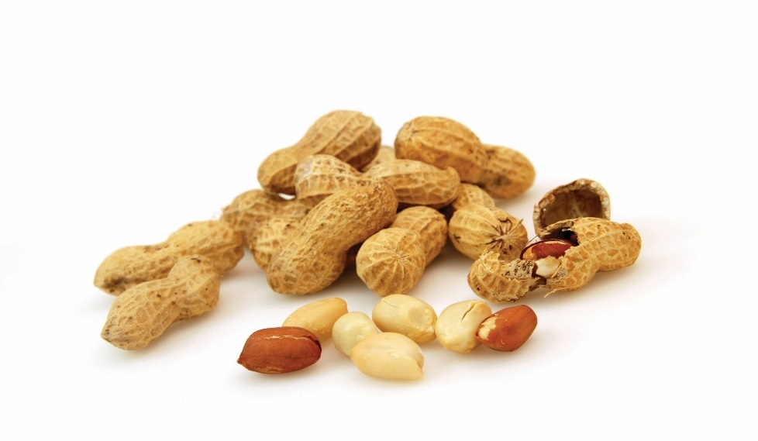
Types of nuts
Peanut:
Tan, pod-like shell
Papery brown skin
Off-white-colored nut
Sweet flavor
Available in shell or shelled, skinned
Peanut butter and peanut oil
Eaten raw, roasted, in baked goods, confections
Notes:
Description:
• Tan, pod-like shell
• Papery brown skin
• Off-white-colored nut
• Sweet flavor
• Available whole in shell or shelled, skinned
• Used to produce peanut butter and peanut oil
Common Culinary Uses:
• Raw or roasted
• Sweet or savory dishes, baked goods, confections, salads
• Eaten out of hand

Slide 47
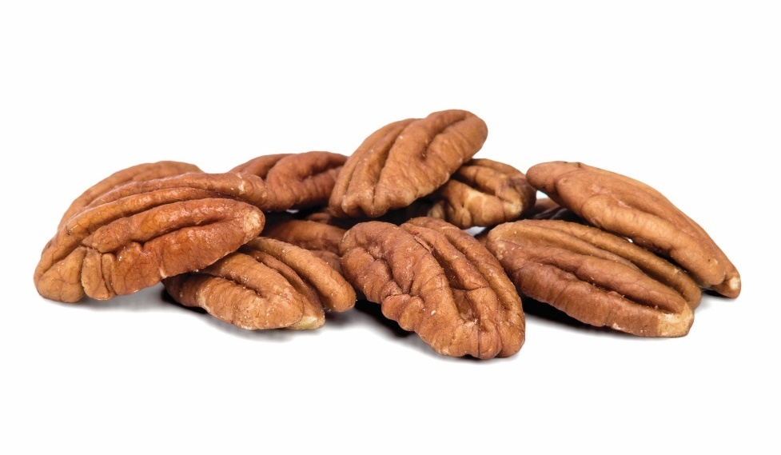
Types of nuts
Pecan:
Smooth, hard, thin, oval shell
Two-lobed
Brown nut, cream-colored interior
Rich, buttery flavor
Available in shell or shelled, halved, chopped
Eaten raw, roasted, in baked goods, pie, confections, salads
Notes:
Description:
• Smooth, hard, thin, oval shell
• Two-lobed
• Brown nut, cream-colored interior
• Rich, buttery flavor
• Available whole in shell or shelled, halved, chopped
Common Culinary Uses:
• Raw or roasted
• Sweet or savory dishes, baked goods, pie, confections, salads
• Eaten out of hand

Slide 48
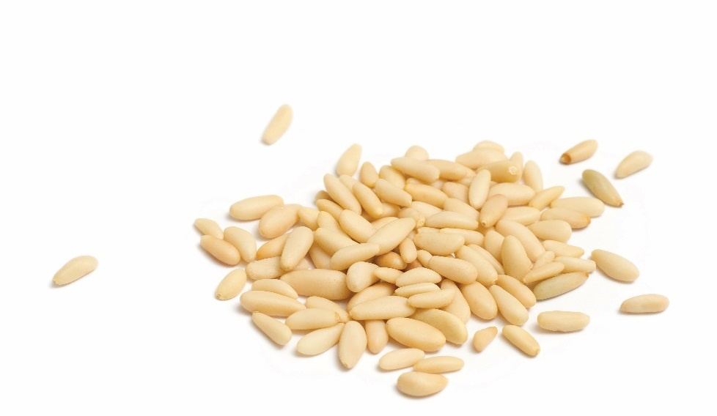
Types of nuts
Pine/pignoli:
Small, elongated kernel
About ½-inch long
Lightly tan
Buttery, mild flavor
Eaten raw, roasted, in baked goods, pesto
Sweet and savory dishes
Notes:
Description:
• Small, elongated kernel
• About ½-inch long
• Light tan
• Buttery, mild flavor
Common Culinary Uses:
• Raw or roasted
• Sweet and savory dishes, baked goods, salads, pesto

Slide 49
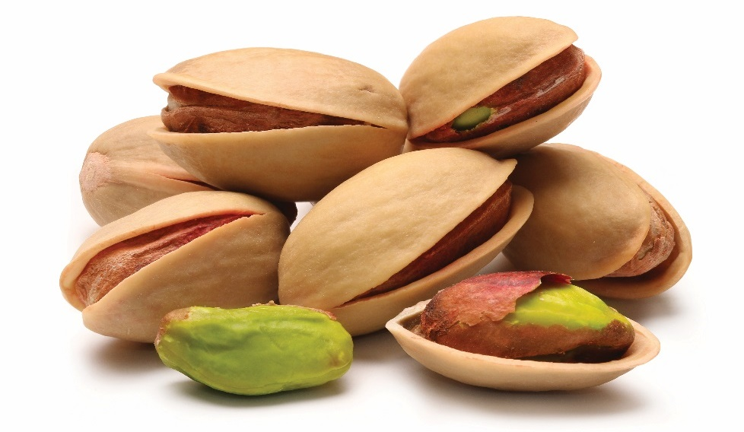
Types of nuts
Pistachio:
Tan, green nut
Subtle, sweet flavor
Available whole in shell
Roasted, usually salted
Shells sometimes dyed red
Eaten raw, roasted, in sweet and savory dishes
Notes:
Description:
• Tan
• Shell opens slightly when nut is mature
• Green nut
• Subtle, sweet flavor
• Available whole in shell
• Roasted, usually salted
• Shells sometimes dyed red
• Occasionally shelled, chopped
Common Culinary Uses:
• Raw or roasted
• Eaten out of hand
• Sweet and savory dishes

Slide 50
Types of nuts
Walnut:
Light-brown shell
Thick or thin
Brown nuts
Tender, oily
Mild flavor
Walnut oil
Eaten raw, roasted, in baked goods, confections, salads
Sweet or savoy dishes
Notes:
Description:
• Light-brown shell
• Thick or thin
• Brown nuts
• Grown in gnarled segments
• Tender
• Oily
• Mild flavor
• Available whole in shell or shelled, halved, chopped
• Pickled
• Used to produce walnut oil
Common Culinary Uses:
• Raw or roasted
• In sweet or savory dishes, baked goods, confections, salads
• Eaten out of hand

Slide 51
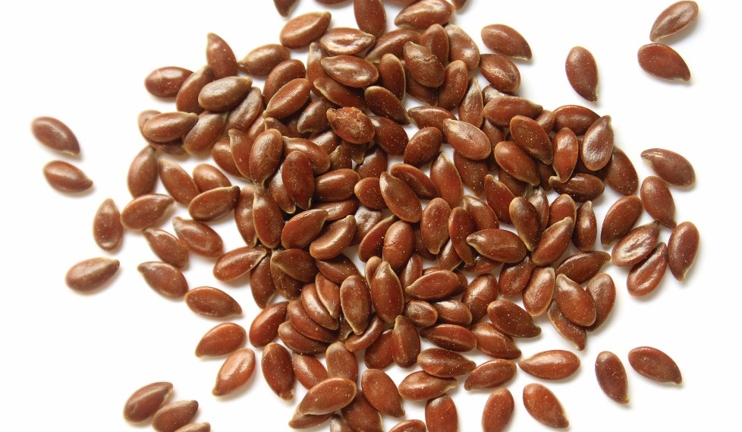
Types of seeds
Flax:
Tiny, oval seeds
Golden or dark brown
Mild nutty flavor
Linseed oil
Used in baked goods, hot and cold cereals
Notes:
A seed is an embryonic plant enclosed in a protective outer covering called the seed coat, usually with some stored food.
Description:
• Tiny, oval seeds
• Golden or dark brown
• Mildly nutty
• Used to produce linseed oil
• Baked goods, hot and cold cereal
Common Culinary Uses:
• Baked goods, hot and cold cereal

Slide 52
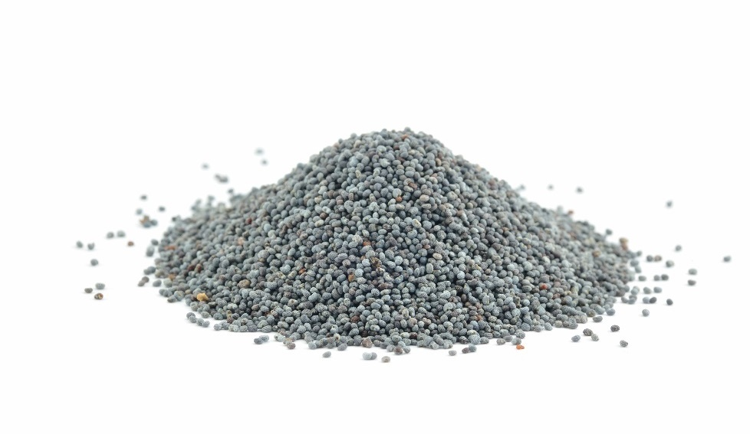
Types of seeds
Poppy:
Tiny, blue-black seeds
Crunchy
Slightly musty flavor
Used to fill and top baked goods, in salad dressings, in European and Middle Eastern cuisine
Notes:
Description:
• Very tiny, round, blue-black seeds
• Crunchy texture
• Rich, slightly musty flavor
• Available whole or ground
• Filling and topping for baked goods
• Used in salad dressings
• Popular in cuisines of central Europe and the Middle East
Common Culinary Uses:
• Filling and topping for baked goods
• Used in salad dressings
• Popular in cuisines of central Europe and the Middle East

Slide 53
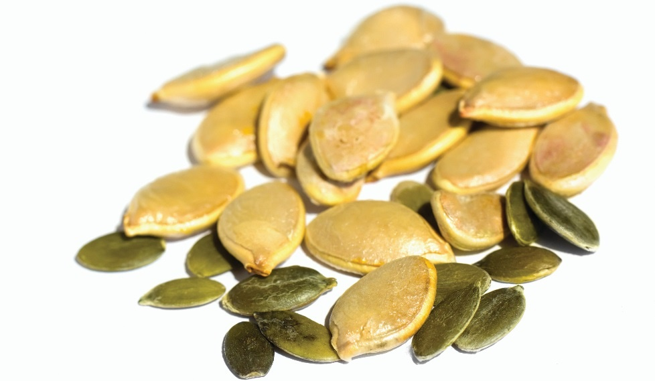
Types of seeds
Pumpkin/pepitas:
Small, flat, oval, soft
Cream-colored hulls
Greenish-brown, oily interior
Delicate flavor
Available whole or hulled, usually salted
Eaten raw, roasted, in sweet or savory dishes,
baked goods
Popular in Mexican cuisine
Notes:
Description:
• Small, flat, oval, soft
• Cream-colored hulls
• Greenish-brown, oily interior
• Delicate flavor
• Available whole or hulled, usually salted
Common Culinary Uses:
• Raw or roasted
• Sweet or savory dishes, baked goods
• Popular in Mexican cuisine

Slide 54

Types of seeds
Sesame:
Tiny, flat, oval seeds
Black, red, tan
Crunchy
Sweet, nutty flavor
Sesame oil and tahini
Eaten raw, toasted, in baked goods, confections, garnishes
Notes:
Description:
• Tiny, flat, oval seeds
• Black, red, or tan
• Crunchy
• Sweet, nutty flavor
• Used to produce sesame oil and tahini (paste)
Common Culinary Uses:
• Raw or toasted
• Sweet and savory dishes, baked goods, confections, as garnish

Slide 55

Types of seeds
Sunflower:
Small, somewhat flat
Teardrop-shaped seeds
Woody, black-and-white shell
Light tan seed
Mild flavor
Available in shell or shelled, usually salted
Sunflower oil
Eaten raw, dried, roasted, in baked goods and salads
Notes:
Description:
• Small, somewhat flat
• Teardrop-shaped seeds
• Woody, black-and-white shell
• Light tan seed
• Mild flavor
• Available whole in shell or shelled, usually salted
• Used to make sunflower oil
Common Culinary Uses:
• Raw, dried, or roasted
• Baked goods, salads

Slide 56
Grains
Grasses that grow edible seeds
Meal is coarsely ground seeds of cereal grasses
Grain, meal, and flour are used in everyday cooking
Whole grains haven’t been milled
The milling process removes the germ, bran, and hull
Notes:
Grains are grasses that grow edible seeds. Grains, along with meals (coarsely
ground or crushed edible seeds of cereal grasses, e.g., cornmeal) and flours,
are essential for everyday cooking. Whole grains are grains that have not been
milled. In the milling process, the germ, bran, and hull of the grain are removed
or polished.

Slide 57
grains
Hull—protective coating or husk
Bran
  Tough layer surrounding endosperm
  Rich in fiber and vitamin B
Endosperm
  Largest part
  Source of protein and carbohydrates
Germ
  Smallest part
  Source of fat and thiamin
Notes:
The hull of a whole grain is the protective coating, or husk, that
surrounds the grain. Bran, a great source of fiber and B vitamins, is the tough
layer surrounding the endosperm. The endosperm is the largest part of the
grain and a major source of protein and carbohydrate. The smallest part of the
whole grain is the germ. It is important because it provides a trace of fat and is
rich in thiamin. Figure 7.14 shows the parts of a grain.

Slide 58
grains
Stone ground grains—ground or broken down
Retains more nutrients
All parts of grain included
Wheat, rice, oat products, corn products
Notes:
Grains that are ground and broken down are often referred to as stone ground. In this process, the grains retain more of their nutrients
because the germ, bran, and hull are left intact.

Slide 59


Common wheat varieties
Berries/whole:
Unrefined whole kernels
Light brown to reddish-brown
Chewy texture, nutty flavor
Used in hot cereal, pilafs, salads, breads
Bran:
Separated outer covering of wheat kernel
Brown flakes
Mild nutty flavor
High in dietary fiber
Used in hot and cold cereals, baked goods
Notes:
Berries/Whole
• Unrefined or minimally processed whole kernels
• Light brown to reddish-brown
• Somewhat chewy texture; nutty flavor
• Hot cereal, pilafs, salads, breads
Bran
• Separated outer covering of wheat kernel
• Brown flakes
• Mildly nutty flavor
• Hot and cold cereals, baked goods (bran muffins)
• Used to increase dietary fiber

Slide 60


Common wheat varieties
Bulgur:
Steamed, dried, and crushed wheat
Fine, medium, or coarse
Light brown in color
Tender
Mild flavor
Used in hot cereal, pilafs, salads like Tabbouleh
Cracked:
Coarsely crushed kernels
Light brown to reddish-brown
Chewy texture, nutty flavor
Used in hot cereal, pilafs, salads, breads
Notes:
Bulgur
• Steamed, dried, and crushed wheat
• Fine, medium, or coarse
• Light brown in color
• Tender
• Mild flavor
• Hot cereal, pilafs, salads (Tabbouleh)
Cracked
• Coarsely crushed, minimally processed kernels
• Light brown to reddish-brown
• Somewhat chewy texture
• Nutty flavor
• Hot cereal, pilafs, salads, breads

Slide 61

Common wheat varieties
Farina:
Polished, medium-grind wheat
White, flour-like
Very mild flavor
Used in hot cereal
Germ:
Separated embryo of wheat kernel
Small, brown, pellet-like
Strong, nutty flavor
Available toasted and raw
Used in hot and cold cereals, baked goods
Can increase food’s nutritional value
Notes:
Farina
• Polished, medium-grind wheat
• White; flour-like
• Very mild flavor
• Hot cereal
Germ
• Separated embryo of wheat kernel
• Small, brown, pellet-like
• Strong, nutty flavor
• Available toasted and raw
• Hot and cold cereals, baked goods
• Used to increase nutritional values in food

Slide 62


Common rice varieties
Arborio/Italian:
Short, fat grain
High starch content
Creamy when cooked
Varieties include Carnaroli, Piedmontese, Vialone Nano
Used in risotto and pudding
Basmati:
Long grain
Nutty flavor, delicate texture
Aged to reduce moisture
Can be brown or white
Used in pilafs or salads
Notes:
Arborio/Italian
• Very short, very fat grain
• High starch content
• Off-white
• Creamy when cooked
• Also known as Italian rice
• Varieties include Carnaroli, Piedmontese, and Vialone Nano
• Risotto, pudding
Basmati
• Extra-long grain
• Fine, delicate texture
• Aromatic, nutty flavor
• Aged to reduce moisture content
• Available as brown or white rice
• Popcorn rice is a variety of basmati
• Pilafs, salads

Slide 63


Common rice varieties
Brown:
Whole grain without husk
Light brown
Chewy texture
Nutty flavor
Used in pilafs and salads
Converted/parboiled:
Grain soaked and steamed before removing husk,
bran, germ
Very light brown
Used in pilafs, salads
Notes:
Brown
• Whole grain, with the inedible husk removed
• Light brown
• Chewy texture
• Nutty flavor
• Available as short, medium, or long grain
• Pilafs, salads
Converted/Parboiled
• Unhulled grain soaked and steamed before the husk, bran, and germ are removed
• Fluffy, separated grains when cooked
• Very light brown color
• Pilafs, salads

Slide 64


Common rice varieties
Jasmine:
Aromatic, nutty flavor
Used in pilafs, rice pudding
Rice flour:
Finely milled rice
Mild flavor
Used in baked goods or as thickening agent
Notes:
Jasmine
• Aromatic, nutty flavor
• Pilafs, steamed, rice pudding
Rice flour
• White rice that has been very finely milled
• Powdery, white
• Mild flavor
• Thickening agent
• Baked goods

Slide 65


Common rice varieties
Sticky/pearl/glutinous/sushi:
Round, short grain
High in starch
Sticky when cooked
Sweet, mild flavor
Used in sushi
White/polished:
Husk, bran, germ removed
Mild flavor
Used in pilafs, salads, rice pudding
Notes:
Sticky/Pearl/Glutinous/Sushi
• Round, short grain
• Very starchy
• Sticky when cooked
• Sweet, mild flavor
• Sushi
White/Polished
• Husk, bran, and germ removed
• White color
• Mild flavor
• Available as short, medium, or long grain
• Pilafs, salads
• Short grain used to make rice pudding

Slide 66

Common rice varieties
Wild:
Long, thin grain
Dark brown
Chewy texture
Nutty flavor
Marsh grass, not related to other rice
Used in salads, stuffing, combined with brown rice
Notes:
Wild
• Long, thin grain
• Dark brown
• Chewy texture
• Nutty flavor
• Marsh grass, unrelated to regular rice
• Salads, stuffing
• Often combined with brown rice

Slide 67

Common corn-derived products
Cornmeal:
Dried kernels
White, yellow, blue
Other varieties include corn flour and polenta
Used in hot cereal, baked goods, as coating for frying
Cornstarch:
Dried kernels
Hull and germ removed
Pure white
Used in baking and as thickening agent
Notes:
Cornmeal
• Dried kernels
• Ground to fine, medium, or coarse texture
• Colors: white, yellow, or blue
• Variations: corn flour (finely ground); polenta (coarse-ground)
• Hot cereal, baked goods
• Coating items for sautéing or pan-frying
Cornstarch
• Dried kernels
• Hull and germ removed
• Ground to a powder
• Pure white
• Thickening agent (slurry)
• Baked goods
• Coatings

Slide 68


Common corn-derived products
Grits:
Ground hominy
Used in baked goods, hot cereal, side dishes
Popular in southern cuisine
Hominy:
Dried kernels soaked in lye
Canned or dried
Used in succotash, casseroles, soups, stews, side dishes
Notes:
Grits
• Ground hominy
• Available in fine, medium, and coarse grinds
• Hot cereal, baked goods, side dishes
• Popular in the southern United States
Hominy
• Dried kernels soaked in lye to remove the hull and germ
• Available canned or dried
• Succotash, casseroles, soups, stews, side dishes

Slide 69
Common corn-derived products
Masa:
Dried kernels
Soaked in limewater and ground
Pale yellow
Moist
Used to make tortillas, tamales, Mexican dishes
Notes:
Masa
• Dried kernels
• Cooked and soaked in limewater, then ground into dough
• Pale yellow
• Moist
• Variation: masa harina, dried and ground to a fine flour, which must be reconstituted to make a dough
• Used to make tortillas, tamales, and other Mexican dishes
• Masa harina is often used in baked goods

Slide 70



Common oat products
Bran:
Outer covering of oat
Used in cereals, baked goods
Flour:
Finely milled groats
Used in baking
Groats:
Crushed, hulled grain
Used in cereals, salads, stuffing
Notes:
Bran
• Outer covering of the oat
• Hot and cold cereals, baked goods
Flour
• Groats, milled into a fine powder
• Baked goods
Groats
• Hulled, usually crushed grain, especially oats, but can be wheat, buckwheat kasha, or other cereals
• Hot cereal, salads, stuffing

Slide 71


Common oat products
Rolled/old-fashioned:
Steamed and flattened groats
Pale brown
Round, flake-like
Used in oatmeal, granola, baked goods
Steel-cut/Irish/Scotch:
Groats cut into pieces
Brown, chewy
Used in hot cereal and baked goods
Notes:
Rolled/Old-fashioned
• Groats, steamed and flattened
• Very pale brown, almost white
• Round, flake-like
• Tender
• Also available: ”quick-cooking” and “instant”
• Hot cereal (oatmeal), granola, baked goods
Steel-cut/Irish/Scotch
• Groats, cut into pieces
• Brown
• Chewy
• Hot cereal, baked goods

Slide 72


Other grain varieties
Amaranth:
Whole or milled
Greens can be eaten
Sweet flavor
Used in hot and cold cereals, pilafs, salads
Barley:
Hull and bran removed
Grits and flour
Used in pilafs, salads, soups, to make whiskey and beer
Notes:
Amaranth
• Whole or milled into flour
• Greens are also eaten
• Color ranges from white to tan, gold, or pink
• Sweet flavor
• Hot and cold cereals, pilafs, salads
Barley
• Hulled and pearl (hull and bran removed)
• Varieties: grits, flour
• Nutty flavor
• Tan to white
• Pilafs, salads, soups
• Used to make whiskey and beer

Slide 73


Other grain varieties
Buckwheat:
Whole or milled
Nutty flavor
Used in hot cereal, pilafs; flour used for pancakes, blinis, baked goods
Kasha:
Hulled, crushed kernels
Reddish-brown
Toasty, nutty flavor
Used in pilafs, salads, breakfast cereal
Notes:
Buckwheat
• Whole or milled into flour
• Light brown
• Mildly nutty flavor
• Hot cereal, pilafs
• Flour is used for pancakes, blinis, baked goods
Kasha
• Hulled, crushed kernels (buckwheat groats)
• Roasted
• Reddish-brown
• Chewy texture
• Toasty, nutty flavor
• Pilafs, salads, breakfast cereal

Slide 74


Other grain varieties
Millet:
Whole or milled
Bland flavor
Used in hot cereal and pilafs
Quinoa:
Whole or milled
Tiny, off-white
Used in pilafs, salads, puddings, soups
Notes:
Millet
• Whole or milled into flour
• Bland flavor
• Hot cereal, pilafs
• Flour is used for puddings, flatbreads, cakes
Quinoa
• Whole or milled into flour
• Very tiny circles
• Off-white
• Mild flavor
• Pilafs, salads, puddings, soups

Slide 75



Other grain varieties
Rye:
Whole, cracked, or milled
Light to dark brown
Pumpernickel flour is coarsely ground rye
Used in pilafs, salads, flour in baked goods
Sorghum:
Boiled into thick syrup
Used in porridge, flatbreads, beer, syrup
Spelt:
Whole or milled
Nutty flavor
Used in pilafs, salads
Wheat allergies
Notes:
Rye
• Whole, cracked, or milled into flour
• Ranges from light to dark brown
• Dense
• Pumpernickel flour is very dark, coarsely ground rye
• Pilafs, salads
• Flour is used for baked goods
Sorghum
• Commonly boiled to a thick syrup
• Porridge, flatbreads, beer, syrup
Spelt
• Whole or milled into flour
• Moderately nutty flavor
• Pilafs, salads
• Flour is used for baked goods
• Substituted for wheat flour for people with wheat allergies

Slide 76
Selecting and Storing Legumes and Grains
Fresh, canned, dried, frozen
Packaging intact
Store in cool, dry, well-ventilated area
Avoid excessive heat
Discard moldy, damp, wrinkled items
Store for one or two years
  Best within six months
Notes:
Beans and peas (legumes) are available fresh, canned, dried, or frozen. Dried
legumes’ packaging should be intact with no rips or holes. Canned legumes
should be dent-free.
Store legumes in a cool, dry, well-ventilated area, away from light and excessive
heat. Always discard any beans or peas that appear moldy, damp, or wrinkled.
It is possible to keep dried beans for one to two years; however, they are best
when they are used within six months of purchase.

Slide 77

Selecting and Storing Legumes and Grains
Whole grains have shorter shelf life than milled grains
Use within three weeks
Inspect grains on delivery
Containers should be intact, dry, clean
Store six inches above ground
Store in a dry, ventilated place
Store whole grains in freezer
Store brown and wild rice in refrigerator
Notes:
Whole grains have a shorter shelf life than milled grains. Purchase whole grains
in quantities that can be used within three weeks. Carefully inspect grains when
they are delivered. Check bags, boxes, and all containers to make sure they are
intact, dry, and clean.
Store rice and grains at least six inches above floor level on shelves in a dry,
ventilated, and accessible area. Whole grains should be stored in the freezer.
Brown rice and wild rice should be refrigerated.

Slide 78

Preparing legumes
Soak and rinse legumes before cooking
Cook to develop flavor and remove harmful substances
Firm to the bite
Notes:
Legumes should be rinsed or soaked before cooking (see Figure 7.16).
Cook legumes to develop their flavor, to remove harmful substances, and to
make them easy to chew and digest. Cook them so they are firm to the bite.
Table 7.11, page 173, identifies the soaking and cooking times for various dried legumes.

Slide 79

Cooking grains
Soak grains before cooking
Cook steamed grains in double boiler
Pilaf involves sautéing and simmering
Make risotto by cooking Arborio rice in water or broth and stirring frequently
Notes:
Like legumes, soak grains before cooking them. For example, water softens the outer layer, or bran, of whole grains such as barley and buckwheat. Food preparers can select from several ways to cook grains, including steaming, pilaf, and risotto.
Cook steamed grains in a double boiler with a perforated bottom over simmering or boiling liquid. Properly steamed grains should be tender to the
bite and have a good flavor.
Pilaf (PEE-lahf) is a technique for cooking grains in which the food preparer sautés the grain briefly in oil or butter and then simmers it in stock or water with various seasonings. In the pilaf method, first heat the grain in a pan, either dry or with oil, and then combine it with hot liquid and cook it in the oven or on the stove top. The grains will be tender, remain separate, and have a pleasing, nutty flavor.
Most commonly, food preparers use the risotto (rih-ZO-toh) method with one special medium-grain rice, arborio (ahr-BORE-ee-oh). Risotto has a very creamy consistency because of the starch that is released from the arborio rice as it cooks. This starch makes the finished product sticky and creamy.
In the risotto method, the food preparer stirs the rice constantly while adding small amounts of hot liquid, usually flavored broth or water, which are absorbed. The starch in the rice is released gradually during the cooking process, producing a creamy texture. The best risotto has a porridge-like consistency and can be served as an appetizer or main entrée. The food preparer also can cool and shape it for later use. For example, it could be used for deep-fried balls of risotto with cheese in the center.

Slide 80


Softening dried beans
Soak or cook dry beans
Sort out pebbles, debris, or shriveled beans
Soak dry beans prior to cooking
  Overnight
  Quick soak
Discard soaking water
  Rinse beans
  Cover with clean water
Cook beans until soft
Notes:
Dry beans need to be soaked and cooked before eating.
Sort out any pebbles, debris, or shriveled beans. This is best done on a white plate or surface, so you can see the product more easily.
Soaking dry beans softens them prior to cooking. To quick soak, boil dry beans in water for five minutes, turn off the heat, and then allow them
to soak for one hour prior to cooking, which will soften the beans. The alternative is to soak beans overnight in plenty of water. If salt is added to the soaking water, or the tap water used is very hard (high mineral content), the beans might not soften.
Discard the soaking water, rinse the beans again, and cover them with clean water for cooking.
Cook the beans until they are soft. Flavor the beans for recipes when they are fully cooked and softened.
Remember: The longer dry beans are stored, the longer they take to soften.

Slide 81


Making pilaf
Heat oil or butter in pan
Add onions and sauté
  Stir frequently
Add grain and sauté
  Stir frequently until well coated
Add liquid to grain
  Simmer
  Stir to keep from clumping
Add seasoning or flavors
Notes:
Heat oil or butter in a pan.
Add onions and sauté, stirring frequently until softened and clear (translucent) in appearance.
Add grain all at once and sauté, stirring frequently until well coated with oil or butter.
Add liquid to the grain and bring to a simmer. Stir the grain to keep it from clumping together or sticking to the pan.
Add any remaining seasonings or flavors.

Slide 82

Making pilaf
Cover pot
  Finish cooking on stove top
Done when tender
Remove from heat
  Rest five minutes
Serve immediately
Notes:
Cover the pot and finish cooking the pilaf either on the stove top over low to moderate heat or in the oven. Do not stir the pilaf as it cooks.
The grains are done when they are tender but not mushy.
Remove from heat. Let pilaf rest for five minutes.
Serve while pilaf is still hot.

Slide 83


Making risotto
Heat oil or butter in pot or pan
Add onions and sauté
  Stir frequently
Add rice and sauté
  Stir frequently
Add one-fourth liquid
  Simmer
  Stir until all liquid absorbed
Notes:
Heat oil or butter in a pot or pan.
Add onions and sauté, stirring frequently.
Add rice and sauté, stirring frequently.
Add one-fourth of the liquid to the grain and bring to a simmer. Continue stirring until rice has absorbed all the liquid.

Slide 84


Making risotto
Add remaining liquid
  Stir and simmer
Remove from heat
  Stir in butter
Serve immediately
Notes:
Add remaining liquid, stir, and simmer until the grain absorbs the liquid.
Remove the pot or pan from the heat and stir in butter.
Serve risotto immediately.

Slide 85
Pasta and dumplings
Dried pasta and noodles store well and cook quickly
Staple of American cuisine
Can be purchased fresh or frozen
Pasta varieties named for their shape
Notes:
Fast becoming a staple food item in America, pasta is one of the most versatile
and convenient foods to prepare. Dried pasta and noodles are essential foods
because they store well, cook quickly, and provide a base or accompaniment
for many popular dishes. Many pasta varieties can also be purchased fresh
or frozen. Colored and vegetable-flavored pastas can add color and nutrition
to many entrées. Pasta gets its name from the shape into which it is formed.

Slide 86

Common dried pasta shapes and noodles
Acini di pepe:
Small, rice shaped
Served with sauce
Used in soups, salads, casseroles
Bean thread noodles:
Slender, gelatinous
Made from mung beans
Used in soups, stir-fries, salads, drinks, Asian dishes
Notes:
Acini di pepe
• Small
• Rice-shaped
• Served with a variety of sauces
• Soups, salads, casseroles
Bean thread noodles
• Slender, gelatinous noodles
• Made from mung beans
• Soups, stir-fries, salads, desserts, drinks
• Common to Asian-influenced dishes

Slide 87


Common dried pasta shapes and noodles
Capellini:
Thin, long strands
Thinner version is angel hair
Served with broth, oil, sauce
Couscous:
Grain-like
Similar to coarse sand
Used in hot cereal, pilafs, salads
Notes:
Capellini
• Thin, long strands
• Thinner version: capelli d’angelo (angel hair)
• Served with broth, oil, or very light sauces
Couscous
• Small, irregular shape
• Grain-like
• Similar to coarse sand
• Hot cereal, pilafs, salads

Slide 88


Common dried pasta shapes and noodles
Elbow:
Narrow, curved tubes
Used in soups, salads, casseroles, served with sauce
Farfalle:
Shaped like bow ties
Served with sauce
Used in soups, salads, casseroles
Notes:
Elbow
• Short
• Narrow, curved tubes
• Served with a variety of sauces
• Soups, salads, casseroles
Farfalle
• Medium
• Bow tie–shaped
• Served with a variety of sauces
• Soups, salads, casseroles

Slide 89


Common dried pasta shapes and noodles
Fettuccine:
Thick, flat, long strands
Usually served with cream sauce
Fusilli:
Shaped like corkscrews
Used in soups, salads, casseroles, served with sauce
Notes:
Fettuccine
• Thick, long strands
• Flat, ribbon-shaped
• Served with a variety of sauces, especially cream sauces
Fusilli
• Short
• Corkscrew-shaped
• Served with a variety of sauces
• Soups, salads, casseroles

Slide 90

Common dried pasta shapes and noodles
Israeli couscous:
Larger than traditional couscous
Smooth, round balls
Chewy texture
Used in pilafs, salads, soups
Italian couscous:
Larger than traditional couscous
Used in salads, fish or tomato dishes
Notes:
Israeli couscous
• Larger than traditional couscous
• Pearl-like, smooth, round balls
• Chewy texture
• Sometimes toasted
• Pilafs, salads, soups
Italian couscous
• Larger than traditional couscous
• Irregular shape
• Salads, fish- or tomato-based dishes

Slide 91


Common dried pasta shapes and noodles
Lasagna:
Thick, flat, wide noodles
Ruffled edges
Used in casseroles
Linguine:
Long, flattened strands
Served with sauce
Notes:
Lasagna
• Thick, long, flat, wide noodles
• Ruffled edges
• Casseroles
Linguine
• Thin, long, flattened strands
• Served with a variety of sauces, light to heavy

Slide 92


Common dried pasta shapes and noodles
Orecchiette:
Smooth, curved rounds
Served with sauce
Used in soups, salads, casseroles
Orzo:
Small, grain shaped
Served with sauce
Used in soups, salads, casseroles
Notes:
Orecchiette
• Flat
• Smooth
• Curved rounds
• Served with a variety of sauces
• Soups, salads, casseroles
Orzo
• Small
• Grain-shaped
• Served with a variety of sauces
• Soups, salads, casseroles

Slide 93


Common dried pasta shapes and noodles
Penne:
Short tubes, smooth or ridged
Served with sauce
Used in soups, salads, casseroles
Rice noodles
Long strands
Made from rice flour
Used in Asian-influenced dishes
Notes:
Penne
• Short tubes
• Smooth or ridged
• Diagonally cut
• Served with a variety of sauces
• Soups, salads, casseroles
Rice noodles
• Various widths
• Long strands
• Made from rice flour
• Common to Asian-influenced dishes

Slide 94


Common dried pasta shapes and noodles
Rigatoni:
Thick, ridged tubes
Served with sauce
Used in soups, salads, casseroles
Shells:
Small to large
Look like conch shells
Served with sauce
Used in soups, salads, casseroles
Notes:
Rigatoni
• Thick
• Ridged tubes
• Served with a variety of sauces
• Soups, salads, casseroles
Shells
• Small to large
• Resemble conch shells
• Larger shells stuffed
• Served with a variety of sauces
• Soups, salads, casseroles

Slide 95


Common dried pasta shapes and noodles
Soba noodles:
Long strands
Japanese buckwheat pasta
Used in soups, stir-fries, Asian-influenced dishes
Spaghetti:
Round, long strands
Served with sauce
Notes:
Soba noodles
• Fine, long strands
• Ribbon-shaped
• Japanese buckwheat pasta
• Soups, stir-fries
• Common to Asian-influenced dishes
Spaghetti
• Round, long strands
• Widths range in size
• Served with a variety of sauces, light to heavy

Slide 96


Common dried pasta shapes and noodles
Udon noodles:
Thick, long strands
Similar to spaghetti
Used in soups, stews, stir-fries, Asian-influenced dishes
Vermicelli:
Long strands
Similar to spaghetti
Used in broths, soups, light sauces
Notes:
Udon noodles
• Thick, long strands
• Japanese noodles
• Soups, stews, stir-fries
• Common to Asian-influenced dishes
Vermicelli
• Thin, long strands
• Similar to spaghetti
• Broths, soups, light sauces

Slide 97
Pasta and dumplings
Dumplings are cooked balls of dough with filling
Ravioli and pierogi
Appetizers, salads, entrées, desserts
Notes:
Dumplings are cooked balls of dough that often include a filling ingredient,
such as pork, vegetables, or even sweets. Ravioli, which we refer to as pasta,
really falls under the definition of dumpling. Virtually every type of cuisine has a
dumpling dish, from Chinese dumplings to Polish pierogi (pyeh-ROH-ghee).
Pasta and dumplings are important elements of most cuisines because they
are made from inexpensive, staple ingredients, and they can be used in many
dishes. Pasta is used in appetizers, entrées, salads, and even desserts.

Slide 98
Preparing and cooking pasta
Make pasta or dumplings from starch and liquid
Produces stiff dough that can be stretched and shaped
Fresh pasta cooks quickly
Firm pasta is al dente
Cooking dry pasta takes longer
Notes:
Prepare pasta and dumplings from a dough or batter that includes a starch,
such as flour or potatoes, and a liquid. Use additional ingredients to add shape,
color, texture, and flavor. The basic pasta dough recipe produces a stiff dough
that can be stretched, rolled into thin sheets, and cut into desired shapes.
Many differences exist between fresh pasta and dried pasta. Fresh pasta cooks
very quickly. The pasta is done when it feels firm to the bite, or al dente (ahl
DAN-tay). Because fresh pasta cooks so quickly, food preparers have no reason
to cook it in advance. However, they can hold cooked fresh pasta for short
periods for banquet and buffet service, and then reheat it by placing it in a wire
basket and dipping it briefly in a pot of boiling water.
Cooking dry pasta takes longer than cooking fresh pasta. Like fresh pasta, the
food preparer should cook it al dente and serve it as soon as possible. However,
dried pasta can be held for a longer period of time.

Slide 99
Fresh pasta
Use eggs, salt, olive oil, flour
Add herbs, spices, vegetables
Resting stage
Dough—smooth and moist to touch
After 15 to 30 minutes, roll into thin sheet
Hold fresh, uncooked pasta in refrigerator for one or two days
Notes:
For fresh pasta dough, use four simple ingredients: eggs, salt, olive oil, and flour
(bread flour, all-purpose flour, or semolina flour). For flavor and color, add fresh
herbs, spices, and vegetables. When adding vegetables to the mixture, the food
preparer must ensure that they are as dry as possible before mixing into the
dough. Chop or finely mince fresh herbs.
When mixing pasta dough, the most important stage is the resting stage. If
the dough is not sufficiently relaxed, it will be difficult to roll the dough into
thin sheets. Pasta dough should be smooth and elastic and slightly moist to the
touch. When the dough has rested 15–30 minutes (depending on the specific
recipe), it is ready to be rolled out into thin sheets. Note: Resting time depends
on the type of flour and the type and amount of tenderizing agents used. Follow
the resting time stated in the recipe.
Hold fresh, uncooked pasta under refrigeration for a day or two, or freeze it.
If it is to be stored longer, dry the pasta and store it in the same manner as
commercially prepared dried pasta.

Slide 100
Serving pasta
Sauce should complement pasta
Long, flat pasta serve with cream sauce
Tube and twisted pasta serve with tomato or meat sauces
Pasta can be covered and baked
Used light sauce with filled pasta
Cook one pound of dry pasta in one gallon liquid
One pound of dry pasta yields three pounds cooked pasta
One pound of fresh pasta yields about two pounds cooked pasta
Notes:
Any sauce served with pasta must be the right consistency to complement the
type of pasta. For example, long, flat pastas, such as fettuccine and linguine,
are best served with smooth, light cream sauces. Pair tube and twisted pastas
with heavier sauces, such as thick tomato and meat sauces, because they catch
the sauce. Remember that pasta can be covered and baked in a variety of
ways, such as lasagna.
It is also important to pair the sauce with a pasta’s particular flavor. For example,
the delicate flavor of fresh pasta should be paired with a light cream or butter-based
sauce, while heartier meat sauces are better for dried pastas. Filled
pastas need only a very light sauce because a heavy sauce overpowers or
conflicts with the flavor of the filling. Following are some rules of thumb
for pasta:
• One pound of dried pasta needs one gallon of liquid.
• One pound of dried pasta yields three pounds of cooked pasta.
• One pound of fresh uncooked pasta yields two to two-and-a-half pounds of cooked pasta.

Slide 101


Boiling pasta
Bring large pot of water to boil
  Add salt
Add pasta and stir
  Soft and separate
Cook until done
  Stir occasionally
Drain pasta—colander or strainer
Serve immediately
Notes:
Bring a large pot of water to a boil and add salt.
Add pasta and stir until softened and separated.
Cook until done, stirring occasionally.
Drain pasta in a colander or strainer.
Serve pasta immediately. Pasta can be served with a sauce or tossed with oil.

Slide 102


Cooking dumplings
Make dumplings with dough or batter
Shape dough into small, round balls
Cut open to test doneness
Simmered, steamed, poached, baked, deep-fried
Examples include spaetzle and gnocchi
Notes:
Make dumplings using dough or batter, or even bread and potatoes, as the
main ingredients. Food preparers usually shape dumplings into small, round
balls. The only way to test the doneness of dumplings is to cut into one of them.
Dumplings should never have a doughy, uncooked interior. Simmer dumplings
in a flavorful sauce.
Dumplings can be cooked in a variety of ways: simmered, steamed, poached,
baked, pan-fried, deep-fried, and broiled. Simmered or poached dumplings are
quite popular. In fact, most dumplings are initially cooked by poaching. After
poaching them, finish in any of the ways mentioned previously.
Slight additions or changes can transform pasta dough into a dumpling batter
for spaetzle (SPAYT-z-el), which are small German dumplings, or bread-like
dumplings that are tasty in stews. Gnocchi (nee-YO-key) are small potato
dumplings served in Italian cuisine.

