Slide 2
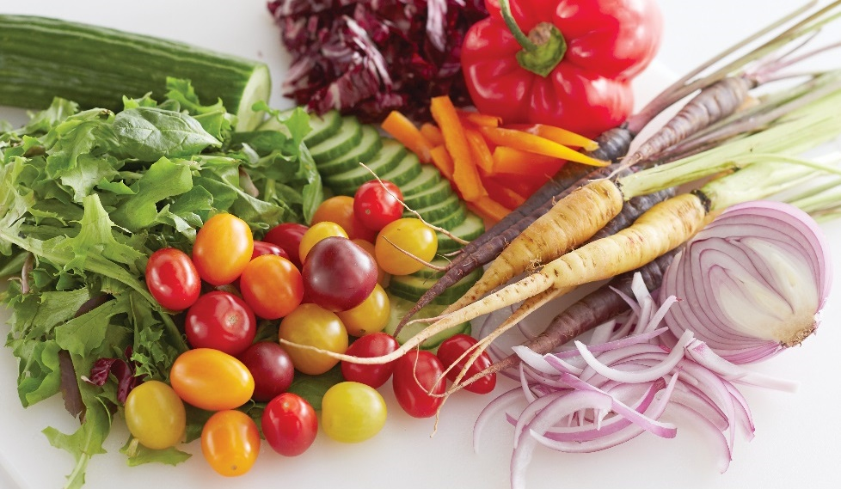
Types and Market Forms
Edible, herb-like plant
Edible parts—leaves, fruit, stems, roots, tubers, seeds, flowers
Usually eaten cooked
Categorized by botanical origin or edible part
  Flower
  Fruit
  Green leafy
  Seed
  Root/tuber
  Stem vegetable
Notes:
A vegetable is an edible, herb-like plant. The parts of vegetables that people
eat include the leaves, fruit, stems, roots, tubers, seeds, and flowers. Vegetables
can be purchased whole or cut in fresh, frozen, canned, and dried forms. Unlike
fruits, vegetables are eaten cooked more often than raw.
Vegetables are often categorized by their botanical origins or by their edible
parts. They may be classified as a flower, fruit, green leafy, seed, root/tuber, or
stem vegetable.

Slide 3
Flower vegetables
Members of the cabbage or cruciferous family
Includes broccoli, cauliflower, Brussels sprouts, cabbage
Contain cancer-fighting compounds
Usually cook the “head” of the vegetable
Avoid items with rubbery texture and dark spots
Notes:
Flower vegetables include broccoli, cauliflower, Brussels sprouts, and
cabbage—although all of these are part of the cabbage or cruciferous family.
These vegetables have generated a lot of interest in the health world due to
their cancer-fighting compounds. When we think of cooking these products,
we focus on the “head” of the vegetable. When purchasing these vegetables,
avoid any with rubbery texture and/or dark decay spots.

Slide 4
Flower vegetables
Broccoli:
Deep green color with tiny buds and thick leaves
Eaten raw or cooked
Served on crudités—French appetizer
Notes:
Broccoli
Broccoli has a deep green color, tiny clustered buds
(florets), and thick crisp leaves. Choose broccoli that
has a dark green color and tight florets. Do not select
broccoli with discolored leaves or florets. Broccoli can
be served raw or cooked and is often used in salads or
on crudités (cru·dee·TAY) platters. Crudités is a traditional
French appetizer with raw whole or sliced vegetables,
often including a dipping sauce or vinaigrette. To
ensure even cooking times for the broccoli florets and
broccoli stems, cut the stems lengthwise and cook with
heads attached.

Slide 5
Flower vegetables
Brussels sprouts:
Grow on tall, thick stalk
Steamed or roasted
Flavor milder than cabbage
Notes:
Brussels sprouts
Brussels sprouts grow on a tall, thick stalk and
resemble miniature cabbages. Flavors tend to be
milder than cabbage, and they are usually steamed or
roasted. Look for tight heads that are heavy and have
a lively green color.

Slide 6
Flower vegetables
Cabbage:
Thick, waxy leaves
Leaves form round heads
Sweet to mild to strong
Bright color and firm core
Notes:
Cabbage
Cabbage has thick, waxy leaves that lay tight
together and form large round heads. Some varieties
have curly leaves and a looser form. Flavors run
from sweet to mild to strong. Cabbage can be eaten
raw but is also found in savory dishes. Cabbage is a
very versatile vegetable and works well with several
cooking methods. Look for heads with vibrant colors
that are tightly packed with firm cores. Cabbage can
be used in coleslaw, stir-fry, and wraps.

Slide 7
Flower vegetables
Cauliflower:
Many colors—white, green, purple
Entire plant is edible
Firm with clusters of florets
Served raw or cooked
Notes:
Cauliflower
Cauliflower is available in several colors, ranging
from white to green to purple. It has hearty stalks
and florets, with leaves at its base. The entire plant
is edible. Look for cauliflower that is firm with tight
clusters of florets. Choose heads that have a bright
white color and bright green leaves. Cauliflower can
be served raw, and like broccoli can be served as
crudités. It can also be sliced or cooked whole and
works well with several cooking methods.

Slide 8
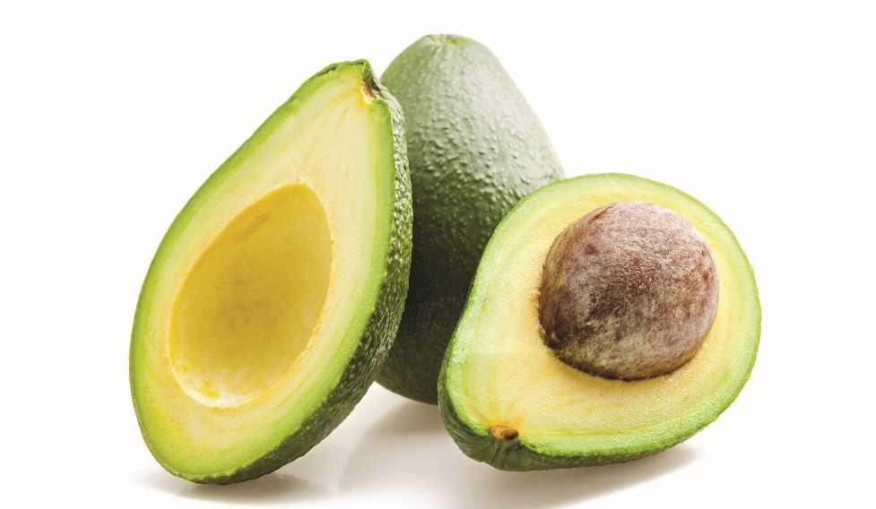
Fruit vegetables
Avocados:
Rich, buttery flavor with dark, leathery skin
Served with citrus to prevent browning
Notes:
Fruit vegetables include avocados, cucumbers, eggplants, peppers, squash,
and tomatoes. These products come from flowering plants and
have seeds, which—botanically speaking—make them fruits. But when we think
of how we prepare and use them from a culinary perspective, we consider them
to be vegetables.
Avocados
There are several varieties of avocado, ranging in
color form bright green to black, with smooth to very
leathery skin. Avocados have a very rich and buttery
flavor, and they have a very smooth, dense texture.
Avocados are usually served with citrus juice to help
prevent the flesh from turning brown. Select avocados
that are free of blemishes or mold. Ripe avocado flesh
should give slightly but not be too soft.

Slide 9
Fruit vegetables
Bell peppers:
Sweet peppers that start green and change color
during ripening
Used in salads and crudités
Good color with no dark spots
Notes:
Bell peppers
Bell peppers or sweet peppers are named for their
shape. All varieties start out green, but as they ripen,
their colors change to red, yellow, orange, purple, or
cream, depending on the variety. Ripe green peppers
are not as sweet as peppers with other colors. We use
sweet peppers raw in salads or crudités or cooked in
a variety of ways. When selecting bell peppers, look
for peppers with good color that are free of blemishes
or soft spots.

Slide 10
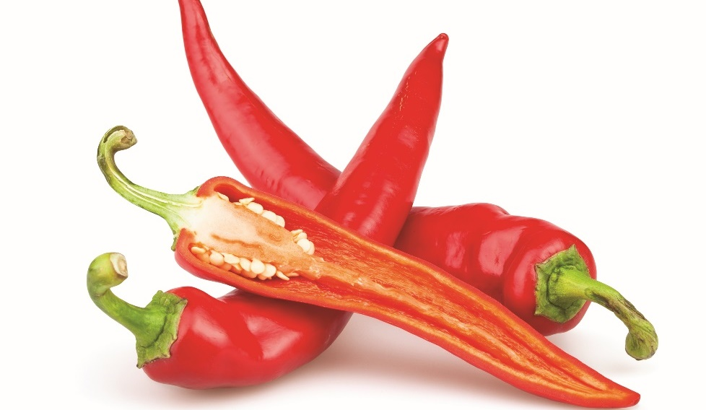
Fruit vegetables
Chili peppers:
Same family as bell peppers
Mild to very hot
Wear gloves when handling
Notes:
Chili peppers
Chili peppers are in the same family as bell peppers;
however, they are smaller and can be very hot. Like
bell peppers, chili peppers are available in a wide
range of colors, from bright red and yellow to black.
Flavors can run from pleasantly mild to extraordinarily
hot. Most of the hot, spicy flavor is in the seeds and
in the white pith membrane. Care should be taken
when handling chili peppers. Wash hands often or
wear gloves while handling. Once a chili pepper has
been seeded and the pith removed, it is not as hot as
whole peppers. When selecting chili peppers, look for
peppers with good color that are free of blemishes or
soft spots.

Slide 11
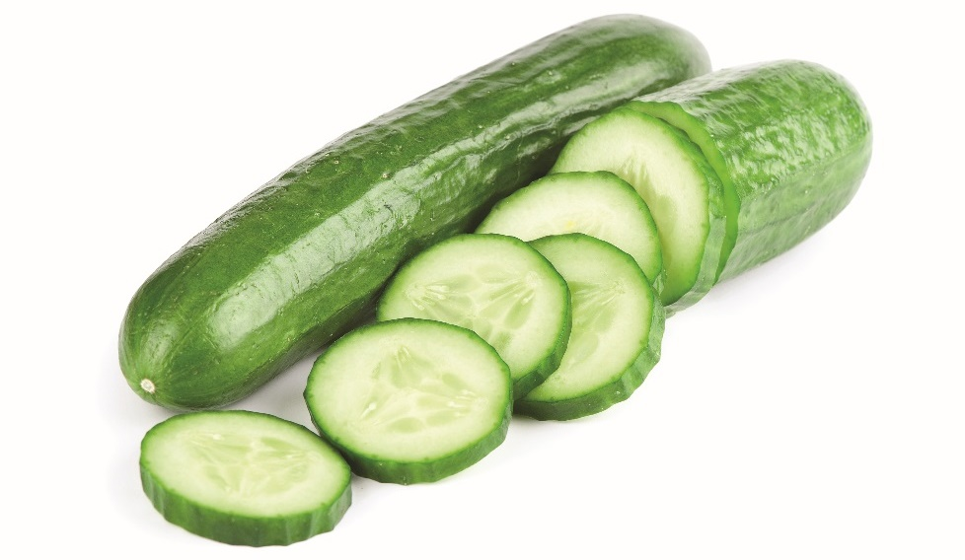
Fruit vegetables
Cucumbers:
Thin skin
Inner core with seeds
Mild flavor
Served in salads or as crudités
Notes:
Cucumbers
Cucumbers have a thin skin, which is sometimes
waxed to prevent moisture loss, and an inner core of
seeds. Cucumbers have a mild flavor and are excellent
in salads or served as crudités. Purchase cucumbers
that are firm and free of soft spots.

Slide 12
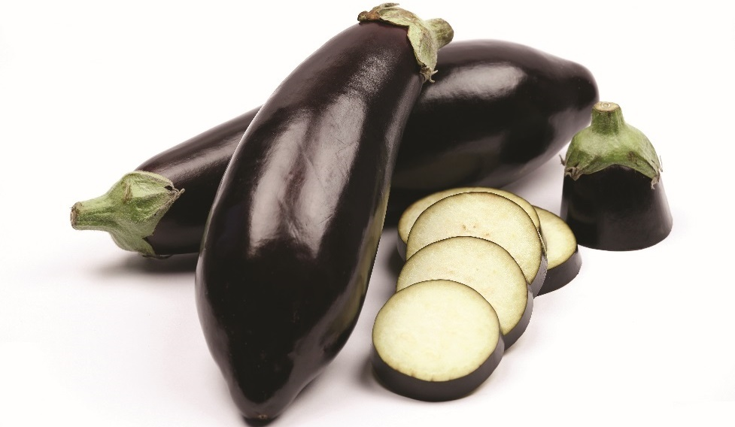
Fruit vegetables
Eggplants:
Many sizes and shapes
Range from white to purple to black
Glossy, smooth skin and no bad spots
Notes:
Eggplants
Eggplants come in several different varieties and
range in size from long and thin to short and plump.
They also range in color from white to violet to
purple to black. Eggplants are glossy, firm vegetables
that are very versatile and can be used with several
different cooking methods. Look for eggplants with
glossy, smooth skin free of blemishes or soft spots.

Slide 13
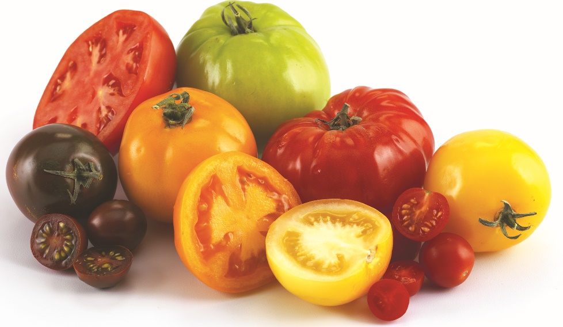
Fruit vegetables
Tomatoes:
Hundreds of kinds
Flavors can be sweet to acidic
Stewed, fried, grilled, baked
Made into sauce or juice
Notes:
Tomatoes
Tomatoes are grown in hundreds of varieties and
come in several different colors, including red, yellow,
and purple. Flavors run from sweet to slightly acidic.
Tomatoes are best when ripened on the vine. Tomatoes
are very versatile and are very popular in salads as
well as other dishes. Tomatoes may be stewed, fried,
grilled, baked, or made into sauce or juice. Choose
tomatoes that have a firm, smooth skin and are free
of blemishes.

Slide 14
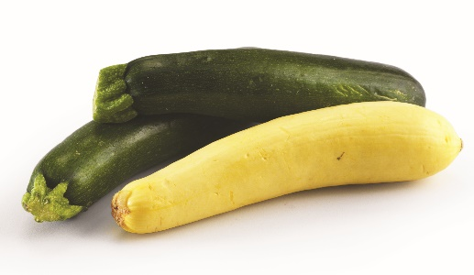
Fruit vegetables
Summer squash:
Zucchini and yellow squash
Thin skin and soft, edible seeds
Mild flavor
Versatile vegetable
Works well with many cooking methods
Bright colors and no soft spots
Notes:
Summer squash
Unlike winter squash, summer squash—zucchini and
yellow squash—is smaller, with thin skin and small,
soft seeds that are eaten. The flavor of summer squash
is very mild, and it can easily take on the flavors of other
foods. Summer squash is a very versatile vegetable
and works well with most cooking methods—in
casseroles or baked goods, or sautéed, to name a few.
It is equally good in salads or crudités. Look for squash
with bright colors, smooth skin, and no soft spots.

Slide 15
Fruit vegetables
Winter squash:
Tough outer shells and large seeds
Pumpkins, spaghetti squash, butternut squash,
acorn squash
Sweet to mild, nutty flavor
Baked, boiled, microwaved
Firm skin and no soft spots
Notes:
Winter squash
Winter squash have hard, tough outer shells and large
seeds. They range in size from large pumpkins to
spaghetti to butternut to the smaller acorn squash.
They range in flavor from sweet to mild, and some
can be bitter. Many have a nutty flavor when roasted.
They are very versatile and can be used with many
different cooking methods—for example, oven
cooking, microwave cooking, or boiling. Look for
squash with firm skin and free of soft spots.

Slide 16
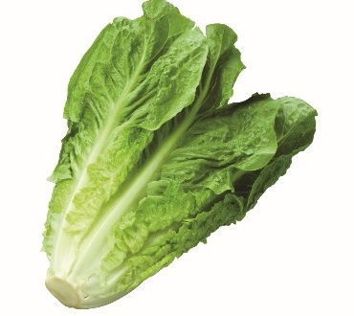
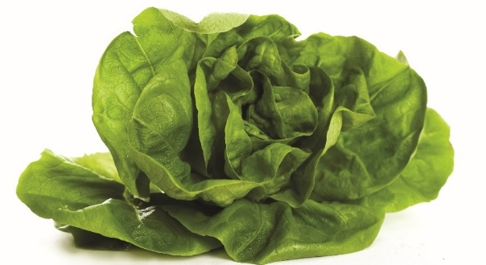
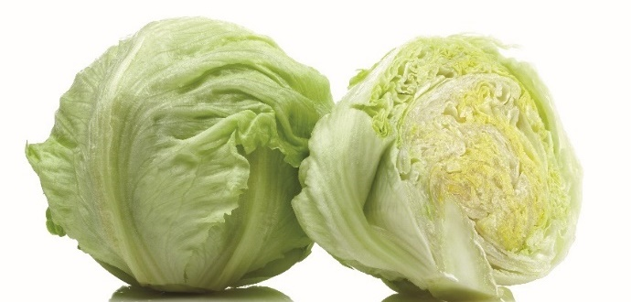
Green leafy vegetables
Lettuce:
Hundreds of varieties; four main groups
Butterhead
  Small, round, loosely formed heads
  Buttery texture
Crisphead
  Light-green leaves
  Mild flavor
Leaf
  Loose leaves, curly edges
Romaine
  Most flavorful
Good color, no blemishes
Notes:
Green leafy vegetables include various types of lettuce, collard greens, mustard
greens, spinach, and Swiss chard. Green leafy vegetables are very high in
vitamins A and C, iron, and magnesium.
Lettuce
There are hundreds of varieties of lettuce with varying flavors, colors, and shapes. In the United States, there
are four main groups of lettuce—butterhead, crisphead, leaf, and romaine. Butterhead lettuce has small, round,
loosely formed heads with leaves that are soft and have a buttery texture. Crisphead lettuce, such as iceberg,
has light-green leaves that are tightly packed together. Its mild flavor makes it good to use in salads and on
sandwiches. The leaf lettuce variety does not grow to form lettuce heads. Instead, it has loose leaves with curly
edges joined at the base stem. Leaf lettuce is mild in flavor. Romaine lettuce, just like leaf lettuce, has loose
leaves with their edges slightly ruffled. Romaine is the most flavorful of the lettuces. When choosing lettuce, look
for heads that have good color and have no blemishes or discoloration on their leaves. Pictured here, clockwise
from left to right, are romaine, butterhead, crisphead, and leaf lettuce.

Slide 17
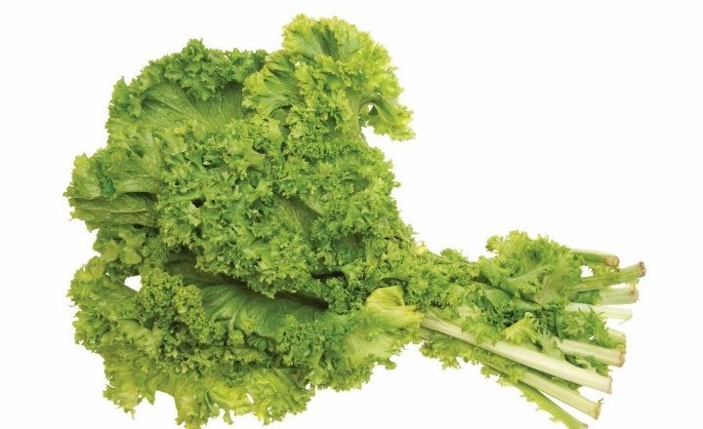
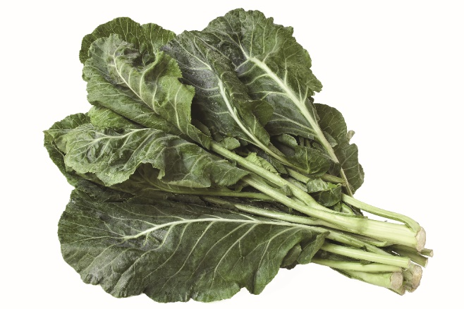
Green leafy vegetables
Mustard greens and collard greens:
Bitter, strong flavor
Dark-green leaves with ruffled edges
Good color and firm stems
Notes:
Mustard greens and collard greens
Both mustard greens and collard greens have a bitter,
strong flavor. The leaves are usually dark green and
have ruffled edges. Collard greens and mustard greens
are fairly versatile and can be used with a number
of cooking methods. Look for leaves with good color
and firm stems that are not wilted. They need to be
cooked longer than spinach and chard.

Slide 18
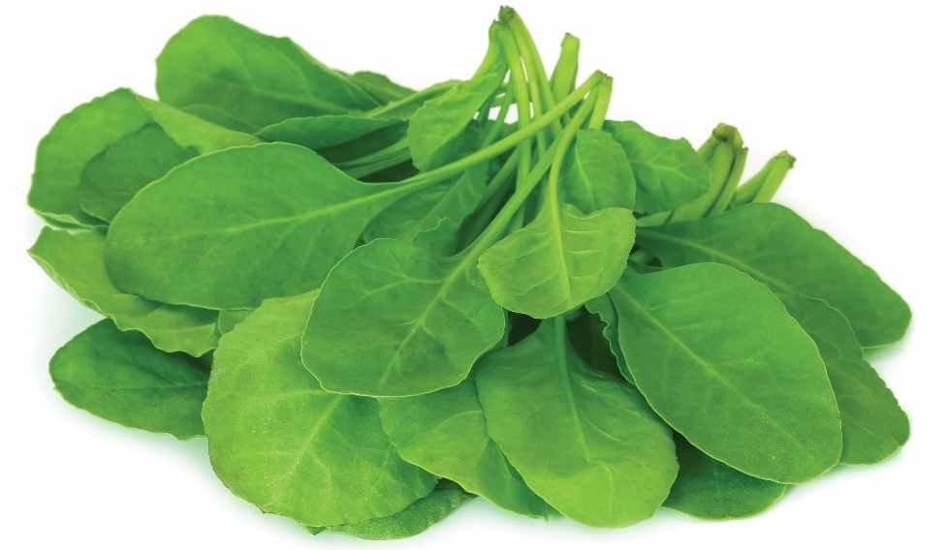
Green leafy vegetables
Spinach:
Dark-green leaves, smooth or curly
Good color and crisp leaves
Eaten raw or in soups and casseroles
Notes:
Spinach
Spinach is one of the most adaptable greens in the
kitchen. It has dark-green leaves that can be smooth
or curly. It can be eaten raw in salads, but it is also
used in soups and casseroles. Choose spinach that
has good color to the leaves and is crisp and tender.

Slide 19
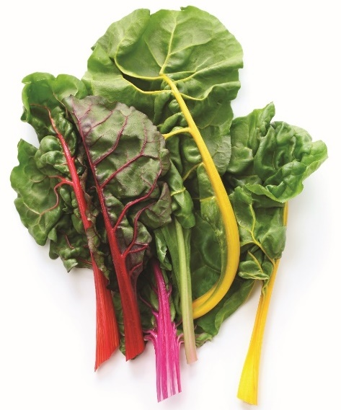
Green leafy vegetables
Swiss chard:
Type of beet without root
Wide, dark-green leaves with colored stalks
Flavor—full and similar to spinach
Green leaves with no discolored spots
Notes:
Swiss chard
Swiss chard is actually a type of beet that does not
have a root. Swiss chard produces wide, dark-green
leaves with brightly colored stalks from yellow to red.
The flavor of Swiss chard is full and similar to spinach.
Swiss chard can be used with multiple cooking
methods. Select chard with fresh green leaves and
avoid chard with wilted or discolored leaves.

Slide 20
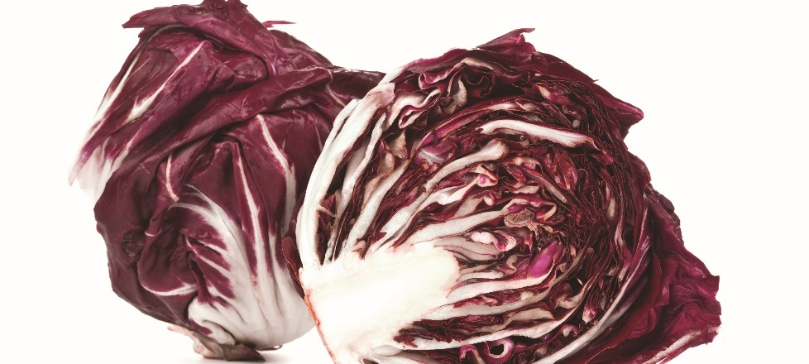
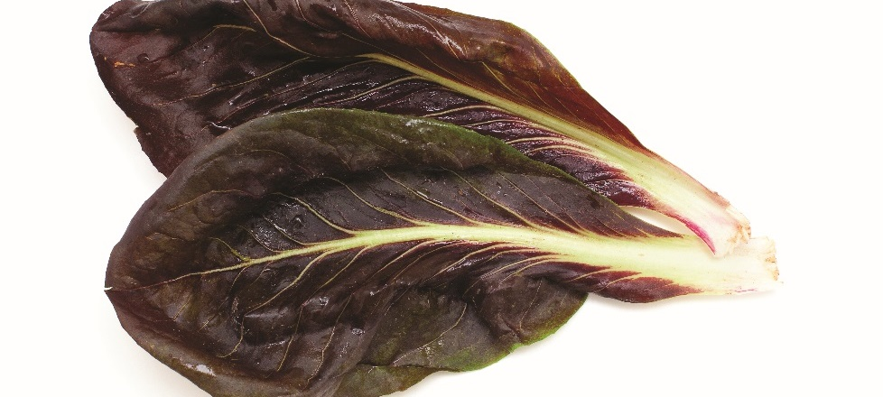
Spring greens and field mixes
Mix of assorted salad greens
Spring greens, field greens, field mixes
Lettuces, cabbages, radicchio (a type of chicory)
Notes:
Not too long ago, a little iceberg lettuce with mayonnaise dressing was
considered a dinner salad. Consumers today are interested in more flavorful
and nutritious salad greens. Variety lettuce mixes have gained popularity in
recent years, both in restaurants and grocery stores.
Spring greens, field greens, field mixes, and other terms are used to describe
a mix of assorted salad greens. Some greens are lettuces; some are related to
cabbage; others, like radicchio, are chicory. Even leafy herbs like cilantro find
their way into flavorful salads.

Slide 21
Spring Greens and Field Mixes
Spring greens
  New leaves of leafy vegetables harvested previous season
  Some survive the winter: brassica (cabbage family) and chicory
Field mixes
  More tender
  Planted in spring for harvest a few weeks later
Mesclun mixes
  Variety of lettuce and other greens
  Can have bold or mild flavors
  Can include arugula, watercress, chive, sorrel, romaine, frisée
Notes:
Not too long ago, a little iceberg lettuce with mayonnaise dressing was
considered a dinner salad. Consumers today are interested in more flavorful
and nutritious salad greens. Variety lettuce mixes have gained popularity in
recent years, both in restaurants and grocery stores.
Spring greens, field greens, field mixes, and other terms are used to describe
a mix of assorted salad greens. Some greens are lettuces; some are related to
cabbage; others, like radicchio (see Figure 6.1), are chicory (see Figure 6.2).
Even leafy herbs like cilantro find their way into flavorful salads.
Spring greens are the new leaves of leafy vegetables that were harvested the
previous season. Some brassica (cabbage family) and chicories are strong
enough to survive the winter. When they begin to send up new growth in March
or early April, the leaves are tender, bright, and flavorful. They are often found
in fresh spring salads.
Field mixes may be more tender and can be planted in the spring for harvest a
few weeks later. Mesclun mix is a seed blend that includes a variety of leafy
lettuce and other greens. Other single greens may be added to blends at
harvest. These assorted leaves may have a bold flavor like arugula, be peppery
like watercress, savory like chive, or tangy like sorrel. Others are milder, like
romaine or frisée.
Combine these mixes with nuts, dried fruit, and goat cheese. When served with
bread, they make a nutritious meal. Or toss them with ripe tomatoes, olive oil
and wine vinegar, balsamic vinegar, or lemon juice. Then they make a colorful
and interesting side dish.

Slide 22
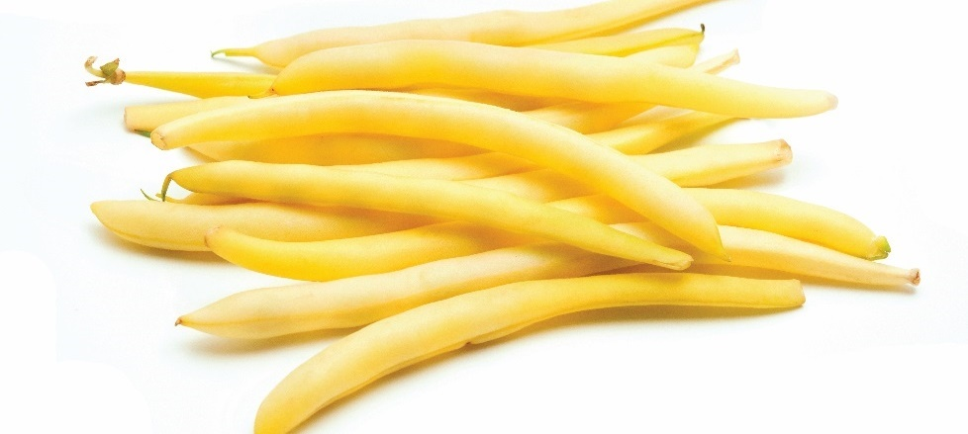
Seed vegetables
Beans:
Green beans and yellow wax beans
Some beans are removed from pods
Usually soaked or boiled before cooking
Notes:
Seed vegetables include corn, peas, and beans In this category,
the edible portions of the vegetable (kernels, peas) are actually seeds.
Beans
Fresh beans include green beans and yellow wax
beans. These beans are small and are most often eaten
while still in the pod. Lima beans and fava beans are
examples of beans that are shelled, or removed from the
pod. They are larger and more firm than green beans.
Fresh beans are very versatile in the kitchen and stand
up well to hardier cooking methods. Dried shelled beans
usually need to be soaked or boiled before preparation
in recipes. Beans are very nutritious and work well in
salads, soups, and side dishes. When choosing fresh beans,
look for pods that have good color and no blemishes.

Slide 23
Seed vegetables
Corn:
White, yellow, bicolored
Sweet or full flavored
Firm and have no discoloration
Sweet corn should be used soon after it’s picked
Notes:
Corn
Fresh sweet corn comes in several varieties, including
white, yellow, and bicolored varieties. Flavors run
from very sweet to more full flavored. Sweet corn
should be used very soon after it is picked. If it is not,
its sugars will begin to turn to starch, making the
corn less sweet and much chewier. Select ears that
are firm and free of mold or brown discolorations.

Slide 24
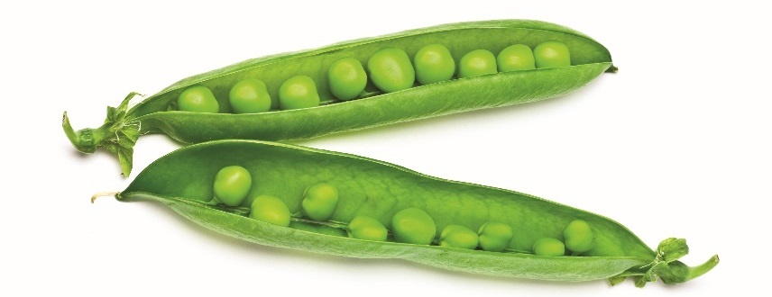
Seed vegetables
Peas:
Most common are green garden peas
Sweet, delicate flavor
Notes:
Peas
The most common peas are green garden peas. They
have a sweet, delicate flavor. Peas are a colorful
addition to salads and soups, as well as other dishes.
Some peas can be eaten in their pods. Snow peas and
(sugar) snap peas are often used in Asian cooking and
have a firm skin and a light flavor.

Slide 25
Root and tuber vegetables
Grow underground or partly underground
Root vegetables
  Rich in sugars, starches, vitamins, minerals
  Single root extends into ground, leafy part above ground
  Carrots, beets, radishes, turnips, onions
Tuber vegetables
  Enlarged, bulbous roots
  Fat, underground stems
  Potatoes, sweet potatoes, yams
Notes:
Root vegetables and tubers are grouped together because of the way
they are grown; either all the way underground or partly underground.
Root vegetables are rich in sugars, starches, vitamins, and minerals.
These plants exist both above and below ground. A single root extends
into the ground and provides nutrients to the leafy green part of the
vegetable that is above the ground.
Some common root vegetables are carrots, beets, radishes, turnips, and
onions. Tuber vegetables include potatoes, sweet potatoes, and yams.
Tubers are enlarged, bulbous roots capable of generating a new plant;
they are actually fat, underground stems.

Slide 26
Root and tuber vegetables
Beets:
Range from red to yellow to white
Earthy flavor caused by chemical geosmin
Pickled, steamed, baked, roasted
Notes:
Beets
Beet colors range from red to yellow to white. The
flavor of beets is somewhat earthy because of a
chemical called geosmin. Cooks prefer smaller beets
to larger ones for two reasons: their appearance is
better, and they cook faster than larger beets. Beets
are popular in salads and soups, and can be served
as a side dish. Pickled beets add spice to many
dishes. Beets can be steamed, baked, or roasted.
Purchase beets that are small to medium sized with
smooth skins.

Slide 27
Root and tuber vegetables
Carrots:
Carotene—converted to vitamin A
Served as crudités, garnishes, raw
Good color and no blemishes
Notes:
Carrots
Carrots contain a large amount of carotene, a pigment
easily converted to vitamin A. Carrots can be served
raw, as crudités, as a garnish, or as an ingredient in
salads. Cooked carrots make excellent side dishes
and can be used in soups and sauces. Carrots can be
used in desserts, both cooked and raw. Carrots are
fundamental to mirepoix. Select carrots that have
good color and are free of blemishes.

Slide 28
Root and tuber vegetables
Leeks:
Resemble green onions, mild flavor
Baked, grilled, stocks, sauces, soups
Bright-colored tops, not wilted
Notes:
Leeks
Leeks resemble large green onions. They have the
mildest flavor in the onion family. They are best when
baked or grilled, but are often used in stocks, sauces,
and soups. Choose leeks that have brightly colored
tops and are not wilted or discolored.

Slide 29
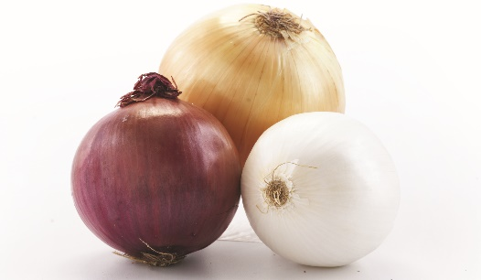
Root and tuber vegetables
Onions:
Strong flavor, aroma, season other foods
White, yellow, Vidalia, red, pearl
Used in mirepoix
Notes:
Onions
All varieties of onions have a strong flavor and aroma,
and are used to season other foods. Common or bulb
onions—like white, yellow, Vidalia, or red—are
best when sliced or chopped for use in stuffing or
casseroles. Small onions, like pearl onions, are best for
boiling or cooking with roasts and stews. They can also
be prepared whole and served as a side dish. Onions
are fundamental to mirepoix. Select onions that are
dry and have not begun to sprout.

Slide 30
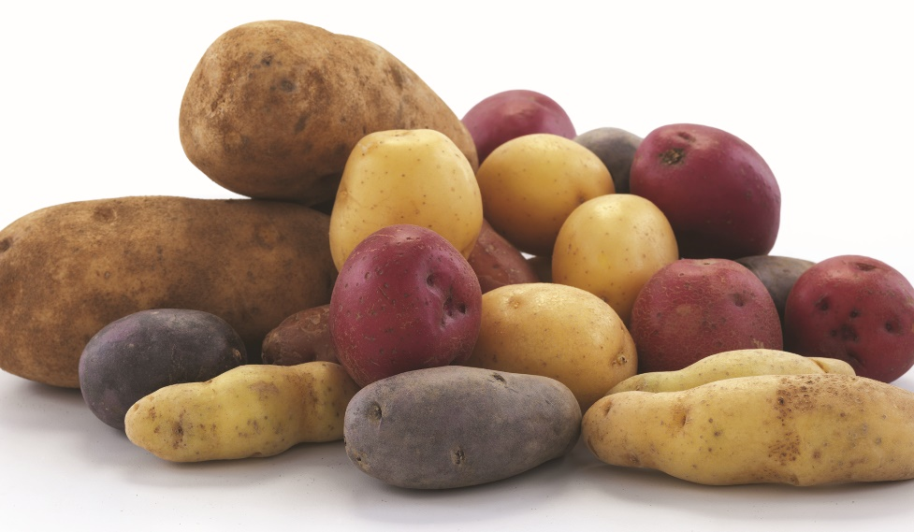
Root and tuber vegetables
Potatoes:
Many varieties, flavors, sizes, textures, colors
Boiled or baked
Firm, free of eyes, well shaped
Notes:
Potatoes
Potatoes are available in many varieties, with
different flavors, sizes, textures, and colors. Moist
potatoes are better suited to boiling, while drier
potatoes are better for baking. Choose potatoes
that are firm, free of eyes, and are well shaped.

Slide 31
Root and tuber vegetables
Radishes:
Crisp texture, peppery flavor
Served as garnishes, crudités, in salads
Firm with bright red color
Notes:
Radishes
Radishes are small, round roots that are available in
many colors, form deep red to pale cream. Their crisp
texture and peppery flavor make them a flavorful
and colorful addition to salads. They can be cut
decoratively as a garnish or served as crudités with
vegetable dip. Select radishes that are firm and have
a bright red color.

Slide 32
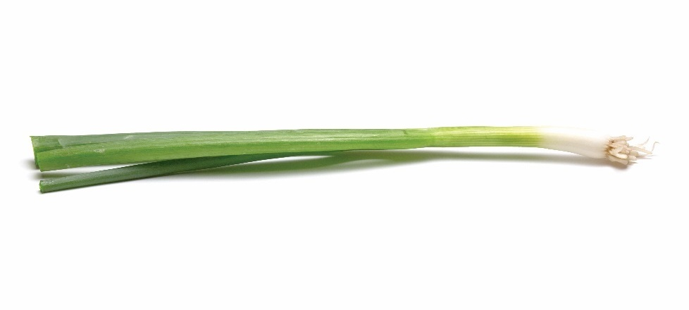
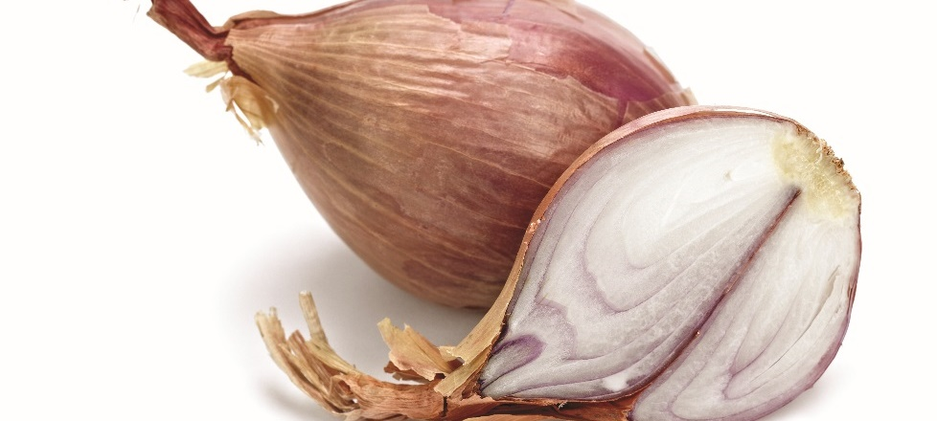
Root and tuber vegetables
Scallions and shallots:
Scallions (green onions)—onions pulled before maturity
Shallots shaped like bulb onions, form small cloves
Salads, sauces, meat dishes
Notes:
Scallions and shallots
Green onions, or scallions, are actually common onions
that are pulled before they are mature. The slender,
dark-green leaves of green onions are attached to the
thick white bulb. Shallots are shaped like small bulb
onions and separate into small cloves when broken
apart. The milder flavor of green onions and shallots
makes them a great addition to salads, as well as
sauces and meat dishes. Select green onions that have
bright green tops and are not wilted. Select shallots
just like you would bulb onions.

Slide 33
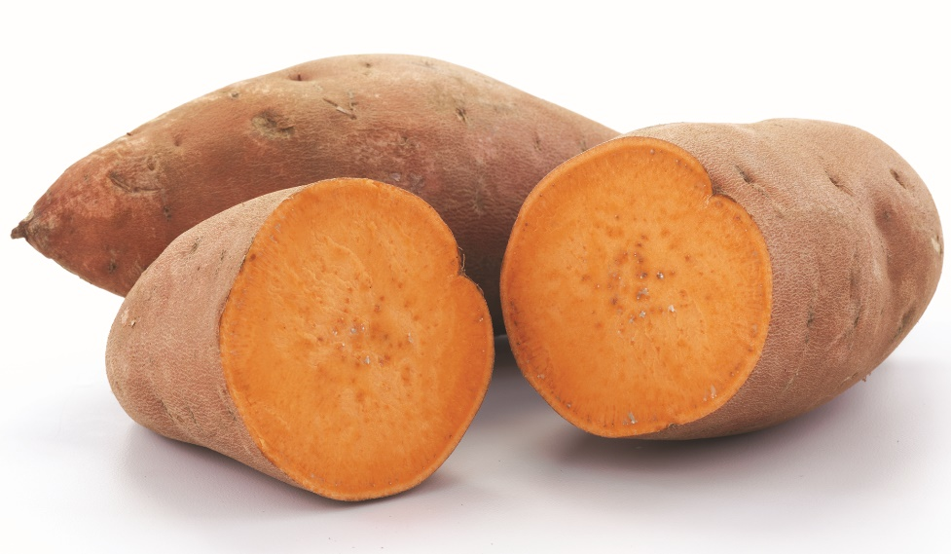
Root and tuber vegetables
Sweet potatoes:
Different botanical family than potatoes
Beta-carotene—bright orange to light yellow
Sweet flavor
Baked, boiled, puréed
Firm, free of eyes, well shaped
Notes:
Sweet potatoes
Sweet potatoes and potatoes come from different
botanical families. Both are root tubers. The sweet
potato's color comes from beta-carotene, which is
a form of vitamin A. Colors can range from bright
orange to light yellow. Sweet potatoes’ sweet flavor
makes them very versatile in the kitchen, and they
are best when baked, boiled, or puréed for soups.
Select sweet potatoes that are firm, free of eyes, and
well shaped.

Slide 34
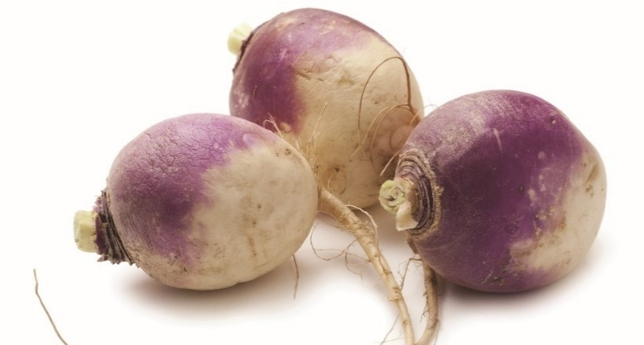
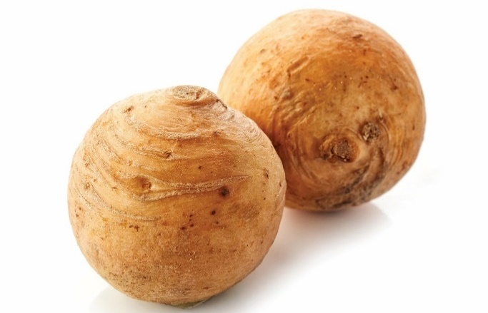
Root and tuber vegetables
Turnips and rutabagas:
Turnips
  Hot, peppery flavor
  Rose-colored flesh, white flesh
  Baked, boiled, steamed, mashed
Rutabagas
  Cross between cabbage and turnip
  Leaves can be eaten as leaf vegetable
Notes:
Turnips and rutabagas
Like radishes, turnips have a hot peppery flavor when
eaten raw and are best when roasted. They are larger
than radishes and usually have a rose-colored skin and
bright white flesh. Turnips are good when baked, but
may be boiled, steamed, or mashed. Choose turnips
that are small to medium sized with smooth skin and
a weighty feel. Rutabagas are root vegetables that
originated as a cross between the cabbage and the
turnip. They are prepared in a variety of ways, and
the leaves can be eaten as a leaf vegetable.

Slide 35
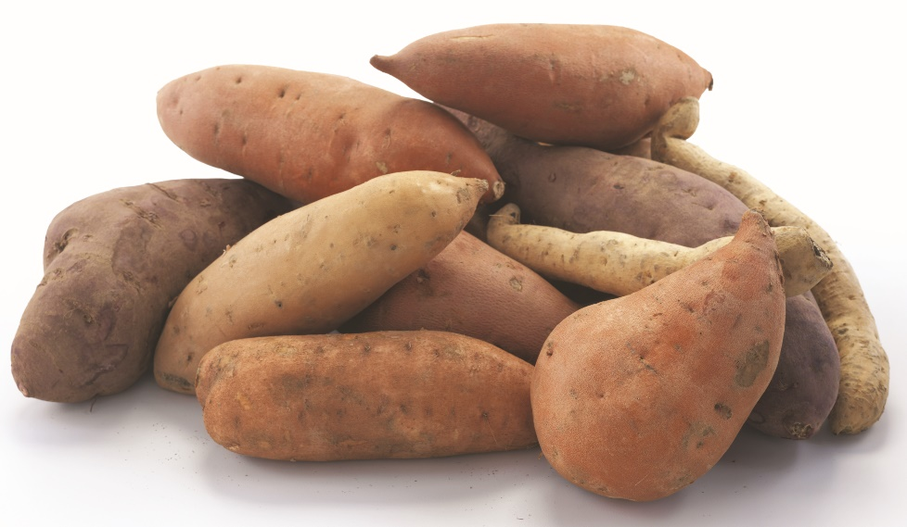
Root and tuber vegetables
Yams:
Similar to sweet potatoes
More sugar and moisture
Deep red to cream
Often substituted for sweet potatoes
Notes:
Yams
Yams are often confused with sweet potatoes. Their
color can range from deep red to creamy white. Yams
have more natural sugar and moisture than sweet
potatoes. They can be substituted for sweet potatoes
in most recipes.

Slide 36
Stem vegetables
Artichokes:
Immature flower of thistle plant
Simmered, steamed, microwaved
Hearts often served by themselves
Mature artichokes—remove choke (fuzzy center)
Dark green, soft when squeezed
Notes:
Stem vegetables include asparagus, celery, artichokes, and mushrooms.
In this category, the vegetables that we eat are the stems of plants.
Artichokes
Artichokes are the immature flowers of a thistle plant.
Whole artichokes can be simmered, steamed, or
microwaved. Often they are served with lemon juice,
garlic butter, or hollandaise sauce. The artichoke heart
may be cooked separately and served in salads or as
a side dish. Young, tender glove artichokes can be
cooked whole. Mature artichokes need to have the
fuzzy center (known as the choke) removed first.
Quality artichokes will have tightly closed outer leaves
and be medium to dark green in color. They should
not be soft when squeezed.

Slide 37
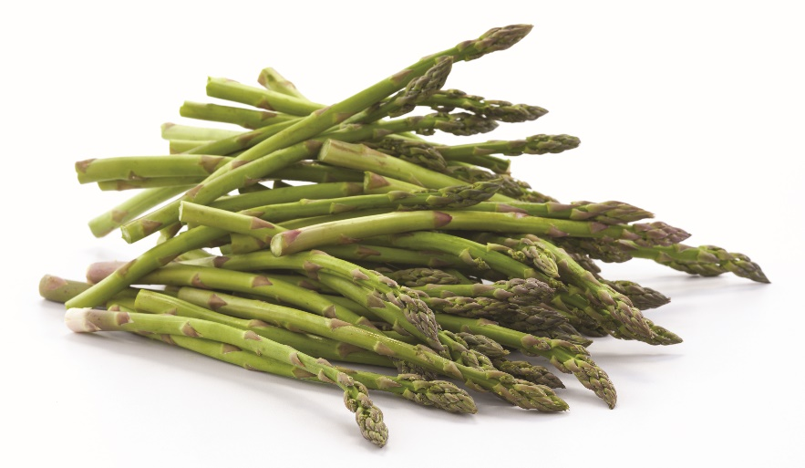
Stem vegetables
Asparagus:
Can be green or white
Have tender stalks and tips
Can be steamed, roasted, sautéed
Should have dry, tight tips, no wilted stalks
Notes:
Asparagus
Asparagus, which can be green or white, has tender
stalks and tips. The thicker the stalk, the older and
more woody the stem. Asparagus can be steamed,
roasted, or sautéed. Choose stalks with dry, tight tips
and avoid limp or wilted stalks.

Slide 38
Stem vegetables
Celery:
Commonly served in salads, soups, stews, as crudités
Used in mirepoix
Straight, rigid stalks, fresh leaves
Avoid pithy, woody, limp stalks
Notes:
Celery
Celery stalks are commonly used in salads, soups, and
stews. The cut stalks can also be served as crudités
with vegetable dip. Celery is a fundamental ingredient
in mirepoix. Choose straight, rigid stalks with fresh
leaves. Avoid pithy, woody, or limp stalks.

Slide 39
Stem vegetables
Mushrooms:
Family of fungi
Button, morel, portobello, crimini, truffles, shiitake
Flavor—delicate and fruity to pungent
Served raw or cooked
Clean and well shaped, no dirt or spots
Notes:
Mushrooms
Fungi (FUN-ghee) are a large group of plants ranging
from single-celled organisms to giant mushrooms.
Mushrooms are a family of fungi, many of which
are edible. Some examples include button, morel,
portobello, crimini, enokidake, truffles, and shiitake.
The flavor of mushrooms ranges from delicate and
fruity to pungent and garlicky. Mushrooms come in
many shapes, sizes, and colors. They are served raw
in salads and are also used in a variety of sauces,
soups, and other recipes. Choose mushrooms that are
clean and well-shaped. Avoid mushrooms with dirt
and spots.

Slide 40
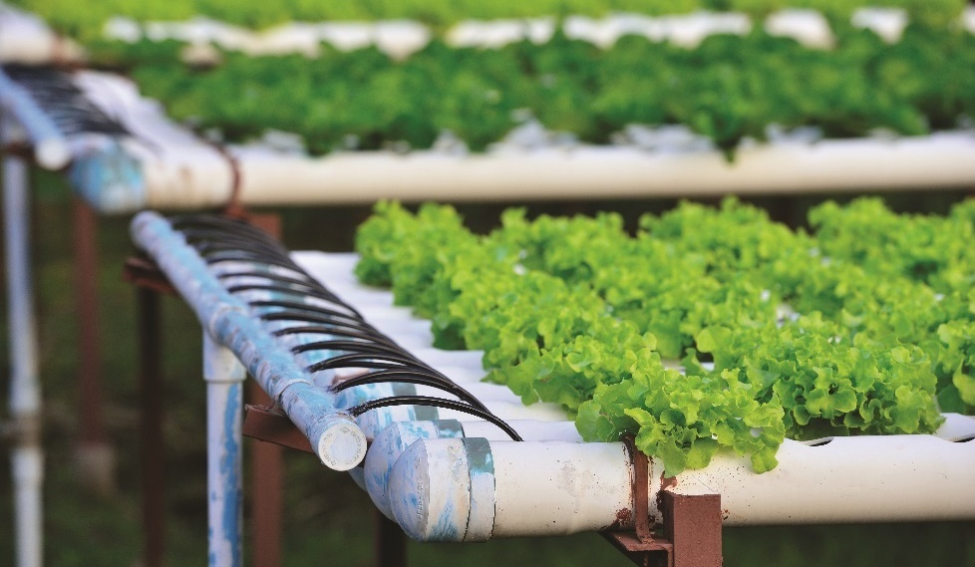
Purchasing vegetables
Most produce now available all year
Hydroponic farming: vegetables are grown indoors in nutrient-enriched water
Quality, ripeness, price vary with the season
During growing season, vegetables are higher quality, lower in price
Notes:
Improved shipping methods and new ways of farming have made most produce
available all year. The use of hydroponic farming is popular. In hydroponic
(hi-dro-PON-ick) farming, vegetables are grown indoors year-round, under
regulated temperatures and light, in nutrient-enriched water. To reduce cost
and promote freshness, some restaurants grow their own fresh vegetables on
the premises.
Some vegetables, such as spinach, potatoes, and broccoli, are available all year.
The quality, degree of ripeness, and price vary with the season. Others, such
as asparagus, summer squashes, tomatoes, and green beans, have a specific
growing season. Knowing the growing season for a particular vegetable is
important. As with fruit, during their growing seasons, vegetables are plentiful,
the quality is higher, and the prices are usually lower. Some operations have
seasonal menus that are based on what is fresh and locally available. Many
guests today have shown an interest in eating local produce and supporting the
restaurants that serve it.
The same factors that could affect the purchasing decisions that operations make
for fruit apply for vegetables.

Slide 41
Quality grades
Same quality grades for vegetables as fruits
USDA grades for fresh vegetables, high to low
  U.S. Extra Fancy
  U.S. Fancy
  U.S. No. 1
  U.S. No. 2
  U.S. No. 3
U.S. Grade A Fancy is best USDA grade for canned vegetables
Notes:
The same quality grades that the USDA assigns to fruit apply to vegetables as
well. Fresh vegetables are graded before shipping. USDA grades (from highest
to lowest) for fresh vegetables include U.S. Extra Fancy, U.S. Fancy, U.S. No. 1,
U.S. No. 2, and U.S. No. 3. Canned products rated U.S. Grade A Fancy have
the highest quality among canned goods.

Slide 42
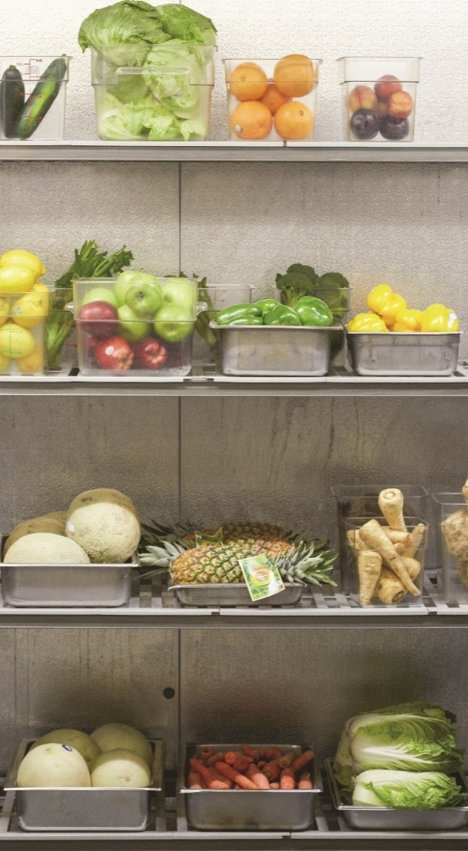
Storing vegetables
Store at 41°F (5°C) or lower
Some should not be refrigerated, like potatoes
Some emit ethylene gas when ripening—store separately
Keep dry
Ripening vegetables—stored at 65°F to 70°F (18°C to 21°C)
Refrigerate ripe vegetables—up to 3 weeks
Notes:
All produce must be properly stored. Roots and tubers should be stored dry
and unpeeled in a cool, dark area. Many of the other ripe vegetables can be
stored at 41°F (5°C) or lower, but not all will be stored at these temperatures.
For example, potatoes should never be stored in the refrigerator because the
low temperatures of a refrigerator convert the starch into sugars. Rather, they
should be stored in a cool, dark place. Remember, if possible, vegetables should
be stored separately in one refrigerator and fruit in another refrigerator. As with
some fruit, certain vegetables emit ethylene gas, which causes fruit to ripen.
Most vegetables need to be kept dry because excess moisture causes produce to
spoil quickly. For this reason, produce should not be peeled, washed, or
trimmed until just before it is used. For example, outer leaves on lettuce should
be left on the head, and carrots should be unpeeled. Leafy tops on root
vegetables (e.g., beets, turnips, carrots, radishes) should be removed and either
discarded or used immediately. These tops can be used for stock, because
they contain flavor and nutrients. The leaves on these green vegetables absorb
nutrients from the root and increase moisture loss.
Vegetables that need to ripen, such as tomatoes and avocados, should be
stored at a room temperature of 65°F to 70°F (18°C to 21°C). Once produce
is ripe, refrigerate it immediately or it will become overripe. Even with proper
storage, most foodservice operations do not keep produce for more than four
days. Some vegetables, such as onions and beets, have a longer life, but most
restaurants limit the storage of these items to three weeks.
Green vegetables must be placed carefully in a refrigerator. A refrigerator
has cold and warm spots, and vegetables can be sensitive to temperature
variations of a few degrees, so it is important to know the temperatures in
your refrigerator.

Slide 43
Preparing vegetables: cleaning
Clean before peeling
Washing removes bacteria, dirt, bugs
Run under water slightly warmer than produce
Leafy greens—remove outer leaves and pull apart before rinsing
Solutions available for cleaning
Wash close to prep time
Notes:
Vegetables must be properly prepared before they are cooked.
Preliminary preparations might include cleaning, peeling, slicing,
dicing, chopping, and mincing.
Cleaning
All fresh vegetables, even if they will be peeled before cutting, must be cleaned
thoroughly. Washing removes surface dirt as well as bacteria and other
contaminants. Leafy vegetables contain sand and dirt, and even bugs. Celery
and leeks are always dirty at the root. To clean vegetables, run them under
water that is a little warmer than the produce. When cleaning leafy greens,
such as lettuce and spinach, remove the outer leaves, and pull the lettuce and
spinach completely apart and rinse thoroughly. As with fruit, special solutions
are available for cleaning vegetables. Wash vegetables as close to preparation
time as possible.

Slide 44
Preparing vegetables: Chopping, dicing, and mincing
Separate containers for peelings and cut pieces
Cutting board
  Large enough for amount of vegetables
  Secure
  Best practice—color-coded cutting boards
Dicing—cutting into half-inch cubes
Mincing—fine chop
Notes:
When cutting vegetables, the cutting surface should be at a comfortable
height so that the elbows are in a natural position. It is best to set up a
cutting station with one container to hold the peelings and another container
to hold the cut vegetables. This allows you to safely cut on a clear cutting
board. The cutting board should be large enough to accommodate piles of
chopped material while the cook is still chopping. It should be securely in place,
and not move as the cook chops. Place an approved rubber mat underneath
the cutting board or use one with a slip-resistant surface on the bottom so that
it is anchored on the counter. It is best practice to use different colored cutting
boards for meat, fish, poultry, and produce to minimize the potential for cross-
contamination. Make sure the vegetables do not touch surfaces exposed to raw
meat, seafood, or poultry.
Dicing is cutting a product into cubes with a chef’s knife. Normally, dicing refers
to about a half-inch cube—the same size as dice. This is a common technique
for use with vegetables. Mincing is a fine chop cut made by using a chef’s knife
or mezzaluna, a knife consisting of a single or double blade with a handle on
each end. This cut is commonly used on smaller foods, such as garlic, fresh
herbs, and ginger.

Slide 45
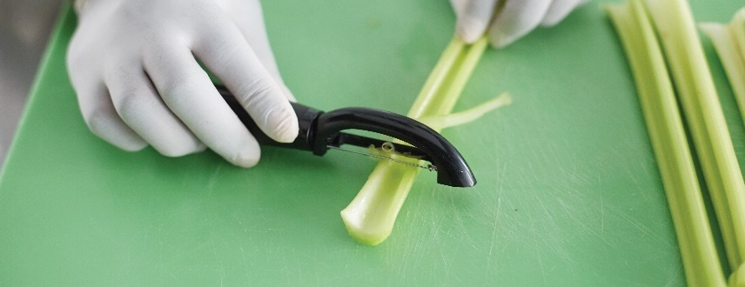
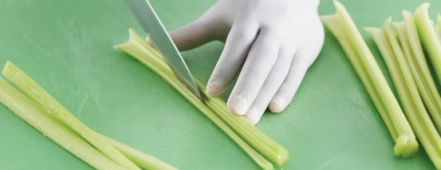
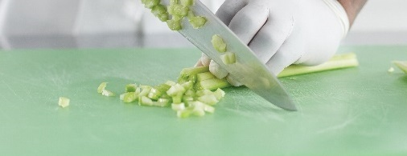
Slicing celery
Chop ends off
  String stalks
Place stalk curved-side up
  Use knife tip to cut into strips
Collect strips and chop across
Notes:
Chop off the ends and quickly string the stalks, removing the major strings using a peeler, if necessary.
Place the stalk curved-side up (similar to the letter U), and use the tip of the knife to cut the stalk into strips.
Once in strips, collect the strips together and chop across them, using the rocking motion of the blade.
The free hand can hold the celery. Keep the fingertips tucked back to protect them from the blade.
The knuckles can help guide the size of the chop. Go very slowly at first, so that your guiding hand does
not come in contact with the sharp edge of the blade.

Slide 46
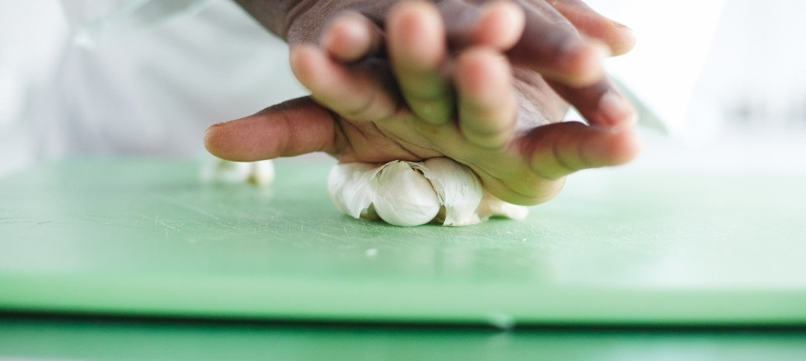
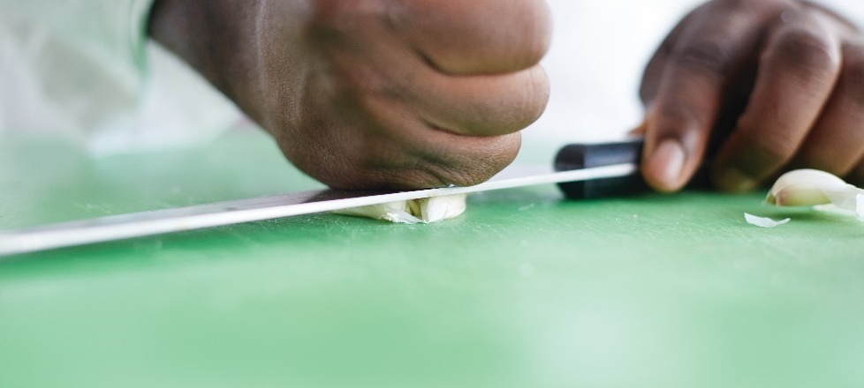
Mincing garlic
Press down on top to separate gloves
Loosen the skin from each clove
  Place on cutting board
  Place flat side of blade on top
  Hit blade with fist or heel of hand
Notes:
Separate garlic cloves by pressing down on the top.
Loosen the skin from each clove by placing a clove on the cutting board, placing the flat side of the
blade on top, and hitting the blade with a fist or the heel of your hand.

Slide 47

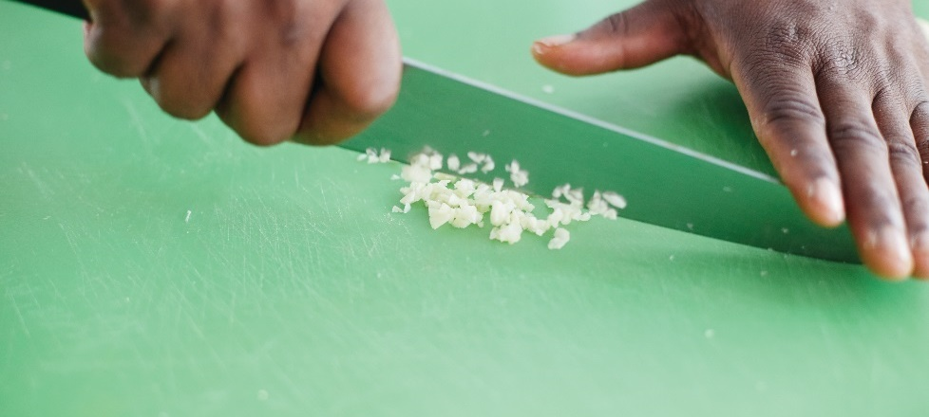
Mincing garlic
Peel off skin
  Remove root end
  Remove any brown spots
Mince cloves using rocking motion
Notes:
Using a knife, peel off the skin and remove the root end and any brown spots.
Mince the cloves using a rocking motion.
Note: Sprinkling a garlic clove with a dash of salt before mincing will allow the salt to absorb a little of
the liquid so the garlic will not stick to the knife and will be easy to mince.

Slide 48
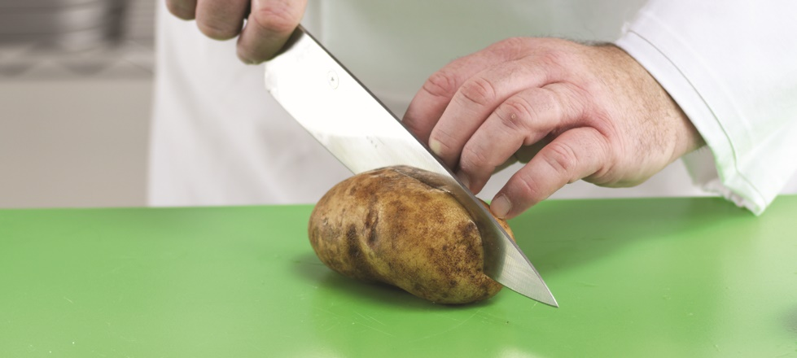
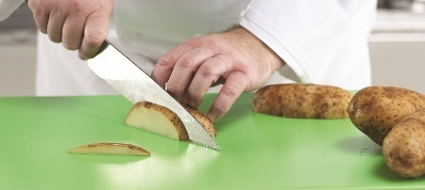
Dicing vegetables
Determine size of cube
Wash and peel vegetable
Trim so sides are straight and at right angles
  Cut in half first
Cut into panels
Notes:
Determine the size of cube that is needed.
Prepare the vegetable by washing and peeling.
Trim the vegetable so that the sides are straight and at right angles. It is often helpful to
cut vegetables in half first so that you are working with a flat surface.
Cut into panels. Before something can be diced, it needs to be cut into logs or sticks, such
as a julienne. Always begin by cutting off one side to make it flat. Next, make rectangular
slices or panels.

Slide 49
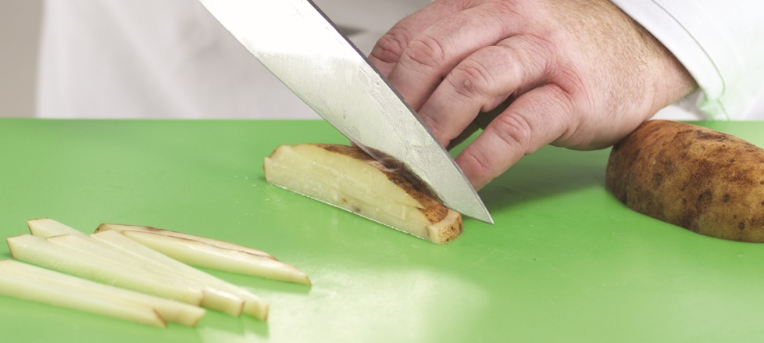
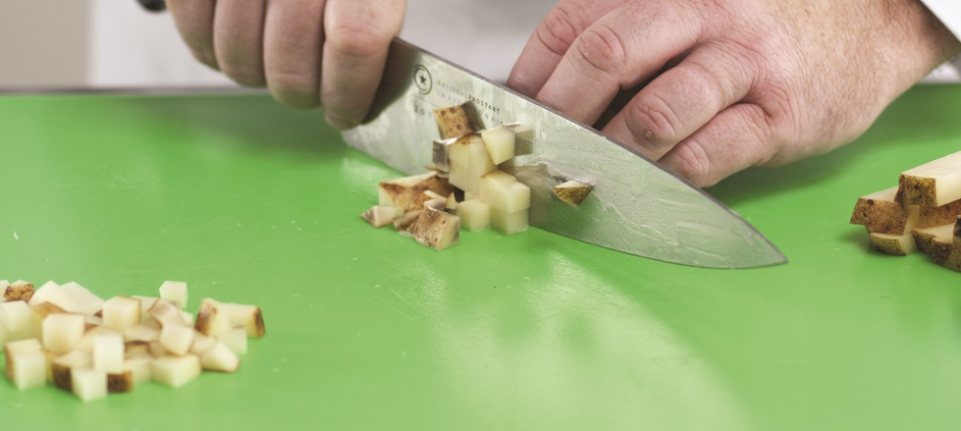
Dicing vegetables
Cut into logs
  Stack panels on top of each other
  Slice lengthwise
Line up logs and cut across
Notes:
Cut into logs. Stack a number of the rectangles or panels on top of each other and then slice
lengthwise, making uniform logs or sticks.
Line up the logs or sticks and cut across them again, creating perfect cubes.

Slide 50
Cooking vegetables
Prep close to cook time
Use high-quality produce
Store and handle properly
Use best-suited cooking process
Overcooking reduces quality, nutrient value, appearance
Notes:
Prepare vegetables as close to the actual cooking time as possible. This will
ensure the vegetables’ freshness and add to the overall quality and flavor of
the finished dish. There are some other factors essential to producing
well-cooked vegetables:
• Purchase vegetables that are at the peak of quality.
• Maintain proper storage and handling standards.
• Select a cooking process that is best suited to the vegetable.
Vegetables must be cooked in a way that protects their texture, flavor, color,
and nutrients. Overcooking vegetables will reduce their quality, nutrient value,
and appearance.

Slide 51
Cooking methods
Boiling (blanching, parboiling)
Steaming
Microwaving
Roasting and baking
Sautéing and stir-frying
Pan-frying
Deep-frying
Grilling
Stewing and braising
Sous vide
Puréeing
Notes:
Maintaining the quality and flavor of the vegetable depends on both the type
of vegetable and the cooking method used. There are many cooking methods
for vegetables:
• Boiling (blanching, parboiling)
• Steaming
• Microwaving
• Roasting and baking
• Sautéing and stir-frying
• Pan-frying
• Deep-frying
• Grilling
• Stewing and braising
• Sous vide
• Puréeing

Slide 52
Vegetable cooking method
Baking:
Carrots, eggplant, mushrooms, onions, potatoes, squash, tomatoes
Boiling:
Dried beans and legumes, cabbage, carrots, corn on the cob, potatoes
Braising:
Cabbage, celery, mushrooms, potatoes, squash, zucchini

Slide 53
Vegetable cooking guide
Broiling:
Eggplant, mushrooms, onions, tomatoes
Deep-frying:
Brussels sprouts, carrots, cauliflower, eggplant, potatoes, squash, zucchini
Steaming:
Artichokes, green beans, beets, broccoli, Brussels sprouts, cabbage, carrots, cauliflower,
celery, onions, potatoes

Slide 54
Vegetable color changes during cooking
White:
Potatoes, turnips, cauliflower, onions, white cabbage
Turn yellow when cooked with acid
Turn yellowish, gray when cooked with alkali
No coloring compounds
Notes:
Cooks use both appearance and texture to test whether or not a vegetable is
properly cooked. Green vegetables show a visible difference from one stage
of doneness to another. White and orange vegetables show very little change
in their color, so cooks check their texture to determine doneness.

Slide 55
Vegetable color changes during cooking
Red:
Beets, red cabbage, NOT tomatoes
Turn red when cooked with acid
Turn blue/blue-green when cooked with alkali
Turn greenish blue, faded when overcooked
Contain anthocyanins that respond to pH changes

Slide 56
Vegetable color changes during cooking
Green:
Asparagus, green beans, lima beans, broccoli, Brussels sprouts, peas, spinach, okra,
green peppers, artichokes
Turn olive green when cooked with acid
Turn bright green when cooked with alkali
Turn olive green when overcooked
Contain chlorophyll that responds to pH changes

Slide 57
Vegetable color changes during cooking
Yellow and orange:
Carrots, tomatoes, rutabagas, sweet potatoes, squash, corn
Little change when cooked with acid
Little change when cooked with alkali
Fade slightly when overcooked
Contains beta-carotene, does not respond to pH changes

Slide 58
Cooking methods
Boiling:
Best for hard, starchy vegetables
Blanching:
Cook in hot water or oil
Plunge in ice water
Skin easy to remove
Sets color
Eliminates or reduces strong flavors
First step in other cooking methods
Parboiling:
Partially cook in boiling water
Notes:
Boiling is best for hard, starchy vegetables, such as corn and potatoes.
You can blanch vegetables by quickly and partially cooking them in hot water
or oil and then shocking them by plunging them into ice water or cold running
water in order to halt the cooking process. This cooking method has some
important effects:
• It makes the skin easy to remove.
• It sets the color of vegetables that are served cold.
• It eliminates or reduces strong flavors.
• It is the first step in other cooking methods.
Parboiling, like blanching, partially cooks vegetables in boiling water.

Slide 59
Cooking methods
Steaming:
Retains vitamins and minerals
Cooks indirectly with hot vapor
Microwaving:
Vibrates food’s molecules to cook
Cook in microwave-safe container
Notes:
Steaming is an excellent way to prepare vegetables for to-order service. It is the
best way to retain vitamins and minerals because the vegetables are cooked
gently in a vapor, or steam bath, not in direct contact with water.
Microwaves cause food molecules to vibrate, and the friction from that vibration
generates heat. This causes the food’s natural liquids to steam the item. Cook
vegetables in a microwave-safe container, covered, in a small amount of liquid.
Or leave the vegetable whole, with the skin or peel intact, and steam it with its
own moisture.

Slide 60
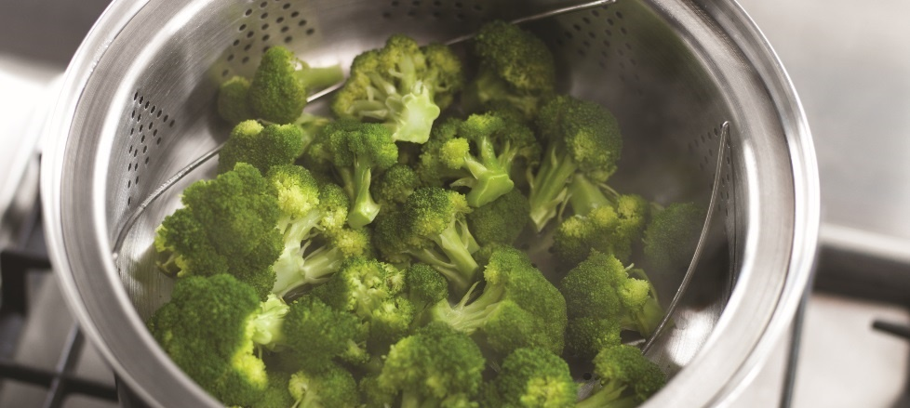
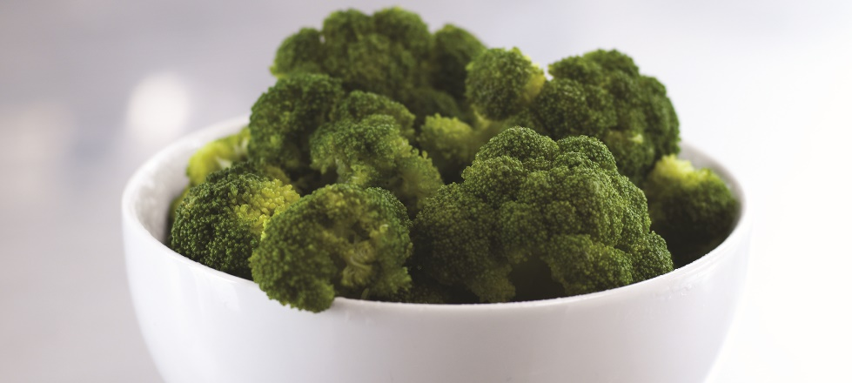
Steaming vegetables
Bring liquid to a boil
  Add seasonings and aromatics
Add vegetables in single layer
Steam to desired doneness
Serve or plunge into ice-water bath
Notes:
Bring the liquid to a full boil, and add the seasonings and aromatics.
Add the vegetables to the steamer in a single layer.
Steam the vegetables to the desired doneness.
Serve the vegetables, or plunge them into an ice-water bath and then refresh and hold.

Slide 61
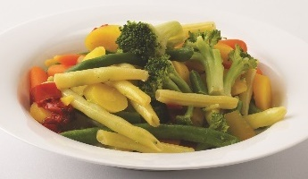
Microwaving vegetables
Place vegetable in appropriate dish or plate
  Cover
Cook to desired doneness
Serve or refresh and hold
Notes:
Place the vegetable in a suitable dish or plate, and cover it.
Place it in a microwave oven, and cook it to the desired doneness.
Serve the vegetables, or refresh and hold.

Slide 62
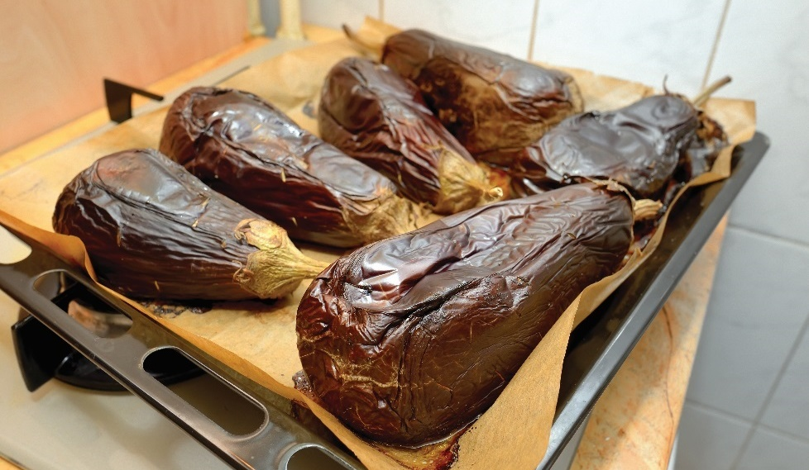
Cooking methods
Roasting and baking:
Popular cooking methods
Cook in hot or moderate oven
Thick-skinned vegetables
Sautéing:
Thin-skinned vegetables
Crispy texture
Raw or partially-cooked vegetables
Notes:
Roasting and baking are two very popular ways to cook vegetables. Roast
or bake vegetables in a hot or moderate oven. Leave them whole or cut them
into large pieces without adding liquid. This cooking method is best suited to
vegetables with thick skins that protect the interior from drying or scorching,
such as winter squash, potatoes, and eggplant.
While thick-skinned vegetables are well suited for roasting, vegetables
with little or no skin are best when sautéed. Sautéing gives vegetables
a crisp texture. Some vegetables are suitable for sautéing in their raw
state, such as mushrooms and onions. Partially cook denser vegetables,
such as green beans and carrots, before they are sautéed.

Slide 63
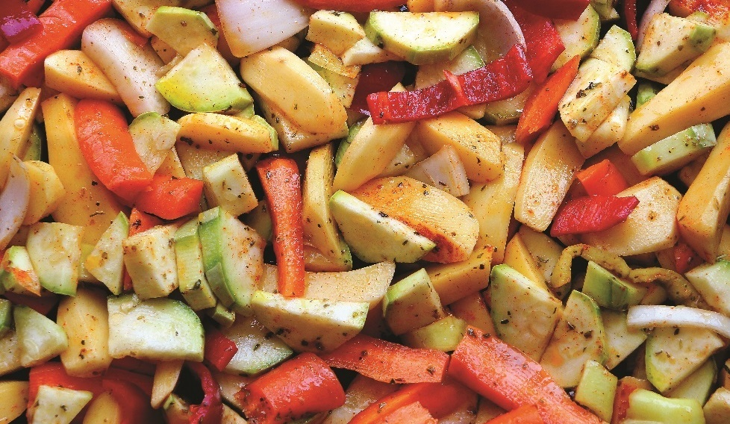
Roasting vegetables
Place vegetables onto preheated, hot pan
  Place into hot or moderate oven
Roast to desired doneness
Serve, hold, use in secondary technique
Notes:
Place the vegetables onto a preheated, hot pan and into a hot or moderate oven.
Roast them to the desired doneness.
Serve, hold, or use them in a secondary technique.

Slide 64
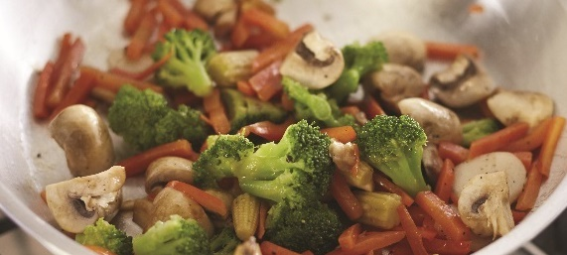
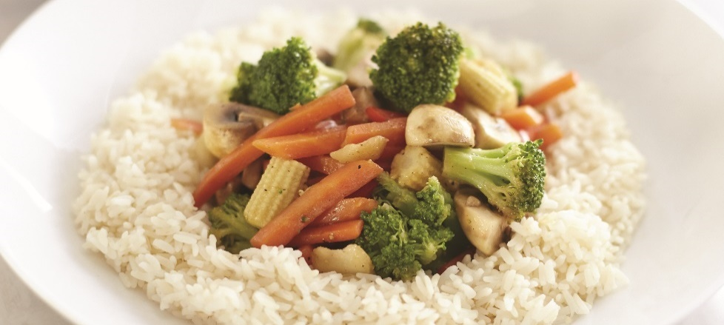
SAUTÉING AND STIR-FRYING VEGETABLES
Heat pan
  Add cooking medium
Add vegetables
Sauté vegetables
  Keep vegetables in motion
Add aromatics, seasonings, glaze
  Heat thoroughly
Serve immediately

Slide 65
Cooking methods
Glazing:
Gives glassy appearance
Coat with honey, sugar, syrup
Pan-frying:
Uses more oil than for sautéing
Cook until browned and crisp
Deep-frying:
Coat with batter
Cook in a deep fryer or large pot
Notes:
Glazing is a finishing technique that gives vegetables a glossy appearance. Add
a small amount of honey, sugar, or maple syrup to the vegetable to coat it and
give it a sheen as the vegetable reheats. For example, cooks often glaze small
pearl onions and baby carrots.
Unlike the cooking methods covered so far, cooks often coat pan-fried
vegetables with breading or batter. The amount of oil used in pan-frying is
greater than that for sautéing. Cook batter-dipped vegetables in oil or butter
until their exteriors are lightly browned and crisp.
As in pan-frying, coat vegetables to be deep-fried with breading or batter just
before cooking. Instead of a shallow pan, use a deep fryer or large, heavy pot.
Blanch slow-cooking vegetables, such as broccoli and cauliflower, before they
are deep-fried to speed the cooking process.

Slide 66
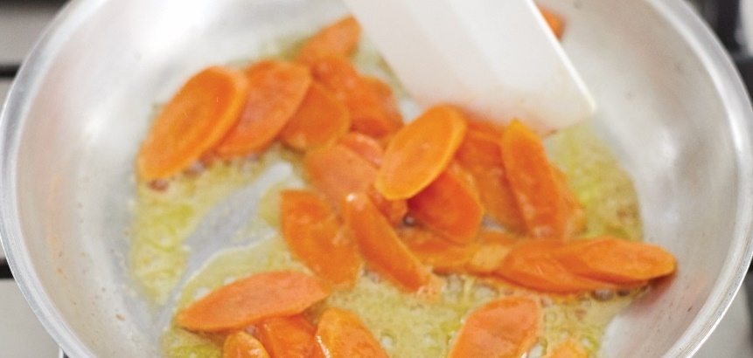
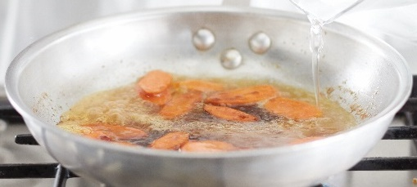
Glazing vegetables
Bring liquid to a simmer
  Season or flavor
Sweat or smother vegetables in cooking liquid or fat
Pour cooking liquid into pan
Cover pan and cook until done
Notes:
Bring the liquid to a simmer and season or flavor as the recipe instructs.
Sweat or smother the vegetables and any aromatics in a cooking fat or in the cooking liquid, if desired.
Pour or ladle enough cooking liquid into the pan to properly cook the vegetables.
Cover the pan and cook until the vegetables are done.

Slide 67
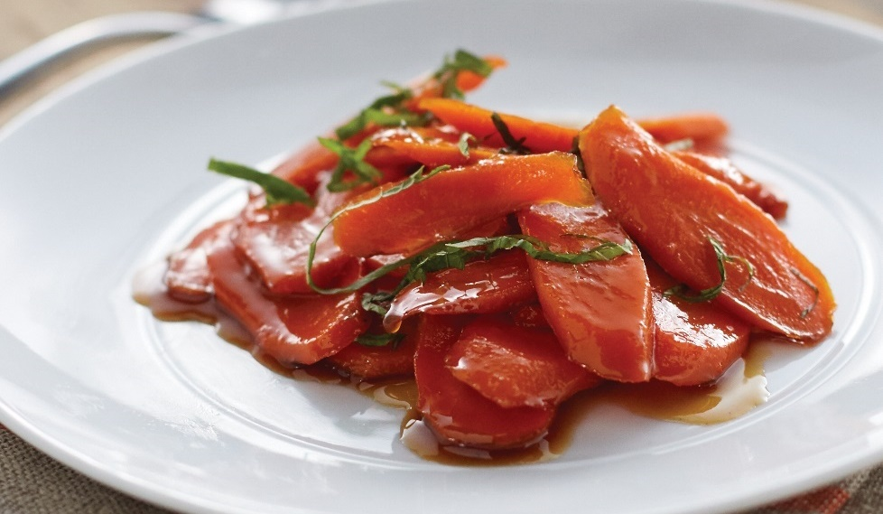
Glazing vegetables
Remove vegetables and drain liquid
Reserve cooking liquid
  Add honey, brown sugar, or maple syrup
  Continue to reduce
Toss vegetables in glaze and plate
Notes:
If there is too much liquid left from glazing, remove the vegetables and drain some of the liquid.
Reserve the cooking liquid. Add honey, brown sugar, or maple syrup and continue to reduce to make the glaze.
Gently toss the vegetables in the glaze and plate.

Slide 68
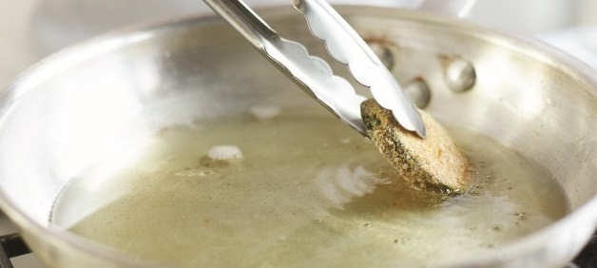

Pan-frying vegetables
Heat pan
Add cooking oil and heat
Add vegetables
Cook until brown and crisp
Blot vegetables
Season and serve
Notes:
Heat the pan.
Add the cooking oil and heat.
Add the vegetables.
Cook until their exteriors are slightly browned and crisp.
Blot vegetables on absorbent paper toweling.
Season and serve immediately.

Slide 69


Deep-frying vegetables
Coat vegetables with breading or batter
Heat oil in deep-fryer
  Add vegetables
Fry until evenly browned or golden
Remove from oil and blot
Adjust seasoning and serve
Notes:
Coat the vegetables with breading or batter.
Heat the oil in a deep-fryer and add the vegetables.
Fry the vegetables until they are evenly browned or golden.
Remove vegetables from the oil and blot them on absorbent paper towels.
Adjust the seasoning and serve the vegetables immediately.

Slide 70
Cooking methods
Grilling:
Raw or marinated
Bell peppers, potatoes, zucchini, onions
Stewing and braising:
Retain vitamins and minerals
Cook in oil or stock
Braising—done in less liquid
Notes:
Grilling is a popular method for cooking vegetables. Some vegetables can be
grilled in the raw state, while others must be marinated. To marinate vegetables,
soak them in oil or vinegar, herbs, and spices. This gives them added flavor
and helps to tenderize them. The vegetable must be able to withstand the grill’s
intense heat. Some vegetables well suited for grilling are bell peppers, potatoes,
zucchini, and onions.
Vegetable stews and braises are good ways to retain the vitamins and minerals
that are transferred to the cooking liquid. For either method, cook vegetables in
oil or stock and then season them. Add broth or another cooking liquid, then
cook the vegetables until tender. In these methods, serve the liquid as part of
the dish. Cut stewed vegetables into small pieces; cut braised vegetables into
large pieces or leave them whole. The primary difference between stewing
and braising is that braising is done in less liquid, while stewing involves using
enough liquid to cover the pieces.

Slide 71

Grilling vegetables
Heat grill or broiler
Marinate vegetables or brush with oil
Cook until tender and properly cooked
Season and serve
Notes:
Heat the grill or broiler.
Marinate the vegetables or brush them with oil.
Grill or broil until the vegetables are tender and properly cooked through.
Season to taste and serve the vegetables immediately.

Slide 72

Stewing and braising vegetables
Heat pan
Heat oil or stock
Add vegetables
  Cover with seasoning or aromatics
Add liquid
  Bring to a simmer
  Cook vegetables
Notes:
Heat the pan.
Heat the oil or stock.
Add vegetables, and cover with seasonings or aromatics.
Add the liquid, bring it to a simmer, and cook the vegetables.

Slide 73


Stewing and braising vegetables
Add remaining vegetables and aromatics
Cook until tender
Adjust seasoning
Serve or hold
Notes:
Add the remaining vegetables and aromatics.
Cook the stew or braise until the vegetables are tender.
Adjust the seasoning, and finish the dish according to the recipe.
Serve the vegetables or hold.

Slide 74
Cooking methods
Sous vide:
Cooking in an airtight bag over long period of time
Bags placed in hot water below boiling point
Puréeing:
Cook and then blend
Custards and soufflés
Notes:
Sous vide is a method in which food is cooked for a long time, sometimes well
over 24 hours. Rather than placing food in a slow cooker, the sous vide method
uses airtight plastic bags placed in hot water well below boiling point. Food is
cooked using precisely controlled heating, at the temperature at which it should
be served.
Serve puréed (pyoo-RAYED) vegetables as individual dishes or use them in
other preparations, custards, and soufflés. Cook the vegetables until tender
enough to purée easily by pushing them through a sieve or food mill, or using
a vertical chopping machine or blender. Some vegetables, such as tomatoes,
spinach, and cucumbers, can be puréed from the raw state.

Slide 75



PURÉEING VEGETABLES
Cook until tender
Drain and remove excess moisture
Purée vegetables
Adjust seasoning
  Serve or use in secondary preparation
Notes:
Cook the vegetables until very tender.
Drain the vegetables and remove any excess moisture.
Purée the vegetables using a sieve, a heavy-duty blender, or an immersion blender.
Adjust the seasoning, finish, and serve, or use in a secondary preparation.

Slide 76


Holding vegetables
Cook soon after purchase
Refresh boiled/steamed vegetables in cold water
Drain starchy vegetables well
Hold baked/roasted vegetables in holding drawer
  If longer than 4 hours, cool and wrap
Hold braised/stewed vegetables in steam table
Reheat by simmering in water, microwaving, sautéing
Notes:
The best way to maintain overall quality is to cook vegetables soon after
purchase and then serve them as quickly as possible. If vegetables must be held
for a period of time before being served, here are some techniques to maintain
their quality:
Boiled or steamed vegetables can be refreshed in cold water.
Starchy vegetables should be well drained and spread out to dry.
Baked or roasted vegetables should be held uncovered in a holding drawer
if they are to be served within four hours of their preparation. If not,
spread them on sheet pans, cool completely, and then wrap them.
Braised or stewed vegetables can be held in a steam table.
Various methods of reheating vegetables include simmering them in
stock or water, microwaving them, sautéing them in butter or cream, or
dry-sautéing using a cooking spray in the pan.
Avoid holding vegetables either in steam tables or directly in water for
extended periods of time.

