Slide 2
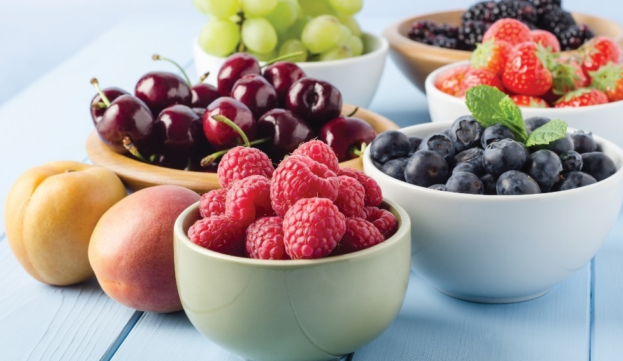
Fruit Types and Market Forms
Seed-bearing part of plant
Added to desserts, soups, main courses, or eaten alone
Many colors, varieties, flavors
Sweetness comes from fructose, a natural sugar
Forms of fruit
  Fresh, whole or cut
  Frozen
  Canned
  Dried
Notes:
Botanically speaking, a fruit is an organ that develops from the ovary of a
flowering plant and contains one or more seeds. From a culinary point of view,
fruit can be the perfect snack food or the basis of a dessert or colorful sauce
or soup, or an addition to meat, fish, shellfish, or poultry. The fruit group offers
an amazing variety of colors, flavors, and textures that can inspire incredible
creativity in the kitchen.
Fruit is often used in sweet dishes, such as puddings, pies, and jellies. It can also
be found in salads or appetizers. The acidity of fruit is used to cut the richness
of meats like pork and duck, or brighten the delicate flavor of fish and veal.
Fruit is both delicious and nutritious. The sweetness of fruit comes from fructose
(FROOK-tose), a natural form of sugar.
Fruit can be purchased in a variety of market forms:
• Fresh—including whole and cut up
• Frozen
• Canned
• Dried
Fruits are grouped by growing season and location. The three main groups of
fruit are summer, winter, and tropical or exotic.

Slide 3
Fruit Types and Market Forms: Summer Fruits
Ripen in summer, depending on climate
Eaten raw or baked/cooked
Includes melons, grapes, berries
Drupes—fruits that have central pit
Notes:
Summer fruits ripen in the summer (depending on your region and climate)
and include berries, cherries, grapes, melons, peaches, nectarines, plums,
and pears. Most summer fruits are delicious when eaten in their whole form
and are also popular baked or cooked in different recipes. Fruits that have
a central pit enclosing a single seed are known as drupes. Cherries, plums,
peaches, nectarines, and apricots are examples of drupes.

Slide 4
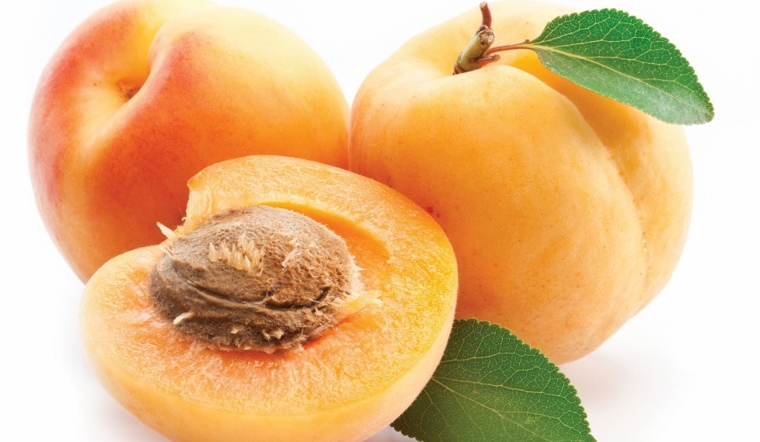
Summer fruits
Apricots:
Resemble peaches
Dry flesh, fuzzy skin
Notes:
Apricots
Apricots resemble peaches with their fuzzy skin, but are smaller and have a slightly drier flesh.

Slide 5
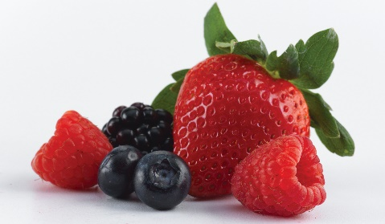
Summer fruits
Berries:
Grow and ripen on vines and shrubs
Perishable and fragile
Grown in most soils and regions
Prepare and use quickly
Plump and free of mold
Wash before use
Minimize handling
Notes:
Berries
Berries (such as blueberries, blackberries, raspberries, and strawberries)
are grown in all major producing regions in North and South America, Europe,
and Asia. They grow in most kinds of soil and in most regions with warm
summers and relatively mild winters. Berries grow on vines and shrubs and
can only be ripened on the vine. They are highly perishable and fragile.
Because of their fragile nature, berries should be prepared and used quickly.
Look for berries that are plump and free of mold. Berries will grow mold
quickly when exposed to moisture. Wash them immediately before use.
Minimize handling and serve berries as soon as possible.

Slide 6
Summer fruits
Cherries:
Grow on trees in temperate climates
Vary from tart to sweet
Used in baking, cooking, preserves
Notes:
Cherries
Cherries grow on trees in most temperate climates but have a short growing
season. They are available in several commercial varieties. Cherries fluctuate
in texture and run from very tart to very sweet. Most sweet cherries are used
in cooking, while tart varieties are used in baking and preserves. You should
select cherries with firm skin that is free of blemishes.

Slide 7
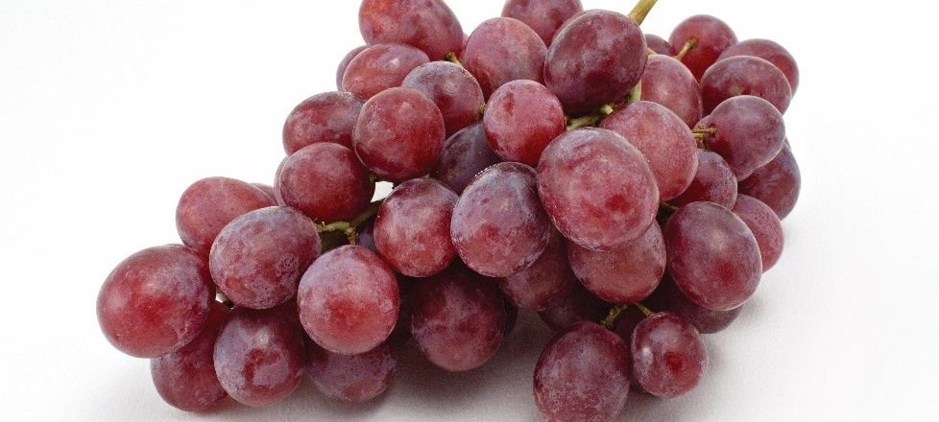
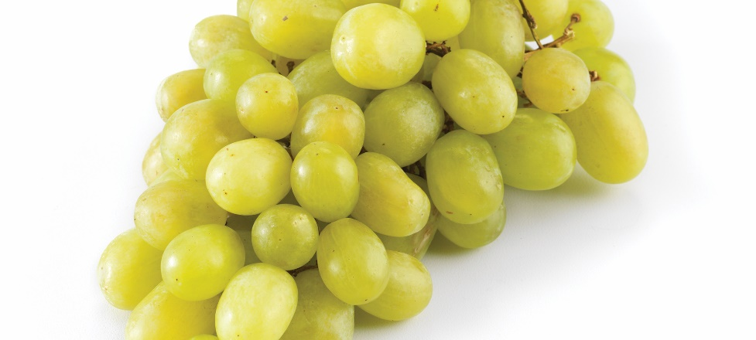
Summer fruits
Grapes:
Grow in nutrient-rich soil
Grow in clusters on vines
With or without seeds
Grape skin—flavor and color
Notes:
Grapes
Grapes grow in places with sufficient water, appropriate temperatures, and
nutrient-rich soil—for example, all over the Mediterranean, in Europe, and in
America. Grapes are often planted in the late winter to early spring months.
The plants start to grow in spring and continue to grow throughout the summer
season. Grapes ripen in the late summer to early fall, depending on the
variety grown. They grow in clusters on vines that are trellised (supported on
a framework), and there are several dozen varieties that are used for cooking.
Grapes are smooth skinned and available with or without seeds. The flavor
and the color are in the skin of the grape. Look for grapes with firm skin that is
free of blemishes.

Slide 8
Summer fruits
Melons:
Two groups: sweet melons and watermelons
Sweet melons
  Tan or yellowish green–colored rind
  Flesh—thick, tight texture
  Central network of seeds
Watermelons
  Large with watery flesh
  Smooth green skin
  Very thick white rind
  Crisp, pink, watery flesh
  Seeds throughout flesh
Notes:
Melons
Melons are divided into two main groups. The first group is sweet melons, such as
muskmelon and honeydew, and the second is watermelons. Sweet melons tend to have
a tan or yellowish green–colored rind and the flesh has a thick, tight texture. These
melons have a network of seeds at the center. Muskmelons include two varieties of
cantaloupes, but not all muskmelons are cantaloupes.
Watermelons are much larger than sweet melons and have a smooth green skin.
Watermelons have a very thick white rind with a very crisp, pink, watery flesh. Seeds
are found throughout the flesh. Select melons that have good aroma.

Slide 9
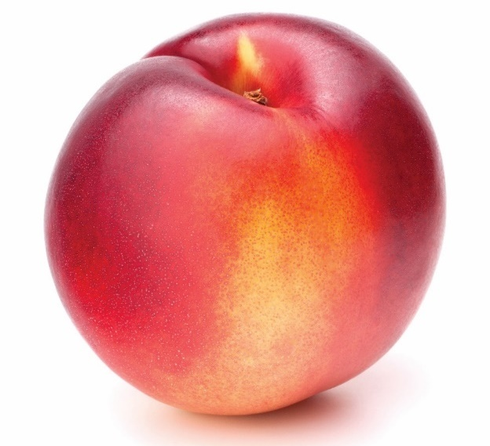
Summer fruits
Nectarines:
Similar to peaches
Smooth skin and firm flesh
Avoid blemishes and bruises
Notes:
Nectarines
Nectarines are similar to peaches in color, shape, and flavor. They have
smooth skin and a firm flesh. When selecting these fruits, look for smooth
skin and few blemishes or bruises.

Slide 10
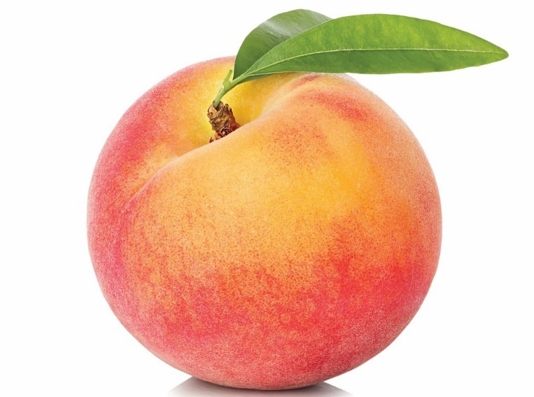
Summer fruits
Peaches:
Sweet with fuzzy skin
Two types: freestone and clingstone
Flesh—varies in color
Notes:
Peaches
Peaches are sweet, with a distinctive fuzzy skin. They are divided into two
groups: freestone and clingstone. The flesh of freestone peaches separates
easily from the pit, while clingstone peaches have flesh that clings to the pit.
Peach flesh can vary in color from white to yellow to yellow-orange to red.
All of these fruits grow in a wide variety of temperate climates, as long as there
is proper water and sunlight. The amount of water and sun required differs by
the specific variety of fruit.

Slide 11
Summer fruits
Pears:
Grow in many regions
Sweet and smooth flesh
Usually harvested before ripening
  Do not ripen on tree
Notes:
Pears
Pears are relatively easy to grow in a wide geographic area, as long as they
have ample water and some sun in the summer. They have a sweet taste
and a smooth succulent flesh. They do not ripen on the tree and are usually
harvested and allowed to ripen. Look for pears that have a nice aroma and
are tender at the stem.

Slide 12
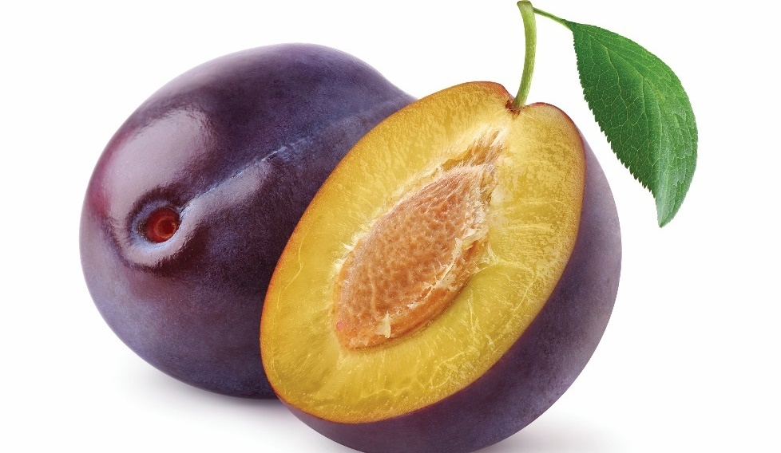
Summer fruits
Plums:
Many colors and sizes
Two types: dessert and cooking
  Both types can be eaten raw
Used in sweet and savory dishes
Notes:
Plums
Plums come in many colors and sizes. There are two general categories:
dessert and cooking. Cooking plums are generally drier and have more acid
than dessert plums. However, both varieties can be eaten raw and are used
in both sweet and savory dishes.

Slide 13
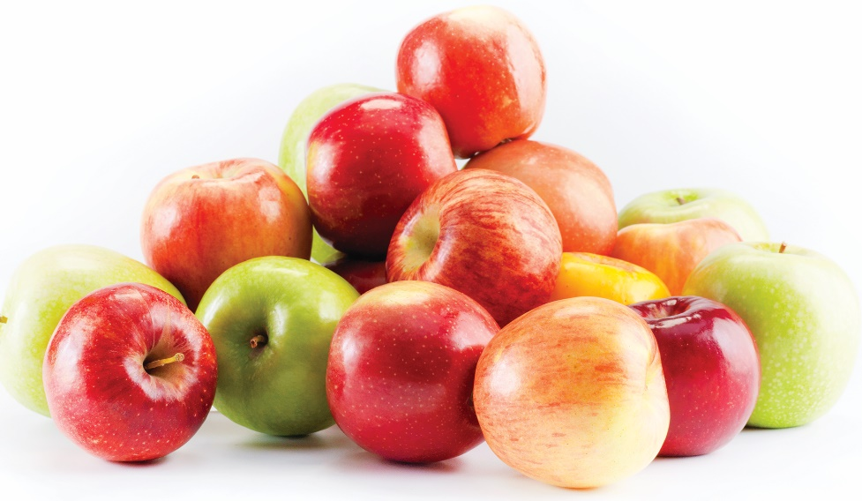
Winter fruits
Apples:
Most grown in China and U.S.
7,500 varieties
Most commonly used fruit
Cooking, juice, desserts, eating raw
Flavor range—tart to sweet
Notes:
Although summer fruits are plentiful, winter fruits also offer a good selection
that provide plenty of nutrition and great flavors. Winter fruits ripen in the
winter (depending on your region and climate) and include apples and
citrus fruits, such as oranges, grapefruit, lemons, limes, and tangerines.
Apples
Over half of all apples are grown in China or the United States. There are
about 7,500 varieties, and apples are among the most commonly used fruits.
They are used for cooking, for desserts and sauces, for juicing, and for eating
raw. The flavor of apples ranges from very tart, like the Granny Smith, to
sweet, like the Golden Delicious. Look for apples with smooth skin and firm
flesh that can be tender or crisp.

Slide 14
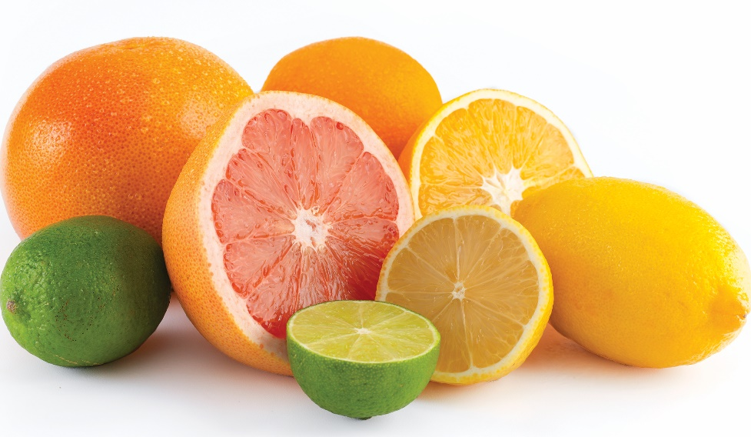
Winter fruits
Citrus:
Grow in many regions
Thick rind and segmented flesh
Contain vitamin C
Can be sweet or tart
Include oranges, grapefruit, lemons, limes, tangerines
Notes:
Citrus
Citrus fruits grow all over—southern China, the Mediterranean Basin,
South Africa, Australia, the southernmost United States, Mexico, and parts
of South America. They generally have a thick rind and segmented flesh.
These fruits have an abundance of vitamin C. The flavors of citrus fruits
range from sweet to very tart. Look for fruits that have smooth skins
and are free of large blemishes.

Slide 15
Tropical fruits
Bananas:
Picked before ripe
Contain carbohydrates, fiber, potassium, vitamins, minerals
Good for eating and baking
Flavor range—sweet to mild
Notes:
Tropical fruits are named for the tropical climatic conditions under which they are grown.
None of these fruits can tolerate frost. Tropical fruits include dates, kiwis, mangoes,
bananas, papayas, pomegranates, guava, star fruit, and passion fruit.
Unlike most fruits, bananas are picked almost green and allowed to ripen
as they travel from the tropics to the wholesaler. Bananas are rich in
carbohydrates, fiber, potassium, vitamins, and minerals. Fully ripe bananas
are excellent for eating and baking. Green bananas can be used in both
sweet and savory applications. Banana flavors range from sweet to mild,
and some varieties are juicy. Ripeness influences sweetness (which is the
case for so many fruits). But bananas are useful at every stage of ripeness.
For example, green bananas are often used in Caribbean recipes, while
overripe bananas are good for banana bread.

Slide 16
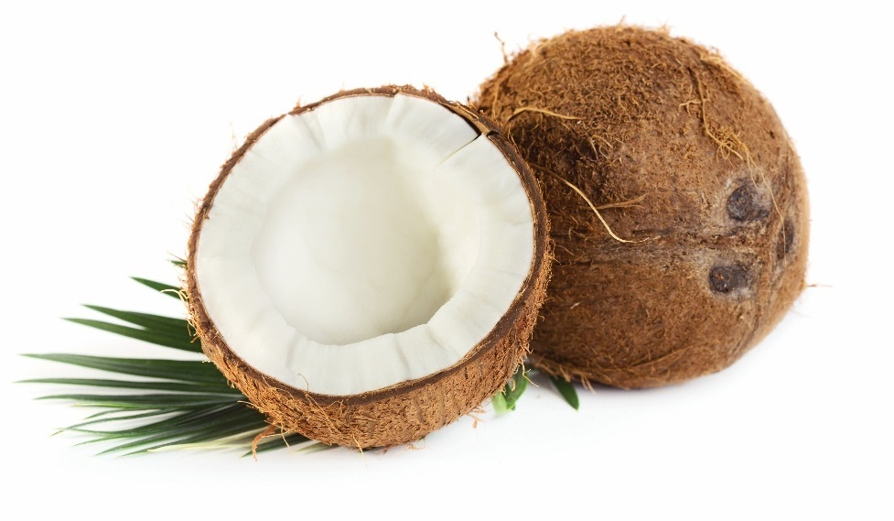
Tropical fruits
Coconuts:
Have many layers
Should be heavy and full of liquid
Contain meat and water
Notes:
Coconuts
The coconut has several layers. Its outermost layer is a smooth,
light-brown covering that is usually removed before shipping. Next is
the familiar dark-brown hairy shell. Beneath that is a thin brown skin
covering the bright white meat. A ripe coconut should be heavy and
should be full of liquid when shaken. The juice in the center is called
coconut water, which is full of minerals and consumed as a beverage.
Coconut meat can be eaten raw and is often grated into both sweet
and savory dishes. Avoid coconuts with mold on the eyes.

Slide 17
Tropical fruits
Kiwis:
Also called Chinese gooseberries
Fuzzy skin and green flesh
Star pattern of tiny black seeds
Used in desserts and garnishes
Notes:
Kiwis
Kiwis are also known as Chinese gooseberries. Kiwis are characterized by
fuzzy skin and bright green flesh with a star pattern of tiny black seeds.
Their flavor is very similar to that of strawberries, and kiwis provide color and
texture to fruit salads, as well as excellent garnish to desserts. Look for kiwis
that just give to the touch and are free of blemishes.

Slide 18
Tropical fruits
Mangoes:
Medium-sized, thick-skinned fruit
Bright yellow to orange flesh
Sweet to spicy-sweet flavor
Good color and aroma, give slightly when pressed
Notes:
Mangoes
Mangoes are relatively medium-sized fruits and are thick-skinned with bright
yellow to orange flesh. They have a sweet to spicy-sweet flavor and are an
excellent addition to fruit salads and smoothies. They translate well into
savory dishes, such as curry. Mangoes should give slightly when pressed and
not be overly soft. Look for mangoes with good color and a good aroma.

Slide 19
Tropical fruits
Papayas:
Pink-orange flesh, black seeds
Sweet-tart flavor and firm flesh
Can be eaten raw or cooked in sweet or savory dishes
Notes:
Papayas
Papayas have a soft pink-orange flesh with a central mass of black seeds.
They have a sweet-tart flavor and firm flesh. Ripe papayas can be eaten raw,
and unripe papayas can be cooked and added to both sweet and savory
dishes. Look for papayas that are plump and free of blemishes. The more
yellow the fruit’s skin, the riper it is.

Slide 20
Tropical fruits
Pineapples:
Diamond-patterned skin and golden flesh
Juicy with sweet to sweet-tart flavor
Raw or cooked
Used in sweet and savory dishes
Good aroma and no dried leaves or stem
Notes:
Pineapples
Pineapples have a diamond-pattern skin and golden flesh. They range in size
from very small to quite large. They are juicy when ripe and have a sweet to
sweet-tart flavor. Pineapples can be eaten raw and are an excellent addition
to fruit salads. Pineapples can also be cooked and are used in both sweet and
savory applications. Look for fruits that have a good aroma and have no dried
out leaves or stems.

Slide 21
Fruit types and market forms
Characteristics of freshness:
Plump
No bruises, mold, brown or soft spots
No pest damage
Attached leaves—firm and not wilted
Color and texture appropriate to fruit or vegetable type
Notes:
How do you know when fruits and vegetables are fresh and of a high quality?
Characteristics of freshness vary from one item to another, but there are some
common traits. Fruits should be plump and free of bruises, mold, brown or soft
spots, and pest damage. Any attached leaves should be firm and not wilted.
Overall, the color and texture should be appropriate to the particular type of
fruit or vegetable. Selecting local, in-season fruits whenever possible is one way
to increase your chances of finding fruits of the highest quality.
See Table 5.4, Characteristics of Fresh Fruits, on pages 100–101.

Slide 22
Purchasing fruits
Some available all year, others have limited growing seasons
During growing season, quality is higher and price is low
Factors in purchasing and selecting fruits:
  Seasonality
  Ripeness
  Price
  Recipe requirements
  Staff skill level
  Vendor
Notes:
Some fruits, such as bananas, apples, pears, and grapes, are available all
year. The quality, degree of ripeness, and price vary with the season. Other
fruits, such as peaches, plums, mangoes, and berries, have a specific growing
season. Knowing the growing season for a particular fruit is important. During its
growing season, the fruit is plentiful, the quality is higher, and the price is usually
lower. Some operations have seasonal menus that are based on what is fresh
and locally available. Many guests today have shown an interest in eating local
produce and supporting the restaurants that serve it.
Fruits are sold by weight or by count and are packaged in containers that are
referred to as flats, crates, or bushels, to name a few. When selecting fruits for
purchase, consider the following:
Seasonality: Is the fruit in season?
Ripeness: Is the fruit ripeness appropriate for the recipe?
Price: Is the fruit priced appropriately for the intended use?
Other factors that could affect the purchasing decisions an operation makes include the following:
Recipe requirements: Many standardized recipes identify the specific varieties and market forms needed.
Staff skills: Highly skilled food handlers can handle natural, uncut produce efficiently. Food handlers with
fewer skills in peeling and cutting will often need to use processed products.
Vendor: Purchasers must spend time to find the vendor that best meets an operation’s needs.

Slide 23
grading
Quality grades
  Rating system developed by USDA
Better-quality fruits have higher quality grade
USDA grades, highest to lowest:
  U.S. Extra Fancy
  U.S. Fancy
  U.S. No. 1
  U.S. No. 2
  U.S. No. 3
U.S. Fancy usually used in foodservice operations
Notes:
The U.S. Department of Agriculture (USDA) has developed quality grades for
fresh fruits and canned fruits. Quality grades are like a rating system based on
quality standards—the better the quality of the fruit, the higher the quality grade
assigned to it. The quality is based on a combination of size, color, shape,
texture, and defects. The price is also usually higher for the best grades.
Fresh fruits are graded before shipping. USDA grades (from highest to lowest) for
fresh fruits include U.S. Extra Fancy, U.S. Fancy, U.S. No. 1, U.S. No. 2, and U.S.
No. 3. Most fruits purchased for foodservice operations are U.S. Fancy. Fruit with
lower grades can be used in dishes such as baked pies, puddings, jams, jellies,
and cobblers, where the appearance of the fruit is not as important.

Slide 24
grading
Grading for canned fruits, highest to lowest:
  U.S. Grade A Fancy
  U.S. Grade B Choice
  U.S. Grade C Standard
Grade A Fancy: good color and flavor, uniformly sized pieces
Grade B Choice: second best, average color and flavor
Grade C Standard: poor quality with imperfections
Notes:
Canned products rated U.S. Grade A Fancy have the highest quality among
canned goods. This means that the fruits’ colors and flavors are excellent
and their sizes and shapes are perfectly uniform. U.S. Grade B Choice fruits
are rated second best, which means that their overall colors and flavors are
average. U.S. Grade C Standard means that the fruit’s quality is poor. Some
of the pieces may be bruised and mushy and have several imperfections.

Slide 25
Storing fruits
Ripe fruits can be stored at 41°F (5°C)
  Except bananas
Store separate from vegetables
Some emit ethylene gas when ripening
  Store separately
Ripening fruits stored at 65°F to 70°F (18°C to 21°C)
Notes:
All fruits must be properly stored to keep from spoiling. Many ripe fruits, except
for bananas, can be stored at 41°F (5°C) or lower. Under the best circumstances,
fruits should be stored in their own refrigerator, separate from vegetables.
Certain fruits (including apples, bananas, and melons) emit ethylene
(ETH-el-leen) gas, which causes fruits to ripen. While this increases ripening
in some unripe fruits, it also causes ripe fruits and vegetables to spoil.
Ethylene-producing fruits should be stored in sealed containers if separate
refrigeration or storage is not available. Another reason to store fruits and
vegetables separately is because some produce items, such as onions or garlic,
give off odors that taint the natural, delicate flavors of dairy items stored nearby.
Most fruits need to be kept dry because excess moisture causes produce to spoil
quickly. To keep moisture down, use the fruit bins in refrigerators, which have
lower humidity than the rest of the refrigerator; do not wash fruit until just before
using it; and do not store it in tightly closed plastic bags.
Fruit that needs to ripen should be stored at a room temperature of 65°F to
70°F (18°C to 21°C). Some citrus fruits have a longer life, but most restaurants
limit the storage of citrus produce items to three weeks.

Slide 26
Preparing fruits
Cleaning:
First step in preparation
Removes pathogens, chemicals, dirt, animal and pest contamination
Wash close to prep time
Use cold water and be gentle
Use brush to remove residue—heavy rinds
Notes:
Cleaning is the first step in preparing fruits. It is important to wash fruit for the following reasons:
The skin on fruit can carry a number of pathogens.
Fruits are exposed to chemicals, dirt, animals, and pests while growing and while being prepared for sale.
There are special solutions available for cleaning fruits, but you should wash fruits as close to preparation time as possible.
Use cold water and a gentle touch to avoid bruising fruits while handling them.
Use a brush on fruits with heavy rinds to scrub away any residue on the skin.

Slide 27
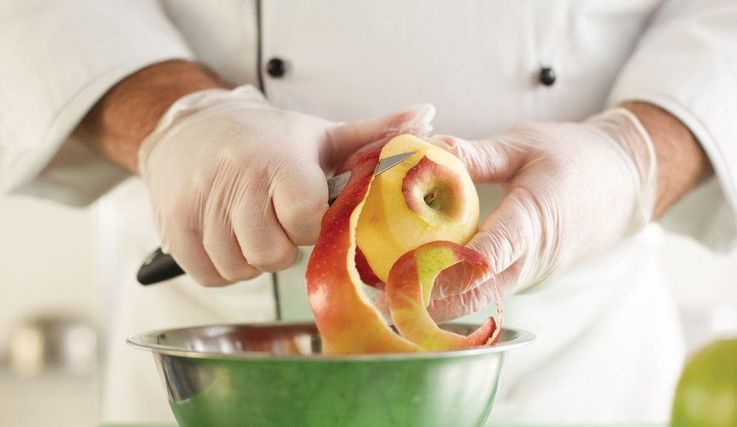
Peeling, Seeding, Trimming
Removing skin:
Some not peeled
Peeled by hand
Peeler or paring knife
Removing cores:
Most do not have cores
Seeds can be scooped out or cut with knife
Remove seeds and stones (pits):
Cut in half and scoop out seeds
Try to remove as little flesh as possible
Some have special pitters
Cut in half and pull pit from flesh
Notes:
Fruits often need to be prepared before they are served. Different fruits are
prepared in different ways. Preparation includes removing skins, removing cores,
removing seeds and stones (pits), zesting, and removing stems:
Remove skins: Some fruits, such as berries and cherries, are not peeled.
Others, such as oranges and bananas, can be peeled by hand: simply grasp
an edge of the peel and pull. Still other fruits, such as papayas and apples,
must be peeled with a peeler or a paring knife: carefully cut into the fruit,
just below the skin, and cut away long strips of peel. Sturdier fruits like
pineapples are stood on end, and the peel is cut away with a utility or
chef’s knife.
Remove cores: Most fruits do not have cores. Pineapples are halved
lengthwise, and the core is cut out with a knife. To core apples and pears,
scoop out the seeds with a parisienne scoop and use a paring knife to
remove the slender core that runs from the stem end to the blossom end.
Remove seeds and stones (pits): To seed fruits with large cavities, like
papayas or melons, cut the fruit in half and scoop out the seeds with a
spoon, taking care to remove as little flesh as possible. To seed citrus fruits,
such as oranges or lemons, cut the fruit horizontally and remove the seeds
with the tip of a paring knife. To remove cherry stones, use a cherry pitter.
Both hand tools and larger hopper-based devices are available. For other
stone fruits, cut vertically through the fruit and twist the two sides of the fruit
apart. The stone (pit) can then be pulled or cut from the flesh. To remove a
pit from a mango, cut off each flat side on the fruit, and then cut away the
remaining flesh from the pit.

Slide 28
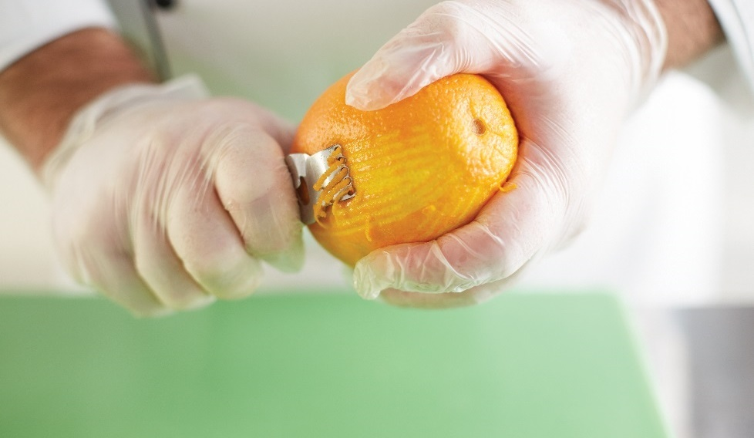
Peeling, Seeding, Trimming
Zest:
Obtain oil from skin of citrus fruits
Use microplane or zester
Can cut peel into strips
Remove stems:
Hard fruit: twist stem from fruit
Soft fruit: pull stem out
Some must be cut
Notes:
Zest: This technique is primarily used to obtain the aromatic oils in the
skins of citrus fruits. Only the surface of the skin is removed, leaving behind
the bitter, white pith. Use either a microplane or a zester to zest the fruit;
alternately, cut and julienne strips of peel.
Remove stems: There are two common ways to remove stems. For harder
fruits, twist the stem from the fruit; for softer items, pull the stem directly out
of the fruit. A few fruits, like figs, demand that the stem be cut away from
the fruit.

Slide 29
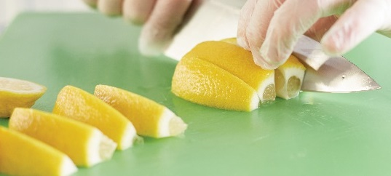
Cutting fruits
Use a sharp knife to make clean cuts
Wedges, slices, chunks, cubes
Some fruits brown after being cut—enzymatic browning
  Occurs more quickly when fruits have polyphenol oxidase
  Prevent browning by coating flesh with acid
  Acids help fruit retain structure
  Alkalis cause fruits’ structure to break down
Notes:
Use a sharp knife to cut fruit to ensure that your cuts are clean. This gives the
fruit a nice, clean appearance and maintains the fruit’s quality because you lose
less juice. Fruits are often cut into wedges, slices, chunks, or cubes for service.
Some fruits, such as citrus fruits, melons, pineapples, and kiwi, keep their
attractive appearance after they have been cut. Others, such as apples, pears,
bananas, and peaches, turn an unappetizing dark color when their flesh has
been exposed to air.
A chemical process called enzymatic (en-zi-MAT-ick) browning occurs when
the oxygen in the air comes in contact with the flesh of cut fruit. This is what
causes the fruit to turn brown. Figure 5.6 shows a photo of enzymatic browning.
The reaction occurs more quickly in fruits that contain the enzyme polyphenol
oxidase (pol-lee-feen-nole OX-ee-days), also referred to as PPO. Enzymatic
browning is a fruit’s survival technique to protect it from the environment.
To keep cut fresh fruits from discoloring, coat them with some form of acid, such
as lemon juice, as soon as they are cut. The acid lowers the pH on the surface
of the fruit, which helps to slow down discoloration.
Acids, such as lemon juice, help fruit to retain its structure. Alkalis, such as
baking soda, cause the cells to break down more quickly, making the fruit soft.

Slide 30
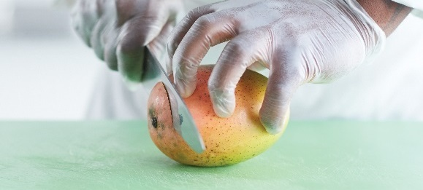
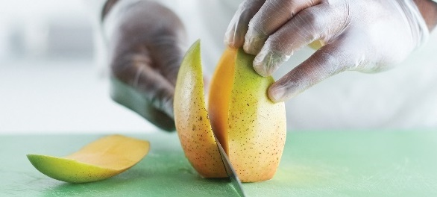
Easy Ways to Cut a Mango
Wash before cutting
Cut stem off
Stand upright on cutting board
  Place knife ¼ inch from widest centerline
  Cut down through mango
  Flip around and repeat
Notes:
A mango has one long, flat seed in the center of the fruit. Once you learn how to work around the seed, the rest is easy.
NOTE: Always use a clean knife and cutting board to cut a mango. Sanitize your hands, work area, utensils, and cutting board before handling or cutting any fruits or vegetables, especially if you have handled or cut any type of meat or seafood.
Always wash the mango before cutting.
Cut the stem off of the mango so it can stand upright without falling over.
Stand the mango on your cutting board stem end down and hold. Place your knife about ¼ inch from the widest centerline
and cut down through the mango. Flip the mango around and repeat this cut on the other side. The resulting ovals of mango
flesh are known as the “cheeks.” What is left in the middle is mostly the mango seed.

Slide 31
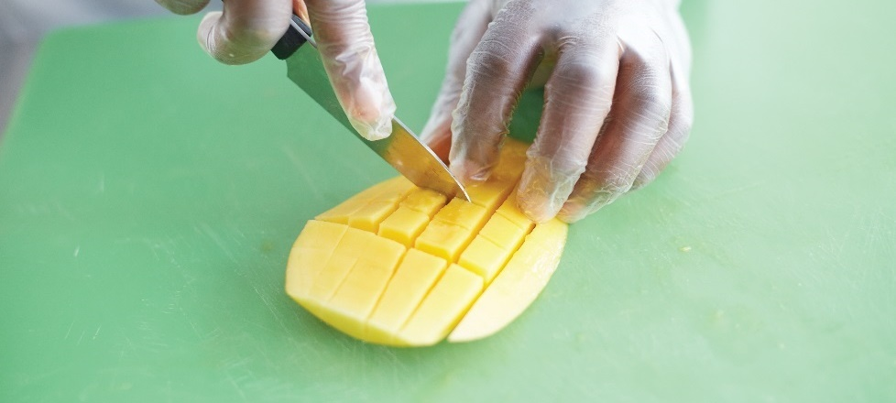
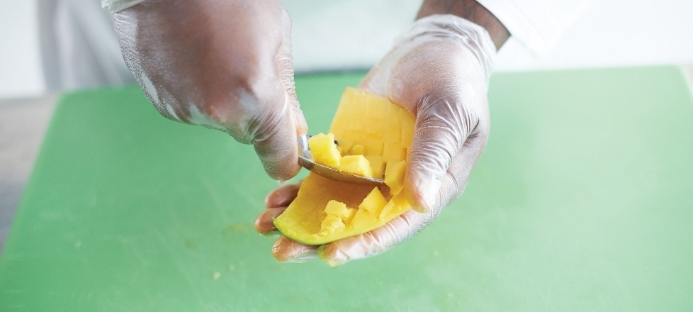
Easy ways to cut a mango
Cut parallel slices into flesh
  Do not cut through skin
  Rotate and cut another set of parallel slices
Choose method: slice and scoop or inside out
Notes:
Cut parallel slices into the mango flesh, being careful not to cut through the skin. Turn the mango cheek ¼ rotation and cut another
set of parallel slices to make a checkerboard pattern.
Here is where you can choose your favorite method: either “slice and scoop” (scoop the mango slices out of the mango skin using a
large spoon) or “inside out” (turn the scored mango cheek inside out by pushing the skin up from underneath and scrape the mango
chunks off of the skin with a knife or spoon).
Hint: If you are making a recipe that calls for diced mango, make your cuts in step 4 closer together. The result is small pieces of diced
mango and no need to further cut up the mango pieces on your cutting board.

Slide 32
Juicing and puréeing
Fresh fruits
Use handheld juicer for citrus fruits
Purée fruit with blender or food processor
Notes:
Fresh fruits can be juiced and puréed. Handheld juicers can be used to juice
citrus fruits. Fruit purée is made by putting prepared fruit (peeled, trimmed, or
seeded as necessary) into a blender or food processor. If the fruit is soft and
juicy, you can make the purée without adding more liquid.

Slide 33
Preparing dried fruits
Requires no preparation
When cooking or baking, rehydrate dried fruit
Drain liquid once rehydrated
Notes:
Dried fruit can be served as is, without any advance preparation. However,
when it is an ingredient in a dish or baked item, rehydrate or soften dried fruit
before adding it. Put dried fruit in a bowl, cover it with warm or hot liquid, and
let it sit until it is ready to use. Be sure to drain all liquid before using the fruit.

Slide 34
Cooking fruits
Served hot or cold
Avoid overcooking
Fruit cooking methods
  Grilling and broiling
  Poaching
  Sautéing
  Baking
  Frying (with or without batter)
  Microwaving
Notes:
Although restaurant and foodservice operations commonly serve fruit raw,
many varieties can be cooked. These varieties of fruit can be served hot or cold,
as part of the main entrée, as a snack, or as a dessert. It is always important to
avoid overcooking fruit. Even minimal cooking can make fruit overly soft or mushy.
When fruit is cooked with sugar, the sugar is absorbed slowly into the cells, firming
the fruit. While every recipe and method is slightly different, most cooked fruit is done
when it is tender and easily pierced with a fork. The following are just some of the
methods used to cook fruit:
• Grilling and broiling
• Poaching
• Sautéing
• Baking
• Frying (with or without batter)
• Microwaving

Slide 35
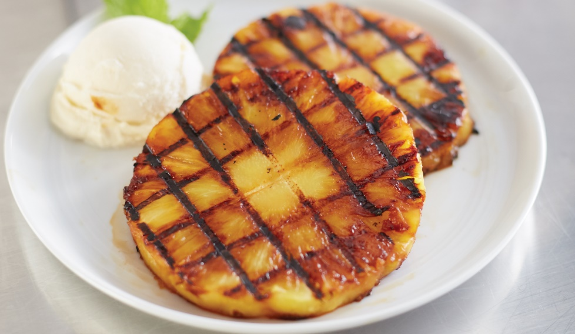
Grilling and broiling
Cook quickly—avoid breaking down structure of fruit
Coat with sugar or honey—produce caramelization
Cook on oiled pan or broiling platter
Notes:
When grilling or broiling fruits, you must cook them quickly to avoid breaking
down the fruit’s structure. Pineapples, grapefruit, bananas, and peaches are
all good fruits to grill or broil. Cut the fruits into slices, chunks, or halves, and
coat them with sugar or honey to add flavor or for caramelization (a browning
process). Place fruits to be grilled or broiled on an oiled sheet pan or broiling
platter. Only thick fruit slices need to be turned or rotated to heat fully.

Slide 36
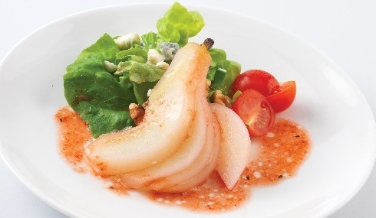
poaching
Cooked in simmering liquid
Use firm fruits to maintain shape
Often served as dessert
Famous dishes—peach Melba and pears belle Hélène
Notes:
Poached fruits are fruits that are cooked in simmering liquid. Therefore, use fruits
that are firm enough to hold their shape during poaching. This includes plums,
apples, peaches, and pears. Apples and pears can be cut into large pieces, but
other small fruit should remain whole. Some famous poached fruit dishes include
peach Melba and pears belle Hélène. Poached fruits are also often used in other
desserts as fillings or toppings.

Slide 37
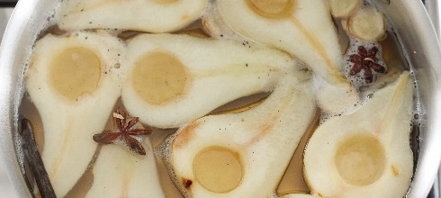
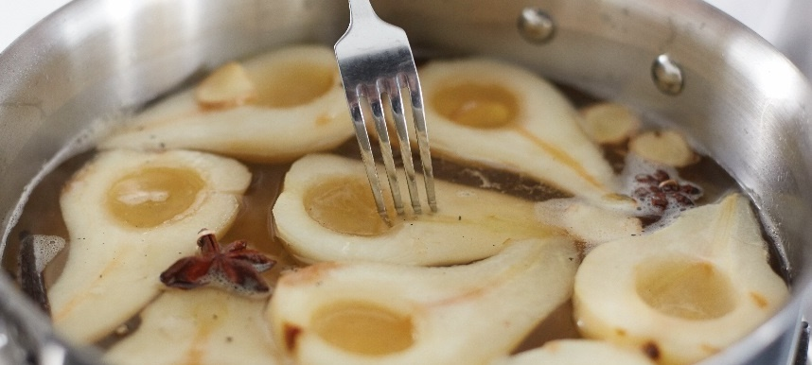
Poaching fruit
Prepare fruit
Combine with poaching liquid
  Cover fruit
  Bring to simmer
Reduce heat until tender
  Test doneness
Let fruit cool or serve immediately
Notes:
Prepare the fruit as necessary (seed, peel, etc.). The peel can be included with the fruit as it poaches to add flavor.
Combine the fruit with enough poaching liquid to cover the fruit and bring it just to a simmer.
Reduce the heat and gently poach the fruit until it is tender. Test the doneness by piercing the fruit with a sharp knife or fork.
There should be little or no resistance.
Let the fruit cool in the poaching liquid, or serve immediately.

Slide 38
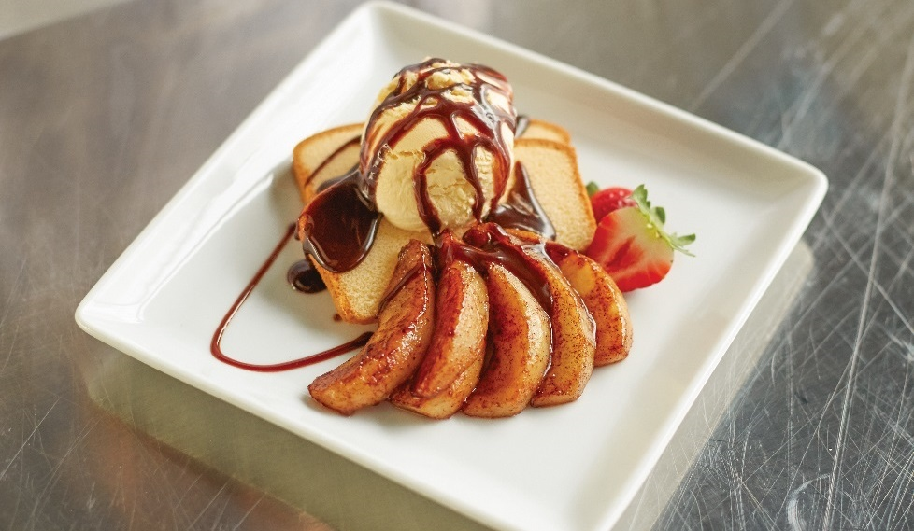
Sautéing
Cooked in butter, sugar, spices
Rich, syrupy flavor
Peel, core, and chop before cooking
Made from many fruits
Fruit sauces: applesauce, fresh berry coulis, compotes
Coulis
  Sauce made from puréed fruit
  Served hot or cold
Compotes
  Simmer fruit in sugar syrup
  Served warm or cold
Notes:
Fruit has a rich, syrupy flavor when sautéed in butter, sugar, and spices.
Cherries, bananas, pears, and pineapples are ideal for sautéing. When
sautéing fruit, peel, core, and seed the fruit and then cut it into uniform sizes.
Dessert fruits can be sautéed with sugar to create a caramelized glaze or syrup,
which can be used to fill crêpes or as toppings for sponge cakes. Recipes for
sautéed fruit that accompanies main entrées usually add onions, shallots, or
garlic to the mixture.
Fruit sauces can be made from a variety of fruits. Some of the most popular fruit
sauces include applesauce, fresh berry coulis (cool-LEE), and compotes. Coulis
is a sauce made from a purée of vegetables or fruits that can be served hot or
cold. Fruit coulis is most often used on desserts. Raspberry coulis, for example, is
especially popular with poached apples.
You may have seen a drizzle of a puréed, sweetened, and reduced fruit coulis
(usually made of berries) on dessert plates. Chefs like it because it can be
drizzled directly onto the plate to add excitement to the presentation. It can also
garnish the dessert itself. A bit of warning: A coulis can also be a distraction
from the dessert itself. Coulis should be an artistic way to apply an important
ingredient of the dish. Salvaging a less-than-perfect dessert or presentation with
a drizzle of berry sauce is not the idea.
Compotes can be made by simmering fresh or dried fruits, such as apricots,
currants, and raisins, in a sugar syrup. They are often served either warm or
chilled and topped with whipped cream, cinnamon, or vanilla sugar. Fresh
berry sauces can be made of cooked or raw fruit. They can also be used as a
base for dessert soufflés or as flavoring for Bavarian creams, buttercreams, and
other fillings and icings. Ideally, sauce should be made from fresh fruits, but a
good-quality sauce can be made by using unsweetened, frozen fruits.
Fruit sauces are made by cooking the fruit in liquid until the fruit has been
broken down. Then a sweetener, such as sugar, honey, or syrup, is added.
Once the sauce has cooled, spices and other flavorings are added to give it
the finishing touch.

Slide 39
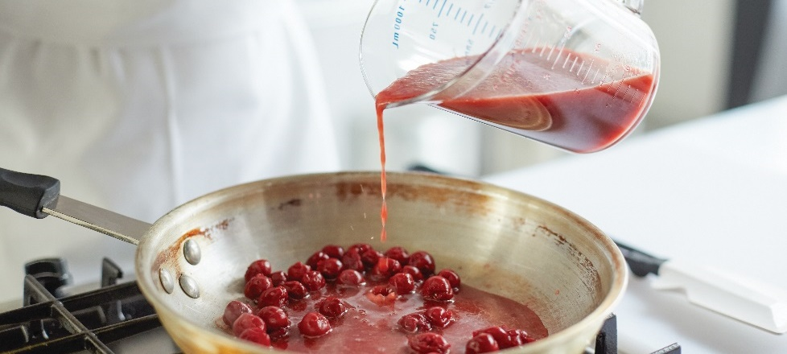
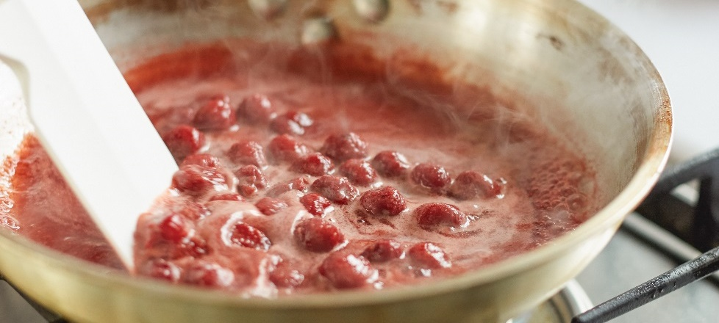
Making a fruit sauce
Peel and cut into small pieces
Add liquid
  Heat purée until almost boiling
  Lower to simmer
  Cover pan
Cook
  Stir occasionally
Sweeten as desired
  Sugar, honey, syrup
Add additional spices or other flavorings
Notes:
Peel the fruit and cut it into small pieces for faster cooking. Alternative: purée the fruit in a blender, food processor, or food mill,
or through a drum sieve.
Add the appropriate amount of liquid, and heat the purée in a saucepan until it is almost boiling. Lower the heat to a simmer, and
cover the pan.
Cook, stirring occasionally, until the fruit has broken down.
Sweeten as desired with sugar, honey, or syrup.
Add any additional spices or other flavorings, such as vanilla, once the sauce has cooled slightly.

Slide 40
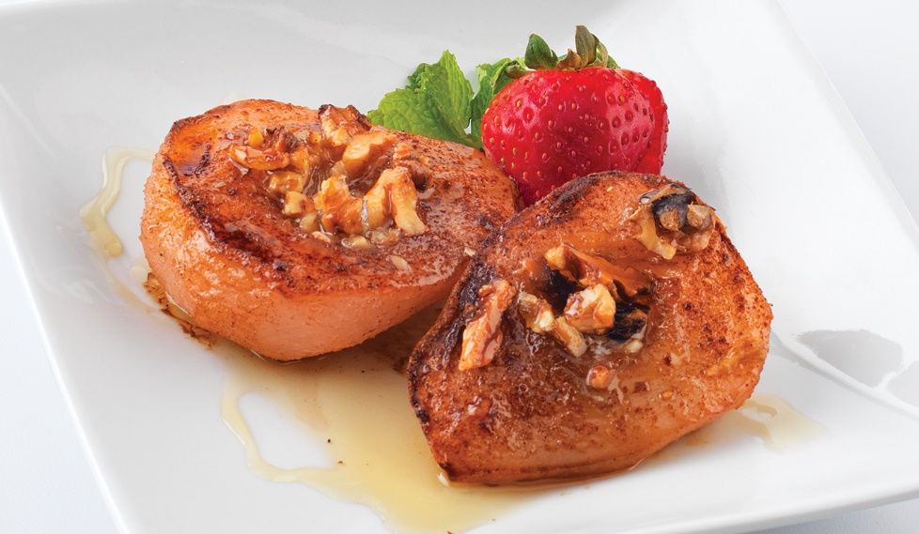
Baking and microwaving
Baking:
Use firm fruits
Apples most popular baked fruit
Microwaving:
Be careful—can overcook
Cover but leave opening for escaping steam
Puncture whole fruits to keep them from exploding
Notes:
Baking
Fruits can also be baked. When baking fruits, you should choose firm fruits
that are whole or cut into large pieces, such as apples, pears, and bananas.
Apples, especially the Rome Beauty variety, are the most popular baked
fruit because they are easy to prepare. Baked fruits are a healthy and
nutritious dessert.
Microwaving
When microwaving fruits, watch the cooking time carefully. It is easy to overcook
fresh fruits because they are so tender. Always cover fruits when microwaving
them, but leave a small opening from which excess steam can escape. When
cooking whole fruits, such as plums or pears, in the microwave, puncture them
with a fork in several places to keep them from bursting.

Slide 41
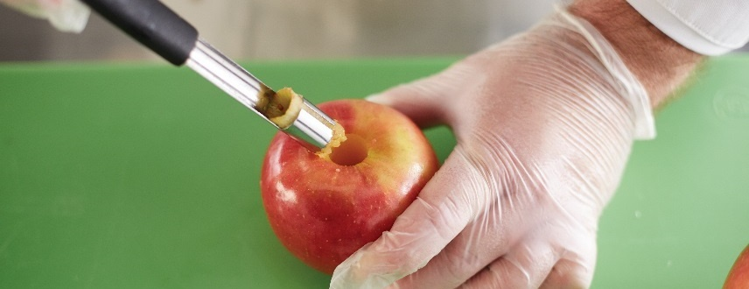
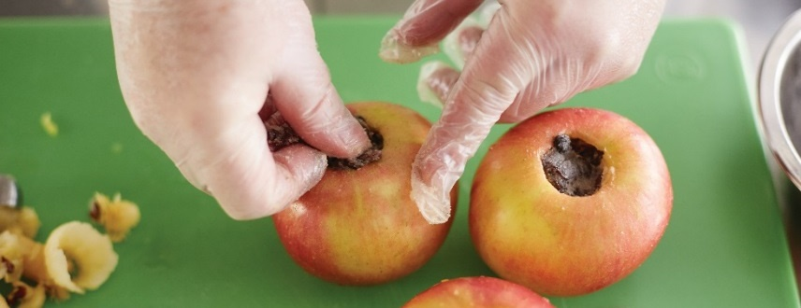
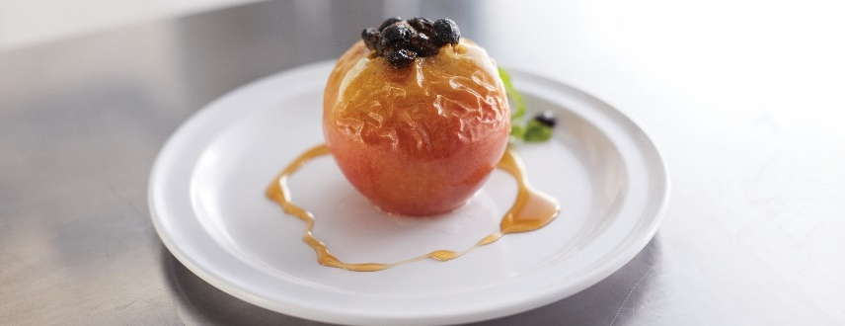
Baking apples
Core apples
Parisienne scoop or apple corer
  Cut thin strip of skin from apple middle
Fill apple’s core cavity
  Cinnamon, nutmeg, raisins, dates
Place apples in ¼ inch of hot water in baking dish
Bake at 350°F (177°C) until tender
  45 to 60 minutes
Notes:
Core apples from the top by removing the stem with a parisienne scoop or apple corer and scooping out the center of the fruit until all seeds are removed and the cavity is large enough to accommodate the desired amount of stuffing.
Cut a thin strip of skin from around the middle of each apple to prevent them from splitting during baking.
Fill each apple’s core cavity with cinnamon, nutmeg, raisins, or dates for variety and flavor.
Place the apples in ¼ inch of hot water in a baking dish.
Bake at 350°F (177°C) until tender, or about 45 to 60 minutes.

Slide 42

Serving fruits
Fruit plates or salads
Serve at room temperature
Used as garnishes on desserts or entrées
Notes:
Fruit plates and salads are a popular way to serve fruit. Serve fruit at room
temperature to make sure it has the best flavor. Fresh fruit can be served as a
garnish with entrées and desserts. For example, use fresh fruit to top cereal or
yogurt, add fresh berries on a chocolate cake, or add a slice of melon with an
omelet at breakfast.

