Slide 2
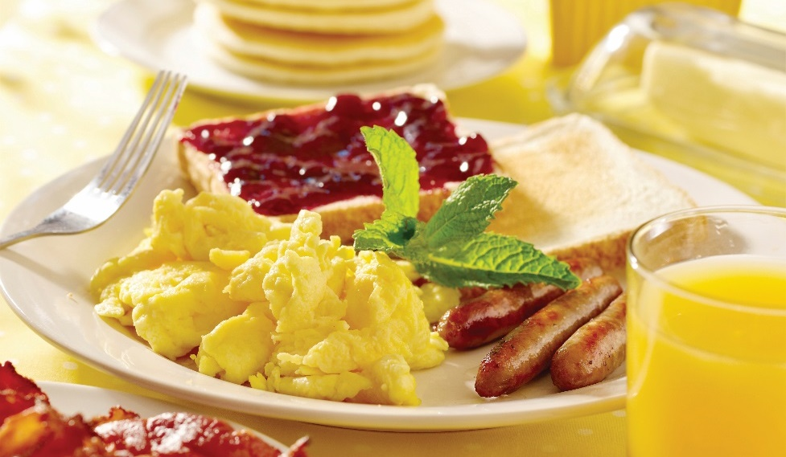
Breakfast Service
American service:
Plated in kitchen
Served individually on plates
Eggs, bacon, sausage, toast, coffee, tea, juice
Notes:
Breakfast food in general is usually wholesome and satisfying. And there are
many different types of breakfast items available. Interestingly, different countries
offer different types of breakfast food. In Europe, for example, you may eat
sliced cold meats, cheese, or yogurt. In Japan, you may eat miso soup, steamed
rice, and grilled fish. Americans tend to like cereals and egg-based dishes.
While the types of dishes vary across countries, the importance of the meal is
the same across the world.
In the United States, there are basically three types of breakfast service
offered: American, English, and Continental.
American service: This is often plated in the kitchen as ordered and served
to the guests individually on plates. It is the most common service used in
hotels and restaurants. Food may include eggs, sliced bacon, sausage,
bread or toast with jam/jelly/butter, pancakes with syrup, French toast,
coffee, tea, or juice.

Slide 3
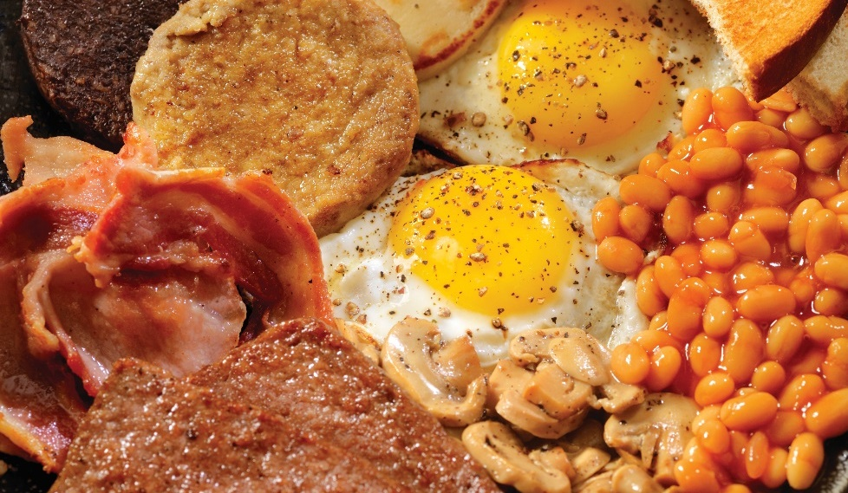
Breakfast Service
English service:
Plated in kitchen
Served on platters to host/hostess
Host/hostess serves food
Sausage, bacon, eggs, fried/grilled tomatoes, baked beans, kippers, mushrooms, fried potatoes
Notes:
English service: In this service, the kitchen staff is responsible for the
elaborate plating of many different breakfast items. The platters are then
presented to the host or hostess at the table. The host/hostess then portions
the food onto plates that are served to the guests. The food is often very high
in fat and calories. Sometimes, this type of breakfast is referred to as a “fry
up.” It includes sausage and bacon, eggs, fried bread, fried/grilled tomatoes,
baked beans, “black pudding” (sausage with oats, pork fat, and pig’s blood),
kidneys, kippers, mushrooms, and fried potatoes.

Slide 4

Breakfast Service
Continental service:
Simpler and self-service
Elements of American and English service
Includes bread, rolls, muffins, toast, cereal with milk, juice, coffee, tea
Notes:
Continental service: Generally, this is a simpler self-service breakfast—an adaptation
of the American and English breakfast service. It usually includes bread, rolls, muffin,
toast with jam/marmalade, cereal with milk, juice, and coffee or tea. Sometimes brioche
and croissants may be served. This evolved because many Europeans wanted a simpler,
lighter meal.

Slide 5
Breakfast Service
Brunch:
Includes breakfast and lunch menu items
Sometimes as buffet
Elements of American and English service
Notes:
Other types of breakfast service may include a brunch or a breakfast buffet.
Brunch includes breakfast and luncheon menu items and is sometimes served
as a buffet. It is usually served as a late breakfast and early lunch. Breakfast
buffets may include continental items or items commonly served in American or
English service.

Slide 6

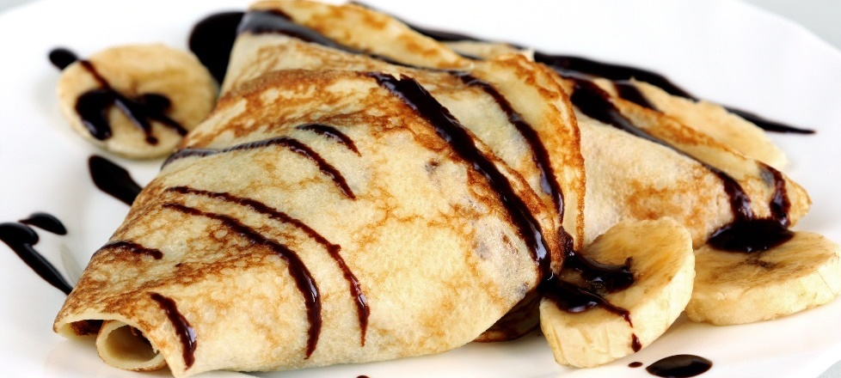
Pancakes, Crêpes, Waffles, and French Toast
Pancakes:
Made with medium-weight batter
Cooked on griddle
Crêpes:
Like pancakes
Thin with high egg content
Cooked on oiled griddle
Swedish pancakes are similar; slightly sweeter and heavier
Notes:
There are many types of breakfast food. Although some traditional foods have already been mentioned (eggs, bacon, toast, etc.), there are other popular choices. These include pancakes, crêpes (CRAPES or CREPPS), waffles, and French toast. The batters for these items are simple to make, and the products do not take long to cook.
Pancakes: Pancakes are made with a medium-weight pour batter and cooked on an open, lightly oiled griddle.
Crêpes: Crêpes are very thin pancake-type items with a high egg content. The result is a delicate, unleavened griddle cake. Crêpes are traditionally cooked in a lightly oiled, very hot sauté pan. Swedish pancakes can be made with a slightly sweetened batter that is a bit heavier than a crêpe batter. Cook these pancakes on a flat griddle or in a special fluted pan.

Slide 7
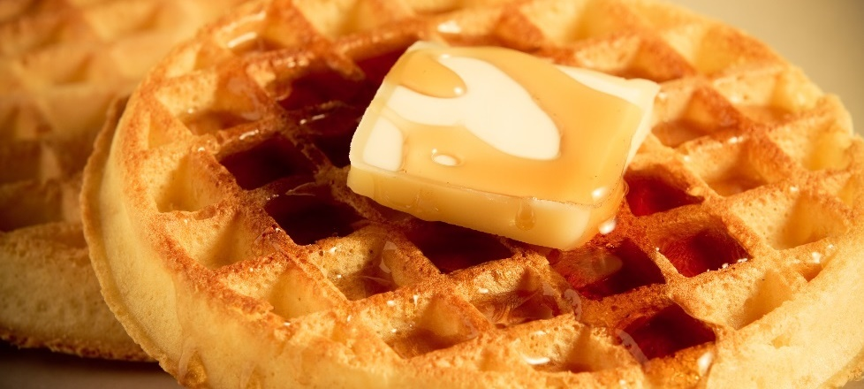
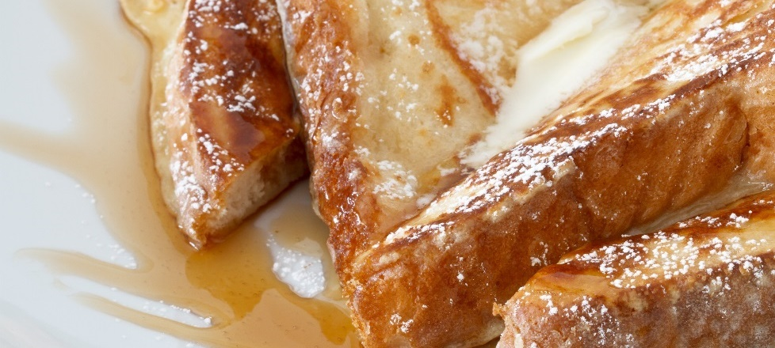
Pancakes, Crêpes, Waffles, and French Toast
Waffles:
Crispy on the outside, soft on the inside
Made with medium-weight batter
Cooked in waffle maker or iron
French toast:
Bread dipped in egg and milk
Can be seasoned
Cooked on griddle or pan
Notes:
Waffles: Waffles are usually of medium thickness and are crispy on the outside
and soft on the inside. Use a medium-weight pour batter similar to pancake batter,
but with more egg and oil. Cook waffles in a specially designed waffle maker, or
iron, that creates grid-like holes or specialty designs.
French toast: French toast is sliced bread (preferably a day old) dipped in an
egg-and-milk mixture. Chefs often season the mixture lightly with cinnamon and
nutmeg. Cook French toast on a lightly oiled griddle or flat pan, or pan-fry it in
clarified butter in a hot sauté pan.
Pancakes, crêpes, waffles, and French toast can be served with butter, various
syrups, powdered sugar, fresh fruit, fruit compotes, and/or whipped cream.
For additional variety, add ingredients such as chocolate chips or blueberries
to pancake or waffle batters.

Slide 8
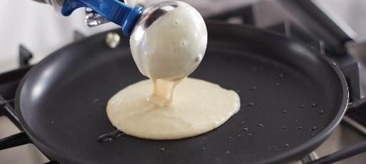
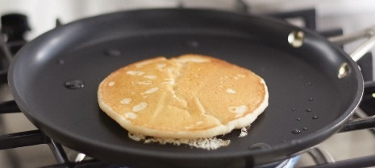
Making pancakes
Prepare batter
Let batter rest
  Heat pan or griddle
Coat pan or griddle
  Oil, clarified butter, nonstick spray
Notes:
Prepare the batter according to the pancake recipe.
While letting the batter rest, heat the pan or griddle.
Lightly coat the pan or griddle with oil, clarified butter, or a nonstick spray.

Slide 9
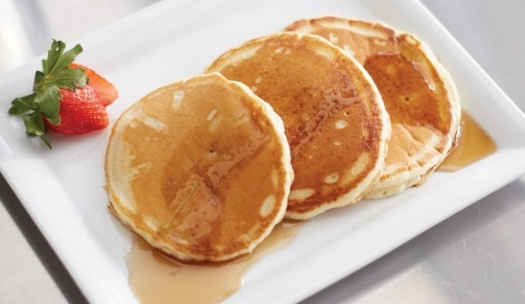
Making pancakes
Pour batter on hot surface
Flip once bottom is golden brown
Serve with syrup and fruit garnish
Notes:
When the surface is hot, pour the batter onto it.
When the bottom of the pancake is golden brown, flip once and cook it on the other side.
Serve finished pancakes with syrup and a fruit garnish, if desired.

Slide 10
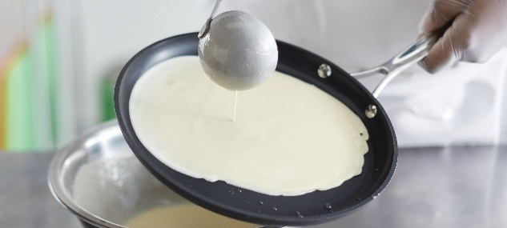
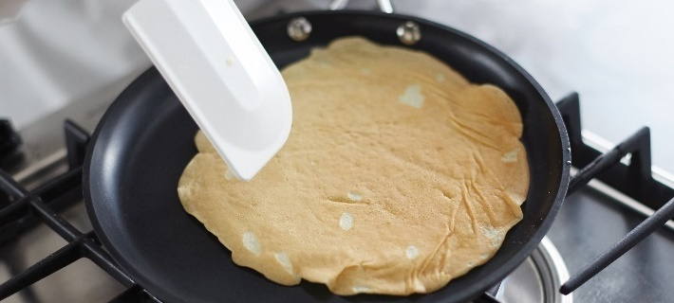
Making Crêpes
Prepare batter
Let batter rest
  Heat pan
Coat pan
  Oil, clarified butter, nonstick spray
Pour batter on hot surface
  Swirl batter—forms round shape up side of pan
Notes:
Prepare the batter according to the crêpe recipe.
While letting the batter rest, heat the crêpe/sauté pan.
Lightly coat the pan with oil, clarified butter, or a nonstick spray.
When the surface is hot, pour the crêpe batter onto it. Swirl the batter until it forms a round shape up the side of the pan.
Note that it is essential not to overpour the batter. Just use enough to coat the bottom of the pan.

Slide 11

Making Crêpes
Turn over and cook other side
Remove light-golden-brown crêpe
  Place on parchment-lined pan
Serve with fresh fruit or fruit compote
Notes:
Turn the item and completely cook it on the other side.
Remove the light-golden-brown crêpe and place it on a parchment-lined sheet pan to cool.
Serve finished crêpes with fresh fruit or a fruit compote.

Slide 12

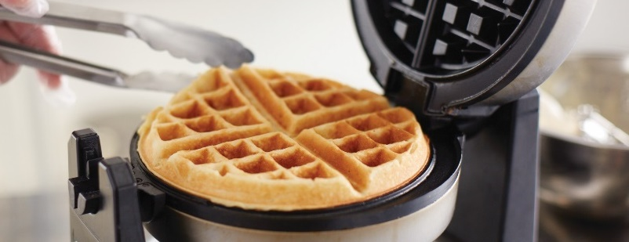
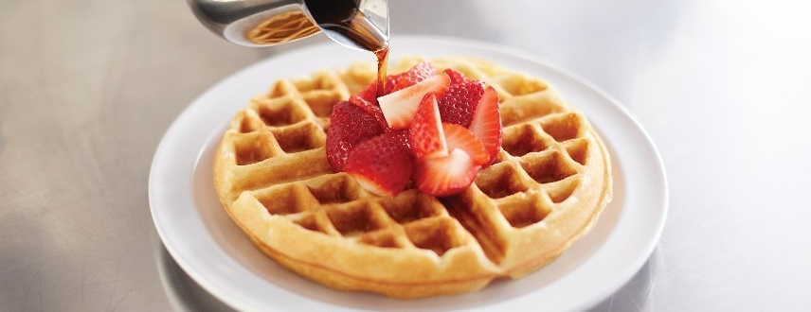
Making waffles
Prepare batter
Let batter rest
  Heat waffle iron
Coat waffle iron
  Oil, clarified butter, nonstick spray
Pour batter on hot surface
  Close waffle iron
Cook until golden brown
Remove and garnish appropriately
Notes:
Prepare the batter according to the waffle recipe.
While letting the batter rest, heat the waffle iron.
Lightly coat the waffle iron with oil, clarified butter, or a nonstick spray.
When the surface is hot, pour the batter onto it. Close the waffle iron.
Cook the waffle until it turns golden brown. Different waffle irons require different cooking times; adjust the timing as necessary.
Remove the waffle to a serving plate and garnish appropriately.

Slide 13
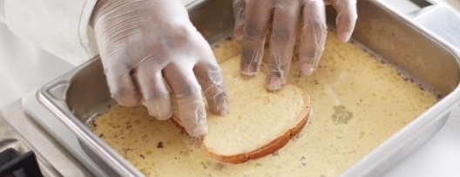
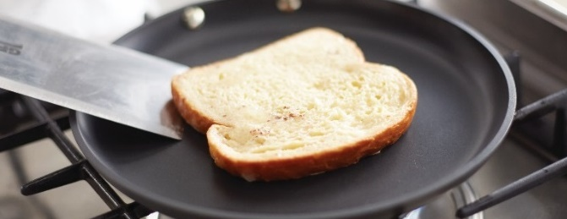
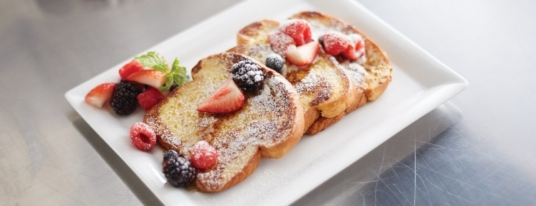
Making French toast
Prepare egg-milk mixture
Place mixture on ice bath
  Heat pan or griddle
Coat pan or griddle
  Oil, clarified butter, nonstick spray
Dip bread in mixture
  Coat both sides
  Place on heated surface
Cook until golden brown
  Flip and cook other side
Remove and garnish
Notes:
Prepare the egg-milk mixture according to the French toast recipe.
Place the egg-milk mixture into an ice bath to keep it cold; heat the pan or griddle.
Lightly coat the pan or griddle with oil, clarified butter, or a nonstick spray.
When the surface of the pan or griddle is hot, dip the bread in the egg-milk mixture, coating both sides. Then place it onto the heated surface.
Allow the bottom to cook until golden brown, then flip one time and completely cook it on the other side.
Remove the cooked French toast to a plate and garnish appropriately.
Note: French toast can be “stuffed”—filled with items such as fruit or flavored cream cheese.

Slide 14
Breakfast meats
Bacon and sausage:
Bacon: 70% fat, shrinks when cooked
Sausage—cook completely
Precooked to save time
Ham and Canadian bacon:
Ham: smoked or cured
Should be heated and browned
Canadian bacon: boneless pork loin, smoked or cured
Notes:
Operations often include breakfast meats, such as bacon, sausage, ham,
Canadian bacon, or hash, to complete the breakfast meal.
Bacon and sausage: Food preparers can cook bacon and sausage in advance.
Bacon is about 70 percent fat and shrinks quite a bit. It can be cooked until it is
crisp, and then drained of fat. Sausage should be cooked completely through—
slightly browned on the outside, but juicy on the inside. Some restaurant and
foodservice operations have begun using precooked bacon and sausage to
reduce labor cost and equipment requirements.
Ham and Canadian bacon: Ham for breakfast service is a smoked or cured item
that only needs to be heated and browned slightly on a griddle or under the broiler.
Canadian bacon is boneless pork loin that has been cured and smoked. It is cooked
the same way as ham—by heating and browning it. If ham and Canadian bacon are
held too long, it will reduce the quality of the food. It is important to cook them as
close to service as is practical.

Slide 15
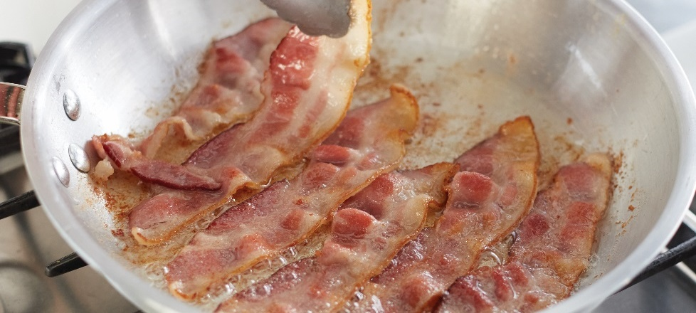
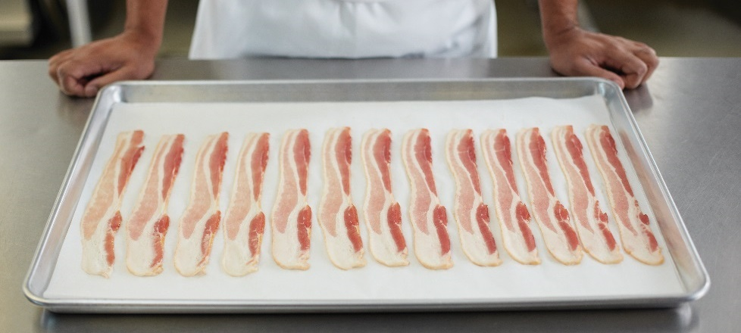
Cooking bacon
Cook in fry pan or griddle—medium heat
Place on sheet pans
  Bake at 375°F (191°C)
  Crisp and brown
Monitor and turn as needed
  Even cooking and browning
Notes:
Cook bacon in a fry pan or on a griddle over medium heat.
Alternatively, place bacon on sheet pans and bake it at 375°F (191°C) in a standard oven until it is crisp and brown as desired.
Monitor the bacon and turn it as needed to ensure even cooking and browning.

Slide 16
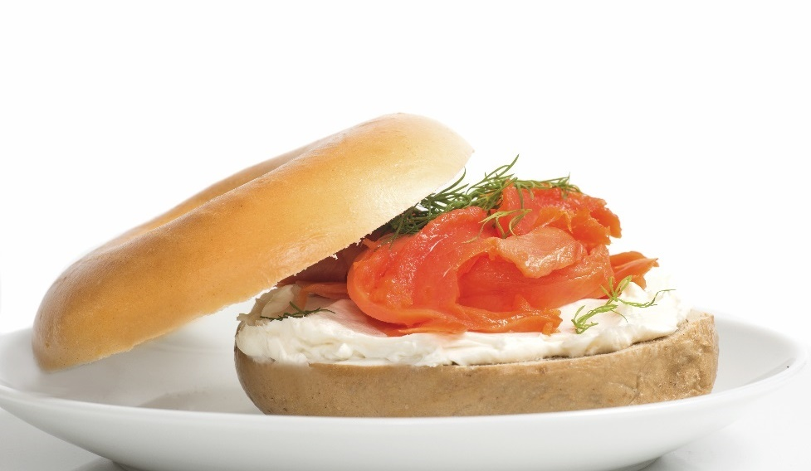
Breakfast meats
Fish:
Usually served cold
Smoked
Includes smoked salmon, trout, kippers
Hash:
Mixture of meat, potatoes, onions
Made with many different meats and vegetables
Fried in patties
Notes:
Fish: Foodservice operations often offer fish, such as smoked salmon (also
called lox) or trout, on breakfast and brunch menus. Generally, these items
are served cold. So all such fish items should remain properly refrigerated
until as close to service as possible. Items such as broiled trout are particularly
popular for breakfast at certain types of resorts. Kippers—whole herrings
that have been sliced in half from head to tail, gutted, salted or pickled, and
smoked—may be served in an authentic English “fry up” breakfast.
Hash: Hash is a mixture of chopped meat (fresh, smoked, or cured), potatoes,
and onions. For example, corned beef hash is one popular version. The ratio
of meat to vegetable is not an exact one, and the cook can include a wide
variety of vegetables to give the dish color and flavor. The goal of the dish
is to achieve a flavorful balance of meat, potatoes, and onion. Hash can be
prepared from leftover meat. The meat should always be of high quality;
otherwise, the result will not be a quality product. Hash is often formed into
patties and fried.

Slide 17
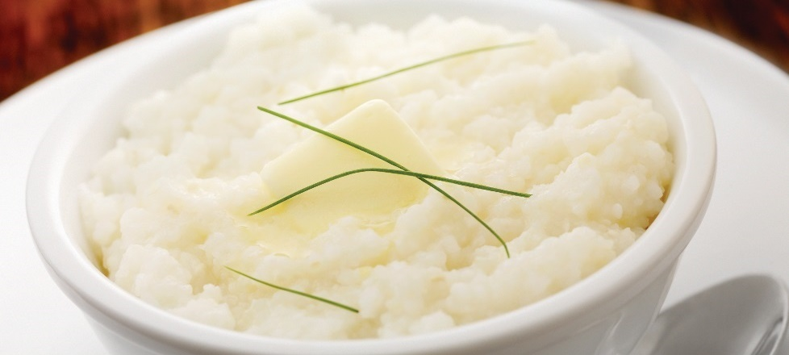
Breakfast starches and fruit
Grits:
Made from hominy
Boiled, seasoned, served with butter or sugar
Southern cuisine
Cereals:
Hot or cold
Served with milk, sugar, fruit
Hot cereal
  Whole, cracked, flaked grains: oatmeal, cracked wheat
  Granular grains: farina, cornmeal
Notes:
Starches and fruit are also a common part of breakfast service. Starches may
include cereals, breads, potatoes, grits, and others. Grapefruit, berries, melons,
and other fruits and fruit juices are common for breakfast.
Grits: Grits are made from a Native American ground corn called hominy. Grits
are usually boiled in water, seasoned with salt and pepper, and served with butter
or sugar. See Figure 4.10. They may be finished with cheese, bacon, sausage,
or red-eye gravy—a thin sauce that is made from pan drippings of sausage or
ham and black coffee. Grits are considered a staple in the southern United States.
“Charleston-style grits” are boiled in milk instead of water, which makes them creamy.
Similar to polenta, leftover grits are often cut into shapes and fried in oil, butter, or
bacon fat.
Cereals: Hot and cold cereals have become more popular as breakfast entrées.
They include a wide variety of choices, from wheat to oat bran to granola. Cold
cereals are simply served with milk or cream, sugar, and fresh fruit, such as
sliced bananas or strawberries. Cold, prepackaged cereals need no formal
preparation. There are two categories of hot cereal: (1) whole, cracked, or
flaked grains (oatmeal and cracked wheat) and (2) granular grains (farina and
cornmeal). When preparing hot cereal, be sure to measure the correct amount
of water, salt, and cereal according to package directions. Adding milk makes
the cereal creamier—and more expensive. When using milk, watch the pot to
make sure the milk does not boil or scorch it. Always add the cereal to the liquid
slowly, stirring constantly to prevent lumps. “Instant” hot cereals are precooked
and dried cereals that are reconstituted in hot water or milk. These cereals have
become popular in homes and commercial kitchens because they need little
preparation time and do not lump easily. To prevent hot cereals from drying out,
keep them covered until they are served. Oatmeal, cream of wheat or rice, grits,
and cornmeal mush are all typical hot cereals. Some kitchens, however, prefer to
make their own granola, often serving it with yogurt and fresh or stewed fruit.

Slide 18

Breakfast starches and fruit
Breads and pastries:
Toast common in U.S.
Can be served with butter, honey, jam
Bagels, biscuits, croissants, doughnuts, coffee cake
Potatoes:
Made into hashed brown potatoes and home fries
Cooked in oil and seasoned
Fruit:
Cereal, salad, juice
Grapefruit, banana, strawberry
Notes:
Breads and Pastries: One of the most common breakfast breads in the United States
is the simple slice of toast. Slices of toasted white, wheat, or sourdough breads, for
example, are served at many breakfast tables. Other examples of breakfast breads
and pastry options include bagels, biscuits, muffins, croissants, doughnuts, cornbread,
coffee cake, English muffins, and sweet rolls. See Figure 4.12. Chefs typically serve
breakfast breads hot or warm, accompanied by butter, honey, cream cheese,
marmalade, or jam.
Potatoes: Potatoes are prepared in a variety of ways for breakfast and brunch.
Most often chefs make them into hashed brown potatoes or home fries. Hashed
brown potatoes, or hash browns, are prepared by steaming or simmering the
potatoes in lightly salted water and then peeling, chilling, and shredding the potatoes.
The shredded potatoes are then cooked on a lightly oiled griddle on medium
heat to a light golden brown on both sides. Home fries are raw potatoes that
have been peeled and then sliced, diced, or shredded. They are cooked on a
well-oiled griddle, or pan-fried until golden brown and cooked through. While
cooking, season hash browns and home-fried potatoes well.
Fruit: A number of fruits are commonly associated with the breakfast table.
Halved grapefruit, either raw or broiled with brown sugar, is very popular on
breakfast menus. Although fresh fruits—whole or sliced, depending on the type—
may appear with cereals, many people enjoy a light fruit salad as part of breakfast.
Fruit compotes and fruit jams can add an attractive flavor and texture to the
breakfast table, especially when paired with bread or common breakfast
starches. Fruit juices, especially orange and tomato, are traditional at breakfast
service as well.

