Slide 2
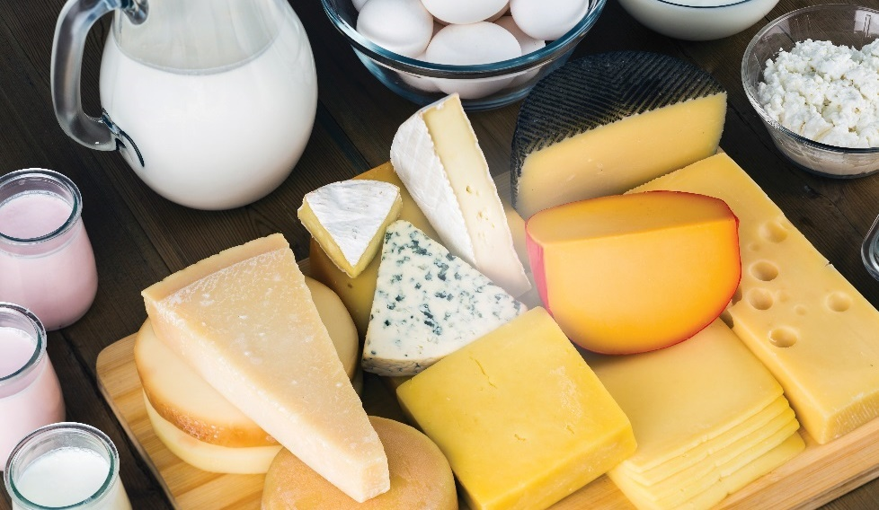
Dairy Milk and Milk Alternatives
Dairy milk comes from mammary glands of mammals
Usually processed to remove harmful bacteria
Two processes used on dairy products
  Pasteurization
  Homogenization
Lactose intolerance—common digestive problem
  Negative reaction
  Caused by all dairy products

Slide 3
Dairy Milk and Milk Alternatives
Pasteurization
  Milk heated to kill bacteria that cause spoilage and disease
  Doesn’t affect nutritional value
Homogenization
  Milk strained through fine holes to break down fat
  Blended into one fluid
Notes:
Dairy milk is milk that comes from the mammary glands of mammals, primarily
cows. Most milk products are processed to remove harmful bacteria that could
make people sick. Two processes applied to milk products are pasteurization
(pass-cher-i-ZAY-shun) and homogenization (huh-MAH-juh-ni-ZAY-shun):
Pasteurization: Milk is heated to kill microorganisms that cause spoilage
and disease without affecting its nutritional value. See Figure 3.1.
Homogenization: Milk is strained through very fine holes to break down
fat and then is blended into one fluid.
Table 3.1 shows types of dairy milk. The type of milk utilized is often based
on the nutritional value. Lactose-intolerant guests may want lactose-reduced or
lactose-free milk. Lactose intolerance is a common digestive issue that causes a
negative reaction to many cultured dairy products, not just milk.
It is also important to recognize that low-fat and skim milks behave differently
in cooking than whole milk does. Fat brings flavor, body, and mouthfeel to a
dish. If a chef reduces the fat in the milk, the ingredient will perform differently
in the recipe.

Slide 4
Types of Dairy Milk
Whole
  Fat content: at least 3.25%
  Closest to cow milk before processing
Low fat
  Fat content: 1% or 2%
  Creamy
  Not as rich as whole milk
Skim
  Fat content: less than 0.5%, usually 0.1%
  Least creamy
  Lowest in calories
Notes:
Whole: At least 3.25%—closest to the way milk comes from the cow before processing
Low fat: Available in 1% and 2%—creamy but not as rich as whole milk
Skim: Less than 0.5% (usually 0.1%) —least creamy and lowest in calories

Slide 5
Types of Dairy Milk
Buttermilk:
Fat content: depends on type of milk
From fresh liquid milk with added bacteria
Sour taste
Doesn’t contain butter
Rich texture and acid taste
Used in baking and prepared dishes
Notes:
Buttermilk Depends on the type of fresh milk used
• Made from fresh liquid milk that has bacteria added to it to create a sour taste
• Does not actually contain butter
• Has a rich, thick texture and tangy acid taste that is valued in baking and the preparation of many items, such as salad dressings

Slide 6
Types of Dairy Milk
Evaporated:
Fat content: at least 6.5%
Removes 60% of water from milk
Canned
Slight cooked flavor
Used in baking
Notes:
Evaporated: At least 6.5%
• Made from milk by removing 60% of the water
• Has a slight cooked flavor from its canning process
• Usually used in baking; helps bring richness without excess moisture

Slide 7
Types of Dairy Milk
Condensed:
Fat content: at least 8.5%
Richer and sweeter than evaporated milk
Removes 60% of water from milk and adds sugar
Used in baking
Take into account sugar and fat content of recipes when substituting for evaporated milk
Notes:
Condensed: At least 8.5%
• Tastes richer and sweeter than evaporated milk
• Made from whole milk by removing 60% of the water and then sweetening with sugar
• Used in specialty baking when richness and sweetness are desired
• Cannot replace evaporated or other milk products unless the recipe’s sugar content and fat content are adjusted

Slide 8
Types of Dairy Milk
UHT (ultra-high temperature):
Fat content: depends on type of milk
Processed with high heat, cooled, packaged in sterile environment
Doesn’t need refrigeration
Shelf life of nine months
Notes:
UHT (ultra-high temperature): Depends on the type of fresh milk used
• Processed with high heat, cooled, and then packaged in a sterile environment to avoid contamination
• Does not need refrigeration
• Has a shelf life of nine months

Slide 9
Types of Dairy Milk
Powdered:
Fat content: depends on type of milk
Made from whole or skim milk
Removes all water from milk
Serving cold can reconstitute flavor
Used in baking
Notes:
Powdered: Depends on the type of fresh milk used
• Usually made from whole or skim milk
• Made from milk by removing all of the water
• Can improve the reconstituted flavor by serving the milk very cold
• Often used in baking

Slide 10
Types of Dairy Milk
Lactose-free milk:
Fat content: depends on type of milk
Added enzymes to break down lactose
Lactose intolerant
Notes:
Lactose-free milk: Depends on the type of fresh milk used
• Made by adding enzymes to milk to break down the lactose
• Good choice for those who are lactose intolerant (have trouble digesting lactose)

Slide 11
Types of Plant-based Milk
Lactose intolerance not true milk allergy
Casein allergy is true protein-sensitive allergy
People with casein allergy must avoid all dairy products
Dairy alternatives are available
Notes:
While lactose intolerance is sometimes called a milk allergy, it is not one. Casein
is a protein found in milk. A casein allergy is a true protein-sensitive allergy, and
people with such an allergy must avoid all dairy food. Dairy alternatives, such
as soy, rice, almond, and coconut milk, can be used instead. Table 3.2 shows
types of plant-based milk.

Slide 12
Types of Plant-based Milk
Soy milk (nondairy):
Fat content: 4 grams of fat per 8-ounce serving (fortified)
Fortified with vitamins such as calcium, vitamin D, riboflavin
Offered in low-fat form
Rich texture and nutty flavor
Multiple flavors
Source of protein with no cholesterol
Notes:
Soy milk (nondairy): Four grams of fat per eight-ounce serving (fortified)
• Often fortified with vitamins (including calcium, and perhaps vitamin D and riboflavin) and offered in low-fat forms
• Has a slightly nutty flavor with a rich texture
• Is available in different flavors
• Good source of protein; has no cholesterol

Slide 13
Types of Plant-based Milk
Rice milk (nondairy):
Fat content: 3 grams or less of fat per 8-ounce serving
Fortified with vitamins such as calcium, vitamin D, riboflavin
Water, brown rice syrup, starch, thickeners
Sweet flavor and thin texture
Multiple flavors
Less protein than milk or soy milk
Notes:
Rice milk (nondairy): Three grams or less per eight-ounce serving
• Often fortified with vitamins (check for the addition of calcium, vitamin D, and riboflavin)
• Usually made with water, brown rice syrup, starch, and other thickeners
• Has a sweet flavor and a thin texture
• Is available in different flavors
• Has less protein than milk or soy milk

Slide 14
Types of Plant-based Milk
Almond milk (nondairy):
Fat content: 2 to 3 grams of fat per 8-ounce serving
Made from ground almonds and water
Low in calories and saturated fat
No cholesterol or lactose
Sweetened or flavored
Fortified with vitamins such as calcium, vitamin D
Notes:
Almond milk (nondairy): Two to three grams per eight-ounce serving
• Made from ground almonds and water
• Low in calories and saturated fat
• Contains no cholesterol or lactose
• May be sweetened and flavored (e.g., chocolate, vanilla)
• Often fortified with calcium and vitamin D

Slide 15
Types of Plant-based Milk
Coconut milk (nondairy):
Fat content (thick): 20% to 22%
Fat content (thin): 5% to 7%
Made from brown coconut and water
Sweet taste, no coconut smell
Baking and cooking
Notes:
Coconut milk (nondairy): Thick: 20% to 22%; Thin: 5% to 7%
• Made from grated brown coconut and water
• Mild, sweet taste, with little or no coconut smell
• Often used in baking and cooking

Slide 16
Creams
Contains more fat than milk
Used in cooking because of fat content
Stable when whipped if more than 30% fat
Different types of cream
Notes:
Cream contains far more fat than milk. Chefs use it primarily for the fat content,
which provides richness. Creams with more than 30 percent fat are stable when
whipped. They add elegance and flavor to many desserts. Heavy creams also
bring richness and a silky texture to sauces and dressings. Table 3.3 shows
common types of cream.

Slide 17
Types of Cream
Light whipping cream
  Fat content: 30% to 36%
  Sauces, soups, dessert garnishes
Heavy whipping cream
  Fat content: 36% to 38%
  Whipped cream
Very heavy whipping cream
  Fat content: 40%
  Greater yield to products
  Longer shelf life
Notes:
Light whipping cream: At least 30% but less than 36%—used in sauces and soups, and as a garnish for desserts
Heavy whipping cream: 36% to 38%—used to make whipped cream
Very heavy whipping cream: 40%—produces a greater yield and a longer shelf life for the products made with it

Slide 18
Types of Cream
Light cream
  Fat content: 18% to 30%
  Coffee cream
Half-and-half
  Fat content: 10.5% to 18%
  One part milk to one part cream
Notes:
Light cream: 18% to 30%—sometimes called coffee cream
Half-and-half: 10.5% to 18%—one part milk/one part cream; technically half-and-half does not have enough
fat in it to be called cream

Slide 19
Cultured Dairy Items
Dairy products that have undergone fermentation
Buttermilk, yogurt, sour cream, crème fraiche
Fermentation: adding bacterial cultures to product and then heating
Usually uses lactic acid bacteria (lactobacillus)
Lowers lactose and pH of milk, producing sour taste
Changes flavor and extends shelf life
Probiotic: food item containing live bacteria
Notes:
Cultured dairy items may include buttermilk, yogurt, sour cream, and crème
fraîche (a soured cream with butterfat, pronounced “krem fresh”). Sometimes
referred to as “fermented” dairy products, these food items have undergone
a process called fermentation. What happens to milk during fermentation?
Bacterial cultures are added to the milk. Many of these products are fermented
with lactic acid bacteria, or lactobacillus. The mixture is then heated to around
110°F (43°C) for several hours. The bacteria eat the sugar (lactose) in the milk.
This lowers the pH level of the mixture. The low pH level causes the “sour” taste
we associate with yogurt, sour cream, and buttermilk. Fermentation changes the
flavor and extends the shelf life of the food. The extended shelf life allows the
item to be kept longer and ensures safer food.
There has been a lot of talk about the health benefits of cultured dairy products.
The term probiotic refers to a dietary supplement containing live bacteria (as
lactobacilli) that is taken orally to restore beneficial bacteria to the body. There
have been many claims about the health benefits of taking probiotics. However,
not much scientific evidence exists to prove these claims. Table 3.4 shows the
common types of cultured dairy items.

Slide 20
Cultured Dairy Items
Buttermilk
  Fat content: 1% to 2%
  Liquid left after churning butter
  Cultured buttermilk fermented using lactic acid bacteria
  Can separate
Yogurt
  Fat content: 0.5% to 4%
  Flavored with fruit
  Source of protein
  “Greek” variety has twice as much protein and more fat per serving
Notes:
Buttermilk: 1% to 2%
• Traditional buttermilk is the liquid left after churning butter out of cream
• Cultured buttermilk has been fermented using lactic acid bacteria
• Can separate as it sits; shake before use
• Also available in a powdered form
Yogurt: 0.5% to 4%
• Many varieties are flavored with fruit
• Source of protein
• Often consumed by vegetarians
• “Greek” variety has twice as much protein as regular yogurt; 15–20 grams per serving
• “Greek” yogurt is higher in fat

Slide 21
Cultured Dairy Items
Sour cream
  Fat content: 18% to 40%
  Available in “light,” “low-fat,” “fat-free”
Crème fraîche
  Fat content: 30% to 45%
  Thinner, less sour, higher fat content than sour cream
Notes:
Sour cream: 18% to 40%—available as “light,” “low-fat,” and “fat-free”
Crème fraiche: 30% to 45%—unlike U.S. sour cream, it is less sour and thinner, with a
higher fat content

Slide 22
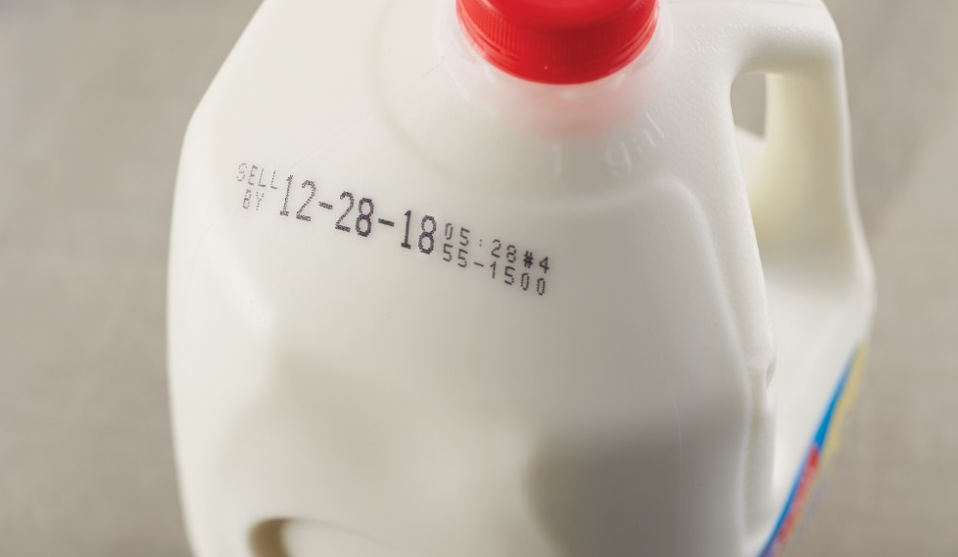
Receiving and Storing Milk, Cream, and Cultured Dairy Items
Milk
  Receive at 45°F (7°C) or lower
  Cool to 41°F (5°C) or lower within 4 hours
Cream and other dairy products
  Receive at 41°F (5°C) or lower
All dairy products labeled “Grade A”
Use FIFO
Throw away products passed use-by, sell-by,
or expiration dates
Notes:
Milk can be received at 45°F (7°C) or lower. Then it must be cooled to 41°F
(5°C) or lower within four hours. Cream and other dairy products must be
received at 41°F (5°C) or lower. All milk, cream, and cultured dairy products
should be labeled “Grade A.” This means that the product meets standards
for quality and safety set by the FDA and the U.S. Public Health Service. Milk,
cream, and cultured dairy products should have a sweetish flavor. Items that are
too sweet or that have a sour, bitter, or moldy taste should be thrown out.
Always use the FIFO (first-in, first-out) method of stock rotation for these
dairy products. With the FIFO method, store products to ensure that the older
products are used first. For example, place products with an earlier use-by or
expiration date in front of products with later dates. Any dairy product that
has passed its use-by, sell-by, or expiration date should be thrown away.

Slide 23
Butter and Butter Substitutes
Best grades—Grade AA or Grade A
Adds flavor, richness, smoothness
Mix cream with 30% to 45% milkfat at high speed
Butter must contain at least 80% butterfat
Two types:
  Sweet butter—pasteurized cream
  Cultured butter (European butter)—fermented cream, higher butterfat, lower salt
Notes:
Different types of butter are chosen based on their flavor and consistency. The
best grades of butter are either Grade AA or Grade A. Butter is most commonly
used to add flavor, richness, or smoothness to a dish.
Butter is made by mixing cream containing between 30 percent and
45 percent milkfat at a high speed. The finished butter must contain at least
80 percent butterfat content. The remaining 20 percent of the butter is milk
solids and water:
Sweet butter is butter made only from pasteurized fresh cream. It is
typically pale yellow and may be salted or unsalted.
Cultured butter (European butter) is made from fermented cream and has
a higher butterfat content and lower salt content than regular butter.
While butter has traditionally been produced in sticks or blocks, spreadable
butter and whipped butter are now available. Both have been chemically
formulated to spread more easily.

Slide 24
Butter and Butter Substitutes
Sticks or blocks
Salted or unsalted
No more than 2% salt
Clarified butter—heated, milk solids and water removed
Higher smoke point
Butter substitute—margarine, olive oil, coconut oil
Notes:
Butter is available salted or unsalted. Most commercially sold butter is lightly
salted. Manufacturers add salt to butter as a preservative and sometimes to
enhance flavor, but butter should contain no more than 2 percent salt. Chefs
often use unsalted butter in desserts and some cooking, because it gives them
more precise control over the amount of salt in a dish.
In cooking, butter is often clarified, which means either the chef or the
manufacturer has heated it and removed the milk solids and water. Clarified
butter is better for many cooking processes because the milk solids in whole, or
unclarified, butter burn easily. The point at which an oil or fat begins to burn is
called the smoke point. Clarified butter has a higher smoke point, which makes
it less likely to burn when heated.

Slide 25
Butter and Butter Substitutes
Margarine:
Usually contains no milk products
Made of vegetable oils and animal fats
Similar fat content to butter
Solid form most popular
Liquid form used in cooking
Notes:
A butter substitute is any alternative used to replace butter in a recipe.
Examples include margarine, olive oils, coconut oil, and soy-based oils, which
are all used to avoid cholesterol, but not fat. (Some of these alternatives are
more heart healthy than butter, but still flavorful.) Additionally, rice-based oils
have less fat content and less cholesterol.
Margarine is one of the most common butter substitutes, but it is a manufactured
food product that often contains no milk products. Margarine is made of
vegetable oils and animal fats with added flavoring, emulsifiers, colors,
preservatives, and vitamins. Contrary to what many people believe, margarine
is not much lower in fat than butter. At least 80 percent of margarine’s calories
must come from fat. Solid margarine is the most popular form. Liquid margarine
is often used in sautéing and grilling. One benefit of margarine is that it usually
has a higher smoke point than butter.
Both butter and margarine must be stored in tightly sealed containers to prevent
them from absorbing the flavors of other foods.

Slide 26
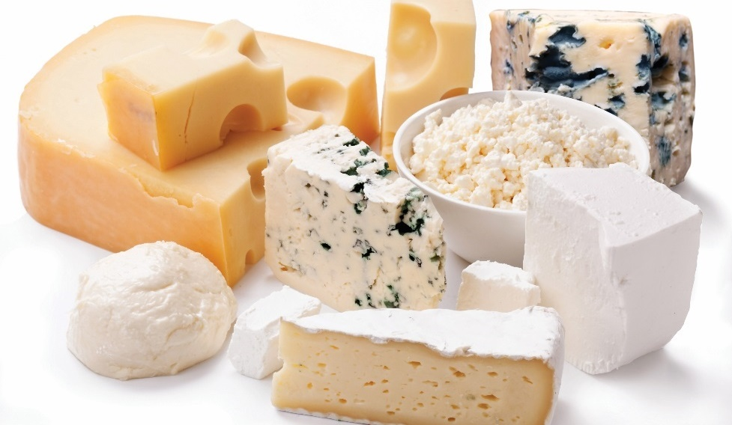
Cheese
Three basic parts:
  Water
  Fat
  Protein
Separate milk’s solids from liquid (whey)—curdling
Ripened or unripened
Processed cheese is ground, blended, formed, pasteurized
Notes:
All cheeses have three basic parts: water, fat, and protein. The amounts vary
depending on the type of cheese. Several varieties of cheese are shown in
Figure 3.3. For example, cottage cheese can have up to 80 percent water
and little fat. On the other hand, a hard cheese like Parmigiano-Reggiano
(Pahr-muh-ZHAH-noh – Reh-jee-AH-noh) might have as little as 30 percent
water, but a high percentage of fat.
Dairies make cheese by separating a milk’s solids from its liquid, or whey,
in a process called curdling. The proteins, or curds, that form are then usually
processed in some way to make a particular type of cheese. A wide variety
of processing techniques, ripening methods, and types of milk are used to
make cheese.
Cheese can be unripened or ripened. Unripened, or fresh, cheeses include
cream cheese and cottage cheese. Unripened cheeses are soft and have a high
moisture content. Ripened cheeses are aged with the modification of added
ripening agents, which give the cheese its unique features, such as taste and
texture. Some cheeses are ripened by external bacteria put into curds (e.g., Brie,
bleu, Roquefort, Camembert). Others are ripened by bacteria naturally present
in the curds (e.g., Swiss, Havarti). Because curdling separates the solids from
the lactose portion of milk and the aging process changes the remaining lactose
into easily digested lactic acid, lactose-intolerant people can eat ripened cheese.
The varieties of cheese range from mild to sharp to extra sharp. Table 3.5
provides a comparison of a variety of cheeses.
Manufacturers make processed cheese by grinding, blending, and forming
one or more natural cheeses. Emulsifiers help to make the product uniform.
Processed cheese is also pasteurized to prevent it from aging. It can have many
flavors, including port wine, herbed, and plain processed (such as American).
The taste is usually mild compared to aged cheese.

Slide 27
Varieties of Cheese
Unripened, fresh:
Soft and white
Eat soon after purchase
Cottage cheese, cream cheese, ricotta, chèvre, mascarpone
Notes:
Unripened, fresh
• Soft and white
• Should be eaten soon after purchase
Cottage cheese
Cream cheese
Ricotta
Chèvre
Mascarpone

Slide 28
Varieties of Cheese
Soft-ripened:
Ripened from rind to center
Powdery white or golden orange rinds
Semisoft to creamy
Mold and bacterial cultures give flavor and texture
Brie, Camembert, Boursin
Notes:
Soft-ripened
• Ripened from the outside (or rind) into the center
• Rinds are powdery white or golden orange
• Can be semisoft to creamy in texture
• Mold and bacterial cultures provide flavor, body, and texture
Brie
Camembert
Boursin

Slide 29
Varieties of Cheese
Semisoft, ripened:
Mild cheese, buttery flavor
Smooth texture
Ripened from interior, sometimes from surface
Gouda, Muenster, fontina, Havarti, Monterey Jack
Notes:
Semisoft, ripened
• Mild cheeses, some with buttery flavor
• Smooth, sliceable texture
• Ripened outward from the interior and sometimes ripened from the surface
Gouda
Muenster
Fontina
Havarti
Monterey Jack

Slide 30
Varieties of Cheese
Blue-veined, mold-ripened:
Blue or green mold injected into cheese before it ages
Creamy texture
Strong flavor
Maytag Blue, Gorgonzola, Roquefort, Stilton
Notes:
Blue-veined, mold-ripened
• Mold is injected or sprayed into the cheese to spread throughout it while it ages (typically blue or green)
• Creamy texture and a somewhat strong flavor
Maytag Blue
Gorgonzola
Roquefort
Stilton

Slide 31
Varieties of Cheese
Firm, ripened:
Bacterial cultures ripen cheese
Curing takes long time
Firm texture, mild to sharp flavor
Cheddar, Gruyère, Emmenthal, Colby, Swiss
Notes:
Firm, ripened
• Bacterial cultures help to ripen the cheese, and curing usually takes a long time
• Firm texture
• Mild to sharp flavor, depending on how long it has been aged
Cheddar
Gruyère
Emmenthal
Colby
Swiss

Slide 32
Varieties of Cheese
Very hard, ripened:
Bacterial culture and enzymes ripen cheese
Slow process, more than two years
Hard, dry texture
Asiago, Parmigiano-Reggiano, Pecorino Romano, Cotija
Notes:
Very hard, ripened
• Ripened with bacterial culture and enzymes
• Very slow process (at least two years in most cases)
• Hard and dry texture; good for grating
Asiago
Parmigiano-Reggiano
Pecorino Romano
Cotija

Slide 33
Varieties of Cheese
Pasta filata:
Curds stretched under warm whey
Plastic texture
Mild, sharp, salty, sweet, buttery
Fresh mozzarella, mozzarella, provolone, string
Notes:
Pasta filata (Italian for "spun paste")
• Curds are stretched and pulled under warm whey, giving them a plastic texture
• May be stored in brine
• Flavor ranges from mild to sharp, salty, sweet, and buttery
Fresh mozzarella
Mozzarella
Provolone
String

Slide 34
Eggs
Outer shell, white (albumen), and yolk
White—protein and water
Yolk—protein, fat, lecithin (natural emulsifier/thickener)
Chalazae—membranes that hold yolk in place

Slide 35
Eggs
USDA grades eggs AA, A, B
Buy Grade AA and Grade A where appearance is important
Grade AA
  Yolk is high
  White won’t spread
Grade A
  Similar to Grade AA
  Clean, unbroken shells
Grade B
  Usually refrigerated or frozen
  Used where appearance doesn’t matter
Notes:
There are USDA grades for shell eggs—Grades AA, A, and B. Buyers purchase
the top two grades (Grade AA and Grade A) for menu items in which the egg’s
appearance is important. A USDA Grade AA egg means that the yolk is high and
the white will not spread much when the shell is broken. A USDA Grade A egg
means that the yolk is fairly high and the white will still not spread too much when
the shell is broken. Both Grade AA and A eggs have generally clean, unbroken
shells. Grade B eggs are not usually purchased fresh by operations, but they
might be bought refrigerated or frozen. Grade B eggs are good for use in menu
items that will hide their appearance, such as baked items. As eggs age, they lose
density. This means the thick part of the white becomes larger, and the egg spreads
over a larger area when it is broken. Figure 3.6 shows the differences in how eggs
should look according to grade.

Slide 36
Egg Size
Eggs come in different sizes
Most recipes based on large eggs
Size and grade determine cost
Egg size
  Jumbo
  Extra large
  Large
  Medium
  Small
  Peewee
Notes:
Buyers must choose eggs by size—ranging from peewee (15 ounces per dozen)
to jumbo (30 ounces per dozen). Figure 3.7 shows the range of actual egg sizes.
Many operations use large eggs (24 ounces per dozen) for all purposes. In fact,
most recipes are based on this size. Size and grade together determine the cost of
eggs. What if the recipe calls for jumbo eggs and you only have medium eggs in
stock? You will find that many recipes call for a certain number of ounces of egg.
So, if you know how many ounces are in a jumbo egg and a medium egg, you
can calculate how many medium eggs you will need to equal the amount called
for in the recipe.
Young hens produce smaller eggs, which are generally of a better quality than
larger eggs. Medium eggs are best for breakfast cooking because the appearance
of the cooked eggs is important.
Eggs come in a variety of forms, as shown in Table 3.6 on the next page.
Like all purchased items, evaluate and order eggs based on characteristics
such as their color, form, packaging, intended use, and preservation method.
Figure 3.8 shows fresh eggs, an egg substitute, and dried eggs.

Slide 37
Market Forms of Eggs
Fresh (shell) eggs
  Breakfast cooking or when whole shell egg is needed
  Use pasteurized—high-risk population or uncooked dishes
Frozen eggs
  Made from high-quality fresh eggs
  Scrambled eggs, omelets, French toast, baking
  Pasteurized and sold in 30-pound cans or cartons
  Two days to thaw
  Whole eggs, whites, yolks, whole eggs with extra yolks
Notes:
Fresh (shell) eggs: These are most often used for breakfast cooking or instances in which a whole shell egg is required.
Use pasteurized shell eggs if the operation mainly serves high-risk populations, such as those in hospitals or senior care
centers, or when making hollandaise sauce, poached eggs, or any other dish calling for eggs that are not fully cooked.
Frozen eggs
• Whole eggs
• Whites
• Yolks
• Whole eggs with extra yolks
Frozen eggs are usually made from high-quality fresh eggs and are excellent for use in scrambled eggs, omelets,
French toast, and baking. They are pasteurized and are usually purchased in 30-pound cans or milk carton–style
containers. Frozen eggs take at least two days to thaw at refrigerated temperatures.

Slide 38
Market Forms of Eggs
Dried eggs
  Baking
  Not good for breakfast cooking
  Whole eggs, yolks, whites
Egg substitutes
  May be egg-free
  Egg whites, dairy/vegetable products instead of yolks
  Low in cholesterol
Organic/other alternatives
  Humanely-raised chickens
  May be certified by USDA
  Vegetarian eggs, Omega-3 eggs
Notes:
Dried eggs
• Whole eggs
• Yolks
• Whites
Use dried eggs primarily for baking. They are not good for breakfast cooking.
Egg substitutes: Egg substitutes may be entirely egg-free or made from egg whites, with dairy or vegetable products substituted
for the yolks. These substitutes are important for people with cholesterol-free diet requirements.
Organic and other alternatives: Many guests now look for organic products and/or products that indicate humane treatment of the animals
that produced the items. Organic eggs come from chickens that have been raised without the use of antibiotics, pesticides, or hormones.
Some organic eggs receive certification through the USDA’s National Organic Program, which confirms the processes used by the producer.
Hens that are fed only vegetable-based food products produce vegetarian eggs. Omega-3 eggs are another kind of egg that has become
common in the market. Eggs naturally have some omega-3 fatty acids, but some egg companies feed their hens special diets to ensure their
eggs have even more of the substance.

Slide 39
Receiving and Storing Eggs
Receive at 45°F (7°C) or lower
Store at 41°F (5°C) or lower
Frozen eggs should stay frozen
Shell egg criteria
  No odor
  Clean and unbroken shells
Pasteurized and USDA inspected

Slide 40
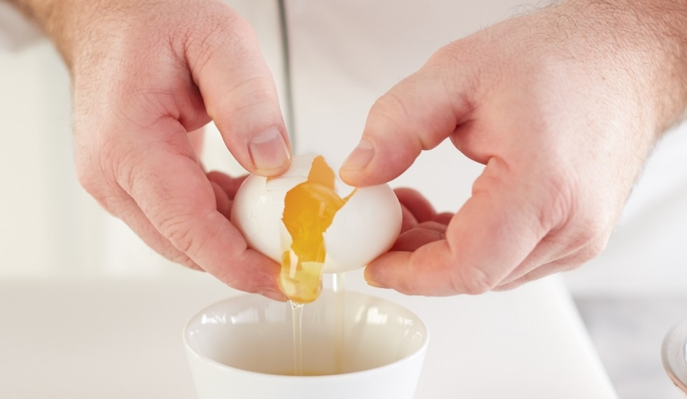
Cooking Eggs
Hard-cooked eggs:
Simmer and shock the eggs
Don’t boil
Breakfast, cold hors d’oeuvres, canapés, salads, garnishes
Shirred eggs:
Baked in ramekin or flat-bottomed dish
Combine with other ingredients
Baking dish affects texture of egg

Slide 41
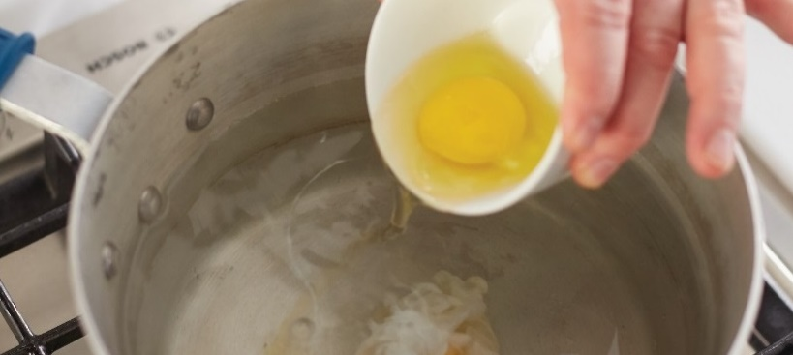
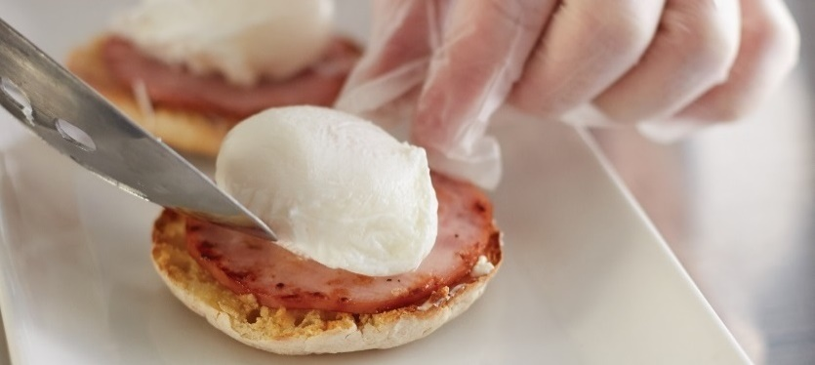
Cooking Eggs
Poached eggs:
Remove shells, simmer in water
Tender and well-shaped
Eggs Benedict, eggs Florentine, toppings
Notes:
For poached eggs, shell the eggs (remove from the shell) and simmer the eggs
in water. A properly poached egg should be tender and well-shaped, meaning
the yolk is centered and the white is not rough or ragged.
Poached eggs are popular in classic dishes such as eggs Benedict (a half
English muffin topped with Canadian bacon, ham, or bacon; a poached egg;
and hollandaise sauce) and eggs Florentine (similar to eggs Benedict, but with
spinach instead of or underneath the meat). Poached eggs are also used as
a topping, such as for hash (meat chopped into small pieces and cooked a
second time, usually with chopped potatoes).
ESSENTIAL SKILLS: POACHING EGGS
Combine water, salt, and vinegar in a shallow skillet or pan and bring it to a simmer.
Break the eggs into a clean cup, and then slide the eggs carefully into the poaching water. Cook until the whites are set and opaque.
Remove the eggs from the water with a slotted spoon and blot them on a single-use paper towel.
Trim, if desired, and serve hot.

Slide 42
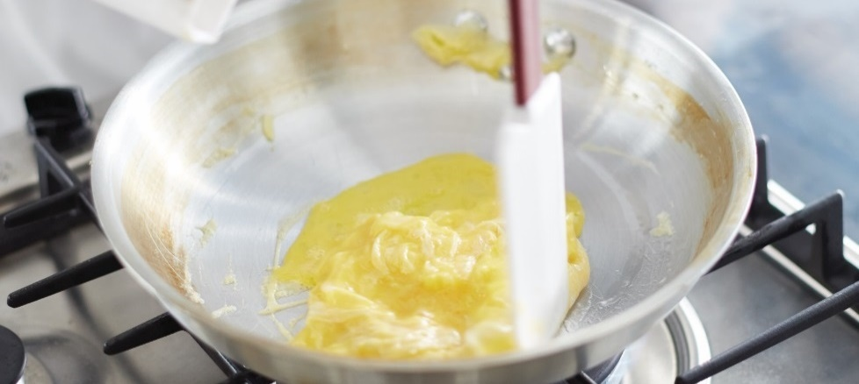
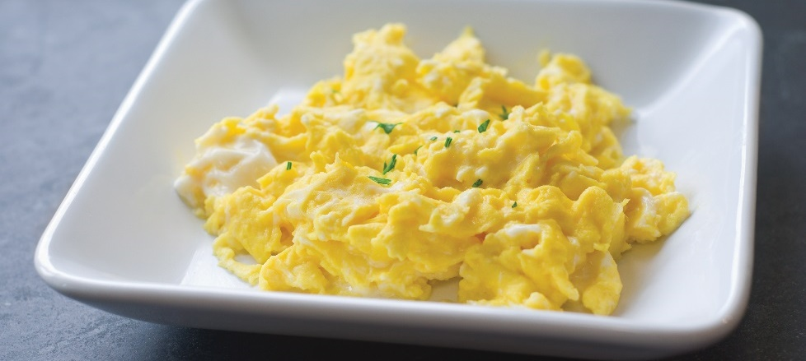
Cooking Eggs
Scrambled eggs:
Light, creamy texture
Best served hot
Combine yolks and whites before cooking
Notes:
Scrambled eggs should have a light texture, creamy consistency, and delicate
flavor. They are best when served very hot. Blend the eggs just until the yolks
and whites are combined, and then add any seasonings. Cook scrambled eggs
over gentle heat while constantly stirring and scraping from the bottom and
sides of the pan to keep them creamy and prevent them from burning.
ESSENTIAL SKILLS: SCRAMBLING EGGS
Beat eggs until they are well blended (see Figure 3.15a); if adding milk, the standard proportion is ½ cup per six eggs.
Water can also be used in place of milk.
Heat the frying pan and add fat.
When the fat bubbles, add the beaten eggs to the pan.
Stir eggs, shaking the pan to keep the eggs moving. See Figure 3.15b. Cook to a creamy consistency with no white showing.
Serve immediately on a warm plate. See Figure 3.15c. If the eggs are being held for service, place them in a lightly oiled
(preferably buttered) warm pan. Holding eggs for an excessive time will result in a grayish-green color on the bottom and
sides of the eggs.

Slide 43
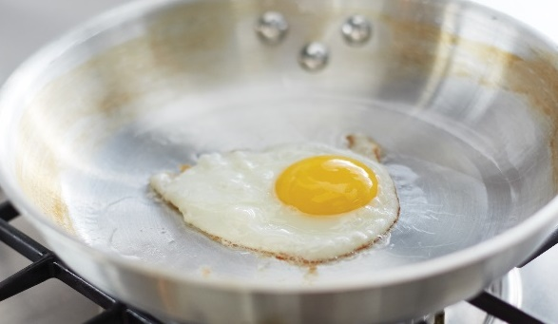
Cooking Eggs
Fried eggs:
Use fresh eggs
Cook at 145°F (63°C) for at least 15 seconds
Notes:
Fried eggs are quick and easy to prepare. To make sure that eggs are fried
with the yolks high and centered, use fresh eggs and an appropriate amount of
cooking fat, cook the eggs to 145°F (63°C) for at least 15 seconds, and serve
immediately. If they are going to be held for a few minutes, cook the eggs
to 155°F (68°C). The yolk should be cooked to whatever doneness the guest
requests. Eggs fried up, sometimes called sunny-side up, are fried only on the
bottom. Eggs fried over easy are fried on the bottom, then turned over and
fried very lightly on their top sides. Basted eggs are fried and then steamed in
a covered pan.
ESSENTIAL SKILLS: MAKING A FRIED EGG
Heat a frying pan and add fat (such as clarified butter, bacon fat, shortening, oil, or margarine).
Break an egg into a small dish.
When the fat in the frying pan bubbles, slip the egg into the pan. See Figure 3.16.
Serve fried eggs immediately on a warm plate.
Here are the details for how to cook the various styles of fried egg:
Over easy:
• Cook the egg until the white is set.
• Flip the egg by pushing the pan forward and pulling back sharply, or use a spatula.
• Continue to cook until the white is firmly set with a soft yolk.
Hard fried:
• Cook the egg until the white is set.
• Puncture the yolk with the edge of the spatula or fork and then flip the egg.
• Continue to cook until the white and the yolk are firmly set.
Basted:
• Fry the egg on one side; do not flip the egg.
• Moisten the egg during cooking with hot fat or cover the pan, allowing the egg to steam slightly until the yolk is slightly whitened.
• Cook until the white is firmly set and the yolk is hot but soft.
Sunny-side up:
• Cook the egg, without flipping or basting, until the white is set.

Slide 44
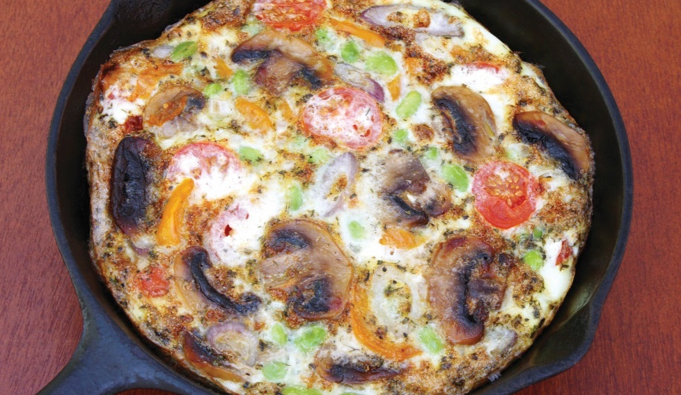
Cooking eggs
Sunny-side up eggs
  Eggs fried only on the bottom
Over easy eggs
  Fried on bottom and lightly on top
Basted eggs
  Fried and then steamed in covered pan
Omelets
  Eggs beaten and cooked in a skillet with filling
Frittatas
  Flat omelets
Notes:
Make omelets by slightly beating eggs and then cooking them in a skillet with
a filling, such as cheese, mushrooms, onions, or ham. Omelets are made rolled,
flat, or souffléed. A rolled omelet should be golden yellow with a creamy, moist
interior and must be made to order. Flat omelets (also called frittatas) may be
made in individual portions or in larger quantities. Souffléed omelets have a
light, fluffy texture because the egg whites are whipped before cooking.
ESSENTIAL SKILLS: ROLLED OMELET
Blend the eggs, liquid (milk, cream, and/or water), and seasonings.
Pour the egg mixture into a heated and oiled pan.
Swirl the pan over the heat, stirring and scraping the eggs simultaneously until curds begin to form. See Figure 3.17a.
Add a filling, if desired.
Cook the omelet until it is set.
Roll the omelet—completely encasing the filling—out of the pan directly onto a heated plate. Shape it, if necessary. See Figure 3.17b.
Rub the surface with butter, if desired.
FLAT OMELET (FRITTATA)
Blend the eggs, liquid (milk, cream, and/or water), and seasoning.
Sauté any garnish ingredients. See Figure 3.18a.
Pour the egg mixture into a hot, oiled pan over the garnish, swirling the pan so the egg mixture covers the entire bottom of the pan.
Cook, without stirring, until the edges are set.
Finish the omelet in a hot oven, adding other garnish ingredients, such as grated cheese. See Figure 3.18b.
Brown under a broiler, if desired.
ESSENTIAL SKILLS: SOUFFLÉED OMELET
Whip the eggs until they are frothy. See Figure 3.19a. Add any seasonings and garnish ingredients.
Pour the egg mixture into a heated and oiled pan.
Cook the omelet until the edges and bottom are set. See Figure 3.19b.
Finish in a hot oven.
Tips for perfect omelets include the following:
• Always use high heat.
• Use the appropriate omelet pan (8 or 10 inches).

Slide 45
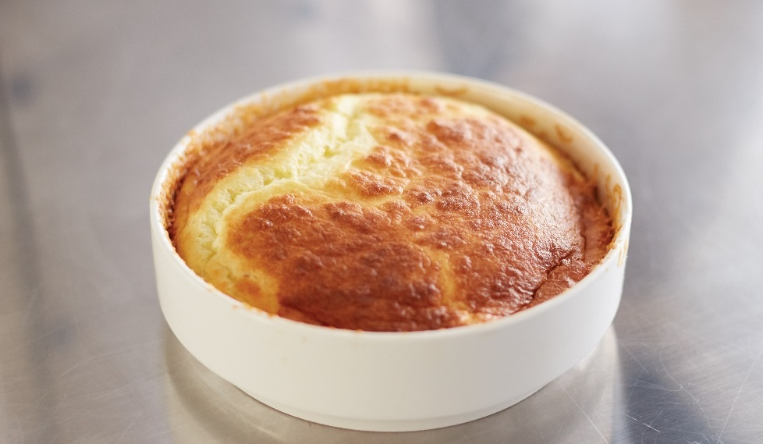
Cooking eggs
Quiche
  Savory baked egg custard
  Blended with milk or cream
  Baked with crust
Soufflés
  Savory or sweet
  Labor intensive
  Made with sauce, egg yolk, egg whites, flavoring
Pooled eggs
  Cracked open and combined in container
  Cook immediately after mixing
  Store at 41°F (5°C) or lower
Notes:
Other favorite egg dishes that can be carried over to lunch or dinner include
quiche (KEESH) and soufflés (soo-FLAYs). Quiche is a savory egg custard baked
in a crust. Blend eggs with milk or cream until smooth and then add a variety of
other ingredients. In one traditional quiche, the Florentine, blend the eggs with
spinach and onion, cheese (usually Gruyère or Swiss, but other cheeses can be
used), and crisp bacon or cooked ham. Regardless of ingredients, season the
mixture of eggs and other ingredients, pour it into an uncooked pie crust, bake
it in a moderately heated oven, and serve it hot. Quiches are easy to reheat in
a microwave oven just before serving.
Soufflés are made of eggs and can be either savory or sweet. While they can
be served at any meal, soufflés take time to bake and must be made to order.
Make a soufflé by enriching a sauce base (generally béchamel) with egg yolk,
whipped egg whites, and flavorings. The egg whites cause the soufflé to puff
during cooking. Soufflés are not difficult to prepare, but timing is everything.
The kitchen staff and the serving staff must work together very closely to assure
that the guest receives the soufflé while it is still hot and puffy. Cheese soufflés
are very popular.
No matter how they are prepared, always follow safety steps to ensure properly
cooked eggs:
Handle pooled eggs carefully. Pooled eggs are eggs that are cracked
open and combined in a container. Cook pooled eggs immediately after
mixing, or store them at 41°F (5°C) or lower. Wash and sanitize the
containers used to hold pooled eggs before making a new batch.
Keep shell eggs in cold storage until ready for use. Take out only as many
eggs as needed for immediate use.
ESSENTIAL SKILLS: MAKING SOUFFLÉS
Prepare a base (usually a béchamel sauce) and add the flavoring.
Whip egg whites and fold the whites into the base. See Figure 3.20a.
Fill the molds. See Figure 3.20b.
Place the molds in a hot oven.
Once they are done, serve the soufflés immediately. See Figure 3.20c.

