Slide 2

Menu Overview
Important interaction between customer and operation
Determines sales
Helps with planning and communication
Notes:
One of the most important interactions people have with a given operation is
through the menu, as illustrated in Figure 2.1. It is where sales are initially won
or lost. If, for example, guests like what is on the menu, and the prices seem
fair, then they are likely to place an order. If, on the other hand, they do not like
what they see, then the operation may lose business. Of course, preparing and
delivering what is on the menu matters greatly, but if a person is not interested
enough to order something from the menu in the first place, then the product
itself does not matter.
The menu functions in two ways—for planning purposes and communication
purposes. For the planning function, the menu provides an end goal to which
all the employees work. The chefs gear each stage of food production toward
putting out the best product at the best price. The menu also helps the staff to
organize themselves by asking certain important questions:
• What is the target market? What segments are we aiming to serve?
• What types of food and service do these segments of the market expect?
• Are the ingredients for the menu items readily available and cost-effective?
• Can the menu items be prepared in the most appealing way possible?
• Is the menu best serving the needs of our target market?
• Is the menu best serving the goals of the operation?
So, using the menu as a planning tool actually helps employees stay focused
on all the behind-the-scenes work and how to best accomplish the goals of
the operation.
As a marketing and communication tool, the menu functions in three ways:
• Informing guests about what the operation offers
• Selling products
• Creating identity

Slide 3
Menu Overview
Planning goals
  Target market
  Types of food/service
  Ingredients
  Serving needs and goals of operation
Communication/marketing goals
  Information about operation
  Sell products
  Create identity

Slide 4
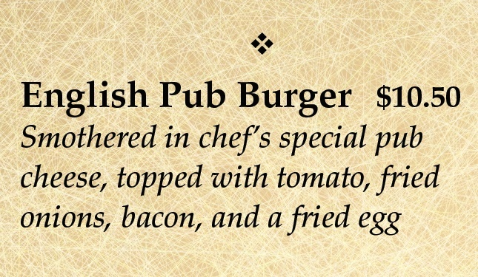
Menu Overview
Informing guests
  Tells what operation offers
  Specific descriptions
  Distinguish from competition
  Explains health concerns
Selling products
  Appeals to guests
  Placement and appearance important
Creating identity
  Communicated through design
  Examples include paper material, font, binding
Notes:
Informing Guests
The most basic function of the menu is to tell guests what the operation has to
offer. But the menu also presents an opportunity to distinguish these items from
those of the competition. Many places serve a burger of some sort, but a chef
can use the menu to describe exactly how a burger is prepared and why it is
better than any of the competitors’ burgers. Do the chefs use a particular kind
of meat or spice? Do they cook it in a different way? Do they offer different
condiments for the dish? Chefs can describe all of this detail on the menu.
Check out the two descriptions of burgers in Figure 2.2. Which is more
appealing to you?
In addition, the menu informs guests about potential health concerns, such
as the risks of eating undercooked food, ingredients that may cause allergic
reactions (for example, tree nuts), or particularities of specific dishes (for
example, degrees of spiciness).
Selling Products
The menu may be an operation’s best sales tool. It can greatly influence what
guests decide to order. How? By appealing to the guests’ appetites through
well-written descriptions of menu items. Guests are also influenced by the
placement of items on the menu. For instance, marketers and chefs may choose
to highlight the items they most want to sell by placing those items at the top of
the menu, putting them in a bolder or bigger font, or even by boxing off the
items altogether in a separate category. The more visual attention certain items
attract, the more likely guests are to consider and order them. A “Daily
Specials” page is one way to use the menu to sell product.
Creating Identity
The menu also helps create the image or identity of an operation. The items
listed on a menu say a lot about an operation, but so does the design of the
menu itself. The font, color scheme, and material or paper stock the menu is
printed on all help communicate the identity of an operation. For example, a
menu using a heavy paper stock, bound in a leather cover, and listing menu
items in a script font may give the impression of a high-end, formal operation.
On the other hand, a menu presented on one sheet of regular paper stock with
menu items printed in a large, colored font may create the impression of an
informal, casual operation.

Slide 5
Menu Types
À la carte
  Each item priced separately
California
  All meals available any time of the day
  Accommodates variety of customers
Cyclical
  Items change periodically
  Can be daily, weekly, or seasonal schedule
Du jour
  Lists items available on a particular day
  Includes daily specials
  Can be inserted into regular menu
Fixed
  Offers same items every day
Notes:
À la carte (ah le cart)
This menu prices each item separately. For example, on an a la carte menu, a
typical meal, such as steak, potatoes, and a vegetable, will have separate prices
for each item, and they need to be ordered individually. In short, nothing on an
a la carte menu comes with anything else.
California
This menu lists all meals available at any time of day. Diners that are open 24 hours
a day might use a California menu. This accommodates a wider variety of guests
who may differ in lifestyle and work schedules. The guests can choose whatever
they want whenever they want it—for example, breakfast at dinner time.
Cyclical
With this menu, chefs or managers change items after a certain period of time.
For example, an operation might serve four different menus that correspond to
the four seasons. Cyclical menus can change on a daily, weekly, or monthly
basis as well; it all depends on the management’s objectives in catering to
the target market.
Du jour (doo-ZHEUR)
This is a French term that means “of the day.” This menu simply lists the menu
items that are available on a particular day. In the United States, this kind of menu
is often presented as a daily specials menu. It can be an insert in the standard
menu, written on a blackboard, or described verbally by the service staff.
Fixed
This menu offers the same items every day. A particular advantage here is that
guests know what to expect every time they return. Many chefs work with a fixed
menu to offer guests consistency, but then supplement the fixed menu with a
du jour menu to offer variety.

Slide 6
Menu Types
Limited
  Few items offered
  Common for quick-service operations
Limited time offer (LTO)
  Items offered for short period of time
  Can market seasonal food or new items
Prix fixe
  Offers multiple courses for set price
Table d’hôte
  Various menu items packaged together
Notes:
Limited
There are typically only a few items offered on a limited menu. Quick-service operations
frequently offer a limited menu. Such a menu makes it easy to keep track of costs
because there are fewer ingredients to account for, and those ingredients are usually
the same through inventory cycles, making it easier to track and monitor pricing.
Limited time offer (LTO)
These menu items are only offered for a short period of time. LTOs are most popular
with quick-service and casual-dining operations. LTOs allow for the marketing of
seasonal food or introduction of new menu ideas and concepts. It is a low-risk way
to test new ideas while increasing guest loyalty and keeping interest.
Prix fixe (PREE FIX)
This type of menu offers guests multiple courses for a single set price. For example,
a choice of appetizer, full entree with sides, and a dessert might be offered for
one price, and that price is often slightly lower than if each course or item were
purchased separately. This type of menu arrangement presents a win-win for
both guest and operation. The operation ensures a higher check total by bundling
multiple courses together, while the guest receives a discount on that higher total.
Both casual and formal operations utilize prix fixe menus.
Table d’hôte (tah-buhl doHT)
This menu is similar to a prix fixe menu in that it bundles various elements of the menu
into one package. For example, such a menu might present—in advance—four meals,
and each would include a number of courses and possibly even beverages, all for one
price. Banquets frequently offer such a menu.

Slide 7
Organizing a Menu
Organized by when items are ordered
Sample order:
Appetizers
Soups
Salads
Sandwiches (can also be before salads)
Entrées
Vegetables
Desserts
Beverages

Slide 8
Organizing a Menu
Menus vary based on operation’s image and resources
Variety of food tastes or textures or focus on one food type
  Larger operations use multiple cooking methods: frying, grilling, baking
  Small operations—one food type with appropriate sides
May divide entrées by category
  Beef, pork, chicken, shellfish, etc.
  Meats items balance with vegetables, salads, and desserts
Notes:
Most menus organize food items according to the order in which they are usually eaten and listed below:
1 Appetizers
2 Soups
3 Salads
4 Sandwiches (sandwiches can be offered before or after salads)
5 Entrées
6 Vegetables
7 Desserts
8 Beverages
Variations in these categories depend on what an operation offers and the
image that management wants to promote. For example, a restaurant that offers
small plates for sharing might break the menu up by types of small plates (often
cold or hot, or by type of meat or vegetable in order to encourage choosing
from multiple parts of the menu.
In larger operations, chefs prepare food using a variety of cooking methods,
such as poaching, roasting, grilling, frying, and baking. This results in a menu
with food items that vary in taste, texture, and seasoning for the right amount
of contrast to meet the tastes of a variety of guests. However, you can also find
operations that focus their menus around one type of food, and therefore only
the guests who want that food—for instance, an operation might have a menu
based solely on fried chicken and sides that might go with fried chicken.
In a full-service operation, chefs or managers can divide entrées by categories,
such as beef, pork, chicken, lamb, veal, ham, shellfish, fish, pasta, egg, cheese,
and vegetarian dishes. They maintain balance through the choice of vegetables,
sauces, and potatoes used to complement entrées. For example, if a menu
contains ham and chicken, offering sweet potatoes or yellow winter squash is
a good balance. Four to six vegetables, including potatoes, should meet most
menu needs. Salads and salad dressings can also reflect balance and variety.
The number of desserts on the menu depends on guests’ tastes and past sales.
Some operations may need to serve only ice cream or sherbet to satisfy their
guests. Others may need to combine these with a limited number of pies or
cakes. And it is fairly easy to add puddings and fruit to extend dessert selections.

Slide 9
Creating a Menu: Planning
Physical layout of facility
  Important for menu design
  Size of facilities: storage, prep, cooking areas
  Determines efficiency of production
Skill of personnel
  Need skilled chef to produce specialized items
  Skill level of staff should match food items
Availability of ingredients
  Balance cost of ingredients to expected profit
  Consider cost and availability of ingredients
Notes:
A menu also needs to reflect a realistic understanding of what chefs are
capable of producing in a cost-effective way. There are two separate steps in
menu creation—planning and design.
Planning
In the planning phase, managers and chefs must think about the following:
• Physical layout of the facility
• Skill of personnel
• Availability of ingredients
• Wants and needs of the target market
• Expectations of the target market
• Profit margin
Physical Layout of the Facility
Planners must take the physical layout, or space, of the actual operation
into account when they design a menu. For example, planners must take
into consideration the size of storage facilities, preparation and cooking
areas, and the service and dining areas. An operation’s physical layout often
determines the kind of menu that chefs will be most capable of producing;
an operation might not succeed if planners put out a menu that the chefs
cannot produce efficiently.
Skill of Personnel
Planners must also consider the staff of an operation. If management wants
to offer a menu of food items that require highly skilled, delicate preparation,
then they need to have cooks on staff that can fulfill those needs. On the other
hand, if managers want a menu with ingredients that are easy to work with
and inexpensive to produce, it would be a mistake to employ a kitchen staff that
is highly trained and experienced (and, therefore, more costly). In short, the
operation’s personnel must fit the menu that planners create.
Availability of Ingredients
Menu planners must be aware of the price and availability of ingredients
when planning menus. Today, fresh, seasonal ingredients are very popular
with guests. But, a menu that consists of many high-priced ingredients might
end up losing money for the operation because food costs will make the items
unprofitable. Planners need to consider not only what their operation can
produce well, but also how cost-efficient the items are to produce.

Slide 10
Creating a Menu: Planning
Wants and needs of target market
  Focus on guest preferences rather than those of owners/managers
Expectations of target market
  Meeting guests’ needs after operation is established
  Important to be consistent
Profit margin
  Amount of money left after expenses are paid
  Operations should set a target margin
Notes:
Wants and Needs of the Target Market
Sometimes, the personal desires of an operation’s owners or managers overtake
the wants and needs of the market they intend to serve. This is a mistake. The
focus should always be on the desires of the guests. An example of this might
be an owner who loves an expensive and hard-to-obtain type of coffee that,
once put on the menu, does not sell any better than a less-expensive, more
readily available coffee.
Expectations of the Target Market
Expectations are closely related to the market’s wants and needs. But the
expectations of the market are more important after an operation has become
established rather than before. Not meeting expectations becomes more
dangerous the longer an operation exists, because management can become
complacent over time. If the operation does not stay true to the needs of its
guests, they might choose to spend their money elsewhere. Consistency is one
of the cornerstones of success in the restaurant and foodservice industry.
Profit Margin
No business can survive if it is not producing at profitable levels. Planners must
create the menu with profitability in mind throughout the entire process. Profit
is defined as the amount of money remaining for an operation after expenses,
or costs, are paid. So, for restaurant and foodservice operations, this is the
amount of money left over from the sale of food and beverages after the cost
of preparing them and paying for other overhead expenses, like rent and
heat. This difference is also called the margin; most restaurant and foodservice
operations set a target margin—the margin they aim to meet—for their operation.

Slide 11
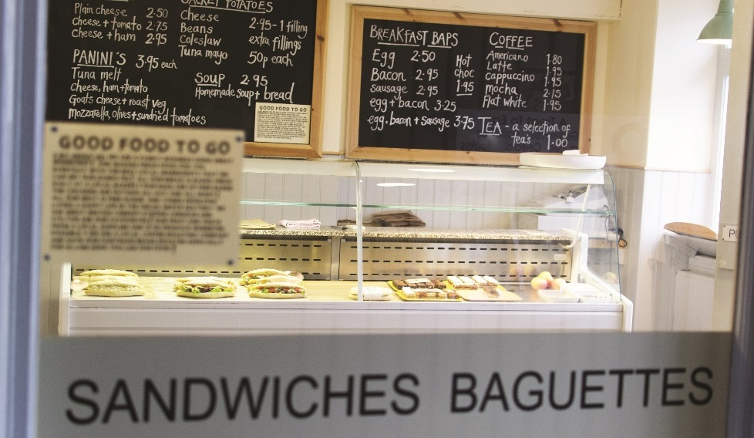
Creating a Menu: Designing
Should be easy to understand and reflect
operation’s design
Various elements of menu design
  Medium
  Layout
  Color
  Font
  Art

Slide 12
Creating a Menu: Designing
Medium (materials and method)
  Usually paper
  Various materials vary in cost
  Nonpaper types include menu boards and spoken menus
Layout (how it is arranged)
  Spacing and sequence important
  Emphasize certain items
Notes:
Once chefs and managers have decided on the items that will be included on a
menu, the design phase can begin. Well-designed menus are pleasing to read,
easy to understand, and clearly express the identity and character of the operation
as a whole. But how do designers actually accomplish this? Designers must
consider the following elements when laying out a menu:
• Medium (materials and method)
• Layout (how it is arranged)
• Color
• Font
• Art
Medium
An operation’s menu can be presented in a number of ways. Most operations
use some sort of paper with the menu items printed on it. The paper stock that
designers use can help to express the identity of the operation. Thicker paper
stock is more expensive and durable, whereas thinner stock is less durable and
more casual. Additionally, many menus are laminated. This is done to save
the menu, ensure its durability, and make it easier to keep clean. Sometimes,
an operation may opt to put its menu on a different medium altogether. For
example, a menu can be written with chalk on a blackboard (see Figure 2.4)
that is visible to all the patrons in a dining room, or even on a wall in the dining
room. These types of menus are called menu boards. Finally, at some
operations, the servers memorize the menu and relay it verbally to the guests.
This is called a spoken menu, and it can help personalize the menu and create
a more intimate feel for the operation as a whole.
Layout
How the menu is categorized and sequenced adds to the identity of an
operation. Is everything on one page, or are items spaced out over multiple
pages? Are items crammed together in a busy, hectic way, or are they spaced
wide apart in a calmer, more subdued manner? All of this can say a lot about
an operation’s personality. In addition, the layout can help emphasize items on
the menu that management wants guests to order most frequently.

Slide 13
Creating a Menu: Designing
Color
  Tone of menu
  Indicate food type
Font
  Highlights different parts of menu
  Italic, bold, dark, angular fonts
Art
  Images, borders, lines
  Indicates type of operation
Notes:
Color
Color is obviously very important to any visual presentation. The colors chosen
by an operation could be the difference between being considered romantic
or rowdy, sophisticated or casual, expensive or inexpensive. Sometimes the
color can even signal to patrons what type of food will be served. For example,
various blue tones could signal seafood, while a blend of orange and red may
signal a spicier cuisine, such as Cajun food. When planning the colors of a
menu, designers should think about the feeling they want guests to get when
considering the operation. Figure 2.5 shows one menu’s color schemes.
Font
Like many elements of design, fonts can work in different ways. A font can, of
course, highlight certain elements on the menu. Italic or bold fonts will stand out
on the page and draw guests’ attention. A large, dark font might be helpful for
an operation catering to segments of the market who might appreciate easy-to-read
print, and sometimes using italics helps provide contrast between the name
of the menu item and its description. Fonts can also signal the personality of an
operation. For example, flowing, bubbly fonts might be appropriate for a kids’
menu (see Figure 2.6). Scripted fonts create a classical feel, while clean, rigid
lines speak to a more modern approach. Menu designers must be careful when
choosing a font for all of these reasons.
Art
Finally, the art on a menu can say a lot about an operation. Illustrations say
“kid-friendly” to many people, while no art at all might say the opposite. A
picture of an old 1950s car will say “diner” to some guests, while a chili pepper
will say “spicy cuisine” to others. The borders that divide various segments of the
menu also fall under the category of art. What kinds of lines are incorporated
in the menu? Straight lines with lots of angles give off a different vibe than
borders with more arcs and curves.

Slide 14
Menu Sales Mix Analysis
Sales mix analysis
  Analysis of popularity and profitability of menu items
  Ideally performed four times a year
  Determine menu changes
Menu engineering
  Breaks down a menu’s components
  Determines the sales performance of menu items
  Data collected after certain amount of time
Notes:
Managers need to monitor the effectiveness of menu items to maximize
profits. A method called the sales mix analysis helps do that. A sales mix
analysis is an analysis of the popularity and profitability of a group of menu
items. To effectively do this, the analysis should be done at least four times per
year. The analysis includes determining which menu items are most popular
and which contribute the most money to expenses and profit. Basically, you
compare menu items in terms of sales and profitability. The results of this
analysis determine whether managers need to make changes in menu
pricing, content, or design.
While there are several methods available to do menu analysis, one of the
most popular is menu engineering. It systematically breaks down a menu’s
components to analyze which items are making money and which items are
selling. Then, managers know which menu items to leave alone, which need
to have an increase or decrease in price, which to promote, and which
to eliminate.
Managers can determine the sales performance of each menu item after the
restaurant has been open for some time and they have enough sales data to
analyze. Gathering information for three months or longer provides more useful
results than data from a shorter time period.

Slide 15
Menu Sales Mix Analysis
Sales volume
  Number of times item is sold in a certain period
  Quantity recorded by hand or POS system
Sales volume percentage
  Number of each menu item sold to total sale
  Percentage of total sales
Notes:
You start to gauge performance by looking at sales volume. The sales volume of
a menu item is the number of times the item is sold in a time period. Generally,
managers sort the sales of items by category (appetizers, entrées, etc.). The
quantity of each item sold can be recorded by hand or by a point-of-sale
(POS) system. Managers can also use sales volume information to compare the
number of each menu item sold to the total number of items sold on the entire
menu in the same time period. So, each menu item’s sales can be expressed as
a percentage of total sales. This is called the sales volume percentage.

Slide 16
Pricing the Menu
Price provides information and determines profitability
Determines market category and guests’ expectations
Ensures profitability
  Price must account for costs
  Costs include food, labor, and overhead
Notes:
Pricing the menu is a critical process for any operation. Price serves two main
purposes—it provides information to guests, and it determines profitability.
The price of items on a menu indicates the market category in which the
restaurant falls. This, in turn, sets guests’ expectations as to the quality of the
food, level of service, atmosphere to expect, etc. Guests, for example, will
expect more by way of service, quality, and atmosphere for a $50 steak
than for a $10 steak. With increased guest expectations comes the need to
execute all levels of food preparation and service on a higher level as well.
Management needs to make sure that pricing aligns with the goals of the
operation and the skill level of the staff.
Price also determines profitability by ensuring that an operation is bringing
in more money than it spends for the product or service. The price of a
menu item must account for all of the costs involved in producing that item
for the guest. This includes food costs, labor costs, and overhead costs. Then,
management must add in the amount of money it wants, and can reasonably
get, in profit. An item that is overpriced in a particular market will likely not sell
enough to be profitable. In contrast, an item that is underpriced may sell well,
but it will lose money because it costs the operation more than it is bringing in.
Striking the right balance requires careful planning and consideration.

Slide 17
Classifying Menu Items
Four categories of menu items
  Stars
  Plow horses
  Puzzles
  Dogs

Slide 18
Classifying Menu Items
Stars
  Popular and profitable
  Prioritize on menu
  Highest-priced items
Plow horses
  Popular, less profitable
  Can increase restaurant’s popularity
  Monitor profit of item

Slide 19
Classifying Menu Items
Puzzles
  Unpopular but profitable
  Limit puzzles on menu
  Promote with advertising, menu placement, name change
Dogs
  Unpopular and unprofitable
  Eliminate if possible
  Carry in inventory but not on menu
Notes:
Puzzles: These items are unpopular, but very profitable. As a result, the
number of puzzles on a menu should be limited. One of the best solutions
to helping out a puzzle is to decrease its price. While this may appear
counterproductive to making a profit, consider that the guest may not
perceive it as a fair value. If an item is not selling, no profit is being made
anyway. Another option is to leave its price alone and reposition it on the
menu, perhaps featuring it in a more popular location. Additionally, try to
advertise it by using table tents, chalkboards, or suggestive selling. Or, you
can rename it. A puzzle’s popularity can be affected by what it is called,
especially if it is unfamiliar to guests. Remember that even if a puzzle is not
selling well, it can make a lot of money, relatively speaking. If sales can be
substantially increased without decreasing the price, the item could easily
become a star.
Dogs: These items are unpopular and unprofitable. Eliminate all dog items
if possible. Replace them with more popular items. Take advantage of hot,
trendy, or cutting-edge listings. Restaurant and foodservice operations are
sometimes intimidated by influential guests who want managers to continue
carrying a dog item on the menu. The way to solve this problem is to carry
the item in inventory (assuming it has a shelf life), but not on the menu.
Offer the special guest the opportunity to have the item made to order on
request. You can charge extra for this service. This would raise the dog’s
price to puzzle status. Some items in the dog category may have market
potential. These tend to be the more popular dogs, and may be converted
to puzzles by increasing prices. Another detail to consider is that the menu
may have too many items. It is not unusual to discover a number of highly
unpopular menu listings that have little, if any, relation to other more popular
and profitable items held in inventory. Do not be afraid to eliminate dogs,
especially when demand is not satisfactory.

Slide 20
Pricing Menu Items: Food Cost Percentage Method
Set percentage of menu price that food cost must be
Calculate price that will provide this percentage
Formula
  Item food cost ÷ Food cost percentage = Menu price
Dependent on food cost and preparation
Notes:
There are many methods of pricing menu items. Here, two main methods are
compared: the food cost percentage method and the contribution margin method:
Food cost percentage method: Set the percentage of the menu price that
the food cost must be, and then calculate the price that will provide this
percentage using the following formula:
Item food cost ÷ Food cost percentage = Menu price
Because food cost percentage is dependent on the costs of the food and
its preparation within the restaurant or foodservice operation, an accurate
food cost percentage will be different for each menu category: appetizers,
salads, entrées, signature dishes, specials, desserts, beverages, etc.

Slide 21
Pricing Menu Items: Contribution Margin Method
Uses data to determine dollar amount to be added to item’s cost
Works for à la carte items as well as grouped items
Can determine for all menu items or each separately
Two-step formula
  (Total nonfood cost + Target profit) ÷ Number of guests = Contribution margin
  Contribution margin + Food cost = Menu price
Notes:
Contribution margin method: This is a pricing method that works for à la
carte menu items as well as menu items that comprise a meal (soup, salad,
entrée, etc.). This method uses operation-wide data to determine a dollar
amount that must be added to each major menu item’s food cost. The
managers of a restaurant or foodservice operation can use the same
contribution margin for all menu items, or they can calculate separate
contribution margins for different menu categories. There are two steps
to the formula:
(Total nonfood cost + Target profit) ÷ Number of guests = Contribution margin
Contribution margin + Food cost = Menu price

Slide 22
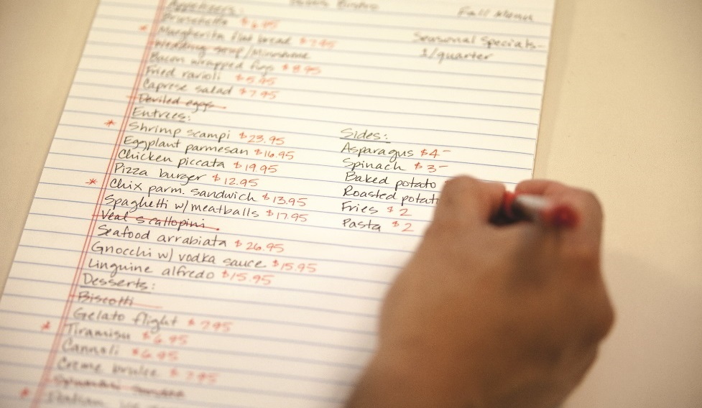
Pricing Menu Items
Two additional pricing methods
  Set dollar amount markup
  Set percentage increase method
Major items only

Slide 23
Pricing Menu Items: Set Dollar Amount Markup
Adds fixed dollar amount to food cost
Must know food cost and amount of markup
Formula
  Food cost + Markup = Menu price
Calculate markup
  Profit per menu item + Labor cost per menu item +
  Operating cost per menu item = Markup

Slide 24
Pricing Menu Items: Set Percentage Increase Method
One step further than set dollar amount markup
Calculates markup percentage in terms of food cost
Formula
  Food cost × Percentage = Markup
  Markup ÷ Food cost = Percentage
Notes:
In addition to these methods, there are two other methods that an operation can
use, but only for major menu items. These methods are the set dollar amount
markup and the set percentage increase method:
Set dollar amount markup: This method simply adds a fixed dollar
amount to the food cost of an item. In order to utilize this method, you
must know the food cost and the dollar amount of the markup. The
equation works as follows:
Food cost + Markup = Menu price
The markup is calculated based on the following:
Profit per menu item + Labor cost per menu item + Operating cost per menu item = Markup
Set percentage increase method: This method builds on the set dollar
amount markup method and takes it a step further. Basically, managers
calculate the markup as described for the set dollar amount markup for
one or several menu items. Then they determine what the percentage
markup is in comparison to the items’ food costs.
Food cost × Percentage = Markup
Markup ÷ Food cost = Percentage
Using the markup and food costs from the set dollar amount markup method
allows managers to calculate a percentage markup for all menu items.

Slide 25
Pricing the Extras
Takes into account items customer receives on top of order
These include salt, pepper, bread, butter, ketchup, sugar cubes
Total cost is Q factor
Incorporate in menu cost
Formula
  Amount of item served over time ÷ Number of entrées served = Average portion used
  Average portion used × Food cost of item = Q factor
Notes:
To determine accurate pricing and food costs, restaurant and foodservice
operations must take into account not just the food the guests order, but
the food that the guests do not order but receive anyway: the salt and pepper
on the table, the bread and butter or olive oil provided, the amuse-bouche or
pre-dessert, the ketchup, the jelly packets—the list is long. And all of those little
things can add up quickly. The total cost of these items is often called the Q factor
and is usually factored into the cost of each entree on the menu. Here is how to
calculate the Q factor:
List all the possible food that you may provide guests for “free.” In addition to
the items already mentioned, include half-and-half, sugar cubes, sliced lemon,
and so on.
Determine how much of each item would be used by a typical consumer (for
instance, 1 ounce of butter or 1⁄8 teaspoon of salt). An easy way to do this is to
keep track of how much of each item is served over a period of time, and then
divide by the number of entrees sold during this period. For instance, if you serve
800 entrees in a two-week period and you use 100 lemons during this time, placing
a half-slice of lemon in each glass of water served, you would divide 100 lemons by
800 entrees to obtain 0.125 (or 1⁄8) lemons served per entree.
Calculate the cost of each item based on the average portion used. If each lemon costs
$0.10, then the cost of each serving of lemon is $0.0125.
Once you determine the cost of each serving of each item, add them all together.
This total is your Q factor.
When costing your entrees, add the Q factor as an ingredient in each.
Using the Q factor is the most efficient and accurate way to determine your costs and prices.
Otherwise, you will be basing your prices on incorrect costs and are likely to lose profits.

