Slide 2

Marketing Overview
Market
  Group that desires product or service
  Can be customers or guests
Marketing
  Communicating message to market/guests
  Communicates availability of product or service
  Uses social media
  Not the same as advertising
Notes:
In order for a business to profitably provide a product or a service, there must
be a group of people who desire that product or service. That group of people,
also known as customers or guests, is called a market. But having a product
or service and a market that desires it is only half the battle. A business also
needs to find a way to reach its ideal market. The business has to communicate
that its product or service is available for purchase. Marketing is the process
of communicating a business’s message to its market/guests. And with the
advent of social media, restaurants and foodservice operations are now using
marketing on social sites to help build a community around their operation,
products, and services.
People often talk about advertising and marketing as if they are the same
thing. They are not. Advertising is just one component of a successful marketing
strategy. Marketing includes determining what products and services to offer,
how to position them in the marketplace, how to promote them to potential
buyers, how to price them so people will buy them, and how to get the goods
to these buyers.
In the current business environment, marketing drives the operation. Managers
now ask, “What do people want that we can provide at a profit?” This means
that an operation has to do the following:
Determine guest needs and wants before doing anything else.
Determine the costs, prices, and profitability of products and services
before starting to produce them.
Organize all aspects of the operation to provide what the guests want.

Slide 3
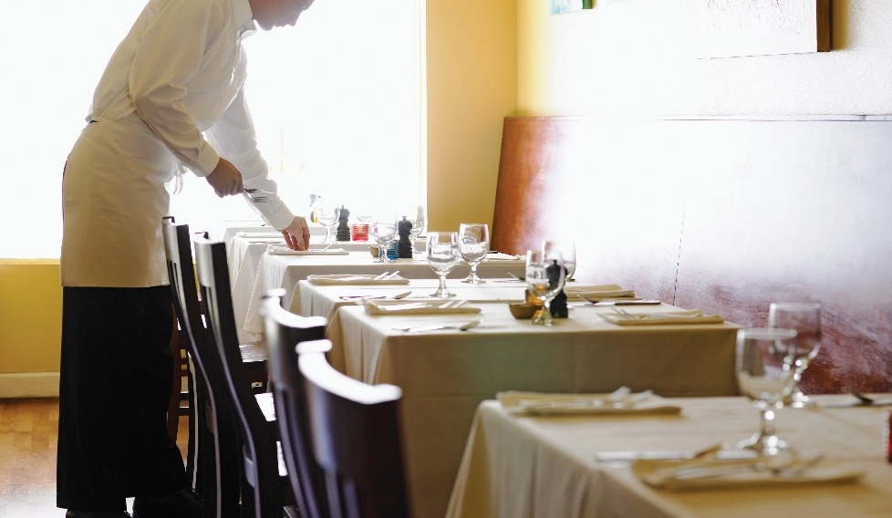
Basic Marketing Concepts
Marketing mix
  Combination of creation, development, sale of products
  Traditional marketing plan
  Four Ps: product, price, promotion, place
Contemporary marketing mix
  Developed to meet current marketing challenges
  Three elements: product-service mix, presentation mix, communication mix
Notes:
All businesses need to engage in vigorous marketing activity. Such marketing
activity is frequently called the marketing mix, which is the combination of all
the factors that go into creating, developing, and selling a product. For decades,
the conventional marketing mix was highlighted by what is known as “the
four Ps.” This framework is very similar to what was covered in the “Marketing
Overview” section, and it all still applies today.

Slide 4
Marketing Mix: Four Ps
Product: Good/service consumers want/need
Price: Determined by competition, production, demand
Promotion: Message that advances sale of products
Place: Where to have product sold
Notes:
Product: A good or service that consumers want or need.
Price: Determine a price based on competition, production, and demand.
Promotion: Messaging that reaches the consumer and advances the sale of the product.
Place: Determine the proper place from which to have your product sold.

Slide 5
Basic Marketing Concepts: Contemporary Marketing Mix
Product-service mix:
All food and services
Important to compete with similar operations
Presentation mix:
How an operation looks
Layout, size, furniture, decorations, lighting, uniforms
Communication mix:
All communication with guests
Includes advertising, menu, guest feedback, social networking
Notes:
In today’s highly competitive restaurant and foodservice industry, marketers
have modified this standard model somewhat to reflect the complexities
and challenges that operations now face. This new model is called the
contemporary marketing mix, and it consists of three primary elements:
• Product-service mix
• Presentation mix
• Communication mix
The product-service mix consists of all of the food and services offered to
guests. Restaurant and foodservice operations are often thought of by the food,
or product, they offer. But the way they provide it—the service—is also a huge
aspect of an operation’s marketing. Operations serving similar food products
at similar prices will often need to enhance their services to gain an advantage
over the competition. Enhanced table-side service, delivery service, take-out
service, and even new trends in curbside take-out services all factor into the
product-service mix.
The presentation mix consists of all the elements that make the operation look
unique. The layout of the operation, its size, the type of furniture it uses, the
decorations, color scheme, lighting, and service uniforms all contribute to the
identity of the operation. All of these elements contribute to an operation’s
aesthetic, or the way it looks and feels to the guests. See Figure 1.2. The choices
that an operation makes with regard to how it actually presents itself to guests
are critical factors in its marketing and branding strategy.
The communication mix includes all of the ways an operation actively tries to
reach, or communicate with, its desired guests. An operation communicates
with its guests using advertising, such as through television, radio, newspapers,
flyers, or websites. See Figure 1.3. But it also communicates with its guests
through its menu, guest survey requests and other guest feedback requests,
local community outreach, and Internet social networking sites. Employing
an effective communication mix is crucial to monitoring, maintaining, and
improving an operation’s relationship with the market that it serves.
These aspects of the contemporary marketing mix are constantly changing. An
operation must continually evolve with the times. In order to do so, operations
need to be aware of what is going on in the immediate community as well as
the surrounding areas.

Slide 6
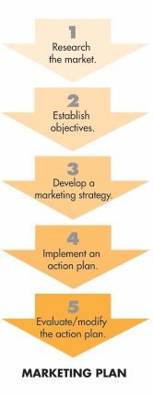
Marketing Plan
List of steps to sell product or service
Directed at specific market
Different for each operation
Notes:
According to current studies from the National Restaurant Association,
50 percent of both casual-dining and fine-dining operators and 40 percent
of family-dining operators say they plan to devote more resources to social
media marketing. That means that while social media is still fairly new, it is
definitely here to stay.
Generally, restaurants and foodservice operations want to use social media for
three main things:
To build a community of people who like and support their products, services, and operation
For promotion
To gain guest feedback and manage guest service
So how do you start? By simply signing up! Research what is being used the
most by your target audience, or in general. For instance, Instagram has over
500 million active users, and people who use Snapchat spend an average of
25–30 minutes a day using it. Look at your marketing plan and see where you
can fit the social media use. Have a strategy for content and timing, based on
what will work best for you. You do not want to post things simply for the sake
of posting. Follow your plan to post things that best promote your operation and
engage your target market. For instance, some companies use Twitter for guest
feedback. Others use Facebook to have designated chats with industry experts.
In 2016, the Bravo television show Top Chef held a challenge for the chefs to
make beautiful food that was then posted to Instagram and voted on by the
public. Thousands of people participated in the voting, showing that Instagram
was a great tool for the show. Research the most popular social media tools
used by your target market, and see how you can incorporate the use of those
tools into your marketing plan.
Remember to keep your audience in mind at all times. What do your guests
need to know? What would they like to see? What information would they find
most beneficial? What would demonstrate your knowledge and expertise in the
industry? What would show how likeable your staff is? Every message should
be tailored to your guests, whether it is inspiring them to act, spreading the
word about your restaurant or an upcoming event, or just using humor to be
friendlier and more likable.
Make sure to engage with your target market. Social media is not just all about
you. It is about connecting. And you best connect by having a conversation—
just like when communicating in person. Show people that you care about their
comments, ideas, and experiences at your operation.
Of course, there are pros and cons when restaurants use social media. The
pros of using social media is it builds your restaurant’s reputation; allows you to
gather guest feedback, build brand loyalty, and interact directly with patrons;
and allows you to offer special promotions to get new guests in the door. The
big con of using social media is that every comment is and stays public—even
the negative comments.

Slide 7

Marketing Plan: Steps
Research the market:
First step
Information from guests, employees, community, government offices
Shows strengths and weaknesses
Establish objective:
Goals to accomplish
Set time frame and deadlines
Develop marketing strategy:
Ways to achieve objective
Weigh pros and cons
Collaborate to find best strategy
Notes:
A marketing plan is a list of steps an operation must take to sell a product or
service to a specific market. There are multiple steps to any plan, but every
marketing plan will have five main components, as Figure 1.4 illustrates:
Research the market.
Establish objectives.
Develop a marketing strategy.
Implement an action plan.
Evaluate/modify the action plan as needed.
Research the Market
Gathering research must be the first step in any marketing plan. It is similar
to running a business, in that managers need to know the ins and outs of the
market and what they are up against. Marketers can gather information from
a variety of reliable sources, such as guests, employees, the community, sales
records, trade journals, and government offices. Through intensive research,
marketers can figure out the strengths and weaknesses of their own operations,
products, and services, as well as those of their competitors. The market
research an operation’s marketer conducts will form the foundation from
which management will make all other decisions.
Establish Objectives
Once marketers have completed a thorough research phase, the next step is to
establish organizational objectives or goals. These objectives should clearly state
what it is the operation wants to accomplish within a set time frame. Providing
not only goals, but also deadlines for achieving those goals, will give the
operation something to work toward. The goal and the timeline for achieving it
will also help shape the marketing strategy the operation will use.
Develop a Marketing Strategy
Once the operation’s goals have been set and a timeline laid out, the managers
and marketers must brainstorm ways to achieve the objectives. It is helpful at this
stage to come up with a number of different strategies and then evaluate the
pros and cons of each. An open-ended, collaborative effort will likely result in
a better exchange of ideas and allow for more creativity than if only one plan
was thought up and immediately decided upon. Once you weigh the pros and
cons of all the ideas, choose the best strategy. Often this will be a hybrid of the
various strategies proposed.

Slide 8
Marketing Plan: Steps
Implement action plan:
Put strategy into practice
Make changes accordingly
Evaluate/modify action plan:
Monitor actions
Determine success of strategy
Revise plan when necessary
Notes:
Implement an Action Plan
The action plan is the way the marketing strategy is put into action. The action
plan is guided by all the steps that have come before it. With an action plan,
management and marketers take marketing strategy theory and actually
put it into practice by making menu changes, adjusting pricing, purchasing
advertising, and so on.
Evaluate/Modify the Action Plan
This stage is an ongoing process of monitoring the actions taken by the
operation and gauging how successful they are. Management and marketers
must continually be asking, “Are we meeting our defined objectives? Is the plan
working? Are there ways it is missing the mark? How can it be improved? What
can we be doing better?” The answers to these questions will help management
determine how to modify or revise the plan to meet the needs and trends of an
ever-changing marketplace.

Slide 9
Monitoring a Promotion Scheme
Develop promotional scheme
Can work with public relations firm
Plan the new promotion
Track sales
Discuss positive and negative effects of promotion
Notes:
Promotions can really drive your business by bringing in new guests and encouraging existing guests to return
more frequently. But simply assuming that more people are coming through the door because the promotion
must be working is not enough. In order to know how well a promotion is working, you must constantly monitor
its results.
Develop a promotional scheme, making sure to bring other members of your team into the planning process.
Many business owners work with public relations firms as well. Figure 1.5 illustrates a team at work.
Plan how you will implement the new promotion: When will it begin and end? What other changes might occur?
For instance, if you are offering two cheeseburgers for the price of one, should you expect a decrease in sales of
other menu items? Can your suppliers meet your anticipated demands?
Once the new promotion has begun, carefully track sales of not only the promotional items, but of all menu items.
What unforeseen changes have arisen?
Meet regularly with your staff to discuss the promotion: How is it working? What have guests reported? Have staff
members experienced any problems with the promotion? Is the promotion successful enough that it should be extended?
You may need to adjust the promotion slightly, but be careful with this; it could anger both potential and long-term
guests if it appears that you are not living up to the implicit bargain of the original promotion.
Once the promotion has ended, discuss the entire process with your staff and/or public relations firm. What positive
and negative aspects of the promotion did they observe? How could the promotion be fine-tuned in the future? Have
the new guests attracted by the promotion continued to visit your restaurant? How have overall sales been, both during
the promotion and after its completion?

Slide 10
Market Segmentation
Target marketing:
Guest-driven
Treats people as different
Focuses marketing appeal to specific guests
Helps operation target resources toward customers

Slide 11
Market Segmentation
Mass marketing:
Assumes everyone has same needs and wants
Restaurants and foodservice operations should avoid
Wastes time and resources
Notes:
An important element of marketing strategy is the selection of the target
market or markets: the people an operation intends to pursue as guests. Every
operation should be guest-driven; that is, making sure that satisfying the wants
and needs of the guest drives the marketing strategy. It is important to know
your target market because it allows you to get in front of your likely guests. Not
knowing your target market wastes time and resources. If you do not know your
target market, how can you expect your business to survive?
Identifying a target market enables an operation to avoid mass marketing
and instead focus on target marketing. Mass marketing treats everyone in
the market as having the same needs and wants. Restaurant and foodservice
operations, however, deal with people’s tastes for food, drink, and services. And
these are definitely not the same for everyone. Target marketing treats people
as being different from each other and tries to make a focused appeal to a
distinct group of guests. Understanding the target market enables an operation
to provide the products and services that are needed. It also helps an operation
focus marketing resources toward the people who buy its products. This is
where the process of market segmentation comes in.

Slide 12
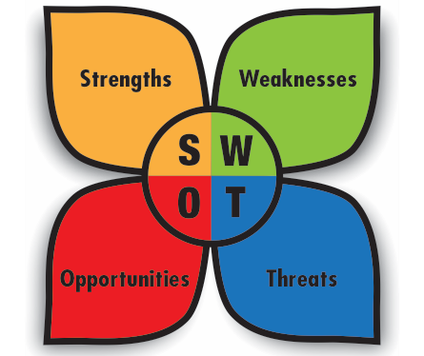
SWOT Analysis
Also called a situation assessment
Stands for: strengths, weaknesses, opportunities, threats
Determines success of operation’s strategy
Used to make improvements
Notes:
To do a SWOT analysis (also called a situation assessment), identify a
restaurant or foodservice operation’s strengths, weaknesses, opportunities,
and threats. These concepts are illustrated in Figure 1.6. Doing a SWOT
analysis is a simple way for the management of an operation to understand
its current situation and take advantage of the opportunities open to it. SWOT
analysis is very important to the process of preparing a marketing plan and to
the success of an operation overall because it helps managers and marketers
stay focused on key issues. To have a successful SWOT analysis, managers must
be realistic about the operation’s strengths and weaknesses and clearly separate
its present conditions from where they want to be in the future.
At every stage of the marketing process, marketers can use a SWOT analysis
as a good assessment tool to evaluate whether a particular plan is working and
to gauge what is currently going on in a market. Following are details of each
aspect of SWOT analysis:

Slide 13
SWOT Analysis
Strengths:
Areas where operation excels
Examples: clean facilities, high food quality, good service
Exceeds guest expectations
Notes:
Strengths: List all of the strengths of the operation—areas where it excels.
Examples of strengths include a well-trained staff, a good location,
well-kept and clean facilities, high food quality, and service that exceeds
guest expectations.
Weaknesses: Identify the operation’s weaknesses. Do this so that
weaknesses can eventually be eliminated. Some examples of weaknesses
could be a boring menu, dirty facilities, limited abilities or resources, poor
service, high staff turnover, or poor reputation.
Opportunities: These are areas where the operation could either increase
revenues or decrease costs. Examples might include launching a delivery
or take-out service, recognizing weak competition, or gaining a volume
discount from a supplier. One goal in any operation’s marketing plan
should be to make the most use of identified opportunities.
Threats: These are the factors outside the operation that could decrease
revenues or increase costs. Identifying threats helps to control them.
Examples of possible threats include increased competition, increased
taxes or costs of certain products, or even road construction.
Management should evaluate the different elements of the operation to identify
which need improving to support the marketing plan and which are working
well. After a full evaluation has been completed, management will know how
successful their past efforts have been and should have good ideas about
where to invest money and energy in the future. They should also know what
aspects should be improved to result in more benefits to guests, to employees,
and to the operation as a whole.

Slide 14
SWOT Analysis
Weaknesses:
Operation should eliminate
Examples: dirty facilities, high staff turnover, poor service

Slide 15
SWOT Analysis
Opportunities:
Areas where operation can improve
Increase revenues or decrease costs
Examples: creating delivery service, getting volume discount
Identify as part of marketing plan

Slide 16
SWOT Analysis
Threats:
Outside factors that can decrease revenues or increase costs
Identify to control
Examples: increased competition, increased costs, road construction

Slide 17
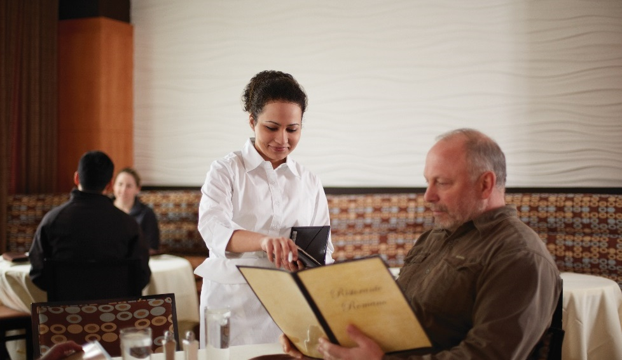
SWOT Analysis
After SWOT analysis:
Evaluate different elements that need improvement
Determine success of past efforts
Invest money and time in benefits for guests and employees

Slide 18
Promotional Mix
Advertising
  Paying to promote products or services
  Uses multiple mediums
Sales promotions
  Short-term incentives
  Identity based on recurring promotions
Personal selling
  Face-to-face interaction
  Communication of operation’s message
Notes:
There are many ways to communicate with an operation’s market. The ways an
operation goes about this process of communication is called the promotional
mix. The promotional mix can consist of any or all of the following:
• Advertising
• Sales promotions
• Personal selling
• Public relations
• Direct marketing
Advertising: This is paying to present or promote an operation’s products,
services, or identity. Advertising can be conducted through multiple mediums.
Television, radio, newspapers, storefronts, and the Internet are all viable options
for advertising. Though there are costs involved with advertising, effective ads can
be a powerful communication tool for any operation. It is important to define the
desired outcome when selecting an advertising strategy: is the ultimate goal to
increase exposure to the brand, or do you need to use a specific call to action
to drive a sale?
Sales promotions: These are limited, or short-term, incentives to entice guests
to patronize an operation. For example, offering two-for-one entrées is a
sales promotion. Sometimes an operation’s identity can actually be based on
sales promotions. An operation might become known for specific reoccurring
promotions, such as half-priced appetizers during certain hours or themed
nights during the week. See Figure 1.7. Creativity in coming up with smart sales
promotions can greatly enhance business. The section titled “Types of Sales
Promotions,” on the next page, covers sales promotions at greater length.
Personal selling: Always key to an operation’s financial success, well-trained
service staff can go a long way in communicating an operation’s message.
Professionalism, politeness, and efficiency can be easily and powerfully
conveyed by the front-of-the-house staff. In fact, face-to-face interactions
between service staff and guests may be the very best way to solidify an
operation’s credibility and identity in a competitive market.

Slide 19

Promotional Mix
Public relations (PR)
  Operation’s interaction with community
  Enhances image with favorable publicity
Direct marketing
  Connect directly with specific market segment
  Includes mail, email, telephone calls, website feedback

Slide 20
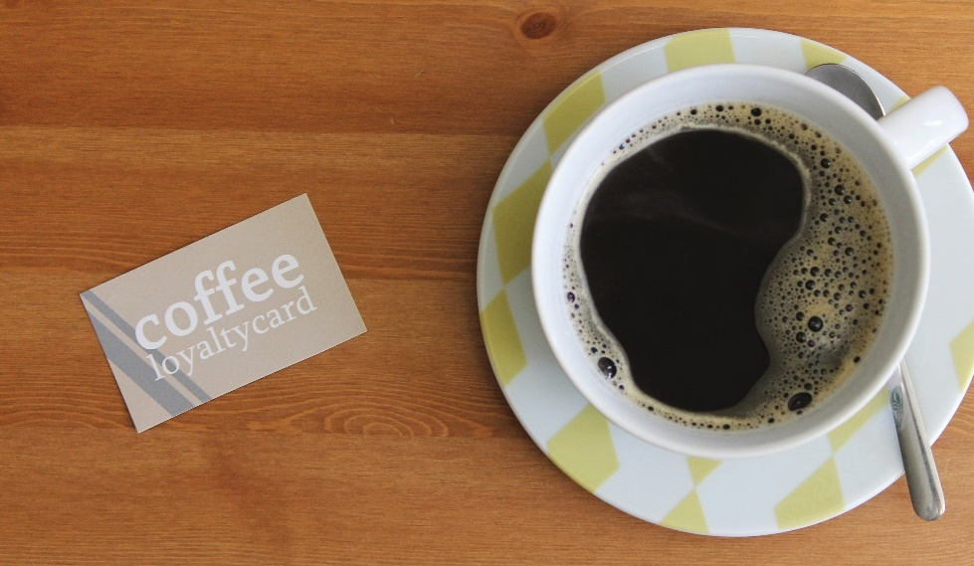
Types of Sales Promotions
Special pricing
  Limited-time reduced price
  Low-risk opportunity
Frequent shopper program
  Benefit of continuing patronage
  Free items or discounts
Premiums
  Free or reduced-price merchandise
  Received with purchase
Notes:
Sales promotions provide special incentives for guests to patronize an
operation. There are many types of sales promotions and different tools or
materials that can be used in a sales promotion. All are designed to give guests
that extra “boost” to get them into an operation or to purchase certain items.
However, sales promotions are only useful when guests know about them, which
is why they are often the focus of advertising.
Here are some types of sales promotions:
Special pricing: Limited-time reduced prices offered through specials,
deals, coupons, or other programs save guests money and create a low-risk
opportunity to try a new item.
Frequent shopper program: Provides a benefit in exchange for continuing
patronage—often free food items or substantial discounts. Figure 1.10
shows a frequent shopper card.
Premiums: Free or reduced-price merchandise, such as a pen or cup that
shows the name and location of the restaurant—usually given away or sold
for a reduced price with the purchase of a food item.

Slide 21
Types of Sales Promotions
Special events
  One-time or periodic incentives
Samples
  Free, small item
  Opportunity for customer to try new item
Contests and sweepstakes
  Program for customer to win prize
Notes:
Special events: One-time or periodic occasions that provide a special
incentive for the guest to patronize your restaurant. These events vary
a great deal but include things like bringing in celebrities or offering
special entertainment.
Samples: Free, small tastes of food items, providing guests a risk-free
opportunity to try a new item.
Contests and sweepstakes: Games and other programs that involve the
guest and provide a prize.
Some sales promotion methods use materials such as coupons for special
pricing programs or toys for premiums. However, other promotional materials
support a marketing plan by continuously promoting an operation even when
it is not running an active promotion program. Promotional materials are
miscellaneous items that do not necessarily offer incentives for visiting an
operation but increase awareness of the establishment. A menu board placed
outside an operation is an example of promotional material.

Slide 22
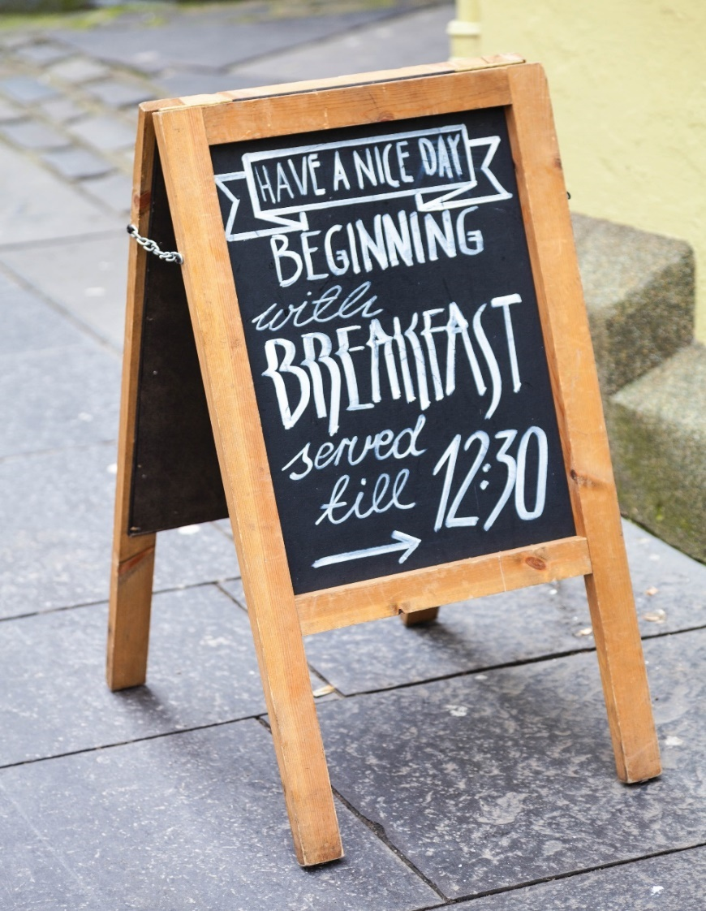
Promotional Materials
Signage
Email promotions
Premiums
Carryout/door hanger menus
Apparel/branded merchandise
Point-of-purchase (POP) materials
Merchandising materials
Direct mail
Cross-selling opportunities
Social media giveaways
Notes:
Some typical promotional materials are listed here:
Signage: Menu boards, directional signs, and other signs that indicate
where the operation is located and/or the items it serves (see Figure 1.11)
Email promotions: Emails distributed to a targeted group to create
awareness of a certain promotion or menu item
Premiums: Token gifts or giveaway items, such as pens, stationery,
children’s toys, mugs, T-shirts, or magnets that display the restaurant name
and location or phone number
Carryout and door hanger menus: Paper menus for guests to use outside of
the restaurant; door hanger menus for hanging on doorknobs or handles
Apparel and branded merchandise: An operation’s name and/or logo on
T-shirts or other garments, mugs, pencils, etc.
Point-of-purchase (POP) materials: Menu boards, video, print pieces, and
other display items near the point of purchase where guests make their
decisions about what to buy; can be at the counter or at the table
Merchandising materials: Table tents and other display items in the restaurant
Direct mail: Mass mailing of coupons, menus, advertising about a
promotion, etc., to guests in a particular area—this is also done via email
and social media
Cross-selling opportunities: A special offer, such as 10-cent wings with the
purchase of a premium beer
Social media giveaways: A giveaway or contest held on an operation’s
social media sites

Slide 23
Sales Promotions
Cooperative sales promotions:
Involves two or more sponsors
Develops complementary promotions/promotional materials
  Reciprocal coupons
Notes:
Yet another type of promotion is the cooperative sales promotion. Cooperative
sales promotions are when two or more sponsors develop complementary
promotions or offer complementary promotional materials. For example, a
restaurant hands out coupons for free admission to a sporting event, and the
sports arena hands out coupons for a free appetizer at that restaurant.

Slide 24
Public Relations
Important to generate positive publicity:
Engage in community affairs
Show local support
Two types of relationships
Notes:
The purpose of public relations is to generate positive publicity. Publicity is the
attention an operation receives. One way to get good publicity is by engaging
in the affairs of the community. A major benefit of this kind of publicity is that
people respond positively to local support. Marketers and managers should
focus on two types of relationships as they incorporate public relations in their
promotion mix: media relations and community relations.

Slide 25
Public Relations: Community Relations
Interacting with local area:
Includes hosting charity events, giving tours, sponsoring teams
Ways to give back
Builds credibility and positive relationships
Costs:
Paying yearly dues/meeting fees
Volunteering and donations
Investment in community and business
Methods:
Offering discounts
Donating percentage of sales
Offering facility or services
Notes:
Community relations involve interacting with the people in the local area to
create awareness of and trust for an operation. Activities such as hosting charity
events, giving tours, and sponsoring sports teams are examples of community
relations. These types of activities are a way to “give back” to the community.
They also provide many benefits for both a restaurant and its management by
doing the following:
• Creating a positive image within the community
• Building credibility within the community
• Building relationships with other community leaders
• Creating a network with other restaurant and foodservice professionals
• Generating positive publicity
• Promoting the restaurant
The cost of becoming involved in organizations and events can vary. An
operation may need to pay yearly dues or meeting fees to be involved with
some organizations, but it probably will not need to pay anything to volunteer
at other organizations, such as a local homeless shelter. If managers choose to
support an organization with donations of food, labor, money, or space, some
of these costs may be tax-deductible. However, owners and managers should
view any costs that are incurred as an investment in both the community and
the business.
Once marketers have identified community relations opportunities that align
with their operations’ marketing plans, they can begin thinking about how to
become involved in a way that generates good publicity. For example, they can
develop promotions or sales, such as the following, that support their chosen
organization or event while generating business for their operation:
Offering discounts to schoolchildren who have good grades or attendance
Donating a percentage of sales to a charity for a given item or period of
time (for instance, all lunch sales)
Offering guests a discount when they bring in a donation for charity
Sponsoring a local children’s sports team and offering incentives for
winning a game
Offering the operation’s facility or providing the catering for a fund-raiser
or meeting
Other types of programs may not generate direct business but can still provide
excellent opportunities for publicity; for example, being part of an ongoing
charity program that donates food, labor, or equipment to a soup kitchen.
Such proactive engagement in the community goes a long way toward shaping
an operation’s identity within the community and, directly or indirectly, affects
people’s likelihood of patronizing the operation.

Slide 26
Public Relations: Media Relations
Interacting through media outlets:
Newspapers, magazines, television, radio
Sending out press releases/media kits
Press release: brief presentation written like news article
Media kit (press kit): information given to media reps
Trying to reach target markets
Notes:
Media relations are the relationships that marketers maintain with media
outlets, which in this context includes newspapers, magazines, television, and
radio. One way that marketers directly generate publicity through the media
is by sending out press releases and/or media kits.

Slide 27
Public Relations: Media Relations
Information given to media:
General info
Menus
Articles/photos
Recent awards
Promotional materials
Notes:
A press release, or news release, is a brief presentation of promotional
information written to sound like a news article. Well-written press releases
present marketing information as news. If an operation is lucky, the information
in the press release will be published or read “as is,” but more often, the
information will be incorporated into a story. A press release may be sent by
itself or as part of a press kit. A press kit, also called a media kit, is a packet of
information given to media representatives to answer questions they might have
about a business or organization. (Press kits also may be given to prospective
guests, employees, or investors.) Some restaurant and foodservice operations also
provide their press kits in an electronic format, often through their website.
Typically, a press kit for a restaurant or foodservice operation is a folder that
contains the following:
• General information about the operation
• Menus
• Any recent articles or press releases
• A list of any recent awards
• Photos of the operation and its menu items
• The operation’s mission or goal statement
• Contact information for the operation’s spokesperson
• Other promotional materials
With any form of marketing communications, marketers need to focus their
efforts on reaching the target market. In media relations, marketers need to
evaluate potential types of media and media vehicles, such as particular
publications or radio stations, by considering the following questions:
Does the media vehicle reach the target market or people who can
influence the target market? If so, how much of the target market does
it reach? The same criteria should be used to evaluate the media vehicle
for an advertising campaign.
How likely is it that the media vehicle will be interested in the stories
being submitted? Is there a story that may interest the target market
or community?

