Slide 2
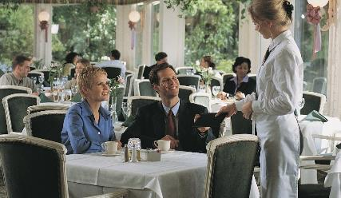
Service Staff Responsibilities
Formal service organization:
Maître d’hôtel—overall management of service
Headwaiter—particular area (banquet room or dining room)
Captain—server area (15–25 guests)
Front waiter—assists captain
Apprentice—server in training

Slide 3
Service Staff Responsibilities
Less formal service structure:
Floor manager
  Runs dining room
  Supervises team of servers
Server—specific section of dining room
Food runners—bring food to tables
Busers
  Dining room attendants
  Clean up and reset tables
Limited-service/quick-service operations
  Cashier
Roles modified—size and type of operation
Notes:
In less formal service structures, the organization may change. Here, a floor manager might run the dining room. The floor manager is in charge of the
operation during a particular shift and supervises a team of servers. Each individual server is responsible for a specific section of the dining room. Food runners are sometimes employed to assist with bringing food from the kitchen to the tables. Busers, also known as dining room attendants, assist with the cleaning up and resetting of tables. And in some limited-service or quick-service operations, a cashier might also act as host, server, and food runner. Roles are often modified to fit the size and type of restaurant as well as how many guests are served.
No matter how an operation organizes its employees, it is important that each person know his or her role, assigned tasks, and responsibilities.

Slide 4
Service Staff Responsibilities
Modified service structure:
Floor manager
  Oversee front-of-house staff
Host or hostess
  Greeters
  Maintain restaurant flow
Waitstaff
  Primary servers
Buser/dining room attendant/runner
  Combined or split
  Assist waitstaff—serving and cleaning tables
Notes:
In today’s contemporary full-service restaurant, many operations follow a modified service structure. Compared to formal service, it is a more collapsed system. This may include the following staff:
Floor manager: This manager is responsible for overseeing the restaurant’s front-of-the-house staff. He or she may assist with the flow of guests and food in the event of a staff shortage or an unusually busy time at the restaurant.
Host or hostess: These are greeters for the restaurant. In addition, they maintain the flow in the restaurant by seating guests. They regulate the number and frequency of people being seated and ensure that the waitstaff have guests that are seated evenly (not too many at one time to properly serve). Finally, they are also an important contact point for guests, as they are the first people with whom the guests will interact.
Waitstaff: These are the primary servers for the restaurant. Their role is to ensure guests are served everything they order in a timely manner. Waitstaff manage a number of functions that are usually handled by several people in formal service.
Buser/dining room attendant/runner: These roles may be combined or split up, depending upon the restaurant’s organization. However, this position serves to assist the waitstaff in both serving and clearing tables.

Slide 5
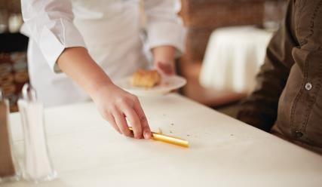
Service Tools and Stations
Service tools:
Corkscrew
Change
Pen
Order pad
Crumber
Notes:
In full-service restaurants, servers usually carry many different service tools with them. These may include a corkscrew, change, a pen, an order pad, and a crumber (which is used to neatly gather and clear crumbs and debris from a table cloth after entrée service).

Slide 6
Service Tools and Stations
Service station:
Frequently used items close by
  Napkins
  Silverware
  Cups and saucers
  Condiments
  Menus
  Water glasses
Notes:
The service station is the area in which an operation keeps additional items such as napkins, silverware, cups and saucers, condiments, menus, and water glasses. A service station prevents servers from having to go to the back of the house to get these tools. It is a good way to keep frequently needed utensils close by.

Slide 7
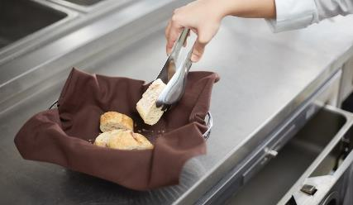
Service Tools and Stations
Serving utensils:
Serve food to guests
Large serving spoons
  Casseroles and vegetables
Pastry tongs
  Individual pastries
Cake and pie servers
Notes:
Servers use different serving utensils when they serve food to guests. They use large serving spoons for casseroles and vegetables and pastry tongs to
serve individual pastries, such as cream puffs and small cakes. Cake and pie servers come in many shapes to match the size of the piece of cake or pie. This keeps the dessert from breaking apart as it is served.
While not all restaurant managers and owners will require servers to carry the full set of server tools (they are less common in less formal settings), standard tools can be considered a pen, a notepad for taking orders (or tablet), and a corkscrew for opening bottles. Serving utensils are not used as often, as most food items are served completed on plates for each guest.
See the Essential Skills feature: Left, Right, Left—Proper Placements for Table Service, on page 438.

Slide 8
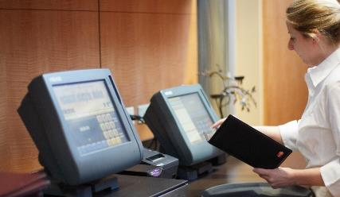
Service Tools and Stations
Point-of-sale (POS):
Orders taken by waitstaff
Punched into POS for production
Proper training
Please crop out half of me – so you don’t see jeans and pony tail
Notes:
Generally, the service station setup is very similar to that in formal operations. The objective is to have the proper equipment (utensils, extra glassware, etc.) nearby to help serve the guests quickly.
One feature found in almost all restaurants is a point-of-sale (POS) system. Guest orders are taken by the waitstaff and punched in on the POS
system for production. Drink orders may either be sent to the bar or taken care of by the waitstaff, depending upon the restaurant setup. Food orders are sent to the kitchen for production.
Waitstaff need proper training on how to use the POS system, from entering the order correctly to creating modifiers if needed, and ensuring that the final check is accurate. Modifiers are any type of modification to a menu item or a special concern. This can range from extra sauce or removal of a condiment from an item to the listing of a food allergy.

Slide 9
Reservations and Requests
Accurate system
Record reservations
Special requests
Implement at right time
Notes:
A lost or incorrect reservation or a mishandled special request can be extremely frustrating for guests. If a guest’s visit starts with this kind of problem, it can be difficult to turn the visit into a positive experience. That is why it is extremely important to have an accurate system to record reservations and special requests and implement them at the right time.

Slide 10
Reservations and Requests
Save in one place
When information recorded
Who recorded information
Guest name
Guest contact information
Date and time of arrival
Number of people in party
Special needs
Notes:
The type, speed, and complexity of the restaurant determine how sophisticated the system is and what technology is used. For example, a fine-dining restaurant with table service may record reservations and special orders in a book or computer at the host station. Reservations and requests are saved in one place and include standard information, such as when the information was recorded and who recorded it. The information recorded should contain the following:
• Guest name
• Guest contact information
• Date and time of arrival
• Number of people in the party
• Any special needs or requests the guest may have

Slide 11
Reservations and Requests
Confirm reservations and special requests
Good customer service
Guests feel important
Helps management plan—labor and food
Special events
  No-shows—charge guests
Flag special requests
  Attentive to request
  Communicate better
  Avoid errors
Notes:
Confirming all reservations and special requests is good customer service. It makes the guests feel important and helps management to plan food and labor needs, controlling the flow of guests and food orders throughout the shift.
Some operations ask for credit card numbers to confirm the reservation when it is placed. This is done frequently for special events. Some places charge guests for “no-shows”—when guests do not honor the reservations they have made.
With special requests, it is important to have a way to “flag” or call attention to the special request. This ensures that cooks, servers, and other
staff will be more attentive to the request, communicate better with each other to fulfill the request, and avoid errors. Taking reservations and completing special requests may seem like simple tasks, but they actually take planning and organization. Proper procedures help operations
build strong guest loyalty.

Slide 12
Reservations and Requests
POS systems:
Capture information for future use
Track reservations
Assign tables
Regulate flow of restaurant
  Limit guest wait times
Track individual needs
  Times dined at location
  Favorite menu items
  Table preferences
  Food allergies
Notes:
Today, with the increased use of POS systems, most of this information can be captured for future use. There are modules within a POS system that can track reservations, assign tables, and even help staff regulate the flow of the restaurant by suggesting when reservations can be taken. This can help the restaurant limit guest wait times for tables.
Individual guest needs can also be entered to help with future reservations. For instance, by using a phone number from a guest, the POS system can track how many times the guest has dined there, what his or her favorite menu items are, any preference on tables, and food allergies, to name a few items. This is a powerful tool that can help attract and maintain repeat business.

Slide 13
Greeting Guests and Taking Orders
Host/greeter:
Ask about reservation
Note special dietary needs, seating arrangements, celebrations, etc.
Arrange guests to be seated
Notes:
The host or hostess, or greeter, provides the first impression of the operation—in appearance, friendliness, and attentiveness. The host or hostess evaluates and determines the guest’s specific needs for the current visit and is responsible for the following:
Asking whether the guests have a reservation and, if so, checking the reservation log for all information pertaining to the guests’ visit (if reservations are taken at the operation)
Noting any special dietary needs, seating arrangements, celebrations, and so on, and passing the information along to the rest of the staff
Arranging for the guests to be escorted to their seats
In a full-service operation without a host or hostess, these tasks fall to the server or dining room manager.

Slide 14
Greeting Guests and Taking Orders
Server notes orders on guest checks
Entered into POS machine
Guest ticket to kitchen staff
Note special requirements
  Confirm kitchen understands
  Double-check requests
Notes:
After the guests are seated, the server takes over. As each guest at the table selects his or her meal, the server notes guest orders on preprinted guest checks or small notepads. These written orders may be entered into a POS machine at the wait station, or the guest ticket may be handed directly to the kitchen staff to start the meal preparation.
Some guests will ask the server whether certain ingredients can be removed from dishes due to food allergies or other special needs.
Servers need to correctly note any special requirements in the preparation of a guest’s food item and ensure that the kitchen understands
the request. Double-checking written receipt of special requests with the chefs is always a good idea.

Slide 15
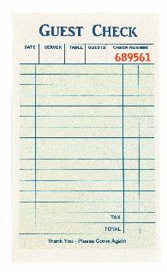
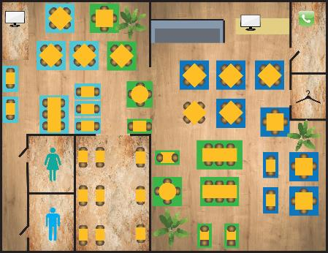
Taking a Table-Side Order
Proper seat and table numbers
  Approach at specific point
Use grid to write down delivery sequence
Standardized abbreviations
Note temperature requests
Repeat order back
Notes:
Orders need to be written down carefully, using the same method each time. A server should do the following when writing the table check:
Include proper seat and table numbers where appropriate. Each dining room has a pivot point, such as the front door, which establishes the location of seat number one—closest to the pivot point. The numbering of seats continues counterclockwise. The server approaches each table at the specific place determined by the floor plan.
Use a grid to write down the order in delivery sequence; for example, drink, appetizer, soup, salad, entrée, and—eventually—dessert. Remember, it is critical to keep everything organized and consistent for all checks.
Use abbreviations, usually standardized by management or the kitchen, to ensure clear communication. Examples can be temps (for temperatures), CB (for cheeseburger), BK (for blackened).
Take and note temperatures for dishes cooked to order, such as burgers and steaks, along with any special requests by the guests.
Finally, repeat the order back to the guests before leaving the table.

Slide 16
Suggestive Selling
Recommend items to guests
Keys to success
Maximizes guest satisfaction
Increases average check—more profits
Success of suggestive selling depends on
  Product knowledge
  Effective communication skills
  Sales training
Notes:
Suggestive selling involves recommending items to a guest. It is one of the keys to the success of any retail business. In a restaurant, suggestive selling
maximizes guest satisfaction and increases the average check, resulting in more profits. The success of suggestive selling depends on product knowledge, effective communication skills, and sales training.

Slide 17
Suggestive Selling
Enhance communication skills
Develop product knowledge
Learn which items compliment one another
Anticipate guest needs
Suggest add-on items
Identify items based on preferences
Notes:
Many employees are reluctant to pursue suggestive selling because they are shy or uncomfortable with selling (feeling that they are acting “pushy”). Managers who train servers commonly point out that it will increase the guest’s check and, therefore, potentially the server’s tip. A good suggestive selling program includes the following efforts from managers and servers:
Enhance servers’ communication skills, so they can be effective with guests.
Develop servers’ product knowledge, so they can vividly and accurately describe items to guests. Servers need to be able to answer specific questions about the menu items, including ingredients, preparation techniques, and levels of seasoning.
Learn which menu items complement one another.
Anticipate guest needs.
Suggest add-on items such as drinks, appetizers, and desserts.
Identify specific items based on guest preferences; for example, “If you like chocolate, you’ll love our new Molten Lava Cake.”

Slide 18
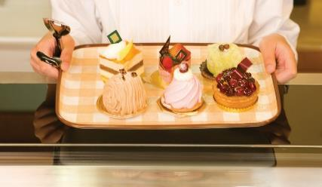
Suggestive Selling
Suggest items servers enjoy
Suggest “best” or “most popular” items
Use props
Observe guest behavior
Positive effect on financial position
Notes:
Suggest items that servers themselves enjoy.
Suggest the operation’s “best” or “most popular” items, increasing the probability that the guest will be happy.
Use props, such as dessert trays, to show the dish.
Observe guest behavior to determine whether they want service or a product; for example, at the end of the meal, watch the guest to see whether he or she wants the check or dessert.
Recognize the positive effect of suggestive selling on the financial position of the operation.

Slide 19
Suggestive Selling
Daily specials
Recommendations
Specialties
Enhancements
Use active and descriptive words
Confirm a good decision was made
Show enthusiasm for guest suggestions
Server recommendations
Training
  Formal
  Ongoing
  Informal—observation and feedback
Notes:
Talking about daily specials is a part of suggestive selling. Most servers mention these “deals” right after the guest is seated. And most guests welcome recommendations and are more than willing to try specialties. In addition, servers can use upselling to add an enhancement, such as chicken on a salad or a premium beverage ingredient.
Using active and descriptive words to explain food is a great way to suggestively sell menu items. Words such as sweet, juicy, mouth-watering,
prime, and rich make food sound appetizing. Other words provide an actual description of the item (e.g., sashimi-grade, organic, heirloom). If the server can legally make these claims, he or she should. For example, “Our Belgian waffles are made with fresh eggs, whole wheat flour, and milk, and are served hot from the griddle, topped with fresh strawberries and pure whipped cream or vanilla ice cream.”
After guests place an order, let them know they have made a good decision by saying something like, “Excellent choice. We get fresh deliveries of salmon daily. I think you’ll really enjoy it.” This makes guests feel good about their decision, and they will look forward to the meal. Show enthusiasm for the items that guests suggest. Servers can also recommend menu items that they personally like. Management should establish a policy that staff be honest with guests when they ask for personal recommendations, as guests can often detect and appreciate sincerity.
Training on suggestive selling is an ongoing effort. First, a manager or designated trainer can conduct training formally. Second, suggestive selling can
be an occasional agenda item for staff meetings. Managers can set aside time at these meetings to discuss the best practices or problem experiences. Third, informal training can occur through observation and feedback. In all cases, practice is the key to successful suggestive selling.

Slide 20
Alcohol Service
Professional and safe
Effects of alcohol
Familiar with local laws
Notes:
The service of alcohol is frequently an integral part of a dining experience. It is essential that alcohol service is conducted professionally and safely. Managers and staff must understand the effects of alcohol and become familiar with all local laws that apply to their operations.

Slide 21
Alcohol Service
States:
Own liquor laws
Oversees sale and service of alcohol
Liquor board/authority:
Develops and enforces regulations
Issues and monitors liquor licenses
Issues citations for violations
Holds hearings for violators
Notes:
Every state has its own liquor laws and oversees the sale and service of alcohol within its borders. Each state’s liquor board or liquor authority develops and enforces these regulations. These agencies also are responsible for issuing and monitoring liquor licenses, issuing citations for violations, and holding hearings for violators of the liquor code.

Slide 22
Alcohol Service
Laws vary state to state
Dram shop laws
Special liability for operations
Counties and towns—stricter laws
Notes:
Laws vary considerably from state to state. Many states have dram shop laws, which create a special liability for operations with liquor licenses and for the people employed there. These laws allow a person, who may not even have been in the operation, to sue the business, its owners, and its employees for injuries caused by a guest who was drinking there. In addition, many counties and towns have their own—often stricter—liquor laws.

Slide 23
Alcohol Service
Criminal charges for:
Serving alcohol to minors
Serving intoxicated guests
Possessing, selling, or allowing sale of drugs
Allowing minors to sell alcohol
Notes:
Sellers or servers of alcohol may face criminal charges for the following actions:
• Serving alcohol to a minor
• Serving a guest who is, or appears to be, intoxicated
• Possessing, selling, or allowing the sale of drugs on the premises
• Allowing a minor to sell alcohol
In Illinois, for example, selling or serving alcohol to a minor is punishable by a fine of up to $2,500 and a jail sentence of up to one year.

Slide 24
Alcohol Service
Blood alcohol content:
Alcohol absorbed in bloodstream
0.1—one drop alcohol/1,000 drops of blood
BAC 0.8 or higher—cannot operate motor vehicle
BAC 0.3—coma or death
Notes:
The amount of alcohol absorbed into a person’s bloodstream is called the blood alcohol content (BAC). A BAC of 0.1 means that there is about one drop of alcohol present for every thousand drops of blood. In all 50 states, it is against the law to operate a motor vehicle with a BAC of 0.08 or higher. A BAC of 0.3 or higher can lead to coma or death.

Slide 25
Alcohol Service
Purchase alcohol—21 years old
Serve alcohol—18 or 21 years old
Notes:
In all 50 states, you must be 21 years old to purchase alcohol. In some states, it is currently legal for a parent or legal guardian to purchase alcohol and serve it to a minor in his or her custody. In general, a server must be 21 years old to serve alcohol, but in some states you can be 18 years old and serve alcohol.
For example, some states allow underage servers to bring alcohol to the table, but they cannot pour it. Other states allow underage servers to take the order and payment for the drink, but do not allow them to serve it. Some states require the underage server to apply to the liquor authority for permission to serve alcoholic beverages. In some areas, the law does not even allow minors to enter a tavern or restaurant bar area.

Slide 26
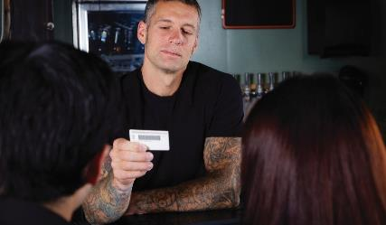
Alcohol Service
Checking IDs:
Politely ask for ID
Verify ID
  Valid
  Not issued to minor
  Genuine
  Belongs to guest
Serve or refuse guest
Notes:
If you sell or serve alcohol, you are responsible for ensuring that guests are of legal age to drink. The best way to do that is by checking each guest’s
identification (ID). The proper procedure for checking IDs is the following:
Politely ask the guest for ID.
Verify the ID. Make sure it is valid, has not been issued to a minor, is genuine, and belongs to the guest. If you are unsure, ask for another form of ID, compare the guest’s signature to the one on the ID, or ask questions only the ID’s owner could answer. (For example, “How tall are you? What is your middle name?”) Notify the manager of any suspicious forms of ID.
Serve or refuse the guest.

Slide 27
Alcohol Service
Genuine IDs:
Signs of tampering
  Bubbles
  Creases
Improper thickness
Ink signatures
ID readers—bar codes or magnetic strips
Fake IDs:
Refuse service
Refuse entry
Confiscate ID
Check with manager
Follow company policy
Notes:
To make sure an ID is genuine, look for signs of tampering, including bubbles and creases, improper thickness, and ink signatures. If you spot a fake ID
there are several possible steps you can take, depending on company policy and the laws in the area. This may include refusing service, refusing entry to the operation, and/or confiscating the ID. Always check with the manager regarding suspicious or fake IDs and follow company policy.
Some operations use ID readers to check IDs with bar codes or magnetic stripes. Although these tools can help verify the age of a person, use them in
conjunction with other checking procedures to make sure the ID is valid.

Slide 28
Alcohol Service
Acceptable forms of photo IDs:
Driver’s license
State ID card
Military ID
Passport
Minor’s ID:
Easy to spot features
  Hologram
  Stamp “Under 21”
Notes:
Acceptable forms of photo ID include the following:
• Driver’s license
• Military ID
• State ID card
• Passport
In most states, proper ID does not include a birth certificate, school ID, or voter’s registration card. All states add special features on a minor’s ID to make an underage guest easy to spot, such as a hologram visible when turning the photo or a stamp of “Under 21” across it.

Slide 29
Alcohol Service
Valid IDs:
Check with manager
Use ID checking guide
Follow operational policies
Notes:
Check with your manager to learn the valid IDs issued by your state, or use an ID checking guide. These guides provide full-size samples of each state’s driver’s licenses, minor IDs, and state ID cards in current circulation.
Because it is illegal to serve alcohol to a minor, card any guest who appears to be under 21 years of age. To take the guesswork out of carding, many
operations require staff to card guests who appear to be less than 30 years old. Always follow house policies on when to card.

Slide 30
Filing Alcohol-Related Reports
Document incident
Provide accurate information
Fill out immediately
Notes:
When an alcohol-related incident—such as a fight or fake ID usage—occurs on an operation’s premises, the manager completes a report to document what happened and what actions were taken to address the situation. The manager should provide accurate information and fill out the report immediately so important facts are not forgotten.

Slide 31
Filing Alcohol-Related Reports
Complete reports for:
Stopping alcohol service
Arranging alternate transportation
Confiscating ID
Illegal activity or violent situation
Guest becomes ill
Guest becomes injured
Notes:
Reports are often completed for all of the following reasons:
• The operation stops alcohol service to a guest.
• The restaurant or foodservice operation arranges alternate transportation for a guest.
• The manager confiscates a guest’s ID.
• An illegal activity or violent situation takes place.
• A guest becomes ill (requiring medical treatment).
• A guest becomes injured.
Remember, incidents involving alcohol use can be very serious. It is always best to have an incident report on file.

Slide 32
Traditional Service
Traditional service
  American
  French
  English
  Russian
Service style matches menu, theme, décor
Notes:
The style an operation uses to serve its guests can often define how people come to think of that operation as a whole. In fact, sometimes the service style is more of a factor in determining the identity of an operation than the food itself. This section discusses traditional service styles and their various table setups, as well as contemporary service. The traditional roles and responsibilities of service staff members are also discussed.
Traditional service reflects four main influences: American, French, English, and Russian. Each service style matches the menu, theme, and décor.

Slide 33
Traditional Service
American service:
Food arranged on plate in kitchen
Brought to guests’ table by server
Complete meal on plate
Easiest service style
Consistent-looking product
Uses fewest tools and utensils
Notes:
American service: Food is arranged on plates in the kitchen by cooks and brought directly to the guests’ table by the server. The complete meal is on one plate. American service has quickly been adopted by many operations because it is one of the easiest service styles, provides a consistent-looking product, and uses the fewest tools and utensils.

Slide 34
Traditional Service
French service:
Most elegant
Very expensive
Guéridon—table-side cart
  Holds food or liquid items
  Dishes and utensils
Réchaud—warming unit in cart
Finishing touches done table-side
  Craftsmanship in culinary arts and service skills
Notes:
French service: This style is typically considered the most elegant, but it is very expensive. Servers present the food to guests from a table-side cart, called a guéridon. A guéridon (gay-ree-DAHN) holds food or liquid items that will be served to guests, as well as dishes and utensils the servers and guests may need. The food is kept hot by a warming unit in the cart, called a réchaud (ray-SHOW). The finishing touch to the food is done table-side to create a memorable moment for the guest. Table-side cooking is the art of showing great craftsmanship in both culinary arts and service skills. This type of service is expensive to implement because of the cost of the carts and the additional skills required of the servers.

Slide 35
Traditional Service
English service:
Family-style dining
Simplest and least expensive
Bowls and platter on table
Seated host places food onto plates
Diners pass dishes around table
Used in conjunction with American style
Notes:
English service: Also known as family-style dining, English service is the simplest and least expensive. In English service, bowls and platters of food are placed on the table and a seated host or hostess places the food onto plates. The host or hostess of the table then serves the meal on the plates for the other diners, or diners pass the dishes around the table so they can serve themselves. Although not as common as American service, family-style dining is gaining in popularity due to its simplicity. It is also used in conjunction with American style for side dishes.

Slide 36
Traditional Service
Russian service:
Most formal
Preparation done in kitchen
Bowls and platters on carts
Servers serve guests
Servers—extensive training
Notes:
Russian service: This style is the most formal service style. All food preparation is done in the kitchen. The bowls and platters of food are then brought on a cart to guests at the table. Servers hold the bowls and platters as they serve the food to each guest. Service platters hold food for tables of up to eight guests, but are very heavy (in previous times they were made of pure silver) and very hot. Servers need to go through substantial training before being able to serve Russian style. The server is essentially in charge of making the plate look perfect.

Slide 37
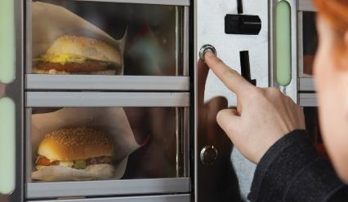
Contemporary Service
Quick-service dining:
Easy and fast
No servers
Guests help themselves
  Food bars
  Order at counters
Drive-through
Buffet
Carry-out
Vending
Cafeteria
Notes:
Quick-service dining is an easy and fast way to dine and typically involves no servers. Instead, guests help themselves to food set up in food
bars or order at a counter. Other forms of quick-service dining include drive-through service, buffet service, carry-out service, vending service,
and cafeteria service.

Slide 38
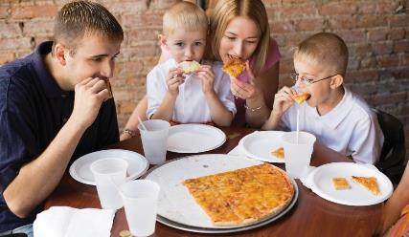
Contemporary Service
Fast casual:
Between full and quick service
Quick-casual or limited-service
Better-quality food
More upscale dining area
Less expensive menu than full-service
Notes:
Fast-casual is relatively modern terminology describing a restaurant that falls between full service and quick service. Also called quick-casual
or limited-service restaurants, these operations are typically distinguished by service type and food quality. Fast-casual restaurants are often
perceived to offer better-quality food and a more upscale dining area than quick-service restaurants, but with less expensive menu items than
full-service restaurants. Pizza restaurants can fall into this category.

Slide 39
Types of Knives
Used to butter bread
Not sharp
Used only to fillet and
cut fish
Used for all entrées and main courses
Not sharp

Slide 40
Types of Knives
Used for salads
Not sharp
Serrated edge
Used to cut beef

Slide 41
Types of Forks
Three tines
Eat cakes, tortes, pies,
and pastries
Broader tine
Cut through soft cake or other pastry like a knife
Used for all entrées and main courses
Not sharp
Notes:
Cake fork
Has only three tines (narrow ends of a fork used to pierce food items) and is used to eat cakes, tortes, pies, and pastries.

Slide 42
Types of Forks
Used for fish
Small, round fork
Used for both oysters and clams

Slide 43
Types of Forks
Smaller than dinner fork
Used for salads, appetizers, desserts, fruit, smoked fish, and other delicate foods
Small, thin fork
Used for shellfish

Slide 44
Types of Spoons
Rounded spoon head
Used for clear soups or broths
Much smaller than coffee spoon
Matches small espresso cups
Smaller than soup or sauce spoon
Used with coffee, tea, and hot chocolate
Used for fruit cocktails and ice cream

Slide 45
Types of Spoons
Jagged tip
Used to carve grapefruit
Used for dishes served with sauce on side

Slide 46
Types of Spoons
Oval spoon head
Used for cream soups and long strands of pasta
Long handle
Dip into deep sundae
Stir large glasses of iced tea

Slide 47
Traditional Service Setups
Snail tongs—used to hold a snail shell
Shell cracker—crack shells of lobsters and crabs
Notes:
Use other utensils for food items that are a bit more difficult to eat. For example, snail tongs are a specialized utensil for holding a snail shell so the snail can be removed. Because the shells of lobsters and crabs are hard and thick, use a shell cracker to crack them.
It is important to note that not all operations use all utensils or set them at tables. Often in quick-service or fast-casual operations, you will only find forks, knives, and spoons; and they are often placed in the dining area buffet-style for guests to choose themselves. They also often use disposable sets of forks, knives, and spoons.

Slide 48
Traditional Service Setups
Drinking glasses:
Many shapes and sizes
Glass, plastic, ceramic
Cold drinks
  Soda, water, iced tea
  Clear glass
Hot drinks
  Coffee, tea, cocoa
  Cups or mugs
  Thick glass or ceramic
  Drinks stay hot
Notes:
Drinking glasses: These come in many shapes and sizes and are usually made of clear glass, plastic, or a thicker, solid ceramic. They also include mugs and cups. Generally, if a drink is cold, like soda, water, or iced tea, it will come in a clear glass. Hot drinks, like coffee, tea, and cocoa, are usually served in cups or mugs made from thick glass or ceramic. This helps drinks stay hot.

Slide 49
Various Types of Drinking Glasses

Slide 50
Various Types of Drinking Glasses

Slide 51
Types of China/Dinnerware
Used for bread and butter
Underliner for jams and other condiments that spill easily
Service plate
Larger plate
Used during full-course dinners
Dress up special events
Ten to twelve inches across
Used for all kinds of entrées and main courses
Underliner for smaller plates and bowls
Notes:
China: Perhaps the most important part of the table setting is the china, which is also referred to as dinnerware. Like glasses, cups, and silverware, plates have adapted to fit the various types of food.

Slide 52
Types of China/Dinnerware
Much smaller than dinner plates
Seven or eight inches across
Used for desserts, salads, and appetizers
Underliner for gravy, sauceboats, sundae glasses
Very small, shallow bowl
Used for relishes or dipping sauces
Notes:
Salad plate
Much smaller than a dinner plate, usually seven or eight inches across, and used for desserts and appetizers as well as salads, and as an underliner plate for gravy, sauceboats, and sundae glasses (served with a napkin or paper doily to prevent slipping).

Slide 53
Types of China/Dinnerware
Flat, round edge
Dip in center
Holds soup, pasta, stew, and shellfish
Small and deep
No flat edge
Used only for soup
Serve with underliners
Notes:
Soup bowl
Smaller and deeper with no flat edge and used only for soup. Soup bowls or cups are sometimes equipped with lids (individual tureen) or a single handle for easier service. Serve these bowls and cups on underliners.

Slide 54
Traditional Service Setups
Tureen
  Large covered bowl
  Serve soup for up to eight people
Snail plate
  Six or twelve indentions for holding snails
Gravy boat
  Special lip or spout
  Prevent spilling when pouring gravy or sauce
Finger bowl
  Small bowl filled with water and citrus fruit slice
  Clean finger after eating
  Shellfish and ribs
Notes:
Though the pieces mentioned previously can be used for many food items, a number of china pieces are used for only one purpose.
For example, use a tureen, a large covered bowl, to serve soup for up to eight people. A snail plate has six or twelve indentions for
holding snails. A gravy boat has a special lip or spout to prevent spilling when pouring gravy or sauce onto the plate. Use a finger bowl,
a small bowl filled with water and often a citrus fruit slice (lemon or orange), to clean the fingers after eating, especially with messier meals
such as shellfish and ribs. And, again, most of these pieces will not be used in less formal quick-service and fast-casual operations, where it
is more common to see a dinner plate and salad plate or disposable plates.
Plates and utensils should be cleared promptly after each course to keep interaction with the guests to a minimum during the meal.
Beverages either need to be refilled or the glassware removed.

Slide 55
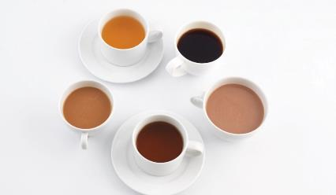
Coffee, Tea, and Cocoa
Coffee:
Ground coffee beans
Berries of tropical shrub
Roasted to develop flavor
Light, medium, dark
Americans—medium roast
Europeans—dark roast
Flavored coffees
Notes:
Beverages are a crucial part of any restaurant’s menu—whether the options being offered are basic or complex. Many times, a sip of coffee or a specialty drink is the first or last impression a guest will have of a restaurant. Today, virtually all operations have both hot and cold beverage options, with many also serving alcoholic beverages in a variety of styles.
U.S. consumers spend billions of dollars every year on coffee, with most Americans drinking more than one cup a day. Coffee is made from
ground coffee beans, which are the berries of a tropical shrub, that are roasted to develop flavor. The degree of roasting, which can be light,
medium, or dark, affects the flavor of the coffee. Americans generally prefer medium roast, while dark-roast coffee is popular in Europe.
Flavored coffees such as hazelnut, almond, mint, chocolate, blueberry, and strawberry are also available.

Slide 56
Coffee, Tea, and Cocoa
Tea:
Leaves of certain plants
Less expensive than coffee
Half the caffeine of coffee
Black tea—fermented leaves
Green tea—leaves not fermented
Oolong tea—partially fermented
Herbal tea
  Different fruits and herbs
  Caffeine-free
Notes:
Tea, which is made from the leaves of certain plants, is generally less expensive than coffee, although some rare teas can be quite expensive. One cup of tea has about half the caffeine contained in a cup of coffee. There are black teas (tea leaves that have been fermented) and green teas (tea leaves that are not fermented). Oolong tea is partially fermented. Herbal tea is made from many different fruits and herbs and is naturally caffeine-free.

Slide 57
Coffee, Tea, and Cocoa
Hot cocoa
  Cocoa powder or shaved chocolate and sugar
  Stirred into heated milk or water
  Lower in fat
  Instant form—dry mix of cocoa powder, sugar, and dry milk
Hot chocolate
  Made from chocolate bars
Topped with marshmallows or whipped cream
Notes:
Hot cocoa is made from cocoa powder or shaved chocolate and sugar stirred into heated milk or water. The terms “hot chocolate” and “hot cocoa” are often used interchangeably, but there is a difference. Hot chocolate is made from actual chocolate bars. Hot cocoa is made from the powder of the cacao bean. Hot cocoa is much lower in fat than hot chocolate because the cocoa butter (which is added back to the chocolate bars when manufactured) is extracted when the cocoa powder is ground from the cacao bean. Hot cocoa is usually made from its instant form—a dry mix of cocoa powder, sugar, and dry milk—mixed with hot milk or water. Hot cocoa drinks can be topped with marshmallows or whipped cream.

Slide 58
Coffee, Tea, and Cocoa
Serve hot beverages hot
Hold brewed coffee for an hour or less
Clean coffee urns regularly
Offer decaffeinated options
Notes:
These beverages can be served at any meal. Follow these guidelines:
• Serve hot beverages hot. All hot beverages should be very hot and steaming for service.
• Hold brewed coffee for only an hour or less. After that time the loss of flavor is considerable. Plan coffee production so that coffee is always fresh.
• Clean coffee urns regularly to avoid mineral buildup and ensure good-tasting coffee. To clean urns, follow the manufacturer’s recommendation.
• Offer decaffeinated options. Some people are sensitive to the effects of caffeine, a stimulant. Both coffee and tea have decaffeinated versions.
Coffee is typically served hot, but iced coffee has also become very popular. Tea is served either very hot or iced.

Slide 59
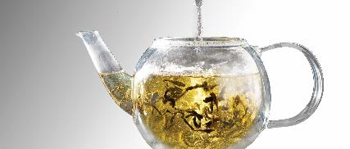
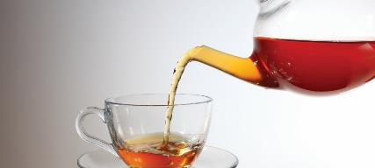
Making Hot Tea with Tea Leaves
Put tea leaves in preheated, empty pot
  Use one tsp of tea or bag for 6 oz of water
2. Pour boiling water into pot
3. Let tea steep for 3 minutes
4. Serve immediately
Notes:
Put tea leaves into a preheated, empty pot. Use one teaspoon of loose tea or one single-service tea bag for every six ounces of water.
Pour boiling water into the pot.
Let the tea steep (soak) for at least three minutes.
Serve immediately after steeping. Tea will become bitter if left to steep too long.

Slide 60
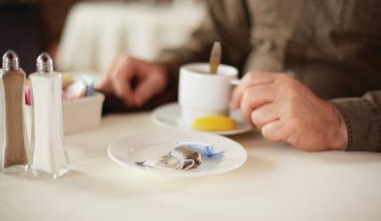
Service of Hot Beverages
Serve beverages quickly and correctly
Dispense table-side or in cups (⅔ full)
Cup and saucer
  Serve on the right
  In front of guest
  Handle—four o’clock
Teaspoons—place on right of guest
Hot water—serve with tea
Sweeteners and milk or cream
  Place on table
  Handles facing right
Small dish to collect used items
Notes:
After taking the beverage order, serve the beverages quickly and correctly. For all hot beverages, the restaurant needs to determine how they will be served: either dispensed table-side or in cups brought over two-thirds filled. In either case, if the guest is dining in, the following service concerns need to be addressed:
• If used, the cup and saucer need to be served on the right, in front of the guest, with the handle facing four o’clock.
• Teaspoons (if not already on the table) need to be placed on the right side of the guest.
• Hot water needs to be served with tea, if servers are dispensing table-side.
• Sweeteners and milk or cream containers are placed on the table with handles facing to the right (if not already present).
• In some operations, a small dish is placed on the table to collect used tea bags, sugar packets, etc., to prevent them from touching the table.

Slide 61
Service of Hot Beverages
Check for refills
Refer to restaurant policy
  New cup and saucer
  Refill at table
Check milk, cream, sweeteners available
  Refill if necessary
Notes:
Servers should check with guests periodically to see if they need refills. If a refill is needed, refer back to the restaurant’s policy on how to perform this
service. Some restaurants bring a completely new cup and saucer, some refill on the table, etc. Check to see that enough milk, cream, and sweeteners are still available for the guest (or refill those, if necessary).

Slide 62
Cold Beverages
Traditional options
Iced tea—sweet and unsweetened
Soft drinks
Bottled water
Nonalcoholic drinks
Notes:
Traditional cold beverage options in a restaurant include iced tea, soft drinks, bottled water, and other nonalcoholic drinks. Very popular in the South, iced tea is a refreshing beverage that is enjoyed typically during the warmer months of the year. Note that both sweet tea and unsweetened tea should be available for service. Make sure you label each type of tea dispenser in the service area to avoid confusion.

Slide 63
Cold Beverages
Iced tea:
Brew large portion of hot tea
Add sugar or sugar syrup
Thoroughly mix
Add ice
Notes:
The best iced tea is made by brewing a large portion of hot tea and then either adding sugar or sugar syrup to the hot tea. This is thoroughly mixed to ensure that all of the sugar has dissolved, and is then chilled through the addition of ice. Treat this procedure as a recipe with measurements to ensure it is made the same each time for guest satisfaction.

Slide 64
Cold Beverages
Soft drinks:
Soda or fountain drinks
Syrup and carbonated water
Contract soda company
Serve half filled with ice
  Proper temperature
  Does not dilute quickly
  Decreases refills
Notes:
Soft drinks, also called sodas or fountain drinks, are also popular. Fountain drinks gain their name from the fountain dispensers that mix different types of sodas from syrups with carbonated filtered water. There are numerous brand names on the market, so adequate research should be done to choose sodas your restaurant should carry to please your guests. It is wise to contract a soda company that will provide and maintain the equipment, only charging for the purchase of the syrups. Serve sodas in a glass half filled with ice to allow for proper temperature. This will not dilute the drink quickly and will lower the number of refills needed.

Slide 65
Cold Beverages
Water provided at table
Bottled water
  Flat
  Sparkling
  Upcharge—premium product
  Bottle disposal—recycle
Notes:
Bottled water has become one of the fastest growing nonalcoholic segments in the industry. Most restaurants automatically provide water at the table. A high proportion of this water is not consumed. The restaurant, therefore, is paying for the water, along with the costs associated with washing the glassware. Bottled water, flat or sparkling, can be considered an upcharge, as the restaurant is now offering a premium product. But the restaurant will now have the issue of disposal of the bottle, preferably through recycling.

Slide 66
Cold Beverages
Nonalcoholic drinks:
Lemonade
Fresh fruits and vegetables
Less sugar than soda
Seasonal opportunities
Signature drink
Use recipes
  Consistency
  Guest satisfaction
Notes:
Nonalcoholic drinks, such as lemonade, are becoming a fashionable alternative to sodas and alcoholic drinks. They can be made with fresh fruits
and vegetables, offer an alternative to more conventional drinks, and tend to contain less sugar than soda. Since they can be made fresh, they offer seasonal opportunities for menu changes and give the restaurant a signature drink. Ensure that recipes are used to maintain drink consistency and guest satisfaction.

Slide 67
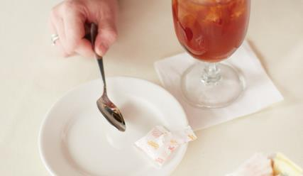
Cold Beverage Service
Serve quickly and correctly
Dispense at server’s area
Coaster or napkin—placed on right
Drink placed on coaster or napkin
Teaspoon, iced tea spoon, or straw
Appropriate sweeteners
Small dish to collect waste
Check for refills
Refer to restaurant policy
  New glass
  Refill at table
Refill sweeteners if necessary
Notes:
As with hot beverages, after taking the beverage order, serve the beverages quickly and correctly. Traditionally, most cold beverages are dispensed at
the server’s area and brought to the table. However, please ensure that the following service procedures are done:
• On tables without tablecloths, either a coaster or napkin is placed in front of the guest, preferably to his or her right.
• The drink is placed on the napkin or coaster.
• Either a teaspoon, iced tea spoon, or straw is served with the drink (as needed).
• Appropriate sweeteners are placed on the table (if not already on the table).
• Again, in some operations, a small dish is placed on the table to collect sugar packets and other refuse, to prevent them from touching the table.
As with hot beverages, servers should check with guests periodically to see if refills are needed. If a refill is needed, refer back to the restaurant’s policy on how to perform this service. Some restaurants bring a completely new glass, some refill at the table, etc. Also ensure that there are enough sweeteners still available for the guests (or refill, if necessary).

Slide 68
Processing Payments
Vital function
Accept and process with thanks and tact
One-time guest vs. repeat guest
Notes:
Processing payments is as vital a function as greeting the guests or serving the food. This is the time at which the guests give back to the operation in return for the service and food that they have received. Accept and process payments with thanks and tact. The way in which a payment is processed can be the difference between a one-time and repeat guest.

Slide 69
Processing Payments
Cash payment:
Cashier accepts payment from guest
Restates total
Counts out change
Credit card payment:
Credit card machines
Swipe through machine
Obtain authorization from databank
Displays authorization response
Notes:
Most operations accept cash or credit. For cash transactions completed with a cashier, the cashier accepts the check and cash payment from the guest, restates the total to the guest, and then counts out the change.
Credit cards now are used more frequently by guests, even for smaller transactions. It is essential to know how the process works. Credit card machines vary, but the procedures are fairly standard. Swipe credit cards through these machines to obtain authorization from a databank.
The credit card machine displays an authorization response.

Slide 70
Processing Payments
Credit card transactions—cashier:
Ask for additional ID
  Ensures card belongs to guest
Process card
Return card to guest
Give copy of receipt
Compare signatures
Guest finalizes total
Notes:
For credit card transactions completed with a cashier, the following steps should be taken:
When the credit card has been received, additional ID should be asked for to ensure the card belongs to the guest. The card is then processed.
After confirming the guest’s identity, the cashier returns the credit card to the guest, along with a copy of the credit card slip. Before returning
the credit card to the guest, the cashier compares the signature on the credit card with the signature on the slip to verify the signature.
After authorization, the guest finalizes the total (noting any tip that he or she wants to add) and signs the slip.
Many operations now have credit card policies that do not require guests to sign for charged transactions under a certain dollar amount,
or even at all.

Slide 71
Processing Payments
Credit card transactions—table service:
Present check at table
Collect payment
Process payment
Return change or credit card receipt and credit card
  Make change away from table
  Do not count out to guest or repeat totals
  Bring credit card and receipt together
  Explain which copy customers should take
  Collect signed receipt after guest leaves
Thank guests
Notes:
The procedure for processing payment as part of table service is very similar to processing at a register. Process a payment when serving guests
table-side by following these steps:
Present the check at the table.
Collect payment from the guests.
Process payment.
Return the change or credit card receipt and credit card.
When processing a cash payment from a table, do not count out the change to the guest and repeat the totals. Simply make change away from the table and then return it to the guest.
For credit card payments, bring the credit card and receipt to the table together. It is helpful for servers to explain to guests which copy they should take. Collect the signed receipt and secure it immediately after the guest has left.
Finally, remember to always thank guests for their patronage.

Slide 72
Processing Payments
Handheld POS systems
  Transactions processed table-side
  Refer to restaurant’s procedures
Gratuity—tip
  Legible
  Total bill accurate
  Gratuity payment
  End of night
  Part of waitstaff check
Notes:
With the arrival of handheld POS systems, credit cards can be processed table-side in front of the guest. If this system is used, refer to the restaurant’s procedures on how to process the card and give the guest a receipt for the transaction.
The gratuity, a tip given to a server, needs to be checked to make sure it is legible. Also check that the bill total is accurate. Refer to the restaurant’s policy on how gratuities are paid out to waitstaff. It can be done either at the end of the night (preferred) or as part of the waitstaff’s check.

