Slide 2
Stocks
Four essential parts:
Major flavoring ingredient
Liquid
Mirepoix
Aromatics
Notes:
Stocks are an important part of any professional kitchen. When preparing stocks, flavor, clarity, and body are the most important attributes to consider.
There are four essential parts to all stocks:
• A major flavoring ingredient, such as meat and bones
• A liquid, most often water
• Mirepoix (meer-PWAH)
• Aromatics

Slide 3
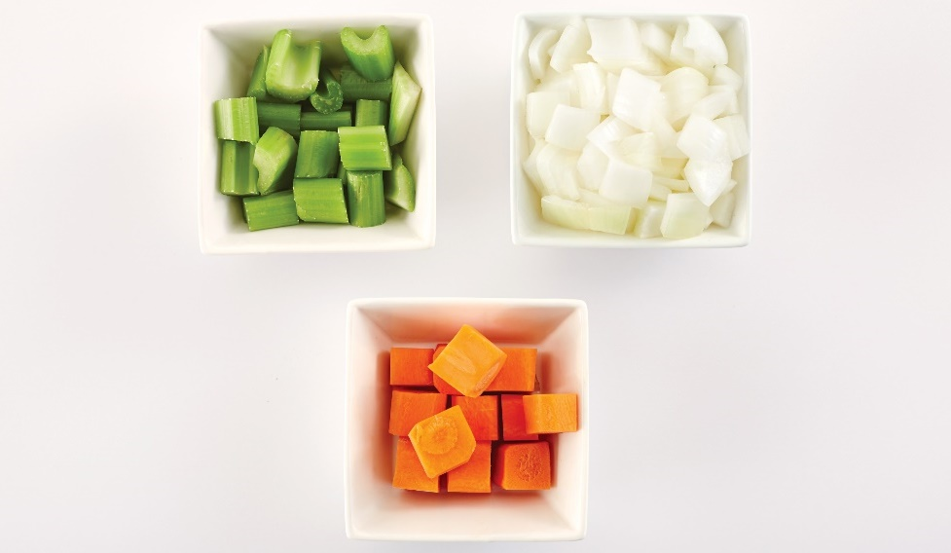
Stocks
Mirepoix:
Coarsely chopped onions, carrots, and celery
Provides flavor base
50% onions
25% carrots
25% celery
White mirepoix:
Substitute parsnips
Additional onions, leeks, and mushrooms for carrots
Notes:
Mirepoix is a French word that refers to the mixture of coarsely chopped onions, carrots, and celery that provides a flavor base for stock. The mixture is usually 50 percent onions and 25 percent each of carrots and celery. For pale or white sauces, such as fish fumet, cooks usually use white mirepoix, in which they substitute parsnips, additional onions, leeks, and even chopped mushrooms for carrots.

Slide 4
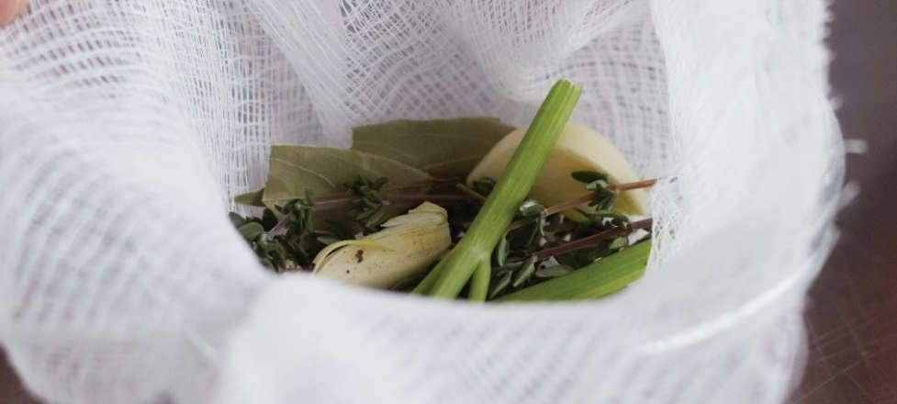
Stocks
Aromatics:
Herbs, spices, and flavorings
Create a savory smell
Bouquet garni:
“Bag of herbs”
Bundle of fresh herbs—thyme, parsley stems, bay leaf
Tied together
Sachet d’épices:
Cheesecloth
Parsley stems, dried thyme, bay leaf, cracked peppercorns
Notes:
Aromatics, such as bouquet garni and sachet d’épices, are the herbs, spices, and flavorings that create a savory smell. Bouquet garni (boo-KAY gahr-NEE),
French for “bag of herbs,” is a bundle of fresh herbs, such as thyme, parsley stems, and a bay leaf tied together. Sachet d’épices (sah-SHAY day-PEESE) is
similar to bouquet garni, except it really is a bag of herbs and spices. The cook places the spices, including parsley stems, dried thyme, bay leaf, and
cracked peppercorns, together in a cheesecloth bag. If the stock is going to be strained, these ingredients do not need to be contained in a bag.

Slide 5
Types of Stocks
Stock:
Flavorful liquid
Simmering bones and/or vegetables
24 hours to cook
Cost-effective
“Building blocks”
  Base for soups and creams
Notes:
A stock is a flavorful liquid made by gently simmering bones and/or vegetables. This extracts the flavor, aroma, color, body, and nutrients of the ingredients.
Some stocks may take up to 24 hours to properly cook, but stocks are one of the most cost-effective ways to use vegetable, meat, and fish trimmings.
Stocks are often called the cook’s “building blocks.” They form the base for many soups and sauces.

Slide 6
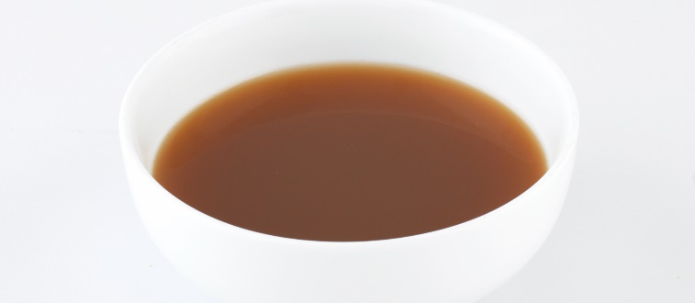
Types of Stocks
Bouillon
Brown stock
Court bouillon
Liquid from simmering meats or vegetables
Broth
Amber liquid
Simmering poultry, beef, veal, or game bones
Bones browned first
Aromatic vegetable broth
Poaching fish or vegetables
Notes:
Bouillon (BOO-yon)
This is the liquid that results from simmering meats or vegetables; also referred to as broth.
Brown stock
This is an amber liquid made by simmering poultry, beef, veal, or game bones that have been browned first.
Court bouillon (court boo-YON)
This is an aromatic vegetable broth used for poaching fish or vegetables.

Slide 7
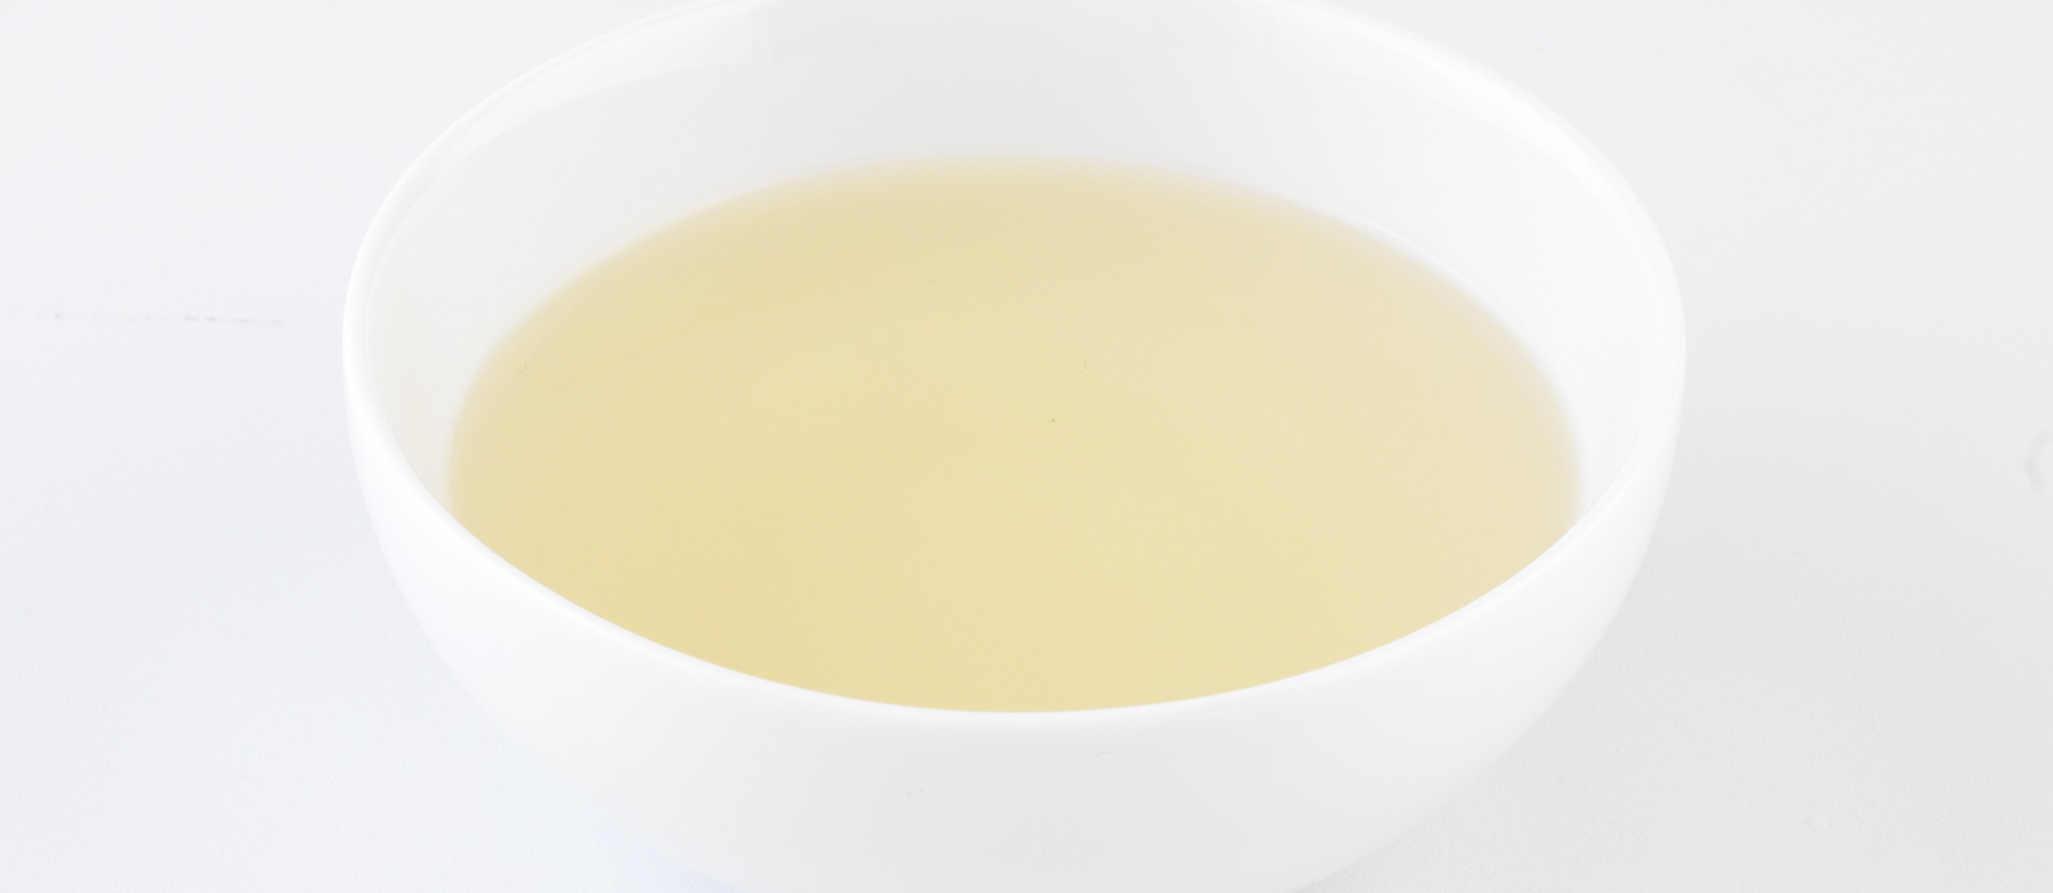
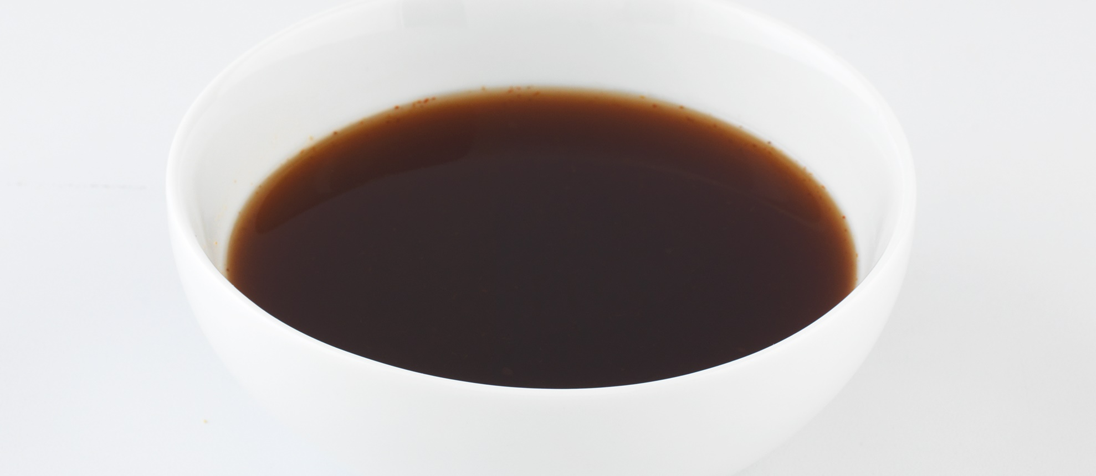
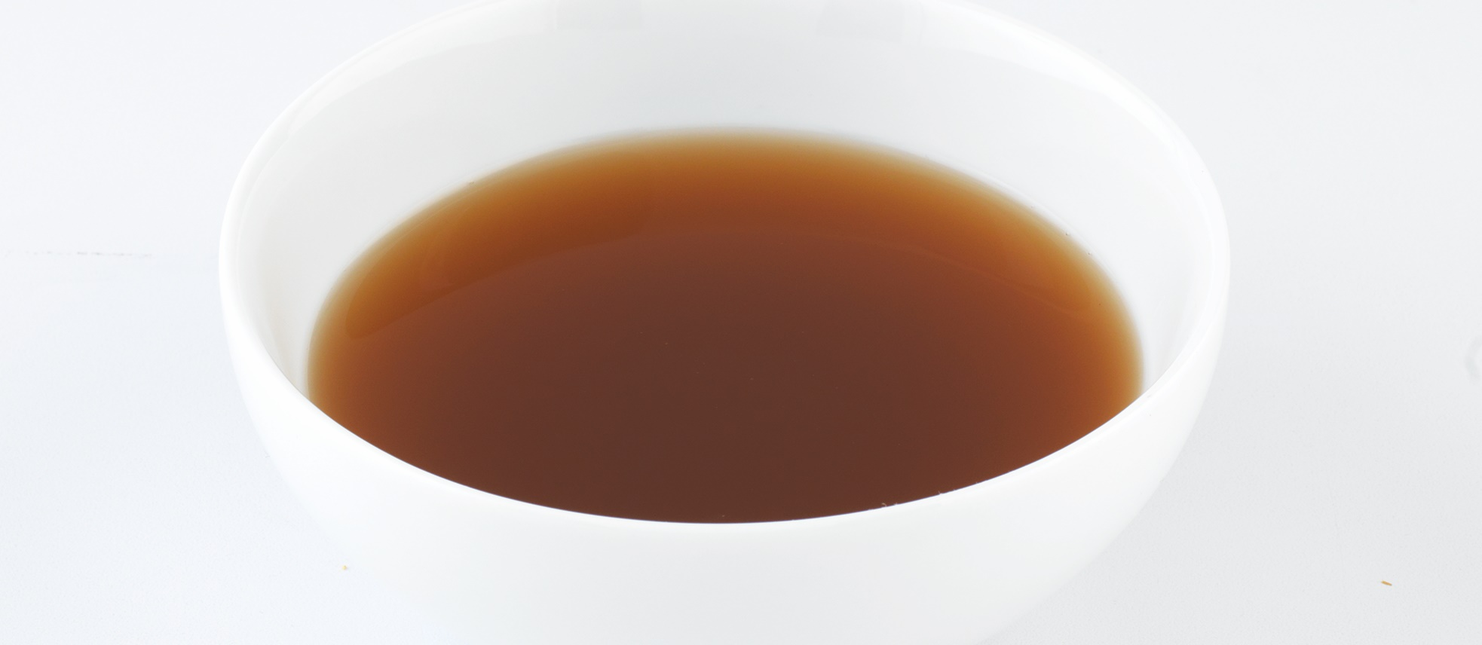
Types of Stocks
Fumet
Glace
Jus
Similar to fish stock
Highly flavored stock
Made with fish bones
Reduced to intensify flavor
“Glaze”
Reduced stock with jelly-like consistency
Made from brown, chicken, or fish stock
Rich, lightly reduced stock
Sauce for roasted meats
Notes:
Fumet (foo-MAY)
Very similar to fish stock, this is a highly flavored stock made with fish bones and reduced to intensify flavor.
Glace (glahs)
Sometimes referred to as “glaze,” this is a reduced stock with a jelly-like consistency, made from brown stock,
chicken stock, or fish stock.
Jus
This is a rich, lightly reduced stock used as a sauce for roasted meats.

Slide 8
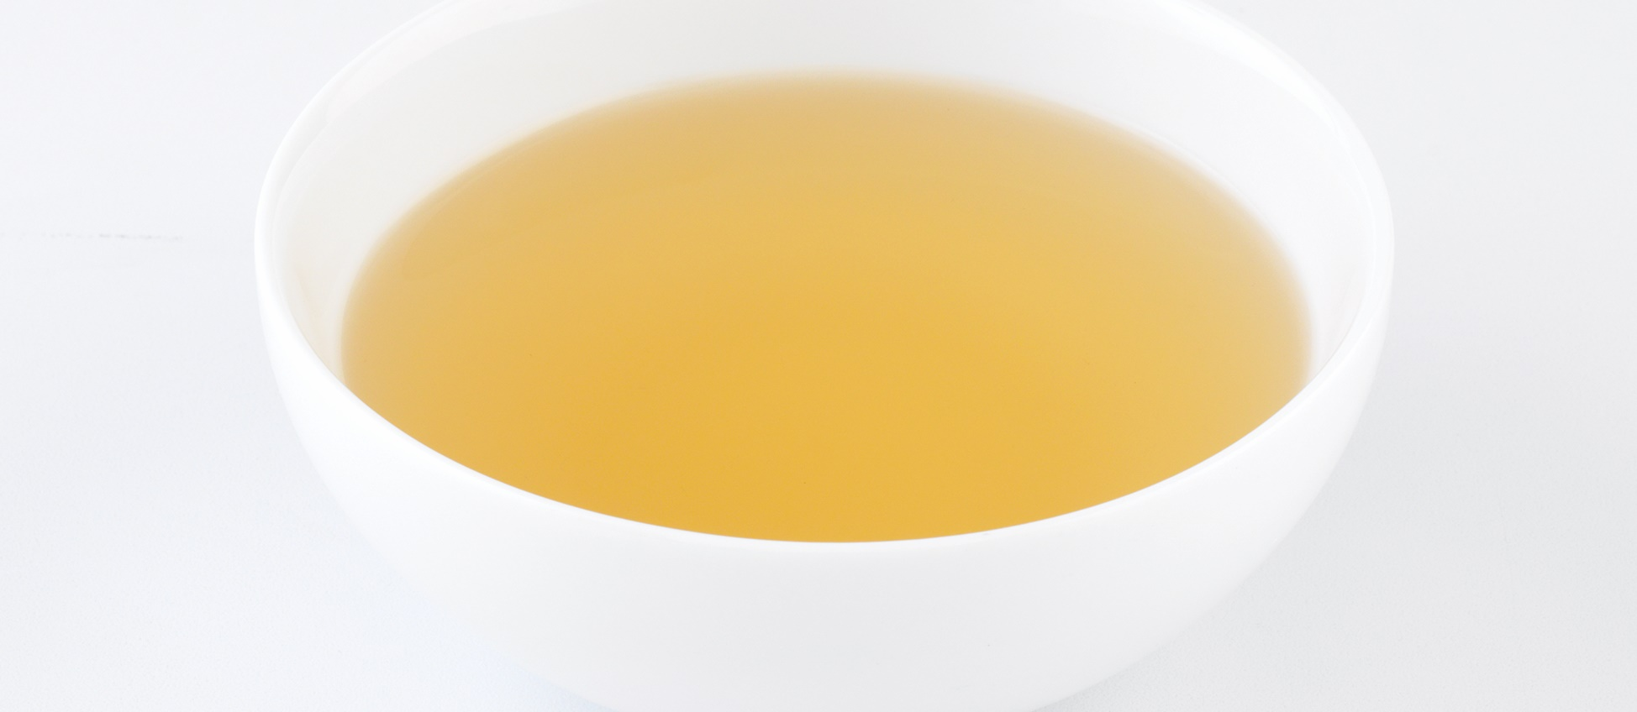
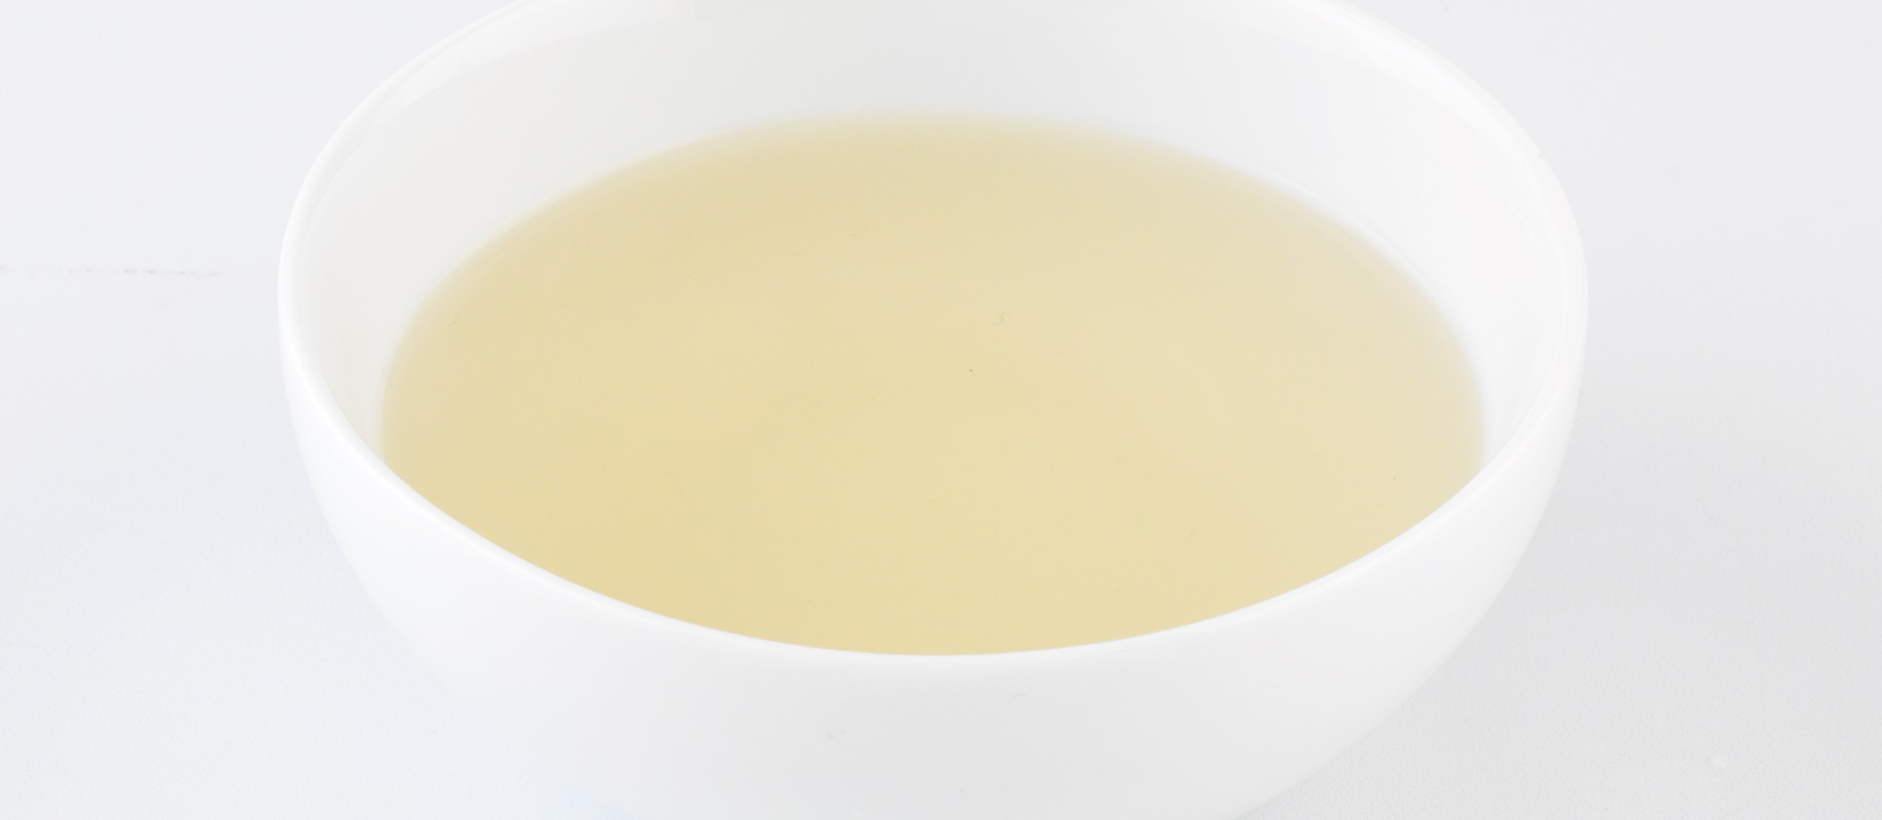
Types of Stocks
Remouillage
Vegetable stock
White stock
Weak stock
Bones used from another preparation
Replace water as the liquid
“Rewetting”
Made from mirepoix, leeks, and turnips
Tomatoes, garlic, and seasoning—darken stock
Avoid leafy greens—bitter
Clear, pale liquid
Simmering poultry, beef, or fish bones
Notes:
Remouillage (ray-moo-LAJ)
This is a weak stock made from bones that have already been used in another preparation, sometimes used to
replace water as the liquid used in a stock; remouillage is the French word for “rewetting.”
Vegetable stock
This is usually made from mirepoix, leeks, and turnips. Tomatoes, garlic, and seasonings may also be added
to flavor or darken the stock. Any vegetable can be included in vegetable stock, but avoid leafy greens, as they
tend to make the stock bitter.
White stock
This is a clear, pale liquid made by simmering poultry, beef, or fish bones.

Slide 9
Types of Stocks
Decrease food and labor costs:
Prepared stocks
Stock or sauce bases
Commercial concentrates
Notes:
Some kitchens use convenience items such as prepared stocks, stock or sauce bases, and commercial concentrates to cut the costs of food and labor in the
kitchen. It is ideal to prepare all items from scratch, but it may not always be possible due to budget issues or staff skill levels. Fortunately, there are many
quality convenience products available that can be used to good advantage in today’s kitchen. The key to choosing any of these products is careful evaluation to
make sure they provide a good level of quality. The quality of the stock affects the quality of all dishes prepared from it; if the prepared stock, base, or concentrate
is high quality and has good flavor, then using it will not compromise quality. High-quality stock helps deliver high-quality product. Keep in mind, though, that
commercially prepared stocks may contain a large amount of sodium (salt), depending on how they are produced.

Slide 10
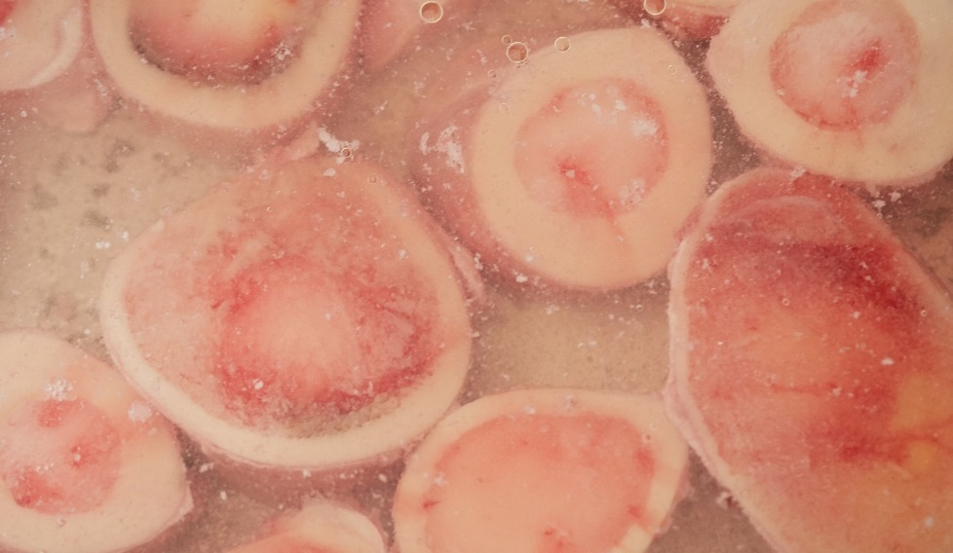
Preparing Bones for Stock
Blanching:
Rids impurities—cloudiness
Put bones in stockpot
Cover with cold water
Bring to slow boil
Remove floating waste or scum
Notes:
Preparing Bones for Stock
To use bones for stock, they must first be cut to the right size and then prepared by blanching, browning, or sweating.
Blanching the bones rids them of some of the impurities that can cause cloudiness in a stock. For blanching, put the bones in a stockpot, cover them with
cold water, and bring them to a slow boil. When the pot is at full boil, remove the floating waste or scum.

Slide 11
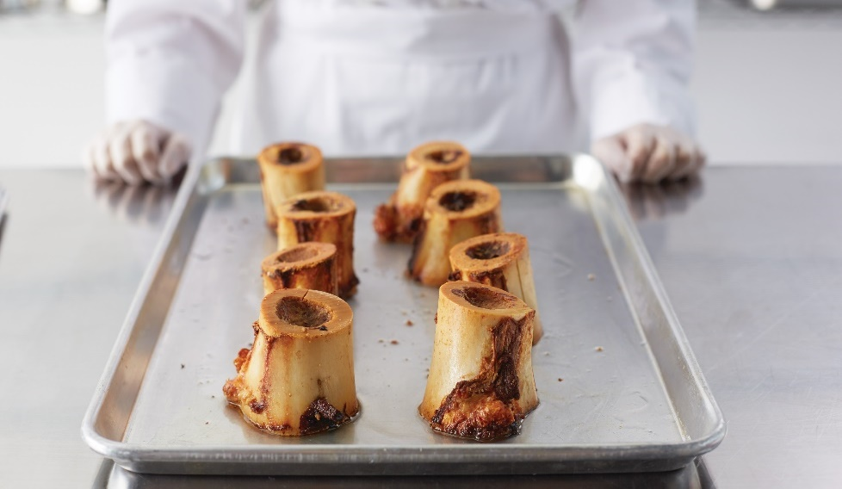
Preparing Bones for Stock
Browning bones:
Roast at 400°F (200°C) for one hour
Golden brown
Place in stockpot
Cover with cold water
Bring to simmer
Rich flavor and deep color
Notes:
To brown bones, roast them in a hot (400°F or 200°C) oven for about an hour, until they are golden brown. Once they are evenly browned,
place them in a stockpot, cover them with cold water, and then bring it to a simmer. This will give the stock a richer flavor and deeper color.

Slide 12
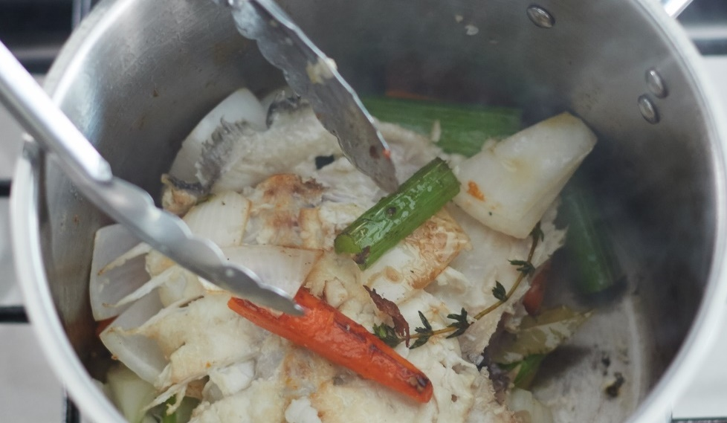
Preparing Bones for Stock
Sweating:
Bones and mirepoix release flavor
Cook bones and/or vegetables
Small amount of fat
Low heat
Soften and release moisture
Notes:
Sweating causes the bones and mirepoix to release flavor more quickly when liquid is added. In the sweating process, cook the bones and/or vegetables in
a small amount of fat over low heat until they soften and release moisture. For example, bones used for making fish fumet must be sweated with vegetables
before adding the cooking liquid and seasoning.

Slide 13
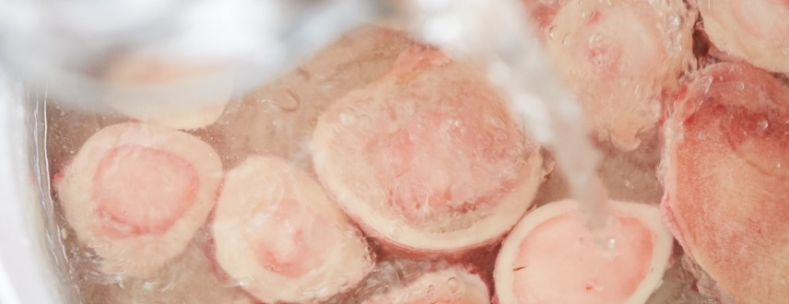

Blanching Bones
Eight pounds of bones
  Cover with cold water
Bring to slow boil
  Skim surface if needed
After full boil, drain bones
Ready for desired recipe
Notes:
Place at least eight pounds of bones in a stockpot and cover with cold water.
Bring the water to a slow boil. Skim the surface if necessary.
Once the water reaches full boil, drain the bones through a sieve or, if the stockpot has one, allow the water to drain away through a spigot. Discard the water.
Now the bones are ready for any recipe that calls for blanched bones.

Slide 14
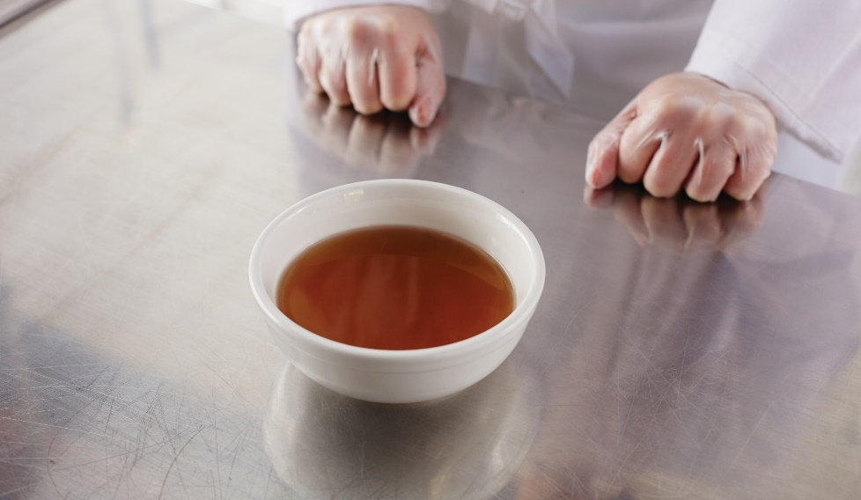
Preparing Ingredients for Stock
Quality of stock
  Flavor
  Body
  Clarity
Does not overpower other ingredients
Strongest flavors—fish, chicken, and beef
Neutral flavor—veal
Crystal clear—except fumet
Notes:
Flavor, color, body, and clarity determine the quality of stock. A stock should be flavorful, but not so strong that it overpowers the other ingredients in the finished
dish. In a chicken noodle soup, for example, you should taste the chicken, noodles, and vegetables as well as the broth. Fish, chicken, and beef stock have the strongest
flavors, while white veal stock is considered neutral. With the exception of fumet, stocks should be almost crystal clear when they are hot.

Slide 15
Preparing Ingredients for Stock
Mirepoix:
Size for type of stock
Short cooking times
  Sliced or diced in half-inch cuts
  Fish stock
Longer cooking times (> one hour)
  One- to two-inch cuts or whole
  Beef stock
Notes:
Mirepoix should be trimmed and cut into a size suited for the type of stock. For stocks with short cooking times, like fish stock, the mirepoix should be sliced
or diced in half-inch cuts. For stocks with cooking times of longer than one hour, such as beef stock, the vegetables may be cut into larger pieces (one to two
inches long), or even left whole.

Slide 16
Preparing Ingredients for Stock
Bouquet garni or sachet d’épices:
Add to simmering stock
Heat brings out flavors
Last hour of cooking
Prevents loss of flavor
Notes:
Bouquet garni or sachet d’épices can be added to the simmering stock. Aromatics are added to allow the heat to bring out their flavors. Aromatics are usually not added until the last hour of cooking, to prevent the loss of flavor (or development of unpleasant flavors) caused by overcooking. The flavors and aromas will be released from the herbs and spices as the stock cooks. Once the stock is flavored to taste, remove the aromatics.

Slide 17
Preparing Ingredients for Stock
Stock | Bones/Vegetables | Water | Mirepoix
Chicken, beef, veal game | 8 pounds | 6 quarts | 1 pound
Fish/shellfish or fumet | 11 pounds | 5 quarts | 1 pound
Vegetable | 4 pounds | 4 quarts | ¾ pound
Notes:
To make stock, the ratio of liquid to flavoring ingredients is standard. To make one gallon of stock, use the following proportions:
• Chicken, beef, veal, and game stock: 8 pounds of bones to 6 quarts of water, adding 1 pound of mirepoix
• Fish/shellfish stock or fumet: 11 pounds of bones or shells to 5 quarts of water, adding 1 pound of mirepoix
• Vegetable stock: 4 pounds of vegetables to 4 quarts of water, adding ¾ pound of mirepoix

Slide 18
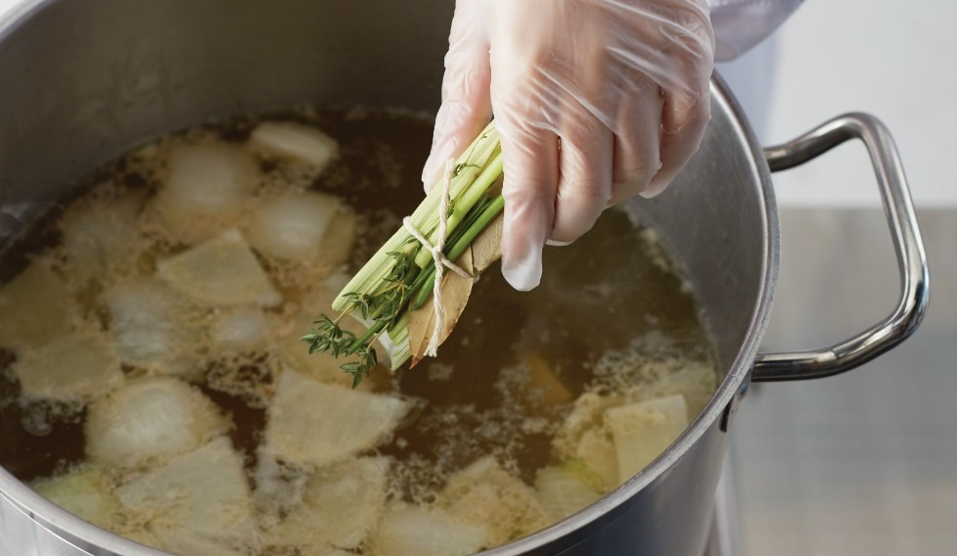
Preparing Stock
Combine major flavorings and cold liquid
Bring to simmer
Skim as necessary
Add mirepoix and aromatics
  Last hour of cooking
Notes:
Combine the major flavoring ingredient and the cold liquid.
Bring to a simmer.
Skim as necessary throughout the cooking time.
Add the mirepoix and aromatics at the appropriate time, usually in the last hour of cooking.

Slide 19
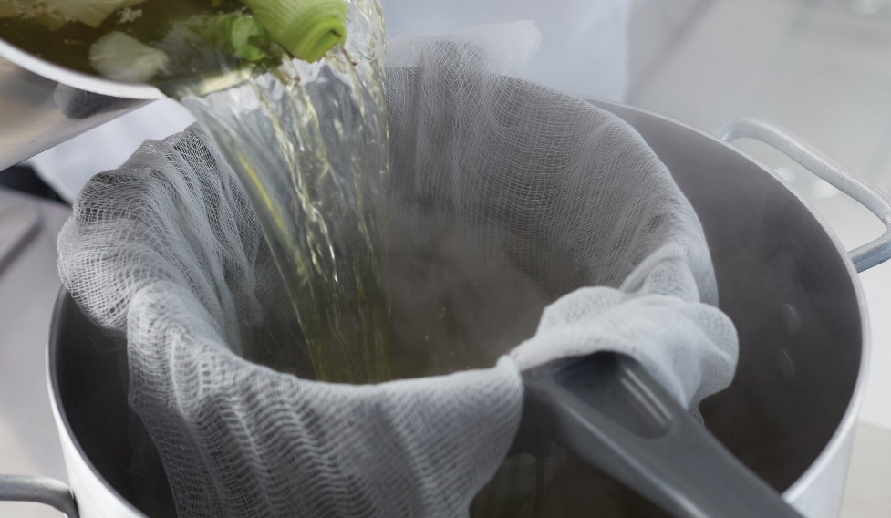
Preparing Stock
Simmer
  Develop flavor, body, and color
Strain
  Cheesecloth or coffee filter
  Use immediately or store
Notes:
Simmer until the stock develops flavor, body, and color.
Strain, then use immediately, or cool and store. Straining through cheesecloth or a coffee filter helps to remove fat. Straining from the bottom is another option. If you do not have a stockpot with a spigot and lifting the stockpot is not realistic, move the hot stock to a table and place another stockpot with a china cap with cheesecloth below it on the floor. Use a food-grade hose that reaches the bottom of the hot stock, and use bellows (a device that sucks or blows a current of air when its sides are pushed together or pulled apart) to draw it into the hose. Once the hot stock is in the hose, quickly place the other end of the hose in the empty stockpot.

Slide 20
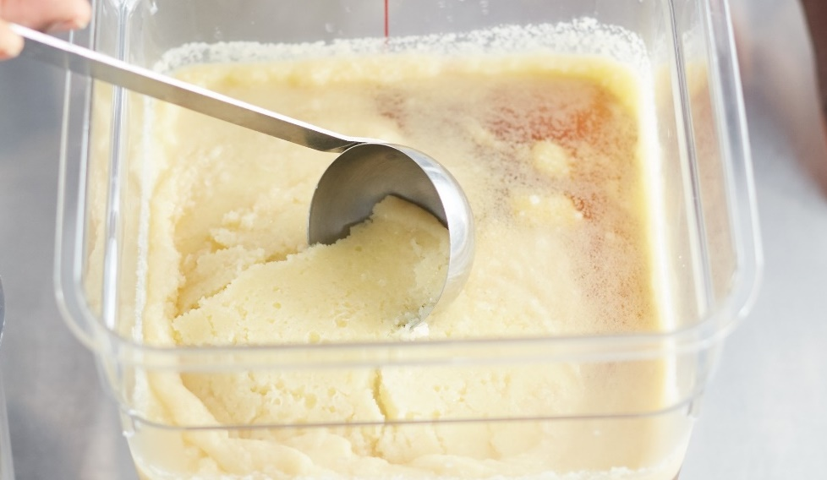
Fat Removal from Stock
Fat removal
  Remove cooled and hardened fat from surface
  Lift or scrape away fat
Clearer and purer color
Removes some fat content—healthier
Reheating stock
  Skim additional impurities
Notes:
After the stock has been stored, it must be separated from the fat on the surface before it can be used. Fat removal is the process of removing fat that has cooled
and hardened from the surface of the stock. Just lift or scrape away the fat before reheating the stock.
Fat removal gives the stock a clearer and purer color. It also removes some of the fat content, making the stock more healthful. As the stock reheats, additional
fat and impurities will rise to the top; skim these off to keep the stock clear.

Slide 21
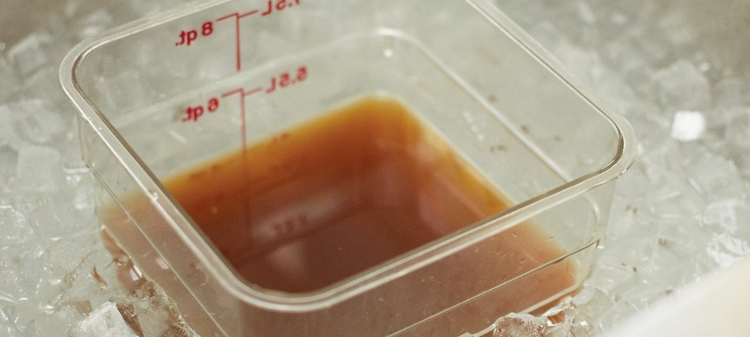
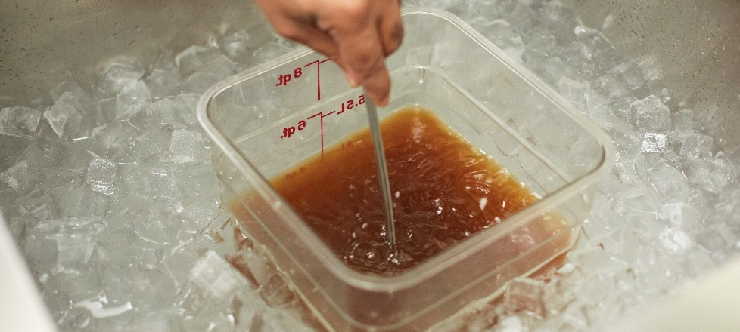
Cooling Stock
Transfer to container
Place in ice-water bath
Stir often
Once cooled, place in cooler
Do not place stockpot in cooler
Cooling
  135°F to 70°F (57°C to 21°C) within two hours
  70°F to 41°F (21°C to 5°C) or lower in the next four hours
Notes:
Foodborne pathogens need time and moisture to grow, but most pathogens will not grow when the temperature of the food is colder than 41°F (5°C) or hotter
than 135°F (57°C). The temperatures between 41°F and 135°F (5°C and 57°C) are in the temperature danger zone (also known as TDZ). Follow proper food
safety practices when cooling stock, so that you minimize the time the stock spends in the temperature danger zone.
Transfer hot stock into a clean, cool stockpot or container, and put that into an ice-water bath. Stir stock often.
When cooled, place the container in the cooler. Alternatively, break down hot stock into smaller portions.
Stir occasionally so the contents of the container cool at the same rate.
Note: Do not put a large stockpot of hot stock in the cooler. It will warm the cooler and its contents. Cool it the proper way. First, cool stock from 135°F to 70°F (57°C to 21°C) within two hours. Then cool it from 70°F to 41°F (21°C to 5°C) or lower in the next four hours. The most effective way to do this is using an ice bath and stirring the stock.

Slide 22
Sauces
“A relish to make food more appetizing”
Adds flavor, moisture, richness, color, and visual appeal
Complement food, not disguise it
Contrasting flavor
Notes:
The word “sauce” comes from the French word that means “a relish to make food more appetizing.” All types of sauces are important in cooking. A good
sauce adds flavor, moisture, richness, color, and visual appeal. Sauces should complement food, not disguise it. You can also use sauces as a contrasting
flavor. For example, the sweetness of roasted pork goes well with a Dijon sauce (a brown sauce with Dijon mustard).

Slide 23
Mother Sauces
Sauce
  Liquid or semisolid product
  Used to prepare other foods
Saucier
  Specializes in making sauces
Roux
  Main ingredient
  Thickener
  Equal parts flour and fat
Notes:
A sauce is a liquid or semisolid product that is used in preparing other foods. A saucier is a cook who specializes in making sauces.
Most sauces start with a roux as one of the main ingredients. Roux (ROO) is a thickener made of equal parts cooked flour and a fat, such as clarified butter,
oil, or shortening.

Slide 24
Mother Sauces
Five classical mother sauces—basis of sauces— “grand sauces”
Béchamel—milk and white roux
Velouté—veal, chicken, or fish stock and white or blond roux
Brown or espagnole sauce—brown stock and brown roux
Tomato sauce—stock and tomatoes
Hollandaise—emulsion made from eggs, butter, and lemon
Notes:
There are five classical mother sauces that are the basis for most other sauces. These are sometimes called “grand sauces.” They include the following:
Béchamel (BAY-shah-MELL): This is made from milk and white roux.
Velouté (veh-loo-TAY): This is made from veal, chicken, or fish stock and a white or blond roux.
Brown or espagnole (ess-spah-NYOL) sauce: This is made from brown stock and brown roux.
Tomato sauce: This is made from a stock and tomatoes (roux is optional).
Hollandaise (HALL-en-daze): This is an emulsion made from eggs, butter, and lemon.

Slide 25
Mother Sauces
Rarely used alone
Used to make small or derivative sauces
Demi-glace—rich brown sauce
Notes:
Mother sauces are rarely used by themselves. They are often used to make small sauces (also known as derivative sauces).
For example, demi-glace (deh-mee glahs), a rich brown sauce, is traditionally made by combining equal parts espagnole
sauce and veal stock and reducing to 50 percent of its starting volume.

Slide 26
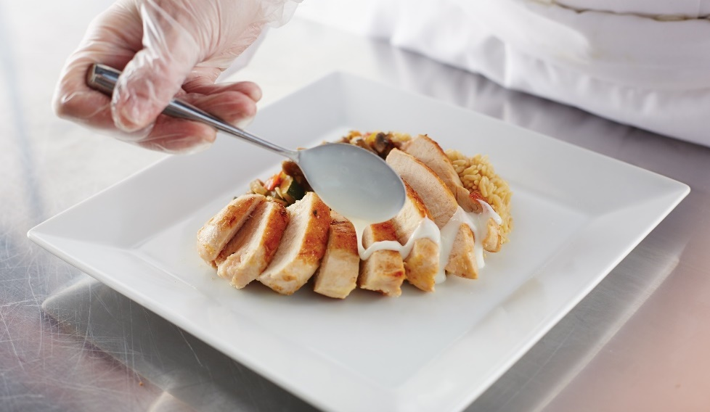
Mother Sauces and Their Derivatives
Béchamel
Small Sauce | Additional Ingredients | Examples of Sauce Usage
Cream | Cream (instead of milk) | Over chicken or fish
Cheddar cheese | Cheddar cheese | Macaroni and cheese
Soubise | Puréed cooked onions | Roasted meats, game, poultry, and vegetables

Slide 27
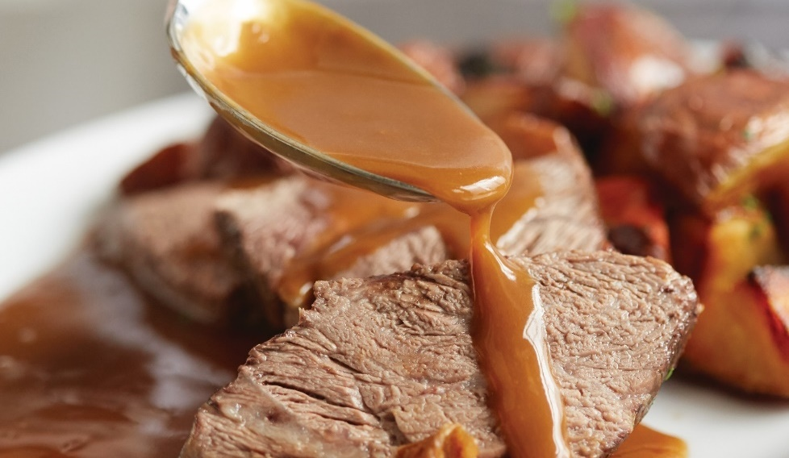
Mother Sauces and Their Derivatives
Brown (espagnole)
Small Sauce | Additional Ingredients | Examples of Sauce Usage
Bordelaise | Red wine, parsley | Red meats such as filet mignon
Chasseur (also called hunter’s sauce) | Mushrooms, shallots, white wine, tomato concassé | Wild game meats, such as venison and rabbit
Lyonnaise | Sautéed onions, butter, white wine, vinegar | Roasts and steaks
Madeira | Madeira wine | Roasts and steaks

Slide 28
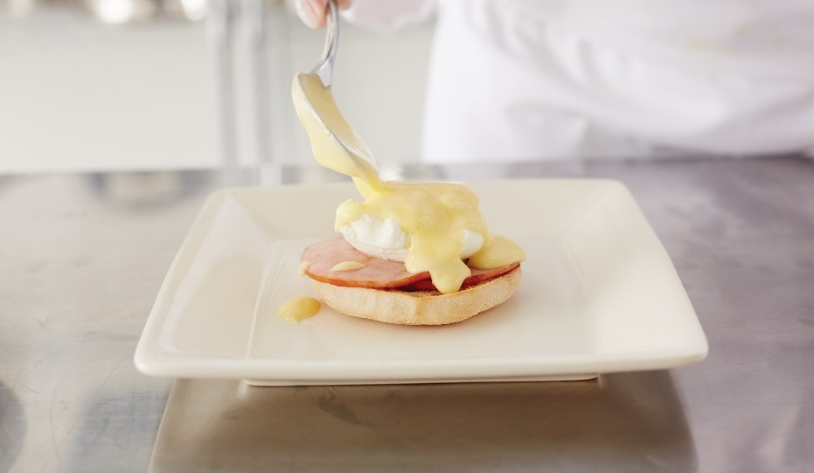
Mother Sauces and Their Derivatives
Hollandaise
Small Sauce | Additional Ingredients | Examples of Sauce Usage
Béarnaise | Tarragon, white wine, vinegar, shallots | Steaks, asparagus, or salmon
Maltaise | Blood orange juice and zest | Fish and vegetables

Slide 29
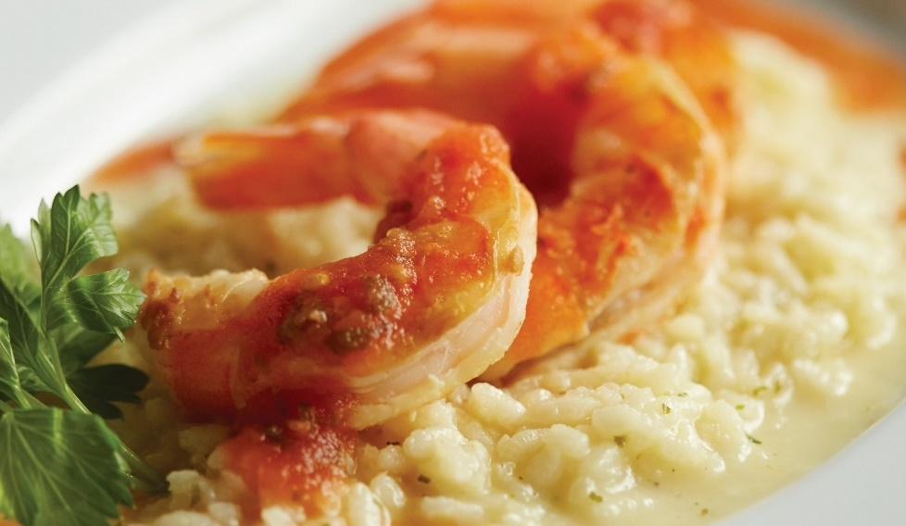
Mother Sauces and Their Derivatives
Tomato
Small Sauce | Additional Ingredients | Examples of Sauce Usage
Creole | Sweet peppers, onions, chopped tomatoes | Shrimp, chicken, or sausages
Portuguese | Onions, chopped tomatoes, garlic, parsley | Chicken and fish

Slide 30
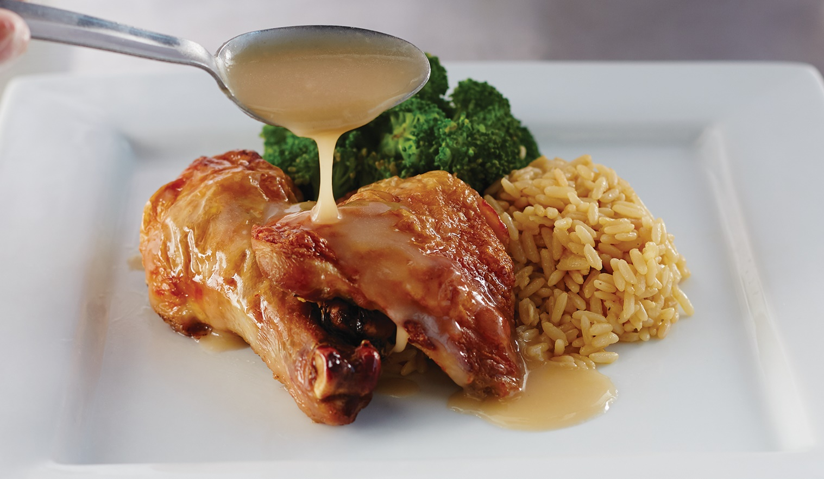
Mother Sauces and Their Derivatives
Chicken velouté
Small Sauce | Additional Ingredients | Examples of Sauce Usage
Mushroom | Cream, mushrooms | Steak, chicken, or potatoes
Supreme | Reduced with heavy cream | Chicken and vegetables
Hungarian | Cream, Hungarian paprika | Chicken, fish, veal, and dumplings

Slide 31
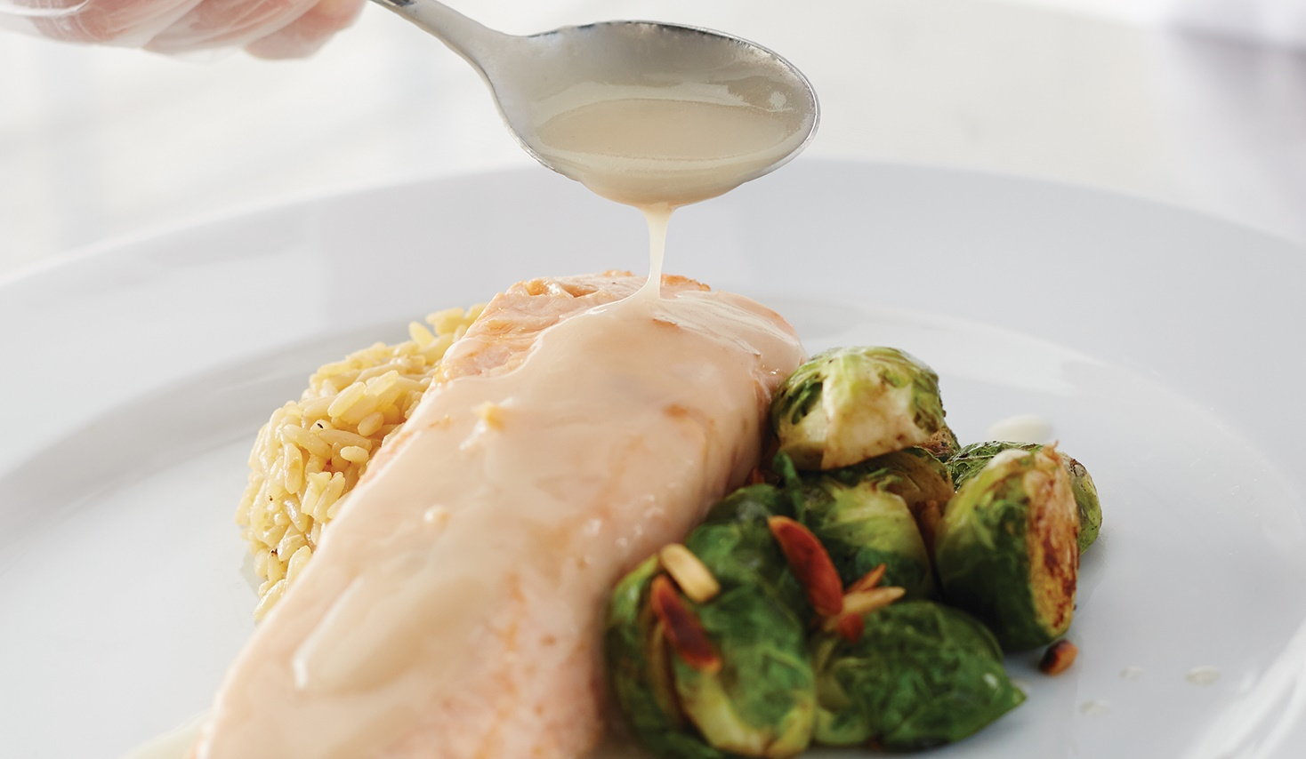
Mother Sauces and Their Derivatives
Fish velouté
Small Sauce | Additional Ingredients | Examples of Sauce Usage
White wine | White wine | White fish
Bercy | White wine, shallots, butter, parsley | White fish
Herb | White wine, herbs | White fish

Slide 32
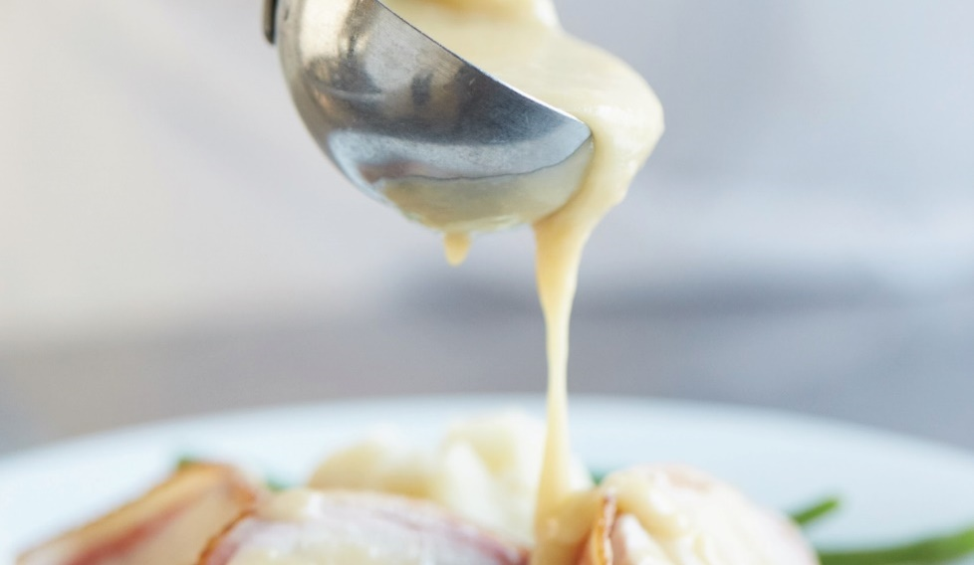
Mother Sauces and Their Derivatives
Veal velouté
Small Sauce | Additional Ingredients | Examples of Sauce Usage
Allemande | Egg yolks | Veal
Hungarian | Egg yolks, Hungarian paprika | Chicken, fish, veal, and dumplings
Curry | Egg yolks, curry spices | Meats and vegetables

Slide 33
Basic Ingredients in Sauces
Liquid component
  Stock
  Milk or cream
  Wine
  Mother sauce
Aromatics
  Complexity and character
Thickener
  Richness and body
  Roux
  Beurre manié
  Slurry
  Liaison
Notes:
Sauces need a liquid component, such as stock, milk or cream, wine, or a mother sauce. You also may add aromatics (herbs and spices) to add
complexity and character to a sauce. A key ingredient in sauce is the thickener, which adds richness and body. Some examples of thickeners are
roux, beurre manié, slurry, and liaison.

Slide 34
Basic Ingredients in Sauces
Roux:
Fat
Flour
Stirred until blended
Color—determined by length of heat time
Notes:
To make a roux, the fat is heated in a pan, and then the flour is added. The mixture is stirred until the flour and fat are fully blended.
The color of the roux is determined by how long the mixture has been heated.

Slide 35
Basic Ingredients in Sauces
White roux:
Little cooking time
Light-colored sauces—béchamel
Bland and starchy
Most thickening power
Notes:
White roux: This is cooked for a very short period of time and is used in sauces where little color is needed, like béchamel.
White roux is bland and a little starchy and has the most thickening power.

Slide 36
Basic Ingredients in Sauces
Blond roux:
Cooked longer than white roux
Flour turns golden
Nutty aroma
Ivory-colored sauces—velouté
More flavorful
Nutty taste
Notes:
Blond roux: This is cooked longer than white roux, until the flour turns golden and has a nutty aroma. It is used
in ivory-colored sauces like velouté. Blond roux is a bit more flavorful and has a nutty taste to match the aroma.

Slide 37
Basic Ingredients in Sauces
Brown/dark brown roux:
Cooked longest
Nutty
Brown roux—rich medium-brown color
Dark brown roux—dark, nutty, roasted flavor
Least thickening ability
Notes:
Brown/dark brown roux: This is cooked until it develops a dark brown color, and is used in dishes that require a dark brown color.
Brown roux is nutty and a rich medium-brown color, while dark brown roux is quite dark, with a nutty, roasted flavor. It has the least
thickening ability because the starch has been cooked the longest.

Slide 38
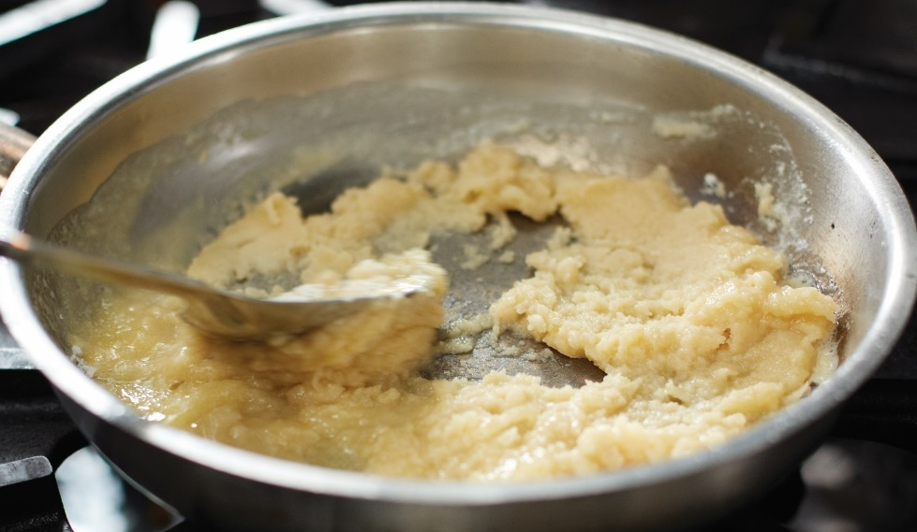
Making a Roux
Heat fat in saucepan
  Add flour
Stir together to form paste
Stir continually
Cook over medium heat
Notes:
Heat clarified butter or other fat in a heavy saucepan.
Add flour and stir together with the fat to form a paste.
Note: Most often, cooks use equal parts flour and fat (by weight), but some sources suggest 60 percent flour and 40 percent fat.
Stir the roux continually to prevent burning.
Cook the paste over medium heat until the desired color is reached.

Slide 39
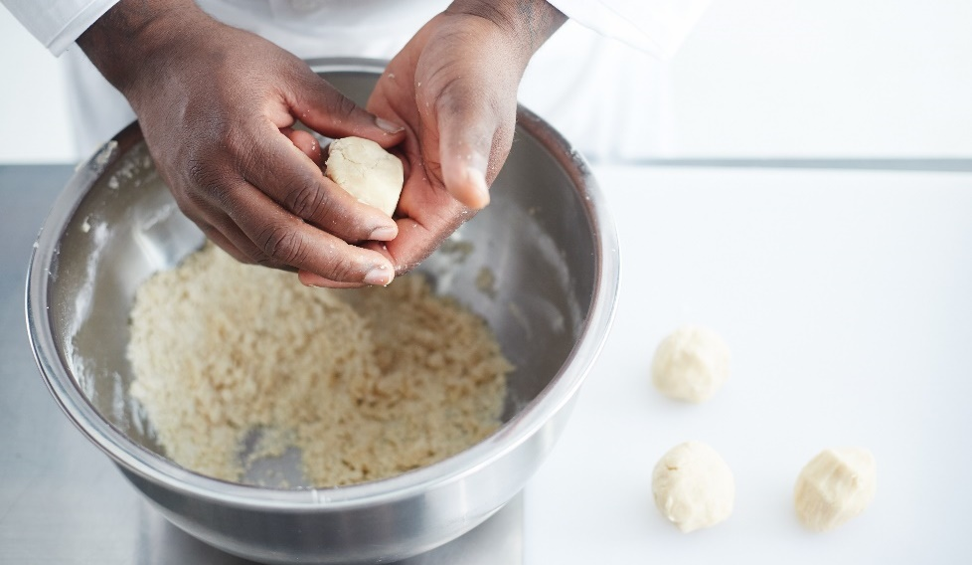
Basic Ingredients in Sauces
Beurre manié:
Thickener
Equal parts flour and butter
Small-sized spheres
Add to cooking sauce
Thickens quickly
End of cooking process
Notes:
Beurre manié (byurr man-YAY) is a thickener made of equal parts flour and soft, whole butter. Mix flour and butter together, and then shape
the mixture into small-sized balls and add to the cooking sauce. Use beurre manié to thicken a sauce quickly at the end of the cooking process.

Slide 40
Basic Ingredients in Sauces
Slurry:
Cornstarch and cold liquid
Can replace roux
Dissolve cornstarch in cold liquid
Consistency—heavy cream
Do not add to sauce—lumpy
Notes:
A slurry, which is cornstarch mixed with a cold liquid, can be used instead of roux. You cannot add cornstarch directly to a sauce; it will make the sauce
lumpy. First, dissolve the cornstarch in a cold liquid. The consistency should look like heavy cream. Do not boil sauces thickened with cornstarch too long
or the starch will break down, creating a watery sauce.

Slide 41
Basic Ingredients in Sauces
Liaison:
Egg yolks and heavy cream
Finish sauces—Allemande
Rich flavor and smoothness
Temper liaison—prevent curdling
Notes:
A liaison (lee-AY-zohn) is a mixture of egg yolks and heavy cream, often used to finish some sauces, such as Allemande sauce. Liaison adds a rich flavor and
smoothness to the sauce without making it too thick. It is important to temper the liaison to prevent the egg yolks from curdling. To temper the sauce, slowly
mix a little bit of the hot sauce with the eggs-and-cream mixture to raise the temperature, and then add the warmed-up egg mixture into the sauce.

Slide 42
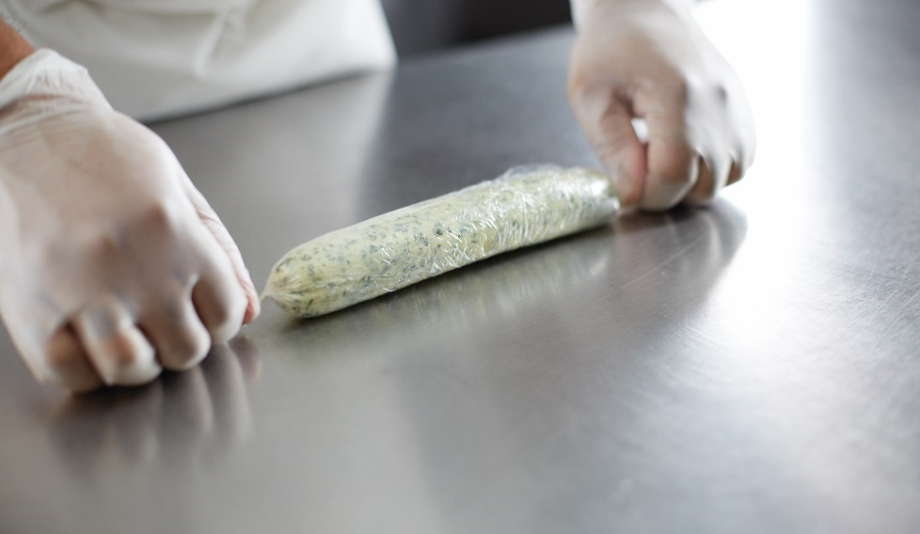
Preparing Different Kinds of Sauce
Compound butter:
Butter and flavoring ingredients
Finish grilled or broiled meats, fish, poultry, game,
pastas, and sauces
Roll into long tube shape
Chill and slice
Maître d’hôtel butter—lemon juice and parsley
  Garnish grilled meat or fish
Notes:
There are various kinds of sauce besides mother sauces and small sauces. These include compound butters, cold or thick sauces like salsa and coulis
(koo-LEE), and sauces made from the natural juices of meat.
Compound butter is a mixture of raw butter and various flavoring ingredients, such as herbs, nuts, citrus zest, shallots, ginger, and vegetables.
Use compound butters to finish grilled or broiled meats, fish, poultry, game, pastas, and sauces, among other uses. Roll the butter into a long tube
shape, then chill and slice for use as needed. One blend is maître d’hôtel (MAY-tra doe-TEL) butter, a softened butter flavored with lemon juice
and chopped parsley. It is often used to garnish grilled meat or fish.

Slide 43
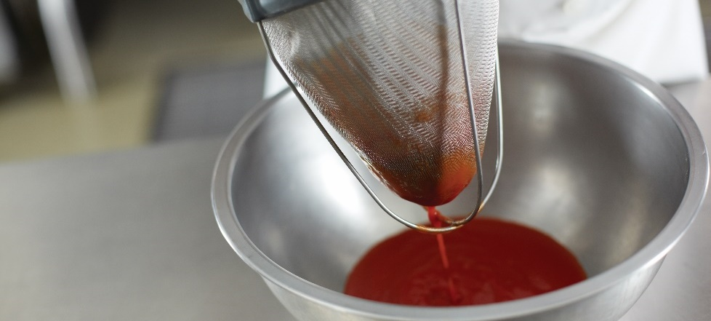
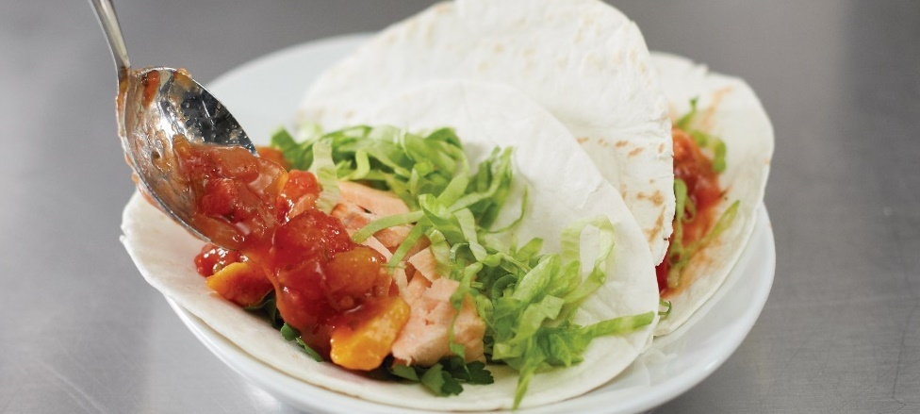
Preparing Different Kinds of Sauce
Coulis
  Thick, puréed sauce—tomato coulis
Salsa
  Cold mixture
  Fresh herbs, spices, fruits and/or vegetables
  Meat, poultry, fish, or shellfish
Add flavor, moisture, texture, and color
Low-fat alternative
Notes:
Other miscellaneous sauces that add flavor, texture, and color to a dish include salsa and coulis. Coulis is a thick puréed sauce.
Salsa is a cold mixture of fresh herbs, spices, fruits, and/or vegetables. It can be used as a sauce for meat, poultry, fish, or shellfish.
These sauces allow cooks to change a menu item by adding flavor, moisture, texture, and color to a dish. One advantage is that
these sauces can provide a lower-fat alternative to the usually heavy mother or small sauces.

Slide 44
Preparing Different Kinds of Sauce
Jus lié:
Cooked meat juices and brown stock
Au jus:
Meat served with its own juices
Notes:
Sauces are sometimes made with the natural juices of meat. Jus lié (ZHEW lee-AY) is a sauce made from the
juices of cooked meat and brown stock. Meats served with their own juices are called au jus (oh ZHEW).

Slide 45
Preparing Different Kinds of Sauce
Finished sauce:
Adjust consistency
  Stock
  Reduction
Taste
  Red or white wine
Notes:
To finish a sauce, adjust the consistency. For example, it may be necessary to add stock to a sauce to thin it out. The added stock will also help flavor the
sauce. Sometimes using a red or white wine can add a very distinctive taste to a sauce. A sauce that is not thick enough can be adjusted by further reduction.

Slide 46
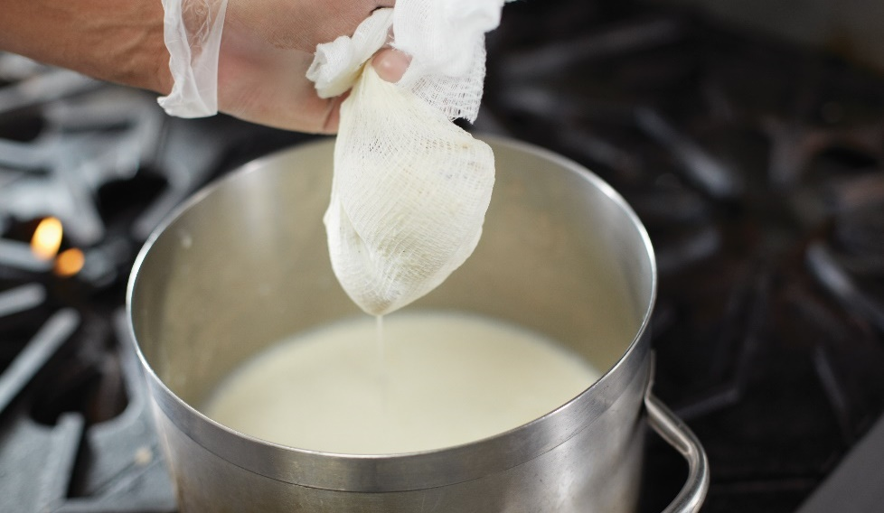
Preparing Different Kinds of Sauce
Wringing method:
Cheesecloth over bowl
Pour sauce
Cloth is twisted
Cheesecloth catches
  Lumps of roux
  Herbs, spices
China cap with cheesecloth
Fine-meshed strainer
Chinois
Notes:
Once the flavor and consistency have been adjusted, the sauce may need to be strained to make sure it is smooth. The easiest way to strain sauce is the
wringing method. In this method, place clean cheesecloth over a bowl, and pour the sauce through the cheesecloth into the bowl. The cloth is then twisted
at either end to squeeze out the strained sauce. The cheesecloth catches the unwanted lumps of roux, or herbs, spices, and other seasonings. Sauces may
also be strained through a China cap lined with cheesecloth, a fine-meshed strainer, or a chinois (chin-WAH). Figure 17.18 shows sauce being strained using
the wringing method.

Slide 47
Preparing Different Kinds of Sauce
Adjust seasoning:
Salt
Lemon juice
Cayenne
White pepper
Notes:
As in all cooking, the final step in finishing a sauce is to adjust the seasonings. Salt, lemon
juice, cayenne, and white pepper can all be used to bring out the flavor of the sauce.

Slide 48
Appropriate Sauce Usage
Style of service
  Plated or self-serve
Main ingredient cooked
  Bold sauces—roasted meat
  Light sauces—white meat, light cooking techniques
Sauce’s flavor—dish’s flavor
  Complement not clash
Notes:
It is important to understand how to use a sauce and how to determine what dish should be paired with a particular sauce.
Obviously, there are classic pairings that have been used over time, such as eggs Benedict and hollandaise sauce.
Several factors help to determine the right sauce for a dish:
What will be the style of service? Some sauces are plated (put on the plate with the food). Others may be available self-serve on a buffet.
How is the main ingredient of the dish being cooked? Bold sauces and garnishes work well for roasted meat. Lighter sauces are best for
white meat and food cooked with light techniques, such as poaching or steaming.
How does the sauce’s flavor work with the dish’s flavor? The sauce should complement, not clash with, the flavor and texture of the dish.
Please remember that a sauce is a flavor accent that should boost the flavor of the dish instead of hiding it.

Slide 49
Appropriate Sauce Usage
Dietary concerns
  Wheat flour
Sauce prepared correctly
  Available equipment and space
Held without quality concerns
  Retain quality
Prepared correctly
  Staff trained properly
Notes:
Are there any dietary concerns that need to be considered? For example, a roux made with wheat flour cannot be used as a thickener for a guest
that has a gluten allergy.
Can the sauce be prepared correctly with the available equipment and kitchen setup? It is hard to make hollandaise on the line if no space is
available during service.
Can the sauce be held without compromising its quality? Some sauces do not retain their quality if left in a pan for some time.
Can the sauce be prepared correctly by your staff? Have they been well trained both on the technique for making it and the proper sanitation
concerns during preparation, holding, and serving?

Slide 50
Appropriate Sauce Usage
Taste
Color
Opacity
Texture
Viscosity
Notes:
Remember that taste is the most important factor, but do not ignore the color, opacity (degree of light that passes through), texture, and viscosity (thickness).

Slide 51
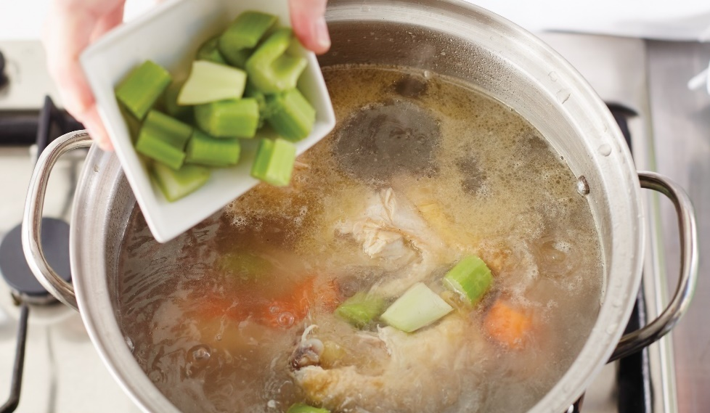
Basic Kinds of Soup
Clear soup:
Flavored stocks, soups, and consommés
Chicken noodle soup, minestrone, onion soup
Thick soup:
Cream and purée soups
Bisques, chowders, cream of tomato, lentil, split pea
Notes:
Serving soup at the beginning of a meal provides an opportunity to make a good first impression. Preparing and serving soups helps you learn more about
basic culinary techniques, seasonings, garnishing, and serving foods.
There are two basic kinds of soup—clear soups and thick soups. Clear soups include flavored stocks, broths, and consommés. Examples include chicken
noodle soup, minestrone (a tomato-based vegetable soup), and onion soup. Thick soups include cream soups and purée soups, such as bisques, chowders,
cream of tomato, lentil, and split pea soup.

Slide 52
Basic Kinds of Soup
Dessert soup:
Ginataan
Fruit soup:
Gazpacho
International soup:
Borscht
Vichyssoise
Traditional regional soup:
New England clam chowder
Gumbo
Notes:
There are many variations of these basic soups, including the following:
• Dessert soups, such as ginataan, a Filipino soup made from coconut milk, milk, fruits, and tapioca pearls, and served hot or cold.
• Fruit soups, such as winter melon or gazpacho, a savory soup with a tomato base.
• International soups, which can be hot or cold. Examples of cold soups are borscht, a beet soup, and vichyssoise (vi-shee-SWAHZ), a French-style soup
made of puréed leeks, onions, potatoes, cream, and chicken stock. Hot soups include Vietnamese pho (pronounced fuh), a rich beef stock with
noodles and thinly shaved beef, or French onion soup, made with beef stock and topped with melted Gruyère cheese.
• Traditional regional soups, such as New England clam chowder, which is cream sauce based, Manhattan clam chowder, which is red sauce based,
or gumbo, which is a Creole soup made with okra and shrimp.

Slide 53
Preparing Soups
Gently simmer
Stirred occasionally
Brighten flavor
  Add chopped herbs, lemon juice, hot pepper
Finishing techniques
Notes:
Soups must be cooked properly. Most soups are cooked at a gentle simmer and stirred occasionally. If a soup is cooked for too long, the flavor can become flat
and nutrients will be lost. Adding chopped fresh herbs, lemon juice, or a dash of hot pepper sauce to soup can brighten its flavor. Finishing techniques are
important when preparing soup for service. For example, the line cook should remove the surface fat on the soup before service by blotting the soup with
strips of unwaxed brown butcher paper. Soups should also be garnished just before service.

Slide 54
Clear Soups
Stock or broth
Broth—water; vegetables; beef, fish, chicken, or veal; mirepoix; bouquet garni
Clear to pale amber
Notes:
Stock or broth is the basic ingredient in clear soups. Broth is made from a combination of water; vegetables; beef, fish, chicken, or veal; mirepoix; and
bouquet garni. It should be clear to pale amber in color and have the flavor of the major ingredient.

Slide 55
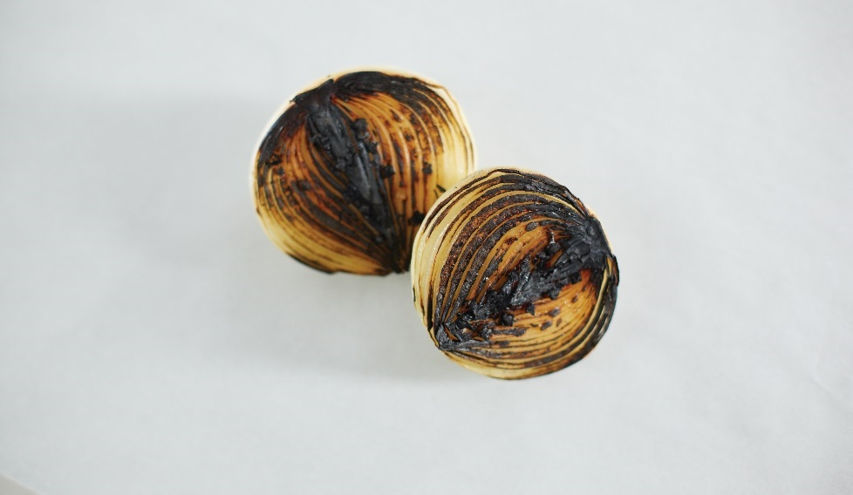
Clear Soups
Consommé:
Rich, flavorful broth or stock—clarified
Clearmeat—ground meats, mirepoix, tomatoes,
egg whites, oignon brûlé
Oignon brûlé—burnt onion
  Cut in half
  Char flat part
  Adds color and flavor
Simmer slowly
Raft—floating layer of egg whites, meat, vegetable
solids, and fats
Clarified—raft removed
Clear and aromatic
Emphasize flavor as major ingredient
Notes:
One type of clear soup is consommé (kon-sah-MAY). This is a rich, flavorful broth or stock that has been clarified. A consommé is made by adding a
mixture of ground meats with mirepoix, tomatoes, egg whites, and oignon brûlé (oy-NYON broo-LAY) to bouillon or stock. This mixture is called clearmeat.
Oignon brûlé is a “burnt onion” (see Figure 17.20). For oignon brûlé, cut an onion in half across its hemisphere, and then char the flat part either on a flattop
range or grill, or in a dry (fat-free) pan. This adds color and flavor to the consommé. Care must be taken to prevent too much burning.
Slowly simmer the mixture until the impurities come to the surface, trapped in a raft, which is the floating layer of egg whites, meat and vegetable solids,
and fats. Remove the raft, and the result is pure and clear, or clarified. Good consommé should be clear and aromatic and should emphasize the flavor of
the major ingredient. If the consommé is too weak, a meat or poultry glaze may be added to enhance the flavor.

Slide 56
Thick Soups
Cream and purée soups
Liquid and sachet d’épices or bouquet garni
Puréed main ingredient
Cream soup
  Thickened with starch—roux
  Smooth texture
  Never boil—fat breaks down
  Garnish with bit of main ingredient
Purée soup
  Thickened with starch from main ingredient—potatoes
  Coarser
Notes:
There are two kinds of thick soup—cream soups and purée soups. Both purée and cream soups are made with a liquid and either sachet d’épices or bouquet
garni. Then a puréed main ingredient, to provide the main flavor, is blended into this base.
The main difference between a purée and cream soup is that cream soups are usually thickened with an added starch, such as roux. Purée soups are
thickened by the starch found in the puréed main ingredient, such as potatoes. Purée soups are coarser than cream soups but should be liquid enough
to pour easily from a ladle.
Cream soups must be thick with a smooth texture. They should never be boiled. Boiling can cause the milk fat to break down, making the soup thin and watery.
Garnish cream soups with a bit of the soup’s main ingredient. For instance, place a few small blanched broccoli florets on top of cream of broccoli soup.

Slide 57
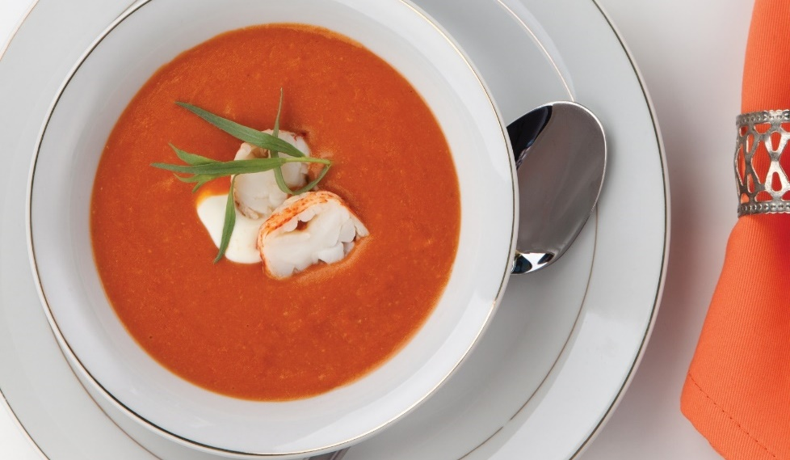
Thick Soups
Bisques:
Cream soup
Puréed shells from shellfish—lobster, shrimp, or crab
Texture slightly grainy
Pale pink or red color
Flavor of shellfish
Notes:
Bisques are another kind of thick soup. Bisque (BISK) is a cream soup usually made from puréed shells from shellfish such as lobster, shrimp, or crab.
The shells are puréed along with vegetables, making the texture slightly grainy. The bisque is then strained, garnished, and served. A properly prepared
bisque should be a pale pink or red color and have the flavor of the shellfish.

Slide 58
Thick Soups
Chowders:
Hearty, thick soup
Made same way as cream soups
Not puréed before cream or milk
Thickened with roux
Large pieces of main ingredients
Garnish
Notes:
Chowders are hearty, thick soups made in much the same way as cream soups. Chowders are not puréed before the cream or milk is added.
They are usually thickened with roux and typically include large pieces of the main ingredients (usually potatoes or seafood) and garnishes.

Slide 59
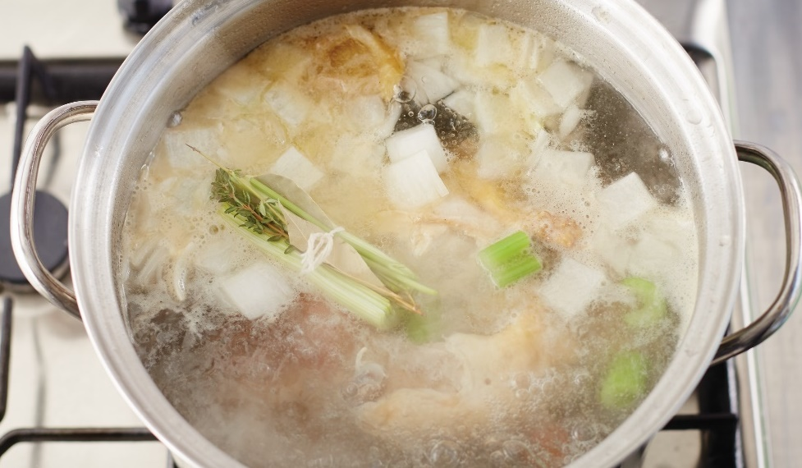
Preparing Basic Broth
Combine meat or vegetables and water
Bring to even simmer
Add mirepoix and bouquet garni
Simmer for appropriate cooking time
  Beef, veal, game, chicken: 2 to 3 hours
  Fish: 30 to 40 minutes
  Vegetables: 30 minutes to 1 hour
Skim and strain
Notes:
Combine the meat or vegetables and water.
Bring to an even simmer.
Add the mirepoix and bouquet garni.
Simmer for the appropriate cooking time depending on the main ingredient in the broth:
Beef, veal, game, chicken: 2 to 3 hours
Fish: 30 to 40 minutes
Vegetables: 30 minutes to 1 hour
Skim and strain. Cool and store, or finish and garnish for service.
Remember: A good broth should be clear, pale amber, with the distinct flavor of the major ingredient.

Slide 60
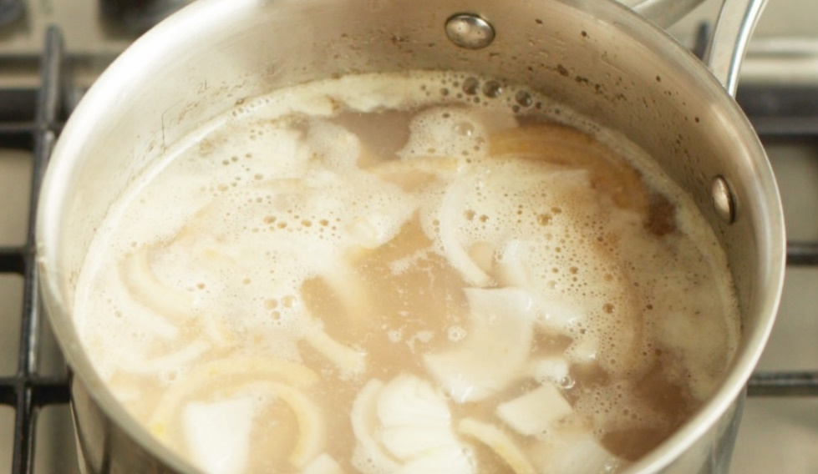
Preparing Basic Consommé
Combine ingredients
Blend in stock
Bring to slow simmer
  Stir frequently until raft forms
Do not stir after raft forms
Break hole in raft
  Continue to simmer
Strain
Cool and store
Notes:
Combine the ground meat, mirepoix, seasonings, tomato product, oignon brûlé, and egg white.
Blend in the stock.
Bring the mixture to a slow simmer (see Figure 17.23), stirring frequently until the raft has formed.
Do not stir after the raft has formed.
Carefully break a hole in the raft and continue to simmer.
Strain using a stockpot with a spigot (best option), or by tilting the pot so that the now clear soup can be ladled from the top of the raft.
Cool and store, or finish and garnish for service.
Remember: Good consommé should be crystal clear, aromatic, and emphasize the flavor of the major ingredient.

Slide 61
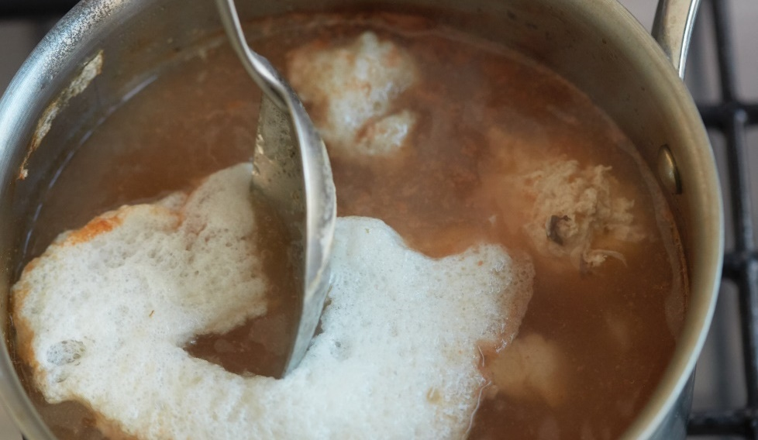
Clarifying Stock
Use egg whites, mild acid, browned onion
Whip egg whites
Add ingredients—100°F (38°C)
Simmer gently
  Medium heat
  Half hour or >
Do not stir raft
Remove raft
Discard raft
Notes:
Use egg whites, a mild acid (such as tomato or lemon juice), and a browned onion.
Whip egg whites until the whites are foamy.
Add these ingredients to the stock when the stock is about 100°F (38°C).
Simmer gently, at medium heat, for half an hour or more.
When the raft of the egg structure and the scum has gathered, be careful not to stir the raft.
Remove the raft by letting it settle completely to the bottom as it cools and then pouring off the clarified stock,
or carefully break a hole in the raft and gently ladle out the stock.
Discard the raft.

Slide 62
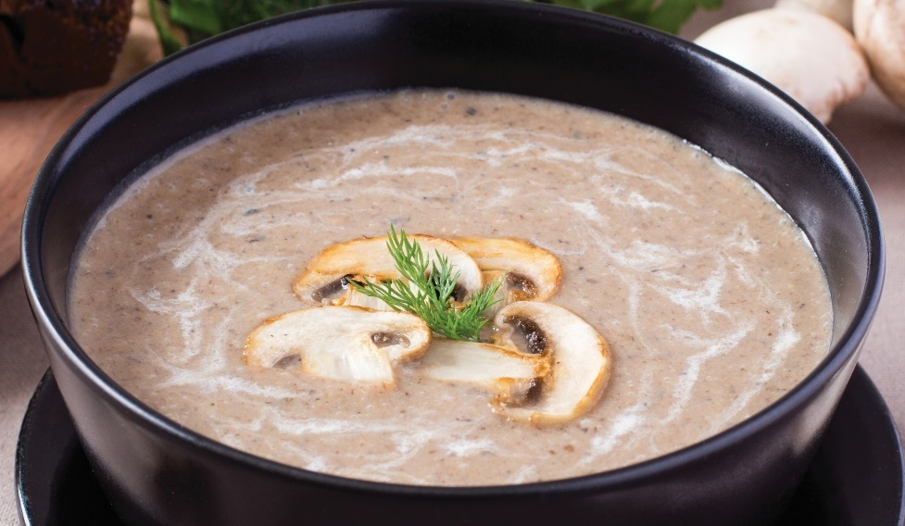
Clarifying Stock
Sauté major flavoring
Make roux
Add ingredients and simmer
Purée and strain
Add additional stock—adjust consistency
Add cream and garnish
Notes:
Sauté the major flavoring—such as mushrooms for a cream of mushroom soup—in a little butter or oil.
Add flour to make a roux, and cook for a short time to remove any starchy taste.
Add stock, sachet d’épices, and any vegetables, and then simmer until tender.
Note: Stock also includes aromatics, but these are separate aromatics being added to the finished stock and other ingredients.
Purée and strain the mixture.
Add additional stock to adjust the consistency as necessary.
Add cream and garnish before serving.

Slide 63
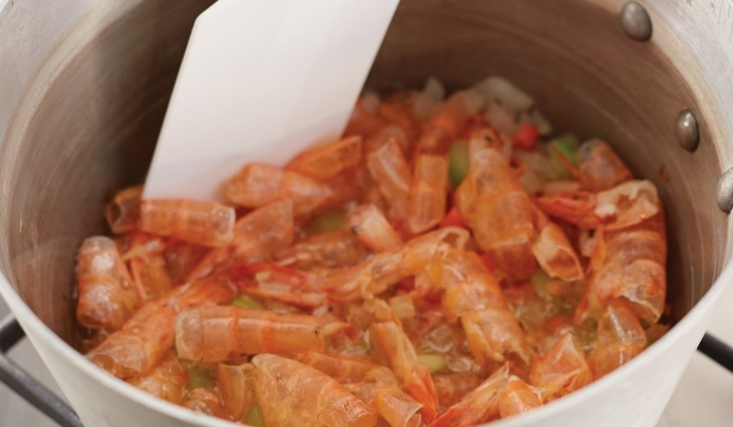
Making Bisque
Sear crustacean shells
Add mirepoix, and sweat
Add tomato product
Reduce to au sec (very dry)
Add stock and sachet d’épices or bouquet garni
Mix in roux
Simmer and skim
Notes:
Sear crustacean shells in a fat, or sweat in stock.
Add mirepoix and sweat.
Add tomato product.
Reduce until the mixture is au sec (oh SEK). This means reduce it until it is very dry.
Add stock and sachet d’épices or bouquet garni.
Mix in the roux.
Simmer and skim.

Slide 64
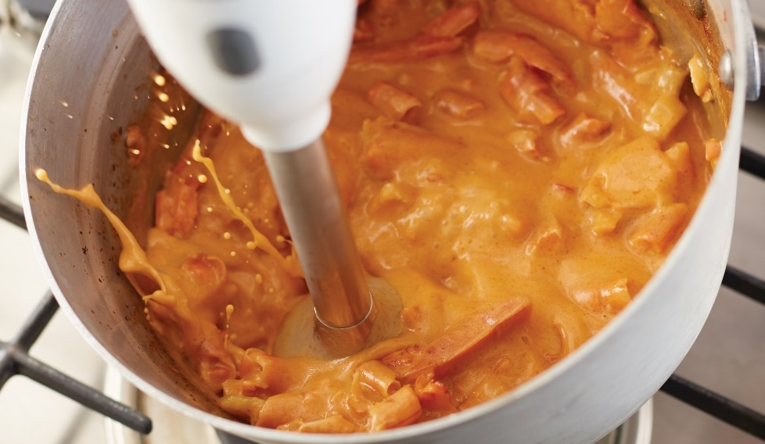
Making Bisque
Discard sachet d’épices or bouquet garni
Strain and purée the solids
Remix liquid to proper consistency
Strain
  Cool and store
  Finish and garnish
Notes:
Discard the sachet d’épices or bouquet garni when you have the desired flavor.
Strain the soup and purée the solids.
Note: The solids that are puréed in this step include crustacean shells, which is why the soup must be strained in step 11 below.
Remix the liquid to the proper consistency.
Note: “Remix” refers to combining the reserved liquid that was strained out in step 9 with the puréed solids. It may not be necessary
to use all of the liquid to achieve the desired consistency in the finished soup.
Strain, then cool and store, or finish and garnish with the cooked, reserved meat from the crustacean.
Remember: A properly prepared bisque should have the flavor of the crustacean and a pale pink or red color.

