Slide 2
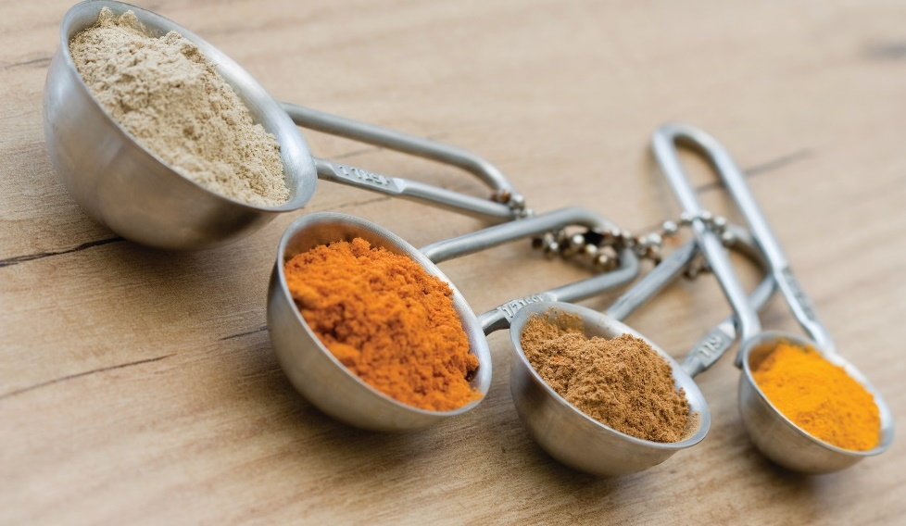
Basic Math Calculations
Managers
  Basic understanding of math
  Apply mathematical principles
Cooks and managers
  Recipe portions
  Recipe changes
  Convert U.S. to metric
Notes:
Restaurant and foodservice managers are expected to have a basic understanding of math and know how to apply mathematical principles to
business situations. Math skills are also essential in the professional kitchen. Cooks and managers need to know how to determine how many portions
a recipe makes, how to change a recipe to produce a different number of portions, and how to convert from U.S. to metric measurements.
Technology has improved efficiency and productivity in foodservice operations. Many restaurants use software for figuring out costs of recipes and menus,
keeping track of inventory, purchasing, and nutritional analysis. Despite this fact, it is important for students to understand how to perform these tasks by
hand. What happens if the computer freezes or if a program does not function properly?

Slide 3
Mathematical Operators
Addition (10 + 2 = 12)
Subtraction (10 – 2 = 8)
Multiplication (10 × 2 = 20)
Division (10 ÷ 2 = 5)
Notes:
As you have probably learned in math class, there are several operations that can be performed on numbers, and each corresponds to a familiar symbol:
• Addition (10 + 2 = 12)
• Subtraction (10 – 2 = 8)
• Multiplication (10 × 2 = 20)
• Division (10 ÷ 2 = 5)
These four basic math operations are the foundation for all other mathematical functions.

Slide 4
Mathematical Operators
Addition:
Line up columns
Assign digits value
Carrying
  Subtracted from one column
  Added to another column
Notes:
Numbers are added by lining them up in columns and then assigning each column of digits a value of 1, 10,
100, 1,000, and so on, beginning with the right-most column. In the number 372, 2 is in the ones column, 7 is
in the tens column, and 3 is in the hundreds column. When adding larger numbers, if a column adds to 10 or
greater, the 1 moves to the left and is added to that column, which is called carrying. This means one is
subtracted from the digit in the tens column, and ten is added to the digit in the ones column.

Slide 5
Mathematical Operators
Subtraction:
Borrowing
  Digit in one column is too large
  10 borrowed from column to left
Notes:
When subtracting large numbers, a technique known as borrowing is often used. If a digit in one
column is too large to be subtracted from the digit above it, then 10 is borrowed from the column
immediately to the left. This means 1 is subtracted from the digit in the tens column, and 10 is
added to the digit in the ones column.

Slide 6
Mathematical Operators
Multiplication
Large numbers
Digit in ones column of second number
First multiplied by digits above it
Notes:
To multiply large numbers, the digit in the ones column of the second number is first multiplied by the digits above it, going from right to left.
Step 1: Multiply 4 by 2
Result is 8
Step 2: Multiply 4 by 3
Result is 12
The final result is 128.

Slide 7
Mathematical Operators
Division
Combination of division and subtraction
Dividend—inside long-division sign
Divisor—placed outside long-division sign
Notes:
Division: Larger numbers are divided using a combination of division and subtraction. The dividend is placed inside the long-division sign, and the divisor
is placed outside. For example, in the problem 728 ÷ 14, 728 is the dividend, and 14 is the divisor.
Step 1: Divide 14 into 72
Result is 5
14 × 5 = 70
Subtract from 72
Step 2: Bring down 8
Divide 14 into 28
Result is 2
14 × 2 = 28
Subtract from 28
The final result is 52.

Slide 8
Fractions, Decimals, and Percentages
Fractions:
Numerators
  Upper portion
  Added and subtracted as whole numbers
Denominators
  Lower portion
  Not added and subtracted the same
Notes:
Culinary professionals need to understand the concepts of fractions, decimals, and percentages. Math influences every decision that a manager makes in a
foodservice operation. It is the foundation of the kitchen and the back office.
Fractions: In adding and subtracting fractions, numerators, the upper portion of a fraction, are added and subtracted the same way as whole numbers (for
example ⅓ + ⅓ = ⅔). Denominators, the lower portion of a fraction, are not added and subtracted the same way.

Slide 9
Fractions, Decimals, and Percentages
Fractions:
Like fractions—denominators are same
Lowest common denominator
  Different denominators
  Determine smallest number both denominators
  divide into evenly
Notes:
If the denominators to be added or subtracted are the same (called like fractions), the denominators remain unchanged.
If the denominators to be added or subtracted are different from each other, then the first step is to determine the lowest
common denominator, which is the smallest number that both denominators can be divided into evenly. For example, to
add ⅔ and ¼, the lowest common denominator would be 12, which is the smallest number that both 3 and 4 can be
divided into evenly. The next step is to multiply each numerator by the number that the corresponding denominator was
multiplied by when calculating the lowest common denominator.
⅔, or 2 x 4 = 8 and 3 x 4 = 12, for 8/12
¼, or 1 x 3 = 3 and 4 x 3 = 12, for 3/12
The results are like fractions that can be added: 8/12 + 3/12 = 11/12

Slide 10
Fractions, Decimals, and Percentages
Fractions:
Expressed as decimals
Based on one-tenth, one-hundredth, etc.
Industry uses decimals more often
Notes:
Fractions are often expressed as decimals. All decimals are based on one-tenth, one-hundredth, one-thousandth, etc. For example, 1.4 is 1 and 4-tenths,
and 6.21 is 6 and 21-hundredths. Industry calculations are typically converted to decimals, not fractions.

Slide 11
Fractions, Decimals, and Percentages
Decimals:
Adding or subtracting—line up decimal points
Multiplying—determine decimal placement with final answer
Count total digits right of decimal of multiplied numbers
Decimal to percentage
  Move decimal two places to right
  Add percent sign
Notes:
Decimals: Decimals are added, subtracted, multiplied, and divided just like nondecimal numbers. When adding or subtracting decimals, the key is to line
up the decimal points.
When multiplying decimals, determine where to place the decimal point after calculating the final total answer. To do this, count the total number of digits to
the right of all decimal points in the numbers that are being multiplied together and then place the decimal point in the final answer by counting that many
places from the right. For example, in Figure 14.9, there are a total of four digits to the right of the decimal points in 8.46 and 4.23. Therefore, the decimal point
goes four places from the right in the answer, 35.7858.
To convert a decimal to a percentage, move the decimal point two places to the right and add a percent (%) sign. If necessary, add a zero on the back to get
the second decimal place. For example, 0.123 = 12.3%, and 0.2 = 20%.

Slide 12
Fractions, Decimals, and Percentages
Dividing decimals:
Bring decimal up above division sign
Round:
Nearest whole number
Less than 5—round down
Greater than 5—round up
Notes:
When dividing decimals, simply bring the decimal point up directly above the long division sign.
When calculators or computers do the math, numbers often have more digits to the right of the decimal point than are practical or useful. In these cases,
numbers are rounded to the nearest tenth, hundredth, or thousandth. Numbers are sometimes rounded to the nearest whole number in order to eliminate the
decimal point.
In rounding, if the next digit to the right is less than 5, then the number is usually rounded down (for example, 5.12 is rounded to 5.1). If the number to the right
is 5 or above, then the number is rounded up (for example, both 5.15 and 5.19 are rounded to 5.2). The number 5.192635 can be rounded to the nearest
thousandth (5.193), hundredth (5.19), tenth (5.2), or whole number (5).

Slide 13
Fractions, Decimals, and Percentages
Percentages:
Part of 100
Fractions
  Convert to decimal
  Add zero
Percent of number
  Percent as decimal and multiply
Percent of another number
  Division
Notes:
Percentages: Percentages are a particularly important mathematical operation in foodservice businesses. Managers and employees often express numbers in
terms of percent, or part per 100. When working with a fraction that should be a percent figure, the first step is to convert the fraction into a decimal.
For example, to express ½ as a decimal, the numerator (1) is divided by the denominator (2) for an answer of 0.5. Then add a zero (0) in the hundredths
place (0.50), and the two digits to the right of the decimal point are expressed as 50 percent, or 50%.
It is also possible to determine that one number is a percent of another number. For instance, if 60 guests out of a total of 300 are ordering the house special,
the percentage of guests ordering the special is found by dividing the portion (60) by the total (300). Remember that dividing is the same as making a
fraction. The total will be the denominator of the fraction, and the portion is the numerator, or the part that gives the number: 60⁄300. When the numerator is
smaller than the denominator, the answer will always be a decimal. Therefore, 60 is 20 percent of 300. Twenty percent of the guests are ordering the special.

Slide 14
Standardized Recipes
Recipe:
Written record of ingredients and preparation steps
Standardized recipes:
Format for anyone to use
Ingredients listed first, in order used
Assembly instructions
Notes:
A recipe is one of the most hardworking tools in the professional kitchen. The ability to read a recipe correctly and to use it in various ways is critical to a
food handler’s success. Strong math skills and careful attention to the details of a recipe will help you to create tasty dishes for different situations—from a party
of four to a wedding reception of 200.
A recipe is a written record of the ingredients and preparation steps needed to make a particular dish. Recipes used at home can follow any format that helps the
cook prepare the dish. But recipes for institutional use, or standardized recipes, must follow a format that is clear to anyone who uses them. A standardized
recipe lists the ingredients first, in the order they are to be used, followed by assembly directions, or the method for putting the ingredients together.

Slide 15
Standardized Recipes
Consistent quality
Consistent portion size
What to purchase
What to prepare and how much
Reduce waste
Accurate information to guests
Meet guest expectations
Control costs
Notes:
Standardized recipes play an important part in a successful professional kitchen. Control of costs, quality, and consistency of product are as important to
the success of a restaurant as the preparation and service of food that looks and tastes great. Consistent production of good food is the result of following
a clear standardized recipe. This means:
• Ensuring consistent quality
• Ensuring consistent portion size
• Helping purchasers to understand what to purchase
• Allowing cooks to understand what to prepare and how much of each ingredient is necessary
• Reducing waste, because no one is guessing amounts
• Helping servers to communicate accurate information to guests, such as dishes with potential allergens
• Meeting guest expectations for consistent dishes
• Helping managers to determine a dish’s costs, which helps to control these costs

Slide 16
Standardized Recipes
Name:
Title of recipe
Yield:
Number of servings or amount
Determines quantity needed
Cost to produce recipe
Notes:
A standardized recipe includes the following information:
Name: This is the title of the recipe.
Yield: This is the number of servings or the amount the recipe makes. This
information is used to determine how much of the recipe quantity is needed.
Yield is critical to understanding how much it will cost to produce the recipe.

Slide 17
Standardized Recipes
Ingredients:
Food items needed
Clearly defined
Amounts
Weight—preferred measurement
Notes:
• Ingredients: These are the food items needed to make the recipe, usually listed in the order in which they are used. This list makes it easier to follow
the recipe and not forget any ingredient.
• Each ingredient must be clearly defined. For example, stating “onion” is not specific enough; it provides many choices, such as yellow, red,
white, green, or pearl.
• Amounts of each ingredient are also given. Avoid terms such as “to taste” and “as needed.” Using specific amounts makes it more likely that the
finished product will be what was intended by the creator of the recipe.
• In commercial recipes, weight is generally the preferred method for measuring ingredients rather than other customary measurements—such
as cups or quarts, or stating “one onion” or “a large apple”—because weight is more accurate.

Slide 18
Standardized Recipes
Portion size:
Individual amount
Temperature, time, and equipment:
Size and type of pans
Other equipment
Oven temperature
Cooking time
Preheating instructions
Notes:
• Portion size: This is the individual amount that serves a person.
• Temperature, time, and equipment: This includes size and type of pans and other equipment needed, the oven temperature, cooking time, and any
preheating instructions.

Slide 19
Standardized Recipes
Step-by-step directions
How and when to combine ingredients
Nutrition information
Not essential
Fat (saturated and unsaturated)
Carbohydrates
Protein
Fiber
Sodium
Vitamins
Minerals
Notes:
• Step-by-step directions: This is how and when to combine the ingredients.
• Nutrition information: This is not essential, but it is useful. Nutrition information may include amounts of fat (saturated and unsaturated),
carbohydrates, protein, fiber, sodium, vitamins, and minerals.

Slide 20
Standardized Recipes
Recipe—road map:
Read recipe completely
Gather and mise en place ingredients
Measure carefully
Follow instructions for preparation
Notes:
The recipe is a road map for the cook. To get good results, follow it carefully:
• Read the recipe completely.
• Gather and mise en place all ingredients as specified. Remember, mise en place is French for “to put in place.” It refers to the preparation and
assembly of ingredients, pans, utensils, and equipment or serving pieces needed for a particular dish or service.
• Measure carefully.
• Follow the instructions for preparation.
Once the recipe has been made as written, the food handler can decide if the end product is of the right quality and taste. When it is clear what the recipe
produces, you can evaluate the result and make changes if desired. In a recipe, each ingredient and method of preparation affects the final product.

Slide 21
Standardized Recipes
Notes:
Example of a standardized recipe.

Slide 22
Converting Recipes
Desired yield—increase or decrease
Impacts total cost
Quality should not vary
Equipment changes
Cooking time adjustments
Notes:
Convert a recipe when the yield of the recipe (the amount it provides) is not the same as the amount of product needed. For example, suppose a recipe
produces 96 portions, but a cook needs 250 portions for a function.
Professional foodservice recipes have a large yield. Sometimes you have to change (or convert) a recipe if the yield is not the amount you need. Using basic
math skills, it is easy to increase or decrease many recipes. Most recipes, even those for baked goods, can be doubled successfully.
The conversion of the recipe will affect the total cost of the recipe, but not necessarily the cost of the portion (the price of the food needed for one
portion). In other words, if a recipe for 24 costs $5.25 per portion, then increasing the recipe for 36 (of the same portion size) would not necessarily
change that price. When properly converted and prepared, the quality of the product produced from the recipe should not vary from the original,
no matter how many portions it yields.
Now, if a change is needed in the portion size, then the calculation requires an additional step. Suppose the cook wants to convert the yield to 250 small
brownies? If 96 big brownies equals 125 small brownies, divide 250 by 125 (the desired yield divided by the actual yield) to get a conversion factor of 2.
The cook would then multiply each ingredient amount by 2 in order to get the desired yield of 250 small brownies.
The conversion of a recipe to produce more or less product can also affect the equipment needed to produce the recipe. For example, assume a recipe
produces 24 portions and requires the use of 1 hotel pan to do the final pan-up of the product. If the recipe is converted to produce 48 portions, 2 hotel pans
will be needed. Or, suppose a recipe calls for 1 tablespoon of an ingredient. If the recipe is increased by a multiplier of 16, then the item measure would be
1 cup (16 tablespoons = 1 cup). The cook needs a cup measure rather than a tablespoon measure. The failure to take equipment changes into consideration
when converting a recipe can cause problems in preparation. Keep in mind that larger equipment might be needed for mixing and cooking larger amounts of
food. Cooking times will often need adjustment as well.

Slide 23
Converting Recipes
Notes:
It is necessary to convert the recipe from a recipe for 96 portions to one for 250 portions.

Slide 24
Formula for Increasing or Decreasing Recipe Yields
Decide servings needed
Desired yield ÷ Original yield = Conversion factor
Multiply each ingredient by conversion factor
Convert answers to logical, measurable amounts
Make adjustments to equipment, temperature, and time
Notes:
Decide how many servings you need (or the desired yield).
Use the following formula:
Desired yield ÷ Original yield = Conversion factor, which is the number by which to multiply the ingredients.
For example, if a chili recipe serves 8, and you need to serve 4, then you would use the equation 4 ÷ 8 = 0.5.
The conversion factor is 0.5.
Multiply each ingredient amount by the conversion factor. This keeps all the ingredients in the same proportion
to each other as they were in the original recipe. Be aware that weights and volumes are not interchangeable, so
when converting a recipe, do not change a volume measurement into a weight measurement. For example, 1 cup
of flour does not weigh 8 ounces.
As needed, convert answers to logical, measurable amounts. Think about the equipment you will use for measuring.
For example: 6⁄4 cups flour = 1 and ½ cups; 12 tbsp brown sugar = ¾ cup.
Make any necessary adjustments to equipment, temperature, and time. The depth of food in a pan affects how fast it
will cook. Use pans that are the right size for the amount of food—neither too large nor too small.

Slide 25
U.S. and Metric Measurement Systems
Customary units
Most American recipes—customary system
Notes:
The most commonly used system of measurement in the United States is based on customary units. Some examples of these customary units are ounces,
teaspoons, tablespoons, cups, pints, and gallons. Most American recipes are written using this customary system.

Slide 26
U.S. and Metric Measurement Systems
Cooking and baking
  Exact weighing and measuring
  Ensure quality and minimal waste
Equivalent—same amount expressed differently
Notes:
Cooking and baking require the exact weighing and measuring of ingredients to ensure consistent quality and minimal waste. It is important to understand that
the same amount can be expressed in different ways by using different units of measure. This is called an equivalent. For example, 4 tablespoons of flour is
equivalent to ¼ cup of flour. Table 14.3 shows the customary units of measure commonly used in the United States and their equivalence to each other.

Slide 27
Units of Measure U.S.: Equivalents
Notes:
Customary units of measure commonly used in the United States and their equivalence to each other.

Slide 28
U.S. and Metric Measurement Systems
Metric system
Other parts of world
Scientists and health professionals
Metric units—multiples of 10
Notes:
The metric system is the standard system used in many other parts of the world. It is also used by scientists and health professionals. Metric units are based on
multiples of 10 and include milliliters, liters, milligrams, grams, and kilograms. For example, just as there are 100 pennies in one dollar, there are 100 milligrams
in one gram.

Slide 29
Equivalent Measure
Notes:
It is important to be very familiar with both systems of measurement. As long as the correct measuring equipment is available, it is not necessary to convert
measurements from one system to the other. If a recipe is written using metric units, use metric measuring tools. It is helpful, however, to understand some
common equivalencies. For example, 4 tablespoons of flour is equivalent to ¼ cup of flour, or about 60 milliliters.

Slide 30
Measuring Temperature
Fahrenheit (°F)—customary measure
Celsius (°C)—metric measure
Notes:
Thermometers measure degrees of temperature in either Fahrenheit (°F), which is the customary measure, or Celsius (°C), which is the metric measure.
Convert between the two measurements easily by following the formulas outlined below.
Temperature Conversion
Fahrenheit (°F) to Celsius (°C): Subtract 32 from the Fahrenheit number, multiply by 5, and then divide by 9.
Celsius (°C) to Fahrenheit (°F): Multiply the Celsius number by 9, divide by 5, and then add 32.

Slide 31
Measuring and Portioning
Measurement—how much is being used
Volume—amount of space ingredient takes up
Weight—heaviness of ingredient
Count—number of items
Accurate measurement
  Quality and quantity control
Notes:
The term measurement refers to how much of something is being used in a recipe. Ingredients can be measured in several ways. Most ingredients are
measured by volume. Volume is the amount of space an ingredient takes up. For example, a salad recipe might list 1 cup cooked pasta or ¼ teaspoon
of pepper. Other ingredients are measured by weight or heaviness, such as 1 pound of fish fillets or 2 ounces of butter. Yet other ingredients may be
measured by the count, or number, of items, such as 1 medium banana or 3 egg whites. No matter how an ingredient is measured, careful, accurate
measurement is necessary for quality and quantity control.

Slide 32
Measuring Volume
Not as accurate as weight
Dry ingredients—herbs and spices
Best for liquids
Fluid ounce—volume measurement
Notes:
Volume is not as accurate a measure as weight—particularly for solids—because the nature of the item creates major variations in the amount of space
it occupies. For example, 1 cup of water weighs 8 ounces, but 1 cup of flour weighs approximately 3–4 ounces, depending on whether or not it has
been “packed.” Volume is often used to measure amounts of dry ingredients such as herbs and spices that are too small to easily and accurately weigh.
Volume measurement is best used for liquids, but remember that even liquids can vary in weight in relation to volume. Always remember that the term fluid
ounce is a volume measurement, not a weight. Only with water or a water-like substance is 1 cup (volume measurement) equal to 8 fluid ounces (volume
measurement) and to 8 ounces (weight measurement). Examples of water-like liquids in the kitchen include milk, oils, thin liquids such as vinegar, and
melted butter.

Slide 33
Measuring Volume
Liquid measuring cups:
See-through
Measurement markings
Fractions of a cup, fluid ounces, and milliliters
1 cup, 1 pint, 1 quart, I gallon
Measuring spoons:
Set of four or five
¼ teaspoon, ½ teaspoon, 1 teaspoon, and 1 tablespoon
Notes:
Liquid measuring cups are see-through and have measurement markings on the side. They are typically marked in fractions of a cup, fluid ounces, and milliliters.
Customary sizes for measuring cups are 1 cup, 1 pint, 1 quart, and 1 gallon. Metric cups usually come in 250 milliliter and 500 milliliter sizes.
Measuring spoons generally come in a set of four or five. Most customary sets include these sizes: ¼ teaspoon, ½ teaspoon, 1 teaspoon, and 1
tablespoon. Metric sets include 1 milliliter, 2 milliliter, 5 milliliter, 15 milliliter, and 25 milliliter measures.

Slide 34
Measuring Weight
Item’s resistance to gravity
Pounds and ounces
Food scale
  Weigh for preparation
  Portion control
Notes:
Weight is the measurement of an item’s resistance to gravity. Weight is expressed in ounces and pounds. Think of the difference between a cup of
popcorn and a cup of water. Both take up the same amount of space, but they do not weigh the same. The water is heavier. To find out how much each
cup weighs, use a kitchen scale, not a measuring cup. Weight is often measured in ounces, while volume—as discussed earlier in this section—is
measured in fluid ounces.
A food scale is helpful for measuring ingredients by weight. Scales are used to weigh ingredients for preparation and portion control. Both ounce/gram and
pound/kilo scales are necessary.

Slide 35
Measuring Weight
Using a food scale:
Decide container to weigh food
Place empty container on scale
Adjust scale to read zero (tare)
Add food to container
Notes:
When using a food scale, do the following:
• Decide in what container to weigh the food.
• Place the empty container on the scale.
• Adjust the scale until it reads zero (or tare).
• Add the food to the container until the scale shows the desired amount.

Slide 36
Measuring Weight
Taring—account for weight of container
Moveable-face scale
  Place container on scale
  Adjust face to zero
Balance-beam scale
  Place container on one end of scale
  Place tare weight on other end
Notes:
Remember to correctly weigh an item and account for the weight of the container in which the item is located. This is known as taring the scale. To do
this properly, you should do the following:
On a movable-face scale (a spring scale or portion-control scale), place the container on the scale. Then adjust the face back to zero.
On a balance-beam scale, place the container on one end of the scale. Then place the tare weight on the other end until the beam balances.

Slide 37
Measuring Weight
Spring scale:
Measures pressure placed on spring
Weight added to “hanging scoop”
Produce department scales
Notes:
There are a few different types of scales available for weighing food:
Spring scale: The scale measures the pressure placed on the spring. An example would be the hanging scales used in the produce department of
grocery stores. Weight is added to a “hanging scoop,” which pulls down and measures the pressure placed on the spring.

Slide 38
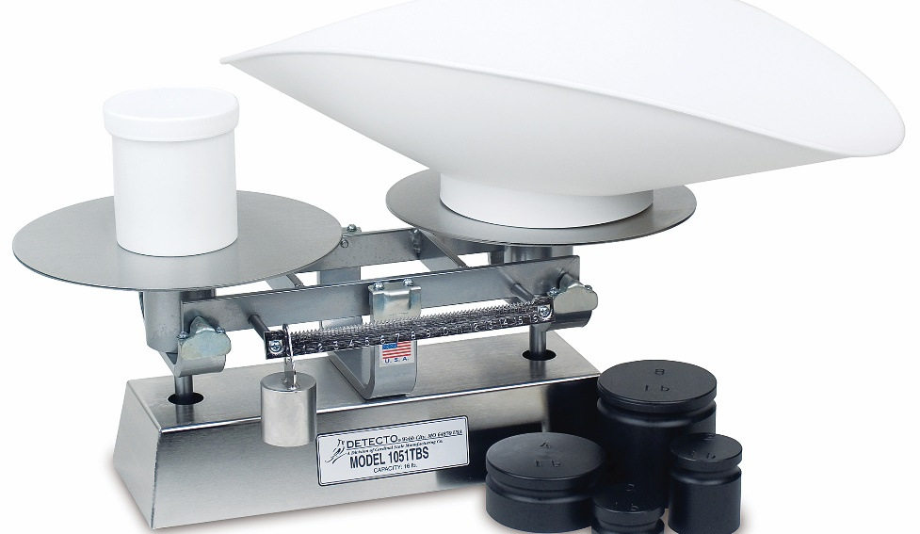
Measuring Weight
Balance beam:
Baker’s scale
Weight placed on one end
Product placed on the other
Scoops, counterweights, and pound measures
added to scale
Ingredients added to balance
Notes:
Balance beam, also called a baker’s scale: The weight of the item is placed on one end, and the product is placed on the other end until the
beam balances. Scoops, counterweights, and pound measures are added to the scale, and ingredients are added to bring balance.

Slide 39
Measuring Weight
Electric scale:
Measures electronically
Digital scales
  Portable
  Cost
Notes:
Electronic scale: This measures resistance electronically. Digital scales are becoming more popular due to their portability and cost.

Slide 40
Measuring Weight
Measuring fat:
Best method—measure by weight
Butter, margarine, shortening
Volume or sticks
Notes:
Measuring Fat: The best method for measuring fats, such as butter, margarine, or shortening, is by weight. Most professional bake shop recipes will ask for fat
to be measured by weight. Some recipes may ask for the fat to be measured by volume (teaspoon, tablespoon, cup, etc.), or by ¼-pound sticks. No matter
which measure is required, it is important to always measure accurately.

Slide 41
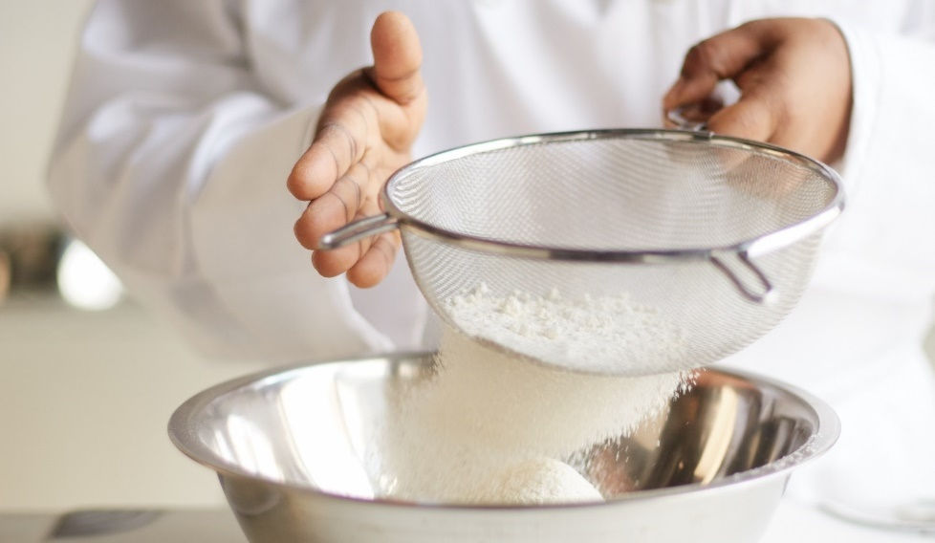
Measuring Weight
Measuring tips:
Sifting
  Removes lumps
  Smoother consistency
Sift dry, powdery ingredients before measuring
Never measure over mixing bowl
Notes:
Measuring Tips: Some recipes call for sifting ingredients; for example, flour, powdered sugar, and granulated sugar might need to be sifted. Sifting is a
process that removes lumps from an ingredient and gives it a smoother consistency. Be sure to sift dry, powdery ingredients before measuring them.
Never measure an ingredient while holding the measuring cup over the mixing bowl. If you overpour, the entire recipe may be ruined.

Slide 42
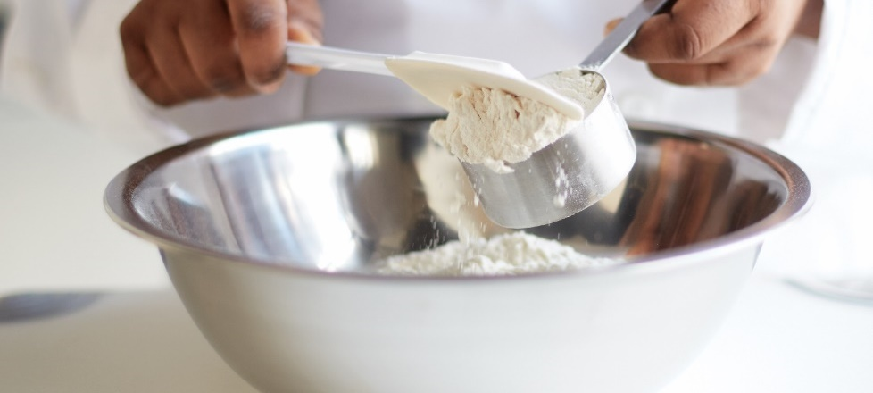
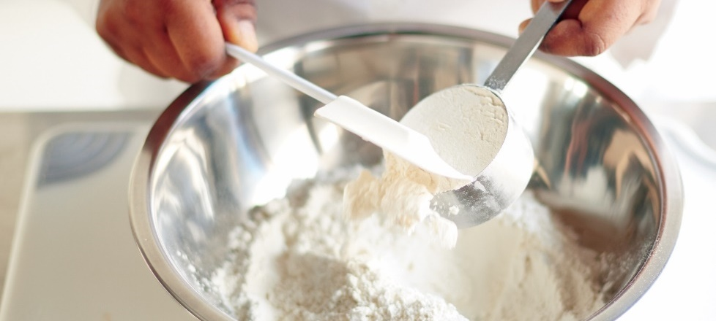
Measuring Dry Ingredients
Fill cup with ingredient
Level off top using straight-edged spatula
Pour ingredient into mixture
Notes:
Fill the cup with the ingredient. Some ingredients, such as flour and sugar, must be spooned into the
cup lightly. Other ingredients, like brown sugar, must be packed down, but only if specified in the recipe.
Level off the top of the cup using a straight-edged spatula.
Pour the ingredient into the mixture. If needed, use a rubber scraper to make sure all of the ingredient
has been emptied out of the cup.

Slide 43
Measuring Liquids
Set measuring cup on level surface
Pour liquid
Check measurement at eye level
Adjust liquid as needed
Pour ingredient into mixture
Small amounts—use measuring spoon
Notes:
When measuring liquid ingredients:
Set the measuring cup on a level surface.
Carefully pour the liquid into the cup.
Bend down to check the measurement at eye level for an accurate reading.
Add more liquid, or pour off excess, until the top of the liquid is at the desired measurement mark.
Pour the ingredient into the mixing container. If needed, use a rubber scraper to empty the cup completely.
For small amounts of liquids, use measuring spoons.

Slide 44
Edible Portion/As Purchased Amounts
Vegetables—trimmed and cut before use
Edible portion (EP)
  Amount of food left to be cooked and eaten after preparation
As purchased (AP)
  Amount before any preparation
Notes:
Most vegetables have to be trimmed and cut before being used in recipes. Almost no vegetable can be used at 100 percent of its weight. As a result, cooks
must calculate the correct edible portion (EP) amount from the untrimmed as purchased (AP) amount. The edible portion is the amount of a food item left to
be cooked and eaten after preparation such as trimming and cutting. The as purchased amount is the amount of a food item as it was purchased, before any
preparation. For instance, while the edible portion of purchased mushrooms will be close to 90 percent, only about 28 percent of corn on the cob is edible after
the corn is husked and cut from the cob.

Slide 45
Percentage Yields of Various Produce Items
Notes:
The table shows percentage yields for a variety of produce items.

Slide 46
Percentage Yields of Various Produce Items
Notes:
The table shows percentage yields for a variety of produce items.

Slide 47
Edible Portion/As Purchased Amounts
To determine AP amount:
Divide EP needed by yield percentage
EP ÷ Yield percentage = AP
To determine EP amount:
Multiply AP by yield percentage
AP × Yield percentage = EP
Notes:
To determine how much of an item is needed as an AP amount, simply divide the edible portion amount needed by the yield percentage. For example, a
recipe for pasta salad calls for 4 pounds of cauliflower. The conversion chart shows that cauliflower has a 55 percent yield. To calculate how much will be
needed to prepare 4 pounds of trimmed cauliflower, divide the desired EP amount by the yield percentage:
EP ÷ Yield percentage = AP
4 pounds trimmed cauliflower ÷ 0.55 = 7.27 pounds untrimmed
The cook needs to purchase 7.27 pounds of untrimmed cauliflower.
The formula can also be used in reverse. For example, the cook has 10 pounds of untrimmed cauliflower, which has a 55 percent yield:
AP × Yield percentage = EP
10 pounds untrimmed cauliflower × 0.55 = 5.5 pounds trimmed cauliflower

Slide 48
Edible Portion/As Purchased Amounts
Cooking loss—cookbooks, purchasing textbooks, yield books
Conversion chart—expected or average shrinkage from AP amount to EP amount
Yield test—amount of product after processing
Butcher test
  Butcher yield test
  Trim loss or “shrinkage” of meat
  Deboning and removing fat and gristle
Notes:
In order to determine the AP quantity needed to result in a given EP quantity, it is also important to know the cooking loss for the item. Many quantity
cookbooks, purchasing textbooks, and yield books include charts of average cooking loss for common food items. A conversion chart is a list of food items
showing the expected, or average, shrinkage from AP amount to EP amount. These charts are tools that a manager can use, and they work well in
most cases.
However, it is wise to conduct your own tests periodically to get the exact AP amount for your operation. A yield test helps to determine the amount of
product that will be produced after the required processing. A butcher test, or butcher yield test, is used to measure the amount of trim loss, or “shrinkage,”
that occurs during the trimming of a meat product. This trimming includes deboning and removing fat and gristle.

Slide 49
Edible Portion/As Purchased Amounts
Usable trim:
Used in other ways
Ground beef
Nonusable trim:
Not used in restaurant
Gills or scales of fish
Notes:
There are several kinds of trim to look for in a butcher yield test.
Usable trim is the trim that is removed from a product but that may be used in a different way than originally intended. When trimming a beef
tenderloin for filet mignon steaks, there is a small amount of meat that may be made into ground meat, or stir-fry. This would be an example
of usable trim.
Nonusable trim is the trim that is removed from a product and has no use in the restaurant. The gills or scales from fish are examples of
nonusable trim.

Slide 50
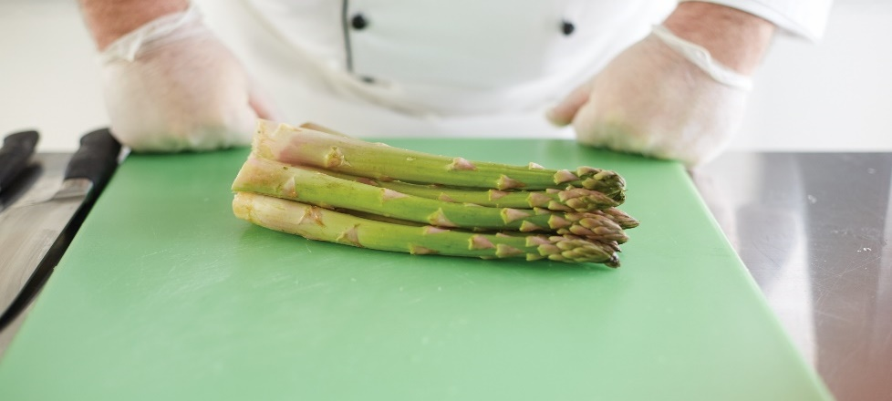
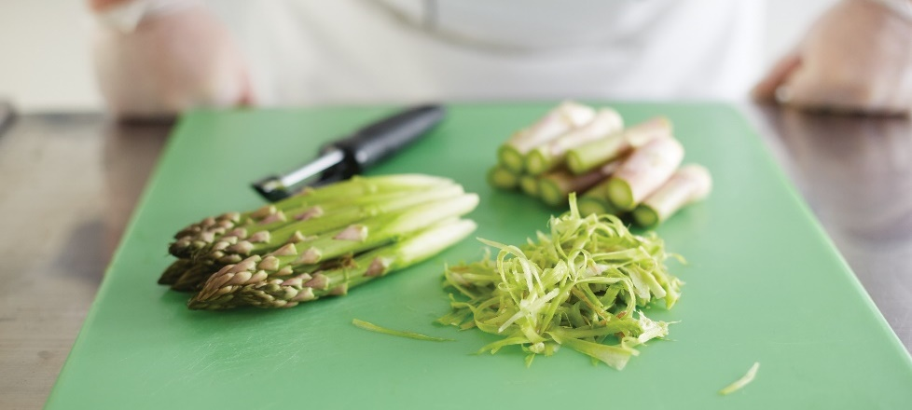
Edible Portion/As Purchased Amounts
Tests important
  High-cost item
  Sold in high volume
Impact operation’s food cost percentage
Convenience food
  Purchased as edible portion
  Price is higher
  Prep time and labor may be lower
Notes:
These tests are particularly important if the product is a high-cost item and if it is sold in high volume at the operation. If these two things are true, then the
item can have a major effect on the operation’s food cost percentage, which is the actual cost of food. (A food cost percentage is the cost of inventory and
purchasing divided by food sales.) So nothing should be left to chance. For example, if prime rib is a house specialty, a conversion chart might not be
accurate. There are many variables that determine the amount of shrinkage, such as the length of time the product is cooked and at what temperature.
Products today can frequently be purchased as an edible portion, usually known as a convenience food. This is something that is purchased already
trimmed and cut, such as precut fries. The price of the item is higher, but prep time and labor cost may ultimately be lower. For example, a manager
should weigh the amount of time saved peeling and cutting potatoes for fries against the cost of buying a product that comes already in that form.

Slide 51
Costing Recipes
Standard portion cost:
Standard recipe cost/cost per serving
Ingredient amounts needed
Market price of ingredients
Multiply or divide ingredient amounts by prices
Add all together = recipe cost
Divide total cost by yield = standard portion cost
Notes:
Other factors that are essential in quantity food production are standard recipe cost and cost per serving, or standard portion cost. To find the total
cost of a standard recipe, you must know both the ingredient amounts needed and the market price of each one. Then multiply or divide the
ingredient amounts by the prices and add it all up to get the recipe cost. Divide the total cost by the yield to get the standard portion cost.

Slide 52
Standard Recipe Cost Calculation for Brownie Recipe
Notes:
Shows how to calculate a standard recipe cost using the ingredients for the recipe in Table 14.1.

Slide 53
Recipe Cost Calculation per Ounce for Brownie Recipe
Notes:
Calculators make it easy to perform the calculations needed in the restaurant and foodservice industry. However, not all measurements are divided into
groups of 10 for a convenient decimal. For instance, one ounce could be expressed as 0.0626 pound, but it is more useful in the kitchen to know there
are 16 ounces in a pound, and 1⁄16 of a pound is simply one ounce. Using the brownie recipe from Table 14.1, the ingredient weights can be converted to
ounces, and then the cost per ounce can be used to figure the total cost. Table 14.8 shows the costing out of the brownie recipe using price per ounce.

Slide 54
Costing Recipes
Round cost-per-ounce prices after calculations
  Truer and more accurate total recipe cost
Ingredient costs—rounded to nearest cent
Portion costs—one-tenth of a cent
Notes:
It is best when performing calculations to not round the cost-per-ounce prices until after performing the calculations. By not rounding, you get a truer and
more accurate total recipe cost. After performing the calculations, ingredient costs are usually rounded to the nearest cent. Portion costs are ordinarily carried
out to one-tenth of a cent (the thousandths place to the right of the decimal).

Slide 55
Costing Recipes
Cost per portion:
Divide total recipe cost by portion yield
Brownie recipe example:
Total recipe cost = $30.44
Yield for recipe = 96 brownies
Cost per portion = Total recipe cost ÷ Yield for recipe
$30.44 ÷ 96 = $0.31708333
Cost per portion = $0.32
Notes:
Now that you have determined how much it costs to prepare a recipe, what can you do with that number? The next step is to figure out how much it costs to
prepare a serving or a portion. Most standardized recipes will state the yield for the recipe. This information is necessary for figuring out the cost per serving (or
cost per portion). To determine a cost per portion, simply divide the total recipe cost by the portion yield listed in the recipe. This can be demonstrated by again
using the brownie example from Table 14.1.
Figuring Cost per Portion
Total recipe cost = $30.44
Yield for recipe = 96 brownies
Cost per portion = Total recipe cost ÷ Yield for recipe
$30.44 ÷ 96 = $0.31708333
Cost per portion = $0.32

Slide 56
Costing Recipes
Price recipes every six months
Compare to national price index twice a year
Index increases or decreases specific percentage
Total recipe cost raised or lowered by percentage
Portion or yield cost recalculated
Complete revision yearly
Notes:
Many operations price out all recipes and then check them every six months to see if they are still accurate. Some compare standard recipe costs to the national
price index twice a year. If the index rises or drops a specific percentage, the total recipe cost is raised or lowered by this percentage, and the portion or yield cost
is recalculated. While this method simplifies the recalculation process, restaurant and foodservice operations should really do a complete revision every year.

Slide 57
Costing Recipes
Combine portion costs
Total cost of meal
  Calculate each food item and add all together
  Average cost of extras and add to items
Salad bars
  Food cost at salad bar
  Number of salad bar patrons
  Cost per serving = divide number of patrons into total cost
Notes:
Sometimes it is necessary to combine portion costs. A steak, for example, may cost $6.50 served by itself, but the cost increases to $10.99 when the steak is
served with a salad, French fries, a roll, and butter. Some operations calculate the exact cost of each food item and then add the figures together to determine
the total cost of a meal. Others simply calculate the average cost of all such extras and add this figure to appropriate items.
When patrons help themselves at a salad bar, there may be an extra calculation necessary to cost out a meal. The usual procedure is to keep an
account of the cost of food in the salad bar and track the number of salad bar patrons served. Dividing the number of patrons into the total cost of the salad
bar will result in the average cost per serving. This figure can be added to the basic entrée cost. For example, if an operation spends $95.68 per day to keep
its salad bar stocked and an average of 84 guests eat from the salad bar each day, the average cost per serving is: $95.68 ÷ 84 = $1.14 per serving.
Costing can be somewhat complicated. However, the success and profitability of a restaurant or foodservice operation depends on balancing costs and prices.

