Slide 2
Receiving Food
Receiving area:
First stop in the flow of food
Food deliveries
Employees check quality and quantity
Notes:
Equipment and tools are divided into categories according to their function—to receive, store, prepare, hold, or serve food.
The receiving area is the first stop in the flow of food. It is here that all food deliveries enter the restaurant or foodservice operation. Before accepting the
product, an employee checks the quality and quantity of the items ordered against those being delivered.

Slide 3
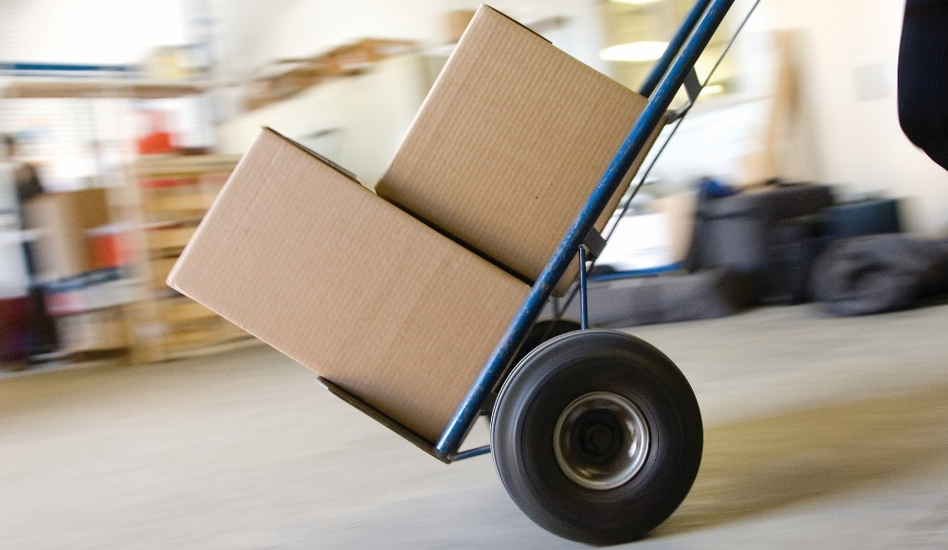
Receiving Food
Receiving table/area
  Weigh, inspect, and check delivered items
Scales
  Confirm ordered matches delivered
Utility carts
  Carry food cases to storage
Notes:
This can be accomplished using several pieces of equipment found in the receiving area:
• Receiving table/area: Employees weigh, inspect, and check delivered items on a receiving table or in a receiving area.
• Scales: Employees weigh items using a scale to confirm that what was ordered matches what is delivered.
• Utility carts: Carts molded of durable injection molding (plastic), molded shelving, or heavy steel are used to carry food cases to storage areas.
Chutes, conveyors, dollies, dumbwaiters, and elevators are all used to move food and supplies from one area of the operation to another.

Slide 4
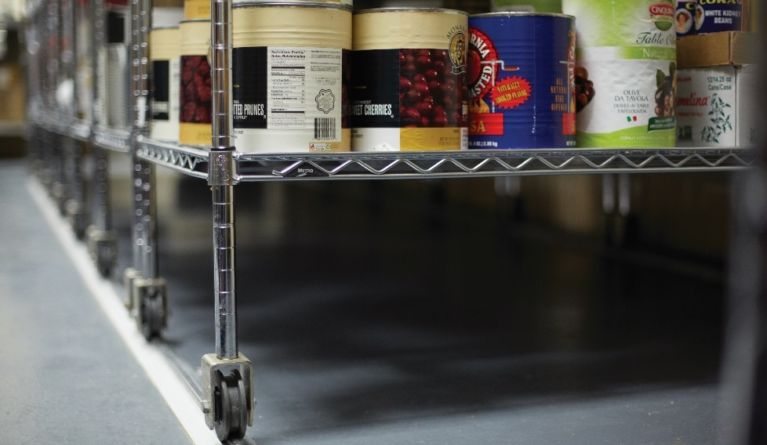
Storing Food
Dry goods
  Store 6 inches off of floor
Perishable goods
  Store in refrigerators and freezers
Notes:
After food is delivered and received into the receiving area, it must be stored properly. Dry goods such as flour, sugar, and grains must be stored at least
six inches off the floor on stainless-steel shelving (see Figure 11.3). Perishable goods such as dairy products, meat, and fresh fruits and vegetables are stored
in refrigerators and freezers.

Slide 5
Storing Food
Shelving:
Stainless steel
Strong, easy to clean
Notes:
Following are some details regarding the shelving and the refrigerators and freezers found in a foodservice operation:
• Shelving: Operations use stainless steel instead of wood because wood is difficult to keep clean and is not acceptable to many local health
departments. Stainless-steel shelves are very strong and easy to clean.

Slide 6
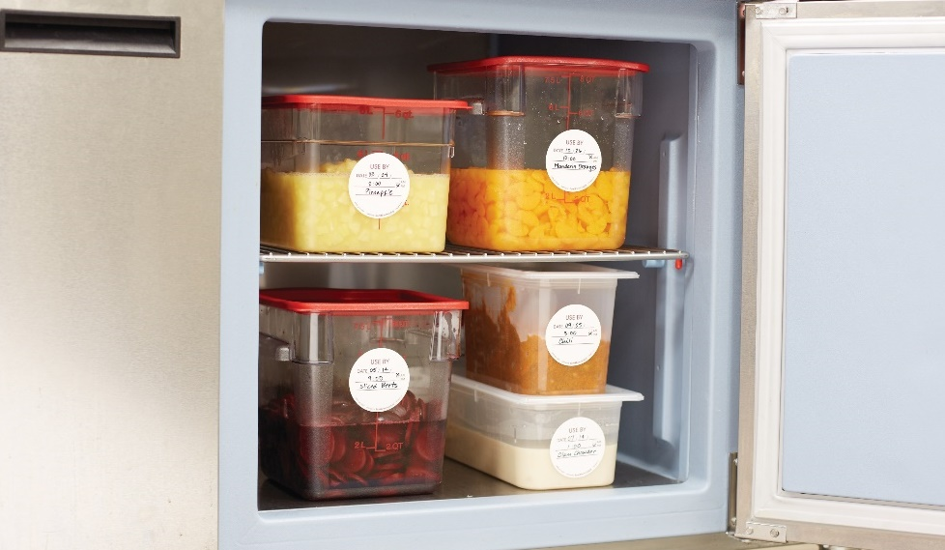
Storing Food
Refrigerators and freezers:
Walk-in refrigerator/freezer or “walk-in”
Reach-in refrigerator/freezer or “reach-in”
  Full size or half doors
  Windows
  Doors on both sides
  Wheels
Portable refrigerators and freezers
Temperature
  Refrigerators: between 32°F and 41°F (0°C and 5°C)
  Freezers: 0°F (–18°C) or lower
Notes:
Refrigerators and freezers:
There are two basic types of refrigerators and freezers. A walk-in refrigerator or walk-in freezer (often just called
a “walk-in”) is built right into the foodservice facility itself. A reach-in refrigerator or reach-in freezer (often just called a “reach-in”) can have
one, two, or three internal compartments. A reach-in might have full-sized doors or half doors, windows in the doors, or doors on both sides of the
freezer or refrigerator. Some have wheels so that they can be used in different areas of the kitchen (see Figure 11.4). There are also roll-in,
display, on-site, and portable refrigerators and freezers. All refrigerators must maintain temperatures between 32°F and 41°F (0°C and 5°C).
Freezers should maintain a temperature of 0°F (–18°C) or lower.

Slide 7
Processing Equipment: Cutters and Mixers
Cut meats and vegetables
Mix sauces and batters
Start on slow speed
Scrape bowl
Never place objects in mixing bowl while it is running
Use safety guards
Properly trained
Notes:
In addition to knives, hand tools, and pots and pans, other items are necessary to prepare food for cooking:
• Cutters and mixers
• Steamers
• Broilers
• Ranges, griddles, and fryers
• Ovens
• Proofing cabinets
In the professional restaurant or foodservice kitchen, cutters and mixers are used to cut meats and vegetables and to mix sauces and batters.
Always start the mixer on slow speed and then move to higher speeds as required to prevent splash over. Always scrape the bowl to ensure that even
mixing takes place. Never place a scraper or any other object in the mixing bowl while the machine is running.
Additionally, it is important to always use safety guards when using cutting machines. Everyone should be properly trained and informed of all precautionary
measures to take when operating the equipment. Remember, it is illegal in most jurisdictions for minors to use, clean, or maintain cutters or mixers.

Slide 8
Types of Cutters and Mixers
Countertop blender:
Purée, liquefy, and blend food
Base houses motor
Removable lid
Propeller-like blade
Speed settings at base
Jars—stainless steel, plastic, or glass
Notes:
Blenders purée, liquefy, and blend food. The blender consists of a base that houses the motor and a removable, lidded jar with a propeller-like
blade in the bottom. Speed settings for the motor are in the base. Jars for the blender are made of stainless steel, plastic, or glass.

Slide 9
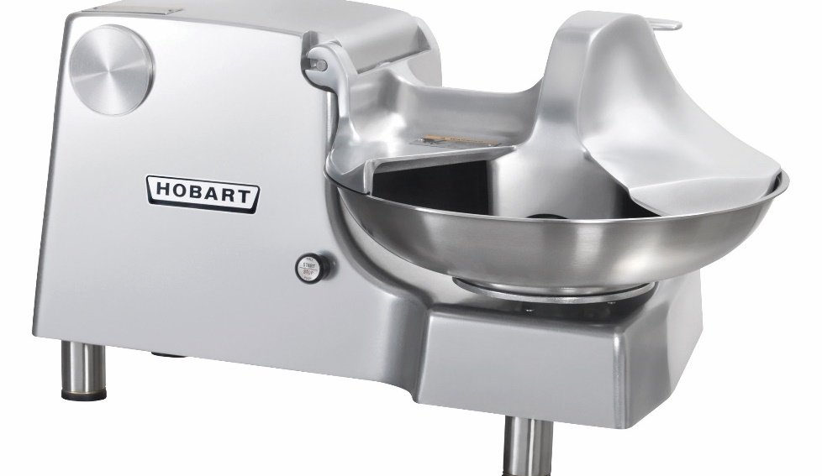
Types of Cutters and Mixers
Food chopper:
Chops vegetables, meat, and other food
Vertical rotating blade
Bowl rotates food under blade
Buffalo chopper
Never push food under cover
Notes:
A food chopper chops vegetables, meat, and other food using a vertical rotating blade and a bowl that rotates
the food under the blade. This unit is often called a buffalo chopper. Never push food under the cover of
the bowl, because your fingers could be caught by the moving blades. To clean the food chopper, first unplug
the unit. Remove the blades carefully, and handle with the same care given a knife.

Slide 10
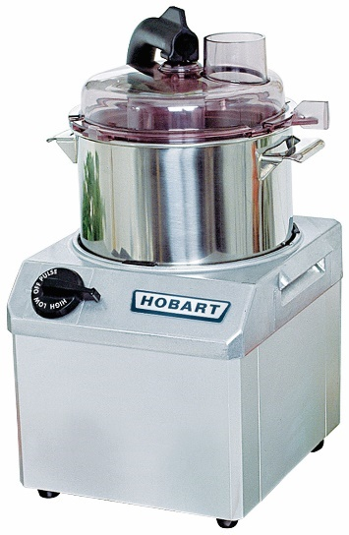
Types of Cutters and Mixers
Food chopper:
Grind, purée, blend, crush, and knead foods
Motor separate from bowl, blades, and lid
Notes:
This is a processing machine that houses the motor separately from the bowl, blades, and lid.
Food processors grind, purée, blend, crush, and knead foods.

Slide 11
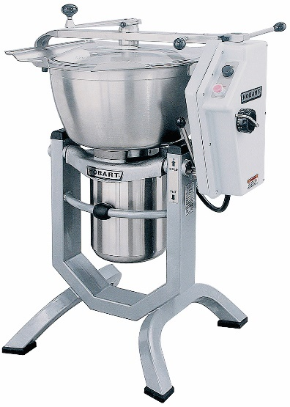
Types of Cutters and Mixers
Horizontal cutter mixer (HCM):
Cuts, mixes, and blends food quickly
High-speed, horizontal, rotating blade
Control length of time blade runs through product
Count to 10 before opening lid
Notes:
The horizontal cutter mixer (HCM) cuts, mixes, and blends food quickly with a high-speed,
horizontal, rotating blade that is housed in a large bowl with a tight cover. To vary from coarse to fine
or actual purée, control the length of time the blade runs through the product. Always count to 10 before
opening the lid after stopping the blade. The force created in the bowl moves the food rapidly. Allow
time for food to stop moving, or it may fly out when the lid is opened. Unplug the unit before cleaning it.
Handle the blades with the same care as a knife. The mixer will not operate if the hinged lid is not locked.

Slide 12
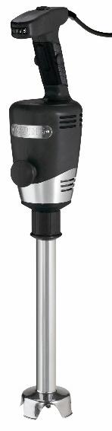
Types of Cutters and Mixers
Immersion blender:
Hand blender, stick blender, burr mixer
Long, stick-like machine
Motor on one end; blade on the other end
Purée and blend food
Place in container of food
Notes:
An immersion blender is also known as a hand blender, stick blender, or burr mixer. It is a long, sticklike
machine that houses a motor on one end of the machine with a blade on the other end. This operates
in the same manner as a countertop blender to purée and blend food, except that a cook holds it manually
in a container of food, whereas a countertop blender contains the food itself.

Slide 13
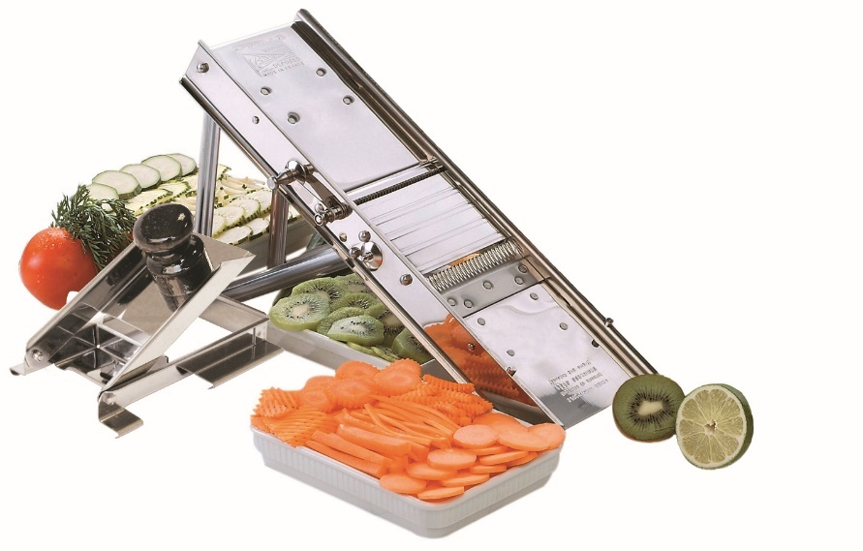
Types of Cutters and Mixers
Mandoline:
Manually operated slicer
Slice and julienne
Small quantities of fruits and vegetables
Stainless steel or plastic
Use a hand guard or steel gloves
Notes:
This is a manually operated slicer made of stainless steel with adjustable slicing blades to slice and
julienne. Its narrow, rectangular body sits on the work counter at a 45-degree angle. It is useful
for slicing small quantities of fruit or vegetables in situations where a large electric slicer is not
necessary. There are also extremely popular plastic models, which may have fixed or adjustable blades.
Typically, these do not stand on counters but are held over a bowl or work surface. Always use a
hand guard or steel gloves to avoid injury.

Slide 14
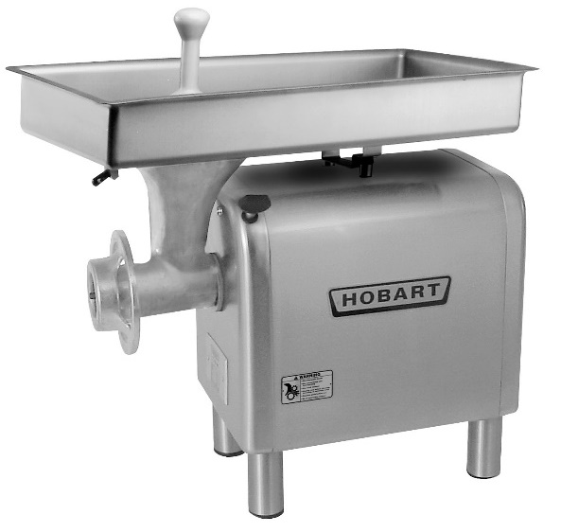
Types of Cutters and Mixers
Meat grinder:
Freestanding machine
Attachment for stand mixer
Drop food through a feed tube
Pulled along by metal worm
Blades cut food
Avoid cross-contamination
Notes:
This is a freestanding machine or an attachment for a standing mixer. Drop food in through a feed tube,
where it is pulled along by a metal worm, and then cut by blades as the food is forced out through the
grinder plate. To avoid cross-contamination, clean all areas of a meat grinder thoroughly after use.

Slide 15
Types of Cutters and Mixers
Slicer:
Slanted, circular blade
Food passes through automatically
Cook pushes a hopper that holds food
Thickness can vary
Guard must be used to move hopper
Notes:
Most meat slicers have a slanted, circular blade. Food either passes through the machine automatically, or a
cook pushes a hopper that holds the product along a carriage into the blade. The thickness of the slicer is set by
increasing and decreasing the distance between the guide plate and the blade. The guard on the hopper must
always be used to move the hopper. This protects the hands. During cleaning, the machine must be unplugged
and the blade set at 0 (no distance between the guide plate and blade). Remember that the blade is a knife
and can cut even when it is not turning. Because slicer blades are very sharp, it is important to pay close
attention when using them.

Slide 16
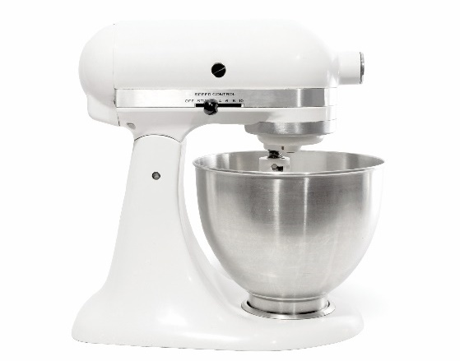
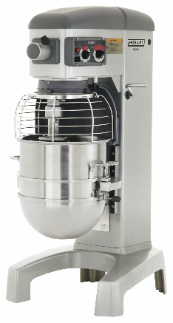
Types of Cutters and Mixers
Mixer:
5-quart, 20-quart, 60-quart, and 80-quart sizes
Mix and process large amounts of food
Specialized attachments
Notes:
Mixers come in 5-quart, 20-quart, 60-quart, and 80-quart sizes. Cooks use them to mix and process large amounts of food with any number of specialized
attachments, including paddles, wire whips, dough hooks, meat grinders, shredders, slicers, and juicers.

Slide 17
Types of Cutters and Mixers
Mixer attachments:
Flat beater paddle
  Mix, mash, and cream foods
Wire whip
  Beat and add air to light foods
Wing whip
  Heavier version of the wire whip
  Whip, cream, and mash heavier foods
Dough arm (hook)
  Mix heavy, thick dough
Notes:
• A flat beater paddle is used to mix, mash, and cream soft foods.
• A wire whip is used to beat and add air to light foods, such as egg whites and cake frosting.
• A wing whip is a heavier version of the wire whip and is used to whip, cream, and mash heavier foods.
• A dough arm (hook) is used to mix heavy, thick dough.

Slide 18
Steamers
Used to cook vegetables and grains
Food comes in direct contact with steam
Heats food very quickly
Notes:
Steamers are used to cook vegetables and grains. A steamer allows the food to come into direct contact with the steam, heating the food very quickly. Cooking
with steam is a very efficient method of cooking. There are different types of steamers in use at restaurant and foodservice operations.

Slide 19
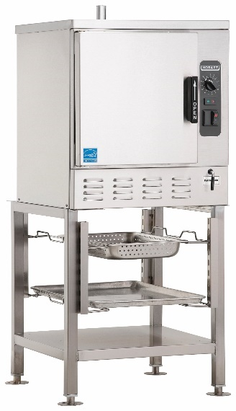
Types of Steamers
Steamer:
Vegetables and grains
Low or high steam pressure
Consists of stacked pots
  Lower pot—boiling water
  Upper pot—perforated bottom
Cooks food quickly
Hot water vapor—212°F (100°C)
Notes:
Use a steamer to steam food such as vegetables and grains. A steamer uses low or high steam pressure and often consists of a set of
stacked pots. The lower pot holds boiling water. The upper pot has a perforated bottom that allows the steam to enter through and cook the
food in the pot above. All types of steamers cook food quickly in very hot (212°F/100°C) water vapor.

Slide 20
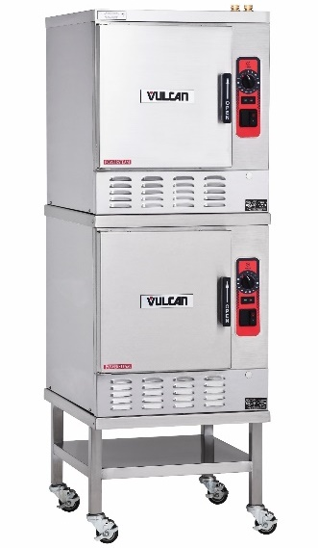
Types of Steamers
Convection steamer:
Steam generated in boiler
Piped to cooking chamber
Vented over food
Pressure does not build
Pressure continually exhausted
Can open door without danger
Cook large quantities of food
Notes:
In a convection steamer, the steam is generated in a boiler and then piped to the cooking chamber, where it is vented over the food.
Pressure does not build up in the unit. Rather, it is continually exhausted, which means the door may be opened at any time without
the danger of scalding or burning that comes with a pressure steamer. Cooks use convection steamers to cook large quantities of food.

Slide 21
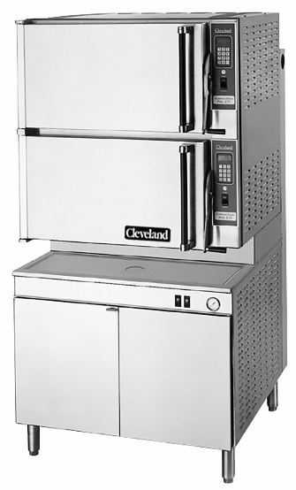
Types of Steamers
Pressure steamer:
Cooks food with high-pressure steam
Water heated under pressure
Temperatures greater than 212°F (100°C)
Release pressure before opening door
Cooking time controlled by automatic timers
  Vent steam
Notes:
A pressure steamer cooks food with high-pressure steam. Water is
heated under pressure in a sealed compartment, allowing it to reach
temperatures greater than 212°F (100°C). It is very important to
release the pressure before opening the door on a pressure steamer.
The cooking time is controlled by automatic timers, which open the
exhaust valves at the end of the cooking time to vent the steamer.

Slide 22
Types of Steamers
Steam-jacketed kettle:
Freestanding and tabletop
Bottom and sides have two layers
Steam circulates between layers
Heat liquid food quickly and evenly
Food less likely to burn
Notes:
These kettles come in freestanding and tabletop versions and in a very
wide range of sizes. The kettle’s bottom and sides have two layers,
and steam circulates between the layers, heating liquid food like soups
and stews quickly and evenly. Because the circulating steam evenly heats all
sides of the kettle instead of just the bottom, food cooks faster and more
evenly and is less likely to burn.

Slide 23
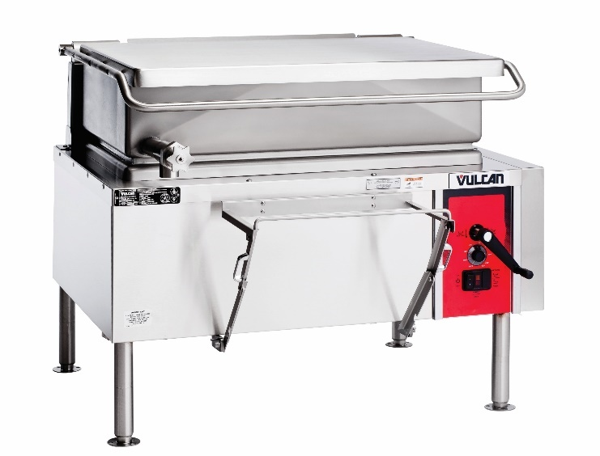
Types of Steamers
Tilting fry pan:
Fry pan or skillet
Grill, steam, braise, sauté, and stew
Many kinds of food
Can function as a steamer
Notes:
Although this piece of equipment is often called a fry pan or skillet, cooks use it to grill, steam, braise, sauté, and stew
many different kinds of food. Most tilting fry pans have lids that allow the unit to function as a steamer. They are very
easy to clean.

Slide 24
broilers
Intense, direct heat
Cook food quickly
Heat source is above or above and below
Notes:
There are several types of broilers that are commonly used in restaurant and foodservice operations. Using very intense direct heat, broilers cook food quickly.
For broilers, the heat source is above or both above and below to heat the food.

Slide 25
Types of Broilers
Charbroiler:
“Grills”
Gas or electricity
Mimic effects of charcoal grill
Food drips onto heat source
  Flames and smoke
  Adds flavor to food
Notes:
Charbroilers use gas or electricity to mimic the effects
of charcoal in a grill, and as a result are sometimes referred
to as grills. Food juices drip onto the heat source to create
flames and smoke, which adds flavor to food.

Slide 26
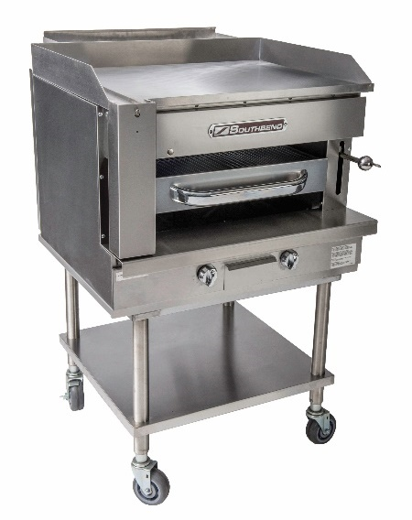
Types of Broilers
Countertop broiler:
Small broiler
Sits on top of worktable
Quick-service restaurants
Intense radiant heat
Notes:
This is a small broiler that sits on top of a worktable.
Primarily quick-service restaurants use these. The heat
source is located above the food and produces an
intense radiant heat.

Slide 27
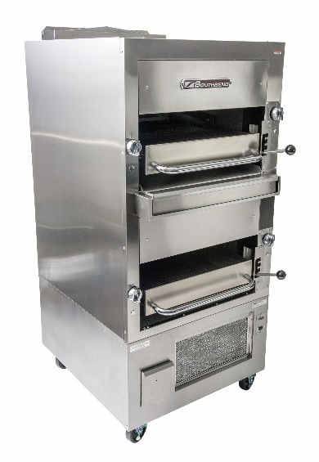
Types of Broilers
Hotel broiler:
Large radiant broiler
Cooks large amounts of food quickly
Notes:
Use this large radiant broiler to broil large amounts of
food quickly.

Slide 28
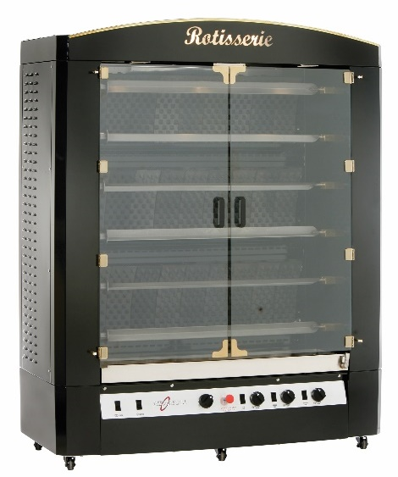
Types of Broilers
Rotisserie:
Place food on a stick or spit
Roast it over or under heat source
Open or enclosed
Cook chicken, turkey, or other poultry types
Notes:
In a rotisserie, cooks place food on a stick, or spit, and
roast it over or under a heat source. The unit may be open
or enclosed like an oven. Cooks use it most often for
cooking chicken, turkey, and other types of poultry.

Slide 29
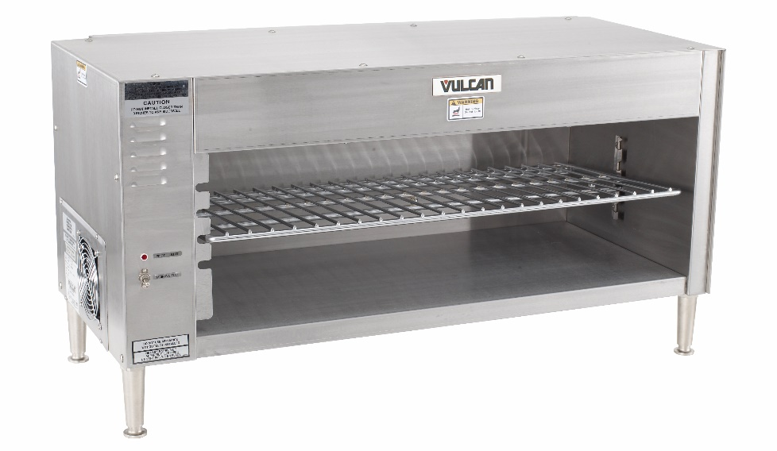
Types of Broilers
Salamander:
Small radiant broiler
Attached to back of range
Brown, finish, and melt food
Notes:
In a rotisserie, cooks place food on a stick, or spit, and
roast it over or under a heat source. The unit may be open
or enclosed like an oven. Cooks use it most often for
cooking chicken, turkey, and other types of poultry.

Slide 30
Ranges, Griddles, and Fryers
Cooking units with open heat sources
Multiple sizes
Variations to specific needs
Notes:
In restaurant and foodservice kitchens, the range is usually the most frequently
utilized piece of equipment. Ranges are cooking units with open heat sources.
Like much of the restaurant and foodservice equipment mentioned earlier,
ranges come in multiple sizes and variations suitable to the specific needs of an
individual operation.

Slide 31
Types of Ranges, Griddles, and Fryers
Deep-fat fryer:
Gas or electric
Cook food in oil
Temperature between 300°F and 400°F (149°C and 204°C)
Notes:
Gas and electric fryers cook food in oil at temperatures between 300°F and 400°F (149°C and 204°C).
Some computerized fryers lower and raise the food baskets automatically.

Slide 32
Types of Ranges, Griddles, and Fryers
Flat-top burner:
French top
Flat-top burner
Cooks food on cast iron or steel plate
Even and consistent heat
Notes:
A flat-top burner cooks food on a thick slate of cast iron or a steel plate that covers the heat source.
A flat-top burner provides even and consistent heat.

Slide 33
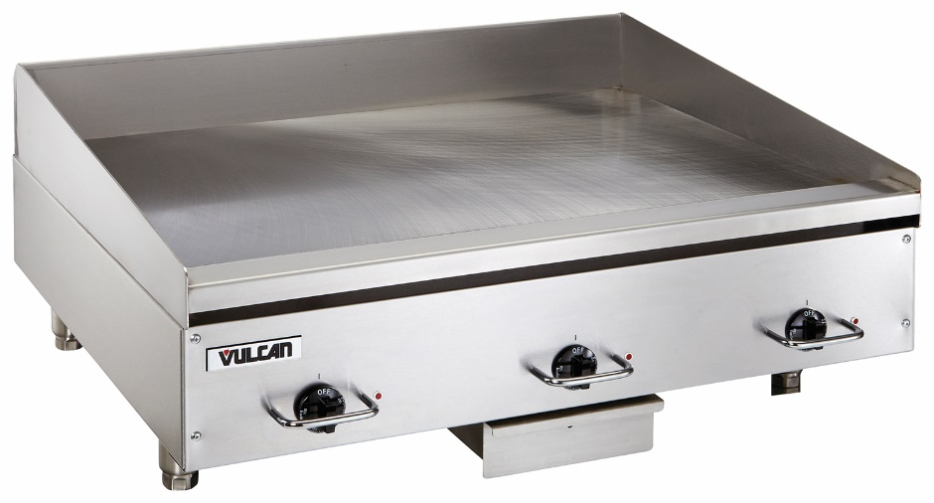
Types of Ranges, Griddles, and Fryers
Griddle:
Similar to flat-top range
Heat source beneath thick plate of metal
Edges to contain food
Drain to collect waste
Notes:
Similar to a flat-top range, a griddle has a heat source located beneath a thick plate of metal.
Cook food directly on this surface, which is usually designed with edges to contain the food and a
drain to collect waste.

Slide 34
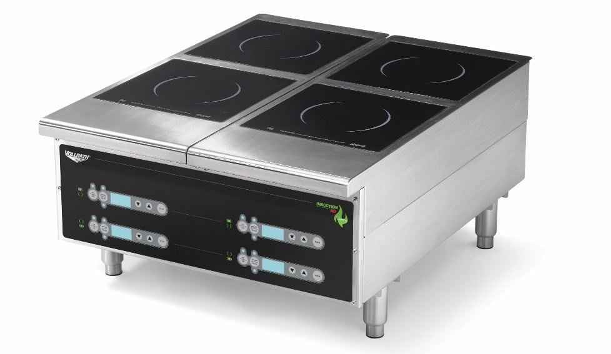
Types of Ranges, Griddles, and Fryers
Induction burner:
Magnetic attraction between cooktop and steel or
cast-iron pot
Cooktop remains cool
Reaction time is faster
Do not use copper or aluminum pans
Notes:
An induction burner generates heat by means of magnetic attraction between
the cooktop and a steel or cast-iron pot or pan. The cooktop itself remains cool.
Reaction time is significantly faster with the induction cooktop than with traditional
burners. Do not use copper or aluminum pans on this burner. They will not work.

Slide 35
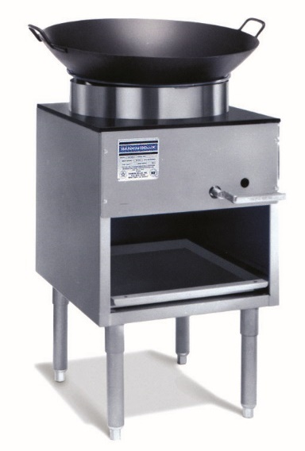
Types of Ranges, Griddles, and Fryers
Wok burner:
Gas burner
Cradle a rounded wok pan
Extremely intense heat
Wok hei—savory, charred flavor
Notes:
This is a gas burner (or propane for home use) with multiple jets, designed to cradle a rounded wok pan
in extremely intense heat. The high heat of a wok burner produces the “wok hei,” which is a particularly
savory, charred flavor associated with the best wok-cooked dishes.

Slide 36
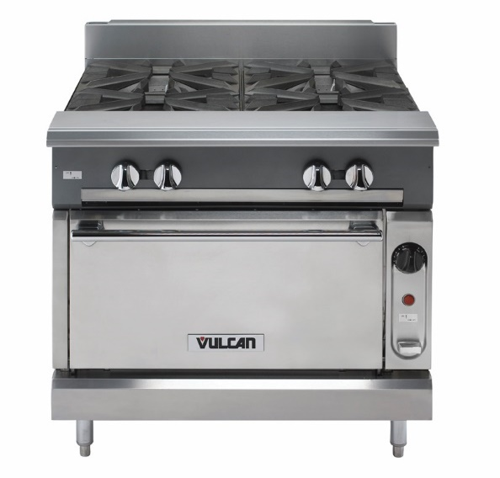
Types of Ranges, Griddles, and Fryers
Open burner:
Grate style
Gas burner
Direct heat by open flame
Heat easily controlled

Slide 37
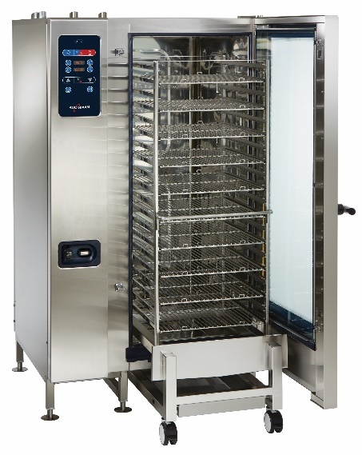
Types of Ovens
Combi-oven:
Convection oven and steamer
Convective steam, convective dry hot air, or both
Efficient, flexible units
Expensive
Notes:
There are many types of ovens available to suit a variety of restaurant and
foodservice operations. They vary in size and method of operation.
This unit combines a convection oven with a steamer. Using a combi-oven, cooks can work
with convective steam, with convective dry hot air, or with a combination of both. These are
very efficient, flexible units, but they are relatively expensive.

Slide 38
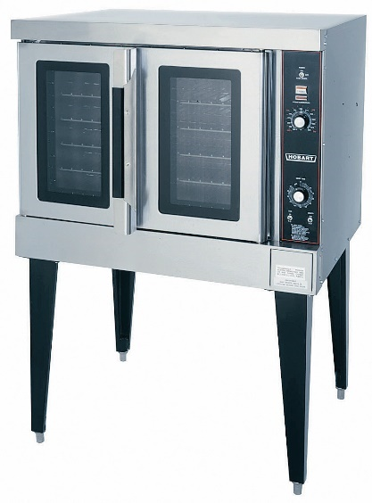
Types of Ovens
Convection oven:
Fan circulates heated air
Shortens cooking time
Energy used efficiently
Reduce recipe temperatures by 25 to 50 degrees compared to conventional ovens
Notes:
Convection ovens have a fan that circulates heated air around the food as it cooks. This shortens
cooking times and uses energy efficiently. Reduce recipe temperatures designed for conventional ovens
by 25 to 50 degrees Fahrenheit (4 to 10 degrees Celsius), because the circulating air is so much
more efficient.

Slide 39
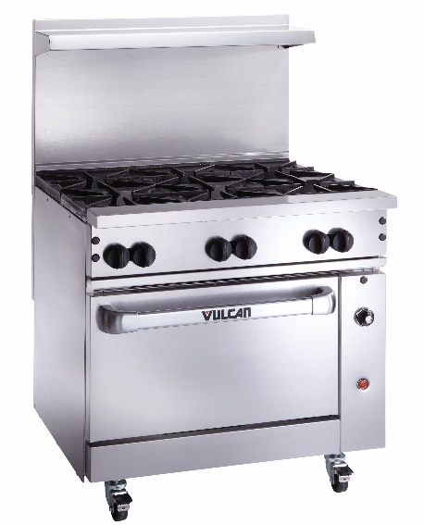
Types of Ovens
Conventional (standard) oven:
Heat source located on floor of oven
Heat rises into open space
Contains racks for food
Usually located below a range-top burner
Inexpensive
Easy to integrate with other cooking equipment
Notes:
In a conventional oven, the heat source is located on the floor of the oven. Heat rises
into the cavity, or open space in the oven, which contains racks for the food to sit on as it cooks.
These ovens are usually located below a range-top burner. Conventional ovens are inexpensive
and easy to integrate with other pieces of cooking equipment.

Slide 40
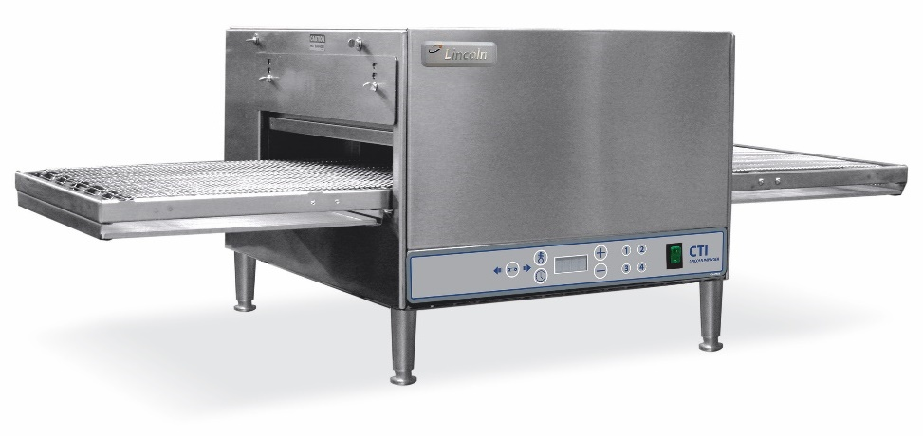
Types of Ovens
Conveyor oven:
Conveyor belt moves food along
Heat sources on top and bottom
Notes:
In this type of oven, a conveyor belt moves the food along a belt in one direction. It cooks with
heat sources on both the top and bottom.

Slide 41
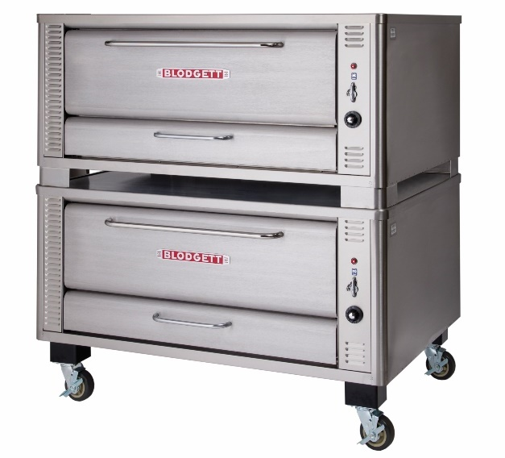
Types of Ovens
Deck oven:
Two to four shelves
Stacked on top of each other
Food cooks on shelves
Notes:
A deck oven is a type of conventional oven in which two to four shelves are stacked on top of
each other. Cook food directly on these shelves, or decks.

Slide 42
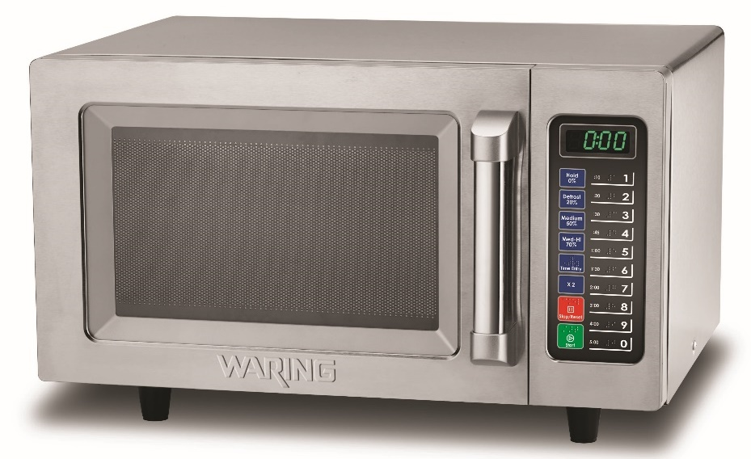
Types of Ovens
Microwave oven:
Microwaves of energy
Food molecules move rapidly
Create heat inside food
Thaw and reheat foods
Notes:
Microwave ovens heat food not with heat, but with microwaves of energy that cause a food’s
molecules to move rapidly and create heat inside the food. In restaurant and foodservice
kitchens, cooks use microwaves mainly to thaw and reheat foods.

Slide 43
Types of Ovens
Rotary oven:
Three to five circular shelves
Food cooks as shelves move
Products put on a speed rack
Rack goes into the oven
  Moves on a spinning track
  Lifted and spun around
Notes:
A rotary oven has three to five circular shelves on which food cooks as the shelves move
around a central rod. Products are put on a speed rack, the rack is pushed into the oven,
and it either moves on a spinning track or is lifted and spun around.

Slide 44
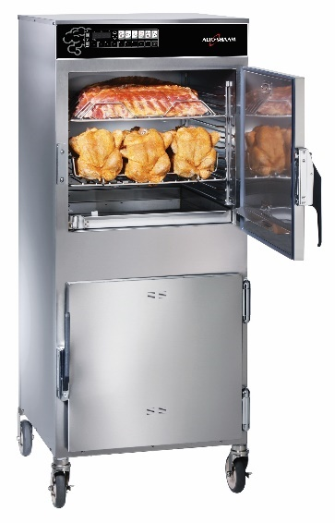
Types of Ovens
Slow-roasting oven:
Roast meat at low temperatures
Preserve meat’s moisture
Reduce shrinkage
Brown meat’s surfaces
Notes:
Use this oven to roast meat at low temperatures. This helps preserve the meat’s
moisture, reduce shrinkage, and brown the meat’s surfaces.

Slide 45
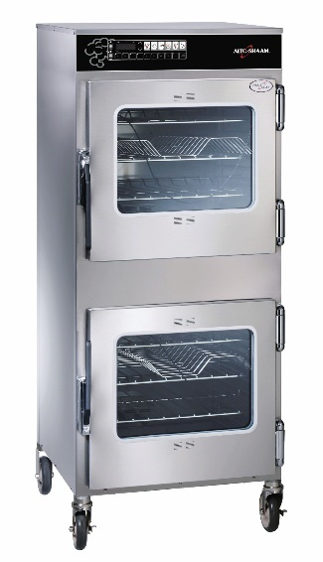
Types of Ovens
Smoker:
Smoking or slow-cooking food
Treats food with smoke
Cool or hot temperatures
Racks or hooks—smoke evenly
Notes:
Use a smoker for smoking and slow-cooking food. A true smoker treats food with smoke and operates
at either cool or hot temperatures. Smokers generally have racks or hooks, allowing food to
smoke evenly.

Slide 46
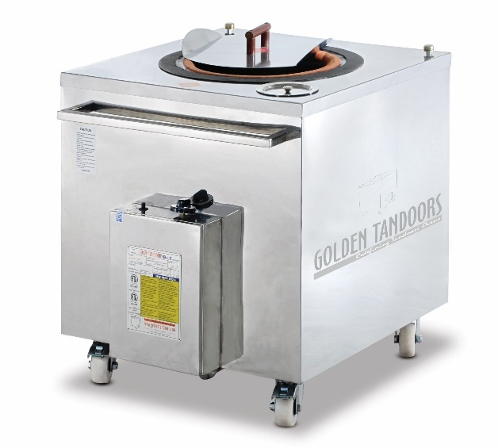
Types of Ovens
Tandoor oven:
Cylindrical or barrel-shaped oven
Made of clay
Wood or charcoal fire inside
Open top
Cooked on metal spike
Dough cooked against inside of oven
800°F to 900°F (427°C to 482°C)
Notes:
This is traditionally a cylindrical or barrel-shaped oven, often made of clay, with a wood
or charcoal fire inside at the base and an open top. There are also stainless-steel versions
of tandoor ovens, as shown here. Food can be thrust inside the oven on long metal spikes
(famously, chicken), or portions of thin dough can be slapped against the inside of the oven
to develop characteristic bubbling and charring. These ovens easily reach 800°F to 900°F
(427°C to 482°C).

Slide 47
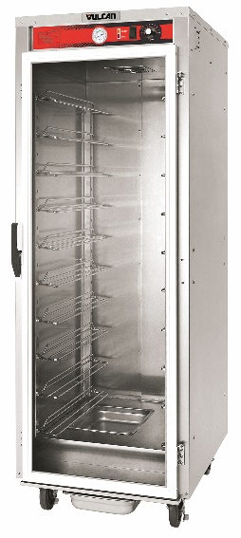
Proofing/Holding Cabinets
Proofing cabinet:
Proof dough
Keep hot after baked
Control temperature and humidity of dough
Consistent product
Save space and time

Slide 48
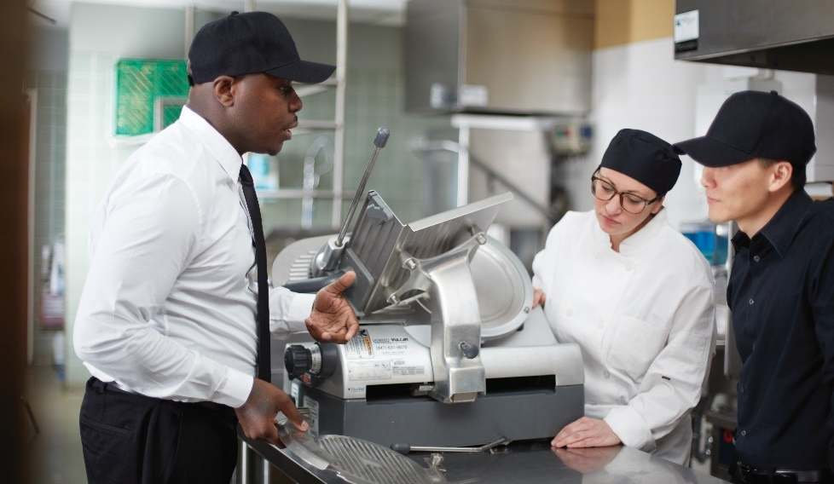
Safety Precautions
Read manufacturer's instructions
  Train employees
  Demonstrate proper use
  Disassemble all equipment
Use all safety features
Notes:
When working with large equipment, observe safety precautions. It is important to perform proper and consistent maintenance and cleaning. Follow these
general guidelines when working with large equipment:
Learn to use the machines safely by getting proper instruction and reading the manufacturer’s instructions. Ensure that all employees are thoroughly
trained on handling all equipment for safety concerns. Make sure that they can demonstrate both the proper use and disassembly of all equipment
before allowing them to use it.
Use all safety features—make sure that lids are secure, use hand guards, and make sure machines are stable.

Slide 49
Safety Precautions
Turn off and unplug after use
Unplug before disassembly
  Clean and sanitize
Reassemble properly
  Leave unplugged
Report problems or malfunctions
Notes:
Turn off and unplug electrical equipment completely after each use.
Check to ensure that the equipment is unplugged before disassembly. Clean and sanitize the equipment thoroughly after each use.
Reassemble all pieces of equipment properly, and leave machines unplugged after each use.
Report any problems or malfunctions promptly, and alert coworkers to the problem.

Slide 50
Instructions for Professional Kitchen Tools
Deep-fat fryer:
Use caution
Proper training
Observe all safety procedures
Wear PPE
Use tools with handles
Use correct grease level and cooking temperatures
Avoid reaching over or climbing over fryers
Dispose of used oil properly
Keep floors clean and dry
Wear slip-resistant shoes
Notes:
Of course, there are specific instructions for many of the tools used in a professional kitchen.
Description
When using a deep-fat fryer, please observe all of the safety features.
Please remember that the oil can reach temperatures of 400°F (204°C)
if not checked and can cause serious injuries.
Safety/Usage Instructions
Use caution when working around hot oil.
Get trained in the proper use and maintenance of your deep fryer.
Observe all safety procedures and wear all protective equipment provided for your use while preparing hot items.
Use gloves, scrapers, and other cleaning tools with handles provided by your employer.
Use the correct grease level and cooking temperatures for your deep fryer.
Avoid reaching over or climbing on top of fryers and other hot surfaces. Clean vents when oil is cool.
Dispose of used frying oil by following the manufacturer’s recommendations.
Keep floor surfaces clean and dry to prevent slipping or falling onto hot surfaces. Wear slip-resistant shoes. Floors should be
cleaned often with grease-cutting solutions.

Slide 51
Instructions for Professional Kitchen Tools
Deep-fat fryer:
Do not work close to hot fryers with a wet floor
Do not spill water or ice into oil
Do not store drinks near fryers
Do not overfill
Do not pour excess ice from packages
Do not overheat oil
Do move hot oil containers
Do not store oil on the floor by grill area
Extinguish oil/grease fires—class B or K fire extinguisher
Notes:
Safety/Usage Instructions
Do not work close to hot fryers when the floor is wet.
Do not spill water or ice into oil. Do not store employee drinks by deep fryers—they could be easily bumped into the hot oil
and cause a flare-up.
Do not overfill or pour excessive amounts of product into a deep fryer at one time. Overfilling causes excessive splashing and
bubbling over of hot oil.
Do not pour excess ice from packages into the fryer.
Do not overheat the oil; use only the manufacturer’s recommended cooking temperatures.
Do not move or strain hot oil containers; wait until the oil is cool.
Do not store oil on the floor by the grill area. Someone could slip and fall into the oil.
Extinguish hot oil/grease fires by using a class B or class K fire extinguisher.

Slide 52
Instructions for Professional Kitchen Tools
Slicer:
Avoid distractions
Wear cut-resistant gloves
Secure food correctly
Turn off and unplug machine
Set blade to zero
Notes:
Description
A meat slicer is a rotating or spinning blade with which you slice food. These
machines are dangerous and should never be used without proper instruction
and guidance.
Safety/Usage Instructions
Dedicate your full attention to the slicing task and avoid distractions.
Wear cut-resistant gloves when operating or cleaning the machine.
Secure the food correctly so it does not slip.
Turn off and unplug the machine, and set the blade adjustment to zero before
cleaning. This makes sure that the knife edge is not exposed.

Slide 53
Instructions for Professional Kitchen Tools
Slicer:
Keep work area clean
Use tampers or pushers
Do not use hands to feed food into slicer
Do not reach across the blade
Use locking features
Notes:
Safety/Usage Instructions
• Keep the work area clean and free of clutter.
• Always use tampers, or pushers, to push food into place.
• Never use hands to feed food into the slicer.
• Never reach across the blade for any reason.
• Use locking features to keep the blade in place when not in operation.

Slide 54
Instructions for Professional Kitchen Tools
Steamer:
Use caution when opening the door
Check steamer for leaks
Check safety valve
Check steam pressure
Clean up spilled food
Notes:
Description
As stated earlier, there are different types of steamers available
for use. Always follow the manufacturer’s instructions on how to
properly clean and use these machines.
Safety/Usage Instructions
Guard against possible steam burns when opening the door.
If steam leaks around the door after tightening, have the steamer checked by a
reliable service person.
Be certain that the safety valve is in good working order.
If steam pressure rises above the safety level, shut off the steam and call a reliable
service person.
Clean up spilled food immediately.

Slide 55
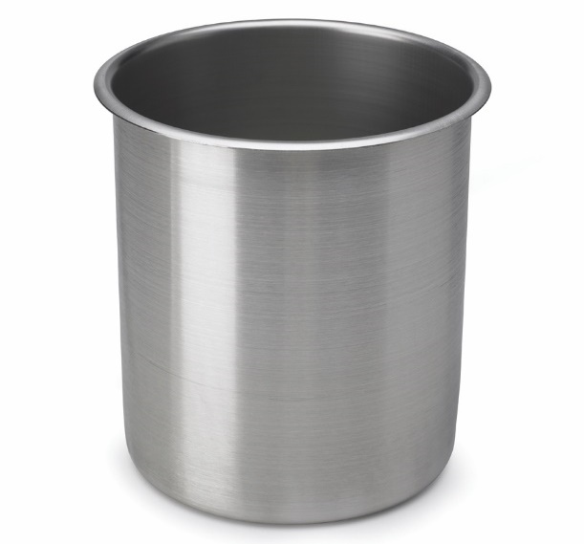
Types of Holding and Serving Equipment
Bain-marie:
Cylindrical stainless-steel pot
Sits in steam table
Hot-water bath
Many sizes
Do not use to reheat food
Notes:
Once the food arrives in the holding and service area, it is usually ready to be presented to the guest. The kitchen staff have taken great care and all
precautions to ensure that the meals served to guests have been prepared accurately and safely.
Though most of the hard work in preparing a meal has already been done, the final touches made in the holding and service areas are important to
delivering a quality meal.
A bain-marie is a cylindrical stainless-steel pot meant to sit in a steam table. These may or may not be held in a hot-water bath,
depending upon the type of steam table. Inserts come in many sizes, ranging from one quart to 36 quarts. A bain-marie, when set properly,
holds food at 135°F (57°C). Never use it to cook or reheat food.

Slide 56
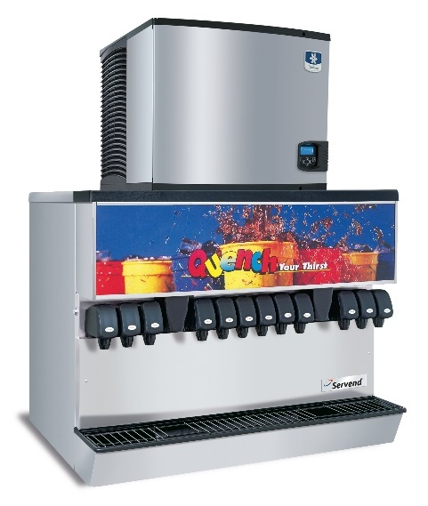
Types of Holding and Serving Equipment
Carbonated beverage machine:
Attached to premixed blends of soft drinks and CO₂ tanks
Automatically mixes
Refrigeration unit chills lines
  Reduces foam
Notes:
A carbonated beverage machine is attached to tanks that hold premixed blends for selected soft drinks and a tank that contains
CO₂. When the switch is pressed on the unit, it automatically mixes the blend and gas to make the beverage. The machine contains
a refrigeration unit to chill the lines to reduce foaming in the dispensed beverage.

Slide 57
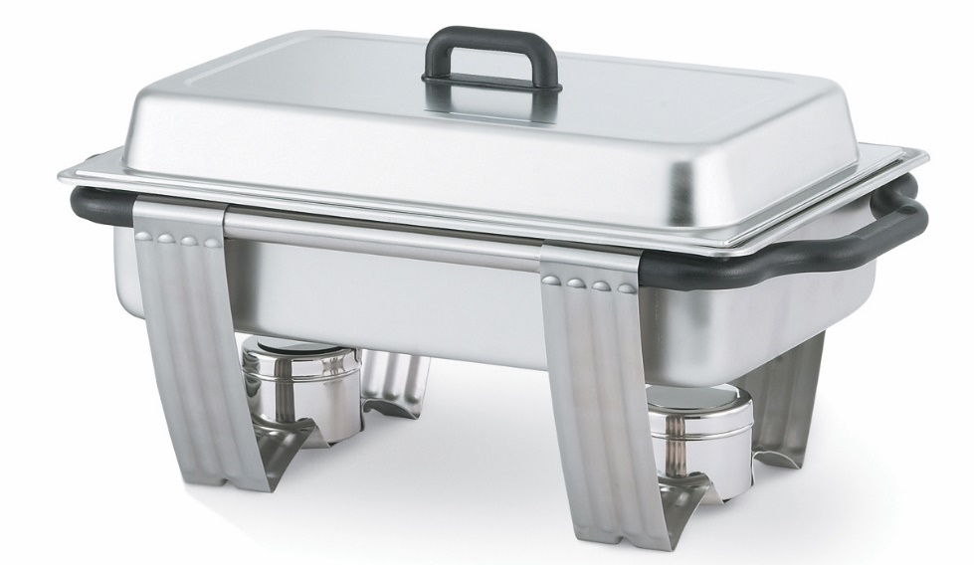
Types of Holding and Serving Equipment
Chafing dish:
Keeps food hot on buffet
Fuel source—canned fuel
  Placed underneath
Chafers filled with hot water
Notes:
Use chafing dishes (or chafers) to keep food items hot on a buffet table. Typically, the heat source for chafers is canned fuel, which is
placed underneath the chafers filled with hot water.

Slide 58
Types of Holding and Serving Equipment
Coffeemaker:
Automatically makes coffee
Connected to a water supply
Variety of sizes
Notes:
A coffeemaker is a machine that automatically makes coffee. The operator adds coffee and, because the unit is usually
connected to a water supply, simply pushes a button to make the coffee. The units come in a variety of sizes, from those
that make a single 12-cup pot to the large banquet-size urns that make 100 or more cups.

Slide 59
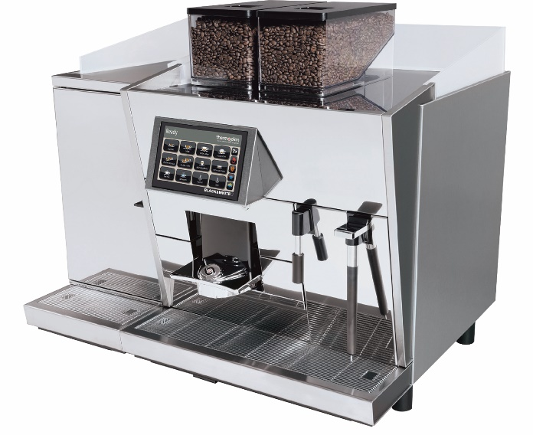
Types of Holding and Serving Equipment
Espresso machine:
Traditional Italian coffee beverage
Espresso—concentrated coffee
Hot water forced under pressure through finely
ground coffee
Notes:
An espresso machine produces the traditional Italian coffee beverage called espresso. Espresso is a concentrated coffee
beverage brewed by forcing hot water under pressure through finely ground coffee.

Slide 60
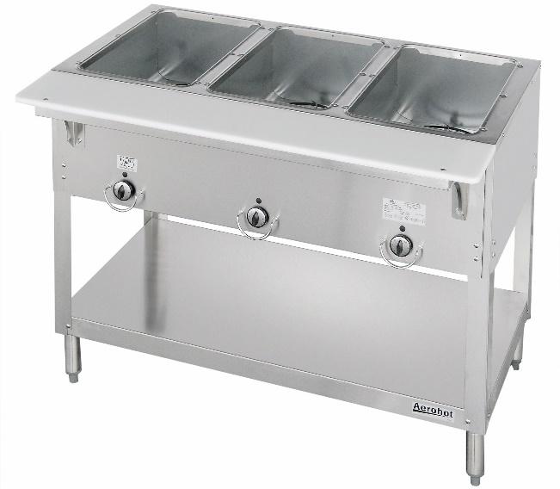
Types of Holding and Serving Equipment
Food warmer or steam table:
Holds hotel pans
Full-size pans or multiple smaller pans per slot
Can use with or without water
Holds food at 135°F (57°C)
Do not cook or reheat food
Notes:
This unit is designed to hold hotel pans (or steam table pans), either one full-size pan or multiple smaller pans per slot. Different types of units are
designed to work with water in the holding unit, without water, or either way. A food warmer/steam table, when set properly, holds food at
135°F (57°C). Never use it to cook or reheat food.

Slide 61
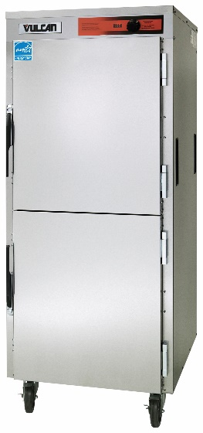
Types of Holding and Serving Equipment
Hot-holding cabinet:
Heavily insulated cabinet
Hold hotel pans or sheet pans
Thermostat controls temperature
Controls for humidity
Easily movable
Notes:
The hot-holding cabinet is a heavily insulated cabinet designed to hold either hotel pans or sheet pans on racks in the interior. A thermostat
controls the temperature, so that the cabinet holds food at the desired temperature. Often these units also have controls for humidity to
prevent stored food from drying out. Some units have wheels to make it easy to move them to the service area.

Slide 62
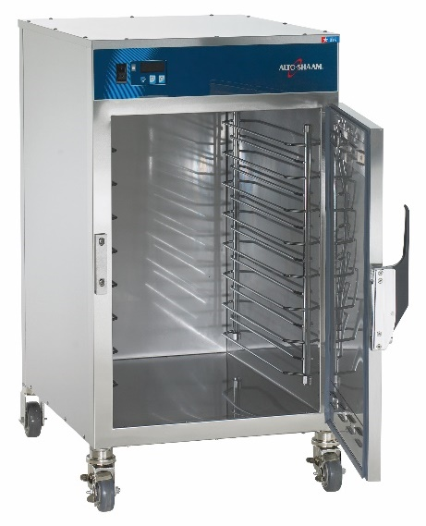
Types of Holding and Serving Equipment
Hot box:
Insulated
Holds sheet pans and hotel pans
Notes:
A hot box is an insulated piece of equipment designed to hold sheet pans and hotel pans of food.

Slide 63
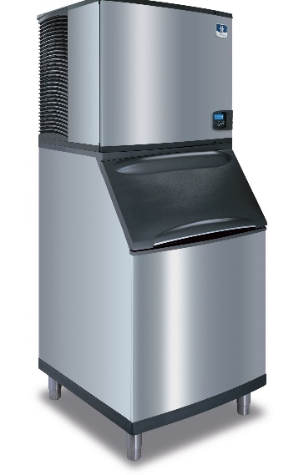
Types of Holding and Serving Equipment
Ice machine:
Makes ice cubes, flakes, chips, or crushed ice
Use proper ice scoop
Notes:
Ice machines can make ice cubes, ice flakes, ice chips, and crushed ice. Always scoop ice with a proper ice scoop.

Slide 64
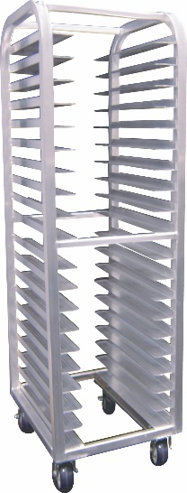
Types of Holding and Serving Equipment
Speed racks:
Metal
Holds sheet pans
Easily movable
Kitchens, bakeshops, dry storage, refrigerators,
and freezers
Notes:
These racks are generally made of metal and have slots that food handlers can slide sheet pans into. This can create
shelves of various heights depending on need. Speed racks, equipped with wheels, are suitable for kitchens,
bakeshops, dry storage, refrigerators, and freezers. A wider variant is made to hold large serving trays for banquets,
so that cooks can make plates up in advance and store them (for instance, composed salads can be assembled and
stored without dressing).

Slide 65
Types of Holding and Serving Equipment
Tea maker:
Same functionality as a coffeemaker
  Automatically makes tea
  Connected to a water supply
  Variety of sizes
Notes:
A tea maker works the same as a coffeemaker, but it makes tea for iced tea.

