Slide 2
Foodborne Illness and Its Costs
Foodborne illness—disease transmitted to people by food
Foodborne-illness outbreak
  2 or more people
  Eat same food
  Investigation is conducted
  Laboratory analysis confirmed
Notes:
A foodborne illness is a disease transmitted to people by food. A foodborne-illness outbreak is when:
• Two or more people get the same illness after eating the same food.
• An investigation is conducted by state and local regulatory authorities.
• The outbreak is confirmed by laboratory analysis.
Overall, the restaurant and foodservice industry does an excellent job of providing safe food to the public. But foodborne illness still costs the United
States billions of dollars each year. National Restaurant Association figures show that one outbreak can cost an operation thousands of dollars and might
even force it to close.

Slide 3
Foodborne Illness and Its Costs
48 million cases each year
One out of six Americans
128,000 hospitalizations
3,000 deaths
Notes:
The Centers for Disease Control and Prevention (CDC) estimates that there are 48 million cases of foodborne illness in the United States each year.
That is about one out of every six Americans. Of these, approximately 128,000 require hospitalization and 3,000 end in death.

Slide 4
Foodborne Illness and Its Costs
Impacts on operation:
Loss of guests and sales
Loss of reputation
Negative media exposure
Lowered staff morale

Slide 5
Foodborne Illness and Its Costs
Impacts on operation:
Lawsuits and legal fees
Staff absenteeism
Increased insurance premiums
Staff retraining
Notes:
Consider the following cases:
At an East Coast school, over 400 children got sick after they were served lunch. Later, it was discovered that the source of the illness was
contaminated egg salad sandwiches that the students ate.
A nationwide Salmonella Typhi outbreak traced to peanut butter sickened more than 700 people in 46 states, and three elderly people died
from the outbreak. The peanut butter was distributed to schools, hospitals, and long-term-care facilities.
An elderly woman died and several hundred other people got sick after eating food served at a state fair. Most of the people who got sick
were tourists. Health departments across the country received reports of illness, and many people were hospitalized.
People in five states got sick in a Listeria outbreak that was linked to cheese. The outbreak resulted in the death of one person and one
pregnancy miscarriage.

Slide 6
Foodborne Illness and Its Costs
Victims may experience:
Loss of work
Medical costs
Long-term disability
Death
Notes:
Most important are the human costs.
You will play an important role in keeping food safe. And preventing foodborne illness does not need to be complicated. In fact, sometimes it can be as easy
as remembering to wash your hands. Once you understand the basics of food safety, you can take steps to prevent food-related problems.

Slide 7
Populations at High Risk for Foodborne Illness
Higher risk for foodborne illness
  Weakened immune systems
  Cannot fight illness
Immune system—defense against illness
Notes:
Certain groups of people have a higher risk of getting a foodborne illness than others. These groups are known as high-risk populations. The main reason
these people have a higher risk is that they have weakened immune systems. The immune system is the body’s defense against illness. When the system is
weak, it cannot fight off illness as easily as a healthy system.

Slide 8
Populations at High Risk for Foodborne Illness
Elderly people
Preschool-age children
Compromised immune systems
  Cancer or chemotherapy
  HIV/AIDS
  Transplant recipients
  Medications
Notes:
These are the three main groups of high-risk populations:
Elderly people: People’s immune systems weaken with age.
Preschool-age children: Very young children have not yet built up strong immune systems.
People with compromised immune systems: People with cancer or on chemotherapy, people with HIV/AIDS, and transplant recipients all have
immune systems weakened by illness or treatment. Certain medications can also weaken the immune system.
These people are all considered high-risk populations for foodborne illness. Operations that serve these groups—such as nursing homes or day care
centers—must sometimes follow special rules.

Slide 9
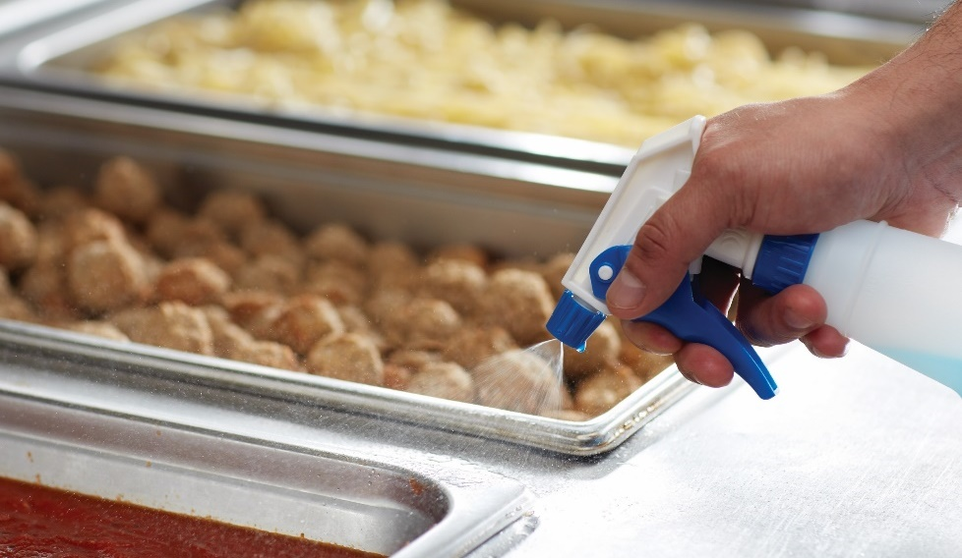
Forms of Contamination
Hazard—potential to cause harm
Three categories
  Biological
  Chemical
  Physical
Notes:
To prevent foodborne illness, it is important to recognize the hazards that can make food unsafe. A hazard is something with the potential to cause harm.
In the preparation of food, hazards are divided into three categories: biological, chemical, and physical. Figure 6.1 shows examples of these hazards.

Slide 10
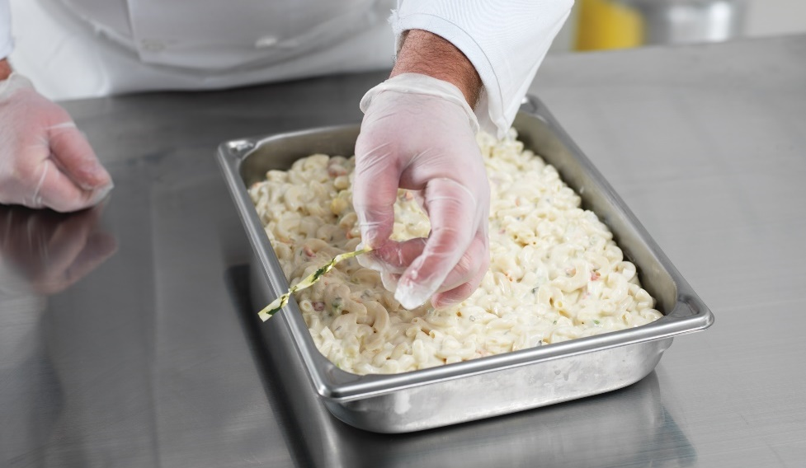
Forms of Contamination
Contamination
Harmful items present in food
Unsafe to eat
Notes:
Many hazards contaminate food because someone has handled the food incorrectly. Contamination means that harmful things are present in food,
making it unsafe to eat.

Slide 11
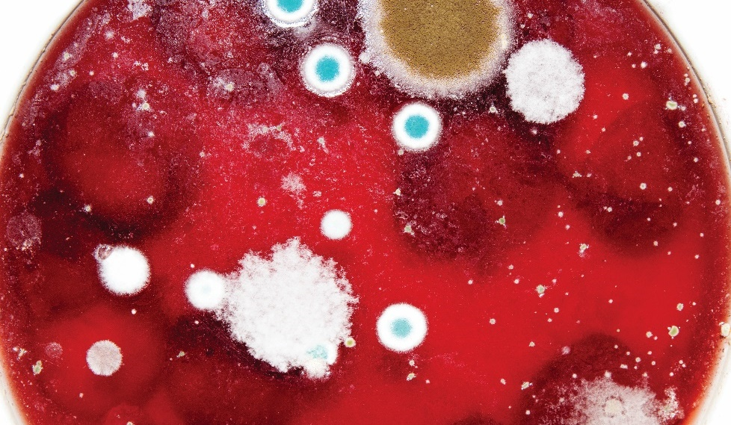
Biological Contamination
Microorganisms
Small, living organisms
Only seen through a microscope
Humans can carry them
Cause illness = pathogens
Pathogens—food safety threat
Notes:
Microorganisms are small, living organisms that can be seen only through a microscope. Most living things, including humans, carry microorganisms
on, or in, their bodies. Microorganisms that cause illness are called pathogens. They can be transferred from surfaces and hands to food and
other surfaces. Pathogens are the greatest threat to food safety in a restaurant or foodservice operation.

Slide 12
Biological Contamination
Four types of pathogens:
Viruses
Bacteria
Parasites
Fungi
Notes:
There are four types of pathogens that can contaminate food, causing foodborne illness.
Many viruses, bacteria, and parasites cause illness but cannot be seen, smelled, or tasted. On the other hand, some fungi, like mold, change the appearance,
taste, or smell of food but might not cause illness.

Slide 13
Viruses
Leading cause of foodborne illness
Survive refrigerator and freezer temperatures
Cannot grow in food
Grow in person’s intestines
Food, water, contaminated surface, other people
Hepatitis A and Norovirus
Notes:
Viruses can survive refrigerator and freezer temperatures. They cannot grow in food, but once they are eaten, they grow inside a person’s intestines. People can
get viruses from many things, including food, water, any contaminated surface, or from other people. Examples of viruses that can cause foodborne illness
include Hepatitis A and Norovirus.

Slide 14
Viruses
Prevent the spread of viruses:
Stay home
  Vomiting
  Diarrhea
  Jaundice
Wash hands
Avoid using bare hands
Notes:
Foodborne illness caused by viruses can generally be prevented if you take the right precautions. People carry viruses in their feces and can transfer them to
their hands after using the restroom. And that is why workers are always told to wash their hands after using the restroom—because otherwise they could
contaminate food and make guests sick. The best ways to prevent the spread of viruses are to:
• Stay home if you have been vomiting or have diarrhea or jaundice (yellowing of skin and eyes).
• Wash your hands at the right times and in the right way.
• Avoid using bare hands to handle ready-to-eat food.

Slide 15
Bacteria
Can grow rapidly
Can create toxins
Cooking does not kill toxins
Toxins cause illness
Examples: Salmonella Typhi, nontyphoidal Salmonella, Shigella spp.,
and Shiga toxin–producing E. coli (STEC)
Notes:
Knowing what bacteria are and how they grow can help you control them. If the conditions are right, bacteria will grow rapidly, doubling
their number as often as every 20 minutes. Some bacteria, as they grow and die, create toxins (poisons) in food. Cooking may not destroy
these toxins, and people who eat the food can become sick. Examples of foodborne bacteria include Salmonella Typhi, nontyphoidal Salmonella,
Shigella spp., and Shiga toxin–producing E. coli (STEC).

Slide 16
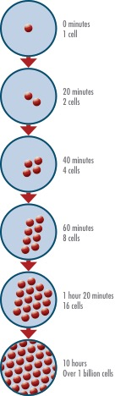
Bacteria
Six conditions to grow:
  Food
  Acidity
  Temperature
  Time
  Oxygen
  Moisture
FAT TOM
Notes:
Picture shows bacteria growth on a tomato at 20 minute intervals and after 10 hours.

Slide 17
Bacteria
Six conditions to grow:
  Food
  Acidity
  Temperature
  Time
  Oxygen
  Moisture
FAT TOM
Notes:
Bacteria need six conditions to grow. An easy way to remember these conditions is by remembering the phrase FAT TOM: food, acidity, temperature,
time, oxygen, and moisture.

Slide 18
Bacteria
Food:
Energy source
Carbohydrates
Proteins
Notes:
To grow, bacteria need an energy source. Carbohydrates such as baked potatoes and proteins such as beef are examples.

Slide 19
Bacteria
Acidity:
pH—measure of acidity
pH scale—0 to 14
Best growth—pH of 7.5 to 4.6
Food with little or no acid
Notes:
Bacteria grow best in food that contains little or no acid. An example of food with a lot of acid is lemons. Food items with little acid
include chicken and cooked corn.
Figure 6.3 on page 106 includes the pH level of common foods.

Slide 20
Bacteria
Temperature:
Between 41°F and 135°F (5°C and 57°C)
Temperature danger zone
Notes:
Bacteria grow well in food that has a temperature between 41°F and 135°F (5°C and 57°C). This range is known as the temperature
danger zone.

Slide 21
Bacteria
Time:
Time in temperature danger zone
Grow to unsafe levels
Notes:
Bacteria need time to grow. The more time bacteria spend in the temperature danger zone, the more opportunity they have to grow to
unsafe levels.

Slide 22
Bacteria
Oxygen:
Grow with oxygen
Grow without oxygen
Notes:
Some bacteria need oxygen to grow. Others grow when oxygen is not there. For example, some bacteria that grow without oxygen would
grow quickly in a pot of cooked rice.

Slide 23
Bacteria
Moisture:
Food with high levels
Example: tomatoes
Notes:
Bacteria need moisture in food to grow. For example, tomatoes and melons have a large amount of water in them, which
means they can easily support the growth of pathogens.

Slide 24
Bacteria
Control FAT TOM:
Time
Temperature
Notes:
Food handlers can help to keep food safe by controlling FAT TOM. Most of the time, however, a restaurant or foodservice operation is only going to be able to
control time and temperature.

Slide 25
Bacteria
TCS food:
Time and temperature control for safety
FAT TOM conditions
Commonly involved in foodborne-illness outbreaks
Notes:
Food that is most vulnerable to pathogen growth is also referred to as food that needs time and temperature control for safety—
TCS food for short. All these types of food have the FAT TOM conditions needed for bacterial growth. Not surprisingly, they are also
commonly involved in foodborne-illness outbreaks.

Slide 26
TCS Food
Notes:
Food that is most vulnerable to pathogen growth is also referred to as food that needs time and temperature control for safety—
TCS food for short. Table 6.1 lists TCS food. All these types of food have the FAT TOM conditions needed for bacterial growth.
Not surprisingly, they are also commonly involved in foodborne-illness outbreaks.

Slide 27
TCS Food
Notes:
Food that is most vulnerable to pathogen growth is also referred to as food that needs time and temperature control for safety—
TCS food for short. Table 6.1 lists TCS food. All these types of food have the FAT TOM conditions needed for bacterial growth.
Not surprisingly, they are also commonly involved in foodborne-illness outbreaks.

Slide 28
TCS Food
Notes:
Food that is most vulnerable to pathogen growth is also referred to as food that needs time and temperature control for safety—
TCS food for short. Table 6.1 lists TCS food. All these types of food have the FAT TOM conditions needed for bacterial growth.
Not surprisingly, they are also commonly involved in foodborne-illness outbreaks.

Slide 29
TCS Food
Notes:
Food that is most vulnerable to pathogen growth is also referred to as food that needs time and temperature control for safety—
TCS food for short. Table 6.1 lists TCS food. All these types of food have the FAT TOM conditions needed for bacterial growth.
Not surprisingly, they are also commonly involved in foodborne-illness outbreaks.

Slide 30
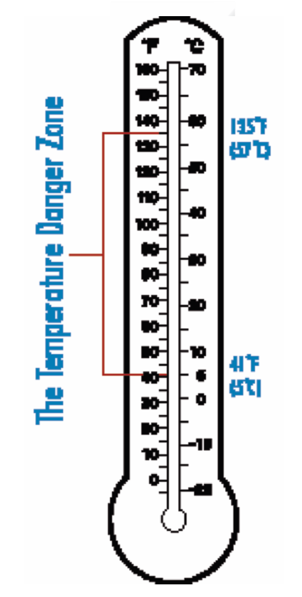
Bacteria
Temperature danger zone:
Between 41°F and 135°F (5°C and 57°C)
Keep TCS food out of range
Notes:
You can control the growth of most bacteria by keeping food out of the temperature danger zone—the temperature range between 41°F and 135°F
(5°C and 57°C). Bacteria grow well in this temperature range.
To reduce the risk of foodborne illness, food handlers must keep TCS food out of the temperature danger zone as much as possible. But the reality is that TCS
food is most likely going to spend some time in this range. Taking deli meat out of a cooler in order to prepare a sandwich would be one example.

Slide 31
Bacteria
Ready-to-eat food:
Careful handling
Food eaten without further:
  Preparation
  Washing
  Cooking
Examples: Washed fruit, deli meat, seasonings
Notes:
You can control the growth of most bacteria by keeping food out of the temperature danger zone—the temperature range between 41°F and 135°F
(5°C and 57°C). Bacteria grow well in this temperature range.
To reduce the risk of foodborne illness, food handlers must keep TCS food out of the temperature danger zone as much as possible. But the reality is that TCS
food is most likely going to spend some time in this range. Taking deli meat out of a cooler in order to prepare a sandwich would be one example.
Like TCS food, ready-to-eat food also needs careful handling to prevent contamination. Ready-to-eat food is exactly what it sounds like: food that can
be eaten without further preparation, washing, or cooking. Some examples of ready-to-eat food items include washed fruit and vegetables (both whole and
cut), deli meat, bakery items, sugar, spices, seasonings, and cooked food.

Slide 32
Parasites
Not as common
Do not grow in food
Hosts
  Nourishment
  Protection
  Person, animal, plant
  Water
Notes:
In the United States, illnesses from parasites are not as common as those from viruses and bacteria. However, it is still important to understand what parasites
are and how to prevent contamination.
Parasites do not grow in food. They get nourishment and protection from other living organisms known as hosts. A host may be a person, animal, or plant.
Parasites can live in cows, chickens, pigs, and fish—many types of food that humans like to eat. They also can contaminate water.

Slide 33
Parasites
Foodborne parasites
  Protozoa
  Roundworms
  Tapeworms
  Toxoplasma gondii
Prevention—approved, reputable suppliers
Notes:
In the United States, the most common foodborne parasites are protozoa, roundworms, and tapeworms. The foodborne parasite that causes the most
hospitalizations and deaths in this country is Toxoplasma gondii, which causes toxoplasmosis.
Illness caused by parasites is preventable. The most important measure that restaurant and foodservice managers can take to prevent parasites is to
purchase food from approved, reputable suppliers.

Slide 34
Fungi
Can cause illness
Spoils food
Found in:
  Air
  Soil
  Plants
  Water
  Some food
Notes:
Fungi can cause illness, but most commonly they are responsible for spoiling food. Fungi are found in air, soil, plants, water, and some food. Mold
and yeast are two examples of fungi.

Slide 35
Fungi
Mold:
Tiny mold plants
Grow under any condition
Acidic food
Little moisture
Examples: jams, jellies, bacon
Notes:
Mold that is visible to the human eye is actually a tangled mass of thousands of tiny mold plants. Molds share some basic characteristics. They grow under
almost any condition, but they grow especially well in acidic food with little moisture. Jams, jellies, and cured, salty meat such as bacon are examples of this
kind of food.

Slide 36
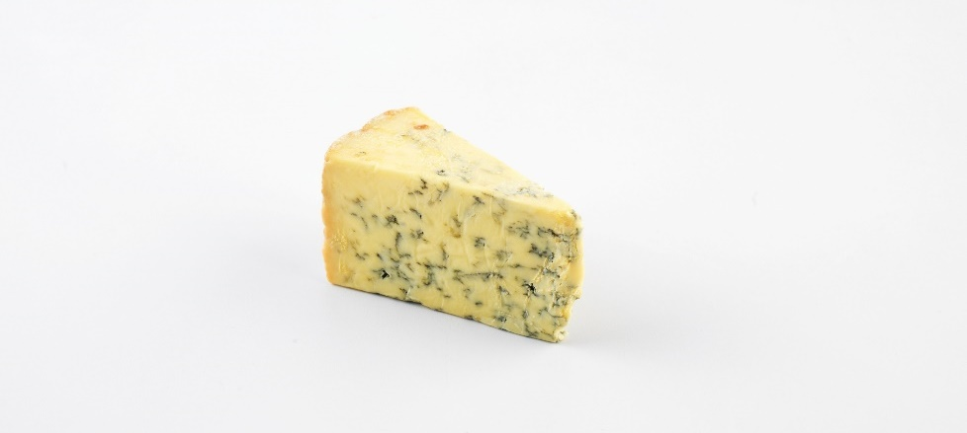
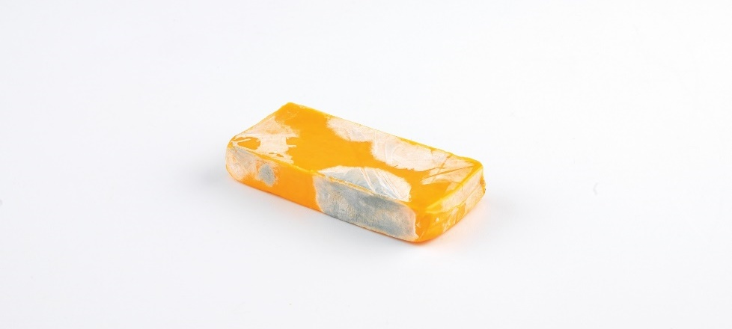
Fungi
Mold:
Spoil food
Can produce toxins
Cold temps do not kill them
Intentionally used for flavor
Notes:
Molds often spoil food and sometimes produce toxins that can make people sick. Refrigerator and freezer temperatures may slow the growth of molds, but
cold does not kill them. Sometimes mold is intentionally used to affect the flavor or characteristics of a product. This is often done with cheese. Brie, camembert,
and gorgonzola are good examples. Unless the mold is a natural part of the product, throw out all moldy food.
Image: Mold may be a natural part of cheese, such as the gorgonzola on top. But cheese that has turned moldy, such as the moldy cheddar on the bottom, should be thrown out.

Slide 37
Fungi
Yeast:
Spoils food quickly
Smell or taste of alcohol
White or pink discoloration
Slime
Bubbles
Notes:
Yeast can spoil food quickly. The signs of spoilage include the smell or taste of alcohol, white or pink discoloration, slime, and bubbles.

Slide 38
Fungi
Yeast:
Acidic food
Little moisture
Discard spoiled food
Examples: jams, jellies, honey
Notes:
Like molds, yeasts grow well in acidic food with little moisture. Examples include jellies, jams, syrup, honey, and fruit or fruit juice.
Throw out any food that has been spoiled by yeast.

Slide 39
Biological Toxins
Plants or animals
Contain natural toxins
Contaminated in food chain
Make people sick
Notes:
Some pathogens make biological toxins, or poisons. Certain kinds of plants or animals contain toxins naturally. Sometimes plants or animals can become
contaminated with biological toxins somewhere in the food chain. Examples of this might be contaminated seafood resulting from fish eating toxic algae,
or poisonous wild mushrooms. Toxins can make people sick, so restaurant and foodservice managers must be aware of them.

Slide 40
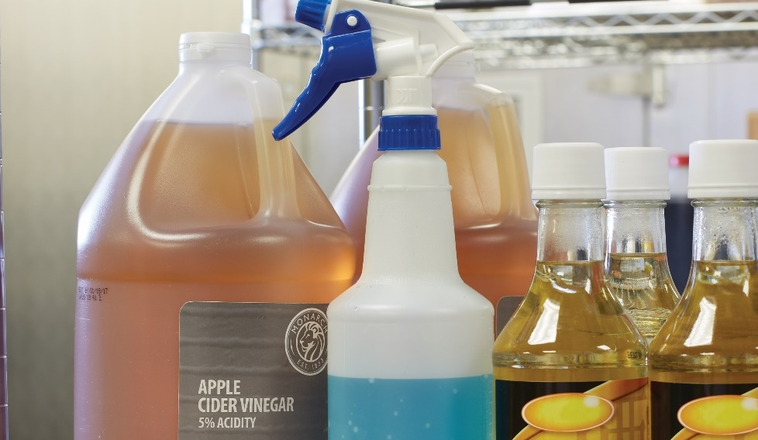
Chemical Contamination
Used or stored incorrectly
Cleaners, sanitizers, polishes
Separate area
Away from food, utensils, equipment
Follow manufacturer’s directions
Notes:
Chemical contaminants pose a risk to food safety. These contaminants come from everyday items that may be found in many restaurant and foodservice
operations.
Restaurant and foodservice chemicals can contaminate food if they are used or stored in the wrong manner. This includes cleaners, sanitizers, polishes, and
machine lubricants. Chemicals should be stored in a separate area away from food, utensils, and equipment used for food. You should always follow the
manufacturers’ directions when using chemicals, especially while food is being prepared.

Slide 41
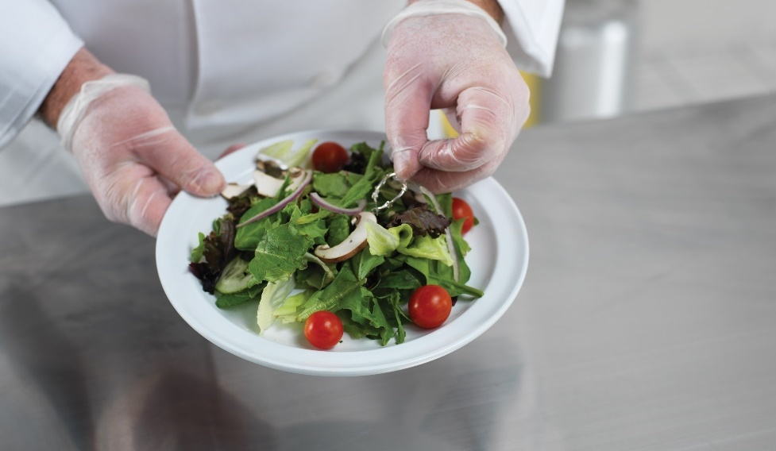
Physical Contamination
Objects in food
Naturally occurring
Accidents and mistakes
Notes:
Physical contamination happens when objects get into food. These objects can be naturally occurring, such as the bones in fish. Other contaminants result from
accidents and mistakes.

Slide 42
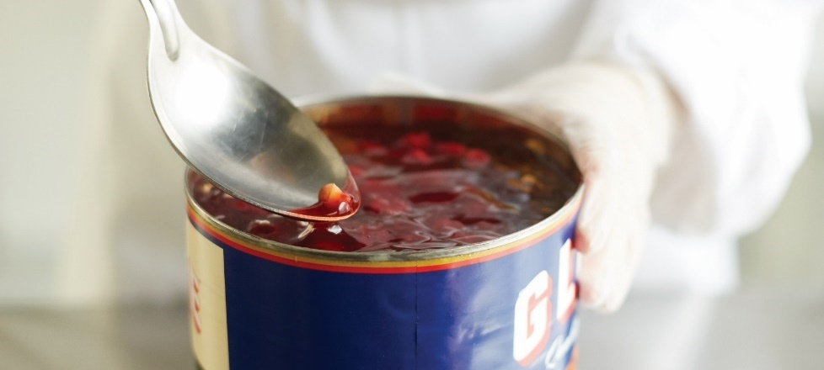
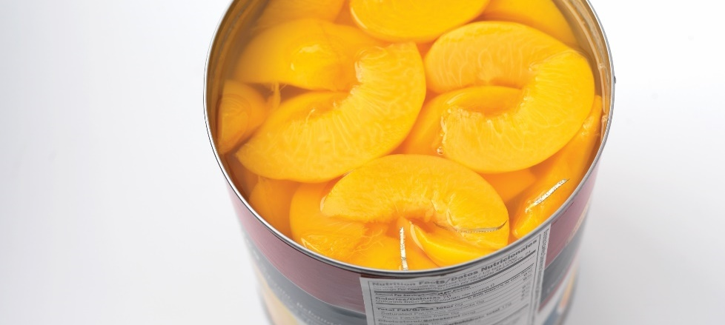
Common Physical Hazards
Fingernails, hair, and bandages
Fruit pits
Glass from broken light bulbs
Jewelry
Metal shavings from cans

Slide 43
Physical Contamination
Prevention:
Inspect food closely
Good personal hygiene
Safe preparation procedures
Notes:
Most physical contamination can be prevented by doing the following:
• Inspecting food closely when it is received
• Practicing good personal hygiene
• Following safe preparation procedures

Slide 44
Food Allergies
Food allergy—negative reaction to food protein
Food allergens—proteins causing allergic reactions
Immune system attacks protein
Causes allergic reaction
Notes:
The number of people in the United States with food allergies is increasing. A food allergy is the body’s negative reaction to a food protein. The proteins
that cause allergic reactions are called food allergens, and these proteins occur naturally. When enough of the allergen is eaten, the immune system
mistakenly considers it harmful and attacks the protein. This can result in an allergic reaction.

Slide 45
Food Allergies
Cross-contact:
Allergen food item touches another food item
Proteins mix
Notes:
People with food allergies can become sick or sometimes die from eating even a tiny amount of a triggering allergen. In fact, if a food allergen even
touches a dish that an allergic guest eats, it can be enough to trigger a reaction. When a food item containing an allergen comes in contact with
another food item and their proteins mix, it is called cross-contact. It sounds similar to cross-contamination, but cross-contact refers specifically to
food allergens.

Slide 46
The “Big Eight” Food Allergens
Notes:
In a restaurant or foodservice operation, managers, servers, and kitchen staff must each do their part to keep guests with food allergies safe. That means
keeping the food allergens away from the guests who are allergic to them.
The “Big Eight” food allergens account for 90 percent of all food allergy reactions in the United States.

Slide 47
The “Big Eight” Food Allergens
Notes:
People who work with food need to be aware of the “Big Eight.” It is also important to know which menu items contain them. When a guest says that he
or she has a food allergy, you need to pay attention.

Slide 48
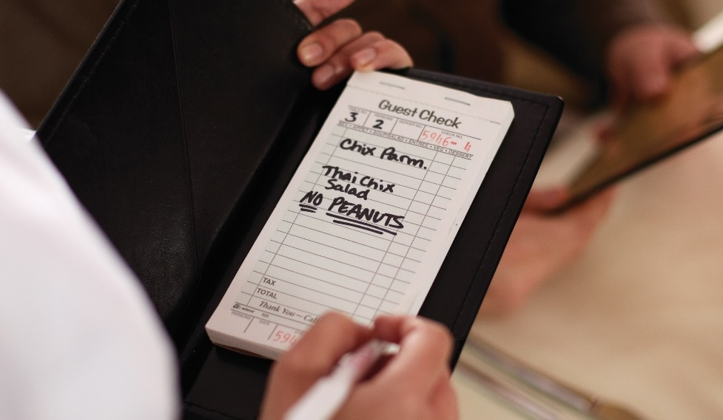
Serving Guests with Food Allergies
Explain how dish is made
State “secret” ingredients
Suggest alternative items
Identify special order
Hand-deliver order
Never guess—ask the manager
Notes:
When serving guests with food allergies, servers must be ready to answer guests’ questions about any menu item. It is also important to know how to
prevent cross-contact. Here is how to keep guests safe:
Tell the guest how each dish is made. It is important to know which dishes contain “Big Eight” allergens.
Tell the guest about any “secret” ingredients that may contain allergens. While you might not want to share these recipes with the public, you still
must be able to tell the guest if the dish contains an allergen.
Suggest alternative menu items that do not have the food allergen.
Identify the allergen special order. Clearly indicate the order for the guest with the allergy. This is important for the kitchen staff. Figure 6.8 shows one
example of this. It is also a good idea to verbally tell the kitchen staff about the food allergen.
Hand-deliver the allergen special order to the guest. Do this separately from other food to prevent cross-contact.
Servers should never take a guess about what a menu item contains. If they do not know, they should ask someone who does, such as the manager or
kitchen staff.

Slide 49
Prepping Food for Guests with Food Allergies
Don’t transfer allergens
Cannot make food safe again
Set food aside
Do not serve
Notes:
When preparing food for guests with food allergies, kitchen staff must make sure that allergens are not transferred from food containing an allergen
to the food served to the guest. For example, think about a guest with a shellfish allergy who orders chicken nuggets. What happens if the chicken
nuggets are cooked in a fryer that was used for shrimp? As you may have guessed, that is cross-contact.
Once food has come in contact with an allergen, it cannot be made safe again. For example, someone might be tempted to pick the almonds off of a
salad for a guest with a tree nut allergy. But that salad can still cause an allergic reaction, even with the nuts removed. If you see cross-contact happen, set the
food aside and do not serve it to a guest with a food allergy.

Slide 50

Steps to Avoid Cross-Contact
Check recipes and ingredient labels
No allergen present
Notes:
Steps that kitchen staff must take to avoid cross-contact.

Slide 51
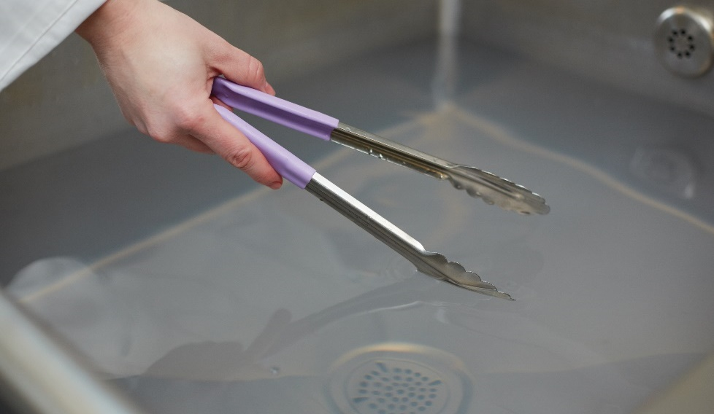
Steps to Avoid Cross-Contact
Wash, rinse, and sanitize
Cookware, utensils, and equipment
Food-prep surfaces
Separate utensils
Notes:
Wash, rinse, and sanitize cookware, utensils, and equipment before preparing the food. This includes food-prep surfaces. Some operations use a separate set of utensils just for allergen
special orders.

Slide 52
Steps to Avoid Cross-Contact
Keep allergens separate
Food, beverages
Utensils, equipment, gloves
Notes:
Make sure the allergen does not touch anything that is going to be served to or used by these guests. This includes food, beverages, and utensils, or anything that is used in preparing food for
them, such as equipment and gloves.

Slide 53
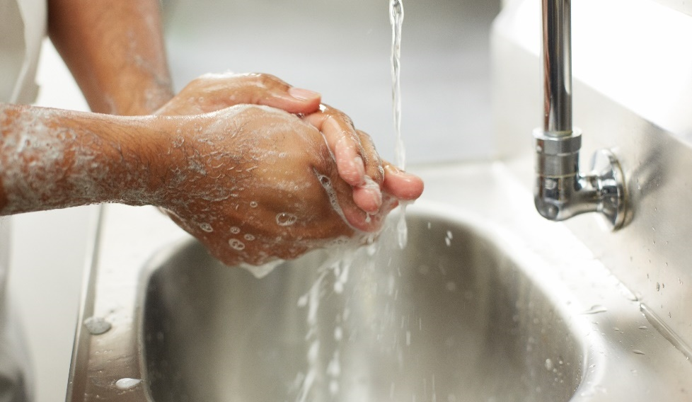
Steps to Avoid Cross-Contact
Wash hands
Change gloves
Notes:
Wash your hands and change gloves before preparing the food.

Slide 54
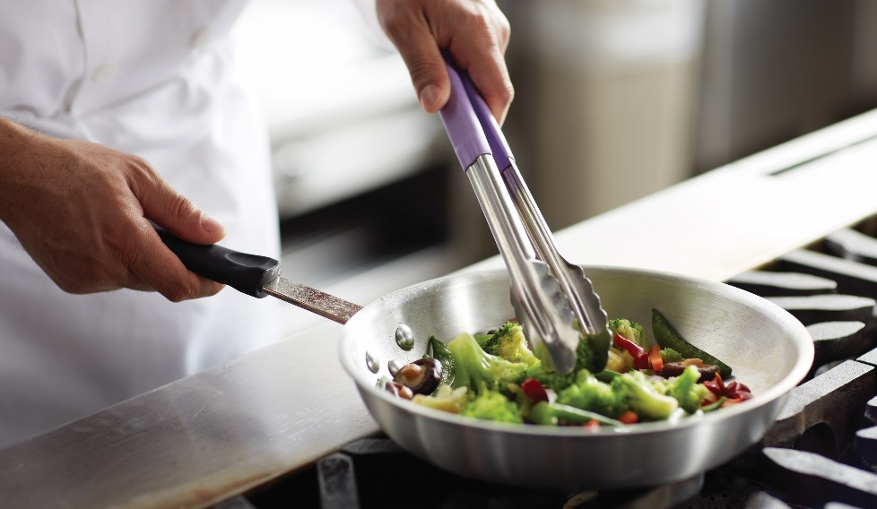
Steps to Avoid Cross-Contact
Assigned equipment
Separate fryers and oil
Notes:
Use equipment assigned only for preparing allergen special orders. Use separate fryers and cooking oils when frying food for guests with food allergies.

Slide 55
Food Defense
Prevent purposeful contamination
Competitors, former staff, guests
Tamper with food
Can occur anywhere
Make it difficult to tamper
Notes:
The prevention measures discussed throughout this section will help prevent accidental contamination of food. But restaurant and foodservice employees
also must take steps to prevent people from purposely contaminating food. Competitors, vendors, former staff, guests, or terrorists may try to tamper with
the food in your operation. Attacks might occur anywhere from the farm to the restaurant. They are usually focused on a specific food item, a manufacturing
process, or a business. The best way to protect food is to make it as difficult as possible for someone to tamper with it.

Slide 56
Food Defense
Prevention:
Control access
Uniforms and name tags
Security badges
Report suspicious activity
Notes:
One important way to prevent tampering is to control access to the operation’s food-storage and preparation areas. Uniforms and name tags help identify staff
and vendors. Security badges also help ensure that only the people who belong there are in the specific food area. All staff in an operation, from buser to
executive chef, should report anything that seems suspicious. As the saying goes, “If you see something, say something.”

Slide 57
U.S. Regulation of Food Safety
The Food and Drug Administration (FDA)
  Writes the FDA Food Code
FDA Food Code
  Recommends regulations
  Code is not law
  States adopt
  State or local health departments enforce
Notes:
Today, many government departments monitor food safety. In the United States, most regulations that affect restaurant and foodservice operations are written at
the state level. However, federal, state, and local governments are all involved.
The Food and Drug Administration (FDA) writes the FDA Food Code, which recommends specific food safety regulations for the restaurant and foodservice industry.
But the code is not actual law. Each state decides whether to adopt the FDA Food Code or some form of it as law. The laws passed at the state level are then enforced
by state or local (city or county) health departments.

Slide 58
U.S. Regulation of Food Safety
Inspection
  Formal review or examination
  Operation following food safety
All operations serving public inspected
Some may temporarily close
Guests at risk
Out of business
Notes:
Health inspectors from city, county, or state health departments conduct inspections in most states.
An inspection is a formal review or examination conducted to see if an operation is following food safety laws. All operations serving food to the public
are inspected. If violations are found, operations such as restaurants, hospitals, nursing homes, and schools may be temporarily closed. The most important
reason for inspections is that failing to keep food safe can put the health of guests at risk. Failing an inspection could also result in an operation going
out of business.

Slide 59
U.S. Regulation of Food Safety
Successful managers:
Understand requirements
Create policies
Conduct self-inspections
Ensure operation is always prepared
Notes:
Successful restaurant and foodservice managers understand local food safety requirements and design policies that address them. They also conduct their
own self-inspections. A self-inspection should check for the same things that a health inspector would look for, so that an operation is always prepared and
functioning appropriately.

