Slide 2
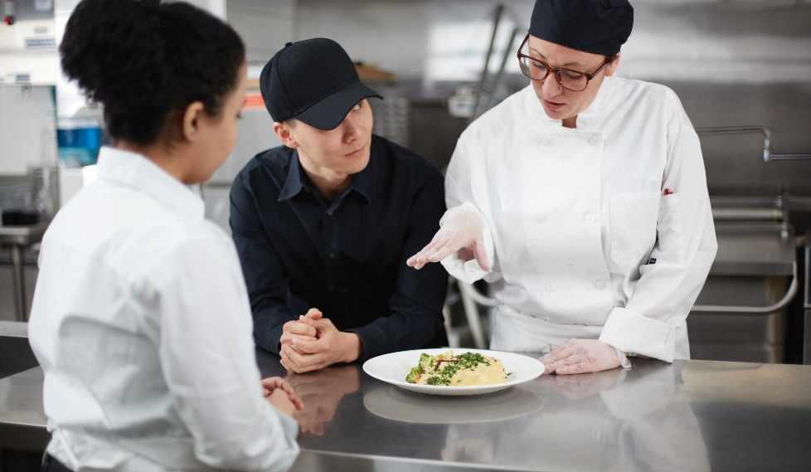
Communication
Communication: act or process of using:
  Words, sounds, signs, behaviors
  Express or exchange information
Verbal—speaking and writing
Nonverbal—body language and gestures
Builds relationships
Notes:
Communication is the act or process of using words, sounds, signs, or behaviors to express or exchange information or to express your ideas,
thoughts, feelings, etc., to someone else. Communication is a learned skill. Most people are born with the ability to express themselves but need to
learn how to do it effectively. Communication includes both verbal (speaking and writing) and nonverbal communication (body language and gestures).
Understanding how the communication process works is important for building strong relationships with employees and customers. It is not only what
people say that is important—how they say it has a major impact on a message’s effectiveness.

Slide 3
The Process of Communication
Five parts:
Sender
Message content
Message channel
Context
Receiver
Notes:
The communication process has five parts: sender, message content, message channel, context, and receiver.
The following is an example of the communication process at work in a restaurant:
Sender: Chef
Message content: Fire three shrimp on table 10.
Message channel: Verbal (speaking)
Context: The line cook is behind, and the chef really needs that food out quickly.
Receiver: Line cook

Slide 4
The Process of Communication
Sender:
Begins communication process
Wants something done
Thinks about:
  Who will receive it?
  What is the message?
  How should it be sent?
  Other factors to consider?
Notes:
Often, the sender wants something done as a result of the communication.

Slide 5
The Process of Communication
Receiver:
Usually needs to respond
Communicates understanding of message
Interprets message
Acts on the message
Makes decisions
Notes:
Make decisions along the way to complete the actions.

Slide 6
The Process of Communication
Message content:
Connection between sending and receiving
Historical information—already happened
Action-required information—immediate or future
Notes:
The main connection between the people sending and receiving a message is the message content. This content might include:
1. Historical information: Examples include company history and orientation information, status updates, and management decisions.
Receivers do not usually need to do anything with these messages. They simply provide knowledge for future situations.
2. Action-required information: This is information that requires some type of action response from the receiver, either immediately or in the future.
One example is an order from a supervisor. It can be as simple as, “Clean that table.”

Slide 7
The Process of Communication
Message channel:
Clear method for audience
Words: verbal or written
Sounds: bell ringing or siren
Graphic illustrations: pictures, diagrams, job aids
Signs and symbols: gestures and nonverbal forms
Notes:
The sender must decide the best way for the message to be delivered. Which method or medium will help the message be as clear as possible for its intended
audience?

Slide 8
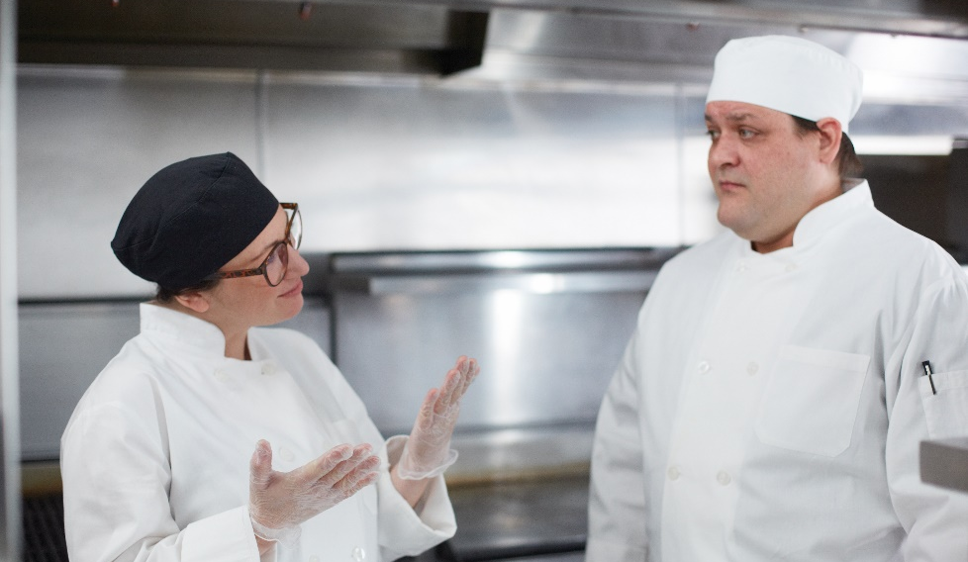
Interpersonal Communication
Share face-to-face:
  Feelings
  Ideas
  Emotions
  Information
Two-way communication
Immediate feedback
Heart of working with people
Goal—achieve a specific outcome
Body language and facial expressions
Notes:
Interpersonal communication occurs when people share their feelings, ideas, emotions, and information face-to-face with each other. It is any two-way
communication that has immediate feedback—in short, it is a conversation. The people in the conversation are trying to relate to each other at some level.
Interpersonal communication is at the heart of working with people—it is how we get to know each other, how we give and receive most feedback, and how
we learn to cooperate.
The goals of interpersonal communication are to achieve a specific outcome, such as provide performance feedback, and to improve the relationships
of the people involved.
Interpersonal communication is not only about what is said and what is heard, but also about how it is said. Body language and facial expressions play an
important role in these exchanges. And while communication occurs in all relationships, it can vary depending on the relationship type. For example,
the short interaction restaurant and foodservice employees have with guests is different than the relationship they have with friends and family. And
exchanges between employees and managers may have a different tone than communication between coworkers.

Slide 9
Effective Speaking
Expressing thoughts and feelings in spoken language
Communicate key points
Brief and clear
Answer five “W” questions and “how” question
  Who?
  When?
  What?
  Why?
  Where?
  How?
Notes:
When we think of communicating, we usually think of speaking. Speaking is the act of expressing one’s thoughts and feelings in spoken language. Just like any
other skill, you can learn to be an effective speaker.
When delivering a message, communicate the key points in a brief and clear manner. To ensure that you have provided all the vital information, answer the
five “W” questions and “how” question, as follows:
• Who?
• When?
• What?
• Why?
• Where?
• How?
Think about how your audience will respond to the message. Consider ways to personalize or customize the content, so that your audience recognizes
the importance of the information.

Slide 10
Qualities of an Effective Speaker
Interact with the audience
Comfortable interpersonal environment
Comfortable physical environment
Maintain eye contact
Notes:
Create a comfortable interpersonal and physical environment through tone and surroundings.

Slide 11
Qualities of an Effective Speaker
Use suitable language
Minimize jargon and buzzwords
Avoid slang and sarcasm
Define technical terms

Slide 12
Qualities of an Effective Speaker
Use appropriate nonverbal communication
Use appropriate gestures
Use appropriate facial expressions
Show an appropriate demeanor
Notes:
Use appropriate gestures, including postures that promote confidence.
Show an appropriate demeanor (for example, enthusiastically deliver a motivating speech; do not deliver bad news with a smile).

Slide 13
Qualities of an Effective Speaker
Vary your speech patterns
Vary tone and pitch
Pronounce words clearly
Use complete, professional sentences
Minimize dialect
Eliminate mumbling
Speak at a steady pace
Speak with confidence
Notes:
Vary the tone and pitch of the voice.
Use complete sentences that are professional, not casual.
Minimize any dialect in speech.
Eliminate mumbling or swallowing word endings.
Speak with confidence; be prepared for speaking.

Slide 14
Qualities of an Effective Speaker
Close the conversation
Verify understanding
Repeat the message
Thank listeners
Present opportunities for follow-up
Notes:
Repeat the message to ensure understanding.

Slide 15
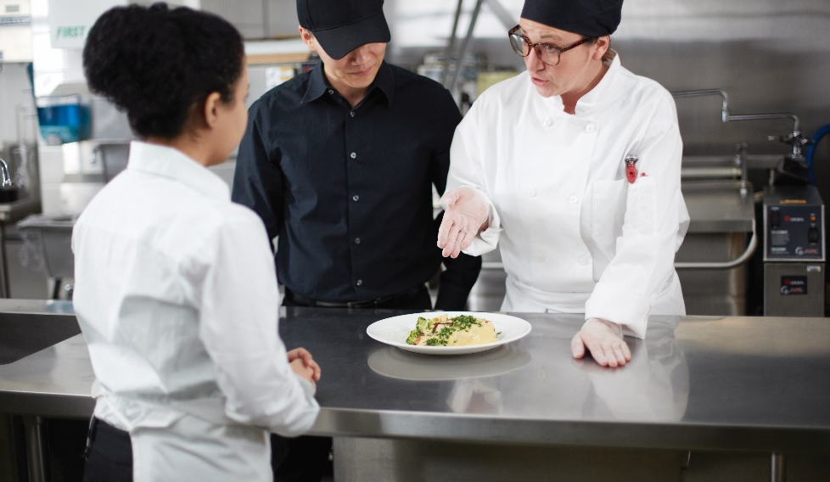
Effective Listening
Listening
Focus on what another person is saying
Summarize true meaning of message
Effective listening
More information
Increase trust
Reduce conflict
Better communication with others
Notes:
Listening is the ability to focus closely on what another person is saying to summarize the true meaning of a message. Almost everyone believes that he or
she listens effectively. In fact, listening effectively is something that many of us cannot do. It is not because listening effectively is so difficult. It is just that many
of us have never developed the habits that would make us effective listeners.
By listening effectively, you can get more information from other people, increase others’ trust in you, reduce conflict, and better understand how to
work with others. An effective listener actively participates in the communication process.

Slide 16
Effective Listener
Participates in the communication process
Prepare to listen—stop talking
Use body language
  Maintain eye contact
  Nod
  Lean in
  Facial expressions
Do not interrupt
Ask questions to clarify
Notes:
Prepare to listen. Stop talking and focus on the other person.
Use body language to show that you are paying attention. You can:
• Maintain eye contact.
• Nod to show your approval.
• Lean toward the person speaking to show you are interested.
• Use appropriate facial expressions to show empathy or understanding.
Do not interrupt and do not finish the other person’s sentences in your mind or aloud.
Ask questions to clarify.

Slide 17
Effective Listener
Participates in the communication process
Occasionally rephrase and repeat
Listen between the lines
Do not overreact
Record key ideas and phrases
Notes:
Occasionally rephrase and repeat what you have heard. Check listening skills by saying, “Here’s what I think I hear you saying….”
Listen between the lines. Often, it is not what someone says but how the person says it.
Do not overreact if you disagree.
Record key ideas and phrases. While most people probably do not need to take notes when talking to friends, note-taking is a valuable way
to improve listening skills in the classroom or workplace.
Practice listening as often as you can. Listening is a learned skill, just like learning a knife skill or a cooking technique.

Slide 18
Effective Writing
Text messages, memos, faxes, emails, letters, reports
Common parts of written messages:
  Introduction
  Body of message
  Conclusion
Notes:
In the restaurant business, much of the communication with staff, guests, and supervisors is done verbally, either in person or on the phone. However, written
business communications are also important when sharing information. These types of messages can include text messages, memos, faxes, emails, letters,
and reports.
Other than text messages, written messages tend to have a more formal structure than spoken messages.

Slide 19
Effective Writing
Introduction:
Audience attention
Reason for message
Identifies topics
Establishes point of view
Notes:
This gets the audience’s attention, gives the reason for the message, identifies the topics of the message, and establishes the writer’s
point of view.

Slide 20
Effective Writing
Body of message:
Presents content
Topics of message

Slide 21
Effective Writing
Conclusion:
Summarizes key points
Calls for action
Identifies benefits and value
Notes:
The writer summarizes key points, calls for action, and identifies the benefits and value of the message.
To write a successful message, you need to plan what to say. You need to build a structure. Writing can be challenging.

Slide 22
Steps for Effective Writing
Think about the audience
Think about the purpose
Think about the situation and details
Identify the benefits to the message
Notes:
For instance, the monthly financial update to the vice president of sales has a different audience
than a training manual written for new servers.
What needs to be accomplished, and what action is desired as a result of the written message?
Ask questions to answer the five Ws and how, and write the answers (Who? Where? Why? What? When? How?).
How will it help the company, the reader, the customers, and the communicator?

Slide 23
Steps for Effective Writing
Identify topics
Write main body
Read draft
Write final draft
Notes:
Identify the topics in a logical order, and group the details underneath.
It might be easiest to write the main body first, then the introduction, and then the conclusion.
Edit and revise the draft for content, grammar, spelling, flow, and readability. If necessary, ask someone else, such as a peer, to read the draft and make suggestions for improvement.
Finish the final draft and distribute the communication.

Slide 24
Developing Written Communication
Be concise
Be clear and complete
Write with an upbeat attitude
Take a time out
Notes:
When developing written communications, keep these points in mind:
Be concise. Write like the spoken word, simple and to the point, while avoiding any slang.
Be clear and complete. Although being brief is important, be sure not to sacrifice clarity or completeness.
Always write with an upbeat attitude. Even if the message needs to deliver troubling news, make sure to include long-term benefits.
Take a time out. Set written messages down and come back to them later, even if it is only a few hours. It will be easier to spot and
correct errors and awkward phrases.

Slide 25
Well-written email
Notes:
Two sample workplace emails, both trying to convey the same material. One is well-written, answers the W and how questions, and
is properly organized, and the other is not. Do you see the difference?

Slide 26
Poorly-written email
Notes:
Two sample workplace emails, both trying to convey the same material. One is well-written, answers the W and how questions, and
is properly organized, and the other is not. Do you see the difference?

Slide 27
Barriers to Communication
Barriers:
Language
Lack of time
Fear of confrontation
Take time to communicate
Be consistent
Values and priorities should remain the same
Notes:
Anything that interferes with or affects communication—from language barriers to lack of time to fear of confrontation—can set up a barrier.
Be aware of the potential obstacles to good communication before presenting any message. Remember that every communication,
large or small, sends a message about your values and priorities. Take the time to consider what you want to communicate. Make sure that you are consistent.
The message may differ, but the underlying values and priorities should remain the same.

Slide 28
Obstacles to Good Communication
Language differences
Different accents and dialects
Dialect—variation of language spoken
Be patient
Example: soda vs. pop
Notes:
Description:
We all speak with accents and dialects that reflect where we live now and where we have lived in the past. A dialect is the variation of a
language spoken by a particular group of people, such as Easterners, Southerners, or Bostonians. Even if everyone is speaking the same
language, members of different groups must often work hard to understand what is being said.
For many people, including those working in the restaurant and foodservice industry, English is a second language. It takes a lot of
concentration and energy to master something new when someone is not completely familiar with the language. Be patient with people who are
still learning. Do not let the way a person speaks affect you negatively.
Examples:
Soda versus pop, or hoagie versus hero versus submarine versus grinder.
It may also be something as easy as understanding the dialect. For example, in the North Midland area of the United States
from Pennsylvania into the Central Midwest, doughnuts are often called dunkers or fatcakes.

Slide 29
Obstacles to Good Communication
Semantics (what words mean)
Replace phrases with multiple meanings
Use simpler terms
Intended meaning is clear
Example: mouse—rodent or computer device
Notes:
Description:
Not everyone understands words in the same way. Can the audience understand the message as you intended? Does the audience
understand the actual words of the message as well as the speaker does? Do words or phrases mean one thing to the communicator and
another thing to the audience? Consider replacing “common” phrases (or adages) or words that have multiple meanings with simpler
terms. Make sure the intended meaning is clear.
Examples:
The word “ill” means “to be sick,” but sick can also mean “cool.”
The word “mouse” means “rodent” or “computer device.”
Cup of soup, cup of coffee, and cup of flour all mean something different—one is a bowl,
one is drinkware, and one is a measurement.

Slide 30
Obstacles to Good Communication
Jargon
Avoid:
  Buzzwords
  Technical language
  Slang
Example—loop in or heads-up
Notes:
Description:
Buzzwords, technical language, and slang usually should not be used unless the communicator is absolutely sure that the audience
understands these words. It is better to avoid jargon altogether.
Examples:
Use of “loop in” to mean “keep informed,” or “heads-up” to mean “be aware” or “watch out.”

Slide 31
Obstacles to Good Communication
Tone of message
Judge speaker by tone
Avoid negativity and sarcasm
Sound sincere
Example: “Sit down” vs. “Sit down, please”
Notes:
Description:
Speakers can say something in a tone that differs from the meaning of what they are saying. People often judge the sincerity of a speaker
by his or her tone.
Is the tone one of open sharing and inclusion? Or does the speaker sound negative, snobby, or disapproving? Avoiding negativity and
sarcasm is critical to sounding sincere.
Examples:
“Turn in your time card by the end of the day,” versus, “Time cards should be turned in at the end of the day, please.”

Slide 32
Obstacles to Good Communication
Clarity
Check the message structure
Clear as possible
Good business writing guidelines
Example: “Let’s eat, grandma” vs. “Let’s eat grandma”
Notes:
Description:
Bad writing can cause confusion and/or leave room for interpretation. Check the structure of the message to make sure that
the message is as clear as possible. Follow good business writing guidelines.
Examples:
Remember, “Let’s eat, Grandma,” versus, “Let’s eat Grandma.” The first sentence invites grandma to eat. The second sentence
invites others to eat grandma.

Slide 33
Obstacles to Good Communication
Assumptions
Understand audience knowledge level
Before delivering message
Notes:
Description:
Do you assume someone knows how to solve a problem when it happens? Have you provided enough instruction to get the problem
fixed? Or are you providing too much basic information? Make sure you understand what your audience knows before you deliver
a message.
Examples:
Stating, “We have too many people waiting to be seated,” identifies the problem, but it does not offer a fix. It assumes the recipient
will fix it and/or knows how to fix it.

Slide 34
Obstacles to Good Communication
Cultural differences
Can dictate communication
More direct, explicit language
Nonverbal cues or interpretation
Notes:
Description:
Cultural differences can dictate how people communicate. Some use more direct, explicit language. Others leave much of the
message to be understood through context, nonverbal cues, and between-the-lines interpretation.
Examples:
Americans tend to expect messages to be specific, while some Asian cultures look for meaning in what is not said—
body language, silences and pauses, and in knowing the person with whom they are communicating.

Slide 35
Obstacles to Good Communication
Prejudices and biases
Preconceived idea
Can impact message
Experiences, upbringing, cultural beliefs
Notes:
Description:
A prejudice or bias is a preconceived idea about something that could affect a message, usually negatively. They come from many factors,
including experiences, upbringing, and cultural beliefs. People can be biased against a group, a particular person, or even a situation.
Do you carry certain biases based on experiences you have had? Do you think certain groups of people have a tendency to do something
or not do something? Do you have attitudes that influence the way you send your message? Are you afraid to talk to certain people?
Answer these questions honestly for yourself. Then reexamine your communications to make sure your messages do not include any bias.
Examples:
Some examples include thinking that all teenagers are lazy or that all older people do not know how to use technology.

Slide 36
Obstacles to Good Communication
Noise
Interferes with clear reception
Remove noise
Reduce noise
Notes:
Description:
Noise is any sound that interferes with clear reception. Will machinery, loud-talking people, or blaring radios interfere with the
clear reception of the message? Is the noise associated with a specific time or location? Try to find a place to either get rid of or
reduce this noise.
Examples:
Trying to speak to an employee in the loud, busy entryway of a restaurant is not conducive to good communication.
It would be better to move the conversation to somewhere quieter to ensure the recipient hears everything being communicated.

Slide 37
Obstacles to Good Communication
Nonverbal boundaries
Personal space varies
Based on upbringing and experiences
Give space before beginning
Notes:
Description:
Face-to-face meetings can be difficult for people who need a lot of personal space. The amount needed can vary based on people’s
upbringing and experiences. Give the other person space before beginning communication.
Examples:
North Americans usually feel comfortable with greater personal space, whereas Europeans prefer to be closer to their companions.
While this may seem unimportant, opinions associated with the acceptable amount of personal space can become a problem.
Moving too close to a North American could appear insolent or even threatening. Moving too far from a European could appear disdainful or aloof.

Slide 38
Obstacles to Good Communication
Gestures
Body movement
Send the right message
Avoid conflicting gestures
Notes:
Description:
Does your body movement interfere with listening? Do your gestures help send the right message?
You should avoid using gestures that might appear to be in conflict with the message.
Examples:
An example might be smiling and nodding your head while rolling your eyes..

Slide 39
Obstacles to Good Communication
Other distractions
Personal life
Mood
Not always obvious
Notes:
Description:
Many other things can affect how successful communication is. For example, personal life and mood might have an impact.
Sometimes, what is acting as a barrier to communication is not obvious until the communicator tries to deliver a message.
Examples:
Be more careful with how you communicate with other people if you wake up restless and in a foul mood.

