Slide 2

The Expectations of an Industry Professional
Professionalism is the combination of:
Trained skills
Polite and positive behaviors
Good judgment
Notes:
Over the course of your career, you will acquire a wide variety of skills and interests. When you are first starting out, however, you must recognize what
employers require from any employee—regardless of title or responsibility. All employees across the industry must meet some basic expectations to ensure that
restaurant and foodservice operations are successful from day to day. If you are just entering the workforce, meeting these expectations will help you gain
credibility and respect from your coworkers and managers. Once you are a manager yourself, you will see the value of these qualities in the people on
your team.
In total, these are the qualities and expectations that define what it means to be a professional. Professionalism is the combination of trained skills, polite and
positive behaviors, and good judgment a person uses at work.

Slide 3
Your Presence at Work
Professional image:
Show up according to the schedule
Clean and neat appearance
Well-maintained and ironed uniform
Notes:
It all starts with showing up. The most basic requirement for any employee is to go to work according to the schedule that has been assigned. Being on time is
equally important. People are depending on you to be there to help make the business successful. If you are not able to go to work because of illness or an
emergency, or if you are running late, be sure to contact your manager before your shift begins.
Your appearance matters too. Remember that you will be working with food and people—preparing, serving, and removing food or greeting guests. In the
restaurant and foodservice industry, cleanliness and neatness are absolutely essential. Employers expect employees to be clean and neat in their appearance
every day on the job. This covers everything from clean nails and hands to washed hair. Clean, well-maintained, and ironed uniforms are also required,
whether you are in the front or back of the house. All of this together comprises your professional image.

Slide 4
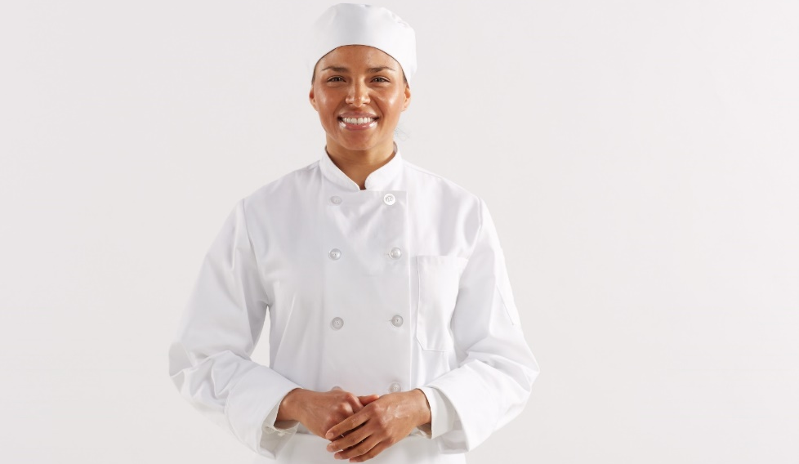
Your Presence at Work
Cooks and chef uniforms:
Comfortable leather shoes
Hemmed trousers
Double-breasted jacket
Apron
Neckerchief
Hat or toque
Notes:
Traditionally, cooks and chefs wear the following:
• Comfortable leather shoes that are polished and kitchen safe (with nonskid soles and closed toes)
• Trousers (either solid white, solid black, black-and-white checked, or black-and-white striped) that are hemmed and fit appropriately, possibly with a belt
• Clean, ironed, white double-breasted jacket
• Clean, ironed apron
• Clean neckerchief, usually knotted or tied cravat style
• Hat or toque

Slide 5
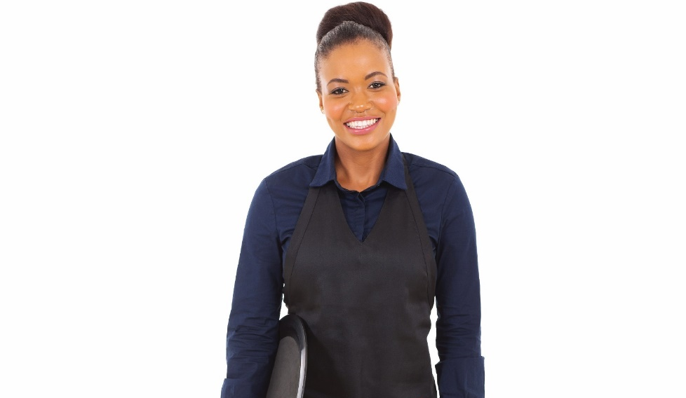
Your Presence at Work
Front-of-the-house uniforms:
Vary by operation
Jewelry may be limited
Clean, ironed clothing
Reflect company dress code
Notes:
Front-of-the-house uniforms vary according to the operation. Servers, for example, often wear polo shirts or button-down shirts with ties. Hosts and
hostesses may be required to dress according to a specific color scheme or have a uniform themselves. Jewelry and other accessories may also be limited.
Nevertheless, all front-of-the-house employees must also be sure to wear clean, ironed clothing that reflects the company’s dress code.

Slide 6
Your Attitude at Work
Positive attitude
Remain upbeat and calm
Flexible approach
Reflects respect of yourself, your work, and other people
Notes:
Have you ever approached a test or homework assignment with dread? At best, you probably felt relief once the experience was over, rather than
pleased with your performance. Work tasks are similar. How you approach your work mentally affects both how you think of the work and how you are
perceived by the people around you.
People with positive attitudes are more likely to be positive around guests and coworkers. Remaining upbeat and calm can help you work through difficult
tasks and busy times. And taking a flexible approach, such as showing a willingness to jump in to clean dishes or help at the host stand, is also key to
helping yourself meet new challenges and learn new skills.
In total, the attitude you present at work reflects the respect you give yourself, your work, and other people. You can use it to your advantage, no matter the
task in front of you.

Slide 7
Your Actions at Work
Work well with others
Take responsibility for results
Respect for others
Communication skills
Strong commitment
Notes:
You have probably heard the saying, “Actions speak louder than words.” The actions that employees and managers take in the workplace show people a lot
about who they are and what they value.
The most valued employees in a restaurant or foodservice operation are able to work well with others while taking responsibility for their individual results. You
will work with many types of people in the restaurant world, each with his or her own contribution to make to a business’s success. With respect for others,
some basic communication skills, and a strong commitment to your work, you will be able to make good decisions for the team and for yourself.

Slide 8
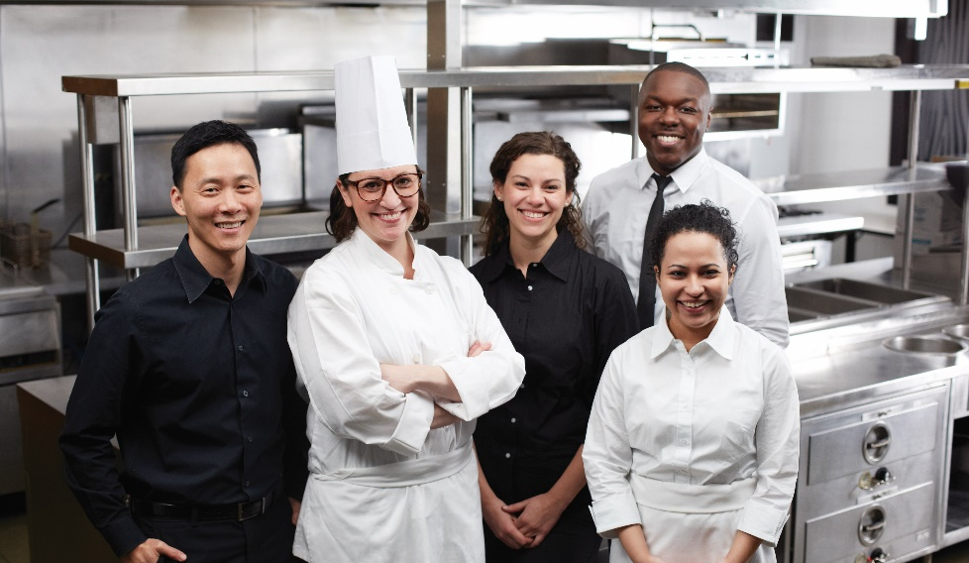
Teamwork
Takes a team of professionals
Uses team members’ strengths
More success as a group
Respect opinions
Create positive results
Notes:
In the restaurant and foodservice industry, no one person can make an operation run well. It takes a team of professionals. Throughout your time in
this industry, you will work on many types of teams.
You have probably had plenty of chances to work on a team—maybe in class as a part of a project or as a member of a sports team. Do you remember
a time when you tried to accomplish a task by yourself, only to realize you needed the help of a friend, classmate, or coworker? Chances are the two of
you finished the task more efficiently than by doing it alone.
In the same way, teams form the basic work structure for restaurant and foodservice operations. For example, the kitchen team works
together to make the food. One person does not make each dish from prepping to garnishing. The servers work with the hosts and busers to keep things
moving smoothly in the front of the house.
Teamwork uses each team member’s strengths so the group has more success working together than working alone. The most successful teams respect each
other’s opinions and find ways to work together to create positive results.
People on successful teams are more likely to feel a responsibility to the other team members. Why? Because a team is a group of individuals with different
skills and experience levels, but they are all working to complete the task or meet the goal. Often, the people doing the work have a better understanding
of where breakdowns might happen, and they can build a solution together.

Slide 9
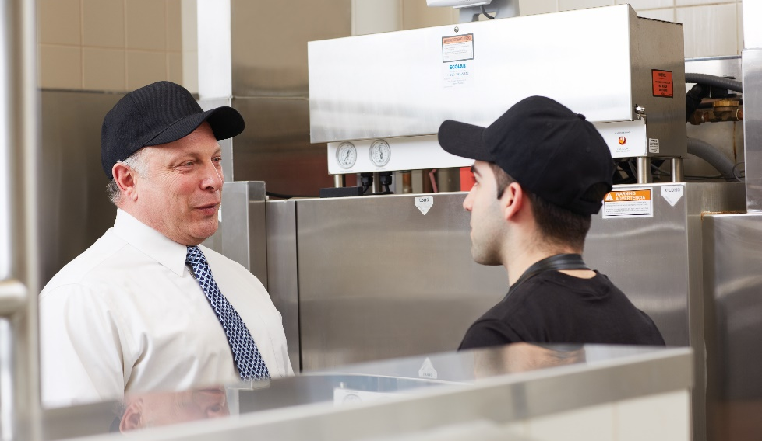
Personal Responsibility
Follow directions
Follow time frame
Communicate
Notes:
Performing tasks correctly is another fundamental aspect of a job. You have the responsibility to follow the directions for the tasks you have been assigned. You
also must complete those tasks in the time frame your manager has assigned.
In some cases, you may realize that you have an obstacle to completing a task. Maybe you need to help the busload of guests that just came in before you can
clean tables, or perhaps you have not yet been trained on how to use a new piece of equipment. Regardless of the reason, you are still accountable for the
work that your manager assigned. So what can you do? The answer is simpler than you might think: communicate. By communicating frequently and clearly,
you give your coworkers and managers the opportunity to help you remove obstacles so that you can complete your work.

Slide 10
Ethics
Code of conduct
Ethics—set of moral values
  Based on honesty, integrity, and respect
  Influenced by backgrounds, religious beliefs, personal code of conduct, experiences
Workplace ethics—professional tone and behaviors
  Acceptable vs. unacceptable
Notes:
As an employee, you will also be expected to follow the code of conduct for your company. These codes often cover a wide range of topics, including
decision making, dress code, and standards for behavior. Most companies have a written code that is rooted in the ethics of its leaders. Ethics are a set of moral
values that a group of people holds. They are typically based on the principles of honesty, integrity, and respect for others. They can be influenced by cultural
backgrounds, religious beliefs, personal codes of conduct, and individual experiences. They help guide the decisions people make, sometimes whether
they realize it or not.
In the business world, workplace ethics set the professional tone and behaviors for employees in an operation. These codes help everyone understand what is
considered acceptable or unacceptable behavior.

Slide 11

Workplace Diversity
Diversity
Backgrounds
Experiences
Opinions
Religions
Ages
Talents
Abilities
Benefits
Pleasant work environment
Stronger relationships
Team success
Notes:
With millions of employees across the country, the restaurant and foodservice industry is a tremendously diverse environment. Diversity refers to the great
variety of people in today’s world and their backgrounds, experiences, opinions, religions, ages, talents, and abilities.
As a member of this dynamic community, you will be expected to respect the differences of your coworkers and guests. The benefits are undeniable—a more
pleasant work environment, stronger relationships, and more success for the entire team. So it is worth spending some time on understanding the forces that
can work against diversity.

Slide 12
Stereotypes and Prejudices
Stereotypes—generalizations about a particular group
Prejudice—judgments unrelated to abilities
Bias—based on a prejudice
Cultural tendencies—based on beliefs and habits
Notes:
Stereotypes are generalizations that individuals make about particular groups. These generalizations assume that all members of that group are the same.
Stereotypes are hard to change because they are usually not based on actual experience. All people are hurt by stereotyping—those who are being labeled
and those who think the labels are true. People who believe in stereotypes—either positive or negative—are cheated out of genuine relationships with people.
This will cloud their personal and business judgment in untold ways.
Stereotypes produce prejudice and bias. Prejudice is a general attitude toward a person, group, or organization on the basis of judgments that are unrelated
to abilities. Some people are brought up in an environment where they learn to like certain people and groups and dislike others. Prejudice can come from
personal experience, lessons from adults and family, and media representations. Bias is a tendency toward a particular perspective or idea based on prejudice.
On the other hand, many groups of people do have common beliefs, such as religion, or share common ways of acting. These groups have cultural tendencies
to do some things based on their beliefs and their habits. In contrast, stereotypes do not distinguish between what a group of people may tend to do or believe
and what an individual actually does or believes.
Smart restaurant and foodservice managers understand the value of overcoming stereotypes and biases.

Slide 13
Showing Empathy
Empathy—identifying with feelings, thoughts, or attitudes
Nonjudgmental acceptance
Genuine concern
Connect with coworkers
Build trust and respect
Notes:
You already know about the need to communicate in this industry. Teams talk to each other, and service staff talk frequently to guests. Your ability to connect
with people by listening and showing understanding is another critical skill for an industry employee.
Empathy is the act of identifying with the feelings, thoughts, or attitudes of another person. Empathetic individuals put others at ease with nonjudgmental
acceptance. Often it is referred to as “standing in someone else’s shoes.” You cannot always connect with another person’s feelings simply by acknowledging
them verbally. For example:
Employee to manager: “Sam called in sick again today. He’s been out a lot lately. It’s been hard on all of us!”
Manager to employee: “I know that it’s been tough on you and the rest of the team. I appreciate that you’ve all been pitching in to keep everything
running smoothly. I’m working on this situation so that it won’t continue to be a problem.”
In this scenario, the manager acknowledged the employee’s feelings and made it clear that she understood how difficult the situation was. The manager showed
empathy for the employee’s frustration.
By using empathic statements in your communication with other people at work, you have the chance to show genuine concern about the people you work with
and an understanding of their needs and feelings. This communication and understanding can help ensure you are able to connect with your coworkers
in a positive way. This will help you build trust and respect with others—a particularly important skill once you become a manager who is responsible
for building strong teams.

Slide 14
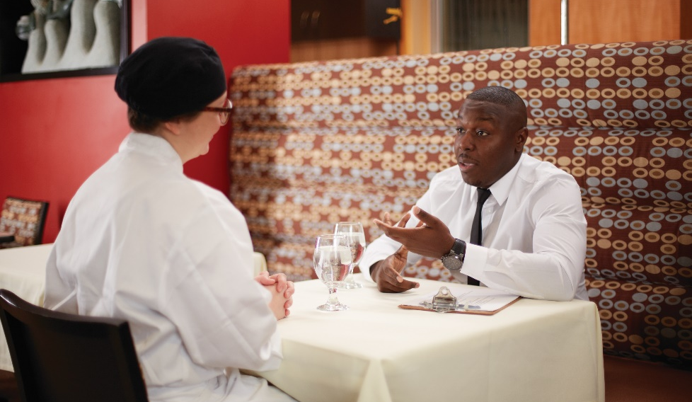
Feedback
Helpful information
Working well/needs improvement
Primary tool managers use
Quick and verbal
Formal performance evaluation
Continuous feedback
Accept and learn from feedback
Notes:
Throughout our lives, we all receive input on the success and impact of our actions and attitudes. At school, for example, your report cards, awards,
comments on essays, and coaching advice are all forms of feedback. Essentially, feedback is helpful information that is given to someone to say what is working
or needs to be improved about a particular action or performance.
Feedback is the primary tool that managers use to help employees understand what they are doing correctly and incorrectly in their jobs.
Sometimes, feedback might be quick and verbal. For example, “Shanna, you should not be wearing ripped gloves. Please go change them immediately.”
Other times, you will participate in more formal performance evaluations and discussions.
Ideally, feedback is not just about what is wrong. Strong managers provide continuous feedback and make sure to include positive feedback as well. For
example, “Shanna, great job getting all the orders out during our lunch rush so quickly! I appreciate your hard work.”
Either way, you must be prepared to handle both the praise and the criticism that will come your way. As an employee, you must be able to accept and learn
from the feedback that you receive. Your ability to act upon the feedback—by either continuing to perform well or making adjustments to your performance—
will make the difference in your ability to learn and grow.

Slide 15
Your Role in the Success of an Organization
Direct impact on success
Goals
Mission statements
Notes:
As you begin your career, perhaps in an entry-level role as a dish washer or a host, it can sometimes be difficult to understand how the work you do every day
affects your company’s larger picture. But the truth is that every employee of a company, particularly in a service industry like ours, has a direct impact on the
company’s success.
Many companies lay out the goals for their business so that the public and their employees can understand what the company strives to achieve. They
often do this through official mission statements. A mission statement basically states what a company is trying to do. For example, The Cheesecake Factory’s
mission is “to create an environment where absolute guest satisfaction is our highest priority.”
Can you envision how a hostess might affect guest satisfaction? Or how a dish washer’s work could? Every employee at a restaurant has a role to play
in embodying the mission of the company. A mission statement is nothing if employees are not acting on it. As you gain more responsibility, you will also be
expected to help employees on your team to see their impact on the company’s success—and provide them with the tools and empowerment to live up to
those goals.

Slide 16
Resigning from a Job
Reasons
  Better opportunity
  Change in school schedule
Two weeks’ notice
Inform in person
Letter of resignation
  Avoid negative comments
  Thank employer
Leave on a positive note
Notes:
What happens if it just does not work? Most people eventually leave a job because of a better opportunity, change in school schedule, or any number
of other reasons. Well, there are expectations of how a professional handles this situation.
Give a current employer two weeks’ notice before leaving. It is standard business practice. Inform him or her in person, or write a letter of resignation.
Do not resign in an email. This is a serious and formal process.
Take care in writing a letter of resignation. Include the reasons for leaving, but always be polite. Avoid any negative comments, and always thank the
employer for providing the opportunity. As learned when filling out a job application, prospective employers ask about work records and request
references from previous employers. Showing negativity when resigning might ruin future opportunities.
A good guide to follow throughout your working career is to always leave on a positive note. Keep long-term goals in mind, and rise above any negative
words and attitudes of others. Have the patience and persistence to see a career vision to its ultimate goal. Possessing excellent skills and having a good
education and training are only part of the equation for a successful career in the restaurant and foodservice industry; successful employees also need
commitment to service, a positive attitude, and perseverance to get to the top.

Slide 17
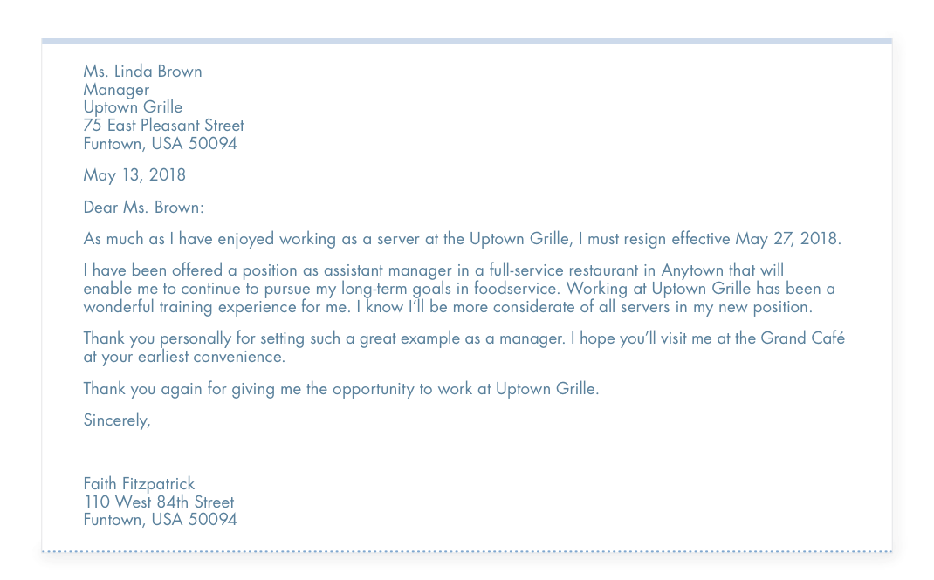
Resignation Letter Example
Notes:
What happens if it just does not work? Most people eventually leave a job because of a better opportunity, change in school schedule, or any number
of other reasons. Well, there are expectations of how a professional handles this situation.
Give a current employer two weeks’ notice before leaving. It is standard business practice. Inform him or her in person, or write a letter of resignation.
Do not resign in an email. This is a serious and formal process.
Take care in writing a letter of resignation. Include the reasons for leaving, but always be polite. Avoid any negative comments, and always thank the
employer for providing the opportunity. As learned when filling out a job application, prospective employers ask about work records and request
references from previous employers. Showing negativity when resigning might ruin future opportunities.
A good guide to follow throughout your working career is to always leave on a positive note. Keep long-term goals in mind, and rise above any negative
words and attitudes of others. Have the patience and persistence to see a career vision to its ultimate goal. Possessing excellent skills and having a good
education and training are only part of the equation for a successful career in the restaurant and foodservice industry; successful employees also need
commitment to service, a positive attitude, and perseverance to get to the top.

