Slide 2
Restaurant industry’s financial health
Annual sales: $782 billion
Revenue: > 90% of world’s economies
Employment: > 14 million people
Job availability: estimated 1.7 million more jobs by 2025
Notes:
Restaurants are also at the center of the nation’s financial health. With over $782 billion in annual sales, the restaurant and foodservice industry’s revenue
is larger than 90 percent of the world’s economies. Over 14 million people are employed in the industry. It is one of the largest private-sector employers in the
United States. And it will just continue to grow—with an estimated 1.7 million more jobs available by 2025.

Slide 3
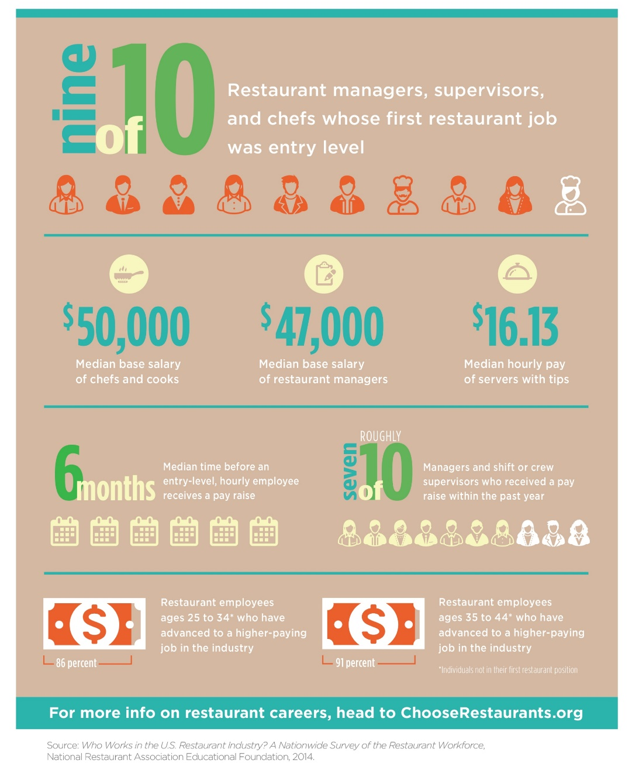
Career statistics of the restaurant industry
Notes:
Latest statistics on career success in the industry.

Slide 4

The Restaurant and Foodservice Industry
Two major segments:
Commercial
  80% of the industry
Noncommercial
  20% of the industry
Notes:
The restaurant and foodservice industry can be divided into two major parts or segments: commercial and noncommercial.

Slide 5
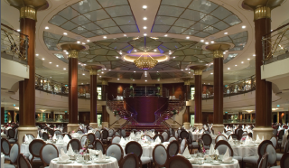
Commercial Restaurants and Foodservice Segments
Restaurants
Catering and banquets
Retail
Stadiums
Cruise ships and airlines

Slide 6
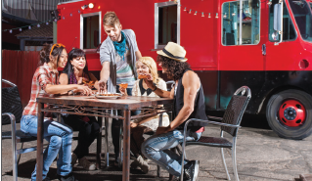
Restaurant Segments
Family dining full-service
Casual dining full-service
Fine dining full-service
Quick-service
Quick-casual
Food trucks
Notes:
The way food is served is different from restaurant to restaurant.
In recent years, restaurants have also become mobile.
Food trucks are now a growing part of this category.

Slide 7
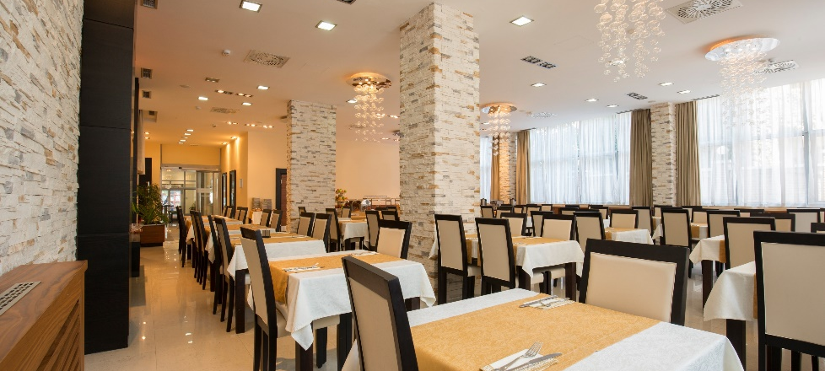
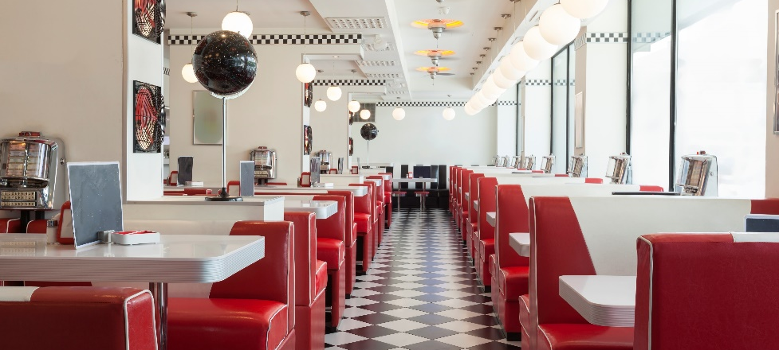
Restaurant Concept
Unique combination of:
  Menu offerings
  Pricing
  Service style
  Ambiance
  Décor

Slide 8

Restaurant Segments: Family dining full-service restaurant
Service at table
Guest sits while ordering
Payment after meal
Menu emphasis = families
Average check: $10 or less
Example: Denny’s

Slide 9
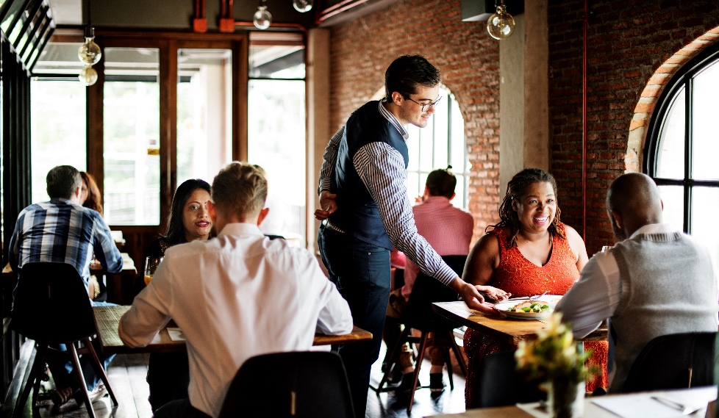
Restaurant Segments: Casual dining full-service restaurant
Service at table
Guest sits while ordering
Payment after meal
Cooked to order
Average check: $10–$25
Example: Buffalo Wild Wings

Slide 10
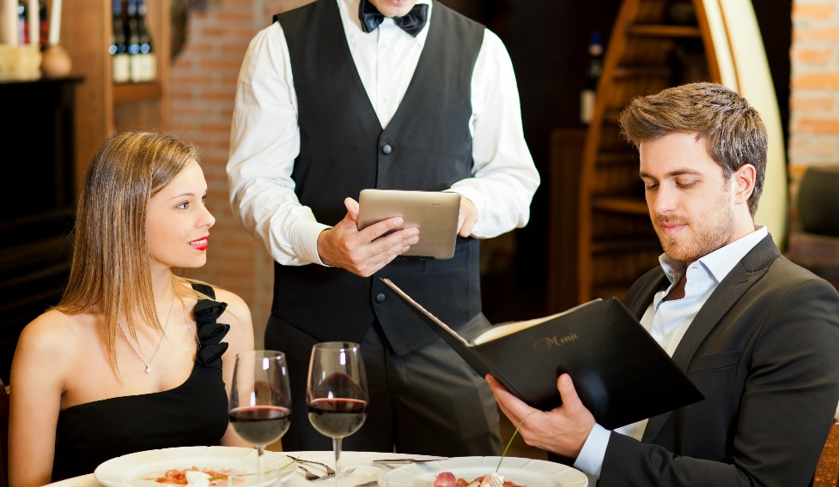
Restaurant Segments: Fine dining full-service restaurant
Service at table
Guest sits while ordering
Payment after meal
Intricate dishes
Tableware is high quality
Average check: $25 or more
Example: Ruth’s Chris Steak House

Slide 11

Restaurant Segments: Quick-service restaurant (a.k.a. fast-food restaurant)
Guest orders at counter/window
Pay before eating
Take out, eat in, or delivery
Snack or beverage bars
Average check: $3–$6
Example: McDonald’s

Slide 12

Restaurant Segments: Quick-casual restaurant
Guest orders at counter/window
Pay before eating
Freshly prepared with high-quality ingredients
Receive food quickly
Average check: $7–$9
Example: Panera

Slide 13
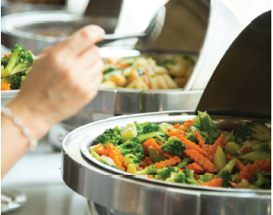
Commercial Segment: Catering and Banquets
Event host chooses menu
Caterers located in:
  Own facility
  Another business
Food delivered
Restaurants have catering and banquet operations
SS Mgr: Ch 7 – 7.3
Notes:
The menu is chosen for a group of diners.
The food is delivered to the event location.
Many restaurants also have catering and banquet operations.

Slide 14
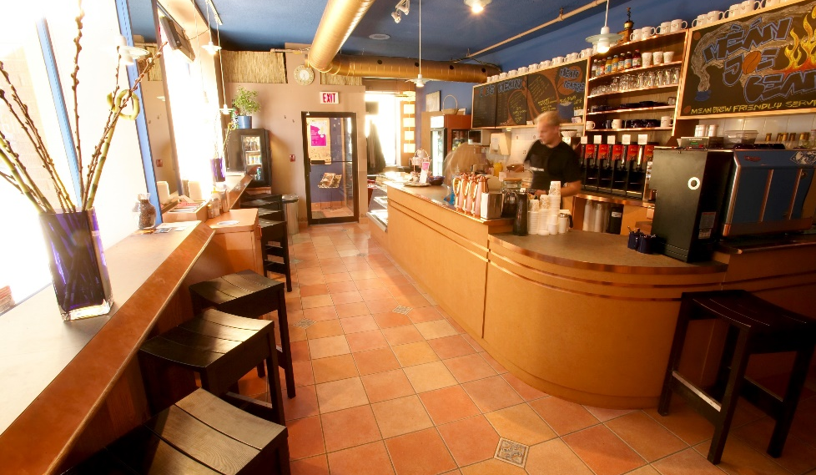
Commercial Segment: Retail
Offer prepared meals
Eat in store or at home
Located in:
  Supermarkets
  Convenience stores
  Specialty retail operations
Sell limited items
Vending machines
Notes:
Limited items include: coffee, specialty drinks, and quick bites.

Slide 15
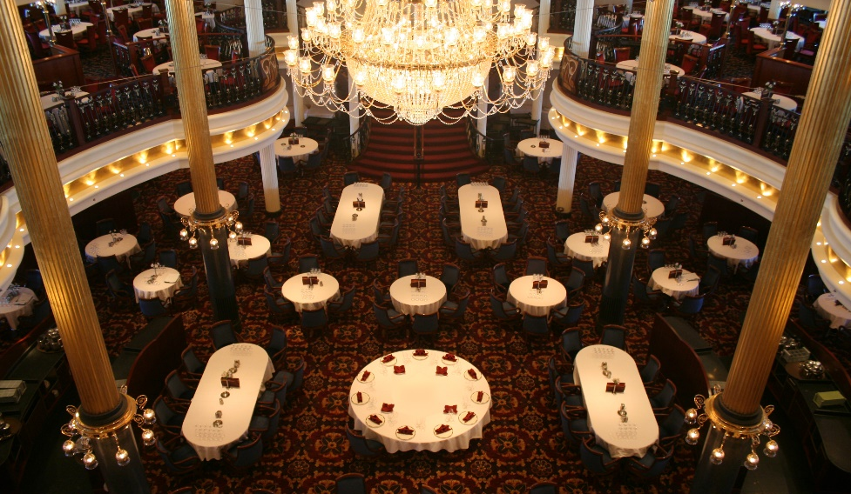
Commercial Segment: Cruise ships and Airlines
Cruise:
Food always available
Dining styles vary
Food selections vary
Notes:
Options range from casual dining and buffets to elegant dining and room service.
Food selection also varies, from steak to vegetarian to children’s meals and pizza.
Cruise ships sometimes serve thousands of meals in one seating.

Slide 16
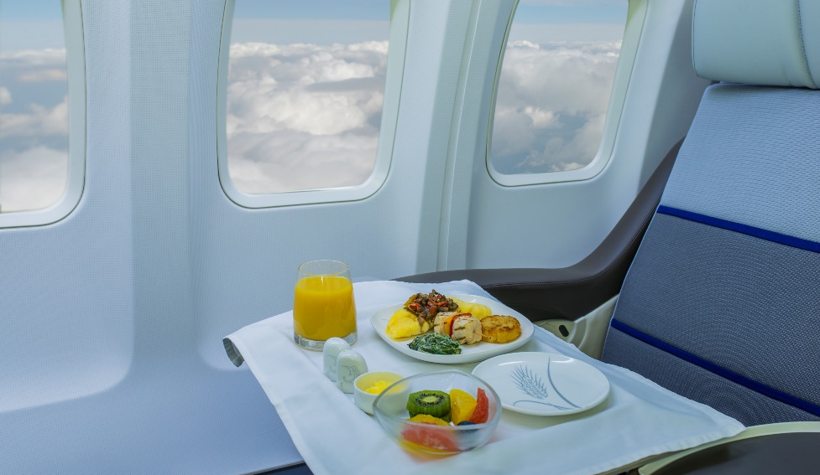
Commercial Segment: Cruise ships and Airlines
Airlines:
Short flights—beverage service & small snacks
Long flights—seven-course meal
International
Catering companies
Airports offer many options
Notes:
Beverage service and small snacks for purchase are common on short flights in economy class.
But on long flights, you might eat a seven-course gourmet meal using real dishes and glassware.
Recently, many airlines have stopped offering food to passengers. Airports instead have stepped in to provide food to travelers, with many food options
now found among the gates.

Slide 17

Noncommercial Foodservice Segment
Schools & universities:
On-campus food
Students and staff
Health-care facilities:
Guests and patients
Hospitals, nursing homes
Notes:
This segment prepares and serves food in support of some other establishment’s main function or purpose. For example, the cafeteria at a local
university supports the school’s goal of educating students by serving them meals so that they have the energy to participate in class and activities.
Health-care facilities: Hospitals, nursing homes, and assisted-living centers all typically provide foodservice for guests and patients.

Slide 18
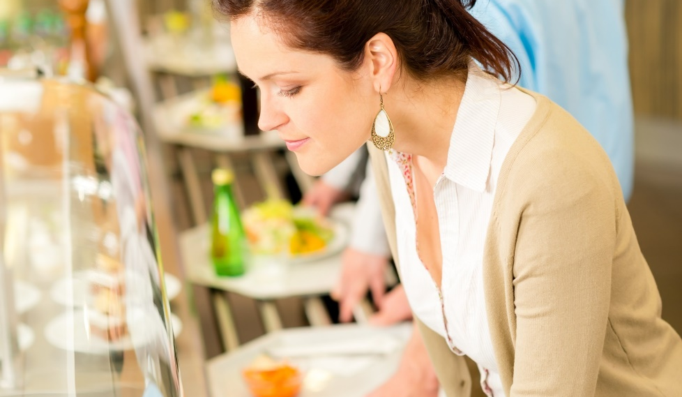
Noncommercial Foodservice Segment
Business & industry:
Employees
Cafeterias, vending, executive dining
Clubs:
Member-based organizations
Gyms, golf clubs
Government:
Military bases and ships, government buildings, correctional facilities
Notes:
• Business and industry: Many buildings provide cafeterias, vending machines, and executive dining to the employees of companies that work there.
• Clubs: Most of these member-based organizations have foodservice options. Examples include gyms, alumni clubs, and golf clubs.
• Government: Military bases and ships, government buildings, and correctional facilities are included here. Some locations may have clubs
as well, such as an officer’s club.

Slide 19
Noncommercial Foodservice Segment
Contract feeding:
Operate in manufacturing or service industry
Manage and operate employee dining facilities
Self-operators:
Manufacturing and service companies
Hire own staff
Notes:
Within the noncommercial segment, foodservice is typically handled in one of two ways.
In contract feeding, contractors are businesses.
Self-operators hire their own staff to operate foodservices.

Slide 20
The Big Picture: The Hospitality Industry
Hospitality:
Services away from home
Restaurants and hotels
Hospitality segments:
Foodservice
Lodging
Event management
Notes:
Hospitality refers to the services that people use and receive when they are away from home.
Foodservice is a key sector in the hospitality industry.
Foodservice: Includes restaurants, retail establishments, and hotels.
Lodging: Includes hotels, motels, and resorts.
Event management: Includes stadiums, convention centers, and trade shows.

Slide 21
The Rise of Clubs—Ancient Greece
Lesche—private clubs
Phatnai—catered to travelers, traders, visitors
Meals nourished the soul
People ate on couches
Performances enhanced experience
Notes:
The evolution of the restaurant and foodservice industry has been driven by a combination of social, scientific, and physical advancements for many centuries.
The people of ancient Greece rarely dined out, although they enjoyed the social aspect of dining and often got together for banquets.
Other establishments, called phatnai (FAAT-nay), catered to travelers, traders, and visiting diplomats.
It is most likely that travelers brought standard fare like grapes, olives, bread, dried fish, cheese, and wine with them to clubs.
People ate while reclining on couches, with performances of music, poetry, and dance to enhance their experience.

Slide 22
Spices, Cafes, and Guilds—The Renaissance through the French Revolution
Cooks used exotic spices
Venice controlled spice trade
Sold at high prices
Notes:
Partly to show off their wealth, European noblemen instructed their cooks to use large amounts of exotic spices in their dishes.
Because of their location on the Adriatic Sea, it was not long before merchants in Venice controlled the spice trade.
They could easily get spices from India and sell them at very high prices to distributors headed north.
Venice prospered as a seaport and bought and sold spices and other goods, trading with merchants bound for other destinations.

Slide 23
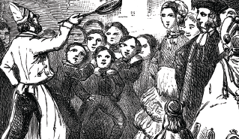
Spices, Cafes, and Guilds—The Renaissance through the French Revolution
Epicurean—appreciation for fine wine and food
Haute cuisine—elaborate and refined food preparation
Notes:
The expansion of world travel changed the mind-set of the artists and philosophers of that time.
They adopted epicurean (ep-i-KYOO-ree-uhn) lifestyles—showing great appreciation for fine wine and food.
While the majority of the population was unaffected by this renewed interest in all things Greek and Roman, it did much to create the food-preparation system
we now call haute cuisine (hote kwee-ZEEN), an elaborate and refined system of food preparation.

Slide 24
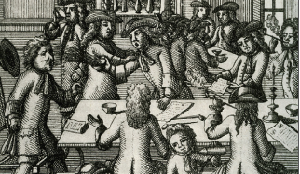
Spices, Cafes, and Guilds—The Renaissance through the French Revolution
International trade improved life
First coffeehouse/café opened
Cafés welcomed women
Acceptable to eat in public
Notes:
International trade also greatly improved the European way of life. For example, Europeans were introduced to coffee from Africa.
The first coffeehouse, or café, opened in 1650 in Oxford, England.
The new coffeehouses were open, airy, and inviting. Bakers soon started selling pastries as well.
Unlike taverns and ale houses, cafés welcomed women, and the coffee shop soon made it acceptable to eat in public.

Slide 25
Spices, Cafes, and Guilds—The Renaissance through the French Revolution
Guilds
  Associations of people
  Similar interests or professions
Cooking guilds—established professional standards and traditions
Notes:
Guilds were associations of people with similar interests or professions. They were organized during the reign of Louis XIV in France in an attempt to increase
the state’s control over the economy.
Each guild controlled the production of its specialties and could prevent others from making and selling the same items.
Two of these guilds were the Chaine de Rotissieres (roasters) and the Chaine de Traiteurs (caterers). Cooking guilds like these established many of the
professional standards and traditions that exist today.

Slide 26
Spices, Cafes, and Guilds—The Renaissance through the French Revolution
Boulanger
  Served hot soups (restaurers)
  Origin of restaurant
Unemployment caused the opening of restaurants
Paris has > 500 restaurants
Notes:
In 1765, Boulanger began serving hot soups called restaurers (meaning restoratives) for their health-restoring properties.
He called his café a restorante, the origin of our modern word restaurant. His restorante became very popular.
People enjoyed having a place to go for a hot meal and good conversation with friends.
The foodservice guilds believed Boulanger was moving in on their business and took their case to court. But the French
government was under even stronger pressure to lessen the poverty causing social unrest in Paris.
Despite the government’s attempt to end the political unrest, the French Revolution began. When the French Revolution was over, large numbers of
cooks and other guild members found themselves unemployed. They followed Boulanger’s example and began opening restaurants of their own.
Within 30 years, Paris had over 500 restaurants serving meals. Dining out on a large scale was born.

Slide 27
Inns—Colonial North America
Boston and New York—trade centers
1634: Boston inn—food and lodging
Colonial Americans rarely traveled or dined out
Travelers stayed in inns
Notes:
The first Europeans to settle in North America were city dwellers poorly equipped for farming. As more people immigrated to the New World to find
their fortunes or to escape religious persecution, cities along the East Coast grew. Boston and New York became major centers of trade.
As early as 1634, an inn in Boston called Cole’s offered food and lodging to travelers.
However, very few early colonial Americans ever traveled or dined out. Once they settled down, they rarely traveled more than 25 miles from their homes.
When people did travel, they stayed at inns, often sleeping together in the same large room and even sharing a single bed. Not much care was given to the
preparation of meals. If travelers arrived after dinner had been served, they would not eat.

Slide 28
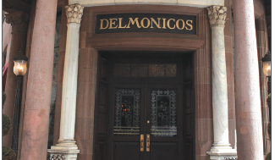
From Cafeterias to Elegance—The Late 1800s
Delmonico's and Astor House
  Elegant surroundings
  18-course meals
Gold rush
  Population growth
  Cafeteria developed
Notes:
When American high society dined out, they did so in style. Entrepreneurs in New York during the Gilded Age (1870s to 1900) opened fancy restaurants,
such as Delmonico’s and the Astor House, so that people could dine and be seen in elegant surroundings. Dinners of up to 18 courses were popular.
On the other side of the continent, California was in the middle of the gold rush. People poured into the area to claim their fortunes. With such a sudden
growth in population, meeting the demand to feed so many at once was nearly impossible.
Clever restaurateurs developed the cafeteria, an assembly-line process of serving food quickly and cheaply without the need for servers.

Slide 29
The Rise of Modern Restaurants—The Twentieth Century
Employment was high
People ate out more—lunch
Economy grew—car ownership
Quick-service segment grew
Notes:
By the turn of the century, employment in the United States was at an all-time high. More and more people went to work in new factories, stores, and office
buildings. People were therefore eating out more, especially for lunch.
After World War II, in the 1940s and 1950s, the quick-service segment of the restaurant industry grew quickly.
The economy was growing quickly too, and more of the population now also owned cars.
People began to stop for food more often during the day and as part of road trips.
Entrepreneurs of the time began to look for ways to offer the food more quickly and at a cheaper cost to both them and
their guests. Some even offered curb service—delivering the food directly to cars.

Slide 30
The Global Industry—Today and Beyond
1970s: rapid growth of national chains
“Eating out” vs. eating at home
Busier households
American restaurant brands on many continents
Notes:
The rapid growth of national chains since the 1970s has changed the face of the restaurant and foodservice industry. It has caused a major shift in how
people look at food and the social context of food. “Eating out” has become almost as commonplace as eating at home—not just for special occasions or as
a convenience. In the last few decades, lifestyles have moved steadily toward busier households that no longer have a dedicated daily food preparer.
Global connections via technology and the rapid growth of international trade have also allowed restaurant companies to grow even larger. Some of
the most famous American restaurant brands can be found in countries on many continents. At the same time, many guests have begun to expect local,
sustainable options in their dining choices. So restaurants have also begun exploring how to offer menus and ingredients that satisfy these trends.
The restaurant and foodservice industry is one that is often bound by tradition, but it must also be responsive to changes in the society it serves. It provides the
familiar and comfortable, while also working to deliver innovation and adventure. The restaurant of the twenty-first century does not differ from Boulanger’s 1765
restorante in that they both “restore” guests’ comfort. The goal is to provide guests with an opportunity to reenergize.

Slide 31

The Role of Entrepreneurs
Entrepreneur—starts and runs a business
Howard Schultz—CEO of Starbucks
Chains—groups of restaurants
White Castle, McDonald’s, and A&W—first quick-service chains
Darden and Brinker—full-service
Lettuce Entertain You—appealing themes and high-quality menus
Notes:
An entrepreneur is a person who starts and runs a business, taking on financial risk to do so. The hospitality industry’s growth is linked to the vision and dedication
of entrepreneurs throughout history. These individuals believed in the hospitality industry and sought out opportunities to offer guests options.
In 1837, two brothers opened Delmonico’s, a steak restaurant in New York City. Within 20 years, the family owned 10 restaurants of the same name in the area. Fred Harvey tied his
restaurants, named Harvey House, to the growth of railroads. These restaurants, started in the late nineteenth century, were built near railroad stops across the
United States to take advantage of the crowds of passengers.
In the twentieth century, quick-service chains grew along with the nation. White Castle, McDonald’s, and A&W were among the first companies to offer this style of food and service.
Two other important entrepreneurs later in the century, Norman Brinker and Bill Darden, looked for ways to offer a full-service restaurant experience to the middle class at
good prices. Brinker opened Steak and Ale in 1966, and Darden opened Red Lobster in 1968. Today, Brinker International and Darden Restaurants operate restaurants around the globe under many brands.
Chains today vary widely. Some are focused on fine dining, like Ruth’s Chris Steak House. Ruth Fertel knew little about restaurants when she bought her first
one in 1965. She eventually opened dozens of restaurants around the country. Richard Melman is another important example who paved a new path like
Fertel did. His Lettuce Entertain You Enterprises has grown to more than 100 restaurants in the United States since the 1970s. Melman has specialized in
appealing themes and high-quality menus, with many styles of food and service. His range of restaurants goes from the Eiffel Tower restaurant at the
top of the Paris Hotel in Las Vegas, to Wow Bao, which features popular Asian street food.
What do all of these entrepreneurs have in common? They started with just one restaurant. The success stories are simply amazing. Think about Starbucks as a
recent example: this global brand was once one tiny coffee shop in Seattle. In less than 50 years, Starbucks now has more than 20,000 stores worldwide. The
company’s huge expansion was led by Howard Schultz, who started in the Starbucks marketing department.

Slide 32
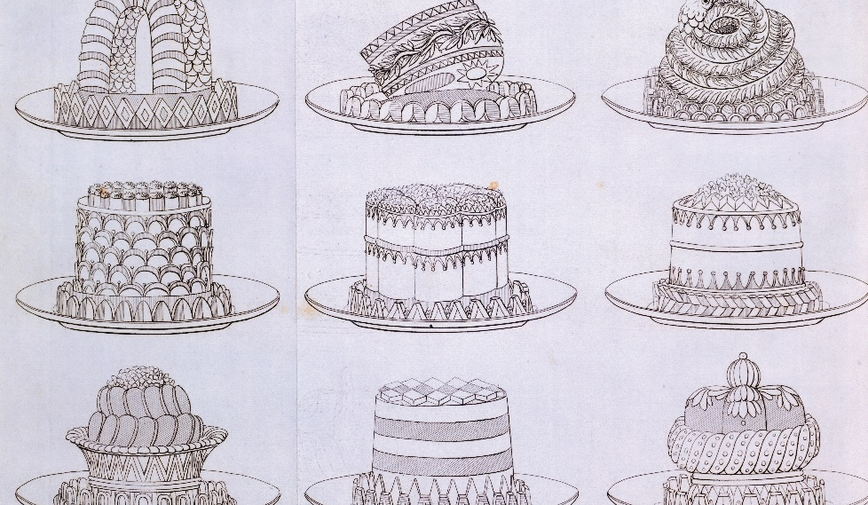
The Role of Chefs
Marie-Antoine Carême
  Pièces montées—decorative art
  French sauces
  Haute cuisine
  Trained many chefs
Cuisine was a branch of architecture
Notes:
Throughout history, chefs have been as critical to the growth of the industry as entrepreneurs. Today, the term chef is a mark of respect and distinction that
describes a professional who has reached the position through hard work and dedication to quality. Two important figures that led the way to such a level of
respect and admiration for chefs today are Carême and Escoffier.
Marie-Antoine Carême (1784–1833) believed that cuisine was simply a branch of architecture, as demonstrated by his elaborate pièces montées, which were masterpieces of decorative art.
He also perfected the recipes for many fine French sauces, placing them into four categories. Put simply, he defined the art of haute cuisine, which includes artful presentation, complex dishes,
and refined cooking techniques. Many would agree that Carême’s greatest claim to fame was training many other chefs who went on to become famous.
They were his followers and continued his traditions in many fine hotels and restaurants.

Slide 33
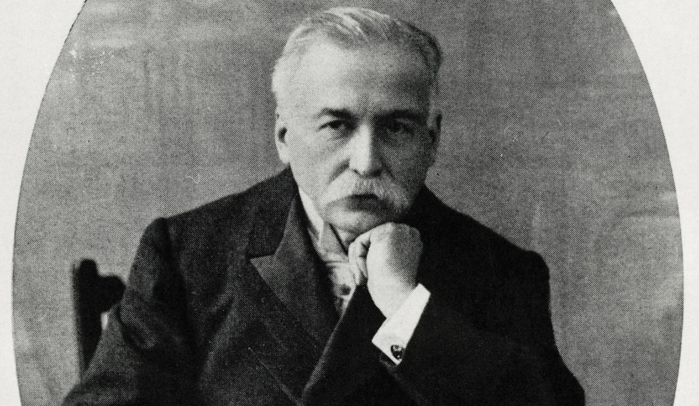
The Role of Chefs
Georges August Escoffier
“King of the Kitchen”
Transitioned haute cuisine
Established rules of conduct and dress
Developed kitchen brigade system
Expediter (aboyeur)
Notes:
Georges August Escoffier (1846–1935) helped transition Carême’s haute cuisine into more contemporary cuisine. He also established exact rules of conduct and
dress for his chefs. Escoffier’s staff always dressed neatly and worked quietly. He also organized and defined the role of workers in the professional kitchen,
developing the kitchen brigade system. This system assigns certain responsibilities to kitchen staff.
For example, Escoffier introduced the aboyeur, or expediter, who takes orders from servers and calls out the orders to the various production areas in the kitchen.

Slide 34

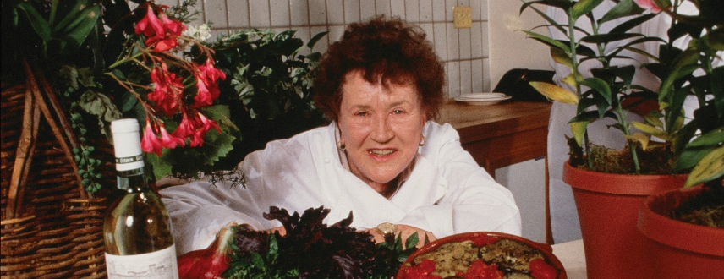
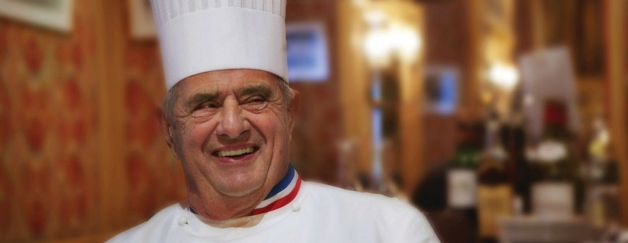
The Role of Chefs
Fernand Point
  Father of modern French cuisine
Julia Child
  Television series and cookbooks
Paul Bocuse
  Lighter, healthier dishes
Notes:
The industry has continued to produce iconic chefs who have added to the culinary arts and the business of serving guests. Here are a few of the most
influential chefs of the twentieth century.
Fernand Point: Known as the father of modern French cuisine, Point created lighter sauces using regional ingredients.
Julia Child: As great a personality as she was a chef, Child popularized French cuisine and technique with the American public through her
cooking television series and cookbooks.
Paul Bocuse: Following Fernand Point, Bocuse created lighter, healthier dishes that still reflected classical French flavors. He was also one of the
first chefs dedicated to teaching other aspiring chefs.

Slide 35

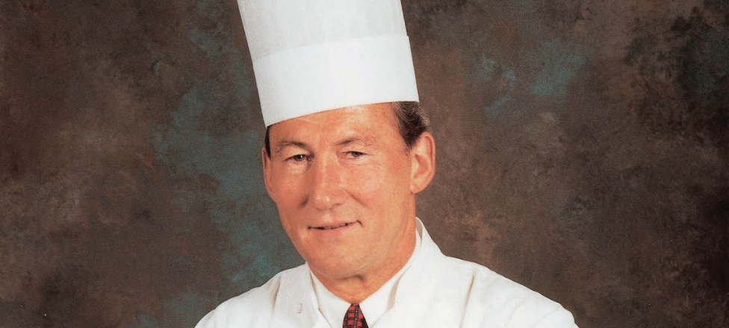
The Role of Chefs
Alice Waters
  Forefront of sustainable agriculture
Ferdinand Metz
  Certified master chef
Notes:
Alice Waters: Waters’s goal was to provide dishes that used only seasonal, local products at the height of freshness and quality. She is still
at the forefront of sustainable agriculture in foodservice. Her restaurant, Chez Panisse, is a well-known operation in Northern California.
Ferdinand Metz: Served as the president of the Culinary Institute of America. He led the U.S. Culinary
Olympic team to three consecutive world championships. He has offered the profession countless lessons on innovation and professionalism.

Slide 36
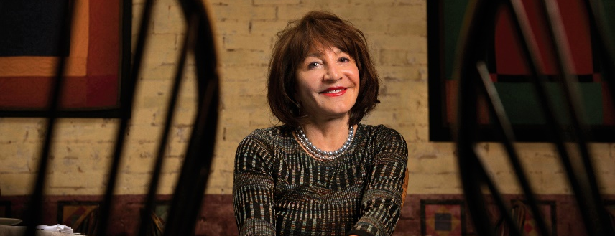
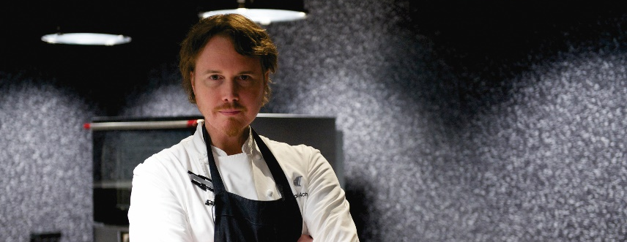
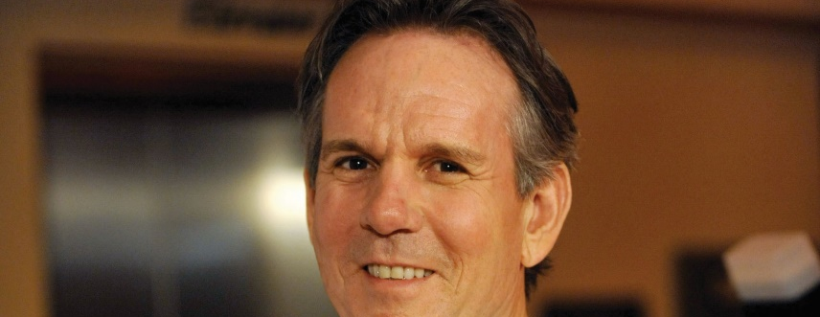
The Role of Chefs
Nora Pouillion
  First certified organic restaurant
Grant Achatz
  Molecular gastronomy
Thomas Keller
  Founder of The French Laundry
Notes:
The roles of chef and entrepreneur have also frequently become blended, with many chefs investing in restaurants. Some have even created chains. Here
are a few examples of contemporary chefs and their contributions to today’s culinary scene.
Nora Pouillion: Owns the first certified organic restaurant in the United States—Restaurant Nora in Washington, DC. More than 95 percent
of the restaurant’s ingredients are organic. She is also active in many conservation groups.
Grant Achatz: Named Best Chef in the United States in 2008 by the James Beard Foundation, Achatz is a leader in molecular gastronomy—
a modern style of cooking that leverages science in its unusual preparation techniques. His restaurant, Alinea, has been ranked among the best
restaurants in the world.
Thomas Keller: Another chef/entrepreneur, Keller is the founder of The French Laundry in the Napa Valley and Per Se in New York City. He is credited with
revitalizing interest in fine dining with intricate menus and exceptional service. His restaurants have also been ranked as some of the world’s best.

Slide 37

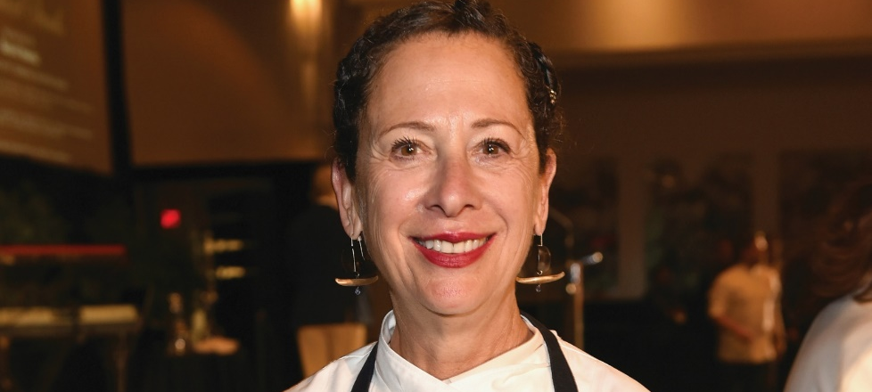
The Role of Chefs
Marcus Samuelsson
  Owns restaurants worldwide
Nancy Silverton
  Respected baker
  James Beard winner
Notes:
Marcus Samuelsson: Often seen today on television, Samuelsson began his career in New York City. He began opening restaurants in his twenties
and has also authored cookbooks. He now has restaurants in many hotels and cities throughout the world.
Nancy Silverton: One of the most respected bakers in the industry, Silverton has also won James Beard awards, both as chef and pastry chef.
She started La Brea Bakery, which quickly became one of the largest bakeries in the industry and an example of a brand that moved into supermarkets.

